Slide 1
Comprehensive Internship
This presentation encapsulates the internship experience of Ayush Kumar at TestingXper†s Chandigarh, focusing on †he
Report on DevOps Training
DevOps training undertaken and the tools used during †he program.

Slide 2
Comprehensive Internship
I NTE RN SHI P RE PORT
Report on DevOps Training
This comprehensive report highlights †he valuable in†ernship experience of Ayush Kumar during his DevOps
training at TestingXperts Chandigarh in the vear 2025.
r eoted using presentations ai

Slide 3
Practical Learning Application
This internship served as a vital platform to apply theoretical knowledge in a real-world environment, bridging the gap between academia and industry.
Understanding the
Deepened Software Testing Knowledge
Enhanced my comprehension of the software testing field, specifically within the DevOps framework, fostering a beNer grasp of industry practices.
Importance of Internship Experience
Hands-On Experience with Tools
Exploring the Valuable Lessons Learned
Acquired practical skills using industry-standard †ooIs, equipping me for future
professional challenges and enhancing my employability.
c eoted using
presentations GB

Slide 4
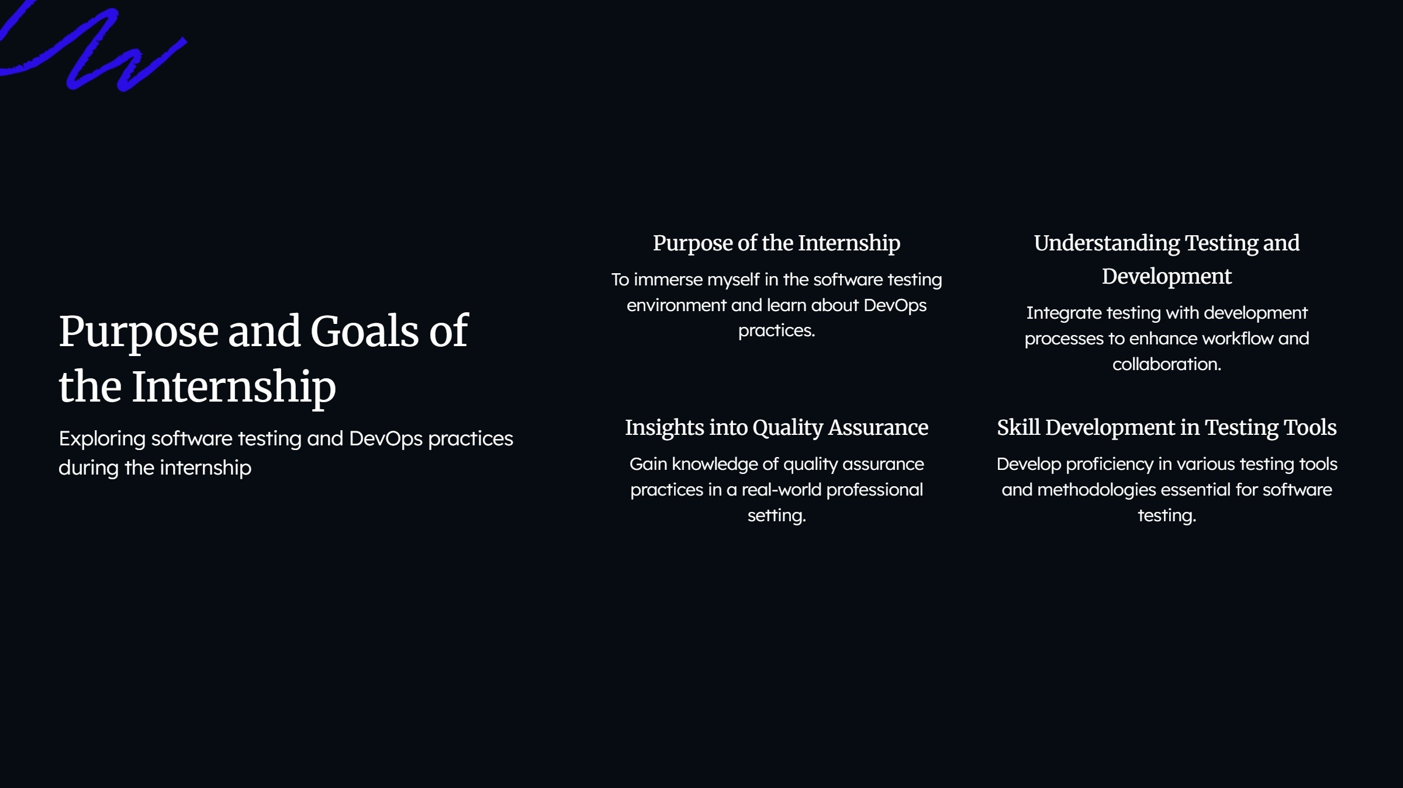


Slide 5
Global Leader in Quality Engineering
TestingXperts is recognized as a †op five provider of Quality Engineering and Digital Assurance services
worldwide.
ÿ‘ presentations ai

Slide 6



c eoted using ÿ‘ presentations GB

Slide 7
Overview of DevOps Training
Essential Skills for Bridging Development and Operations
Internship Focus on | Automation of Testing | Continuous Integration and | Collaboration Between
DevOps Training | Processes | Delivery | ’l'eams
The internship emphasized the | A crucial area of focus was on | Implementing continuous | Fostering collaboration among
importance of DevOps training to | automating the testing processes | in†eqration and delivery pipelines | cross-functional †eams was
unify development and | to enhance efficiency and reduce | was essential for fas†er software | critical to achievinq DevOps
operations. | manual errors. | deployment. | objectives.
r eoted using
presentations ai

Slide 8
Overview of Key Projects Undertaken
A summary of essential projects completed
Automated Testing Framework
Implementation of CI/CD Pipeline
Development
Established a comprehensive CI/CD pipeline
Created a robust framework utilizing Selenium and Jenkins for seamless continuous testing.
using Git, Docker, and Jenkins to enhance deployment efficiency.
c eoted using
presentations GB

Slide 9
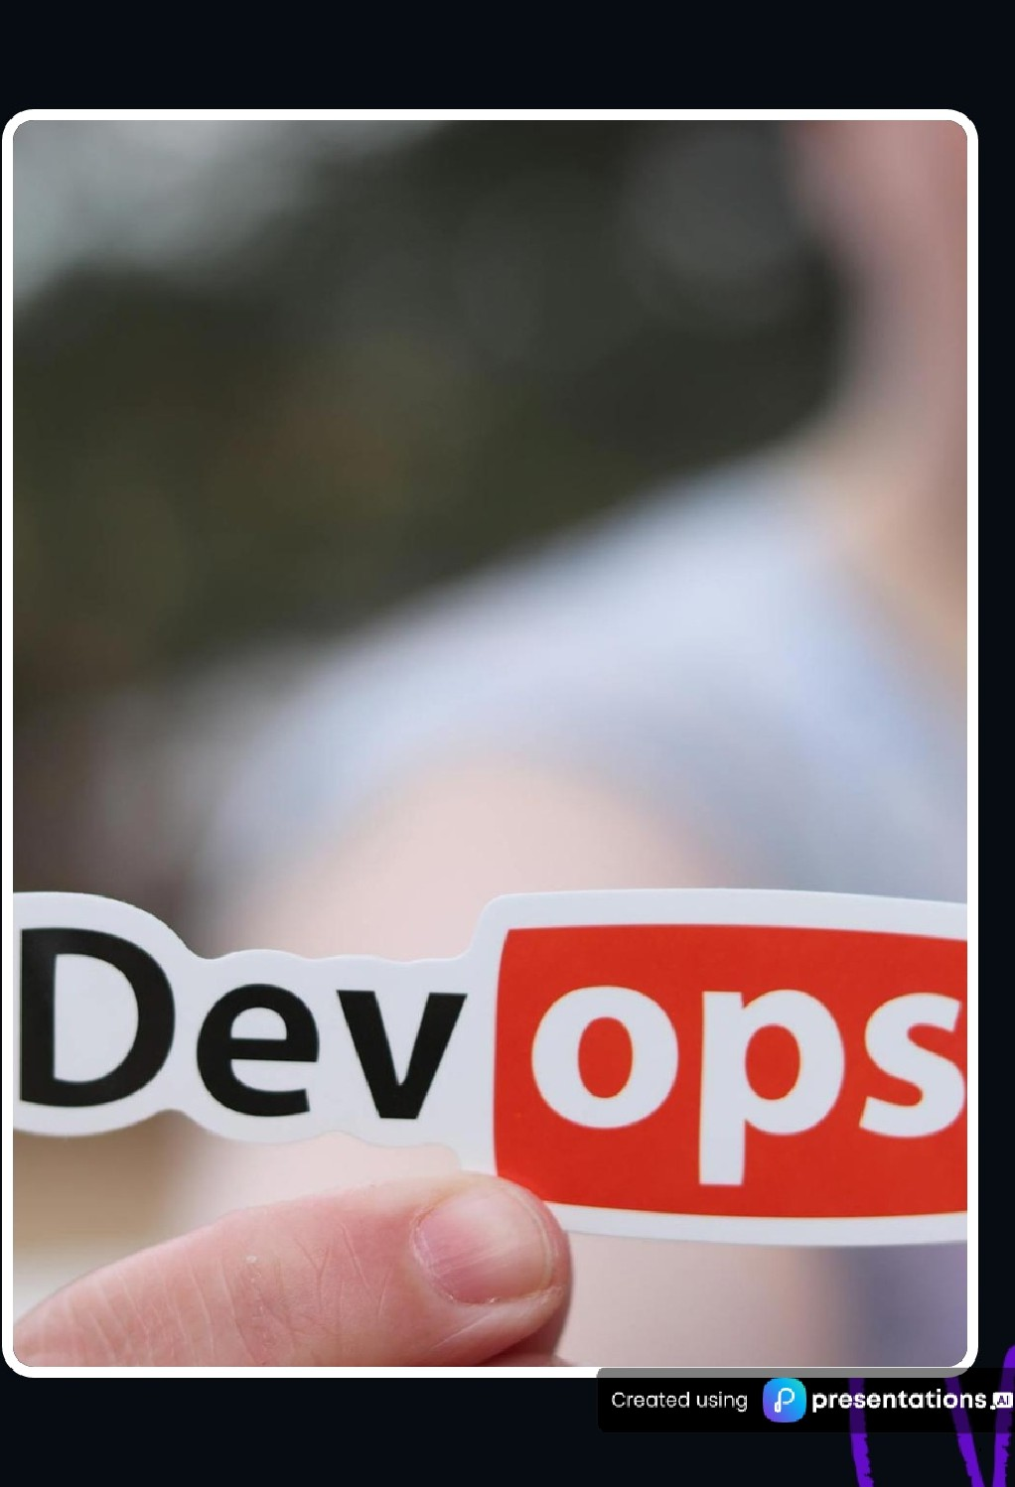
Implementing DevOps
Methodologies
Exploring Agile Practices, Continuous Integration, and Delivery
O Agile Practices
Adopted agile methodologies to boost team collaboration and adopt quickly to changes.
O Continuous Integration (CI)
Regularly integrated code changes with automated testing to enhance software quality.
O Continuous Delivery (CD)
Streamlined deployment processes to ensure software con be released at any time.

Slide 10
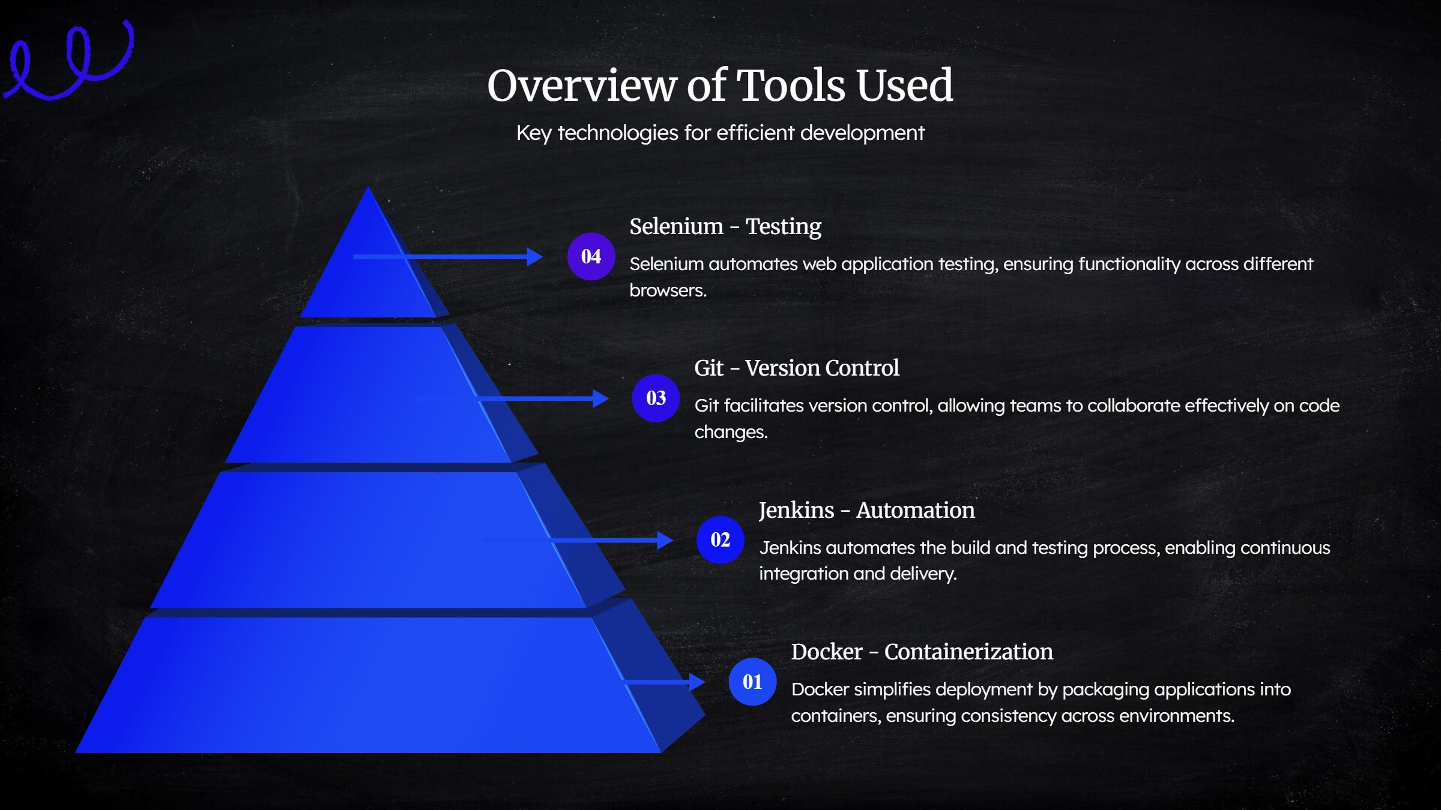

Slide 11
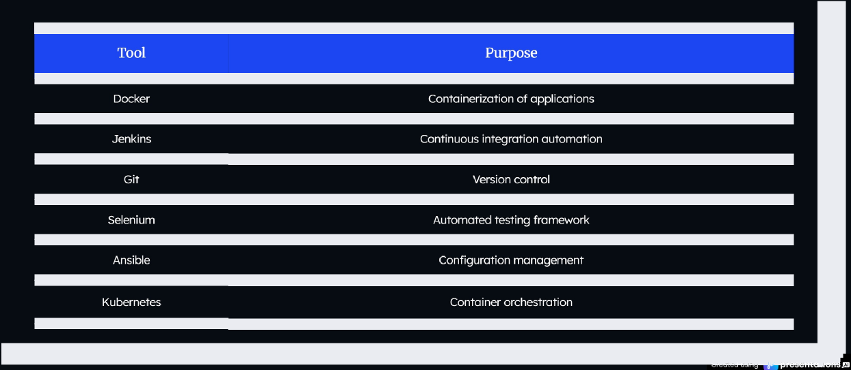
Detailed List of Tools
Overview of Tools and Their Purposes

Slide 12
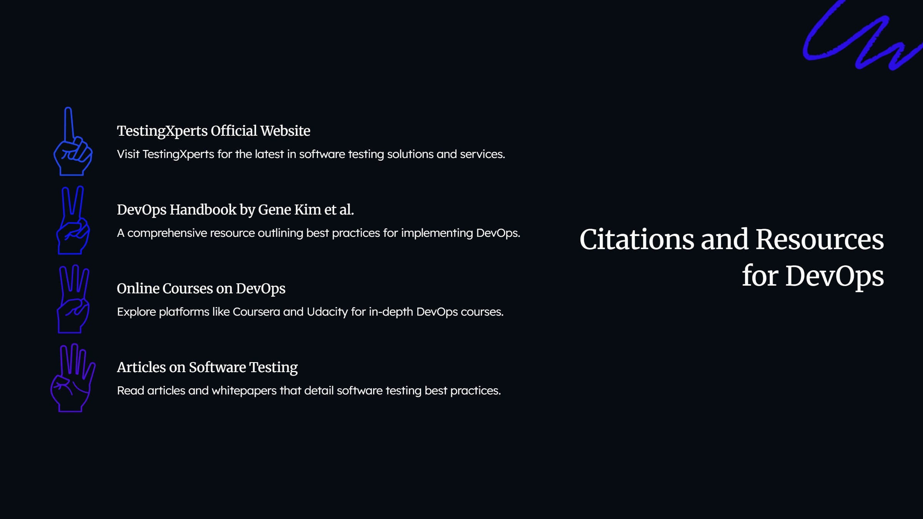

Slide 13
Summary of Internship Experience
Key Takeaways from My Internship journey
02

Slide 14

John Smith
Jane Doe
Bob Johnson
r eoted using
presentations ai

Slide 15
Career Goals After Internship Journey
Exploring Goals in Software Development and DevOps
01
02
03
Pursue a career in DevOps
Specialization in Automation Testing
Focus on CI/CD Practices
Aspire to establish a successful career in DevOps
Aim to specialize in automation testing to enhance
Seek to master Continuous Integration and
and software quality assurance. software reliability and efficiency. Continuous Deployment practices for streamlined
development.
05
Innovative Technologies Exploration
Adoption of Advanced Methodologies
Eager to explore opportunities with innovative
Desire to adopt advanced methodologies thot
technologies in the software development
enhance software development processes.
landscape.
c eoted using
presentations GB

Slide 16
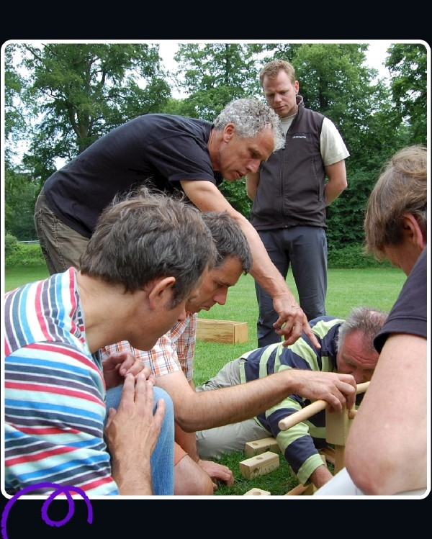
Q&A Session: Addressing Your
Queries
Engage with insights from my internship
O Invitation for Questions
This is on open invitation for any questions.
O Internship Experience
Feel free to inquire about my internship experiences.
O Project Insights
Ask about the various projects I undertook.
r eoted using
presentations as

Slide 17


join us †o discover valuable insights gained
Explore Insights from DevOps
Internship Experience
during the internship, highlighting impactful
†ooIs and methodologies †ha† shape effective
DevOps training.

