Slide 1
LM35
Teperature Sensor

Slide 2
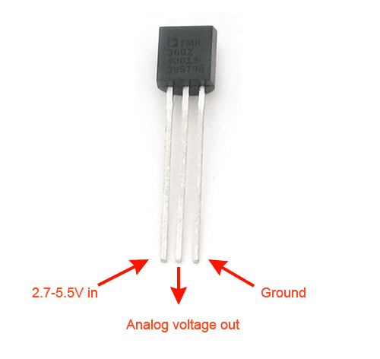

Slide 3
LM35 is an integrated analog temperature sensor whose electrical output is proportional to Degree Centigrade.
LM35 Sensor does not require any external calibration or trimming to provide typical accuracies.
The LM35’s low output impedance, linear output, and precise inherent calibration make interfacing to readout or control circuitry especially easy.

Slide 4
Features of LM35 Temperature Sensor
Calibrated directly in Degree Celsius (Centigrade)
Linear at 10.0 mV/°C scale factor
0.5°C accuracy guarantee-able (at a25°C)
Rated for full -55°C to a 150°C range
Suitable for remote applications
Low cost due to wafer-level trimming
Operates from 4 to 30 volts
Less than 60 mA current drain
Low self-heating, 0.08°C instill air
Non-linearity only 0.25°C typical
Low impedance output, 0.1Ωfor 1 mA load

