Slide 1
SENSORS

Slide 2
What is a sensor?
There are numerous definitions as to what a sensor is but I would like to define a Sensor as an input device which provides an output (signal) with respect to a specific physical quantity (input).
The term “input device” in the definition of a Sensor means that it is part of a bigger system which provides input to a main control system (like a Processor or a Microcontroller).
Another unique definition of a Sensor is as follows: It is a device that converts signals from one energy domain to electrical domain. The definition of the Sensor can be better understood if we take an example in to consideration.

Slide 3
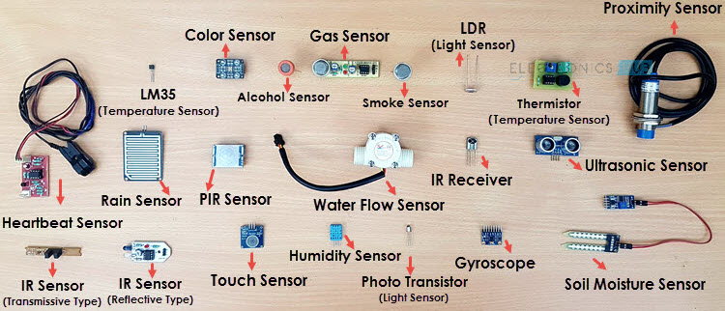

Slide 4
CLASSIFICATION
In the first classification of the sensors, they are divided in to Active and Passive.
Active Sensors are those which require an external excitation signal or a power signal.
Passive Sensors, on the other hand, do not require any external power signal and directly generates output response.
The other type of classification is based on the means of detection used in the sensor. Some of the means of detection are Electric, Biological, Chemical, Radioactive etc.
The next classification is based on conversion phenomenon i.e., the input and the output. Some of the common conversion phenomena are Photoelectric, Thermoelectric, Electrochemical, Electromagnetic, Thermotic, etc.
The final classification of the sensors are Analog and Digital Sensors.
Analog Sensors produce an analog output i.e., a continuous output signal (usually voltage but sometimes other quantities like Resistance etc.) with respect to the quantity being measured.
Digital Sensors, in contrast to Analog Sensors, work with discrete or digital data. The data in digital sensors, which is used for conversion and transmission, is digital in nature

