Slide 1
REAL ESTATE
PRICE PREDICTION
Here is where you will get the best predicted price

Slide 2
Introduction
In this project we will build a machine learning model for house price prediction.
This project will be very helpful for real estate market.
This model can be used by both house seller and house buyer
Multiple regression model is used to create this model with great accuracy.

Slide 3
Project Specification
01
02
03
To predict House price based on certain features like Number of Bedrooms, Number of Bathrooms, size/area and Location.
We are using a Machine Learning Algorithm to create a predictive model.
Multiple regression model is used to train and test the model in our project.

Slide 4

Procedure
STEP 1
Mathematical interpretation and understanding of recommendation and prediction
STEP 2
Algorithm design and development
STEP 3
Code and environment selection
STEP 4
STEP 5
Model building Based on python
Model Validation and evaluation

Slide 5
PIPELINE
Data Cleaning
Feature Engineering
Outlier Detection
MYHOME
Outlier Removal
REAL ESTATE
Model Creation

Slide 6
Data Cleaning
The main aim of Data cleaning is to identify and remove Errors and Duplicate data in order to create a relevant Dataset.
Process of Data cleaning is done by Python library Pandas.
Initially those columns are dropped from our dataset which are not important in deciding the final price.
The columns having characters and integer value are converted to integer value only.
Example
Bedrooms
2 bhk
2 bedroom
Bedrooms
2
2
Converted As

Slide 7
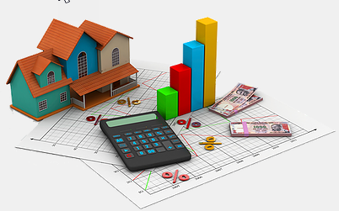
Outlier Detection
Outlier is an observation that diverges from an overall pattern on a sample.
There are many types of outlier detection techniques such as Z-score or Extreme value analysis, Probabilistic and Statical modeling, Standard Deviation etc.
We have used simple domain knowledge of real estate market to detect the outliers in our set.

Slide 8



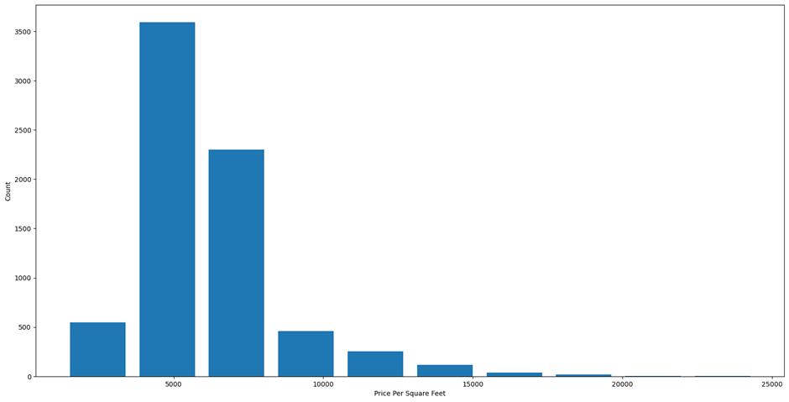
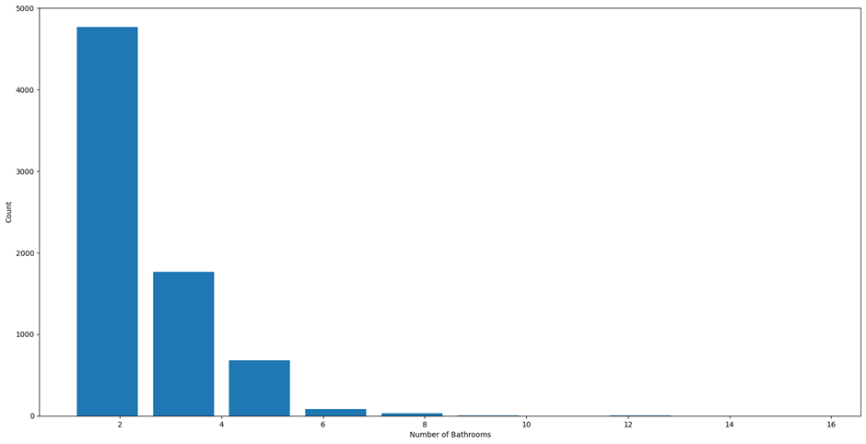
Outlier Removal
After detecting the outlier ,correct that errors if possible and if you cannot fix it remove it.
In our dataset we observed variations in the relation between values of some attribute.
Scatter plots are used to detect some more outliers and they are also removed from the dataset.

Slide 9
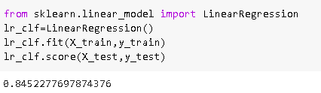
Model Creation
The process of Modeling means training a machine learning algorithm to predict the labels from the feature.
The Accuracy rate of our model is 84.5% which is pretty good.

Slide 10
“Real estate cannot be lost or stolen, nor can it be carried away. Purchased with common sense, paid for in full, and managed with reasonable care, it is about the safest investment in the world.”
Franklin D. Roosevelt

Slide 11
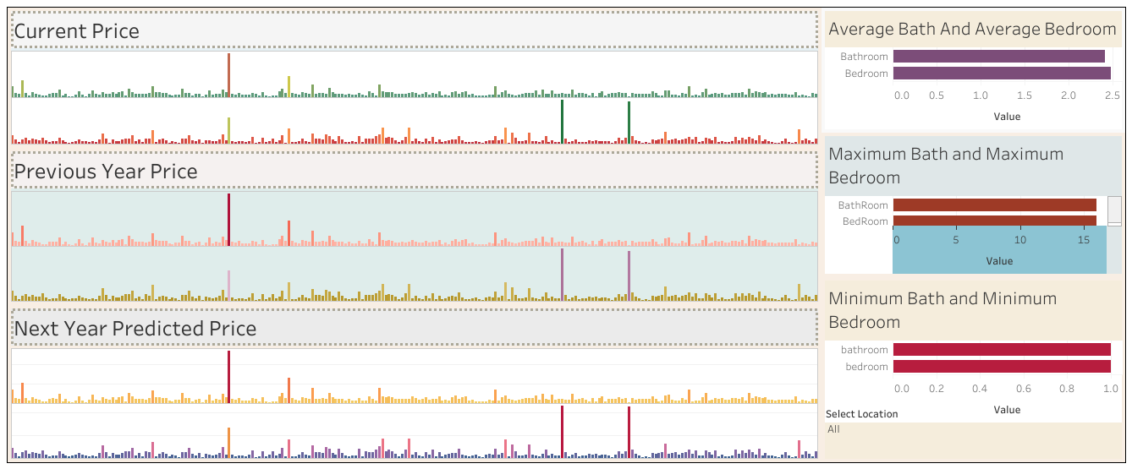
GUIDING PRINCIPLES

Slide 12

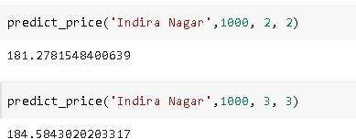
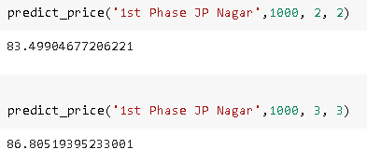
Result / Output
We created a function to predict the price.
Our function be like “predict_price ( location, sqft, bath, bhk)”
When we will pass the values it will give us the predicted price.

Slide 13


Thank You
Submitted By:
Name: Ayush Kumar
Section: L(10)
University roll no. : 201500179
Mentor: Mr. Ankit Arora

