Slide 1
CloudSafe
Secure Cloud File Storage & Recovery System
Cloud Computing
Presented by: Ayush Kumar
Technology: Amazon Web Services (AWS)
Amazon S3 • IAM • Versioning • Lifecycle • CloudTrail

Slide 2
Introduction
CloudSafe is a secure cloud file storage and recovery prototype.
Amazon S3 provides the central object storage.
IAM controls authorized access.
S3 Versioning protects previous file versions.
S3 Lifecycle supports cost optimization.
CloudTrail provides audit visibility.
User
→
IAM
→
Amazon S3
→
Versioning / Lifecycle
Amazon S3
→
CloudTrail
→
Audit

Slide 3
Problem Statement
Accidental deletion of files.
Accidental overwriting of files.
Unauthorized access.
Increasing storage requirements.
Higher cost for long-term frequently accessed storage.
Lack of visibility into file operations.
Deletion → Data Loss Risk
Unauthorized Access → Security Risk
Old Data → Cost Challenge
No Audit → Low Visibility

Slide 4
CloudSafe – Proposed Solution
Problem | CloudSafe Solution
Unauthorized access | AWS IAM
Accidental deletion | S3 Versioning
File recovery | Previous versions + delete-marker recovery
Long-term storage cost | S3 Lifecycle → Standard-IA
Activity visibility | AWS CloudTrail
Cloud storage | Amazon S3

Slide 5
Objectives
Securely store files in Amazon S3.
Control access using IAM.
Retain previous versions of files.
Recover accidentally deleted files.
Optimize long-term storage cost.
Maintain an audit trail.
Provide a simple demonstration interface.

Slide 6
Technology Stack
Service / Technology | Actual Name | Purpose
Amazon S3 | cloudsafe-ayush-2026 | Main cloud storage
AWS IAM | CloudSafeS3Access | Access control
IAM Group | CloudSafeUsers | Permission management
IAM User | CloudSafeUser | Authorized identity
S3 Versioning | Enabled | Previous versions
S3 Lifecycle | CloudSafeCostOptimization | Cost optimization
AWS CloudTrail | CloudSafeAuditTrail | Auditing

Slide 7
System Architecture
Authorized User
→
AWS IAM
CloudSafeUser
→
Amazon S3
cloudsafe-ayush-2026
Versioning
Lifecycle
Auditing
S3 Versioning
CloudSafeCostOptimization
S3 Activity
↓
↓
↓
Previous Versions
Standard-IA after 30 days
CloudSafeAuditTrail
↓
↓
Recovery
CloudTrail Event History / Logs

Slide 8
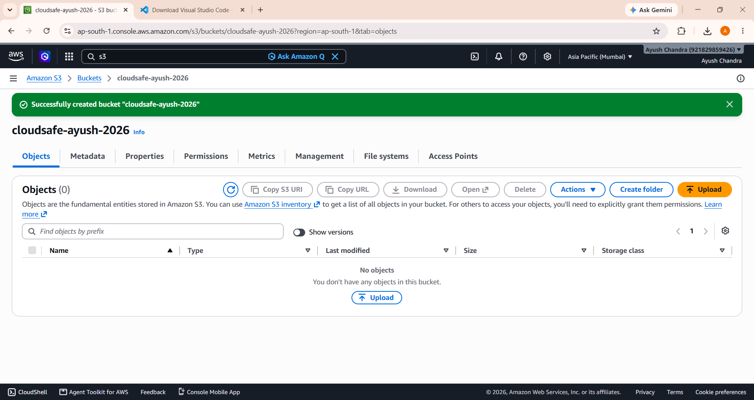
Step 1 – Create Amazon S3 Bucket
Bucket Name:
cloudsafe-ayush-2026
Region:
ap-south-1 – Asia Pacific (Mumbai)
The S3 bucket is the main storage layer.
Files are stored as S3 objects.
CloudSafe uses this bucket for secure file storage and recovery.
CloudSafe S3 bucket created in Mumbai region

Slide 9
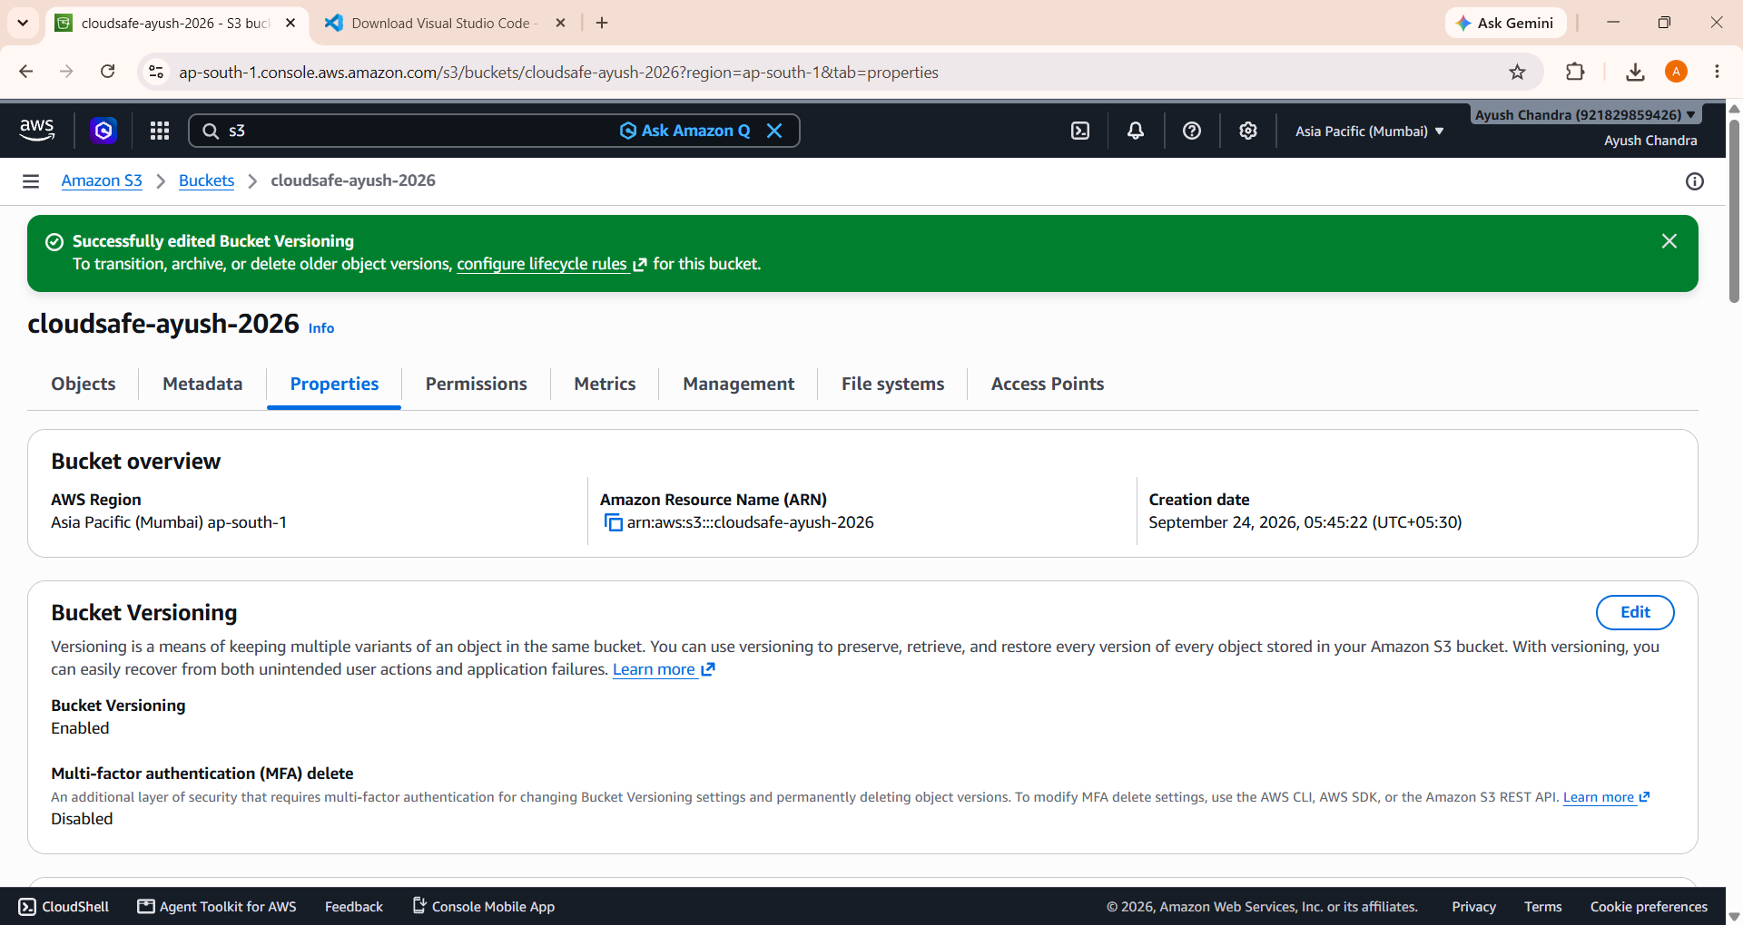
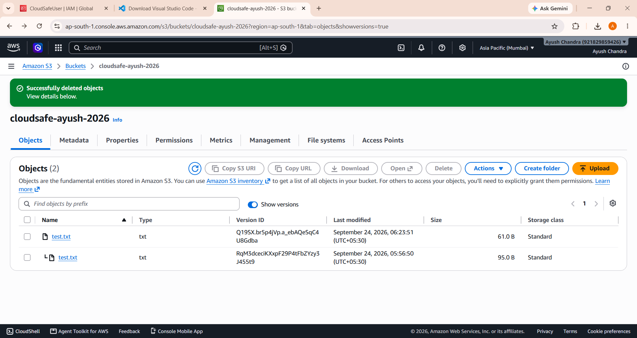
Step 2 – Enable S3 Versioning
Versioning was enabled on cloudsafe-ayush-2026.
test.txt was used for testing.
Multiple versions of test.txt were created.
Previous versions remained available.
📸 SCREENSHOT PLACEHOLDER
Versioning Enabled
📸 SCREENSHOT PLACEHOLDER
test.txt Multiple Versions
test.txt – Version 1
↓
test.txt – Version 2
↓
Current Version

Slide 10
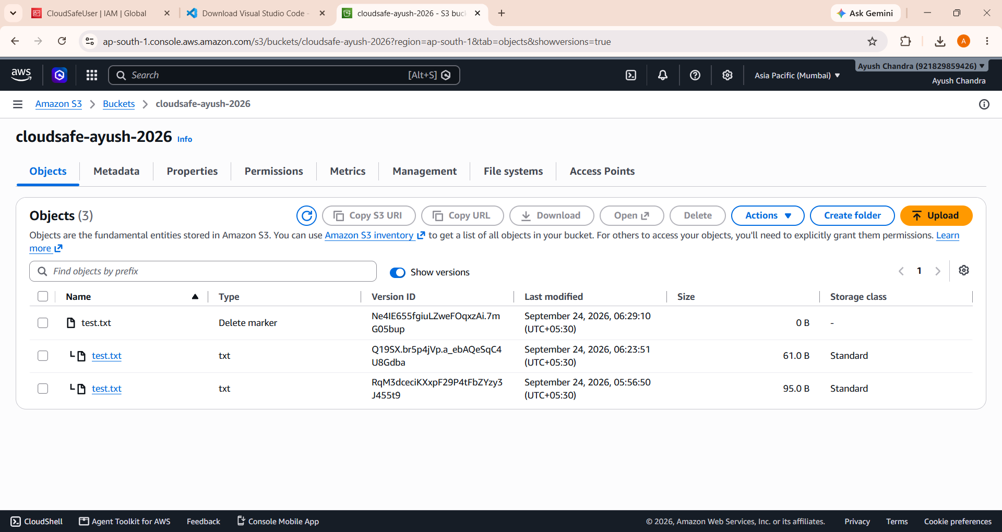
Step 3 – Accidental File Deletion & Recovery
Uploaded test.txt.
Created another version with different content.
Deleted the current test.txt.
S3 created a delete marker.
Previous versions remained retained.
Removed the delete marker.
test.txt became accessible again.
test.txt
→
Version 1 + Version 2
→
Delete
→
Delete Marker
→
Previous Version Retained
→
Remove Delete Marker
→
File Recovered

Slide 11
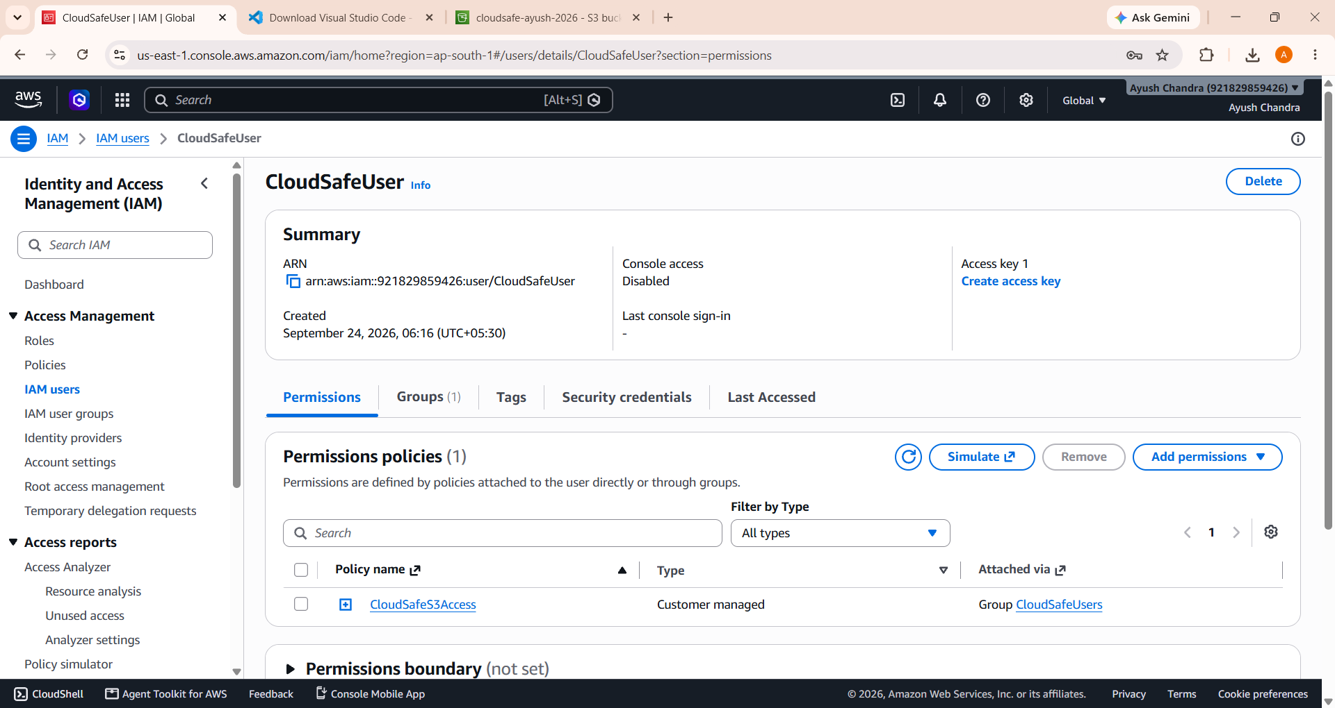
Step 4 – AWS IAM Access Control
IAM Group: CloudSafeUsers
↓
IAM User: CloudSafeUser
↓
Policy: CloudSafeS3Access
Permissions: ListBucket • GetObject • PutObject • DeleteObject
IAM controls who can perform S3 operations.
Policy is attached through the group.
Access is restricted to CloudSafe S3 resources.
No AWS credentials in index.html or style.css.

Slide 12
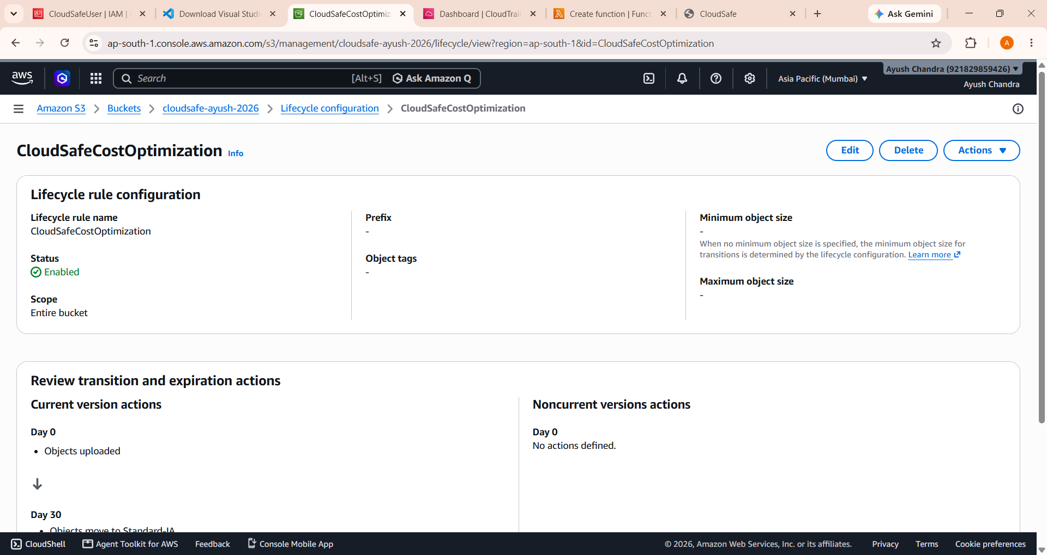
Step 5 – S3 Lifecycle Cost Optimization
Rule: CloudSafeCostOptimization
Current versions → Standard-IA after 30 days
Noncurrent versions → Standard-IA after 30 days
Lifecycle rules automate storage-class transitions.
Supports lower long-term cost for suitable access patterns.
Rule is shown as configured; we did not wait 30 days.
No expiration/deletion is configured.
Day 0
S3 Storage
→
Day 30
Standard-IA

Slide 13
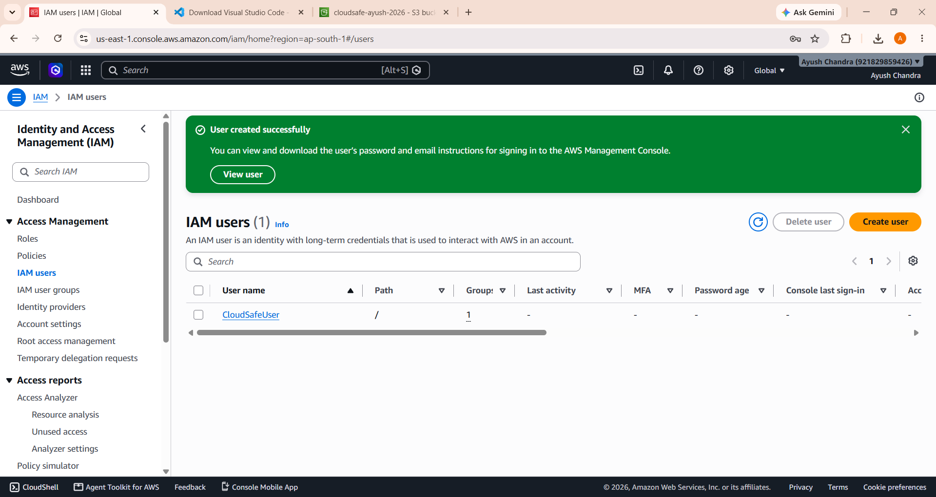
Step 6 – AWS CloudTrail Audit Logging
Trail: CloudSafeAuditTrail
CloudTrail is used for audit visibility.
S3 data events configured (Read + Write) for the demo setup.
audit-test.txt was uploaded to generate S3 activity.
Upload can be investigated via an event such as PutObject.

Slide 14
End-to-End Workflow
User
→
CloudSafeUser
→
IAM Authorization
→
S3 Bucket
cloudsafe-ayush-2026
Upload / Modify / Delete
→
S3 Versioning
→
Recovery if Required
→
Lifecycle Policy
CloudSafeCostOptimization
→
Standard-IA after 30 days
S3 Activity
→
CloudSafeAuditTrail
→
CloudTrail Audit
Parallel audit path →

Slide 15
Testing & Results
Feature | Actual Test / Result
S3 Bucket | cloudsafe-ayush-2026 created
File Upload | Tested
Versioning | Enabled
test.txt versions | Created
File deletion | Tested
Delete marker | Observed
File recovery | Successfully demonstrated
IAM | Configured
Lifecycle | Configured
CloudTrail | Configured
audit-test.txt | Uploaded for audit test
HTML/CSS interface | Completed

Slide 16
Benefits & Future Scope
Current Benefits
Future Scope
Secure S3-based storage
IAM-controlled access
Version-based recovery
Lifecycle-based cost optimization
CloudTrail audit visibility
Simple architecture
Easy-to-demonstrate workflow
NOT CURRENTLY IMPLEMENTED
Real login system
Web-based upload/download
Backend API
AWS Lambda
API Gateway
User-specific dashboards
Automated monitoring and alerts
Advanced encryption policies

Slide 17
Conclusion
CloudSafe demonstrates secure cloud file storage using Amazon S3.
IAM provides controlled access.
S3 Versioning protects previous versions.
Deleted files can be recovered using retained versions.
Lifecycle policies support long-term storage cost optimization.
CloudTrail provides audit visibility.
The HTML/CSS interface provides a simple demonstration layer.
“CloudSafe combines secure storage, access control, recovery, cost optimization and auditing into one practical cloud-storage solution.”
THANK YOU
Questions & Answers

