Slide 1
ADVANCED DRIVER ASSISTANCE SYSTEMS
BY:
ADITYA SINGH CHAUNHAN (211EE206)
AMAN RAJ (211EE211)
AYUSHMAAN SRIVASTAVA (211EE217)

Slide 2
ABOUT ADAS
Almost all vehicle accidents are caused by human error, which can be avoided with Advanced Driver Assistance Systems (ADAS).
Autonomous application solutions are partitioned into various chips, called systems on a chip (SoCs). These chips connect sensors to actuators through interfaces and high-performance electronic controller units (ECUs) to gain 360-degree vision.

Slide 3
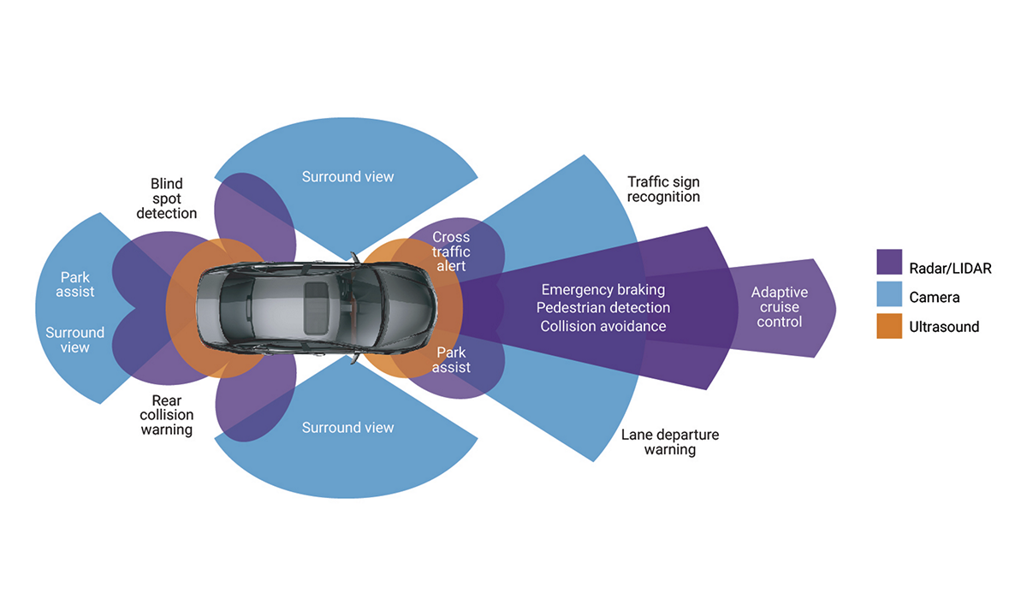
Almost all vehicle accidents are caused by human error, which can be avoided with Advanced Driver Assistance Systems (ADAS).
Autonomous application solutions are partitioned into various chips, called systems on a chip (SoCs). These chips connect sensors to actuators through interfaces and high-performance electronic controller units (ECUs) to gain 360-degree vision.

Slide 4
Why IS ADAS IMPORTANT ?
According to the August 2016 Survey done by the National Highway Traffic Safety Administration (NHTSA), “The Nation lost 35,092 people in crashes on U.S. roadways during 2015.”
Thus , ADAS can reduce the incidence of driving accidents and reduce casualties in a car accident.
According to the research of the US Road Safety Insurance Association, the Collision Avoidance System can reduce 27% the rear-end car accident; the Blind Spot Detection System can reduce 14% of the collision accident during the lane to reduce the accident; the lane deviation warning system can reduce 21% of the deadly fatal accident.

Slide 5
FUTURE OF ADAS?
The trend is shifting from distributed ADAS electronic controller units (ECUs) to a more integrated ADAS domain controller with centralized ECUs.
Current ADAS functions are limited by what the vehicle’s own sensors can detect, which today extends to a useful forward range of around 250 meters.
The next step-change for the advancement of ADAS will be the widespread adoption of:
vehicle-to-vehicle (V2V),
vehicle-to-infrastructure (V2I) and
vehicle-to-everything (V2X) communications.

Slide 6
Future OF ADAS (CONTD)
V2V communication allows appropriately equipped vehicles to communicate with each other directly and share information on relative speeds, positions, directions of travel and even control inputs, such as sudden braking, accelerations or changes in direction.
An extension of V2V, V2I provides vehicles with information from the road network’s infrastructure, such as traffic lights and signals, variable speed limits and congestion information thus enabling free flow of traffic.
V2X, meanwhile, adds data streams from beyond the immediate road network, including cloud-stored information, meteorological updates and possibly cyclists, pedestrians and other vulnerable road users (VRUs).

Slide 7
ABOUT OUR PROJECT
We will be showing the following examples using our codes on MATLAB using the Automated Driving System Library.
Visual Perception of a Driving Scenario using Monocular Camera.
Forward Collision and Autonomous Emergency Braking
Radar Sensors on Vehicles
Blind Spot detection Using Lidar
Pedestrian Detection and Avoidance and Sensor Fusion

Slide 8
Visual Perception Using Monocular Camera

Slide 9
Introduction
A monocular is a compact refracting telescope used to magnify images of distant objects, typically using an optical prism to ensure an erect image, instead of using relay lenses like most telescopic sights.
The proposed algorithm for visual perception is motivated by the fact that humans can reliably estimate the scene structure without using binocular vision (with one eye only) by relying on motion parallax and on their vestibular system

Slide 10
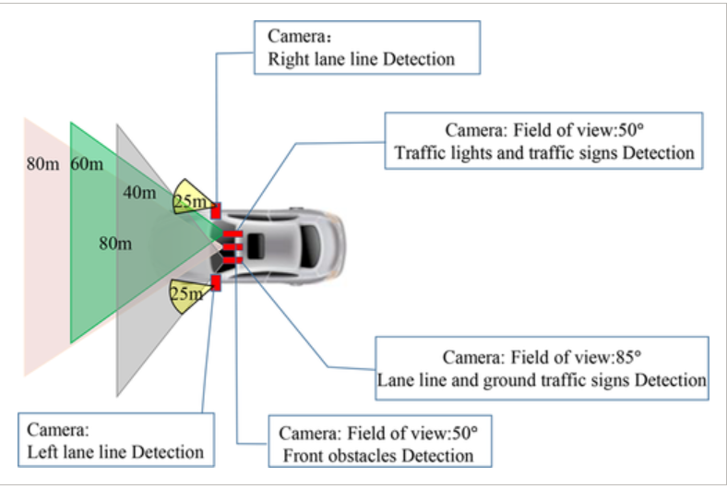
Working
The algorithm works in the following way:
Define Camera Configuration
Load a Frame of Video
Create Bird’s-Eye-View Image
Find Lane Markers in Vehicle Coordinates
Determine Boundaries of the Ego Lane
Locate Vehicles in Vehicle Coordinates

Slide 11
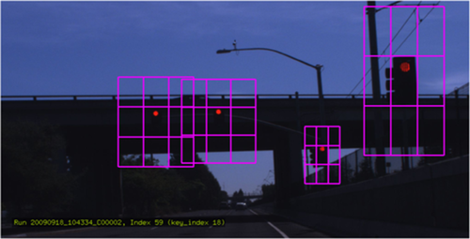
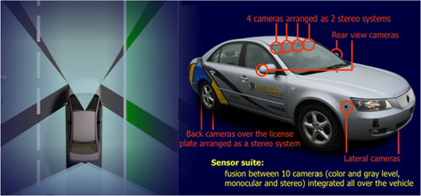
Applications
Lane information extraction technology.
Obstacle detection technology
Identification of traffic signs
Visual SLAM technology

Slide 12
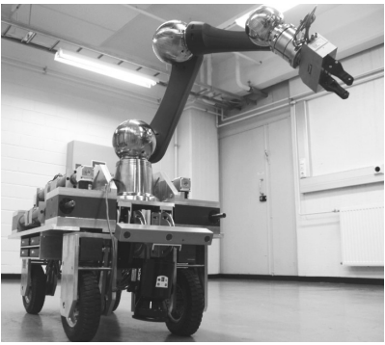
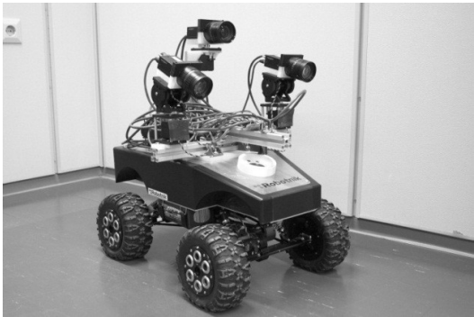
Future scope
The algorithm can be implemented in the two mobile robots as shown in the adjacent images. The first is a robotic manipulator arm mounted on a mobile base and the second is a commercially available Robotnik mobile platform.
These mobile platforms are also equipped with machine vision cameras connected to the computer. The instrumentation includes a triaxial accelerometer, gyro and magnetometer, temperature sensors, and an on-board processor that fuses the measurements to provide static and dynamic orientation and translation measurements

Slide 13
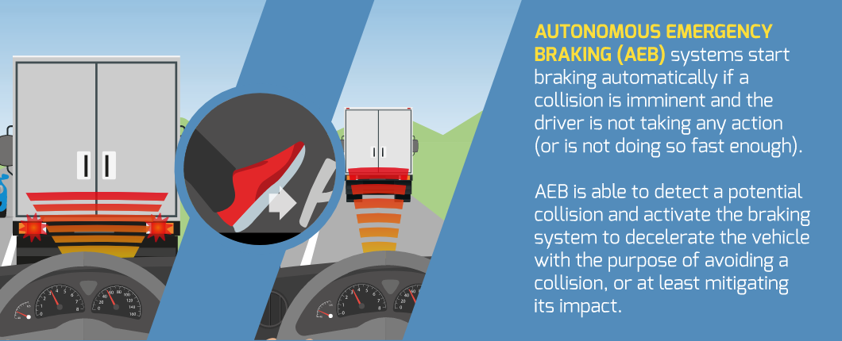
Autonomous emergency braking (AEB) (introduction)

Slide 14
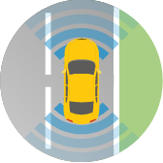
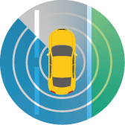
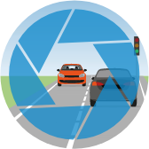
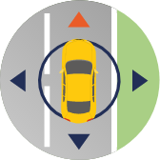
How does AEB work?
AEB systems use Lidar (light detection and radar) or camera sensors, or a combination of both, to help prevent potential accidents.
Information gleaned via these elements – together with data on a vehicle’s travel speed and trajectory – helps the AEB system to decide whether a hazardous situation is developing.
When detecting a potentially critical situation most systems will first try to warn the driver that action is needed. If no driver action is taken and the AEB system judges a collision is expected, the brakes will be applied automatically.
SENSOR
RADAR
CAMERA
GPS

Slide 15
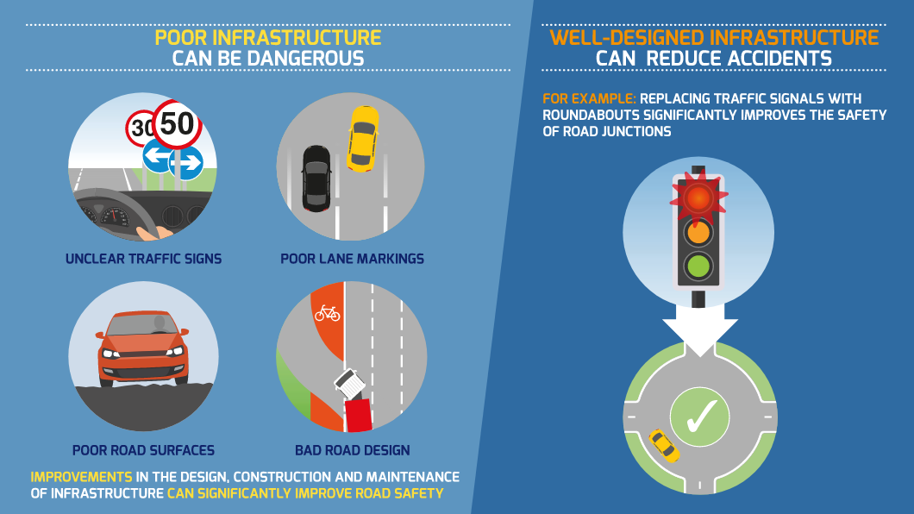
WHAT ROLE DO ROAD USERS AND INFRASTRUCTURE PLAY IN IMPROVING SAFETY?
Where seatbelts and airbags are in place to protect passengers in the case of a crash, AEB aims to reduce the likelihood of a crash happening in the first place.
A 2015 study by The European New Car Assessment Programme (Euro NCAP) and Australasian NCAP found that AEB led to a 38% reduction in real-world rear-end crashes.
Researchers at the University of Adelaide also found in a study of 104 crashes, AEB could have reduced fatal collisions by 20-25% and the likelihood of injury by 25–30%.

Slide 16
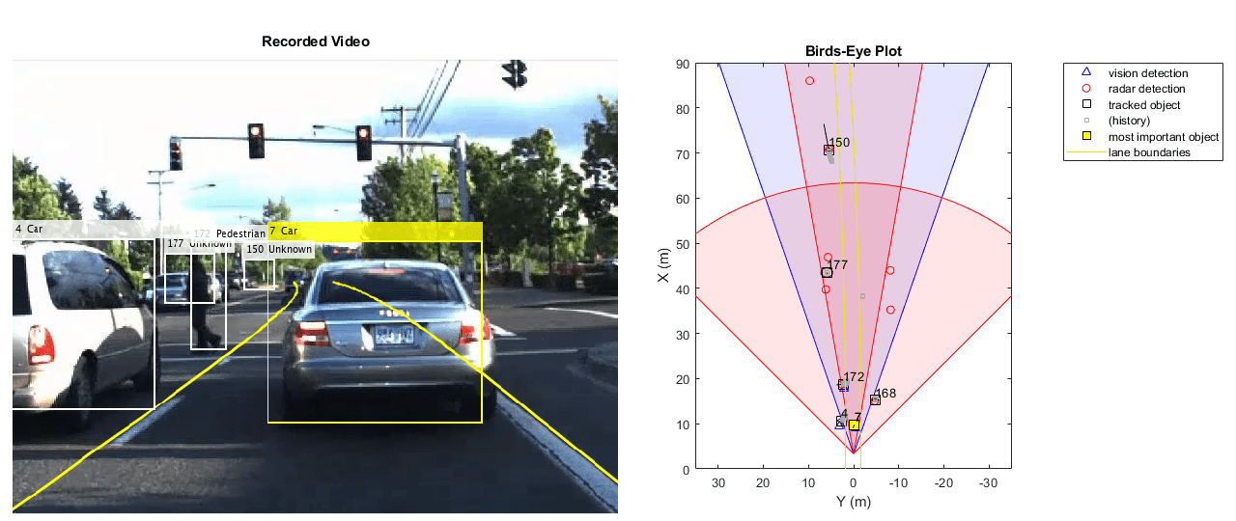
FORWARD COLLISION WARNING SYSTEM

Slide 17
WHAT IS FORWARD COLLISION WARNING SYSTEM?
Forward collision warning (FCW) is an important feature in driver assistance and automated driving systems, where the goal is to provide correct, timely, and reliable warnings to the driver before an impending collision with the vehicle in front.
To achieve the goal, vehicles are equipped with forward-facing vision and radar sensors.
Sensor fusion is required to increase the probability of accurate warnings and minimize the probability of false warnings.

Slide 18
The sensors used for this PROJECT were
1. Vision sensor, which provided lists of observed objects with their classification and Information about lane boundaries. 2. Radar sensor with medium and long range modes, which provided lists of unclassified observed objects. 3. IMU which reported the speed and turn rate of the vehicle 4. Video camera which recorded a video clip of the scene in front of the car.

Slide 19
STEPS INVOLVED
The process of providing a forward collision warning comprises the following steps:
Obtain the data from the sensors.
2. Fuse the sensor data to get a list of tracks, i.e., estimated positions and velocities of the objects in front of the car.
Issue warnings based on the tracks and FCW criteria. The FCW criteria are based on the Euro NCAP AEB test procedure and take into account the relative distance and relative speed to the object in front of the car.
The visualization is done using monoCamera and birdsEyePlot.

Slide 20
WORKING OF FCWS
If vehicle is equipped with this safety feature, the system alerts the driver through visual, aural, or tactile methods.
Sometimes it issues a warning in just one of these ways, and sometimes with a combination of warnings. It depends on the system’s design and, if the option to customize the notification exists, how the vehicle’s owner has calibrated it.
If the system employs Automatic Emergency Braking, the technology can slow or stop the vehicle before impact if the driver takes no action. If the system is not paired with automatic emergency braking, it will only warn the driver, who must take action.

Slide 21
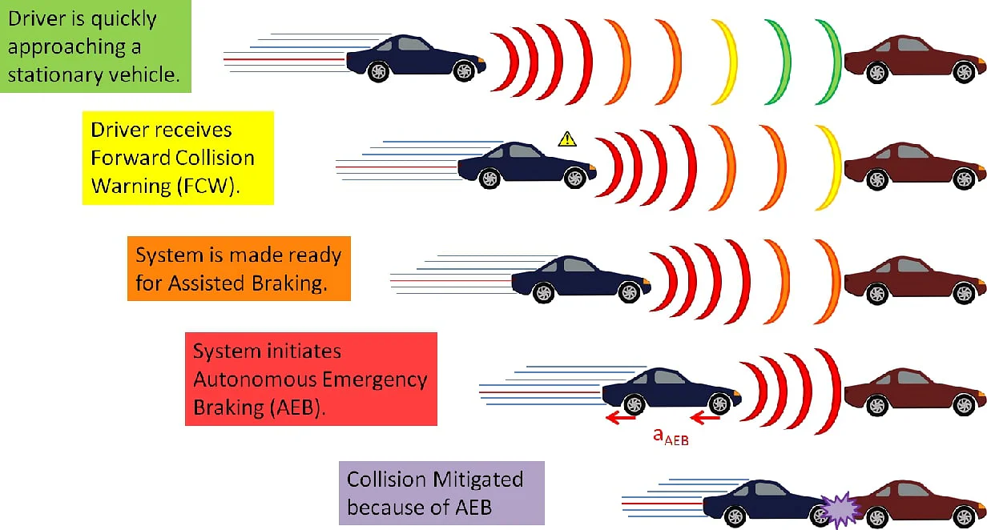
WORKING OF FCWS

Slide 22
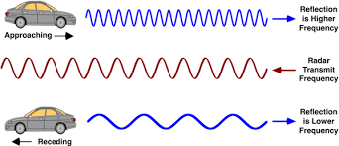
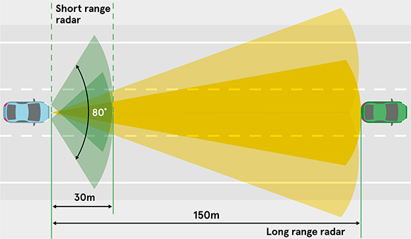
RADAR SENSORS

Slide 23
Why radar sensors ?
Radar sensors are an integral part of advanced driver assistance systems (ADAS) in modern cars. Radar sensors are not only vital for autonomous vehicles, but also improve safety and comfort features for drivers as well. Radar sensors for cars are typically deployed for :
Blind spot detection (BSD)
Lane change assistance (LCA),
Collision mitigation (CM)
Parking aid (PA)
Rear cross traffic alert (RCTA)

Slide 24
Why radar sensors (Contd) ?
Radar Sensors measure the distance, velocity and relative speed of the noticed object above wide distances .
These sensors uses wireless detecting technology like FMCW (Frequency Modulated Continuous Wave) to detect the motion by figuring out the object’s shape, position, motion trajectory and motion characteristics.
As compared to other sensors, these are not affected by darkness & light. These sensors can detect longer distances and is harmless for people & animals.

Slide 25
HOW RADAR SENSORS WORK ?
The working principle of a radar sensor is to compute the speed of an object along with its direction by detecting the change in frequency wave which is known as Doppler Effect.
Here extremely high carrier frequency wave (62 GHz) is modulated constantly with a lower frequency (10 MHz). Once the signal from an object is reflected back, it evaluates the phase shift between the two frequencies.
Here, the difference in transmitting time & receiving time is used to determine the distance between the sensor & an object.

Slide 26
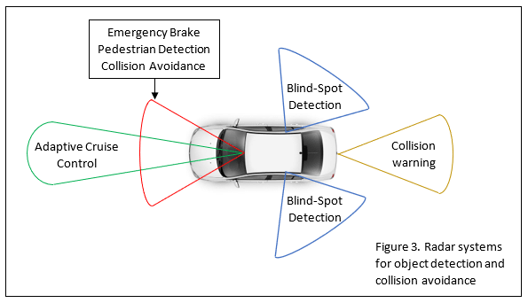
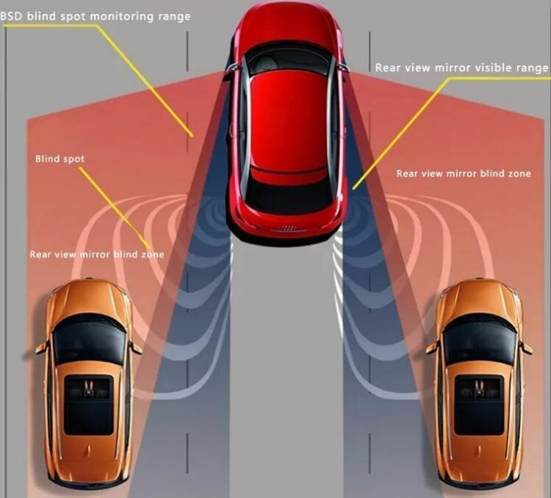
HOW RADAR SENSORS WORK?

Slide 27
ADVANTAGES
DISADVANTAGES
The radar sensor is independent of different weather conditions
Bears excessive cold & heat
It works in bad lighting conditions
It works in the dark
Its maintenance is free
It cannot differentiate & resolve numerous targets which are extremely close like our eye.
It cannot identify the colour of the objects.
It cannot observe objects which are too deep and in the water.

Slide 28
OTHER APPLICATIONS
Military
Security system
Automotive electrons
Intelligent traffic radar
UAV radar
Intelligent lighting
Medical treatment

Slide 29
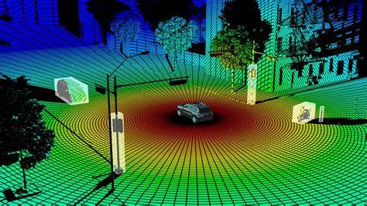
Lidar Systems

Slide 30
What IS LIDAR?
LIDAR is an acronym for Light Detection and Ranging. In LIDAR, laser light is sent from a source and reflected from objects in the scene.
The reflected light is detected by the system receiver and the time of flight (TOF) is used to develop a distance map of the objects in the scene.
LIDAR systems can be used to create a three-dimensional model of a dynamic scene, such as what may be encountered by an autonomous driving vehicle.

Slide 31
WORKING OF LIDAR
Laser, Scanning mechanism, GPS and inertia measurement and Computer are essential components of LIDAR.
LiDAR scanning units can fire hundreds of thousands of pulses per second. These light waves bounce off objects and return to the LiDAR sensor.
The sensor uses the time it takes for each pulse to return to calculate distance (time of flight). Each of these pulsed laser measurements, or returns, can be processed into a 3D visualization known as a ‘point cloud’.
A typical LiDAR system fires around million pulses each second. One of the key parameters to be considered before using the data of reflected pulse is the height of the unit and the velocity of the vehicle which houses the sensor so as to get an accurate estimation of mapping.

Slide 32
Working of lidar (cont.)
A CNN model can infer on any objects surrounding the autonomous machine and plan its path without colliding with other objects or vehicles on the road.
Apart from obstacle detection LiDAR is also used in localization-SLAM (simultaneous localization and mapping).
LiDAR detection in general practice is classified in to two categories namely :coherent and incoherent.
Coherent detection- The scanning mechanism that receives the pulses after reflection uses ToF (Time of flight) to determine azimuth and elevation.
Incoherent detection- The scanning mechanism compares the received pulse with that of the transmitted one to determine azimuth and elevation.
Each of the reflected pulses irrespective of detection method are processed for a 3D object detection using point cloud processing techniques.

Slide 33
APPLICATIONS
In atmospheric sciences, LiDAR has been used for the detection of many types of atmospheric constituents and to characterize aerosols in the atmosphere, investigate upper atmospheric winds, profile clouds, aid the collection of weather data.
In astronomy, LiDAR has been used to measure distances, both for distant objects such as the moon and for very near objects.
In agriculture, LiDAR can be used to map topology and crop growth, which can provide information on fertilizer needs and irrigation requirements.
In archaeology, LiDAR has been used to map ancient transportation systems under thick forest canopy.
Today, LiDAR is frequently used to create a three-dimensional model of the world around the LiDAR sensor.

