Slide 1
Student Attendance Analysis
r = 0.351
attendance vs final marks
Analyzing the relationship between attendance and academic performance
SIMULATED DATA | B.Tech Data Science & AI
Presented by:
AYUSHMAN SHUKLA(202410101150186)
LUCKY PRATAP SINGH(202410101150185)
UDBHAV NATH SHUKLA(202410101150184)
Notes:
Good morning everyone. My project is Student Attendance Analysis: does higher attendance go with better academic performance, and can attendance help us spot students who need support? Please note that all data in this project is simulated, so the findings describe the simulated dataset, not a real college.

Slide 2
Introduction
200
1,165
5
8
students
student-subject records
departments
semesters
Attendance is recorded daily; most colleges require 75%
Analytics can test whether attendance relates to results
Goal: an end-to-end, reproducible, beginner-friendly project
Stack: Python, SQL and Power BI, all free tools
Notes:
Attendance is one of the few indicators colleges record every day, and most require seventy-five percent. This project uses a simulated dataset of two hundred students and about twelve hundred records across five departments to test the common belief that attendance matters, using only free tools.

Slide 3
Problem statement
Does higher attendance correlate with better academic performance, and can attendance data help identify students who may need academic support?
1
2
3
Correlation
Support, not blame
Honest data
is not causation: we test for confounders
flags start a conversation, not a verdict
simulated, so conclusions are provisional
Notes:
The central question is on the screen. Two cautions guide the whole project: correlation is not causation, and any risk flag is meant to start a supportive conversation, not to label a student. And because the data is simulated, conclusions are provisional.

Slide 4
Objectives
1
2
3
Build and clean a realistic synthetic dataset
Explore attendance by department, semester, subject
Measure the attendance-marks link, with its limits
4
5
6
Flag students for support using clear rules
Design a normalised SQL database and queries
Design a 3-page Power BI dashboard
Notes:
There are six objectives: build and clean the data, explore it, measure the relationship honestly, flag students using transparent rules, store everything in a normalised SQL database, and design a three-page Power BI dashboard.

Slide 5
Technology stack
Python
Matplotlib / Seaborn
SciPy / scikit-learn
Pandas, NumPy: cleaning and analysis
charts and visual EDA
statistics and baseline model
SQLite
Power BI
Jupyter
normalised database, 14 queries
interactive 3-page dashboard
executed, documented notebook
Notes:
Everything uses free tools. Python with Pandas and NumPy handles cleaning, Matplotlib and Seaborn draw charts, SciPy and scikit-learn do statistics and the baseline model, SQLite stores the data, Power BI presents the dashboard, and Jupyter documents the analysis.

Slide 6
Dataset and attributes
Identity: Student_ID, Name, Department, Semester, Subject
Attendance: Total_Classes, Classes_Attended, Attendance_Percentage
Assessment: Assignment_Score, Internal_Marks, Final_Exam_Marks (each /100)
Context: Study_Hours_Per_Day, Previous_Semester_CGPA
Outcome: Overall_Performance_Category
seed 42
fully reproducible
1,215 rows
raw, with injected errors
1,165 rows
after cleaning
Notes:
The dataset has fifteen columns. Marks are out of one hundred and CGPA is out of ten. It is generated with a fixed seed so anyone can reproduce it. The raw file has twelve hundred and fifteen rows including deliberate errors, and about eleven sixty-five rows remain after cleaning. To use real data, you would export an anonymised file with the same columns.

Slide 7
System architecture and workflow
1
2
3
4
5
6
Generate
>
Clean
>
Analyse
>
Flag
>
Store
>
Visualise
seeded CSV
validate, log
EDA, stats
risk rules
SQLite, 14 queries
Power BI
One command re-runs everything: python src/run_all.py
Notes:
The workflow has six stages. Data is generated, cleaned and validated, analysed, scored with risk rules, loaded into SQLite, and exported as star-schema tables for Power BI. A single command re-runs the whole pipeline, which makes the project reproducible.

Slide 8
Data cleaning and preprocessing
Problem found | Rows | Decision
Exact duplicates | 15 | Dropped
Inconsistent department labels | 20 | Standardised
Attended > total classes | 8 | Dropped (unknown truth)
Stored % differs from counts | 15 | Recalculated
Marks > 100 / study hours > 12 | 8 | Set to missing
Missing final / internal marks | 27 | Dropped (never impute outcome)
Missing CGPA / study / assignment | 78 | Imputed (student/subject median)
Attendance % is always recomputed as attended / total x 100
Notes:
The raw data was deliberately messy. We removed duplicates, standardised department names, dropped impossible attendance entries, and recalculated attendance from the counts. Invalid marks became missing. We never impute the outcome, final marks, but fill student-level gaps from the same student's other rows.

Slide 9
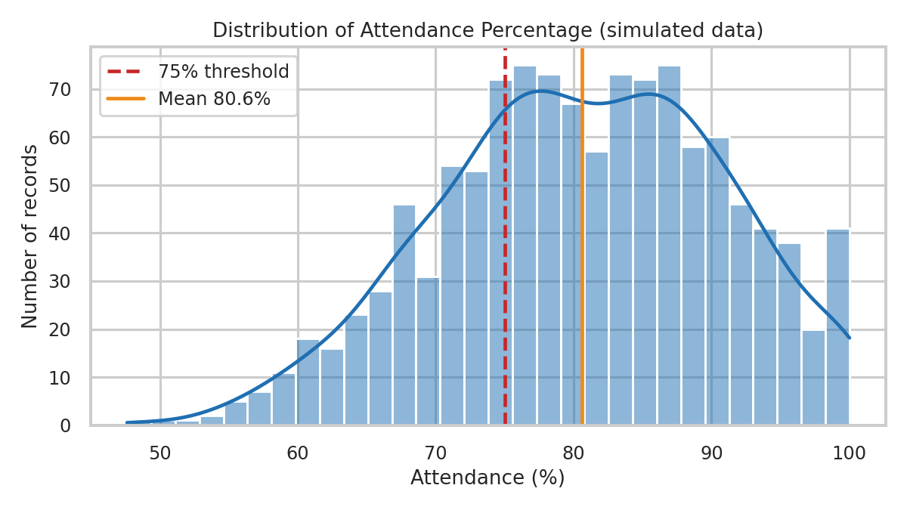
Exploratory data analysis
Mean attendance 80.59%; 29.2% of records below 75%
Highest shortage: ECE (36.8% of records below 75%)
Marks rise steadily with each attendance band
Notes:
Average attendance is about eighty-one percent, and roughly 29 percent of records fall below the seventy-five percent threshold. ECE has the largest share of shortages in this simulation. On the right, average final marks climb from about 48.79 for students under sixty percent attendance to about 63.84 for those above eighty-five.

Slide 10
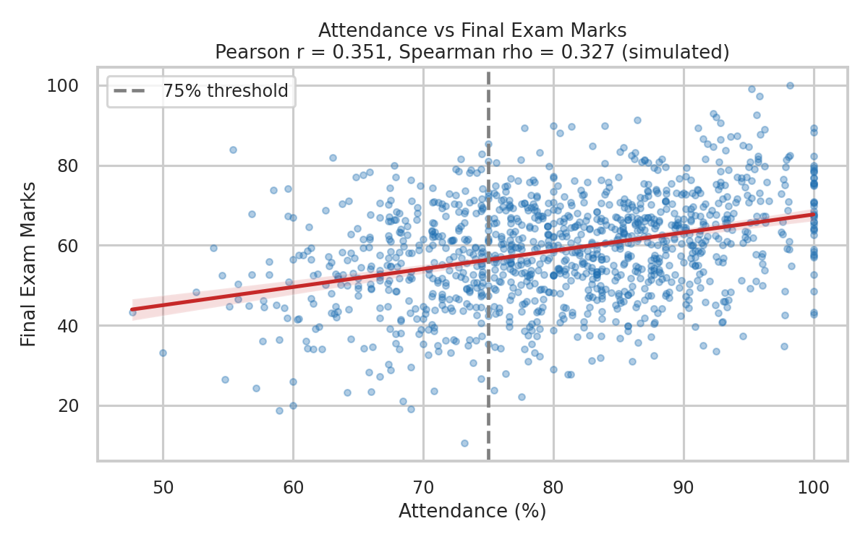
Attendance versus marks
0.351
Pearson r (moderate)
0.327
Spearman rho
0.097
r after controlling CGPA + study hours
Above 75% attendance: 61.06 marks vs 53.64 below (Welch p < 0.001). Association, not proof of cause.
Notes:
Attendance and final marks have a Pearson correlation of 0.351 and a Spearman correlation of 0.327, a moderate positive link. Students at or above seventy-five percent average 61.06 marks versus 53.64 below. But after holding previous CGPA and study hours constant, the correlation drops to about 0.097. So much of the link is shared with other factors like motivation. Correlation is not causation.

Slide 11
SQL database and queries
Students
Subjects
14 queries, e.g.
Overall attendance 80.64%
Dept-wise attendance
SQL Pearson r = 0.351
Students below 75%
Data-quality audit = 0 bad rows
PK Student_ID
PK Subject_ID
Attendance
Assessments
Academic_Performance
FK student, subject
FK student, subject
FK student, subject
Primary keys, foreign keys and CHECK constraints keep data valid; no orphan rows (audit query = 0).
Notes:
The database has five tables with primary and foreign keys. Fourteen queries cover overall and department attendance, shortage lists, subject performance, top students, trends and a data-quality audit. I even computed the Pearson correlation in plain SQL and it matches Python at zero point three five one.

Slide 12
Power BI dashboard design
1 Executive overview
2 Attendance and performance
3 Support and risk
KPI cards, threshold slider, band chart, department chart, slicers
Scatter + trend line, correlation card, subject comparison
Risk donut, flagged-student table, conditional formatting, drill-through
Status: all CSV tables, DAX measures and build steps are ready (powerbi/). The .pbix file is built in Power BI Desktop; screenshots are shown in the live demo.
Notes:
The dashboard has three pages: an executive overview, an attendance-and-performance page, and a support-and-risk page with conditional formatting and drill-through. The star-schema CSV files, DAX measures and step-by-step build guide are ready. I am being upfront that the pbix file itself is built in Power BI Desktop, so I will show it live rather than as slide screenshots.

Slide 13
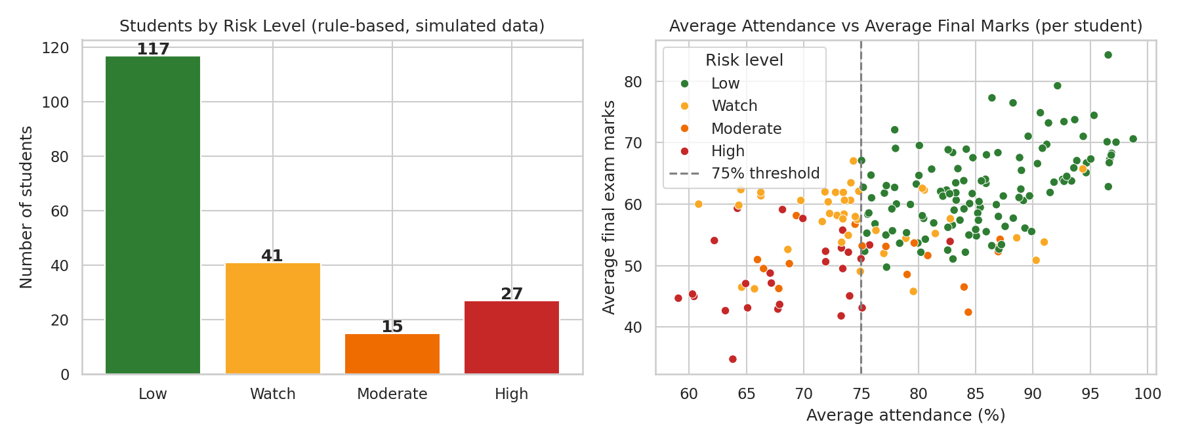
Student risk analysis and baseline ML
Model | MAE | R2
Mean baseline | 10.23 | -0.009
Linear, no attendance | 8.77 | 0.238
Linear + attendance | 8.75 | 0.252
Random forest | 8.92 | 0.216
Grouped split by student, no leakage. Attendance adds little beyond other predictors; predictions are estimates, not guarantees.
Rules: attendance < 75, internal < 50, assignment < 60, CGPA < 6
42 of 200 students (21%) have 2+ flags
Flags start support conversations, not labels
Notes:
The risk system uses four transparent rules, and two or more flags suggests a supportive conversation. 42 of two hundred students are flagged. For the optional model, I split by student to avoid leakage. Linear regression cuts the error from 10.23 to about 8.75 marks, but attendance adds very little beyond other variables, and the random forest did not do better. Predictions are estimates, not guarantees.

Slide 14
Limitations and future scope
Limitations
Future scope
Simulated data, not real students
One snapshot per student; rows are clustered
No causal design; confounders remain
Simple threshold rules miss context
Real anonymised institutional data
Weekly attendance time series
Mixed-effects and causal methods
Fairness audit and mentor alerts
Notes:
Key limitations: the data is simulated, each student appears once with several subject rows, and nothing here proves causation. Future work includes real anonymised data, weekly attendance time series, causal methods, fairness audits and automatic alerts for mentors.

