Slide 1
Project : 02
Availability, Accessibility, and Inequalities
of Water, Sanitation, and Hygiene (WASH) Services in Indian Metro Cities
Ayushman Anupam (bmat2006)
Kush Muzunder (bmat2011)
Priyansh Pankaj (bmat2017)
Utpalraj Kemprai (bmat2032)
15 December 2021

Slide 2
Content :
Introduction
Data Source
Sample
Background variables
Outcome variables
PCA – Principal Component Analysis
Inequalities and logistic Regression
Inference
Dependence on outcome variables
Conclusion

Slide 3
Introduction
WASH is related to any country’s concern in relation to the health of their people. It becomes the right of the citizen to acquire safe water, sanitation and hygiene measures. WASH are among the most crucial for human to create healthy life. The paper is about availability and accessibility of water, sanitation, and hygiene (WASH), and the overall ‘WASH’ performance in terms of levels, trends and inequality across the six major cities (Mumbai, Delhi, Chennai, Bangalore, Kolkata, and Hyderabad) of India using data from two rounds of the India Human Development Survey conducted during 2004-05 and 2011-12.
Report tells us that accessibility, availability and overall WASH performance during 2011-12 were better than that of 2004-05 but the change is not so significant and not uniform over all the cities , this one-sided asperity is traceable to literacy, housing condition, economic stability ,categorical status , etc.

Slide 4
Data source
The data in the paper is from the first and second rounds of the India Human Development Surveys (IHDSs). These two rounds of surveys were conducted in 2004–05 (IHDS-I) and 2011–12 (IHDS-II), with the collaboration of the University of Maryland by the National Council of Applied Economic Research (NCAER), New Delhi. IHDS has covered a multi-topic panel survey of 41,554 households in 1,503 villages and 971 urban blocks of 276 towns and cities (Desai et al., 2010). In these surveys, a special representative sample design is adopted for the six largest populated cities in India i.e- Mumbai, Delhi, Bangalore, Hyderabad, Chennai and Kolkata
The study is limited to these six cities due to data availability, but the sample sizes allow us to conduct an suitable statistical analysis. The surveys collected information on income, consumption, the standard of living, employment, education, and various aspects of gender and family relationships. The surveys also collected information on water, sanitation, and hygiene, as well as the educational, medical, and village infrastructure.

Slide 5
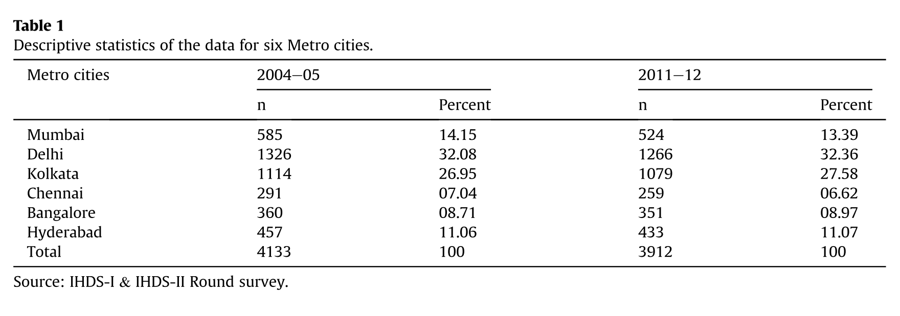
Sample
The sample size of data for the selected cities in 2004-05 [N = 4133] and 2011-12 [N = 3912] with distribution as for Delhi, Kolkata, Mumbai, Hyderabad, Bangalore, and Chennai respectively (as in Table 1)

Slide 6
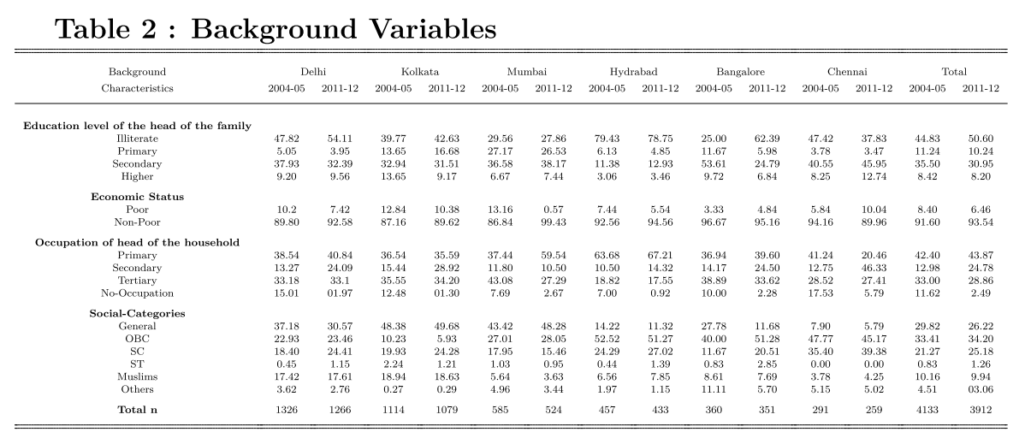
Background Variables
In this study, WASH availability, accessibility, and overall performance have been compared using a good range of Background-Variables as shown in Table 2. These variables aren’t used in estimation of WASH score and inequalities but rather in showing their dependency on them

Slide 7
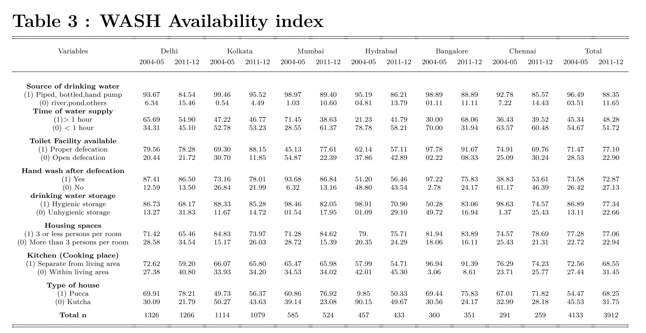
Outcome Variables

Slide 8
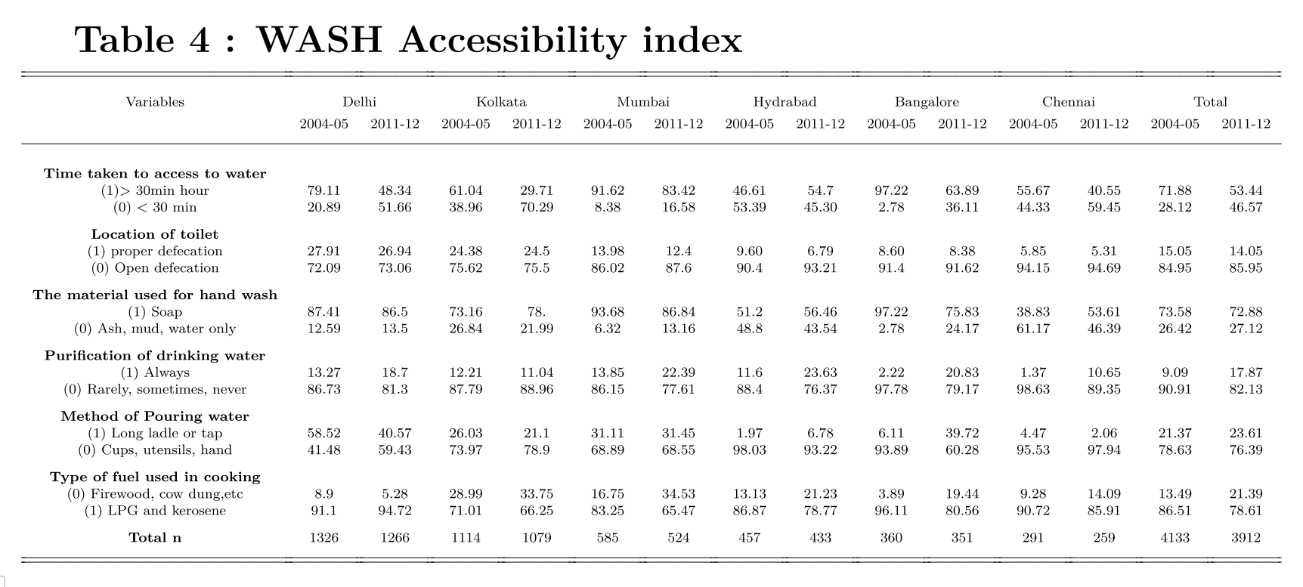

Slide 9
Statistical Analysis
Principal Component Analysis:
PCA was invented in 1901 by Karl Pearson, as an analogue of the Principal Axis Theorem in mechanics.
Principal Component Analysis, or PCA, is a dimensionality-reduction method that is used to reduce the dimensionality of large data sets, by transforming a large set of variables into a smaller one that still contains most of the information in the large set.
Let us illustrate the process with an example :

Slide 10
An example to illustrate Principal Component Analysis
Suppose John, Mike and Kate get the following percentages for exams in Math, Science, English and Economics as follows:
Name\Subject | Math | Science | English | Economics
John | 80 | 85 | 60 | 55
Mike | 90 | 85 | 70 | 45
Kate | 95 | 80 | 70 | 50
In this case there are 12 scores in total. Each score represents the exam results for each person in a particular subject.
We wish to reduce the no. of variables (subjects) and we do this using PCA

Slide 11

An example to illustrate Principal Component Analysis
Step 1: Standardization
In our example it will be (subject score – mean score in subject)/sd(subject) for each of the subjects.
Why is it done ?
It is critical to perform standardization prior to PCA, is that the latter is quite sensitive regarding the variances of the initial variables. That is, if there are large differences between the ranges of initial variables, those variables with larger ranges will dominate over those with small ranges which will lead to biased results.

Slide 12
An example to illustrate Principal Component Analysis
After standardizing the marks we get the standardized scores as:
Name\Subject | Math(x1) | Science(x2) | English(x3) | Economics(x4)
John | -1.0910895 | 0.5773503 | -1.1547005 | 1
Mike | 0.2182179 | 0.5773503 | 0.5773503 | -1
Kate | 0.8728716 | -1.1547005 | 0.5773503 | 0
-1.0910895 | 0.5773503 | -1.1547005 | 1
0.2182179 | 0.5773503 | 0.5773503 | -1
0.8728716 | -1.1547005 | 0.5773503 | 0
A =

Slide 13

An example to illustrate Principal Component Analysis
Step 2: Constructing the Covariance matrix for the variables
Next construct a pxp Covariance matrix using the standardized scores:

Slide 14
An example to illustrate Principal Component Analysis
Covariance matrix for the standardized scores in the example
58.33 | -16.67 | 41.67 | -25
-16.67 | 33.33 | -8.33 | 0
41.67 | -8.33 | 8.33 | -25
-25 | 0 | -25 | 25

Slide 15
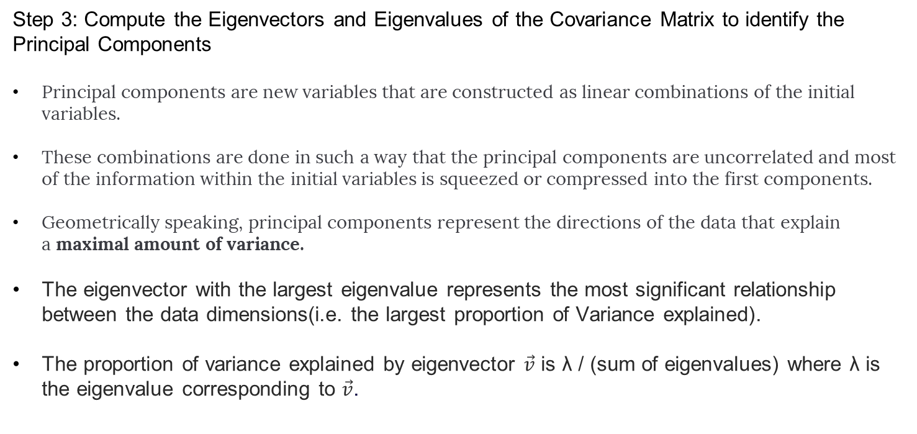
An example to illustrate Principal Component Analysis
Step 3: Compute the Eigenvectors and Eigenvalues of the Covariance Matrix to identify the Principal Components
Principal components are new variables that are constructed as linear combinations of the initial variables.
These combinations are done in such a way that the principal components are uncorrelated and most of the information within the initial variables is squeezed or compressed into the first components.
Geometrically speaking, principal components represent the directions of the data that explain a maximal amount of variance.
The eigenvector with the largest eigenvalue represents the most significant relationship between the data dimensions(i.e. the largest proportion of Variance explained).
The proportion of variance explained by eigenvector $\vec{v}$ is λ / (sum of eigenvalues) where λ is the eigenvalue corresponding to $\vec{v}$.

Slide 16
An example to illustrate Principal Component Analysis
For the covariance in our example , the output for the Eigenvalues and Eigenvectors in R:
$values
[1] 102.138968 32.223124 8.737505 18.109597
$vectors
[,1] [,2] [,3] [,4]
[1,] 0.7566449 0.002294343 0.53190416 0.38021196
[2,] 0.2393186 0.905411394 0.35013508 0.01903257
[3,] 0.4626645 0.115718070 0.03074996 0.87841067
[4,] 0.3951665 0.408453513 0.77041407 0.28891404
Here the first and second eigenvalue represent 0.63 and 0.20 of the total variance ,i.e. first two components represent over 80% of the variance.

Slide 17
An example to illustrate Principal Component Analysis
Step 4 : Discard the eigenvectors with less significance and form with the remaining ones a matrix of vectors say F to calculate the Principal Component Scores
In our example we discard the last two eigenvalues and from matrix F as
0.7566449 | 0.002294343
0.2393186 | 0.905411394
0.4626645 | 0.115718070
0.3951665 | 0.408453513
We then calculate the Principal component scores as $F^{T}$A

Slide 18
An example to illustrate Principal Component Analysis
Name\Principal Components | PC1 | PC2
John | -0.8264691 | 0.7950700
Mike | 0.1752371 | 0.1815965
Kate | 0.6512320 | -0.9766665
So we have reduced the number of variables without losing much information

Slide 19
Using PCA for calculating the WASH scores
We repeat the process described in the example for the outcome variables for WASH availability and WASH accessibility and take the First Principal component as the score for performance for both the years.
The overall WASH score is the average of the WASH availability and WASH accessibility scores.

Slide 20
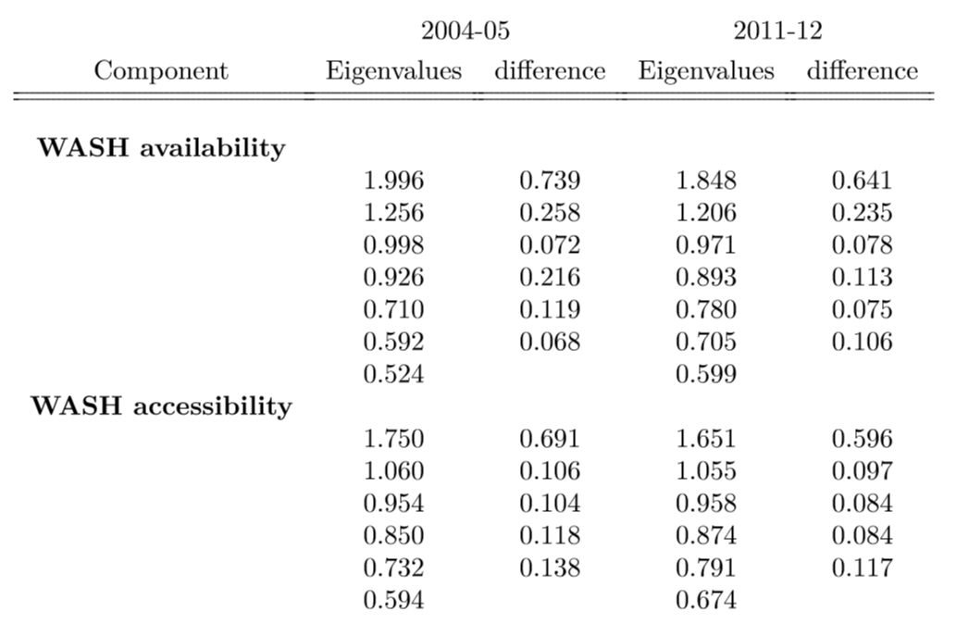
Eigenvalues for WASH scores

Slide 21
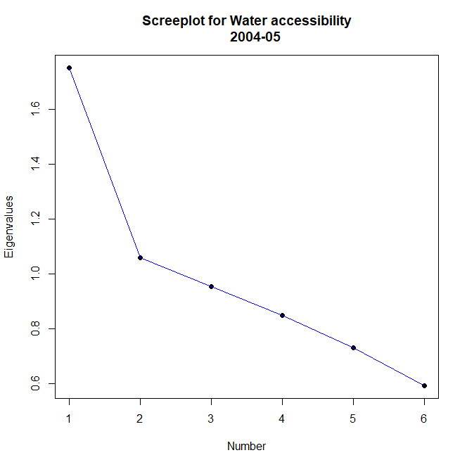
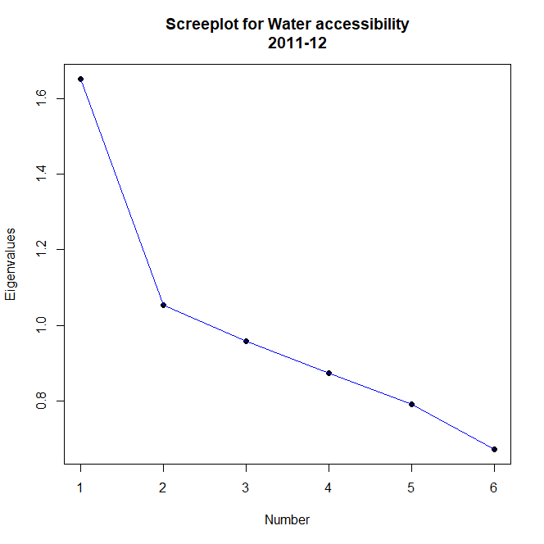
Screeplots for Eigenvalues of WASH accessibiilty

Slide 22
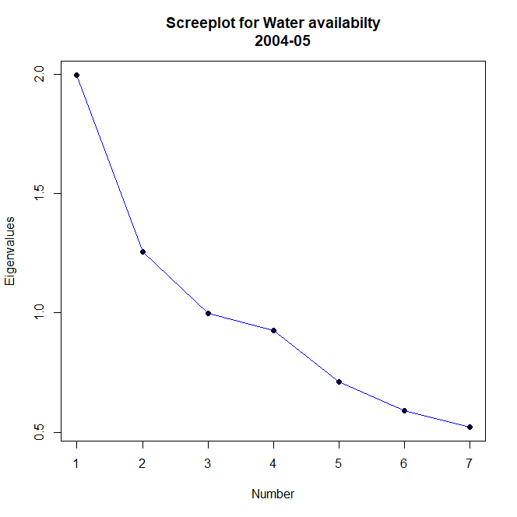

Screeplots for Eigenvalues of WASH availabilty

Slide 23
Binary Logistic Regression
Binomial or binary logistic regression deals with situations in which the observed outcome for dependent variable can have only two possible types, "0" and "1" (which may represent, for example, "pass" vs. "fail" or "win" vs. "loss").
Binary Logistic is used to estimate the probabilities of dependent variable being 0 or 1 based on the values of the independent variable.
An example where it can be used will be Probability of passing an exam versus hours of study
Hours | 0.5 | 0.75 | 1 | 4 | 2 | 2.5 | 1.75
Pass | 0 | 0 | 1 | 1 | 1 | 1 | 0

Slide 24
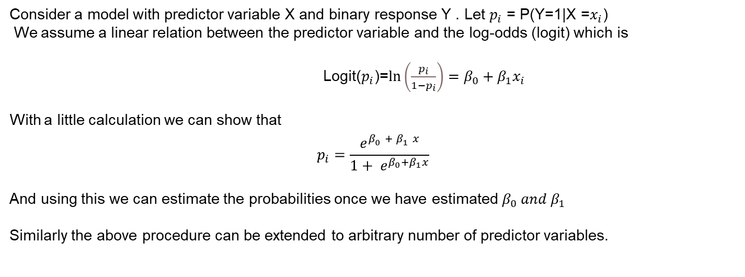
Theory of Binary Logistic Regression
Consider a model with predictor variable X and binary response Y . Let $p_{i}$ = P(Y=1|X =$x_{i}$)
We assume a linear relation between the predictor variable and the log-odds (logit) which is
Logit($p_{i}$)=$\ln\left(\frac{p_{i}}{1−p_{i}}\right)=β_{0}+β_{1}x_{i}$
With a little calculation we can show that
$$p_{i}=\frac{e^{β_{0}^{}+ β_{1}^{}x}}{1+ e^{β_{0}+β_{1}x}}$$
And using this we can estimate the probabilities once we have estimated $β_{0} and β_{1}$
Similarly the above procedure can be extended to arbitrary number of predictor variables.

Slide 25
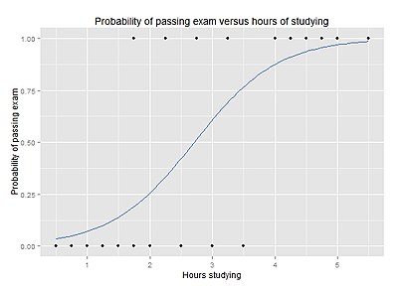
Theory of Binary Logistic Regression
Rough plot of $p_{i } vs x_{i}$ for the study hours vs pass example

Slide 26
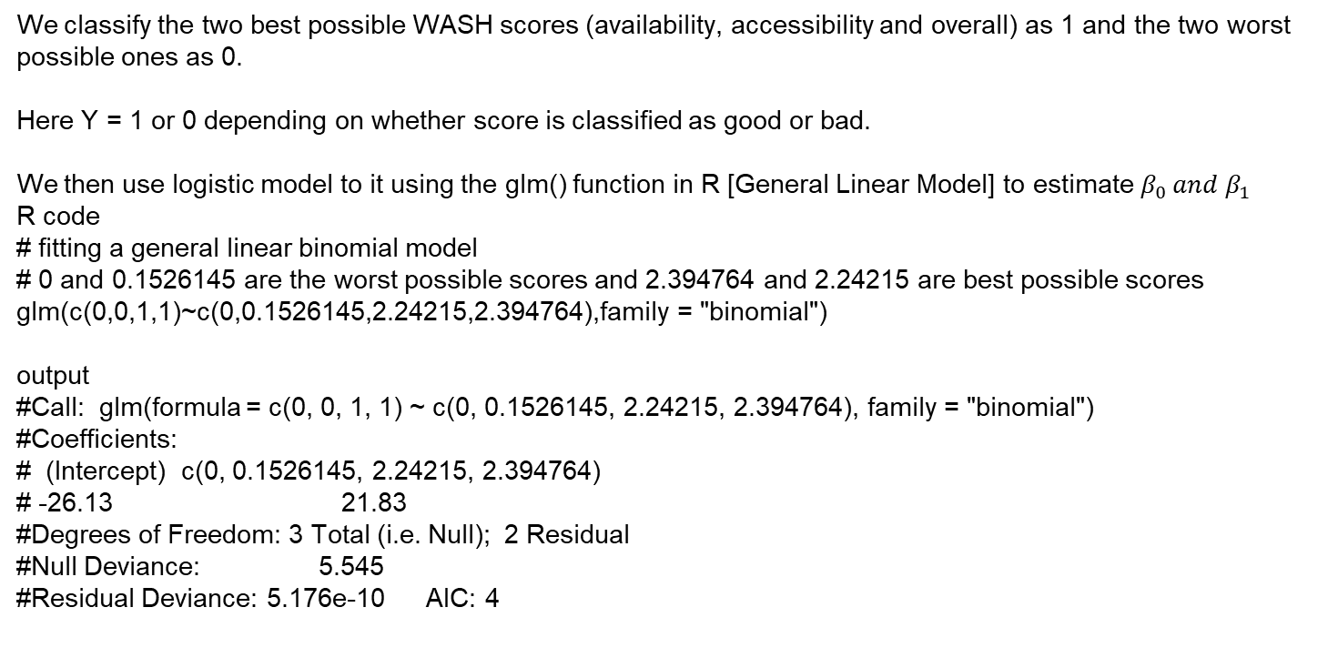
Binary Logistic Regression for Classifying WASH scores as good or bad
We classify the two best possible WASH scores (availability, accessibility and overall) as 1 and the two worst possible ones as 0.
Here Y = 1 or 0 depending on whether score is classified as good or bad.
We then use logistic model to it using the glm() function in R [General Linear Model] to estimate $β_{0} and β_{1}$
R code
# fitting a general linear binomial model
# 0 and 0.1526145 are the worst possible scores and 2.394764 and 2.24215 are best possible scores
glm(c(0,0,1,1)~c(0,0.1526145,2.24215,2.394764),family = "binomial")
output
#Call: glm(formula = c(0, 0, 1, 1) ~ c(0, 0.1526145, 2.24215, 2.394764), family = "binomial")
#Coefficients:
# (Intercept) c(0, 0.1526145, 2.24215, 2.394764)
# -26.13 21.83
#Degrees of Freedom: 3 Total (i.e. Null); 2 Residual
#Null Deviance: 5.545
#Residual Deviance: 5.176e-10 AIC: 4

Slide 27
Binary Logistic Regression for Classifying WASH scores as good or bad
Classification :
We estimate the probabilities for WASH each score in the data.
If the probability of Y = 1 is greater than 0.5, the score is considered to be good and bad otherwise.
We classify the percentages of households with good and bad WASH in each of the 6 cities of the study.

Slide 28
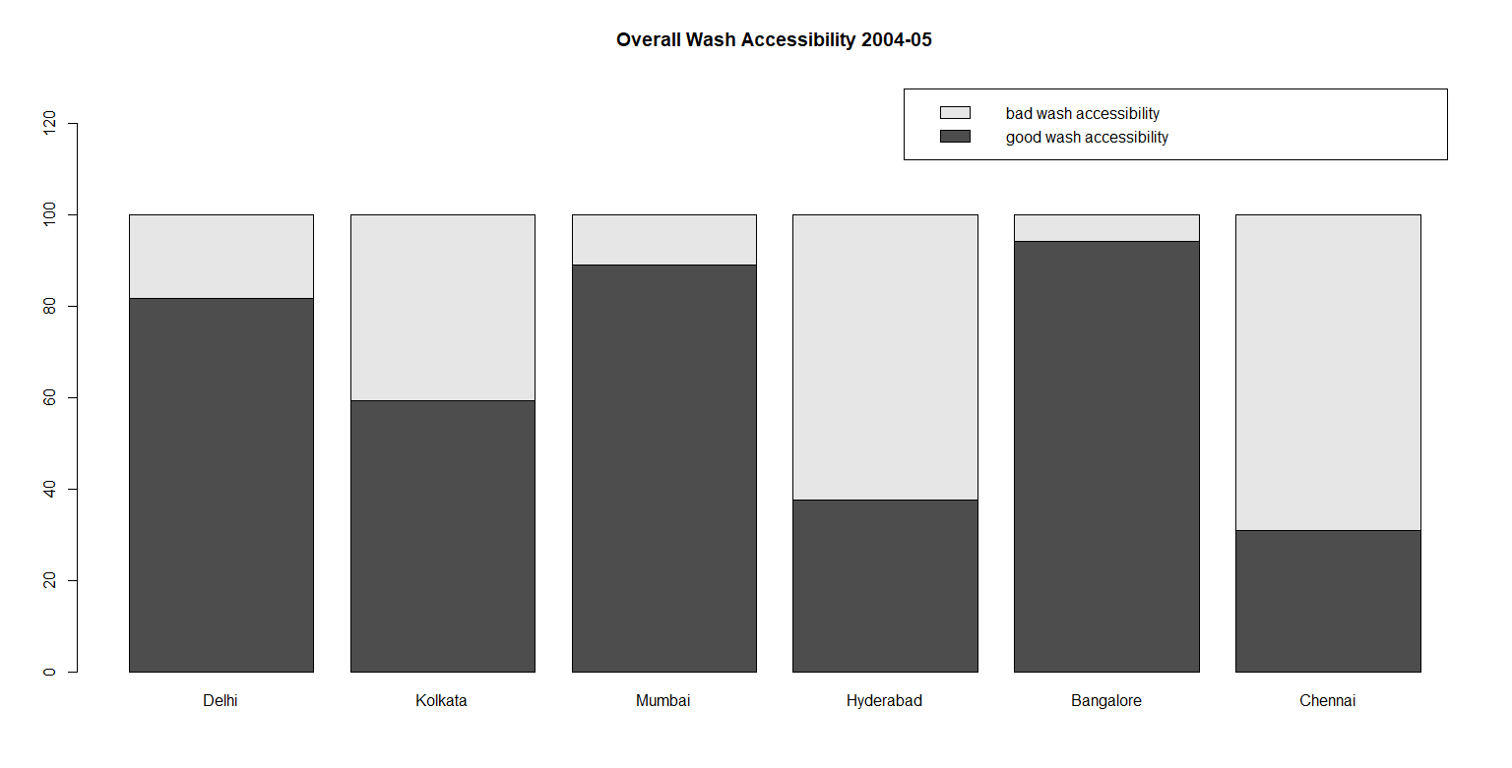
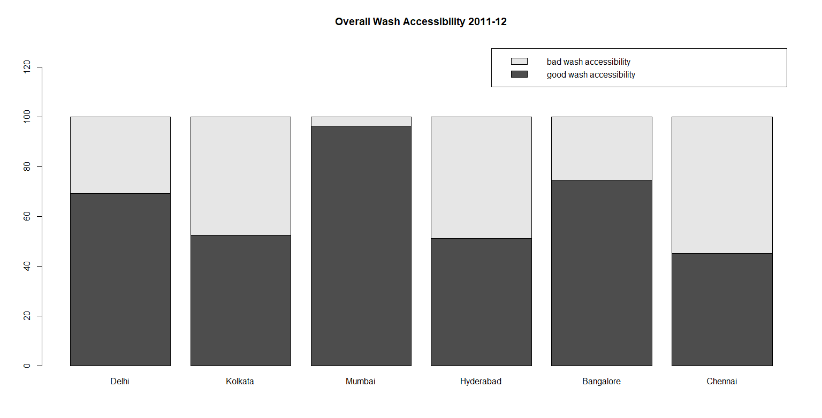
Plots for classification of scores as good or bad

Slide 29
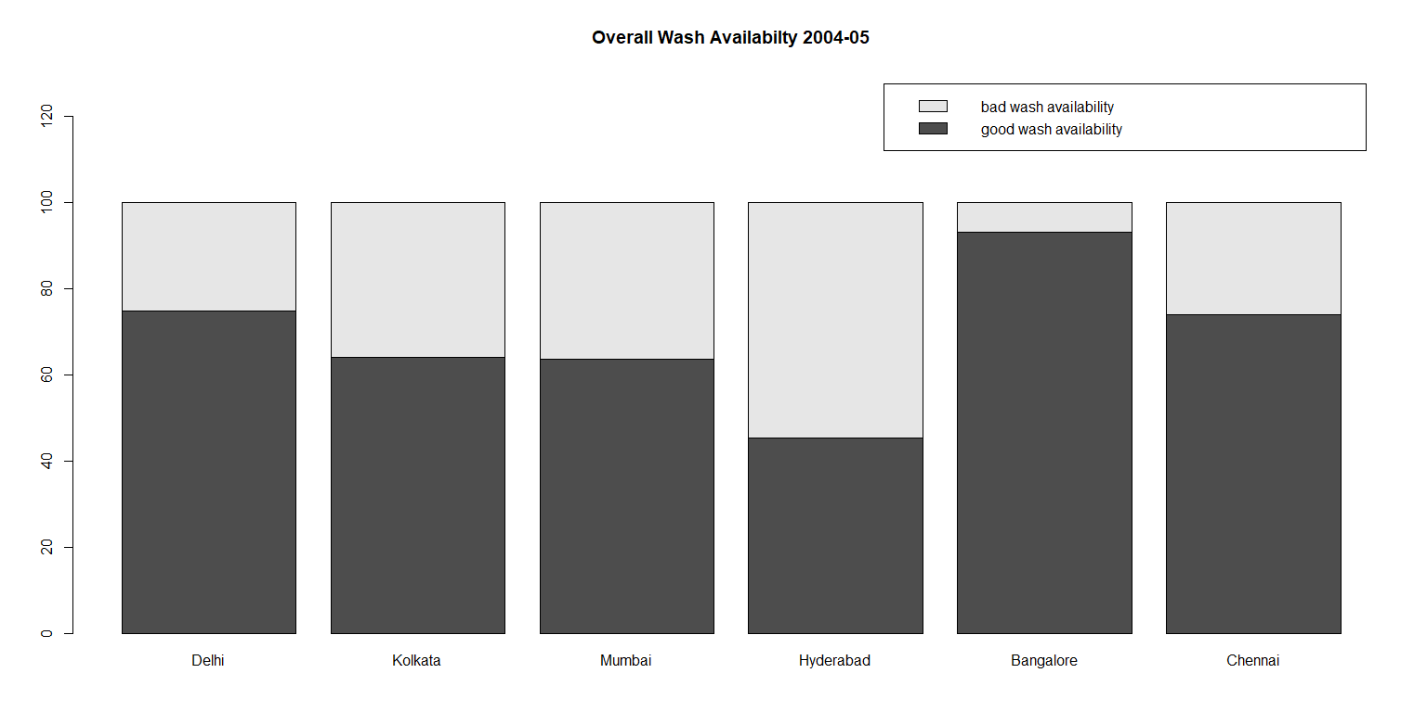
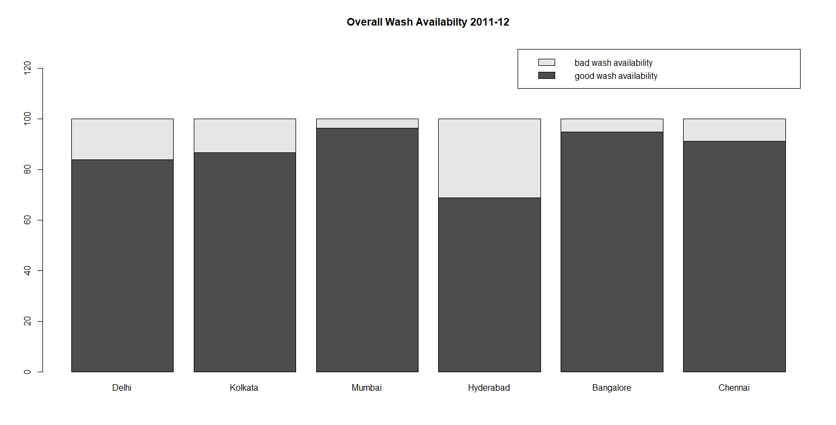
Plots for classification of scores as good or bad

Slide 30
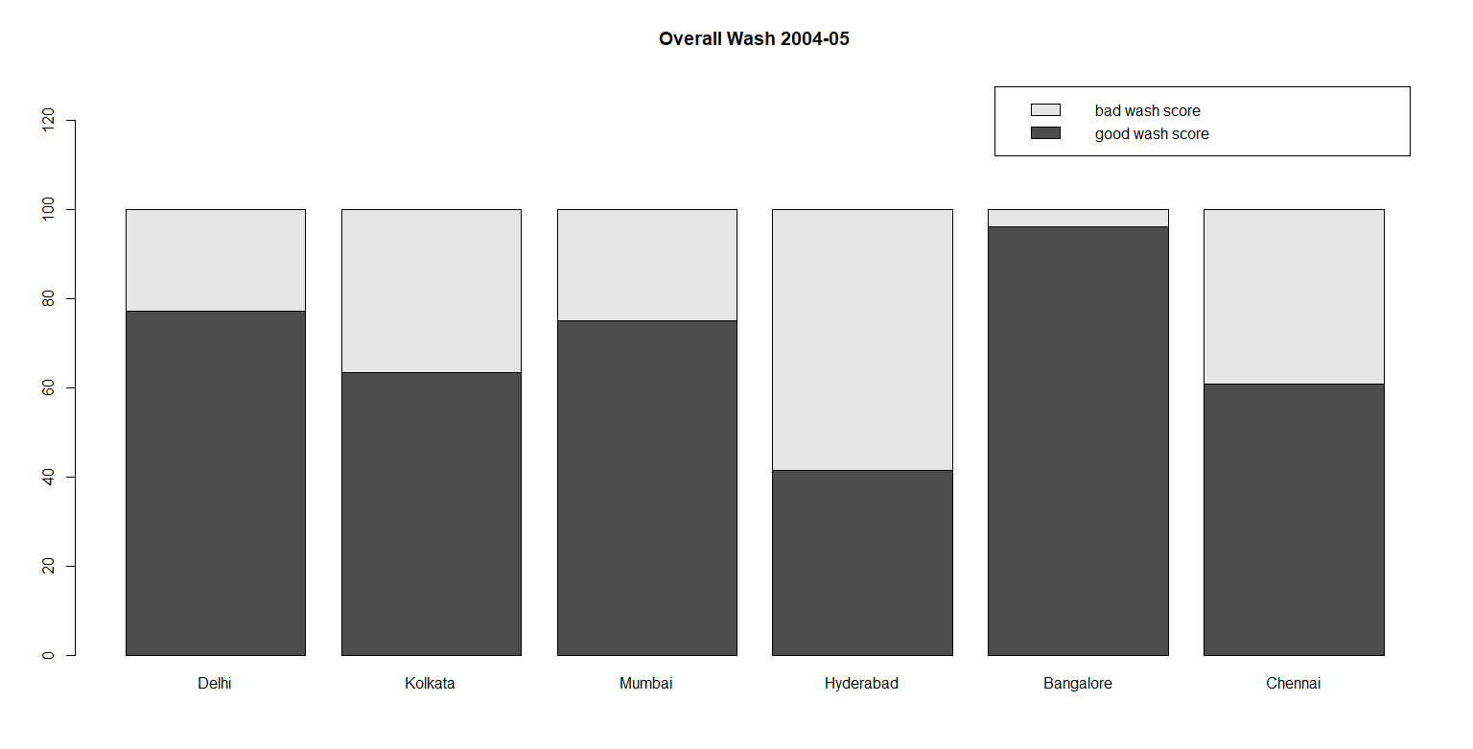
Plots for classification of scores as good or bad

Slide 31
Inequalities in WASH among and between cities
Gini Coefficient or Gini Index
Gini coefficient: The Gini index or Gini coefficient is a statistical measure of distribution, commonly used as a gauge of economic inequality.
In simpler terms, higher the Gini Index, higher the inequality among the values of the variable.

Slide 32
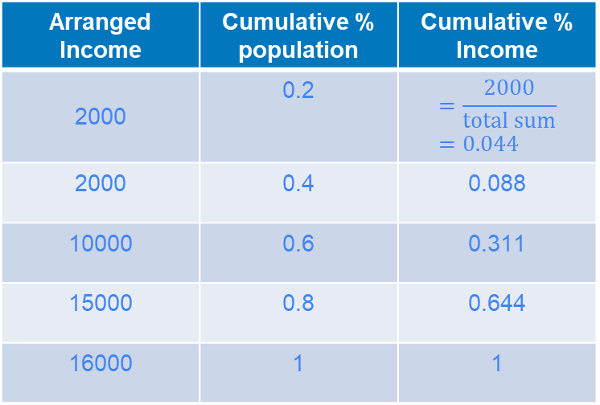
Gini Coefficient – An illustration to show how it’s computed
Person | Income
1 | 2000
2 | 10000
3 | 2000
4 | 15000
5 | 16000
Arranged Income | Cumulative % population | Cumulative % Income
2000 | 0.2 | $$=\frac{2000}{total sum}=0.044$$
2000 | 0.4 | 0.088
10000 | 0.6 | 0.311
15000 | 0.8 | 0.644
16000 | 1 | 1

Slide 33
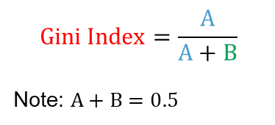
Computing Gini Index and it’s intuitive understanding
$$Gini Index=\frac{A}{A+B}$$
Note: $A+B=0.5$
A perfect equality is when, for example 10% of population amounts to exactly 10% of income.
A

Slide 34
Using Gini Inequality to estimate the intra city inequalities in WASH scores
2004-05: Gini Index = 0.1728
2011-12: Gini Index = 0.1609

Slide 35
Like shown above, the Gini coefficient for WASH inequalities within Delhi was small for both surveys, implying the WASH scores were distributed almost equally among the people with minimal inequality present. The decrease in the Gini index in 2011-12 survey explains the development in WASH during the years.

Slide 36
Theil Index
Now Theil Index is another tool we’ll be using to estimate the inequalities between the cities in the IHDS surveys during the years 2004-05 and 2011-12.

Slide 37

Computing the Theil T statistic – an illustration
 | Total Personal Income | Population | Average Income
Alabama | $10,276,100 | 3,449,846 | $2,979
…
Arizona | $6,897,021 | 1,794,912 | $3,843
United States | $834,455,000 | 203,798,722 | $4,095
Input data for Theil’s T statistic of Inequality between US states in 1970
Let’s say, here our task is to compute the Theil element for Alabama. We start with finding Alabama’s population share in the U.S.
$=\frac{3,449,846}{203,798,722}=0.0169$

Slide 38
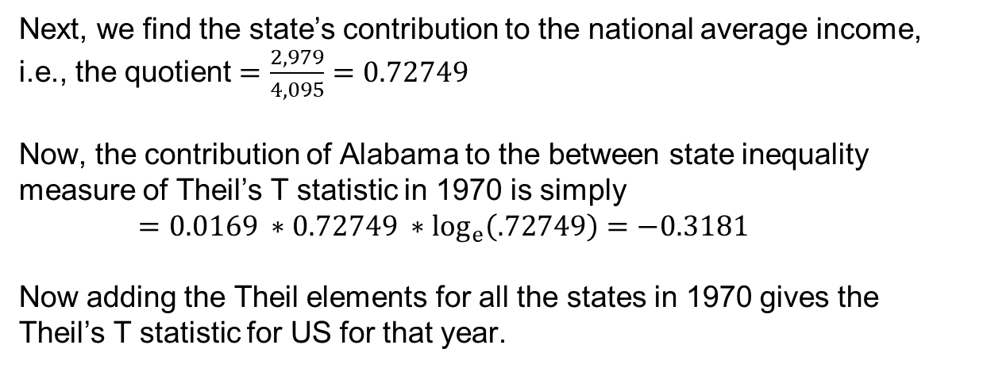
Computing the Theil T statistic – an illustration
Next, we find the state’s contribution to the national average income, i.e., the quotient $=\frac{2,979}{4,095}=0.72749$
Now, the contribution of Alabama to the between state inequality measure of Theil’s T statistic in 1970 is simply
$=0.0169 ∗0.72749 ∗\log_{e}\left(.72749\right)=−0.3181$ Now adding the Theil elements for all the states in 1970 gives the Theil’s T statistic for US for that year.

Slide 39
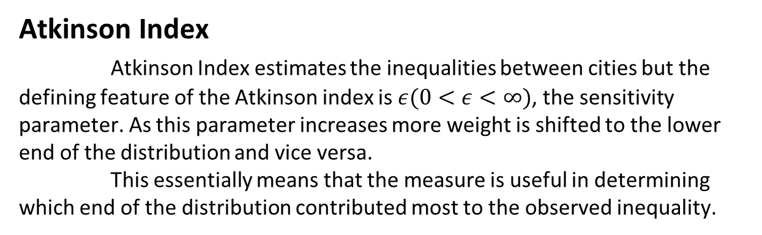
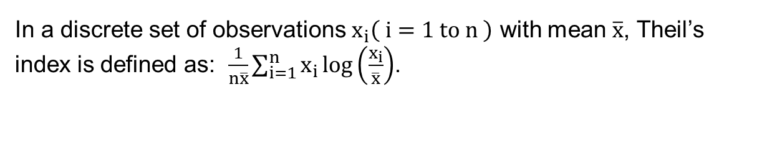
Theil and Atkinson Indices
In a discrete set of observations $x_{i}\left( i=1 to n \right)$ with mean $\overline{x}$, Theil’s index is defined as: $\frac{1}{n\overline{x}}\sum_{i=1}^{n}{x_{i}\log\left(\frac{x_{i}}{\overline{x}}\right)}$.
Atkinson Index
Atkinson Index estimates the inequalities between cities but the defining feature of the Atkinson index is $ε(0<ε<∞)$, the sensitivity parameter. As this parameter increases more weight is shifted to the lower end of the distribution and vice versa. This essentially means that the measure is useful in determining which end of the distribution contributed most to the observed inequality.

Slide 40
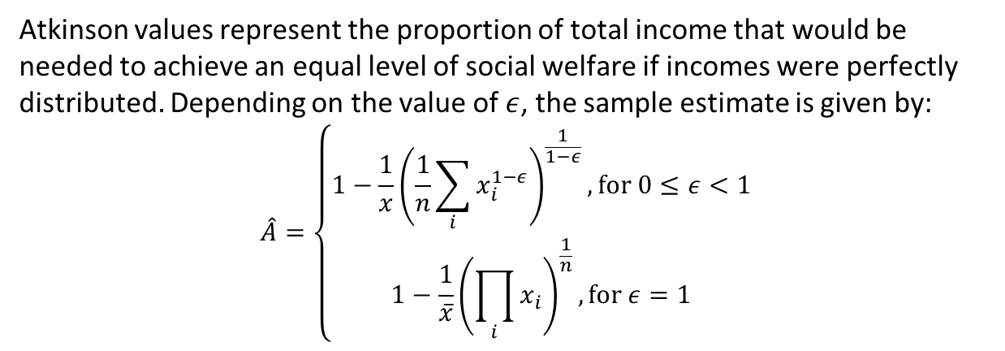
Computing Atkinson Index –
Atkinson values represent the proportion of total income that would be
needed to achieve an equal level of social welfare if incomes were perfectly
distributed. Depending on the value of $ε$, the sample estimate is given by:
$$\hat{A}=\left\{\begin{aligned}1−\frac{1}{x}{\left(\frac{1}{n}\sum_{i}{x_{i}^{1−ε}}\right)}^{\frac{1}{1−ε}}, for 0≤ε<1 \\ 1−\frac{1}{\overline{x}}{\left(\prod_{i}{x_{i}}\right)}^{\frac{1}{n}}, for ε=1\end{aligned}\right)$$

Slide 41
Cities | Gini | Theil | Atkinson
Delhi | 0.16 | 0.041 | 0.040
Kolkata | 0.17 | 0.0502 | 0.027
Mumbai | 0.068 | 0.009 | 0.0049
Hyderabad | 0.249 | 0.106 | 0.0602
Bangalore | 0.11 | 0.025 | 0.0135
Chennai | 0.154 | 0.044 | 0.024
Overall | 0.16 | 0.047 | 0.032
Cities | Gini | Theil | Atkinson
Delhi | 0.17 | 0.06 | 0.036
Kolkata | 0.22 | 0.09 | 0.051
Mumbai | 0.15 | 0.037 | 0.020
Hyderabad | 0.26 | 0.12 | 0.067
Bangalore | 0.069 | 0.012 | 0.007
Chennai | 0.23 | 0.103 | 0.0603
Overall | 0.20 | 0.076 | 0.043
WASH Inequality in 2004-05
WASH Inequality in 2011-12

Slide 42
Conclusion
This study presents a comparative assessment of WASH inequalities and the associated factors in the six major metro cities (Mumbai, Delhi, Kolkata, Chennai, Bangalore and Hyderabad) of India. It presents the inequality between cities and also among them between different social classes.
Although there are impressive attempts made by the government to promote urban development, the real challenge, unaddressed yet, lies in ensuring the availability and equitable access to basic civic amenities, particularly water and sanitation for the large proportion of population including those inhabiting peri-urban areas. Despite several government policies and programs running over decades, the striking intra-city inequality in terms of WASH, primarily in the metropolitan cities, suggests an exclusionary urban development and urban poverty.

Slide 43
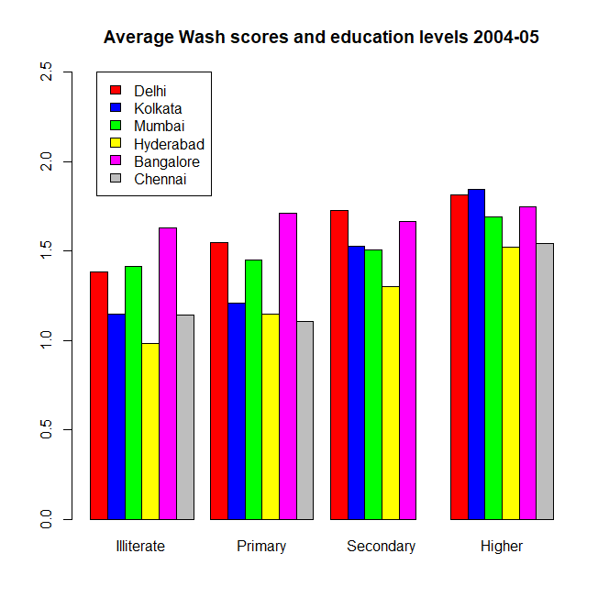
For example, we can say about (2004-05) that
The people with higher education have better WASH scores than the illiterate with 99.79% confidence.
The people with secondary education have better WASH scores than the illiterate with 94.25% confidence.
The people with primary education have better WASH scores than the illiterate with 71.01% confidence.
The literate have better WASH scores than the illiterate with 98.49% confidence.

Slide 44
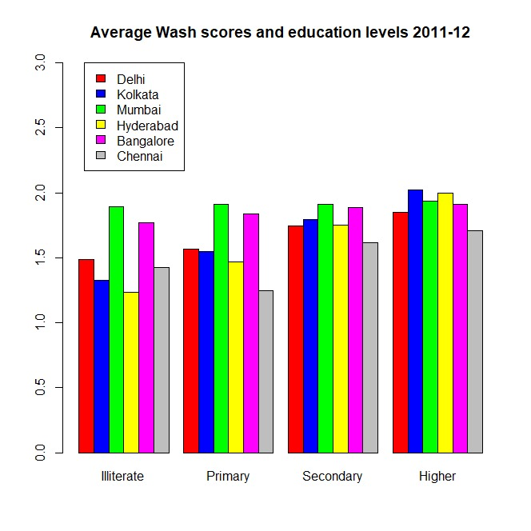
The same for 2011-12 we can say that
1. The people with higher education have better WASH scores than the illiterate with 99.61% confidence.
2. The people with secondary education have better WASH scores than the illiterate with 97.83% confidence.
3. The people with primary education have better WASH scores than the illiterate with 69.20% confidence.
4. The literate have better WASH scores than the illiterate with 98.56% confidence.

Slide 45
We notice that though the inequality between WASH scores between the pairs (people with higher education, illiterate people) and (people with secondary education, illiterate people) decreased, the inequality between the people with secondary education and the illiterate people increased resulting in the total increase in the inequality between the literates and the illiterates.

Slide 46
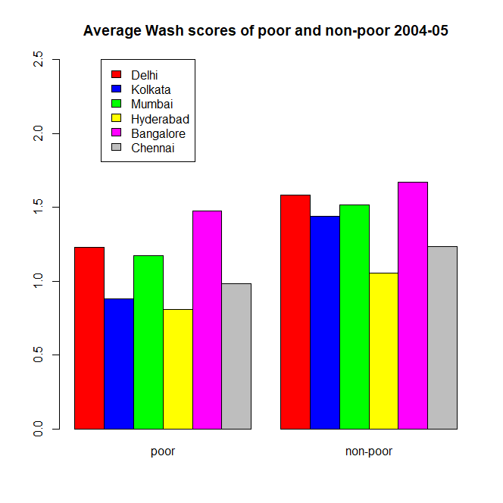
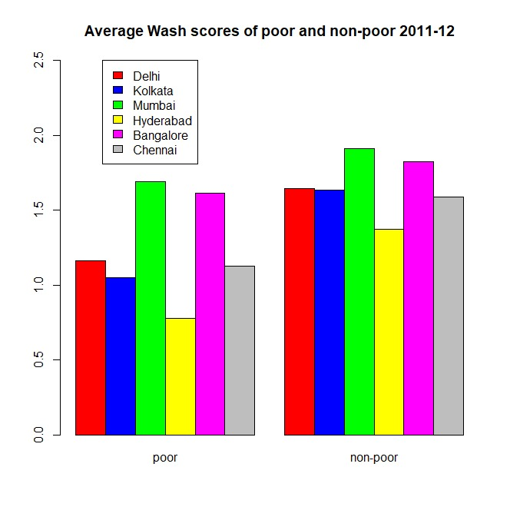
We also notice the inequality between the rich and the poor. In 2004-05 we could say that the rich have better wash scores than the poor with 97.79% confidence. But, in 2011-12, this value increased to 98.73%. This shows that the inequality between the rich and the poor has also increased in 7 years. So, overall the social inequality is increasing over the years.

Slide 47
According to existing city policies, we recommend giving priority to fair and affordable distribution Water and sanitation are essential for inclusive urban development. To achieve this goal, it will It is crucial to solve the problem of underrepresentation of heterogeneous populations at the policy level Urban areas, as well as identifying governance failures. Strengthen local governance Improving the living conditions of the urban poor will be an important step towards decentralization And the inclusive growth of cities to improve prospects for achieving the Sustainable Development Goals by 2030.

