Slide 1


LectureAI –
Your personal
AI Tutor
Ayushman Anupam
Tejaswi Sherawat
Mentors:
Animesh Guchhait, Chandrashish Prasad,
Hithesh KK, Rahul Shah

Slide 2
Abstract
LectureAI is an agentic AI solution designed to revolutionize how users learn from video content. The last decade has witnessed an exponential growth in educational videos, which are often presented in a linear format. This approach can result in information overload and time-consuming searches.
LectureAI overcomes these challenges by transforming passive video consumption into an interactive, personalized learning experience.
This presentation will:
Outline the core problems with traditional video-based learning.
Present our agentic AI solution, highlighting its capability to let users interact with, learn from, and be evaluated by the content in real time.
Provide an overview of its features and underlying workflow.
Conclude with a short demo and Q&A session.

Slide 3
🧩 Problem Statement
In classic lectures, videos, and various forms of media, information is often presented linearly, leading to several key drawbacks
Information Overload:
While videos are rich in content, users struggle to quickly locate specific insights or moments.
Time-Consuming Search:
Finding relevant answers or segments often requires manually scrubbing through long durations of video.
Limited Interaction:
Traditional video players offer only basic functionality—no intelligent search, no contextual Q&A, no real-time summarization.
Workflow Breaks from Knowledge Gaps: When the video doesn’t answer a user’s question, they must leave the platform to search elsewhere, disrupting focus and continuity.
No Personalized Feedback or Understanding Metrics: There’s no way to assess what the viewer has understood, where they’re weak, or how their learning can be improved.

Slide 4





💡 Our Agentic AI Solution
We built an agentic AI “LectureAI” to address these critical challenges, our agent transforms video content into an interactive, insightful, and personalized learning experience.
With our agentic AI, users don’t just watch lecture — they interact with it, learn from it, and get evaluated in real-time.
Query-Based Interaction
MCQ Generator and Evaluator
Timestamp-Based Summarization and Concept Locator
Mind Map Generator
Visual map of video’s structure and key concepts.
Beyond Video Knowledge
Responds using web knowledge or LLM memory if answer isn't in the video
Generates well-structured notes including introduction, key takeaways, conclusion, and further resources.
LectureAI

Slide 5
⚙️ Workflow of our Agentic AI App
Known Lecture - Resource is available
LectureAI Session
Video Lecture
Unknown Lecture - Resource is not available
Create Resource

Slide 6
Lecture-AI
MindMap
Smart Video Player
Lecture Chatbot
Lecture RAG Chatbot
Find TimeStamp
Explain TimeStamp
General Chatbot
Testing & Evaluation
Notes

Slide 7
Resource Creation from Video Lecture
Generating Raw-Data
Plain Transcript
.txt file
Sentence Transcript
List of dictionaries { text: ..., start: …,
end: … }
Video Lecture
Audio
Word Transcript
Semantic Chunk Transcript
List of dictionaries { text: ..., start: …,
end: … }
List of dictionaries { word: .., start: ..,
end: }
Time bounded Chunk
List of dictionaries { text: ..., start: …,
end: … }

Slide 8
Processing Raw-Data into usable form
LectureAI Chatbot
Mindmap, Summary
MCQs
Semantic Chunk Transcript
Plain Transcript
Semantic Chunk Transcript Id
Vector-Store/ DataBase
Generated MCQs and Resources
MindMap Generation
Summary
LectureAI Chatbot

Slide 9
LectureAI Chatbot
LectureAI Chatbot is an agentic AI system programmed to operate on lecture content. It uses APIs to remotely query and process information.
It has four AI agent tools at its disposal and a central tool that decides which agent to use for the current query. Additionally, it includes a Validation component that uses an API-based LLM call to validate the response to the query.
The four agentic tools are:
RAG_Chatbot Tool
Uses Retrieval-Augmented Generation (RAG) with LLM API calls.
Incorporates chat history to answer general lecture-related queries based on both relative and fixed context.
2. Find_Timestamp_Tool
Given fixed or relative context in the query, this tool identifies where that occurred in the lecture video.

Slide 10
3. Explain_Timestamp_Tool
Designed to explain concepts taught at specific timestamps
Combines RAG, LLM, and chat history to provide answers grounded in the exact or relative moment of the lecture.
4. General_Chatbot_Tool
Answers broader academic or general queries
Utilizes parametric knowledge, web scraping, and the Tavily Search API to fetch accurate and current information.
These tools are controlled by the central agent called LectureAI-Agent, which uses an LLM to decide which tool to invoke.
The Validation component ensures the final response is accurate by making an API-based LLM validation call.

Slide 11
MCQs Generation
Our MCQs are generated using Langchain workflows:
MCQs Data generation chain: A plain transcript is submitted to an LLM API, along with a carefully crafted prompt to generate MCQs question and related data.
MCQ Validation chain : Another LLM is then used for mcq validation, regarding their relevance, clarity etc.
[
{ “options”: {…..},
“question”: “……”,
“topic”: “….”,
“difficulty”: “….”,
“explaination”: “…”},
……
]
Plain Transcript
MCQs data

Slide 12
Evaluation Report
Once you submit the test, following are generated:
Overall score
Detailed explanation :- This includes- for each question- whether it was marked correct or not, what is the correct option and explanation for each of the options- why they were correct or incorrect.
Topic-wise accuracy report :- presented in the form of a bar graph
Performance by difficulty level

Slide 13
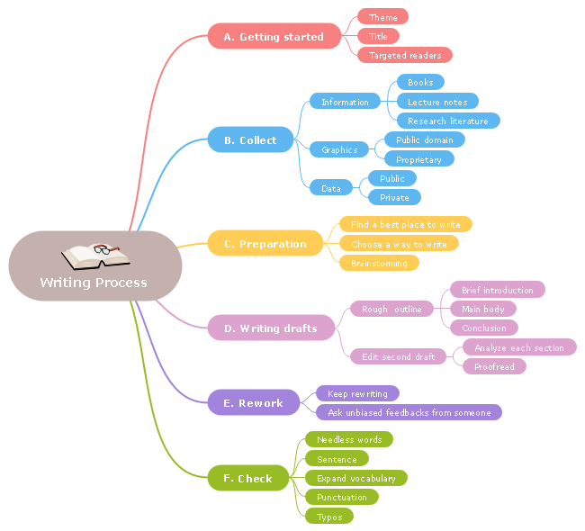
Mind-Map Generation
Generating Mind Maps: A Two-Step Process
Transcript to Graphviz DOT: Transcripts are sent to an LLM API to generate Graphviz DOT code (digraph G { ... }). This code is then cleaned and formatted properly
Rendering & Graph Maintenance: The cleaned DOT code is then rendered to create and maintain the mind map graph.
Transcript
Graphviz DOT code
Mind-Map
digraph G {
rankdir=LR;
node[ ..metadata..];
A -> B;
A -> G;
}

Slide 14
Summary Generation
Note Generation: Timestamp based transcripts are sent to an LLM API with a specific prompt to generate summary in a structured way.
Semantic Chunk Transcript Id
Summary

Slide 15
Demo
of App

Slide 16
Multilingual Video Support
Understand and respond to videos in multiple languages
Real-Time Interaction
Live captions and instant Q&A during video playback or meetings
Multimodal Input Support
Process video, audio, text, PPTs, clipart, and more
Future Works
Subject-Specific Fine-Tuned Models:
Tailored educational models for each subject domain
LMS Integration
Seamless compatibility with platforms like Moodle, Canvas, etc.

