Slide 1
CareConnect Theme: Healthcare
Sujoy De 22BCY10010 Samriddhi Tripathi 22BCY10041
Jasswant Singh Sandhu 22BCY10011
Ayushman Kumar Singh 22BCY10121
Pranjali Tripathi 22BCY10264

Slide 2
Contents of Presentation
Objective of the project
Novelty of the project
Block diagram & Working principle
Result / Demonstration/ screenshot/demo video link
Conclusion & Future Scope
Reference

Slide 3
Objective of the project with inline thematic domain
Dedicated team with a passion for emergency medical services
Goal to advance GPS monitoring for ambulances
Aim to improve patient care worldwide
Commitment to data security and compliance with healthcare regulations
Emphasis on continuous improvement and adaptation

Slide 4
Novelty of the project
Focus on advancing GPS monitoring for ambulances.
Real-time and fragmented online appointment booking.
Commitment to improving patient care worldwide
Emphasis on data security and compliance with healthcare regulations
Agile development cycles and regular user feedback incorporation
Continuous improvement and adaptation to remain at the forefront of healthcare innovation
Integration of medical history of a person with different hospital

Slide 5
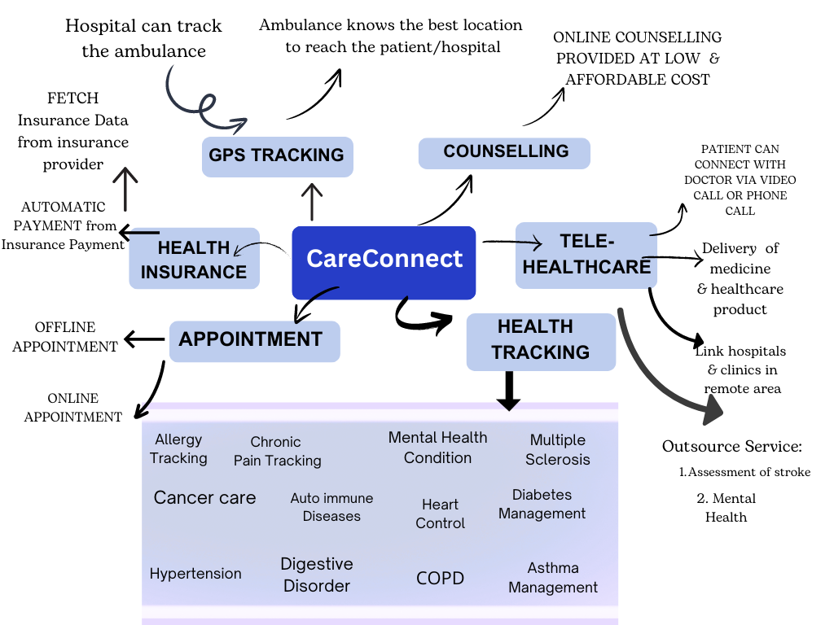
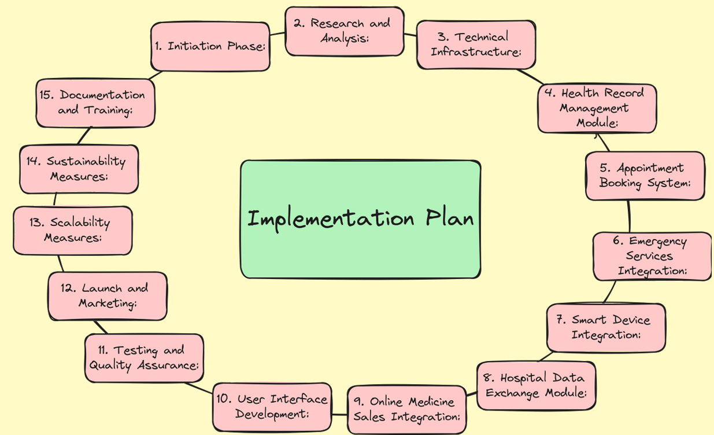
Block Diagram

Slide 6
Working principle
Comprehensive health management
Streamlined appointment booking
Rapid access to emergency services
Holistic health monitoring
Efficient hospital data exchange
Convenient online medicine access
Profit-driven free healthcare sessions
Enhanced user experience

Slide 7
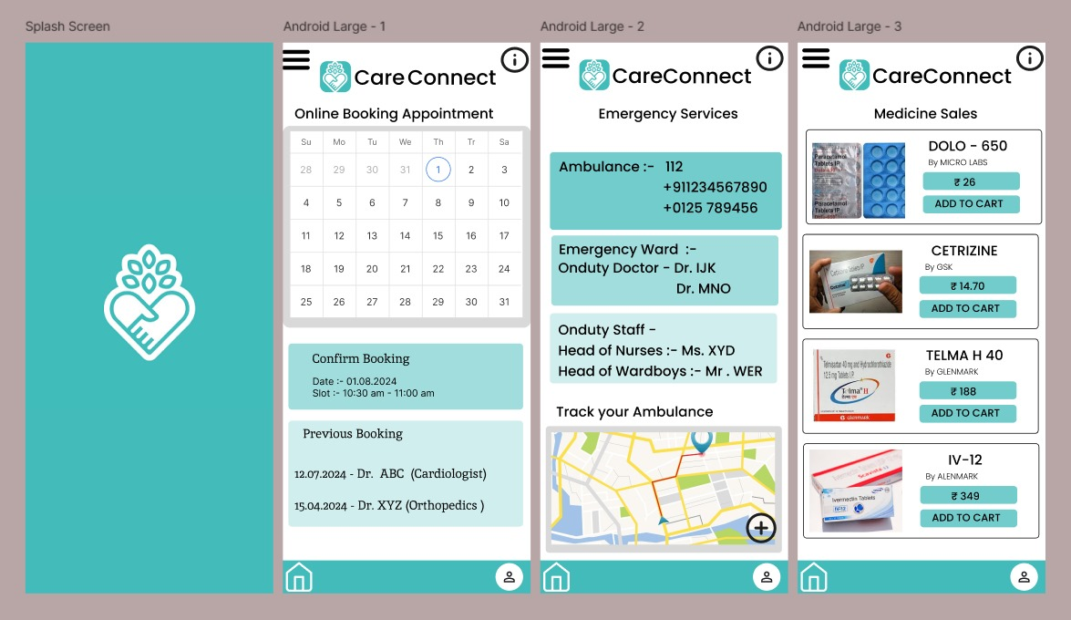
Result / Demonstration/ screenshot

Slide 8

Demo video link
In this video, you will see a comprehensive
overview of our application's features,
functionality, and user interface.

Slide 9
Conclusion & Future Scope
Target Audience: CareConnect serves health-conscious individuals, hospitals, and pharmacies.
Digital Health Trends: The digital health market is rapidly growing, focusing on personalized care and remote monitoring.
Potential Market Size: CareConnect can reach millions globally, with hospitals and pharmacies expanding its scope.
Current Market Gaps: Existing solutions lack integration, requiring multiple platforms for health records, appointments, and emergency services.
Increasing Health Awareness: Rising awareness of health and wellness drives demand for proactive digital solutions.

Slide 10
Conclusion & Future Scope
Remote Healthcare Services: The growth of telehealth offers CareConnect opportunities for online and offline healthcare integration.
Global Accessibility: CareConnect’s digital platform is globally accessible, reaching urban and remote users.
Strategic Partnerships: Collaborations with healthcare providers, insurers, and pharmaceutical companies can extend CareConnect’s reach.
Revenue Streams: Diverse revenue streams, including online medicine sales and premium features, ensure financial sustainability.
User Adoption Potential: A user-friendly interface and smart device integration enhance adoption across demographics.
Competitive Landscape: CareConnect's comprehensive solution offers a unique advantage in the digital health market.

Slide 11
REFERENCES
mvSERS: A Secure Emergency Response Solution for Mobile Healthcare in Vehicular Environments- Chanying Huang; Hwaseong Lee; Hyoseung Kim; Dong Hoon Lee
Emergency Healthcare Workflow Modeling and Timeliness Analysis
A Mobile Care System With Alert Mechanism- Ren-Guey Lee; Kuei-Chien Chen; Chun-Chieh Hsiao; Chwan-Lu Tseng

Slide 12

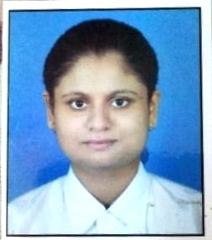
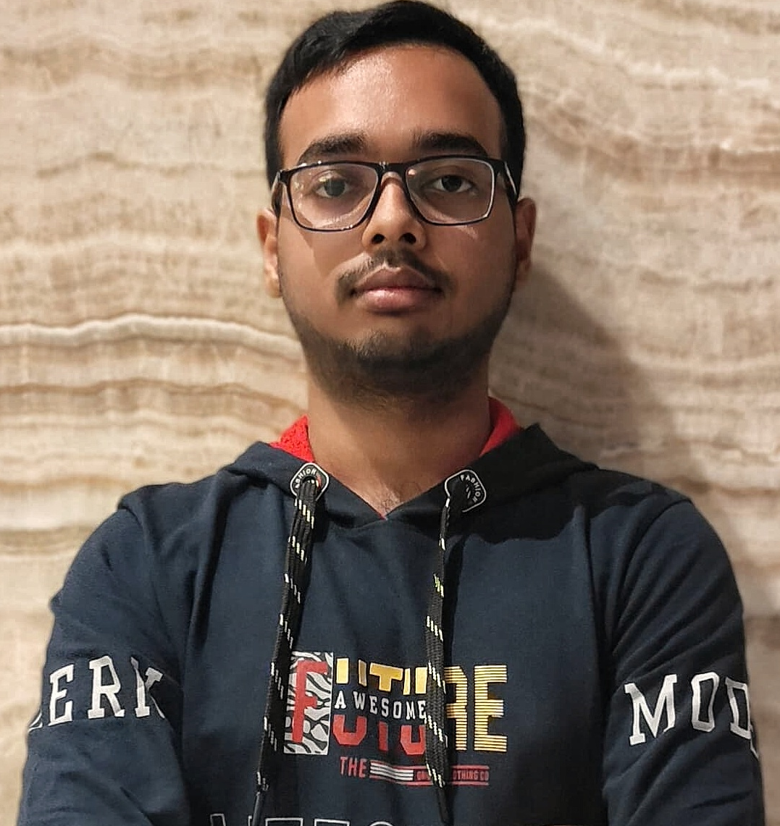
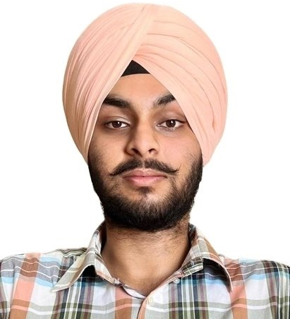
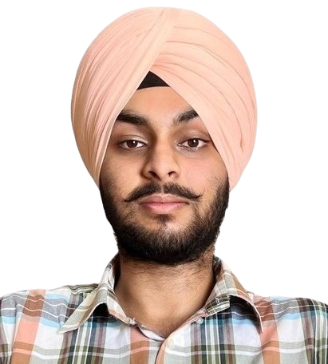
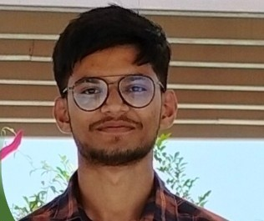
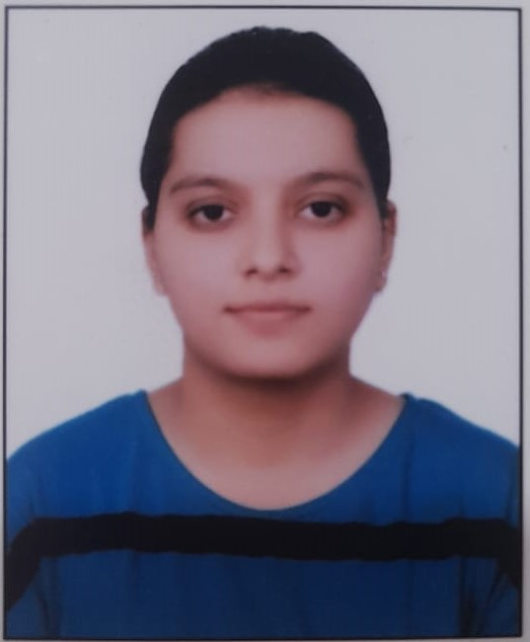
Team Details
SNo |  | Reg. No | Name | VIT Bhopal EmaiId
1. |  | 22BCY10041 | Samriddhi Tripathi (TEAM LEAD) | samriddhitripathi2022@vitbhopal.ac.in
2. |  | 22BCY10010 | Sujoy De | sujoyde2022@vitbhopal.ac.in
3. |  | 22BCY10011 | Jasswant Singh Sandhu | jasswantsinghsandhu2022@vitbhopal.ac.in
4. |  | 22BCY10121 | Ayushman Kumar Singh | ayushmankumarsingh2022@vitbhopal.ac.in
5. |  | 22BCY10264 | Pranjali Tripathi | pranjalitripathi2022@vitbhopal.ac.in

Slide 13
Thank You

