Slide 1
















Safer
Problem Statement 9
Digital Odisha
Cybersecurity + Artificial Intelligence
Together
CYBER
GU RD
AI-Powered Cyber Threat, Phishing & Digital Impersonation Detection
and Response System
Detect
Analyze
Explain
Response
Multi-Modal
AI Detection
Human Threat
Protection
Network & IoT
Defense
Autonomous
SOC & Firewall
Built for
Odisha Knowledge Corporation Limited (OKCL)
Domain: Cybersecurity + Artificial Intelligence
Team
Team ID
Date
Cybernates
BH26PS09T049
10 October 2026

Slide 2
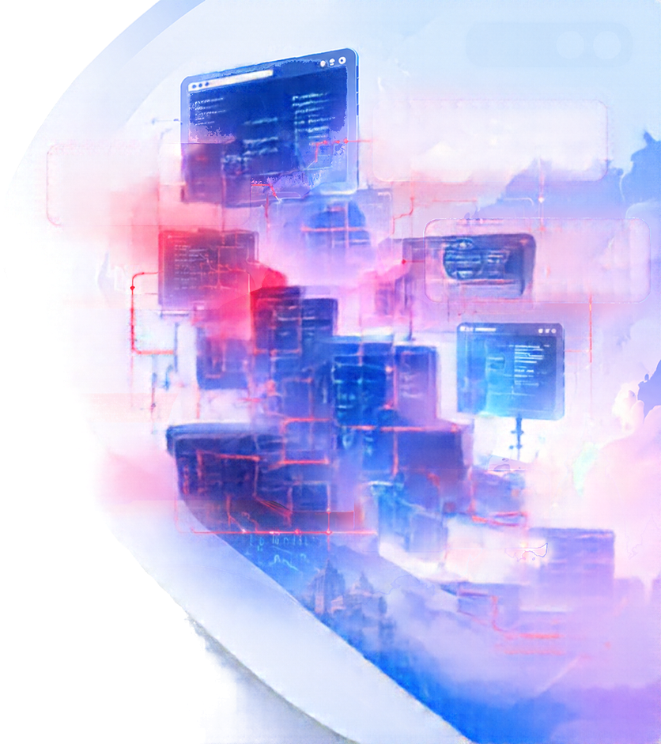



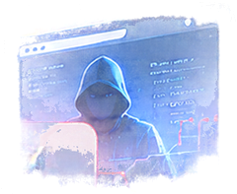

























2/10
Problem Statement 9
Deepfake
(Image/Audio/Video)
Phishing
The Growing Cyber Threat Landscape
(Email/SMS)
The rapid adoption of digital platforms, online communication, cloud services, social media, digital payments and e-governance systems has significantly increased exposure to sophisticated cyber threats.
Fake Websites
& Malicious URLs
Credential Theft
Attackers are increasingly using AI and Generative AI to create highly convincing phishing emails, fake websites, malicious links, cloned voices, deepfake videos and personalised social-engineering attacks.
& Account Takeover
Traditional rule-based security systems are often inadequate to identify such evolving and AI-generated threats.
Malware / API Abuse
IoT Attacks
There is a need for an AI-powered intelligent cyberdefence platform capable of detecting technical cyber threats as well as human-targeted phishing, impersonation and deepfake-based attacks.
Increasing
More
Advanced
Need for
Cyber Attacks
Digital Platforms
AI-Generated Threats
Smarter Defence
Every Year
Higher Exposure
Harder to Detect
AI-Powered Solutions

Slide 3

































3/10
Our Solution: CYBERGUARD
An end-to-end, autonomous Security Operations Center (SOC) and Adaptive Firewall Platform that unifies multiple layers of cyber defence.
AI Detection
Real-time
Monitoring
CYBERGUARD
Technical & IoT
Network Plane
Identity & Behavioral
Plane
Automated
Response
Human Trust Plane
Explainable
Insights
DDoS, Port Scans
Malware, API Abuse
IoT/Edge Protection
Network Anomaly Detection
Phishing (Email/SMS)
Deepfakes (Image/Audio/Video)
Digital Impersonation
Malicious URLs & QR Codes
Abnormal Login Attempts
Credential Stuffing
Anomaly Detection
Insider Threats
AI-Powered Detection
Explainable Intelligence
Automated Response
Multi-model analysis across
text, vision, audio, network and IoT
Human-readable reasoning,
evidence and indicators
Adaptive firewall rules, alerts
and mitigation actions

Slide 4

































4/10
Key Threat
Scenarios
Cyber threats are evolving across multiple channels, targeting both technology systems and human trust. Our solution addresses the following key threat scenarios:
AI-Powered
Phishing Detection
Credential Theft &
Account Takeover
  Emails, SMS, Social Media
  QR-code Phishing
  Fraudulent Websites
  Malicious URLs
  Failed Login Attempts
  Password Spraying
  Unusual Locations
  Suspicous Sessions
  Sudden Account Behaviour Changes
Deepfake Detection
Malicious URL & Website Detection
  Images, Videos, Audio
  Voice Cloning
  Video Calls
  AI-generated Multimedia
  Domain Spoofing
  Look-like Domains
  Malicious Redirects
  Suspicous SSL / Domain Characteristics
  Fake Login Pages
Digital Impersonation Detection
Intelligent Cyber Threat Detection
  Government Officials
  Senior Management
  Teachers / Authorities
  Financial Institutions
  Friends, Relatives or Known Contacts
  Malware Indicators
  Suspicious Network Traffic
  API Abuse
  Data Exfiltration
  Insider Threats
  Unusual System or Application Logs

Slide 5

































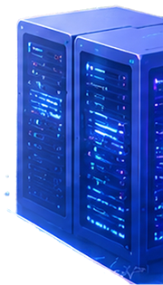











5/10
System Architecture:
Multi-Model AI Ensemble
Multi-Source Ingestion
Email
SMS
URLs
Images
Audio
Video
Network Logs
IoT/Edge
Auth Logs
Tabular / Network (Flow ML)
NLP / Text (Phishing)
Audio / Vision (Deepfake)
Graph Intelligence (Relationships)
  KNN / XGBoost
  Autoencoder
  Anomaly Detection
  DDoS / Intrusion
  RoBERTa / DeBERTa
  Intent Analysis
  Token Attribution
  Malicious URL Detection
  CNN (ResNet50)
  RawNet2 (Voice)
  Spectral Analysis
  Image Forensics
  PyG / RGAT
  Entity Linking
  Attack Graphs
  Lateral Movement
Qwen 2.5-3B / 7B
Contextual Reasoning & Explanable AI
Deterministic Policy Engine
nftables
Kernel Verification

Slide 6


















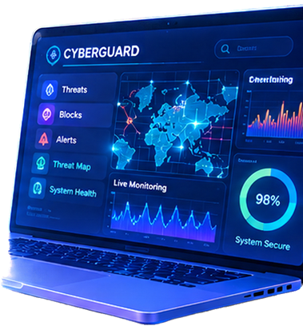













OKCL HACKATHON
Problem Statement 9
6/10
OKCL
Odisha Knowledge Corporation Limited
Cybersecurity + Artificial Intelligence
Key Features &
Capabilities
A comprehensive, AI-driven cyber defence platform for proactive, intelligent and automated threat mitigation.
Multi-Modal
Threat Detection
01
Explainable
AI Insights
02
Adaptive
Firewall & Response
03
  Analyse text, images, audio,
  video, network and IoT data
  Detect known and unknown threats using AI ensemble models
  Real-time analysis and threat scoring
  Human-readable explanations
  for every alert
  Visual reasoning with key indicators
  Builds trust for security analysts
  and decision-makers
  Automated blocking and mitigation actions (e.g., nftables)
  Dynamic policy updates based on real-time threat intelligence
  Self-learning from new attack patterns
User & Behavioural Analytics
04
Real-time
Monitoring & Alerts
05
Scalable & Modular
Architecture
06
  Detects abnormal user behaviour
  Identifies insider threats
  Behavioural profiling using
  graph and sequence models
  Live threat dashboard
  Instant alerts with severity levels
  Correlation across multiple data sources for accurate detection
  Cloud + On-Premise deployment
  Modular microservices design
  Supports integration with
  existing government and
  enterprise systems
Higher
Detection Accuracy
Faster
Response Time
Stronger
Security Posture
Scalable for
Real-World Use
AI Ensemble Models
Real-time Mitigation
Adaptive & Self-Learning
Enterprise & Government Ready

Slide 7
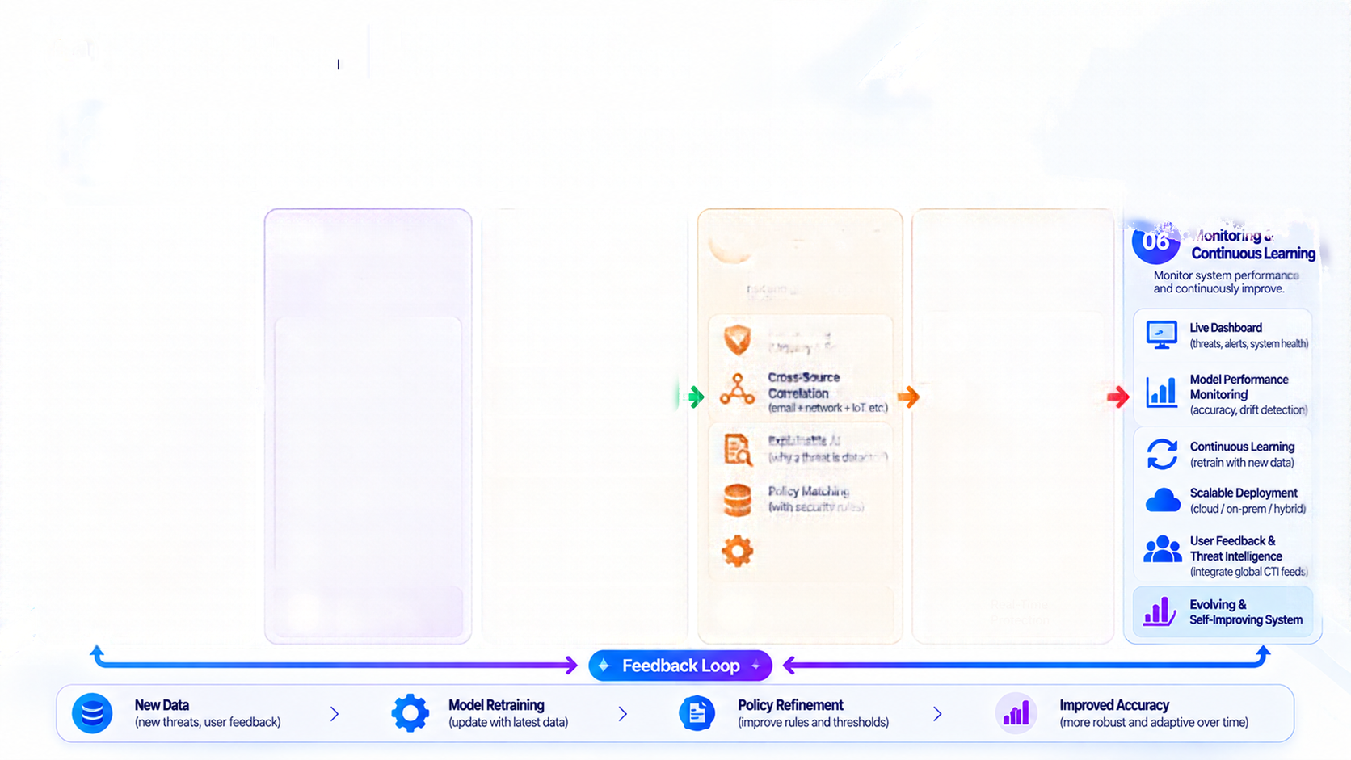


































































OKCL HACKATHON
Problem Statement 9
OKCL
Odisha Knowledge Corporation Limited
Cybersecurity + Artificial Intelligence
Methodology:
End-to-End Workflow
A multi-stage AI-driven pipeline for intelligent, real-time and automated cyber threat detection and response.
01
Data Ingestion
02
Preprocessing & Feature Extraction
03
Multi-Model
AI Analysis
04
Threat Analysis & Decision Engine
05
Automated
Response
Collect data from multiple sources and formats.
Clean, normalize and transform raw data into meaningful features.
Analyse data using specialized AI/ML models for different modalities.
Correlate insights, assess risk and generate actionable decisions.
Take real-time action to mitigate and contain threats.
Emails
Tabular / Network Models (KNN, XGBoost, Autoencoder)
SMS / Messages
Data Cleaning(noise removal)
Risk Scoring (Urgency & Severity)
Block Malicious IPsand URLs
URLs & Web Data
Normalization
NLP / Text Models(RoBERTa, DeBERTa)
Cross-Source Correlation(email + network + IoT, etc.)
Adaptive Policy Updates(real-time rule changes)
Images
Audio / Voice
Feature Extraction(statistical, behavioural)
Audio / Vision Models(CNN, ResNet50, RawNet2)
Explainable AI(why a threat is detected)
Real-Time Alerts(to SOC / Admin)
Video
Network Logs
Vectorization(TF-IDF, embeddings)
Graph Intelligence(PyG, RGAT)
Policy Matching(with security rules)
Threat Mitigation(isolate / quarantine)
IoT / Edge Devices
Authentication Logs
Data Enrichment(context, metadata)
LLM for Reasoning(Qwen 2.5–3B / 7B)
Rule & Alert Generation(dynamic and adaptive)
Incident Logging(full audit trail)
Multi-Source
Multi-Format Data
Structured &
Enriched Data
Multi-Modal
Threat Analysis
Actionable
Threat Insights

Slide 8












































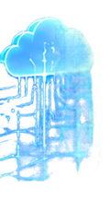













OKCL HACKATHON
Problem Statement 9
8/10
OKCL
Odisha Knowledge Corporation Limited
Cybersecurity + Artificial Intelligence
Models Used &
Dataset Overview
A combination of state-of-the-art AI/ML models trained on diverse and real-world datasets for robust cyber threat detection
Tabular / Network
Models
NLP / Text
Models
Audio / Vision
Models
Graph Intelligence
Models
LLM for Reasoning
& Explanation
Models Used
Models Used
Models Used
Models Used
Model Used
  KNN
  XGBoost
  Autocoder
  (Anomaly Detection)
  RoBERTa
  DeBERTa
  Intent Analysis
  Token Attribution
  CNN (ResNet50)
  RawNet2 (Voice)
  Spectral Analysis
  Image Forensics
  PyG
  RGAT
  Entity Linking
  Attack Graph Analysis
  Lateral Movement Detection
  Used 2.58 / 3B (Contextual Reasoning)
  Instruction-tuned for Cybersecurity
XGBoost
Hugging Face
Transformers
PyTorch
PyTorch Geometric
NetworkX
Qwen
OpenCV
Dataset Overview
Dataset Overview
Dataset Overview
Dataset Overview
Dataset Overview
  CIC-ID52017
  CSE-CIC-ID52018
  UNSW-AB15
  Bot-IoT
  Custom network traffic logs (realtime)
  Enron Email Dataset
  SpanAssassin
  Uphising Email Corpus
  SMSSpam Collection
  Custom phishing dataset (from real-world samples)
  FaceForensics++
  DFDC (DeepFake Detection Challenge)
  Celeb-DF
  ASVspoof (Voice Spoofing)
  Malware deepfake & synthetic media dataset
  OpenGraphBenmark
  DARPA APT Dataset
  Cyber Threat Intelligence (CTI) feeds
  Custom attack graph data
  Security advisory
  Threat reports (MITRE ATT&CK)
  Malware analysis reports
  Custom knowledge base
  (CTI + Government Sources)
Type: Network Traffic
Size: ~ Millions of records
Type: Text (Email / SMS / URLs)
Size: ~ 100K – 1M samples
Type: Images / Audio / Video
Size: ~ 100K – 500K samples
Type: Graph / Relational
Size: ~ 100K+ entities & edges
Type: Security Test / Knowledge Size: ~ 100K+ documents
Multi-Modal Learning
Real-World Datasets
Text + Vision + Audio + Network + Graph
Public + Custom + Live Data

Slide 9






























































9/10
Adaptive AI Firewall:
Smarter & Proactive Protection
From static rules to intelligent, context-aware and self-adaptive defence.
Existing Solutions
Our Solution (CYBERGUARD)
Traditional / Rule-Based Security
Adaptive + Deterministic AI Firewall
Incoming Traffic
(Emails / URLs / Network / IoT / Apps)
Static Rule-Based Detection
AI-Powered Multi-Model Detection
Relies on predefined signatures and fixed rules (e.g., basic firewalls, IDS/IPS).
Combines ML, Deep Learning, Graph AI and LLMs for comprehensive threat detection.
AI Threat Analysis Engine
Limited Threat Intelligence
Context-Aware Threat Intelligence
ML Models
(KNN, XGBost)
NLP Models
(RoBERTa, DeBERTa)
Detects only known threats, struggles with zero-day and evolving attacks.
Analyses multiple data sources (text, images, audio, network logs, graphs) in real-time.
Isolated Systems
VS
Graph Models
(PyG, RGAT)
LLM (Qwen)
Resonning & Explanation
Works on individual logs or limited data sources, lacking correlation.
Unified & Correlated Analysis
Correlates threats across email, SMS, URLs, network, IoT and system logs.
Manual Updates
Self-Adaptive Policy Updates
Deterministic Policy Engine (nftables / Rule Generation)
Works on individual logs or limited data sources, lacking correlation.
Dynamic rules and automated response based on real-time threat intelligence.
Higher False Positives
Lower False Positives
Often generates unnecessary alerts,
leading to alert fatigue.
Uses context and explainable AI to reduce
false alerts and improve accuracy.
Allow
(Legitimate)
Block
(Malicious)
Quarantine
(Suspicous)
Log & Explain
(Audit Trail)
Proactive Threat Mitigation
Real-time & Adaptive
Higher Security Posture
Reduced Operational Load
Blocks threats before they cause harm
Learns and updates continuously
Context-aware and accurate
Automation with explainable decisions

Slide 10
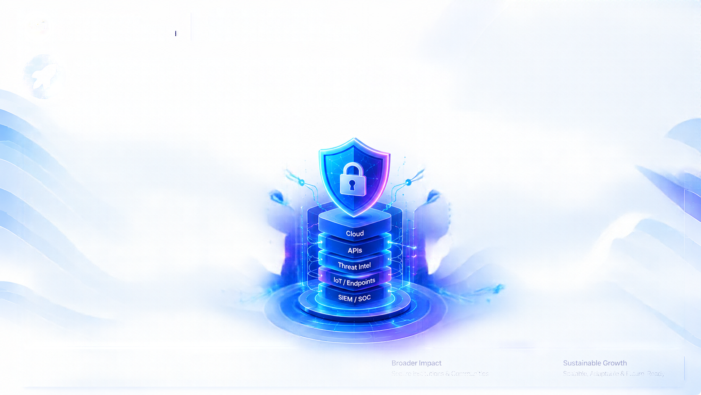

























































10/10
Future Integrations & Scope
Expanding capabilities for a safer, more resilient and intelligent digital ecosystem.
Future Integrations
Building a connected and collaborative cyber defence ecosystem.
Scope & Impact
Toward a secure, resilient and digitally empowered future.
Cloud Integration
01
Threat Intelligence
Feeds
02
Wider Adoption
01
Scalability
02
Deploy on Google Cloud / AWS / Azure for scalable threat intelligence.
Integrate with global CTI, cities, and critical MISP, AllenVault, etc. )
Deployment across government departments, educational institutions, NGOs and enterprises.
Support for city-wide, state-wide and national level deployments.
Government &
CERT Ecosystem
03
IoT & Smart
Infrastructure
04
Proactive Cyber Defence
03
Awareness & Training
04
Connect with CERT-In, state SOCs and national threat databases.
Connect IoT devices, smart cities, and critical infrastructure networks.
Early detection and prevention of advanced and emerging threats.
Use insights for cybersecurity awareness, capacity building and community training programs.
Email & Communication Security
05
Endpoint & EDR Integration
06
Research & Innovation
05
Real-World Impact
06
Integrate with email gateways, SMS filters and collaboration tools (Google Workspace, Microsoft 365).
Connect with endpoint integration tools for unified threat visibility and response.
Scope for continual model improvement, new datasets and advanced AI techniques.
Safer digital environment for citizens, organisations and critical services.
SIEM & SOC Platforms
07
Open API & Third-Party Integrations
08
Long-Term Vision
07
Integration with Spunk, ELM-Stack, ORadar for enterprise deployments.
Provide APIs for NGOs, educational institutions, and enterprises to integrate easily.
Evolve into a comprehensive, AI-driven cybersecurity platform that adapts to future threats and contributes to a secure Digital India.
Stronger Ecosystem
Greater Resilience
Integrated & Collaborative Defence
Prepared for Future Threats

Slide 11

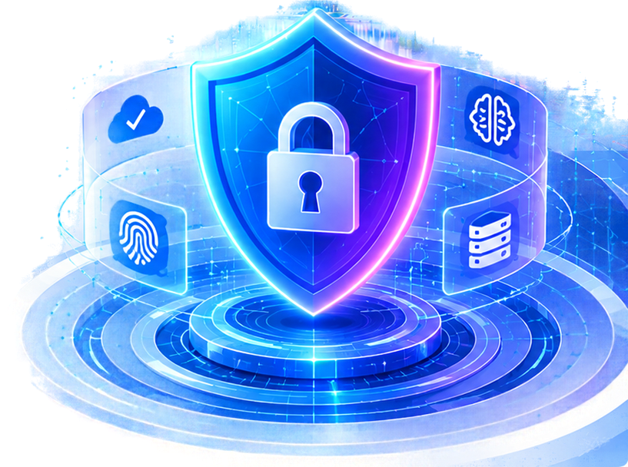










Thank You!
For your time, support and valuable feedback.
Q&A
We are happy to answer your questions!
Safer
Digital India
Intelligent
Cyber Defence
Collaborative
Innovation
Real-World
Impact
“Together, let’s build a safer, smarter and more resilient digital future.”

