Slide 1
Report For Task 4
Submitted by: Ayushman Saini
Data Analytics Intern
WA Group: DA3_BJ

Slide 2
Purpose
To find the loopholes in our current work flow of approaching companies thereby increasing our conversion rate.

Slide 3
Remarks and Interest Rating Columns
Remarks written by our colleagues were very unstructured so analysing them and getting some useful results was very difficult.
Interest Rating describes the interest of clients in our service. Its very useful parameter to determine if the client is interested or not. But it was not filled thoroughly and very few companies have interest rating along with them.
I have tried to analyse the remarks column and divided them into different categories like:
Interested
Not Interested
Invalid Number
Contact Again
May need us in Future

Slide 4
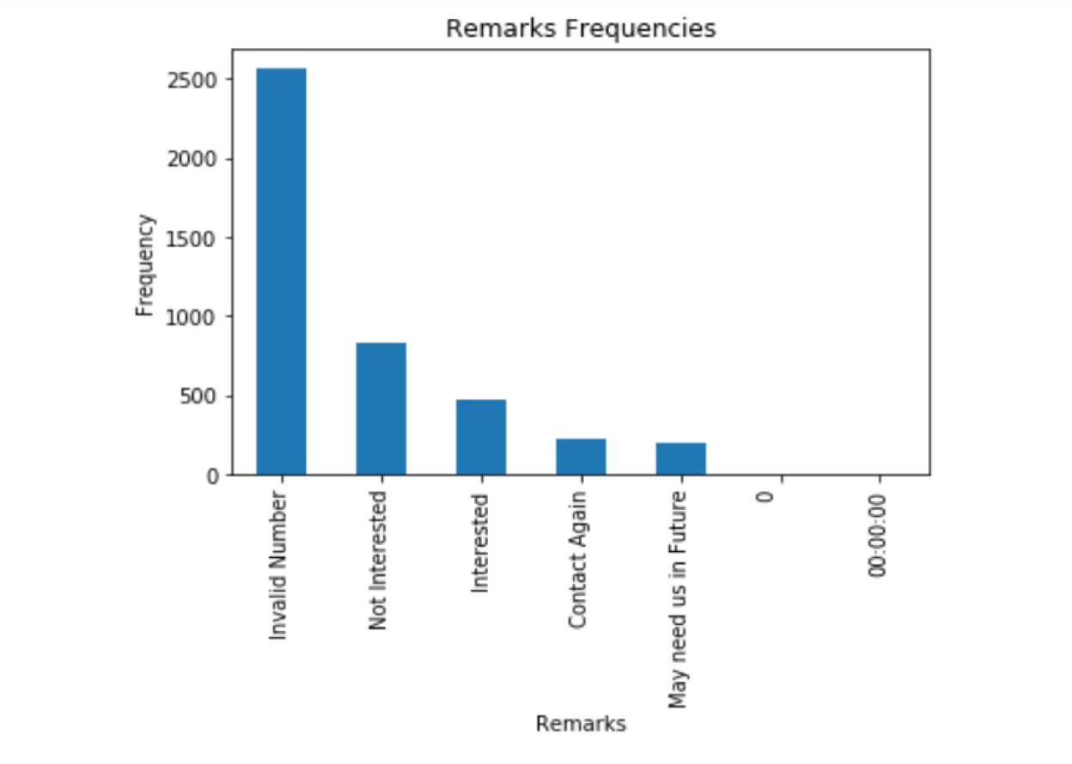

Slide 5
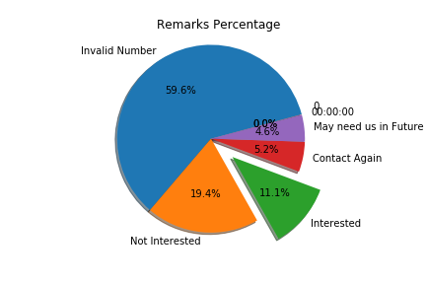

Slide 6
Both the bar graph and pie chart in previous slides shows the division of remarks into various categories. We should notice following things:
Firstly most of the numbers of the companies are invalid or unreachable. We need find the real and verified numbers of the companies.
Secondly there are many companies which may require our services in future. We know that this is mostly because of current situation of Covid19. Also at this point of time there are very few companies which are hiring at this time. So we should approach those companies which are least affected by this situation because they will be hiring new staff.

Slide 7
Interest Ratings
In the following charts I tried to analyse the interest ratings of the companies which were found interested according to the remarks.
Interest Ratings keys:
1 - Not good (Not showing interest)
2- A bit good
3- Average
4- Ready
5- Eagerly waiting

Slide 8
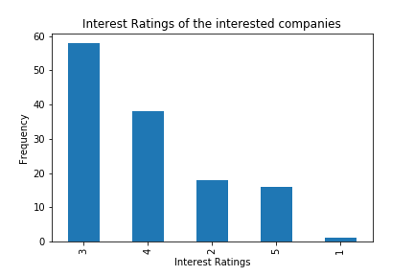

Slide 9
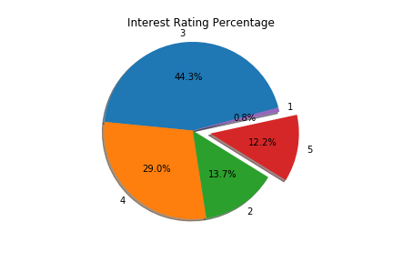

Slide 10
This Pie chart shows the interest ratings of the companies who were interested in our product.
We can see in the chart that only 12.2 % of them have 5 rating.
This denotes that many of them are not fully convinced of using our service or they are not aware of our product or company.
44.3 % of the companies had average(3) interest while having conversation. We know that they are interested and need our services but they are kind of reluctant because of trust issues. To counter that we can offer them discounts on our services too.
We need to convince them in more informative way. It means that we need to introduce ourselves first and show our previous track records and success rates.
This will surely increase our conversion rate.

Slide 11
The End
P.S.: Learnt a lot about Data Visualisation in this Task. It was not easy.

