Slide 1



Git & GitHub CLI Guide

Slide 2
Difference between Git and GitHub ?
Git
GitHub
Distributed
Version Control Software
Collaboration Platform

Slide 3
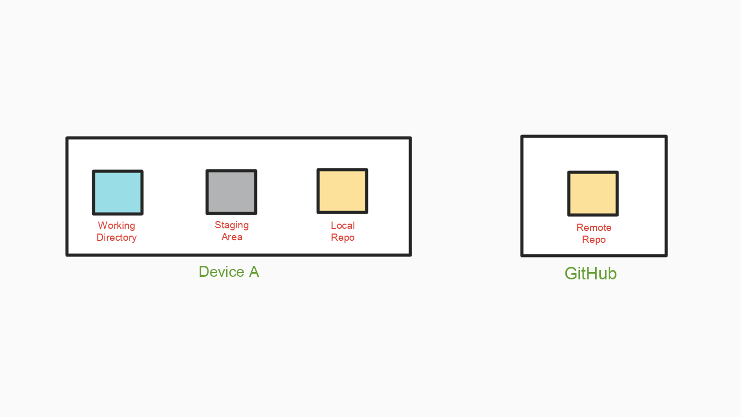

Slide 6
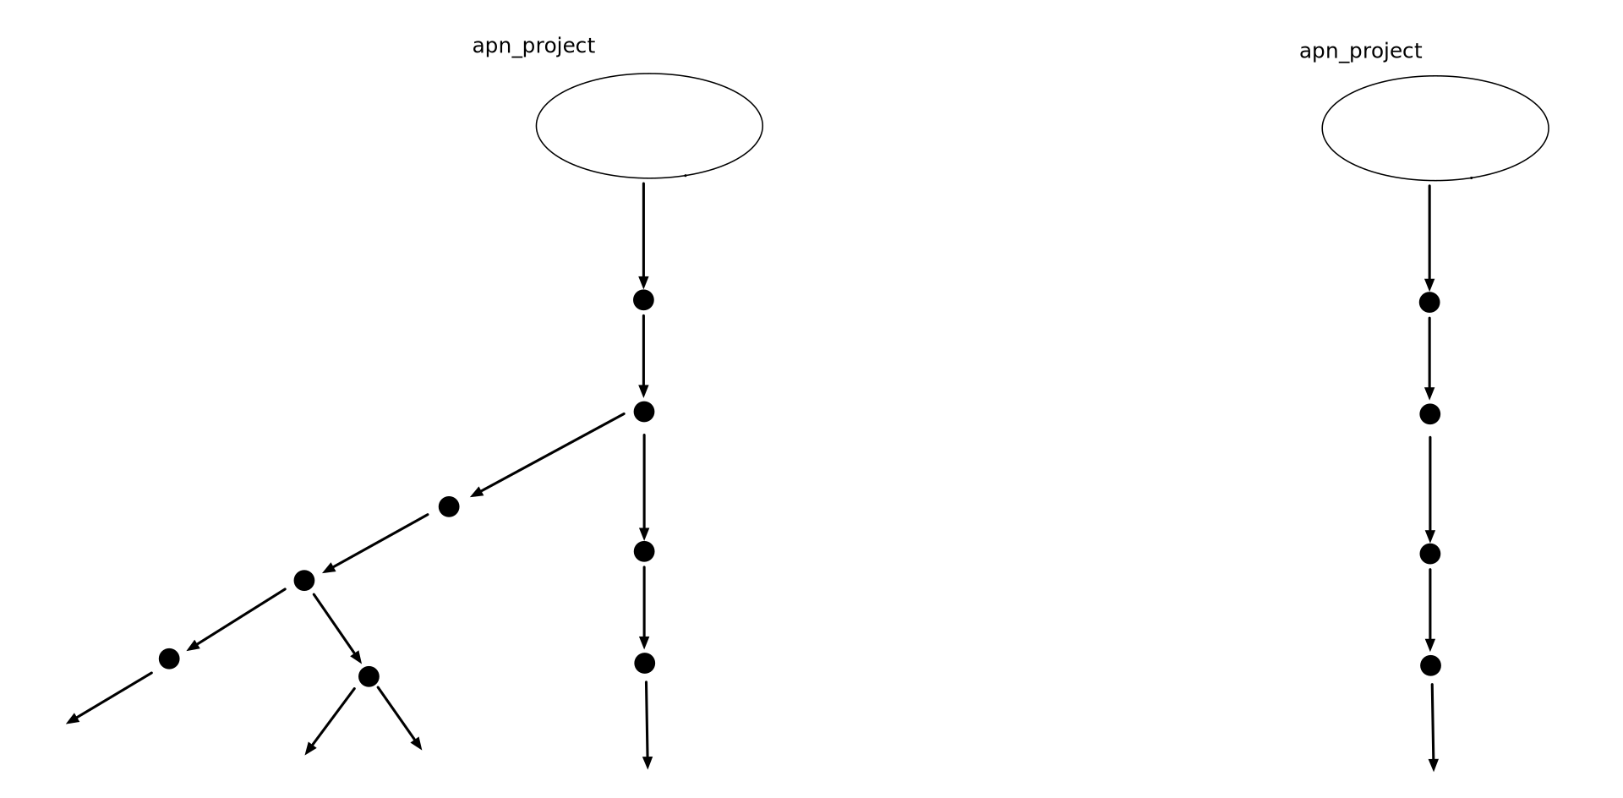
Commit
(hash)

Slide 7
GitHub Flow
Create Branch
1
Open Pull Request
3
Discuss & Review Code
4
Merge
5
Deploy
6
Add Commits
2

Slide 8
A Working Directory: where you’ll be doing all the work: creating, editing, deleting and organizing files.
A Staging Area: where you’ll list changes you make to the working directory
A Repository: where Git permanently stores those changes as different versions of the project

Slide 9
Basic Git Commands

Slide 10
Repository
Local Repo
Remote Repo

Slide 11
Initializing git
Git init
Creates .git folder

Slide 12
Status
Git status

Slide 13
Staging Area
Git add file.js
#Changes Visible in git status

Slide 14
Making a Commit
Git commit –m “Commit Message”

Slide 15
History of Commits
Git log

Slide 16
Add all to staging area
Git add .

Slide 17
Go back to previous version
Git checkout <Commit-hash>
Git log -→ To find commit hash

Slide 18
Branches
Git branch

Slide 19
Git Pull
Git fetch +(origin/master)+ git merge

Slide 20
Fork
Clone
Pull request
Fetch
Branching
Tag
Release
Issue
Merge

Slide 21
Fork

Slide 22
Clone

Slide 23
Pull Request

Slide 24
Fetch

Slide 25
Merge

Slide 26
Branch

Slide 27
Tag

Slide 28
Release

Slide 29
Issue

Slide 30
Collaboration Model
Shared Repository
Fork and pull

Slide 31
GitHub CLI Commands
auth
 | login
 | logout
 | refresh
 | status
config
 | get
 | set
gist
 | create
 | edit
 | List
 | view
issue
 | close
 | create
 | list
 | reopen
 | status
 | view
pr
 | checkout
 | checks
 | close
 | create
 | diff
 | list
 | merge
 | ready
 | reopen
 | review
 | status
 | view
release
 | create
 | delete
 | download
 | list
 | upload
 | view
repo
 | clone
 | create
 | fork
 | view
alias
 | delete
 | list
 | set
api
completion

