Slide 1



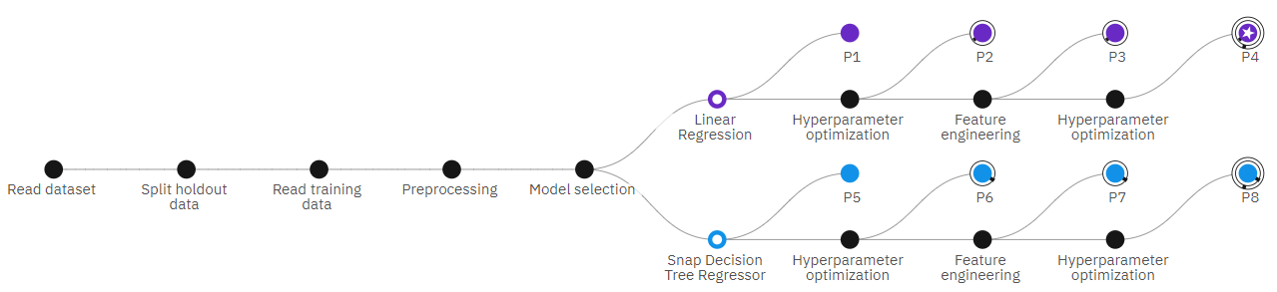
Bitcoin Price Prediction Model
Add Your Professional Profile Photo Here
Program Feedback
Project Short Summary
This was one of the best internships I have attended so far. This program gave me a lot of learnings and experience in AI/ML and Cloud Computing. I also got a chance to attend one of the industry expert sessions from IBM which gave me a lot more learnings and insight for a lifetime.
Grateful to the Edunet Foundations Team for this opportunity.
This project aims to develop a robust Bitcoin price prediction model utilizing a combination of linear regression and decision tree-based machine learning algorithms. By employing eight distinct pipelines within the IBM Watson Studio environment, the model effectively captures complex price patterns and trends. The model leverages historical price data, market indicators, and macroeconomic factors to generate accurate price predictions.
Ayush Nema
Ayushnema2468@gmail.com
Jabalpur Engineering College
#skillsbuild

