Slide 1

Basic Details of the Team and Problem Statement
Ministry/Organization Name/Student Innovation: Ministry of Power
PS Code: SIH1380
Problem Statement Title: lntelligent chatbot to answer queries pertaining to various Maintenance Processes within Substation
Team Name: SARASS
Team Leader Name: Rahul Patel
Institute Code (AISHE):
Institute Name: Hansraj College, Delhi University
Theme Name: Navi Chatbot

Slide 2
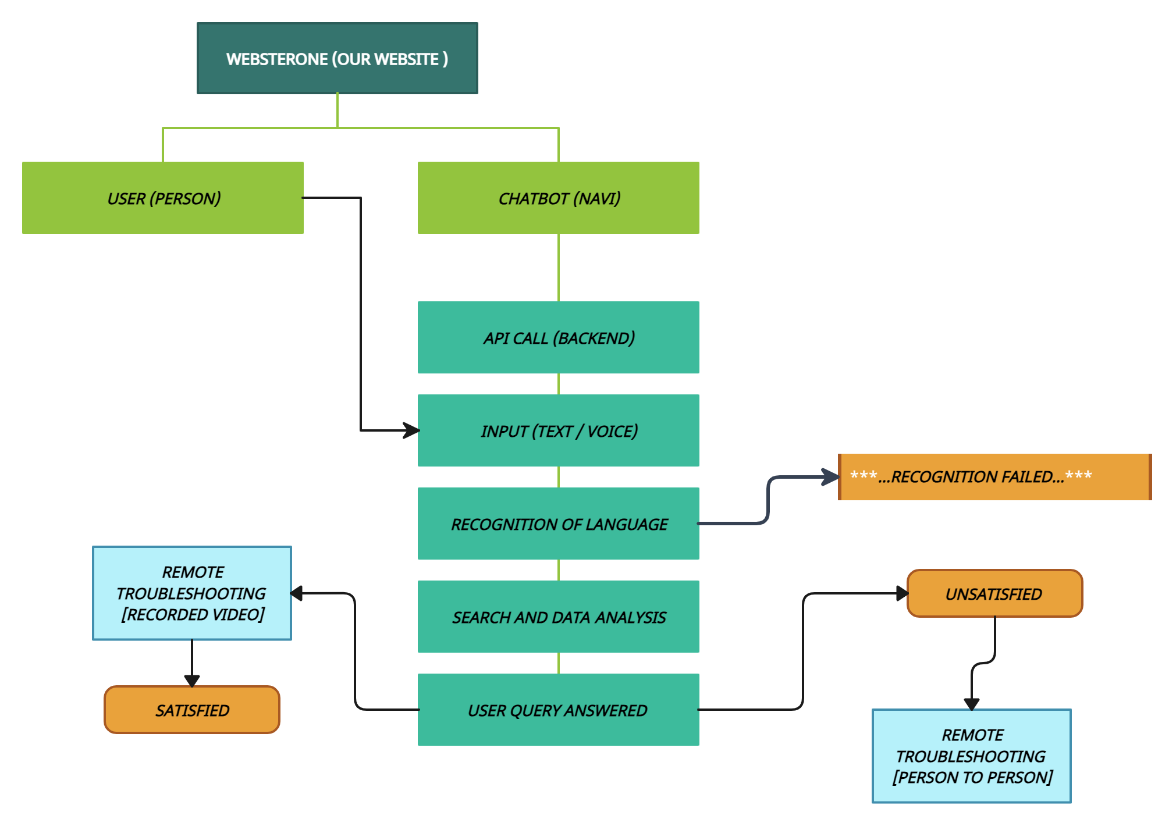




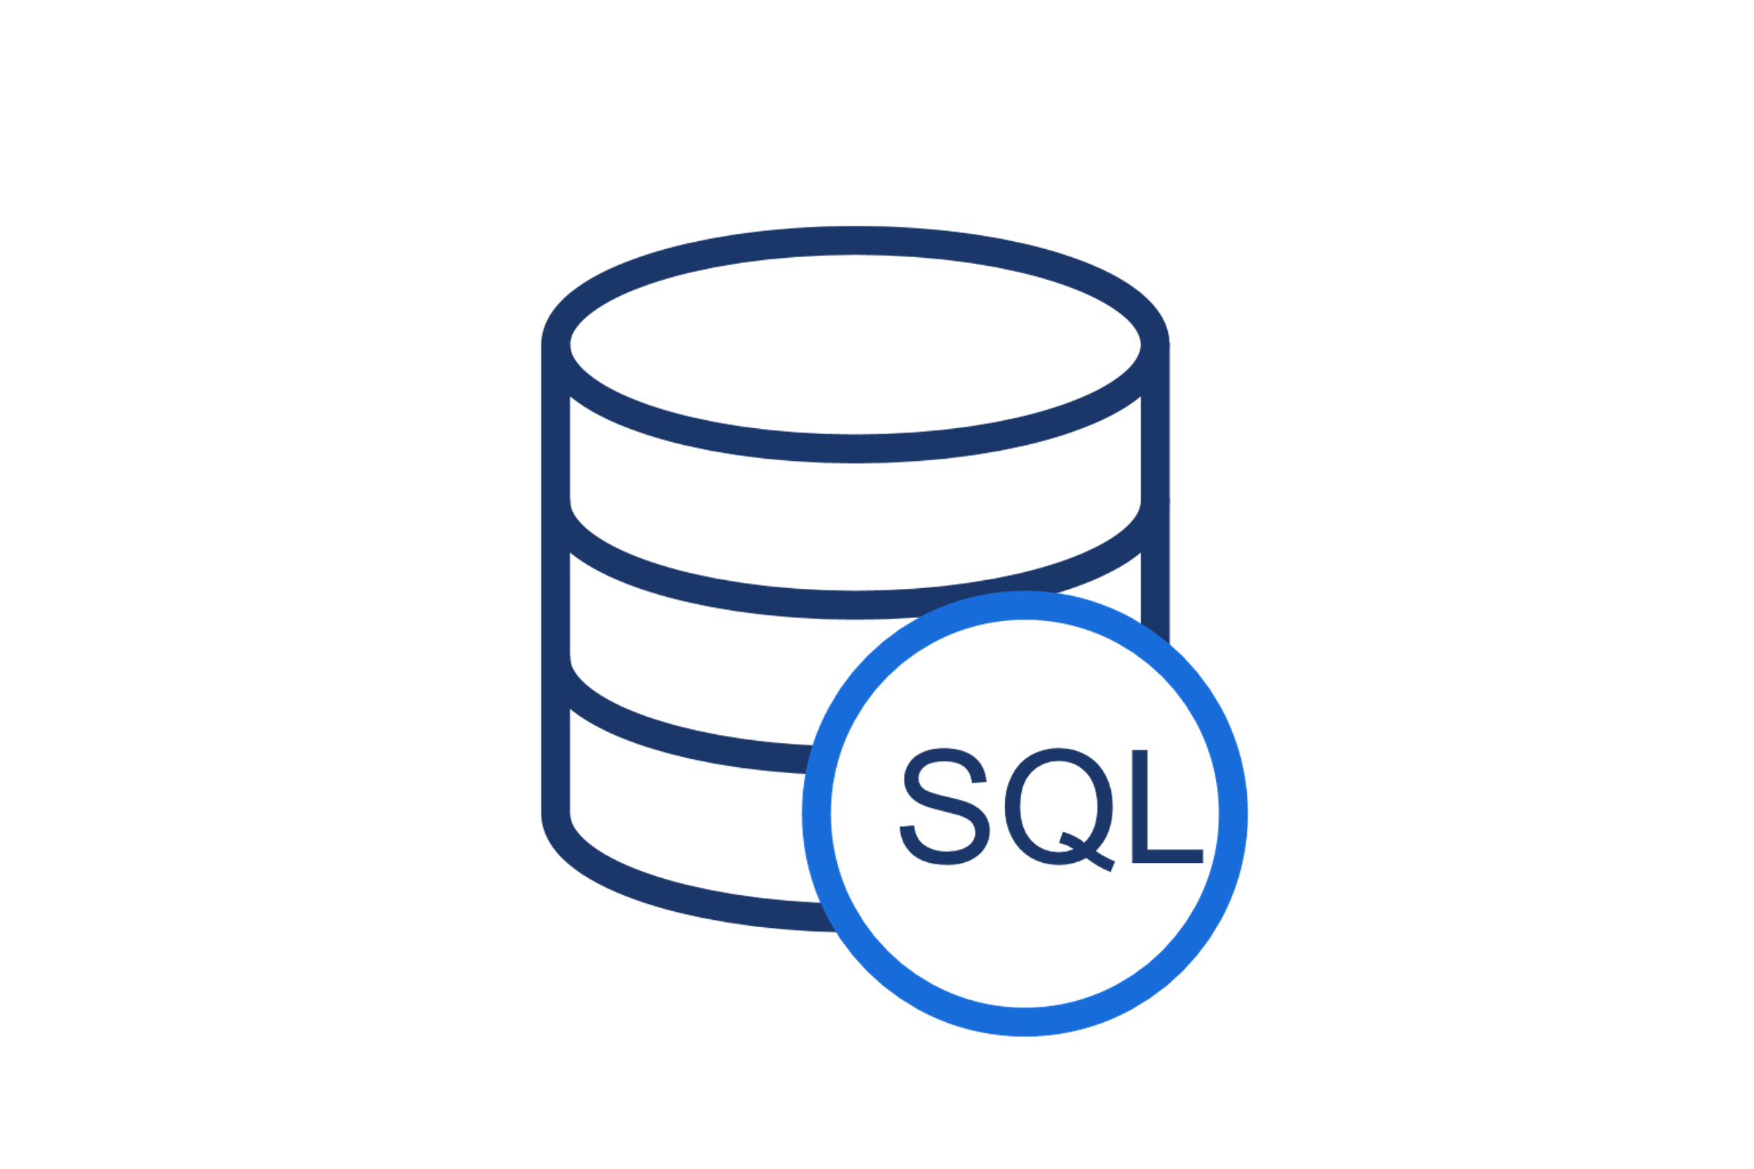






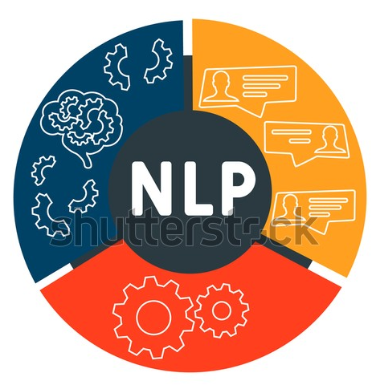






Idea/Approach Details
Book
Idea solutions:
Implementation of an AI driven chatbot named NAVI to aid in answering the ground queries by user to various maintenance activities.
Includes following operations it will perform:
» analyze the limits of machinery and their repairing requirements . » resolve any issue faced during maintenance. Remote access is available. » addresses the queries in understandable way including voice assistant » stores and analyze the data of equipment and technology provides safety and operating manual for various machines Channels: Govt. portals, Electricity generating industries
Revenue Streams: Service based model
Our tech box:

Slide 3








Idea/Approach Details
Use Cases:
Show stoppers:
Voice assistant and accessibility : AI driven voice assistant and accessibility features make it easy for general public as well as visually impaired persons.
Remote troubleshooting assistant : can streamline operations, reduce costs, improve uptime, and enhance the overall efficiency and effectiveness of maintenance and repair processes
Faster problem authentication : can perform failure analysis by identifying many problems related transmission of electricity and overload
Multilingual assistant : promote effective communication, safety,
compliance, and customer satisfaction. ,enhances the ability to also work across language boundaries and supports the needs of a den diverse workforce or customer base. 5) Safety Enhancement : supports safety by identifying potential risk risks and suggesting maintenance actions to mitigate them, risks den reducing workplace accidents. Provides a general user manual to den operate. 6) Anomaly Detection: chatbot can identify anomalies or deviations den from normal operating conditions, helping detect equipment den ten malfunctions or potential issues before they escalate.
Secondary sector(manufacturing and processing units)-- can help in understanding the trends and pattern of a machinery to predict the faults and optimal timing of repair and replacement.
Human development sector - training the staff/engineer /general people to operate the machines
Economical sector -- analyzing the minimal cost of repair and minimizing the loss.
Customer care and help desk sector- analyzing and repairing the faults of goods, and answering to ground queries
Research sector -- understanding the need of new technologies and finding the optimum replacement for pre-existing machinery to boost production and minimize the loss.

Slide 4
Team Member Details
Team Leader Name: Rahul Patel
Branch : B.Sc Stream : Phy. Sci. with CS Year : 1
Team Member 1 Name: Ayush Pal
Branch : B.Sc Stream :Phy. Sci. with CS Year (I,II,III,IV): I
Team Member 2 Name: Sumit Gupta
Branch : B.Sc Stream :Phy. Sci. with CS Year (I,II,III,IV): I
Team Member 3 Name: Suta
Branch : B.Sc Stream :Phy. Sci. with CS Year (I,II,III,IV): I
Team Member 4 Name: Aman
Branch : B.Sc Stream :Phy. Sci. with CS Year (I,II,III,IV): I
Team Member 5 Name: Sushil
Branch : B.Sc Stream :Phy. Sci. with CS Year (I,II,III,IV):I
Team Mentor 1 Name: Vidhi Khanduja
Category (Academic/Industry): Expertise (AI/ML/Blockchain etc): Domain Experience (in years):
Team Mentor 2 Name: Type Your Name Here
Category (Academic/Industry): Expertise (AI/ML/Blockchain etc): Domain Experience (in years):

