Slide 1


Shared Memory Programming using
By
Dr. Nileshchandra Pikle
Assistant Professor,
CSE Department
Indian Institute of Information Technology, Nagpur

Slide 2
How to measure performance of a parallel program?
FLOPS
We write a parallel program to reduce our “time to solution”.
As we convert a program into a parallel program, the wall clock time should decrease.
With additional processors, the wall clock time should continue to decrease until the potential parallelism available from either the hardware or our algorithm is exhausted.
Speedup
Parallel
Efficiency

Slide 3

How to measure performance of a parallel program?
FLOPS
High performance computing (HPC) is largely centered on arithmetic with floating point numbers.
We often think about performance in terms of floating point operations that can be completed in one second of wall clock time.
This unit of measure is called FLOPS: floating point operations per second.
In the late 1980s, a processing unit in the fastest supercomputers at that time (e.g., a Cray 2) ran with a peak performance of 500 Mega FLOPS
Speedup
A common iPhone today runs at over 1200 Mega FLOPS.
The world’s fastest supercomputers should cross the Exa FLOP barrier (10^18 FLOPS).
Parallel
Efficiency
Cray 2 Supercomputer 1985

Slide 4


Top 500 Supercomputers in the world
Top 500 Supercomputers
https://www.top500.org/

Slide 5

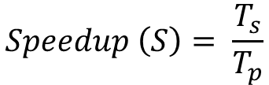
But how to measure performance?
FLOPS
Raw performance expressed in FLOPS is interesting, but to parallel programmers, it is not enough.
We want to measure how much faster our programs run as we add processors.
We want to know about the speedup of our programs.
Speedup
$$Speedup \left(S\right)= \frac{T_{s}}{T_{p}}$$
$T_{s}$ = Sequential run time
$T_{p}$ = parallel run time using p number of processors
Parallel
Efficiency
In the ideal case, the speedup is equal to the number of processors.
If you double the number of processors, the performance should double.
When a program follows this speedup trend we say that it has “perfect linear speedup”.

Slide 6
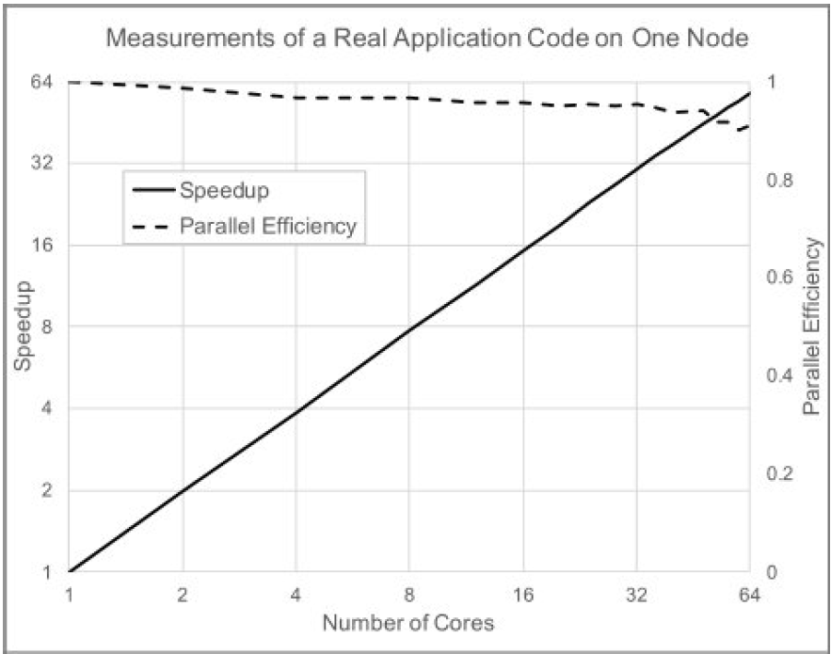


But how to measure performance?
FLOPS
We measure how closely we track perfect linear speedup with a scaled speedup called the parallel efficiency.
One of the oldest “cheats” in high performance computing is to pick a slow algorithm that happens to have a low serial fraction.
Speedup
$$Efficiency \left(E\right)= \frac{S(P)}{P}$$
$S(P)$ = Speedup with P number of processors
Parallel
Efficiency

Slide 7
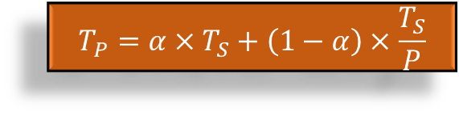
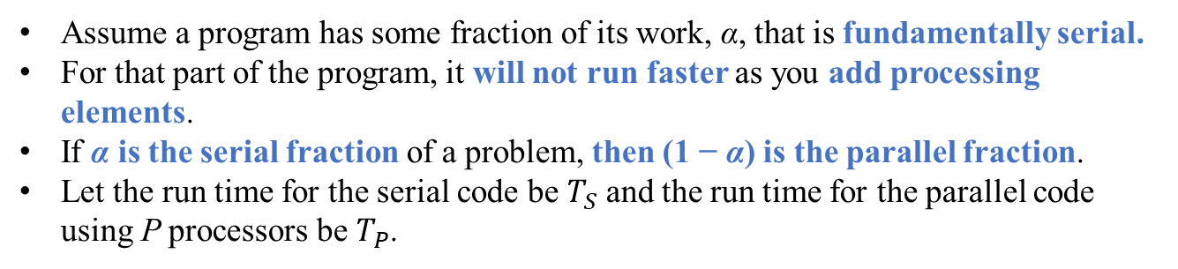
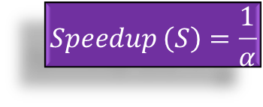
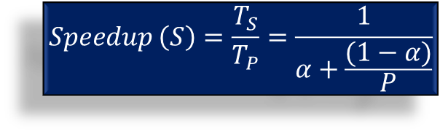
Amdahl’s Law
A central concern in parallel computing is to understand how the performance scales with the number of processors.
If we increase the number of processing elements, will the performance keep improving without bound?
This question was addressed by Gene Amdahl in a 1967.
Not entire program can be executed parallel!
$$T_{P}=α×T_{S}+\left(1−α\right)×\frac{T_{S}}{P}$$
Assume a program has some fraction of its work, α, that is fundamentally serial.
For that part of the program, it will not run faster as you add processing elements.
If α is the serial fraction of a problem, then (1 − α) is the parallel fraction.
Let the run time for the serial code be $T_{S}$ and the run time for the parallel code using P processors be $T_{P}$.
$$Speedup \left(S\right)=\frac{T_{S}}{T_{P}}=\frac{1}{α+\frac{(1−α)}{P}}$$
$$Speedup \left(S\right)=\frac{1}{α}$$
In the limit of P approaching infinity, the parallel term approaches zero and we are left with Amdahl’s law:

Slide 8
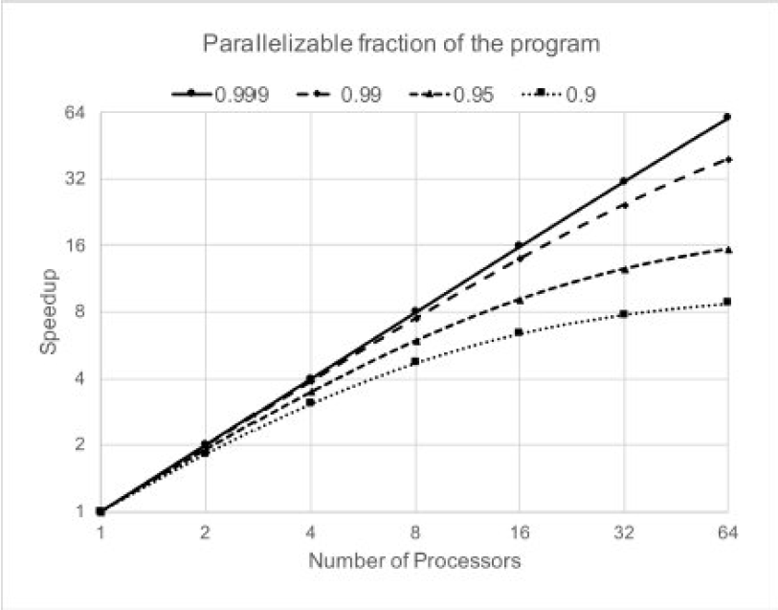
Amdahl’s Law
If your algorithm can speedup 95 percent of your program, for example, then your serial fraction is 0.05 and the best speedup you can achieve given unlimited number of processors is 20x.
According to Amdahl’s law, if only 90% of the code can be parallelized, your serial fraction is 10% and you cannot do better than a speedup of 10 no matter how many processors you have to work with.

Slide 9
OpenMP
OpenMP is a programming language for writing parallel programs on shared memory architectures.
OpenMP (Open Multi-Processing) is an API (application programming interface) that supports multi-platform shared memory multiprocessing programming.
It is not a completely new programming language!
The OpenMP API supports multi-platform shared-memory parallel programming in C/C++ and Fortran.
Provide a consistent API for Fortran, C, and C++ so programmers can easily move between languages.
OpenMP is typically used for loop-level parallelism, but it also supports function-level parallelism.

Slide 10
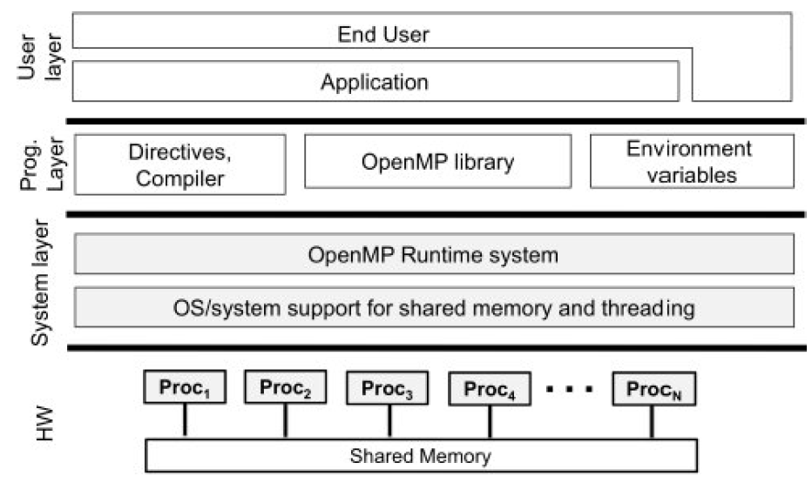
OpenMP Solution stack
Hardware
We begin at the bottom with the hardware.
The OpenMP Common Core assumes an SMP model of the shared memory computer.
OpenMP Solution stack for common core

Slide 11
OpenMP Solution stack
System Layer
Above the hardware sits the System Layer.
The Operating system supports the shared memory computer with some sort of threading model.
OpenMP uses whichever threading model the operating system provides, which in most cases is pthreads.
Above the OS layer is the OpenMP runtime system. This consists of the low level libraries and software components that support the execution of OpenMP programs.
OpenMP Solution stack for common core

Slide 12
OpenMP Solution stack
Program Layer
Directives and an OpenMP aware compiler: the directives tell the compiler what to do on behalf of the OpenMP programmer to create a multithreaded program.
OpenMP library: Functions defined by the API for interacting with the computer as a program executes. It addresses issues that cannot be resolved at compile time such as the number of threads as well as low level primitives to control execution of a program.
Environment variables: control features of an executing
program and set default parameters at runtime.
OpenMP Solution stack for common core

Slide 13
OpenMP Solution stack
User Layer
The final layer is the user layer where by “user” it means the person running (rather than creating) an OpenMP program.
OpenMP Solution stack for common core

Slide 14
Threads vs Process

Slide 15









A C program execution
Here it is a Program i.e passive entity
Processor
Here it is a Process i.e active entity
C program
Compile
Executable
Data
HDD
RAM
OpenMP by Dr. Nileshchandra Pikle

Slide 16
Process structure
Int a,b,c,Result
Int call_func(int a, int b)
{
Int x = a*b
Int y = a-b
Return (y+x)
}
Int main()
{
Read a,b
Result = Call_func(a,b)
print(Result)
Return 0
}
A process is program under execution
A process is more than program code
It also includes
Process ID
program counter
registers
state
open files pointers
children
Current directory, etc.
OpenMP by Dr. Nileshchandra Pikle

Slide 17
Process in Memory
Max
Stack
Process stack contains
Temporary data such as function parameters, return address, and local variables
Int a,b,c,Result
Int call_func(int a, int b)
{
Int x = a*b
Int y = a-b
Return (y+x)
}
Int main()
{
Read a,b,c,Result
Result = Call_func(a,b)
print(Results)
Return main
}
Heap is the memory which is dynamically allocated during process runtime
Data section which contains global variables
A program code is stored in a text section
Heap
Data
A program counter register keep track current instruction being executed and processor registers holds the variable values
0
Text
Process Address Space
OpenMP by Dr. Nileshchandra Pikle

Slide 18
Memory layout of a C program
#include<stdio.h>
#include<stdlib.h>
int x;
int y = 15;
int main(int argc, int *argv[])
{
int *value;
int i;
values = (int *)malloc(sizeof(int) * 5);
for(int i = 0; i < 5; i++)
{
values[i] = i;
}
return 0;
}
Argc, argv
Stack
Heap
uninitialized data
Initialized data
Text
OpenMP by Dr. Nileshchandra Pikle

Slide 19
Limitations of Process
Process address space is bigger in size
To create many processes requires large space in memory
Creating many processes is cumbersome

Slide 20
What is thread?
Thread is a light weight process
Multiple threads can be spawned inside a process
Threads can be executed in parallel
Instead of creating multiple heavy processes we create multiple threads within a process
Process
Thread 0
Thread 1
Thread 2
Thread 3
Thread 4
OpenMP by Dr. Nileshchandra Pikle

Slide 21
Single vs multi threaded process
Code
Data
Heap
Code
Data
Heap
Registers
Stack
Registers
Registers
Registers
Stack
Stack
Stack
Single threaded process
Multi-threaded process
OpenMP by Dr. Nileshchandra Pikle

Slide 22
Process execution
Loop from a C program
for(int i = 0; i < 100; i++)
{
A[i] = A[i] + 5;
}
Core 0
Core 1
Process
Core 2
Core 3
The complete loop gets executed on a single core as one process
OpenMP by Dr. Nileshchandra Pikle

Slide 23
Multiple process execution
Loop from a C program
Process 1
for(int i = 0; i < 25 i++)
{
A[i] = A[i] + 5;
}
Process 0
Core 0
Core 1
for(int i = 25; i < 50; i++)
{
A[i] = A[i] + 5;
}
for(int i = 50; i < 75; i++)
{
A[i] = A[i] + 5;
}
Core 2
Core 3
Process 2
for(int i = 75; i < 100; i++)
{
A[i] = A[i] + 5;
}
Process 3
The complete loop gets divided among 4 processes and executed on four cores as four distinct processes
OpenMP by Dr. Nileshchandra Pikle

Slide 24
Multi Threaded execution
Loop from a C program
Thread 1
for(int i = 0; i < 25 i++)
{
A[i] = A[i] + 5;
}
Thread 0
Core 0
Core 1
for(int i = 25; i < 50; i++)
{
A[i] = A[i] + 5;
}
for(int i = 50; i < 75; i++)
{
A[i] = A[i] + 5;
}
Core 2
Core 3
Thread 2
for(int i = 75; i < 100; i++)
{
A[i] = A[i] + 5;
}
Thread 3
The complete loop gets divided among 4 threads and executed on four cores as four distinct threads of a process
OpenMP by Dr. Nileshchandra Pikle

Slide 25
OpenMP Fork – Join Model
OpenMP by Dr. Nileshchandra Pikle

Slide 26
Fork – Join Model
Master Thread
Fork
Join
The fork-join model – A program starts as a single thread.
It creates (or forks) a team of threads each of which executes a block of code.
When done, the threads join (i.e., are destroyed) and the single original thread continues.
Fork
Sequential
Parts
Join
Parallel
Regions
Fork
Fork
Nested Parallel
Region
Join
Master Thread
OpenMP by Dr. Nileshchandra Pikle

Slide 27
Structure of OpenMP Programs
The directives defined by OpenMP take different forms depending on the host programming language.
In C and C++ the directive is expressed as a pragma.
Most of the OpenMP directives apply to a block of code.
In C/C++ block of code is, lines enclosed within curly brackets { and }
#pragma omp parallel
{
.... do lots of stuff
} // end of parallel region
We use two terms in OpenMP to describe the code executed by an OpenMP program.
A directive and its structured block is called a construct.
OpenMP by Dr. Nileshchandra Pikle

Slide 28
Structure of OpenMP Programs
Constructs and directives
A directive is the OpenMP statement that tells compiler what to do?
The combination of a directive and a structured block is called a construct.
Directive
#pragma omp parallel
{
.... do lots of stuff
} // end of parallel region
Construct
To learn OpenMP, you just need to master a modest number of elements from the OpenMP specification:
Compiler directives
Runtime Library routines
Environment variables
Refer to the code Hello.c
OpenMP by Dr. Nileshchandra Pikle

Slide 29
Structure of OpenMP Programs
OpenMP File – Extension of the file will be either .c or .cpp
For compilation use flag –fopenmp
To compile program – gcc –fopenmp –o output_file_name program_name.c
Execute using ./a.out
Refer to the code Hello.c
OpenMP by Dr. Nileshchandra Pikle

Slide 30
Threads, Cores, Logical cores, Hyperthreading
Thread is a basic execution unit in parallel region of the program.
A process spawns multiple threads and threads share the address space of process in the memory.
A programmer can create any number of threads. However, number of threads executed in parallel is depend on number of cores available.
The core represents actual physical core – dual core (2 cores), Quad core (4 cores), octa core (8 cores) etc.
Intel® Hyper-Threading Technology is a hardware innovation that allows more than one thread to run on each core.
OpenMP by Dr. Nileshchandra Pikle

Slide 31
Threads, Cores, Logical cores, Hyper-threading
Hyper-threading
How does Hyper-Threading work?
When Intel® Hyper-Threading Technology is active, the CPU exposes two execution contexts per physical core.
This means that one physical core now works like two “logical cores” that can handle different software threads.
The ten-core Intel® Core™ i9-10900K processor, for example, has 20 threads when Hyper-Threading is enabled.
Two logical cores can work through tasks more efficiently than a traditional single-threaded core. By taking advantage of idle time when the core would formerly be waiting for other tasks to complete.
Hyper-Threading Technology improves CPU throughput
OpenMP by Dr. Nileshchandra Pikle

Slide 32
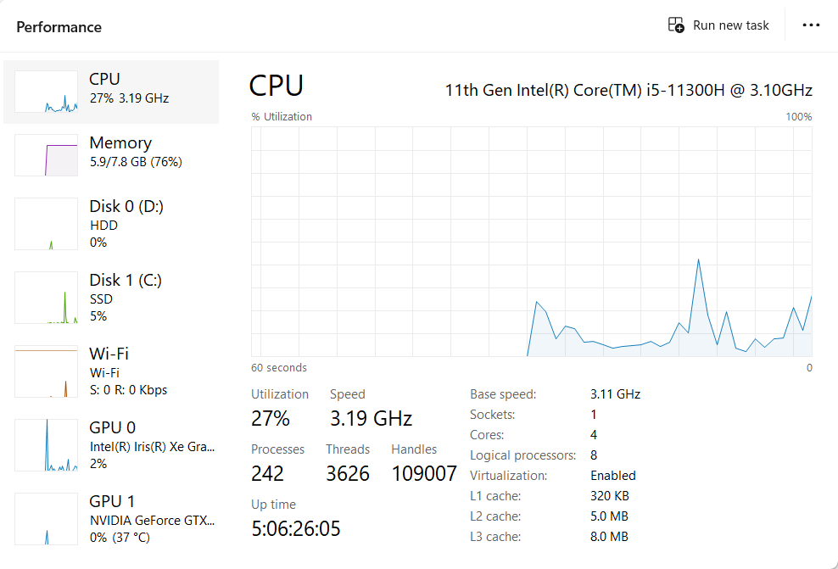
Threads, Cores, Logical cores, Hyper-threading
Task Manager
OpenMP by Dr. Nileshchandra Pikle

Slide 33
OpenMP Library routines
int omp_get_thread_num();
Retrieves thread id
int omp_get_num_procs();
Retrieves number of physical cores in the system
int omp_set_num_threads(threads);
Sets the number of threads in a parallel region
Refer to the code Threads.c
OpenMP by Dr. Nileshchandra Pikle

Slide 34
How threads scheduled on cores?
T0
C0
C1
T0
C0
C1
T2
T1
C2
C3
T1
C2
C3
T3
Number of cores = 4
Number of threads = 2
Number of cores = 4
Number of threads = 4
In this case 2 threads gets scheduled on any two cores
In this case 4 threads gets scheduled on four cores arbitrarily
OpenMP by Dr. Nileshchandra Pikle

Slide 35
How threads scheduled on cores?
Number of cores = 4
Number of threads = 8
T0
T1
T7
T5
Physical view
Without
Hyperthreading
C0
C1
C0
C1
C2
C3
Logical view
With
Hyperthreading
C2
C3
C4
C5
C6
C7
T2
T3
T6
T4
In this case if hyperthreading is supported then logically 8 threads gets scheduled arbitrarily on 8 virtual cores
OpenMP by Dr. Nileshchandra Pikle

Slide 36
How threads scheduled on cores?
Number of cores = 4
Number of threads = 8
T0
T1
T7
T5
Physical view
Without
Hyperthreading
C0
C1
C0
C1
C2
C3
Logical view
With
Hyperthreading
C2
C3
C4
C5
C6
C7
T2
T3
T6
T4
In this case if hyperthreading is supported then logically first 8 threads gets scheduled arbitrarily on 8 virtual cores then remaining 8 threads get scheduled arbitrarily on 8 virtual cores
OpenMP by Dr. Nileshchandra Pikle

Slide 37
How threads scheduled on cores?
Number of cores = 4
Number of threads = 8
T9
T8
T12
T15
Physical view
Without
Hyperthreading
C0
C1
C0
C1
C2
C3
Logical view
With
Hyperthreading
C2
C3
C4
C5
C6
C7
T13
T14
T11
T10
In this case if hyperthreading is supported then logically first 8 threads gets scheduled arbitrarily on 8 virtual cores then remaining 8 threads get scheduled arbitrarily on 8 virtual cores
Refer to the code Threads.c
OpenMP by Dr. Nileshchandra Pikle

Slide 38
Maximum number of threads?
The maximum number of threads you CAN create depends on your system.
In Linux you can find this out using cat /proc/sys/kernel/threads-max
However, launching may threads would totally overload the system.
As a rule of thumb, you should not need to exceed the number of available logical processors in your system.
If you launch many threads than available cores, at max N threads can execute in parallel where N is total number of cores present in the system.
Note that thread creation and deletion has overheads associated with it
OpenMP by Dr. Nileshchandra Pikle

Slide 39
Hello world program Recap
Thread 0
Thread 1
int main()
{
omp_set_num_threads(4);
#pragma omp parallel
{
printf("\n Hello world");
}
return 0;
}
printf("\n Hello world");
printf("\n Hello world");
Thread 2
Thread 3
printf("\n Hello world");
printf("\n Hello world");
No useful work is done in parallel! Rather same task is performed by all threads in parallel
THIS IS NOT PARALLEL COMPUTING!
OpenMP by Dr. Nileshchandra Pikle

Slide 40
What we do in parallel computing
Analyse
Analyse
Parallelize
Optimize
Deploy
Validate
Write sequential code for the given problem statement
Profile:
Find out hotspots in the sequential code using profilers or clock() functions.
Sort all the functions in descending order according to their execution time.
Target one by one function for parallelization.
OpenMP by Dr. Nileshchandra Pikle

Slide 41
What we do in parallel computing
Parallelize
Analyse
Parallelize
Optimize
Deploy
Validate
Select a hotspot from analyse step
Identify the parallelism within the function – independent tasks
Divide the tasks among multiple compute resources
Execute tasks in parallel
OpenMP by Dr. Nileshchandra Pikle

Slide 42
What we do in parallel computing
Validate
Analyse
Parallelize
Optimize
Deploy
Validate
Validate the results – compare the sequential and parallel output
If the results of sequential and parallel execution are matching then only it make sense to measure the performance improvement
Observe the performance improvement
Repeat Parallelize and validate step for all hotspots
OpenMP by Dr. Nileshchandra Pikle

Slide 43
What we do in parallel computing
Optimize
Analyse
Parallelize
Optimize
Deploy
Validate
Using profiler check if any scope for further improvement
Apply different optimization techniques based on profilers suggestions
OpenMP by Dr. Nileshchandra Pikle

Slide 44
What we do in parallel computing
Deploy
Analyse
Parallelize
Optimize
Deploy
Validate
Finally deploy the application in production
Again repeat these steps and try to improve the performs
OpenMP by Dr. Nileshchandra Pikle

Slide 45
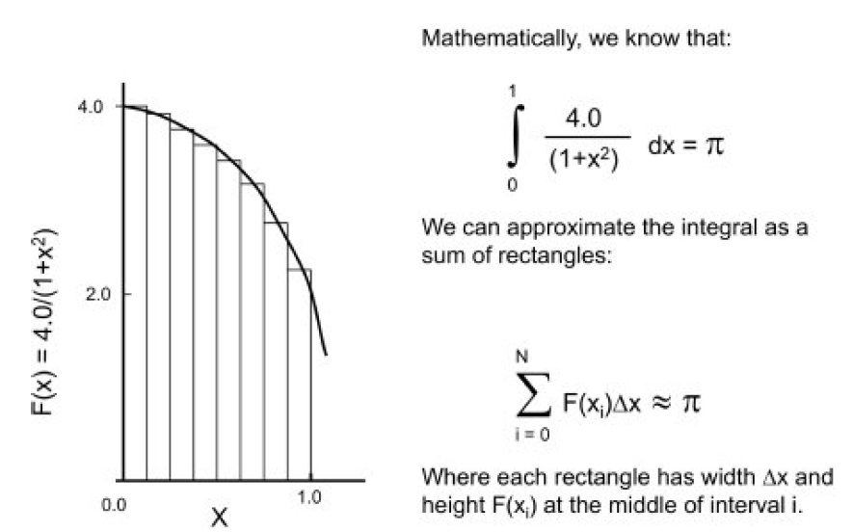
Program 1 – Calculation of Pi value
To calculate value of pi we can use integration method
An integral can be approximated by filling in the area under a curve with rectangles and summing their areas.
Sum of all areas of rectangles approximates the value of pi
OpenMP by Dr. Nileshchandra Pikle

Slide 46
Program 1 – Calculation of Pi value
#include<stdio.h>
#include<stdlib.h>
#include<omp.h>
static long num_steps = 100000000;
double step;
int main()
{
int i;
double x, pi, sum = 0.0;
double start_time, run_time;
step = 1/(double)num_steps;
start_time = omp_get_wtime();
for(i = 0; i < num_steps; i++)
{
x = (i + 0.5)*step;
sum += 4.0/(1.0 + x * x);
}
pi = step * sum;
run_time = omp_get_wtime() - start_time;
printf("\n Pi value = %f total time = %f ",pi,run_time);
return 0;
}
Number of steps decides how precise you want to get value of pi. More the value more precise value of pi you will get.
Number of steps simply means number of rectangles.
Step holds the width of the each rectangle and calculated based on number of steps.
A for loop iterates over number of steps and take sum of all areas of rectangles.
Finally we get value of pi.
OpenMP library routines omp_get_wtime() used to record the time for pi calculation.
OpenMP by Dr. Nileshchandra Pikle

Slide 47
Program 1 – Calculation of Pi value
#include<stdio.h>
#include<stdlib.h>
#include<omp.h>
static long num_steps = 100000000;
double step;
int main()
{
int i;
double x, pi, sum = 0.0;
double start_time, run_time;
step = 1/(double)num_steps;
start_time = omp_get_wtime();
for(i = 0; i < num_steps; i++)
{
x = (i + 0.5)*step;
sum += 4.0/(1.0 + x * x);
}
pi = step * sum;
run_time = omp_get_wtime() - start_time;
printf("\n Pi value = %f total time = %f ",pi,run_time);
return 0;
}
What is the most computationally intensive task in this program?
OpenMP by Dr. Nileshchandra Pikle

Slide 48
Program – Calculation of Pi value Sequentially
#include<stdio.h>
#include<stdlib.h>
#include<omp.h>
static long num_steps = 100000000;
double step;
int main()
{
int i;
double x, pi, sum = 0.0;
double start_time, run_time;
step = 1/(double)num_steps;
start_time = omp_get_wtime();
for(i = 0; i < num_steps; i++)
{
x = (i + 0.5)*step;
sum += 4.0/(1.0 + x * x);
}
pi = step * sum;
run_time = omp_get_wtime() - start_time;
printf("\n Pi value = %f total time = %f ",pi,run_time);
return 0;
}
What is the most computationally intensive task in this program?
Yes! The for loop which is running 100000000 times
OpenMP by Dr. Nileshchandra Pikle

Slide 49




Calculation of Pi – Parallel version 1
How to parallelize for loop?
#include<stdio.h>
#include<stdlib.h>
#include<omp.h>
static long num_steps = 100000000;
double step;
int main()
{
int i;
double x, pi, sum = 0.0;
double start_time, run_time;
step = 1/(double)num_steps;
start_time = omp_get_wtime();
for(i = 0; i < num_steps; i++)
{
x = (i + 0.5)*step;
sum += 4.0/(1.0 + x * x);
}
pi = step * sum;
run_time = omp_get_wtime() - start_time;
printf("\n Pi value = %f total time = %f ",pi, run_time);
return 0;
}
For loop is iterating num_steps times.
Launch N threads
Divide for loop computations across N threads
E.g. If N = 4
Hotspot!
Thread 0
$$0 to \frac{num_steps}{4}$$
Thread 1
$$\frac{num_steps}{4} to \frac{num_steps}{2}$$
Thread 2
$$\frac{num_steps}{2} to 3×\frac{num_steps}{4}$$
Thread 3
$$3×\frac{num_steps}{4} to num_steps$$
OpenMP by Dr. Nileshchandra Pikle

Slide 50




Calculation of Pi – Parallel version 1
How to parallelize for loop?
#include<stdio.h>
#include<stdlib.h>
#include<omp.h>
static long num_steps = 100000000;
double step;
int main()
{
int i;
double x, pi, sum = 0.0;
double start_time, run_time;
step = 1/(double)num_steps;
start_time = omp_get_wtime();
for(i = 0; i < num_steps; i++)
{
x = (i + 0.5)*step;
sum += 4.0/(1.0 + x * x);
}
pi = step * sum;
run_time = omp_get_wtime() - start_time;
printf("\n Pi value = %f total time = %f ",pi, run_time);
return 0;
}
For loop is iterating num_steps times.
Launch N threads
Divide for loop computations across N threads
E.g. If N = 4 if num_steps = 100
Hotspot!
Thread 0
$$0 to 24$$
Thread 1
$$25 to 49$$
Thread 2
$$50 to 74$$
Thread 3
$$75 to 99$$
OpenMP by Dr. Nileshchandra Pikle

Slide 51
Calculation of Pi – Parallel version 1
#define MIN(x,y) ((x<y)?x:y)
static long num_steps = 100000000;
double step; int main()
{
int NThreads = 4;
double x, pi, sum = 0.0;
double start_time, run_time;
step = 1/(double)num_steps;
omp_set_num_threads(NThreads);
int chunk_size = num_steps/NThreads;
start_time = omp_get_wtime();
#pragma omp parallel
{
int tid = omp_get_thread_num();
int lower = tid * chunk_size;
int upper = (tid + 1) * chunk_size;
for(int i = lower; i < MIN(upper, num_steps); i++)
{
x = (i + 0.5)*step;
sum += 4.0/(1.0 + x * x);
}
}
pi = step * sum;
run_time = omp_get_wtime() - start_time;
printf("\n Pi value = %f total time = %f ",pi, run_time);
return 0;
}
Execute: ParallelPi_v1_raceConditions.c
Observe the output value of PI by executing multiple times
Every time you execute the program a different value of PI is displayed!
What could be the reason?
RACE CONDITION
OpenMP by Dr. Nileshchandra Pikle

Slide 52
RACE CONDITIONS

Slide 53

Race Conditions
Problem:- Inconsistency when more than one thread try to update count variable concurrently
Scenario 1
Let's assume initially count value is 5
count
5
1. Thread 0 executes the count++
statement
What will be the value of count?
2. Thread 1 executes the count--
statement
In both cases expected output is 5

Slide 54
Race Conditions
What could possibly go wrong?
Thread 0
Thread 1
counter = counter + 1
counter = counter - 1
register1 = counter
register2 = counter
register1 = register1 + 1
register2 = register2 - 1
counter = register1
counter = register2
counter = counter + 1 statement is implemented in machine level language has 3 steps
Load counter value from main memory to local CPU register
Increment the value loaded into the register by 1
Store the updated value from register to counter variable in main memory

Slide 55
Race Conditions
What could possibly go wrong?
Thread 0
Thread 1
register1 = counter
6
counter
5
register1 = register1 + 1
counter = counter + 1
counter = counter - 1
counter = register1
5
register1
6
register1 = counter
register2 = counter
register1 = register1 + 1
register2 = register2 - 1
register2
counter = register1
counter = register2
Let thread 0 executes first and initial
value of counter is 5

Slide 56
Race Conditions
What could possibly go wrong?
Thread 0
Thread 1
register1 = counter
6
5
counter
5
register1 = register1 + 1
counter = counter + 1
counter = counter - 1
counter = register1
5
register1
6
register2 = counter
register2 = counter
register2 = register2 - 1
register2 = register2 - 1
register2
6
5
counter = register2
counter = register2
Thread 1 executes next and
current value of counter is 6
Final value of counter is 5

Slide 57
Race Conditions
What could possibly go wrong?
Thread 0
Thread 1
register2 = counter
6
5
counter
5
counter = counter + 1
counter = counter - 1
register2 = register2 - 1
counter = register2
5
register1
7
register1 = counter
register1 = register1 + 1
register2
6
5
counter = register1
If thread 1 executes first then thread 0.
Above scenario looks fine when either thread 0 or thread 1 executes at a time

Slide 58
Race Conditions
What could possibly go wrong?
Thread 0
Thread 1
counter
5
counter = counter + 1
counter = counter - 1
register1
register1 = counter
register2 = counter
register1 = register1 + 1
register2 = register2 - 1
register2
counter = register1
counter = register2
Let’s understand what happens when both thread 0 and thread 1 runs concurrently with preemption

Slide 59
Race Conditions
What could possibly go wrong?
Thread 0
Thread 1
register1 = counter
6
6
counter
5
counter = counter + 1
counter = counter + 1
register1 = register1 + 1
register2 = counter
5
register1
6
register1 = counter
register2 = counter
register2 = register2 - 1
register1 = register1 + 1
register2 = register2 - 1
counter = register1
5
register2
6
counter = register1
counter = register2
counter = register2
Now Thread 0 gets preempted and Thread 1 continue execution
Now Thread 1 gets preempted and Thread 0 continue execution
Now Thread 0 completed and Thread 1 starts
Thread 1 completed

Slide 60

Race Conditions
What could possibly go wrong?
Thread 0
Thread 1
register1 = counter
4
6
counter
5
counter = counter + 1
counter = counter + 1
register1 = register1 + 1
register2 = counter
5
register1
6
register1 = counter
register2 = counter
register2 = register2 - 1
register1 = register1 + 1
register2 = register2 - 1
counter = register1
5
register2
4
counter = register1
counter = register2
counter = register2
Value of counter supposed to be remain 7 after
Therad 0 and Thread 1 executes

Slide 61
Race Conditions
A race condition occurs when two or more threads can access shared data and they try to change it at the same time.
Because the thread scheduling algorithm can swap between threads at any time, you don't know the order in which the threads will attempt to access the shared data.
Therefore, the result of the change in data is dependent on the thread scheduling algorithm, i.e. both threads are "racing" to access/change the data.
That’s why if there are race conditions occur the output changes after every execution.

Slide 62
How to resolve race conditions in PI calculation?
#define MIN(x,y) ((x<y)?x:y)
static long num_steps = 100000000;
double step; int main()
{
int NThreads = 4;
double x, pi, sum = 0.0;
double start_time, run_time;
step = 1/(double)num_steps;
omp_set_num_threads(NThreads);
int chunk_size = num_steps/NThreads;
start_time = omp_get_wtime();
#pragma omp parallel
{
int tid = omp_get_thread_num();
int lower = tid * chunk_size;
int upper = (tid + 1) * chunk_size;
for(int i = lower; i < MIN(upper, num_steps); i++)
{
x = (i + 0.5)*step;
sum += 4.0/(1.0 + x * x);
}
}
pi = step * sum;
run_time = omp_get_wtime() - start_time;
printf("\n Pi value = %f total time = %f ",pi, run_time);
return 0;
}
Create a sum[] array of size Nthreads
Each thread keep partial sum at location sum[tid]
As each thread is updating sum at distinct location in sum[] array, there are no race conditions.
Why can’t we use private sum variable for each thread?

Slide 63
How to resolve race conditions in PI calculation?
#define MIN(x,y) ((x<y)?x:y)
static long num_steps = 100000000;
double step; int main()
{
int NThreads = 4;
double x, pi, sum = 0.0;
double start_time, run_time;
step = 1/(double)num_steps;
omp_set_num_threads(NThreads);
int chunk_size = num_steps/NThreads;
start_time = omp_get_wtime();
#pragma omp parallel
{
int tid = omp_get_thread_num();
int lower = tid * chunk_size;
int upper = (tid + 1) * chunk_size;
for(int i = lower; i < MIN(upper, num_steps); i++)
{
x = (i + 0.5)*step;
sum += 4.0/(1.0 + x * x);
}
}
pi = step * sum;
run_time = omp_get_wtime() - start_time;
printf("\n Pi value = %f total time = %f ",pi, run_time);
return 0;
}
Create a sum[] array of size Nthreads
Each thread keep partial sum at location sum[tid]
As each thread is updating sum at distinct location in sum[] array, there are no race conditions.
Why can’t we use private sum variable for each thread?
Each thread can update the partial sum in its own variable
But as soon as parallel region is over all the private variables get deleted!
So partial sum cannot be taken outside the parallel region

Slide 64
How to resolve race conditions in PI calculation?
int main()
{
int NThreads = 32,actual_NThreads;
double pi;
double sum[NThreads];
double start_time, run_time;
step = 1/(double)num_steps;
omp_set_num_threads(NThreads);
int chunk_size = num_steps/NThreads;
#pragma omp parallel
{
double x;
int tid = omp_get_thread_num();
int numThreads = omp_get_num_threads();
if(tid == 0)
{
actual_NThreads = numThreads;
}
sum[tid] = 0.0;
int lower = tid * chunk_size;
int upper = (tid + 1) * chunk_size;
for(int i = lower; i < MIN(upper,num_steps); i++)
{
x = (i + 0.5)*step;
sum[tid] += 4.0/(1.0 + x * x);
}
}
pi = 0.0;
for(int i = 0; i < actual_NThreads; i++)
{
pi += sum[i];
}
pi = step*pi;
return 0;
}
Create a sum[] array of size Nthreads
Each thread keep partial sum at location sum[tid]
As each thread is updating sum at distinct location in sum[] array, there are no race conditions.

Slide 65
Data/compute distribution among threads
int main()
{
int NThreads = 32,actual_NThreads;
double pi;
double sum[NThreads];
double start_time, run_time;
step = 1/(double)num_steps;
omp_set_num_threads(NThreads);
int chunk_size = num_steps/NThreads;
#pragma omp parallel
{
double x;
int tid = omp_get_thread_num();
int numThreads = omp_get_num_threads();
if(tid == 0)
{
actual_NThreads = numThreads;
}
sum[tid] = 0.0;
int lower = tid * chunk_size;
int upper = (tid + 1) * chunk_size;
for(int i = lower; i < MIN(upper,num_steps); i++)
{
x = (i + 0.5)*step;
sum[tid] += 4.0/(1.0 + x * x);
}
}
pi = 0.0;
for(int i = 0; i < actual_NThreads; i++)
{
pi += sum[i];
}
pi = step*pi;
return 0;
}
The computations can be distributed in many ways among the threads. Lets see two possibilities
Block distribution
Cyclic distribution

Slide 66
Data/compute distribution among threads - Cyclic distribution
static long num_steps = 1000000000;
double step; int main()
{
int NThreads = 32,actual_NThreads;
double pi;
double sum[NThreads];
step = 1/(double)num_steps;
omp_set_num_threads(NThreads);
int chunk_size = num_steps/NThreads;
#pragma omp parallel
{
double x;
int tid = omp_get_thread_num();
int numThreads = omp_get_num_threads();
if(tid == 0)
{
actual_NThreads = numThreads;
}
sum[tid] = 0.0;
for(int i = tid; i < num_steps; i+= numThreads)
{
x = (i + 0.5)*step;
sum[tid] += 4.0/(1.0 + x * x);
}
}
pi = 0.0;
for(int i = 0; i < actual_NThreads; i++)
{
pi += sum[i];
}
pi = step*pi;
return 0;
}
The iterations of for loop are distributed among the available threads in cyclic fashion
Let there are 4 threads in parallel region
Thread 0 is responsible for iteration number 0, 4, 8, 12, ...
Thread 1 is responsible for iteration number 1, 5, 9, 13, ...
Thread 2 is responsible for iteration number 2, 6, 10, 14, …
Thread 3 is responsible for iteration number 3, 7, 11, 15, ...
Execute: ParallelPi_v3_sumArray_CyclicReduction.c

Slide 67
Data/compute distribution among threads - Block distribution
int main()
{
int NThreads = 8,actual_NThreads;
double pi;
double sum[NThreads];
double start_time, run_time;
step = 1/(double)num_steps;
omp_set_num_threads(NThreads);
int chunk_size = num_steps/NThreads;
start_time = omp_get_wtime();
#pragma omp parallel
{
double x;
int tid = omp_get_thread_num();
int numThreads = omp_get_num_threads();
if(tid == 0)
{
actual_NThreads = numThreads;
}
sum[tid] = 0.0;
int lower = tid * chunk_size;
int upper = (tid + 1) * chunk_size;
for(int i = lower; i < MIN(upper, num_steps); i++)
{
x = (i + 0.5)*step;
sum[tid] += 4.0/(1.0 + x * x);
}
}
pi = 0.0;
for(int i = 0; i < actual_NThreads; i++)
{
pi += sum[i];
}
pi = step*pi;
The idea is to give each thread an approximately equal sized block of loop iterations.
This block size (chunk_size) is found by dividing the number of steps in the integration by the number of threads (NThreads).
We then multiply that block size by the thread id (tid) to find the beginning of the block (lower) for each thread and by id+1 to find the index for the last iteration of the block (upper).
We need to account for cases where the number of steps in the integration is not evenly divisible by the number of threads.
For that reason MIN() function is defined as macro.
Execute: ParallelPi_v2_SumArray_BlockDistribution.c

Slide 68
Performance comparison
 |  | 2 Threads | 4 Threads | 8 Threads | 16 Threads | 32 Threads
 | Sequential | ParallelPi_v2_SumArray_BlockDistribution.c
 | 2.56 | 2.6 | 2.172 | 1.964 | 1.65 | 1.28
 | 2.52 | 2.46 | 2.27 | 1.737 | 1.63 | 1.21
 | 2.4 | 2.67 | 2.09 | 1.879 | 1.62 | 1.19
 | 2.44 | 2.52 | 1.86 | 1.986 | 1.699 | 1.22
 | 2.52 | 2.35 | 1.92 | 1.94 | 1.66 | 1.224
Avg Time | 2.488 | 2.52 | 2.0624 | 1.9012 | 1.6518 | 1.2248
Speedup | 1 | 0.987301587 | 1.206361521 | 1.30864717 | 1.506235622 | 2.031352057
 |  | 2 Threads | 4 Threads | 8 Threads | 16 Threads | 32 Threads
 | Sequential | ParallelPi_v3_sumArray_CyclicReduction.c
 | 2.56 | 2.533 | 2.57 | 1.94 | 1.77 | 1.17
 | 2.52 | 2.21 | 2.47 | 2.07 | 1.77 | 1.22
 | 2.4 | 2.54 | 2.46 | 1.99 | 1.659 | 1.3
 | 2.44 | 2.42 | 2.36 | 1.95 | 1.65 | 1.18
 | 2.52 | 2.27 | 2.31 | 1.91 | 1.7 | 1.22
Avg Time | 2.488 | 2.3946 | 2.434 | 1.972 | 1.7098 | 1.218
Speedup | 1 | 1.039004427 | 1.022185703 | 1.261663286 | 1.455140952 | 2.042692939

Slide 69
Why performance is getting increased even more threads than cores?
In general, launching more threads than the number of physical cores can still result in improved performance in certain scenarios.
Thread Overlapping:
- When you launch more threads than the number of physical cores, it allows for potential
overlapping of thread execution.
- While some threads are waiting for resources or blocked on certain operations, other
threads can continue executing instructions.
- This overlap can help maximize CPU utilization and keep the cores busy, leading to
improved performance.
Exploiting Resource Hierarchy:
- Modern processors often have multiple levels of cache and memory hierarchies.
- When you have more threads than cores, it increases the chances of having multiple threads
- accessing different levels of cache simultaneously, exploiting the memory hierarchy
effectively.
- This can help reduce cache misses and improve overall memory access patterns, resulting in
better performance.

Slide 70
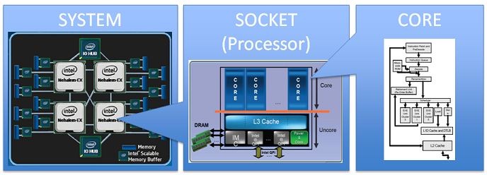
Yet Another Issue: False sharing!
Recall: Memory organization
Processor Bord
Processor Socket
Processor Socket
Processor 0
Processor 1
Core 0
Core 1
Core 0
Core 1
L1 Cache
L1 Cache
L1 Cache
L1 Cache
L2 Cache
L2 Cache
L3 Cache
HDD
RAM

Slide 71
Yet Another Issue: False sharing!
Core
CPU is faster than the memory and clock frequency is typically 3 to 4 GHz
Caches are small in size but expensive
L1 cache is in few KBs ON-CHIP
L2 cache in few MBs ON-CHIP
L3 cache is also in few MBs but bigger than L2 OFF-CHIP
Memory speed is typically ranges from 2 to 3 GHz
Caches are utilized to reduce main memory footprints by loading the data based on temporal or spatial locality.
On-chip cache
Off-chip cache
Main Memory

Slide 72
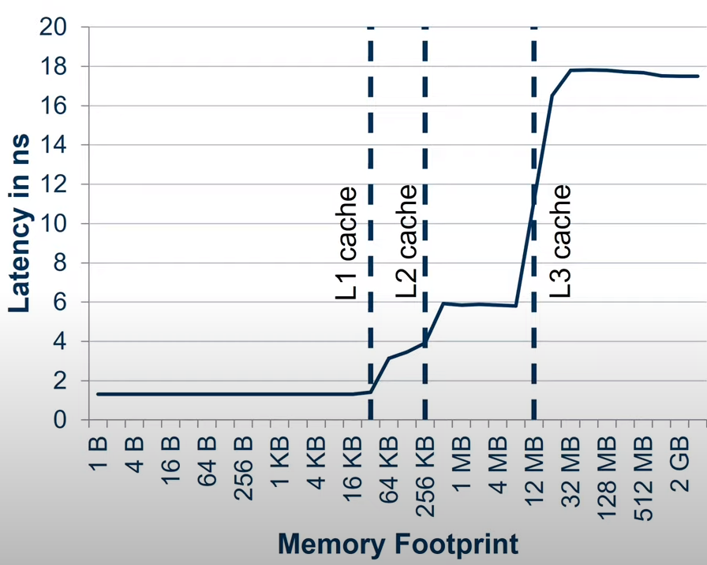
Yet Another Issue: False sharing!
Typically L1 cache is 10 to 20 times faster than main memory
L2 cache is on-chip and bigger than L1 cache but slower than L1
L3 is an off-chip cache, it is typically shared among multiple processor cores in a multi-core system.

Slide 73
Yet Another Issue: False sharing!
Difference: Cache size and cache line
Cache memory is a random access memory.
It lies on the path between the processor and the main memory.
It bridges the speed mismatch between the fastest processor and the slower main memory.
Cache memory is divided into equal size partitions called as cache lines.
The size of cache line affects a lot of parameters in the caching system.
The larger the block size, better will be the spatial locality.
Cache memory
with 3 cache lines
Cache memory
with 6 cache lines

Slide 74
Yet Another Issue: False sharing!
Difference: Cache size and cache line
Core
Cache memory is a random access memory.
It lies on the path between the processor and the main memory.
It bridges the speed mismatch between the fastest processor and the slower main memory.
Cache Memory
Cache memory is divided into equal size partitions called as cache lines.
The size of cache line affects a lot of parameters in the caching system.
The larger the block size, better will be the spatial locality.
Cache Line
Main memory

Slide 75
Yet Another Issue: False sharing!
Core 0
Core 1
int tid = omp_get_thread_num();
.
.
.
for(int i = lower; i < MIN(upper, num_steps); i++)
{
x = (i + 0.5)*step;
sum[tid] += 4.0/(1.0 + x * x);
}
.
.
.
HW thread 0
HW thread 1
HW thread 2
HW thread 3
Sum[0]
Sum[1]
Sum[2]
Sum[3]
Sum[0]
Sum[1]
Sum[2]
Sum[3]
L1 cache
L1 cache
Cache line
Cache line
Sum[0]
Sum[1]
Sum[2]
Sum[3]
Memory / L2 cache
Let we have 2 cores on which 4 threads can execute in parallel (hyperthreading)
When a thread access sum array a chunk of memory is loaded into L1 cache
This chunk of memory is based on cache line and typically ranges from 32 to 256 bytes
For two cores a separate L2 cache is present on the chip
Thread 0 and Thread 1 scheduled on core 0 and Thread 2 and Thread 3 scheduled on core 1

Slide 76
Yet Another Issue: False sharing!
Core 0
Core 1
int tid = omp_get_thread_num();
.
.
.
for(int i = lower; i < MIN(upper, num_steps); i++)
{
x = (i + 0.5)*step;
sum[tid] += 4.0/(1.0 + x * x);
}
.
.
.
HW thread 0
HW thread 1
HW thread 2
HW thread 3
Sum[0]
Sum[1]
Sum[2]
Sum[3]
Sum[0]
Sum[1]
Sum[2]
Sum[3]
L1 cache
L1 cache
Cache line
Cache line
Sum[0]
Sum[1]
Sum[2]
Sum[3]
Memory / L2 cache
Assume! Cache line is 32 bytes i.e. it can load 4 float values
When threads from Core 0 access sum array all 4 values are loaded into L1 cache of Core 0
When threads from Core 1 access sum array all 4 values are loaded into L1 cache of Core 1

Slide 77
Yet Another Issue: False sharing!
Core 0
Core 1
int tid = omp_get_thread_num();
.
.
.
for(int i = lower; i < MIN(upper, num_steps); i++)
{
x = (i + 0.5)*step;
sum[tid] += 4.0/(1.0 + x * x);
}
.
.
.
HW thread 0
HW thread 1
HW thread 2
HW thread 3
Sum[0]
Sum[1]
Sum[2]
Sum[3]
Sum[0]
Sum[1]
Sum[2]
Sum[3]
L1 cache
L1 cache
Cache line
Cache line
Sum[0]
Sum[1]
Sum[2]
Sum[3]
Memory / L2 cache
Let Thread 0 updates sum[0] and Thread 2 updates sum[2]
Note that, entire sum[] array present at L1 cache at both cores

Slide 78
Yet Another Issue: False sharing!
Core 0
Core 1
int tid = omp_get_thread_num();
.
.
.
for(int i = lower; i < MIN(upper, num_steps); i++)
{
x = (i + 0.5)*step;
sum[tid] += 4.0/(1.0 + x * x);
}
.
.
.
HW thread 0
HW thread 1
HW thread 2
HW thread 3
Sum[0]
Sum[1]
Sum[2]
Sum[3]
Sum[0]
Sum[1]
Sum[2]
Sum[3]
L1 cache
L1 cache
Cache line
Cache line
invalidates
Sum[0]
Sum[1]
Sum[2]
Sum[3]
Memory / L2 cache
Sum[0] is updated by Thread 0 at L1 cache of Core 0. However copy of sum[0] is also present at L1 cache of Core 1.
This modification invalidates all other copies of this cache line.
Unfortunately, this means that HW Thread 2 that is about to update Sum[2] believes the values of Sum[2] it has in its cache line is invalid.

Slide 79
Yet Another Issue: False sharing!
Core 0
Core 1
int tid = omp_get_thread_num();
.
.
.
for(int i = lower; i < MIN(upper, num_steps); i++)
{
x = (i + 0.5)*step;
sum[tid] += 4.0/(1.0 + x * x);
}
.
.
.
HW thread 0
HW thread 1
HW thread 2
HW thread 3
Sum[0]
Sum[1]
Sum[2]
Sum[3]
Sum[0]
Sum[1]
Sum[2]
Sum[3]
L1 cache
L1 cache
Cache line
Cache line
Sum[0]
Sum[1]
Sum[2]
Sum[3]
Memory / L2 cache
While we know this is not true, the system cannot distinguish changes at this level and will copy the freshly modified cache line to the L1 cache of Core 1.

Slide 80
Yet Another Issue: False sharing!
Core 0
Core 1
int tid = omp_get_thread_num();
.
.
.
for(int i = lower; i < MIN(upper, num_steps); i++)
{
x = (i + 0.5)*step;
sum[tid] += 4.0/(1.0 + x * x);
}
.
.
.
HW thread 0
HW thread 1
HW thread 2
HW thread 3
Sum[0]
Sum[1]
Sum[2]
Sum[3]
Sum[0]
Sum[1]
Sum[2]
Sum[3]
L1 cache
L1 cache
Cache line
Cache line
invalidates
Sum[0]
Sum[1]
Sum[2]
Sum[3]
Memory / L2 cache
Hardware thread 2 then updates Sum[2], but this automatically invalidates the other copies of this cache line.
Now suppose HW Thread 1 wants to update Sum[1].
It will see an invalid cache line and the system will fetch a copy of the just updated cache line from Core 1.

Slide 81
Yet Another Issue: False sharing!
Core 0
Core 1
int tid = omp_get_thread_num();
.
.
.
for(int i = lower; i < MIN(upper, num_steps); i++)
{
x = (i + 0.5)*step;
sum[tid] += 4.0/(1.0 + x * x);
}
.
.
.
HW thread 0
HW thread 1
HW thread 2
HW thread 3
Sum[0]
Sum[1]
Sum[2]
Sum[3]
Sum[0]
Sum[1]
Sum[2]
Sum[3]
L1 cache
L1 cache
Cache line
Cache line
invalidates
Sum[0]
Sum[1]
Sum[2]
Sum[3]
Memory / L2 cache
This continues with the cache line moving back and forth between the two cores with each update to the Sum.
The program is correct.
There is no problem with data sharing conflicts between the threads.
However, due to the fact that array elements share a cache line, we have a false sharing effect limiting our performance.

Slide 82
How to resolve False Sharing issue?
static long num_steps = 1000000000;
double step;
#define CBLK 8
int main()
{
int NThreads = 32,actual_NThreads;
double pi;
double sum[NThreads][CBLK];
double start_time, run_time;
step = 1/(double)num_steps;
omp_set_num_threads(NThreads);
int chunk_size = num_steps/NThreads;
#pragma omp parallel
{
double x;
int tid = omp_get_thread_num();
int numThreads = omp_get_num_threads();
if(tid == 0)
{
actual_NThreads = numThreads;
}
sum[tid][0] = 0.0;
for(int i = tid; i < num_steps; i+= numThreads)
{
x = (i + 0.5)*step;
sum[tid][0] += 4.0/(1.0 + x * x);
}
}
pi = 0.0;
for(int i = 0; i < actual_NThreads; i++)
{
pi += sum[i][0];
}
pi = step*pi;
return 0;
}
One way to remove false sharing is to pad the array responsible for the false sharing.
Make sum array large enough such that each element of sum[] array fills the separate cache line.
We waste the space in the cache line and eliminate the possibility of exploiting spatial locality.
In this program, however, spatial locality is not important and we are not worried about inefficient utilization of memory since the sum array is quite small (even when the padding is taken into account).
The optimal padding size CBLK is depends on the cache line size and it varies from system to system
Execute: ParallelPi_v4_FalseSharing.c

Slide 83
Synchronization
Critical and Barrier

Slide 84
Synchronization
OpenMP threads execute concurrently; i.e., the instructions from the different threads cannot be placed in a fixed order of execution with respect to each other.
There are times when we need concurrent threads to orchestrate their execution so we can constrain the order of certain operations between threads.
This orchestration is called synchronization.
In the OpenMP Common Core, we have two synchronization mechanisms:
Critical sections
Barriers.

Slide 85



Synchronization - Critical section
Critical section: The most basic synchronization construct defines a mutual exclusion relationship for code running with multiple threads.
Mutual exclusion stipulates that if one thread is executing a block of code and a second thread tries to execute the same code, that second thread will pause and wait until the first thread has finished with the code.
TRIAL ROOM

Slide 86
Synchronization - Critical section
Critical section: The most basic synchronization construct defines a mutual exclusion relationship for code running with multiple threads.
Mutual exclusion stipulates that if one thread is executing a block of code and a second thread tries to execute the same code, that second thread will pause and wait until the first thread has finished with the code.
TRIAL ROOM
I will go inside and lock the door

Slide 87
Synchronization - Critical section
Critical section: The most basic synchronization construct defines a mutual exclusion relationship for code running with multiple threads.
Mutual exclusion stipulates that if one thread is executing a block of code and a second thread tries to execute the same code, that second thread will pause and wait until the first thread has finished with the code.
TRIAL ROOM

Slide 88
Synchronization - Critical section
Critical section: The most basic synchronization construct defines a mutual exclusion relationship for code running with multiple threads.
Mutual exclusion stipulates that if one thread is executing a block of code and a second thread tries to execute the same code, that second thread will pause and wait until the first thread has finished with the code.
TRIAL ROOM
Now I am inside and no one can enter

Slide 89
Synchronization - Critical section
Critical section: The most basic synchronization construct defines a mutual exclusion relationship for code running with multiple threads.
Mutual exclusion stipulates that if one thread is executing a block of code and a second thread tries to execute the same code, that second thread will pause and wait until the first thread has finished with the code.
TRIAL ROOM
Now I am done! You can use now

Slide 90
Synchronization - Critical section
In OpenMP, we define a block of code that executes with mutual exclusion with a critical construct as shown below
TRIAL ROOM
#pragma omp critical
{
... one or more lines of code
}

Slide 91
Synchronization - Critical section
int main()
{
float result = 0.0;
int niters = 10000;
result = executeSequentially(niters);
printf("\n final value after sequential execution is %f",result);
result = 0.0;
#pragma omp parallel
{
float B;
int i, id, Nthreads;
id = omp_get_thread_num();
Nthreads = omp_get_num_threads();
for(i = id; i < niters; i += Nthreads)
{
B = big_job(i);
#pragma omp critical
result += consumeB(B);
}
}
printf("\n final value after parallel execution is %f",result);
return 0;
}
Critical section is the region in the code which can be executed by only one thread at a time.
In this program big_job() function can be executed by all the threads in parallel.
The result update is placed in the critical section.
Only one thread can update the result variable at a time
While a thread is updating result variable, remaining threads waits outside the critical section.
Based on scheduler’s decision next thread will enter into critical section

Slide 92
Synchronization - Critical section
int main()
{
float result = 0.0;
int niters = 10000;
result = executeSequentially(niters);
printf("\n final value after sequential execution is %f",result);
result = 0.0;
#pragma omp parallel
{
float B;
int i, id, Nthreads;
id = omp_get_thread_num();
Nthreads = omp_get_num_threads();
for(i = id; i < niters; i += Nthreads)
{
B = big_job(i);
#pragma omp critical
result += consumeB(B);
}
}
printf("\n final value after parallel execution is %f",result);
return 0;
}
By placing critical construct in the parallel region, the execution would be serialized.
This is disastrous if the goal is good parallel performance.
Placing critical section inside the parallel region is OK if rest of the code in parallel code takes relatively large time to execute compare to critical section code.
Note that there are overheads associated with the critical section.
Execute: Critical.c

Slide 93
Using Critical section Pi calculation program
static long num_steps = 1000000000;
double step;
int main()
{
int NThreads = 32;
double pi, sum = 0.0;
double start_time, run_time;
step = 1/(double)num_steps;
omp_set_num_threads(NThreads);
#pragma omp parallel
{
int tid = omp_get_thread_num();
double x, partial_sum = 0.0;
int nthreads = omp_get_num_threads();
if(tid == 0)
{
NThreads = nthreads;
}
for(int i = tid; i < num_steps; i+=nthreads)
{
x = (i + 0.5)*step;
partial_sum += 4.0/(1.0 + x * x);
}
#pragma omp critical
{
sum += partial_sum;
}
}
pi = step * sum;
return 0;
}
Each thread has its own private variable partial_sum to store partial sum.
Final sum updated in critical section by nthreads number of threads
As sum gets updated in critical section, there are no race conditions
These private variables are extremely unlikely to reside on the same L1 cache lines and therefore, there will be no false sharing.
Execute: ParallelPi_v5_criticalSection.c

Slide 94
Performance comparison
Speedup comparison of all parallel versions

Slide 95
Synchronization - Barrier
Barrier Synchronization:
The most commonly used synchronization construct in OpenMP is a barrier.
A barrier defines a point in a program at which all threads must arrive before any thread may proceed past the barrier.
We have already encountered a barrier when we discussed the behavior at the end of a parallel construct.
When a team of threads reaches the end of the structured block of code within the parallel construct, each thread waits at the end of the structured block until all the threads arrive.
Then the master thread of the team, the thread that encountered the parallel construct in the first place, continues while the other threads shut down.
Execute: Barrier.c

Slide 96
Parallel Loops
#pragma omp for

Slide 97
















Parallel Loops
Lets try to parallelize vector addition program
void vecAddSequential(double *A, double *B, double *C, int N)
{
for(int i = 0; i < N; i++)
{
C[i] = A[i] + B[i];
}
}
A[ ]
1
2
3
4
5
6
7
8
$$+$$
$$+$$
$$+$$
$$+$$
$$+$$
$$+$$
$$+$$
$$+$$
B[ ]
3
2
1
4
5
3
2
2
$$=$$
$$=$$
$$=$$
$$=$$
$$=$$
$$=$$
$$=$$
$$=$$
Three arrays A[ ], B[ ], C[ ] of size N
Let N = 8
Assume no. of threads = 4
How will you parallelize this computation?
C[ ]
4
4
4
8
10
9
9
10

Slide 98
Parallel Loops
Lets try to parallelize vector addition program
void vecAddSequential(double *A, double *B, double *C, int N)
{
for(int i = 0; i < N; i++)
{
C[i] = A[i] + B[i];
}
}
A[ ]
1
2
3
4
5
6
7
8
$$+$$
$$+$$
$$+$$
$$+$$
$$+$$
$$+$$
$$+$$
$$+$$
B[ ]
3
2
1
4
5
3
2
2
$$=$$
$$=$$
$$=$$
$$=$$
$$=$$
$$=$$
$$=$$
$$=$$
Three arrays A[ ], B[ ], C[ ] of size N
Let N = 8
Assume no. of threads = 4
How will you parallelize this computation?
C[ ]
4
4
4
8
10
9
9
10
Block Distribution

Slide 99
Parallel Loops
Lets try to parallelize vector addition program
Thread 0
Thread 1
Thread 2
Thread 3
void vecAddSequential(double *A, double *B, double *C, int N)
{
for(int i = 0; i < N; i++)
{
C[i] = A[i] + B[i];
}
}
A[ ]
1
2
3
4
5
6
7
8
$$+$$
$$+$$
$$+$$
$$+$$
$$+$$
$$+$$
$$+$$
$$+$$
B[ ]
3
2
1
4
5
3
2
2
$$=$$
$$=$$
$$=$$
$$=$$
$$=$$
$$=$$
$$=$$
$$=$$
Three arrays A[ ], B[ ], C[ ] of size N
Let N = 8
Assume no. of threads = 4
How will you parallelize this computation?
C[ ]
4
4
4
8
10
9
9
10
Block Distribution

Slide 100
Parallel Loops
Parallel Vector Addition Naïve Approach
Thread 0
Thread 1
Thread 2
Thread 3
int nThreads = 8;
omp_set_num_threads(nThreads);
int chunkSize = N/nThreads;
#pragma omp parallel
{
int tid = omp_get_thread_num();
int lower = tid*chunkSize;
int upper = (tid + 1)*chunkSize;
for(int i = tid; i < min(upper, N); i++)
{
C[i] = A[i] + B[i];
}
}
A[ ]
1
2
3
4
5
6
7
8
$$+$$
$$+$$
$$+$$
$$+$$
$$+$$
$$+$$
$$+$$
$$+$$
B[ ]
3
2
1
4
5
3
2
2
$$=$$
$$=$$
$$=$$
$$=$$
$$=$$
$$=$$
$$=$$
$$=$$
C[ ]
4
4
4
8
10
9
9
10
Block Distribution
Execute: VecAdd.c

Slide 101
Parallel Loops
int nThreads = 8;
omp_set_num_threads(nThreads);
int chunkSize = N/nThreads;
#pragma omp parallel
{
int tid = omp_get_thread_num();
int lower = tid*chunkSize;
int upper = (tid + 1)*chunkSize;
for(int i = tid; i < min(upper, N); i++)
{
C[i] = A[i] + B[i];
}
}
Problems with Naïve approach
It is error-prone.
We made too many changes in the sequential code.
Each added line of program text is another opportunity to introduce an error.
We need a simpler way to create a parallel loop.
There must be a way to make a compiler automatically carry out such loop transformations.

Slide 102
Parallel Loops
Loop Level Parallelism - #pragma omp for
int nThreads = 8;
omp_set_num_threads(nThreads);
int chunkSize = N/nThreads;
#pragma omp parallel
{
int tid = omp_get_thread_num();
int lower = tid*chunkSize;
int upper = (tid + 1)*chunkSize;
for(int i = tid; i < min(upper, N); i++)
{
C[i] = A[i] + B[i];
}
}
This directive causes the compiler to produce code similar to that shown left
#pragma omp parallel
{
#pragma omp for
for(int i = tid; i < min(upper, N); i++)
{
C[i] = A[i] + B[i];
}
}
Same
Execute: VecAdd_with_parallel_for.c

Slide 103
Work-sharing - Loop Construct
A worksharing construct tells the compiler to split up the work in a construct among a team of threads.
The most commonly used worksharing construct is the worksharing-loop construct.
The directive to split up loop iterations among a team of threads is called a worksharing-loop construct.
To most OpenMP programmers, this construct is the essence of OpenMP.
The loop associated with a worksharing-loop construct immediately follows the directive.
The loop is called for in C
#pragma omp for [clause[[,] clause]... ]
for(init-expr; test-expr; incr-expr)
structured block

Slide 104
Work-sharing - Loop Construct
#pragma omp parallel
{
#pragma omp for
for(int i = 0; i < N; i++)
{
// Body of for loop
}
}
Consider the loop control index i.
Each thread reads and modifies the value of i as it executes its set of loop iterations.
If this variable is shared among the threads, the reads and updates would conflict in unpredictable ways resulting in a data race.
OpenMP requires that the compiler generates code so each thread has its own private copy of the loop control index

Slide 105
Work-sharing - Loop Construct
#pragma omp parallel
{
#pragma omp for
for(int i = 0; i < N; i++)
{
// Body of for loop
for(j = 0; j < N; j++)
{
// Body of for loop
}
}
}
If there are other loops nested inside the worksharing-loop, their indices will not be made private.
It is the responsibility of the programmer to manage those loop control indices.
In this code snippet, j variable must be declared private inside the parallel region
For all worksharing constructs, there is an implicit barrier at the end of the construct.
All threads wait at the end of the worksharing-loop construct until the full team of threads working on the construct has finished.

Slide 106
Combined parallel Work-sharing - Loop Construct
#pragma omp parallel
{
#pragma omp for
for(int i = 0; i < N; i++)
{
// Body of for loop
}
}
#pragma omp parallel for
for(int i = 0; i < N; i++)
{
// Body of for loop
}
Equivalent
This combined construct reduces the number of changes a programmer must make when incorporating parallel loops into a program.

Slide 107
Parallel Computing Pattern
Parallel Reduction

Slide 108
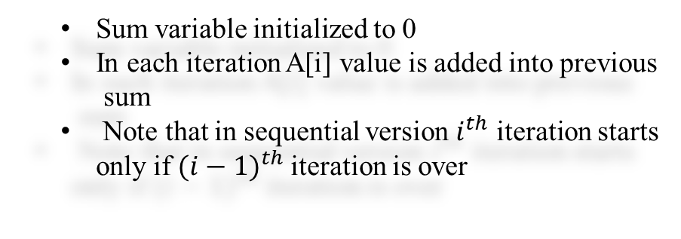

Parallel computing pattern - Reduction
Sequential execution - reduction
4
4
4
8
10
9
9
10
4
4
4
8
10
9
9
10
sum = 0;
for(int i = 0; i < N; i++)
{
sum += A[i];
}
$$+$$
Sum variable initialized to 0
In each iteration A[i] value is added into previous
sum
Note that in sequential version $i^{th}$ iteration starts only if ${(i−1)}^{th}$iteration is over
sum
116
How to parallelize this computation?

Slide 109
Parallel computing pattern - Reduction
Parallel execution - reduction
Using parallel loop construct!
Thread 0
Thread 1
Thread 2
Thread 3
4
4
4
8
10
9
9
10
4
4
4
8
10
9
9
10
sum = 0;
#pragma omp parallel for
for(int i = 0; i < N; i++)
{
sum += A[i];
}
$$+$$
What is wrong with this implementation?
sum
116
Race conditions!
All threads will try to update the global sum variable at the same time. Hence it will result into inconsistency!
Execute: Parallel_Reduction_wrong.c

Slide 110





Parallel computing pattern - Reduction
Parallel execution – reduction solution 1
Make a sum[ ] array to hold partial reduction from each thread
Thread 0
Thread 1
Thread 2
Thread 3
4
4
4
8
10
9
9
10
4
4
4
8
10
9
9
10
partial_[Nthreads] = {0};
#pragma omp parallel
{
tid = omp_get_thread_num();
for(int i = 0; i < N; i++)
{
partial_sum[tid] += A[i];
}
}
for(int i = 0; i < Nthreads; i++)
{
sum += partial_sum[i];
}
$$+$$
$$+$$
$$+$$
$$+$$
Parallel
Sum[0]
20
Sum[1]
38
Sum[2]
20
Sum[3]
38
$$+$$
Sequential
Sum[0]
116
Execute: Parallel_Reduction_using_sumArray.c

Slide 111
Parallel computing pattern - Reduction
Parallel Reduction clause in OpenMP
reduction(op: list)
Parallel reduction using reduction clause
#pragma omp parallel for reduction(+ : sum)
for(int i = 0; i < N; i++)
{
sum += A[i];
}
where op is a basic scalar operator such as +, *, -, min, max, plus logical and bitwise operators.
list is a comma separated list of variables in shared memory.
All the threads in the team can see the values of these list variables
Execute: Parallel_Reduction_using_clause.c

Slide 112
Reduction operators and initial values
It is extremely important to understand that how an implementation of OpenMP combines the results from the partial sums is not defined in the OpenMP specification.
Implementations may use critical, a binary tree, or some other schemes.
Since floating point operations are not strictly associative, this means the result from a reduction may vary from one run of a program to another.
Operator | Initial Value
+ | 0
- | 0
* | 1
MIN | Largest Positive Number
MAX | Most Negative Number

Slide 113
Parallel Pi calculation using reduction clause
int NThreads = 32;
double x, pi, sum = 0.0;
double start_time, run_time;
step = 1/(double)num_steps;
omp_set_num_threads(NThreads);
start_time = omp_get_wtime();
#pragma omp parallel
{
#pragma omp for reduction(+ : sum)
for(int i = 0; i < num_steps; i++)
{
x = (i + 0.5)*step;
sum += 4.0/(1.0 + x * x);
}
}
pi = step * sum;
Execute: ParallelPi_v6_Reduction_Clause.c

Slide 114
Loop Schedules
Static and Dynamic

Slide 115
Loop Schedules
When we use a worksharing-loop construct, it is left to the compiler to choose how to split a loop among the threads
A programmer often has knowledge of an algorithm that goes well beyond what a compiler can deduce.
Hence, they added a clause that can be placed on a worksharing-loop construct to provide more control over how iterations are scheduled onto the threads.
This is done with the schedule clause.
The optional chunk size defines the number of loop iterations that make up the fundamental unit of scheduling.
The chunk size can be a literal value known at compile time or an integer expression with a shared variable that is calculated at runtime.
schedule(static[, chunk])
schedule(dynamic[, chunk])

Slide 116
Loop Schedules
The Static Schedule
The static schedule on a worksharing-loop constructs directs the compiler to define the schedule for mapping loop iterations onto threads at “compile time”.
When a chunk size is not provided, the compiler will break the loop iterations into number of chunks equal to the number of threads, and assign one chunk to each thread.
The chunks are assigned to each thread in a round robin fashion.
Since the decisions such as chunk size, compute distribution are fixed at compile time, the scheduling overhead is reduced and the program could potentially run faster.

Slide 117
Loop Schedules
The Static Schedule – How to select chunk size?
Selecting the best chunk size to use with a static schedule can be complicated.
In practice, you should try a range of chunk sizes and pick the one that works best.
Smaller Chunk Size
A small chunk size means the scheduler will have a larger number of chunks to work with.
These will be distributed using a round-robin or cyclic distribution.
This strategy evenly spreads out variations in per-iteration run times across the team of threads.
Larger Chunk Size
A larger chunk size, however, works well with the cache hierarchy and increase the chances that data can be reused from cache.
Hitting the right balance between the small chunks (load balancing) and large chunks (memory locality) can greatly improve performance.
Execute: Static_schedule.c

Slide 118
Loop Schedules
T0
T1
T2
T3
The Dynamic Schedule –
The static schedule works well when the loop iterations take about the same amount of time to run.
The static schedule runs into trouble, however, in two different situations.
The amount of work per iteration of the loop may vary widely
If the processors in a system run at different speeds, the scheduler has no way to take such differences into account.
Some threads will complete their work much faster than
others depending on which iterations are assigned to the slow
processors and which are assigned to the fast processors
The load imbalance among the threads results in an overall slowdown for the program.
This even leads to poor utilization of the resources!
Work
Idle
Total Time
Imbalanced work amongst threads

Slide 119
Loop Schedules
Performance comparison static vs dynamic scheduling

Slide 120
OpenMP Data Environment

Slide 121
Data Environment
Master Thread
We call the set of variables visible to a thread as it executes a region the data environment for that region.
An OpenMP thread has access to a shared address space and an address space private to the thread.
Variables in the OpenMP Common Core can be assigned one of two storage attributes: private or shared.
Private: If a variable can be accessed by one thread and the other threads in the team have no way to see that variable, the variable is private or equivalently local to a thread.
Shared: When all the threads in a team can access the variable (i.e., both read and write that variable), we say that the variable is shared or global.
Threads
Parallel region
Master Thread

Slide 122
Process in Memory
Max
Stack
Process stack contains
Temporary data such as function parameters, return address, and local variables
Int a,b,c,Result
Int call_func(int a, int b)
{
Int x = a*b
Int y = a-b
Return (y+x)
}
Int main()
{
Read a,b,c,Result
Result = Call_func(a,b)
print(Results)
Return main
}
Heap is the memory which is dynamically allocated during process runtime
Data section which contains global variables
A program code is stored in a text section
Heap
A program counter register keep track current instruction being executed and processor registers holds the variable values
Data
0
Text
Process Address Space
Introduction to Parallel Computing - OpenMP

Slide 123
Data Environment – Storage Attributes
The most basic rule is that variables declared in memory that is visible across all the threads are shared.
This memory is the heap managed by the process.
A variable declared prior to a parallel region is placed in that process-memory and is shared.
If a variable is on a thread’s stack, it is private to that thread.
If a variable is declared inside the parallel region, it is local to each thread, so it is private.
A simple way to think about it is that variables allocated in the process heap are shared, and variables on a thread’s stack are private.
Introduction to Parallel Computing - OpenMP

Slide 124
Data Environment – Storage Attributes
double A[10];
int main()
{
int index[10];
#pragma omp parallel
work(index);
printf(“%d \n”, index[0]);
}
// File #2
extern double A[10];
void work(int *index){
double temp[10];
static int count;
…
}
The variables A, index, and count are placed in the process’s memory.
Since temp is declared inside the function work(), it resides in the function’s stack and is stored in the stack memory of each thread. Each thread will therefore have its own private copy of temp.
All 3 threads see A, index, and count inside the parallel region since they are shared variables.
The variable temp is private to each thread, that is, each thread has its own copy of temp.
At the end of the function work(), temp goes out of the scope. Hence after the parallel region exits, only A, index, and count are visible to the master thread.
Introduction to Parallel Computing - OpenMP

Slide 125
Modifying Storage Attributes
There are circumstances where we need to modify the storage attributes of
variables. We do this with clauses placed on directives for the parallel or worksharing-loop constructs.
In the OpenMP Common Core the clauses shared, private, and firstprivate used to modify storage attributes. Each of these clauses include a comma-separated list of variables.
The clauses set the data sharing attributes of variables as they map into the new region.
Shared Clause
Private Clause
firstprivate Clause
Default Clause
Introduction to Parallel Computing - OpenMP

Slide 126
Modifying Storage Attributes
The default data sharing attribute for these variables is shared.
If a variable is shared, it means that there is one copy of a variable and it is visible to all the threads in the team.
The syntax of the shared clause is:
shared(list)
where list is a comma separated list of variables.
#pragma omp parallel shared(B,C)
The clause indicates that the variables B and C are shared inside the parallel region.
Notice that this is the default behavior.
Of course, shared variables are visible to all threads. It is essential, to make sure there are no data races.
Shared Clause
Private Clause
firstprivate Clause
Default Clause
Introduction to Parallel Computing - OpenMP

Slide 127
Modifying Storage Attributes
The private clause is placed on a directive that generates a new data environment.
The syntax for the clause follows:
private(list)
The private clause changes the default behavior when mapping variables into the new data environment.
The private clause tells the compiler to create a new variable of the same type and name for each thread.
This new variable is private to each thread; that is each thread has a copy of the variable that the other threads cannot access.
The value of the private variable is uninitialized.
Shared Clause
Private Clause
firstprivate Clause
Default Clause
Introduction to Parallel Computing - OpenMP

Slide 128
Modifying Storage Attributes
Shared Clause
The firstprivate clause is placed on a directive that generates a new data environment. The syntax for the clause follows:
firstprivate(list)
The firstprivate variable also masks the original variable inside the parallel region, and the value of the original variable is unchanged after the region.
The difference between firstprivate and private is that with firstprivate, the new private variable is initialized by copying the value of the corresponding original variable.
Private Clause
firstprivate Clause
Default Clause
Introduction to Parallel Computing - OpenMP

Slide 129
Modifying Storage Attributes
Shared Clause
One of the most common sources of errors in an OpenMP program is to have the wrong storage attribute on a variable.
It is surprisingly easy to create such errors given some variables import their data sharing attribute by default and others through explicit clauses.
OpenMP provides default clause.
If default(none)is used on a construct, then all variables passing from the encountering thread into a region must be explicitly listed in a private, firstprivate, reduction, or shared clause.
Private Clause
firstprivate Clause
Default Clause
Introduction to Parallel Computing - OpenMP

Slide 130
Modifying Storage Attributes
A = 1;
B = 1;
C = 1;
#pragma omp parallel private (B) firstprivate(C)
{
.
// Parallel region
.
}
Q. 1 Specify the storage attribute of A, B, and C inside the parallel region
Q. 2 What are their initial values inside the parallel region?
Q. 3 What are their values after the parallel region?
Introduction to Parallel Computing - OpenMP

Slide 131
Modifying Storage Attributes
A = 1;
B = 1;
C = 1;
#pragma omp parallel private (B) firstprivate(C)
{
.
// Parallel region
.
}
Q. 1 Specify the storage attribute of A, B, and C inside the parallel region
A is shared, B is private and C is firstprivate
A was not declared in any clause, so it is a shared variable by default.
Every thread sees its value of 1 when entering the parallel region.
The storage attributes of B and C are modified with the private and firstprivate clauses, so they are both private to each thread.
Introduction to Parallel Computing - OpenMP

Slide 132
Modifying Storage Attributes
A = 1;
B = 1;
C = 1;
#pragma omp parallel private (B) firstprivate(C)
{
.
// Parallel region
.
}
Q. 1 Specify the storage attribute of A, B, and C inside the parallel region
A is shared, B is private and C is firstprivate
Q. 2 What are their initial values inside the parallel region?
A is 1, B is uninitialized, C is 1
Every thread sees A value of 1 when entering the parallel region.
The value of B for each thread is uninitialized,
The value of C is initialized to the value of 1 from its original variable C.
Introduction to Parallel Computing - OpenMP

Slide 133
Modifying Storage Attributes
A = 1;
B = 1;
C = 1;
#pragma omp parallel private (B) firstprivate(C)
{
.
// Parallel region
.
}
Q. 1 Specify the storage attribute of A, B, and C inside the parallel region
A is shared, B is private and C is firstprivate
Q. 2 What are their initial values inside the parallel region?
A is 1, B is uninitialized, C is 1
Following the parallel region, the private copies of B and C go out of scope and B and C revert to the global values of their original variables.
Therefore, both have their original value of 1.
Since A is shared, it will have whatever value was set inside the parallel region.
Q. 3 What are their values after the parallel region?
A is based on modification in parallel region, B is 1 and C is 1
Introduction to Parallel Computing - OpenMP

Slide 134
Arrays and Pointers

Slide 135
Arrays and Pointers
So far we considered data storage attributes on scalar variables.
Pointers and arrays can be used inside data environment clauses.
We will consider two cases
Static Arrays
Dynamic Arrays

Slide 136
Arrays and Pointers
Static Array
Arrays that are declared at compile time with a known size are allocated on the stack.
The compiler knows the size of this array and can manage it for you.
int array[10];
initArray(array,10);
#pragma omp parallel private(array)
{
// Here array of size 10 created as a private copy to each
thread
// Note that array is uninitialized!
for(int i = 0; i < 10; i++)
{
printf("\n Static array[%d] = %d",i,array[i]);
// This will print garbage values
}
}
int array[10];
initArray(array,10);
#pragma omp parallel firstprivate(array)
{
// Here array of size 10 created as a private copy to each
thread
// Note that array is initialized!
for(int i = 0; i < 10; i++)
{
printf("\n Static array[%d] = %d",i,array[i]);
// This will print original values
}
}

Slide 137
Arrays and Pointers
Dynamic Array
Arrays whose size known at run time and memory allocated on heap.
Only pointer values get applied with storage attributes
int *darray = (int *)malloc(10*sizeof(int));
initArray(darray,10);
#pragma omp parallel private(darray)
{
// Here dynamic array of size 10 created as a private copy to each thread
// Note that array pointer is uninitialized!
// Hence you may get segmentation fault or invalid memory access
for(int i = 0; i < 10; i++)
{
//printf("\n Dynamic darray[%d] = %d",i,darray[i]);
}
}
int *darray = (int *)malloc(10*sizeof(int));
initArray(darray,10);
#pragma omp parallel firstprivate(darray)
{
// Here pointer to dynamic array of size 10 created as a private copy to each thread
// Note that array pointer is initialized to the base address of original array!
// Each thread gets same base address of array so each thread refer to the same array
for(int i = 0; i < 10; i++)
{
printf("\n Dynamic darray[%d] = %d",i,darray[i]);
}
}

