Slide 1
Module 1
Probability Primer
Reinforcement Learning

Slide 2
Agenda
Elements of Probability
Random Variables
Covered
To brush up basics of probability and random variables.

Slide 3
Agenda
Elements of Probability
Random Variables
Resources
§ “Probability, Statistics, and Random Processes for Electrical Engineering”, 3rd Edition, Alberto Leon-Garcia - [PSRPEE] - Alberto Leon-Garcia
§ “Machine Learning: A Probabilistic Perspective”, Kevin P. Murphy - [MLAPP] - Kevin Murphy:

Slide 4
Agenda
Elements of Probability
Random Variables
Introduction
§ Probability theory is the study of uncertainty.
§ The mathematical treatise of probability is very sophisticated, and delves into a branch of analysis known as measure theory.
§ We, however, will go through only basics of probability theory at a level appropriate for our Reinforcement Learning course.

Slide 5
Agenda
Elements of Probability
Random Variables
Introduction
§ Probability is the Mathematical language for quantifying uncertainty.
The starting point is to specify random experiments, sample space and set of outcomes.
§ A random experiment is an experiment in which the outcome varies in an unpredictable fashion when the experiment is repeated under the same conditions.
§ An outcome is a result of the random experiment and it can not be decomposed in terms of other results. The sample space of a random experiment is defined as the set of all possible outcomes. An outcome and the sample space of a random experiment will be denoted as ζ and S respectively.

Slide 6
Agenda
Elements of Probability
Random Variables
Introduction
§ Probability is the Mathematical language for quantifying uncertainty.
The starting point is to specify random experiments, sample space and set of outcomes.
§ A random experiment is an experiment in which the outcome varies in an unpredictable fashion when the experiment is repeated under the same conditions.
§ An outcome is a result of the random experiment and it can not be decomposed in terms of other results. The sample space of a random experiment is defined as the set of all possible outcomes. An outcome and the sample space of a random experiment will be denoted as ζ and S respectively.
Notes:
ζ:Zeta (uppercase/lowercase Ζ / ζ)

Slide 7
Agenda
Elements of Probability
Random Variables
Introduction
§ Examples of some experiment
Flipping a coin
Rolling a die
Flipping a coin twice
Pick a number X at random between zero and one, then pick a number Y at random between zero and X.
§ The corresponding sample spaces will be
S₁ = {H, T }
S₂ = {1, 2, 3, 4, 5, 6}
S₃ = {HH, HT, TH, TT }
S₄ = {(x, y) : 0 ≤ y ≤ x ≤ 1}.

Slide 8
Agenda
Elements of Probability
Random Variables
Introduction
§ Examples of random experiment
Flipping a coin
Rolling a die
Flipping a coin twice
Pick a number X at random between zero and one, then pick a number Y at random between zero and X.
§ The corresponding sample spaces will be
S₁ = {H, T }
S₂ = {1, 2, 3, 4, 5, 6}
S₃ = {HH, HT, TH, TT }
S₄ = {(x, y) : 0 ≤ y ≤ x ≤ 1}.

Slide 9
Agenda
Elements of Probability
Random Variables
Introduction
§ Any subset E of the sample space S is known as an event. We, sometimes, are not interested in the occurrence of specific outcomes but rather in the occurrence of a combination of a few outcomes.
This requires that we consider subsets of S
Getting even number when rolling a die, E₂ = {2, 4, 6}
Number of heads equal to number of tails when flipping a coin twice,
E₃ = {HT, TH}
Two numbers differ by less than 1/10,
E₄ = {(x, y) : 0 ≤ y ≤ x ≤ 1 and |x − y| < 1/10}.
§ We say that an event E occurs if the outcome ζ is in E
CS60077
7 / 44

Slide 10
Agenda
Elements of Probability
Random Variables
Introduction
§ Any subset E of the sample space S is known as an event. We, sometimes, are not interested in the occurrence of specific outcomes but rather in the occurrence of a combination of a few outcomes.
This requires that we consider subsets of S
Getting even number when rolling a die, E₂ = {2, 4, 6}
Number of heads equal to number of tails when flipping a coin twice,
E₃ = {HT, TH}
Two numbers differ by less than 1/10,
E₄ = {(x, y) : 0 ≤ y ≤ x ≤ 1 and |x − y| < 1/10}.
§ We say that an event E occurs if the outcome ζ is in E
§ Three events are of special importance.
Simple event are the outcomes of random experiments.
Sure event is the sample space S which consists of all outcomes and hence always occurs.
Impossible or null event φ which contains no outcomes and hence never occurs.
CS60077
7 / 44

Slide 11
Agenda
Elements of Probability
Random Variables
Introduction
§ Any subset E of the sample space S is known as an event. We, sometimes, are not interested in the occurrence of specific outcomes but rather in the occurrence of a combination of a few outcomes.
This requires that we consider subsets of S
Getting even number when rolling a die, E₂ = {2, 4, 6}
Number of heads equal to number of tails when flipping a coin twice,
E₃ = {HT, TH}
Two numbers differ by less than 1/10,
E₄ = {(x, y) : 0 ≤ y ≤ x ≤ 1 and |x − y| < 1/10}.
§ We say that an event E occurs if the outcome ζ is in E
§ Three events are of special importance.
Simple event are the outcomes of random experiments.
Sure event is the sample space S which consists of all outcomes and hence always occurs.
Impossible or null event φ which contains no outcomes and hence never occurs.

Slide 12
Agenda
Elements of Probability
Random Variables
Introduction
§ Any subset E of the sample space S is known as an event. We, sometimes, are not interested in the occurrence of specific outcomes but rather in the occurrence of a combination of a few outcomes.
This requires that we consider subsets of S
Getting even number when rolling a die, E₂ = {2, 4, 6}
Number of heads equal to number of tails when flipping a coin twice,
E₃ = {HT, TH}
Two numbers differ by less than 1/10,
E₄ = {(x, y) : 0 ≤ y ≤ x ≤ 1 and |x − y| < 1/10}.
§ We say that an event E occurs if the outcome ζ is in E
§ Three events are of special importance.
Simple event are the outcomes of random experiments.
Sure event is the sample space S which consists of all outcomes and hence always occurs.
Impossible or null event φ which contains no outcomes and hence never occurs.

Slide 13
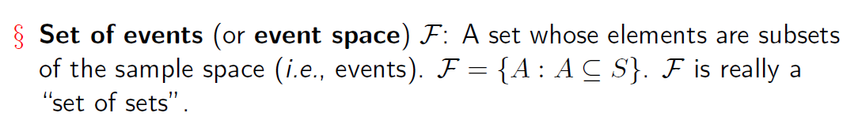
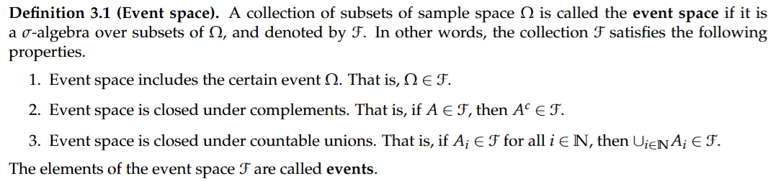
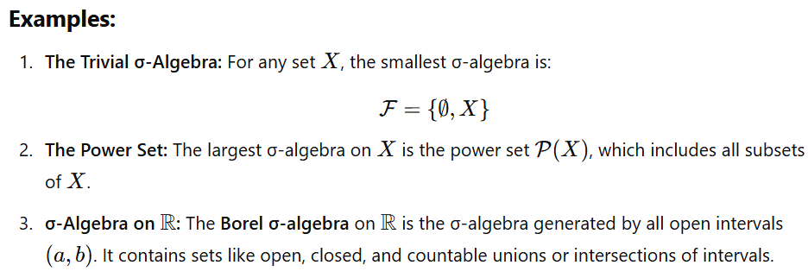
Agenda
Elements of Probability
Random Variables
Introduction
CS60077
Notes:
A σ-algebra can be thought of as a "nice" collection of subsets of XXX that allows us to:
Perform operations like taking complements and countable unions/intersections without leaving the collection.
Define measures (e.g., probabilities or areas) in a consistent way over these subsets.

Slide 14
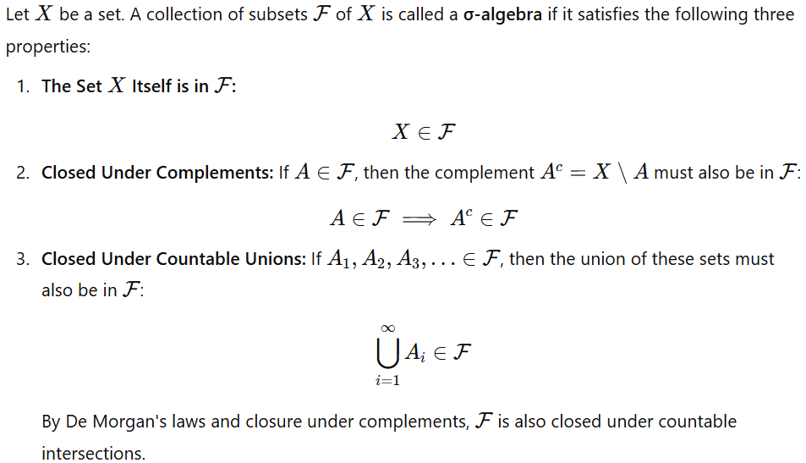
Agenda
Elements of Probability
Random Variables
Introduction
§ Set of events (or event space) 7: A set whose elements are subsets of the sample space (i.e., events). 7 = {A : A ⊆ S}. 7 is really a “set of sets”.

Slide 15
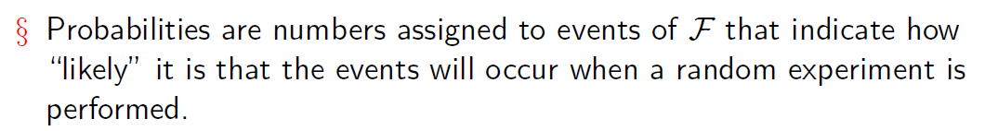
Agenda
Elements of Probability
Random Variables
Introduction
§ Let a random experiment has sample space S and event space 7. Probability of an event A is a function P : 7 → R that satisfies the following properties
P (A) ≥ 0, ∀A ∈ 7
P (S) = 1
If A , A , · · · ∈ 7 are disjoint events (i.e., A ∩ A = φ for i /= j) then,
1 2
Σ
i j
P (∪_{i}A_{i}) = _{i} P (A_{i})
§ These three properties are called the Axioms of Probability.
CS60077

Slide 16
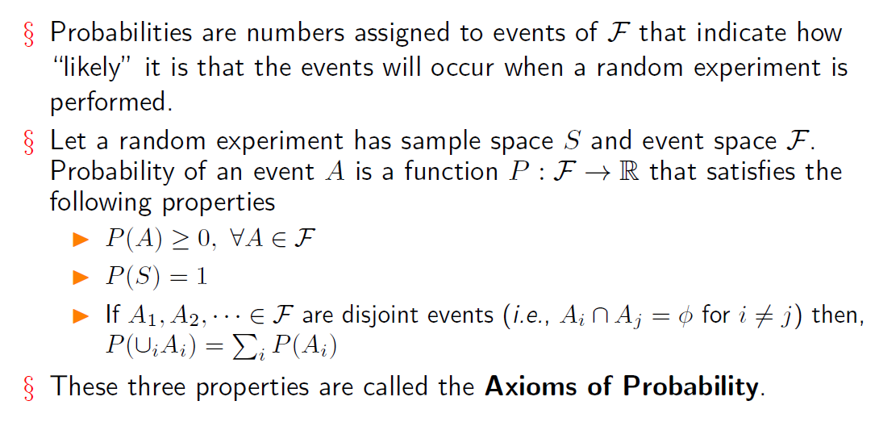
Agenda
Elements of Probability
Random Variables
Introduction

Slide 17
Agenda
Elements of Probability
Random Variables
Introduction
§ Properties
P (A^{c}) = 1 − P (A)
P (A) ≤ 1
P (φ) = 0
If A ⊆ B, then P (A) ≤ P (B).
P (A ∩ B) ≤ min(P (A), P (B))
P (A ∪ B) ≤ P (A) + P (B)

Slide 18
Agenda Elements of Probability
Conditional Probability
Random Variables
§ Conditional probability provides whether two events are related in the sense that knowledge about the occurrence of one, say B, alters the likelihood of occurrence of the other say, A.
§ This conditional probability is defined as,
P (A ∩ B)
P (B)
P (A|B) =
§ Two events A and B are independent (denoted as A ⊥ B) if the knowledge of occurrence of one does not change the likelihood of occurrence of the other. This translates to the condition for independence as,
P (A|B) = P (A)
P (A ∩ B) _{= P (A)} P (B)
P (A ∩ B) = P (A)P (B)

Slide 19
Agenda Elements of Probability
Conditional Probability
Random Variables
§ Conditional probability provides whether two events are related in the sense that knowledge about the occurrence of one, say B, alters the likelihood of occurrence of the other say, A.
§ This conditional probability is defined as,
P (A ∩ B)
P (B)
P (A|B) =
§ Two events A and B are independent (denoted as A ⊥ B) if the knowledge of occurrence of one does not change the likelihood of occurrence of the other. This translates to the condition for independence as,
P (A|B) = P (A)
P (A ∩ B) _{= P (A)} P (B)
P (A ∩ B) = P (A)P (B)

Slide 20
Agenda Elements of Probability
Total Probability Theorem
Random Variables
§ Let B₁, B₂, · · · , B_{n} be exhaustive and mutually exclusive events such that each of these events has positive probabilities. Then for any event A, the total probability theorem says,
n
P (A) = P (A|B )P (B )
(1)
Σ
i i
i=1
§ Proof: Since, B₁, B₂, · · · , B_{n} are exhaustive (i.e., their union covers the whole sample space), A = (A ∩ B₁) ∪ (A ∩ B₂) ∪ · · · (A ∩ B_{n})
P (A) = P (A ∩ B ) ∪ (A ∩ B ) ∪ · · · (A ∩ B )
1 2 n
= P (A ∩ B₁) + P (A ∩ B₂) + · · · + P (A ∩ B_{n})
(as B_{i}’s are mutually exclusive)
n n
Σ Σ
= P (A ∩
B ) = P (A|B )P (B )
i i i
i=1
i=1
Notes:
Mutually exclusive events are the events in probability such that two events can occur at the same time.
Exhaustive events are a set of events in a sample space such that one of them compulsorily occurs while performing the experiment.

Slide 21
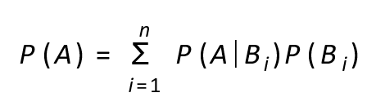
Agenda Elements of Probability
Total Probability Theorem
Random Variables
§ Let B₁, B₂, · · · , B_{n} be exhaustive and mutually exclusive events such that each of these events has positive probabilities. Then for any event A, the total probability theorem says,
(1)
i=1
§ Proof: Since, B₁, B₂, · · · , B_{n} are exhaustive (i.e., their union covers the whole sample space), A = (A ∩ B₁) ∪ (A ∩ B₂) ∪ · · · (A ∩ B_{n})
P (A) = P (A ∩ B ) ∪ (A ∩ B ) ∪ · · · (A ∩ B )
1 2 n
= P (A ∩ B₁) + P (A ∩ B₂) + · · · + P (A ∩ B_{n})
(as B_{i}’s are mutually exclusive)
n n
= P (A ∩
B ) = P (A|B )P (B )
Σ Σ
i i i
i=1 i=1

Slide 22
Agenda Elements of Probability
Total Probability Theorem
Random Variables
§ Let B₁, B₂, · · · , B_{n} be exhaustive and mutually exclusive events such that each of these events has positive probabilities. Then for any event A, the total probability theorem says,
n
Σ
P (A) = P (A|B )P (B )
(1)
i i
i=1
§ Proof: Since, B₁, B₂, · · · , B_{n} are exhaustive (i.e., their union covers the whole sample space), A = (A ∩ B₁) ∪ (A ∩ B₂) ∪ · · · (A ∩ B_{n})
P (A) = P (A ∩ B ) ∪ (A ∩ B ) ∪ · · · (A ∩ B )
1 2 n
= P (A ∩ B₁) + P (A ∩ B₂) + · · · + P (A ∩ B_{n})
(as B_{i}’s are mutually exclusive)
n n
= P (A ∩
B ) = P (A|B )P (B )
Σ Σ
i i i
i=1
i=1

Slide 23
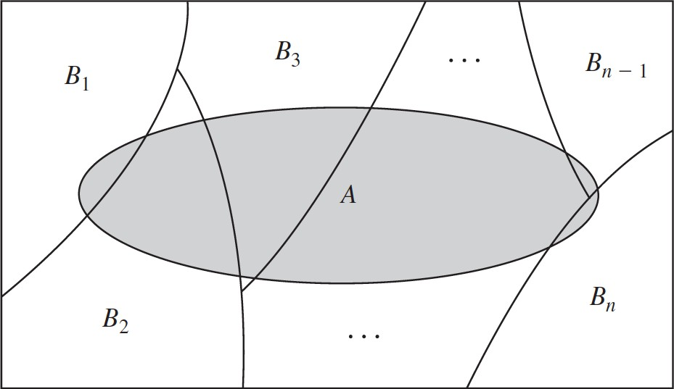
Agenda Elements of Probability
Total Probability Theorem
Random Variables
Figure credit: [PSRPEE] - Alberto Leon-Garcia
§ This is also known as marginalization operation.
§ Such exhaustive and mutually exclusive events B₁, B₂, · · · , B_{n} are also said to form a partition of the sample space.

Slide 24
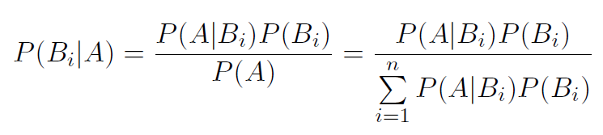
Agenda
Elements of Probability
Random Variables
Bayes Rule
§ The total probability theorem is often used in conjunction with the Bayes’ Rule that relates conditional probabilities of the form P (B|A) with conditional probabilities of the form P (A|B).
§ Let the events B₁, B₂, · · · , B_{n} partitions a sample space such that each of the P (B_{i})’s are non-negative. The Bayes’ rule states,
P (A|B )P (B )
P (A|B )P (B )
P (B |A) =
i i
=
i i
(2)
i
P (A)
n
Σ
P (A|B_{i})P (B_{i})
i=1
§ Bayes’ rule is a very important tool for inference in machine learning.
A can be thought of as the “effect” and B_{i}’s are several “causes” that can result in the effect. From the probabilities of the causes (B_{i}’s) resulting in the effect (A) and the probability of the causes (B_{i}’s) to occur frequently, the probability that a particular cause (B_{i}) is the reason behind the effect (A) is computed.

Slide 25
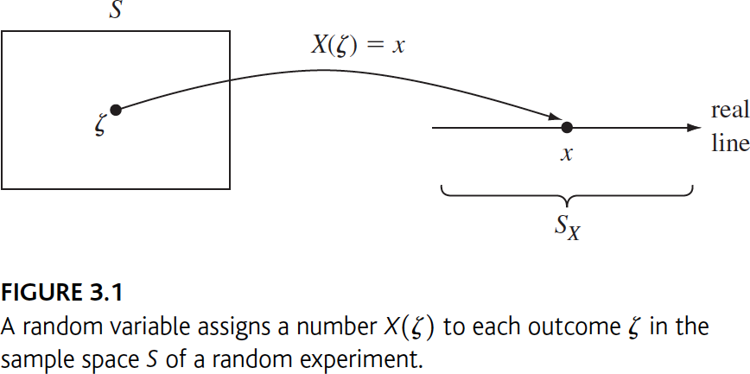
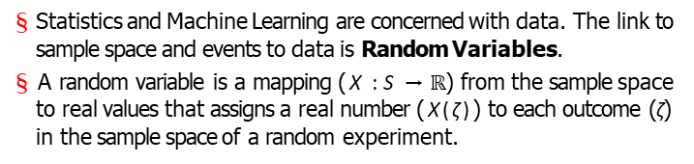
Agenda Elements of Probability
Random Variables
Random Variables
§ Statistics and Machine Learning are concerned with data. The link to sample space and events to data is Random Variables.
§ A random variable is a mapping (X : S → $ℝ$) from the sample space to real values that assigns a real number (X(ζ)) to each outcome (ζ) in the sample space of a random experiment.
§ We will use the following notation: capital letters denote random variables, e.g., X or Y , and lower case letters denote possible values
of the random variables, e.g., x or y.

Slide 26
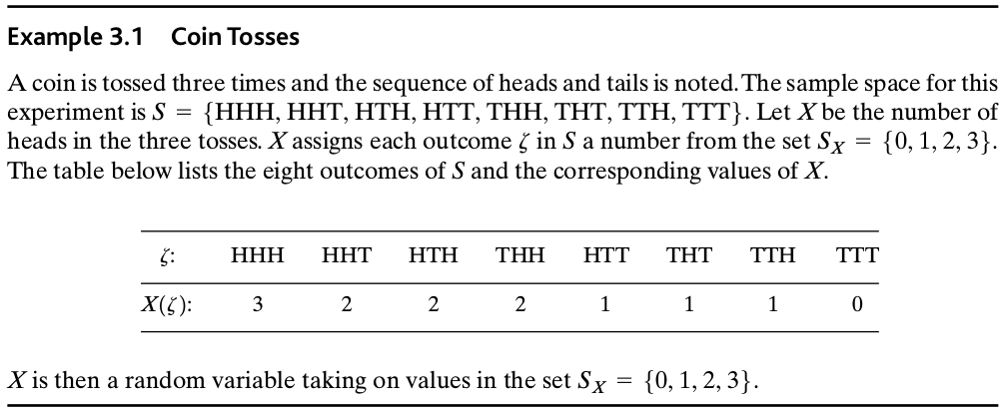
Agenda Elements of Probability
Random Variables
Random Variables
§ An example
§ Since the value of a random variable is determined by the outcome of
the experiment, we may assign probabilities to the possible values of
the random variable.
P (X = x) = P ({ζ ∈ S; X(ζ) = x})
(3)

Slide 27
Agenda Elements of Probability
Random Variables
Random Variables
§ An example
§ Since the value of a random variable is determined by the outcome of
the experiment, we may assign probabilities to the possible values of
the random variable.
P (X = x) = P ({ζ ∈ S; X(ζ) = x})
(3)

Slide 28
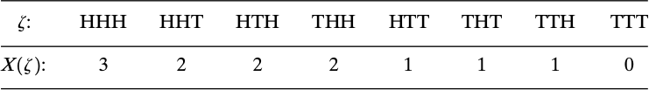
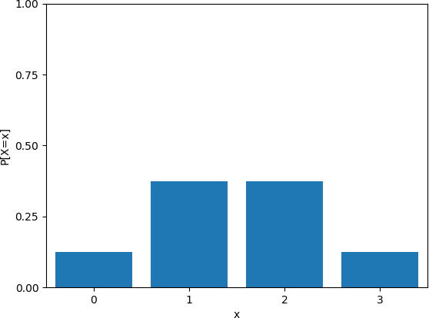
Agenda Elements of Probability
Random Variables
Random Variables
1
8
P [X = 0] = P [{TTT}] =
3
8
P [X = 1] = P [{HTT, THT, TTH}] = P [{HTT}] + P [{THT}] + P [{TTH}] =
3
8
P [X = 2] = P [{HHT, HTH, THH}] = P [{HHT}] + P [{HTH}] + P [{THH}] =
1
8
P [X = 3] = P [{HHH}] =

Slide 29
Agenda Elements of Probability
Discrete Random Variables and PMF
Random Variables
§ A discrete random variable X is defined as a random variable that can take at most a countable number of possible values, i.e.,
S_{X} = {x₁, x₂, x₃, · · · }.
§ A discrete random variable is said to be finite if its range is finite,
i.e., S_{X} = {x₁, x₂, x₃, · · · , x_{n}}.
§ The probabilities of events involving a discrete random variable X forms the Probability Mass Function (PMF) of X and it is defined as (ref eqn. (3)),
P_{X} (x) = P (X = x) = P ({ζ ∈ S; X(ζ) = x} for real x) (4)

Slide 30
Agenda Elements of Probability
Discrete Random Variables and PMF
Random Variables
§ A discrete random variable X is defined as a random variable that can take at most a countable number of possible values, i.e.,
S_{X} = {x₁, x₂, x₃, · · · }.
§ A discrete random variable is said to be finite if its range is finite,
i.e., S_{X} = {x₁, x₂, x₃, · · · , x_{n}}.
§ The probabilities of events involving a discrete random variable X forms the Probability Mass Function (PMF) of X and it is defined as (ref eqn. (3)),
P_{X} (x) = P (X = x) = P ({ζ ∈ S; X(ζ) = x} for real x) (4)
§ Note that P_{X} (x) is a function of x over the real line, and that P_{X} (x)
can be nonzero only at the values {x₁, x₂, x₃, · · · }

Slide 31
Agenda Elements of Probability
Discrete Random Variables and PMF
Random Variables
§ A discrete random variable X is defined as a random variable that can take at most a countable number of possible values, i.e.,
S_{X} = {x₁, x₂, x₃, · · · }.
§ A discrete random variable is said to be finite if its range is finite,
i.e., S_{X} = {x₁, x₂, x₃, · · · , x_{n}}.
§ The probabilities of events involving a discrete random variable X forms the Probability Mass Function (PMF) of X and it is defined as (ref eqn. (3)),
P_{X} (x) = P (X = x) = P ({ζ ∈ S; X(ζ) = x} for real x) (4)
§ Note that P_{X} (x) is a function of x over the real line, and that P_{X} (x)
can be nonzero only at the values {x₁, x₂, x₃, · · · }

Slide 32
Agenda Elements of Probability
Discrete Random Variables and PMF
Random Variables
§ A discrete random variable X is defined as a random variable that can take at most a countable number of possible values, i.e.,
S_{X} = {x₁, x₂, x₃, · · · }.
§ A discrete random variable is said to be finite if its range is finite,
i.e., S_{X} = {x₁, x₂, x₃, · · · , x_{n}}.
§ The probabilities of events involving a discrete random variable X forms the Probability Mass Function (PMF) of X and it is defined as (ref eqn. (3)),
P_{X} (x) = P (X = x) = P ({ζ ∈ S; X(ζ) = x} for real x) (4)
§ Note that P_{X} (x) is a function of x over the real line, and that P_{X} (x)
can be nonzero only at the values {x₁, x₂, x₃, · · · }

Slide 33
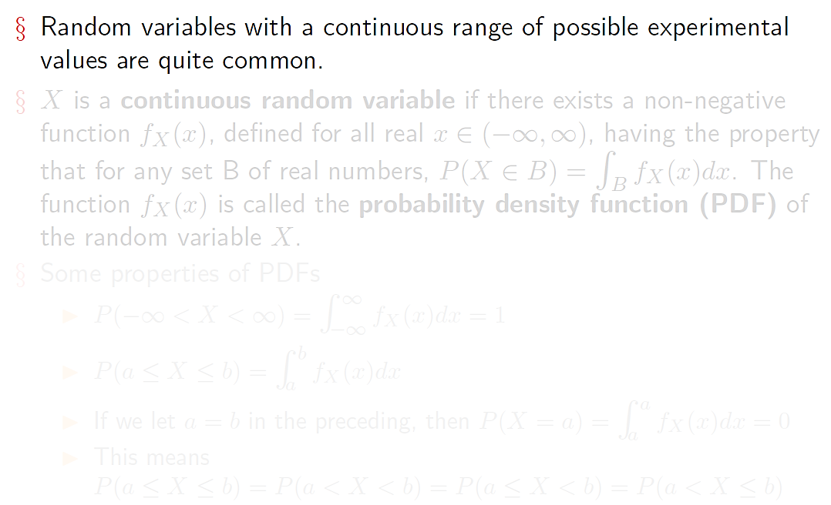
Continuous Random Variables and PDF
Agenda Elements of Probability Random Variables

Slide 34
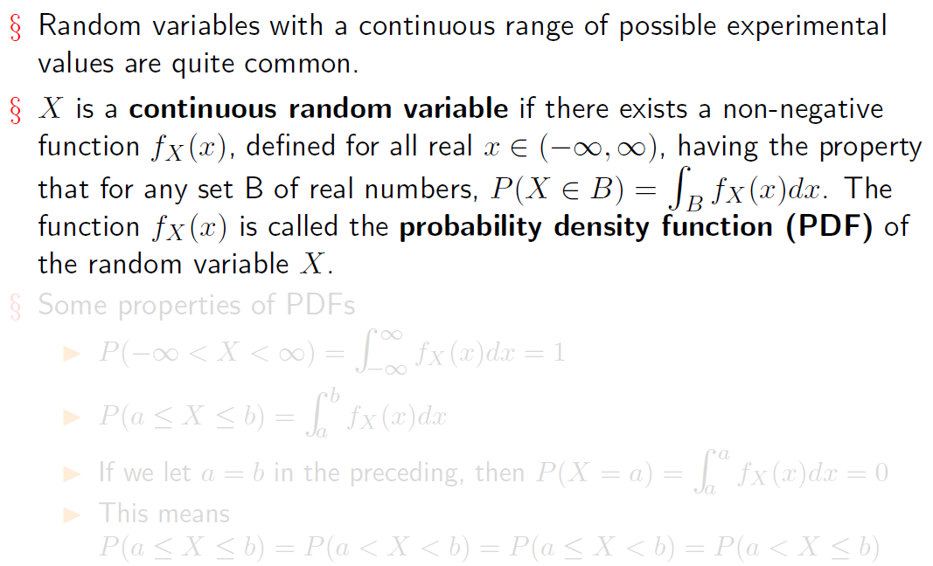
Continuous Random Variables and PDF
Agenda Elements of Probability Random Variables

Slide 35
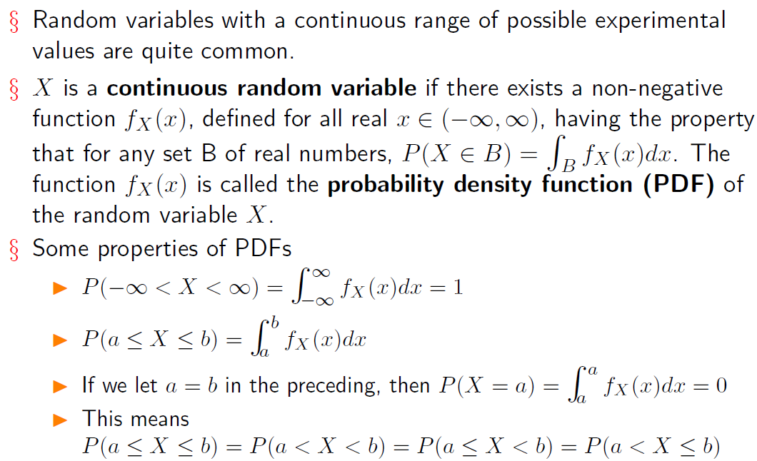
Continuous Random Variables and PDF
Agenda Elements of Probability Random Variables

Slide 36
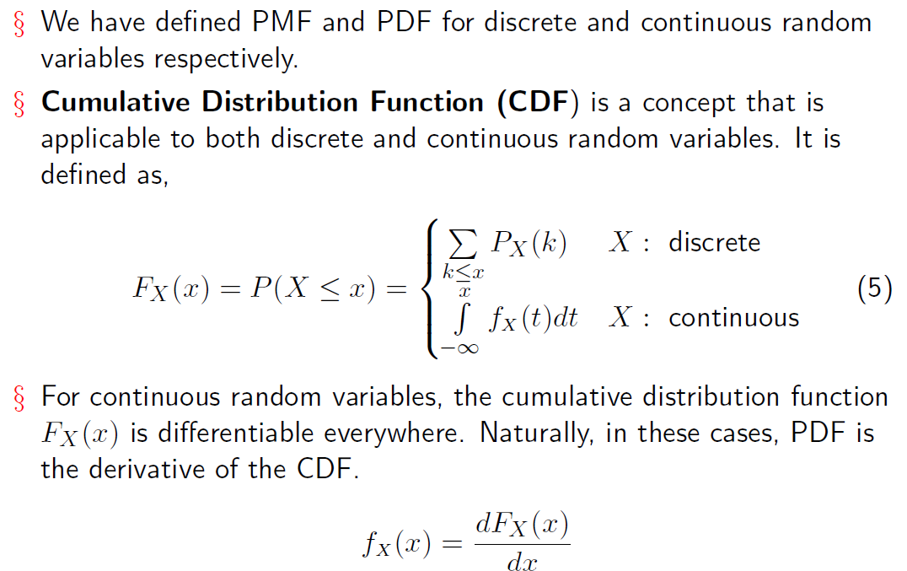
Agenda Elements of Probability
Cumulative Distribution Function
Random Variables

Slide 37
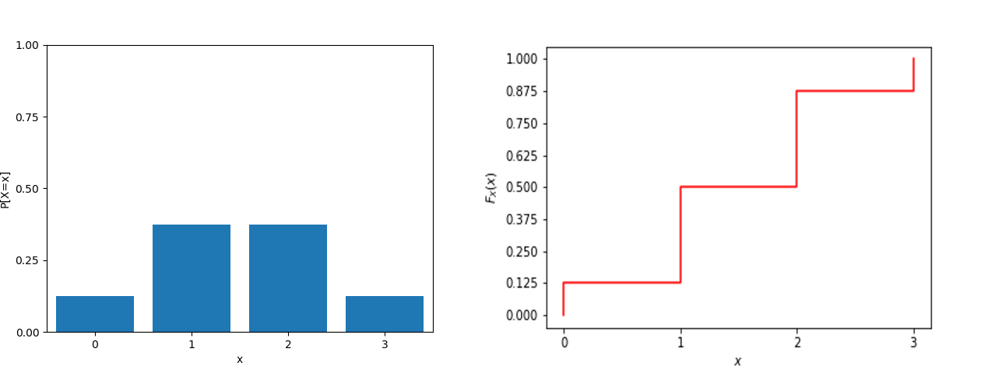
Agenda Elements of Probability
Cumulative Distribution Function
Random Variables

Slide 38
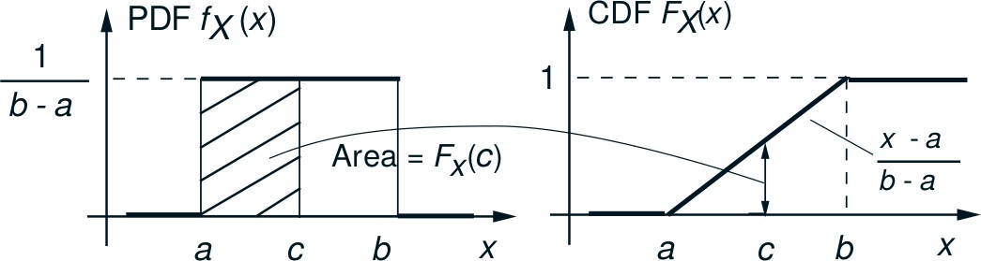
Agenda Elements of Probability
Cumulative Distribution Function
Random Variables
Fig credit: MIT Course: 6.041-6.43, Lecture Notes

Slide 39
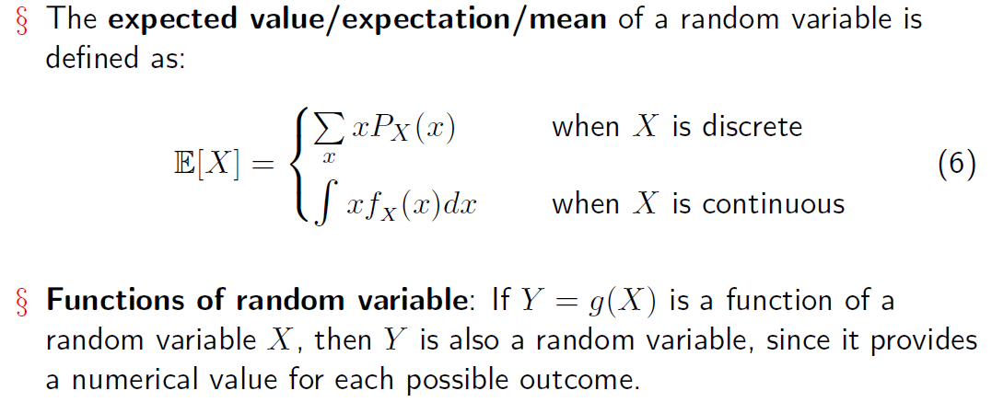
Agenda
Elements of Probability
Random Variables
Expectation

Slide 40
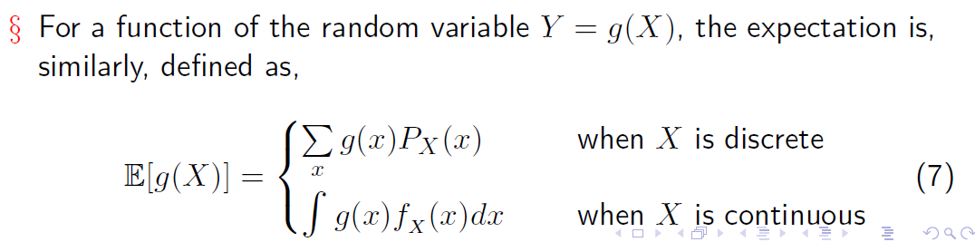
Agenda
Elements of Probability
Random Variables
Expectation

Slide 41
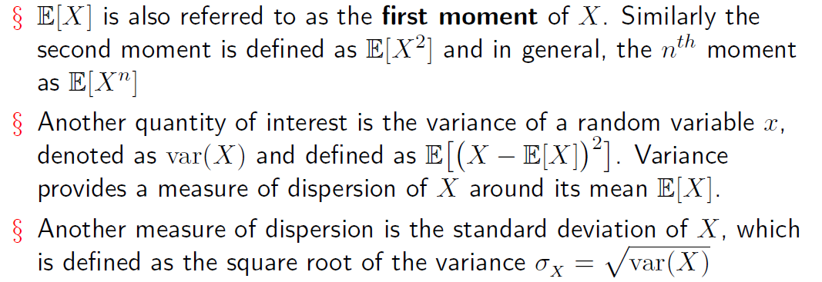
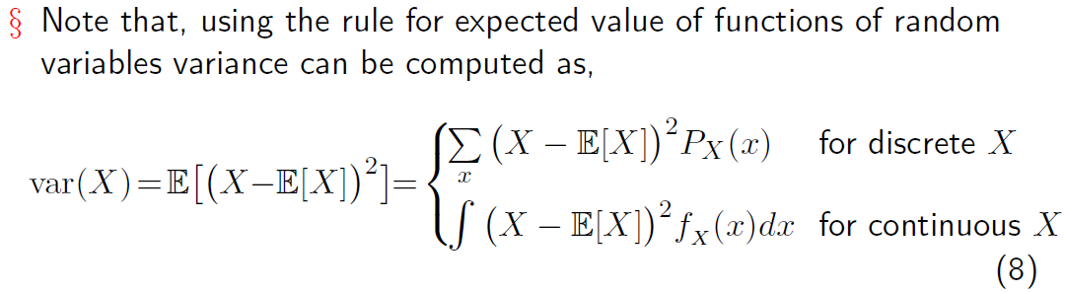
Agenda
Elements of Probability
Random Variables
Variance

Slide 42
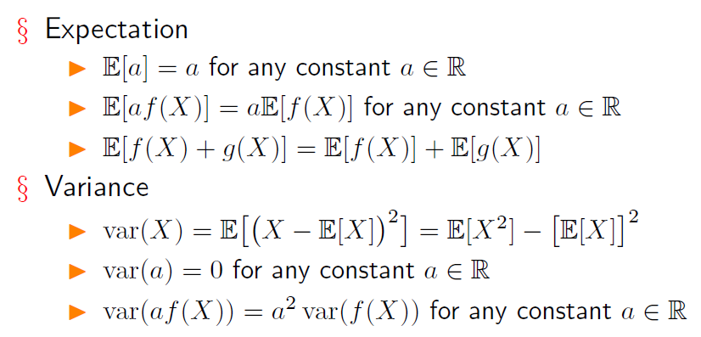
Agenda
Elements of Probability
Random Variables
Properties
CS60077

Slide 43
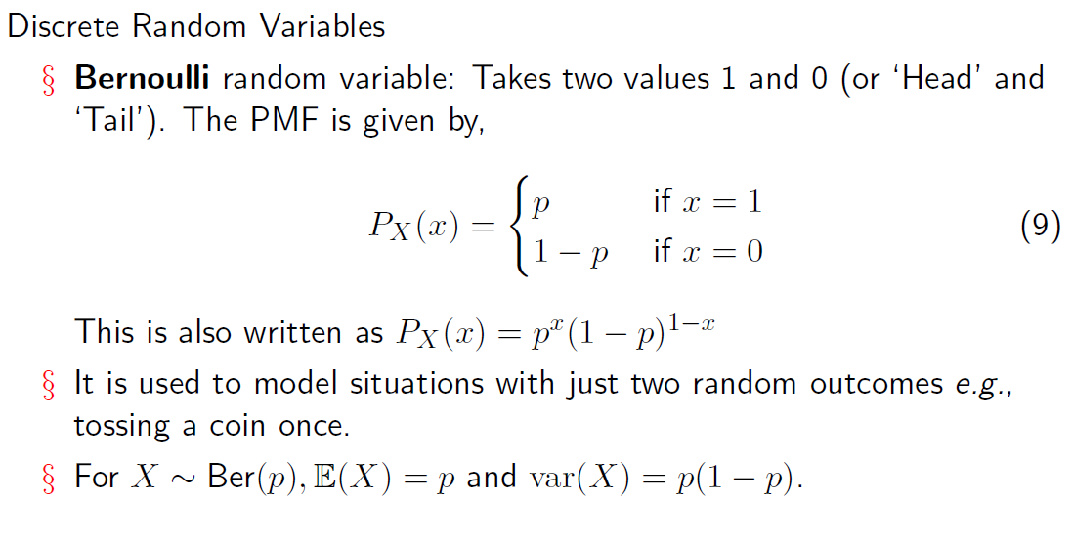
Agenda Elements of Probability
Some Common Random Variables
Random Variables
Coin Toss: Whether a coin flip results in heads (1) or tails (0).
Quality Control: Whether a manufactured item passes (1) or fails (0) a quality inspection.
Online Purchase: Whether a customer clicks on an ad (1) or does not click (0).
Medical Test: Whether a test result is positive (1) or negative (0) for a disease.

Slide 44
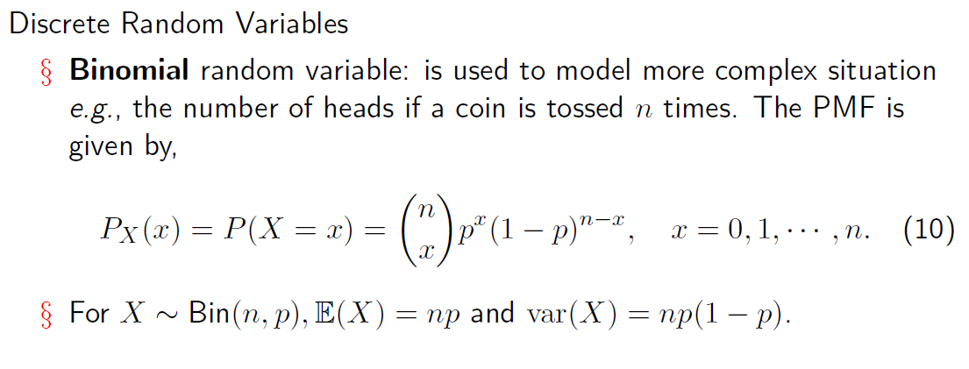
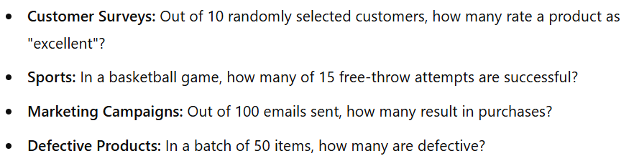
Agenda Elements of Probability
Some Common Random Variables
Random Variables
A binomial random variable represents the number of successes in n independent Bernoulli trials, each with the same probability of success.

Slide 45
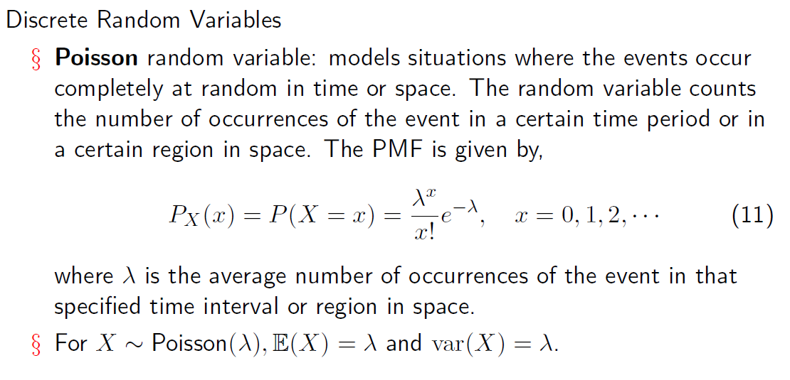
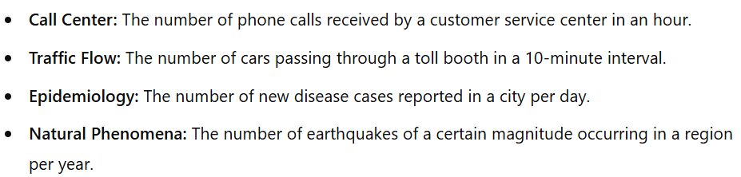
Agenda Elements of Probability
Some Common Random Variables
Random Variables
CS60077
Notes:
models the number of events occurring in a fixed interval of time or space, assuming the events occur randomly and independently.

Slide 46
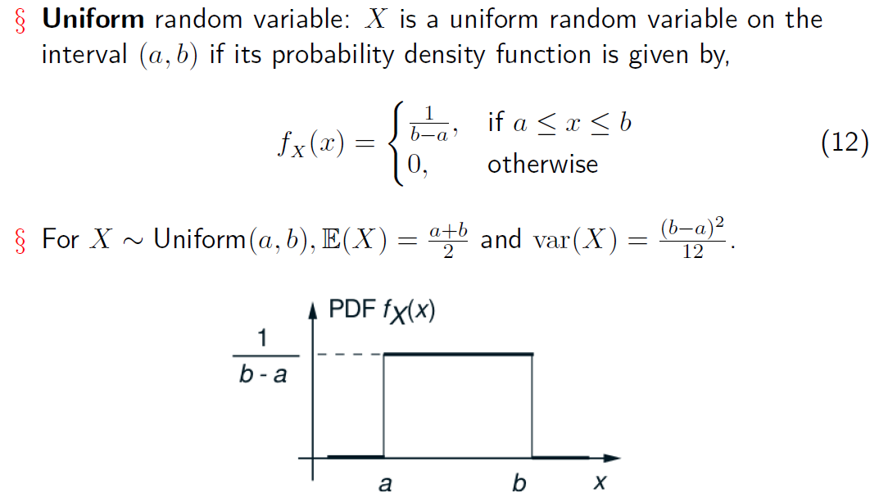
Agenda Elements of Probability
Some Common Random Variables
Random Variables
Continuous Random Variables
Random Number Generation: A random number generator outputs values between 0 and 1 with equal probability.
Notes:
A uniform random variable models situations where every value in a given interval is equally likely. The probability density is constant across the range.

Slide 47
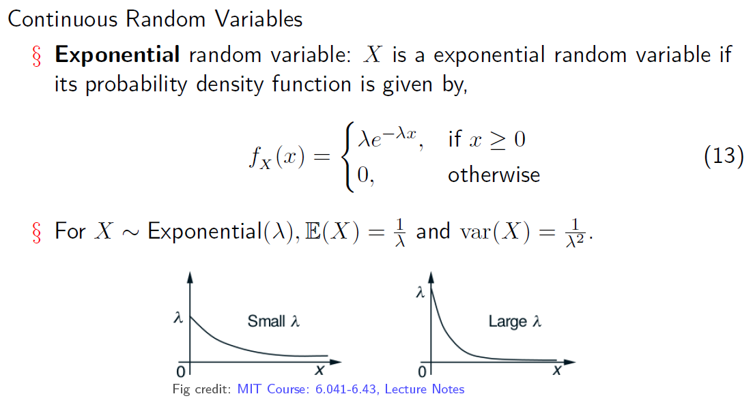
Agenda Elements of Probability
Some Common Random Variables
Random Variables
Queueing Systems: The time between two consecutive arrivals at a bank or a call center.
Failure Time: The time until a light bulb burns out or the time until a hardware component fails (assuming a constant failure rate).
Notes:
An exponential random variable models the time until the first occurrence of an event in a process where events happen continuously and independently at a constant average rate.

Slide 48
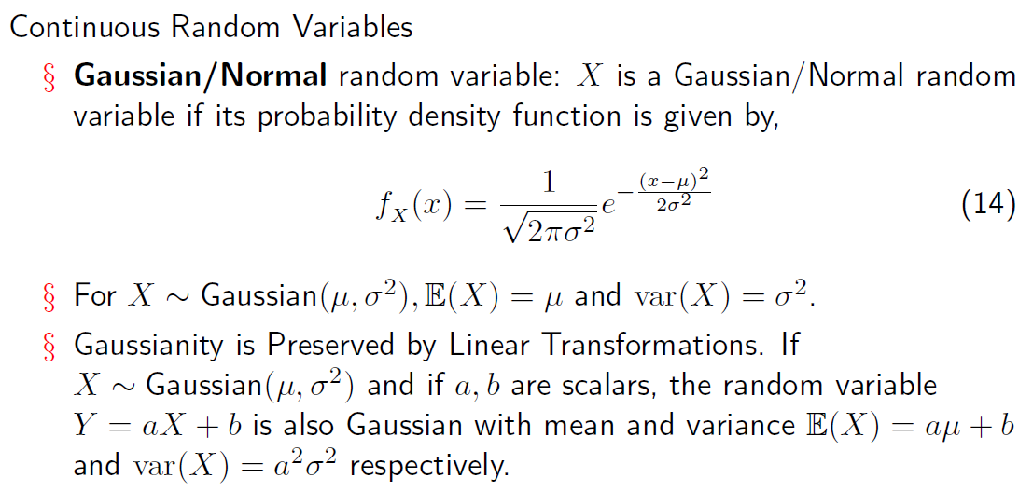
Agenda Elements of Probability
Some Common Random Variables
Random Variables
Human Heights: Heights of people in a population are approximately normally distributed.
Test Scores: Scores on standardized tests, such as the SAT or IQ tests, often follow a normal distribution.
Notes:
a and b are scalars, it means they are single-valued quantities or real numbers

Slide 49
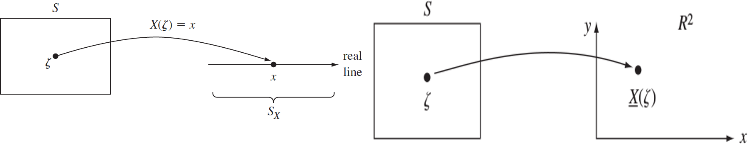
Agenda Elements of Probability
Two Random Variables
Random Variables
§ Many random experiments involve several random variables. For example, temperature and pressure of a room during different days.
Figure credit: [PSRPEE] - Alberto Leon-Garcia
§ Consider two discrete random variables X and Y associated with the same experiment. We will use the notation P (X = x, Y = y) to denote P (X = x and Y = y).
CS60077
31 / 44

Slide 50
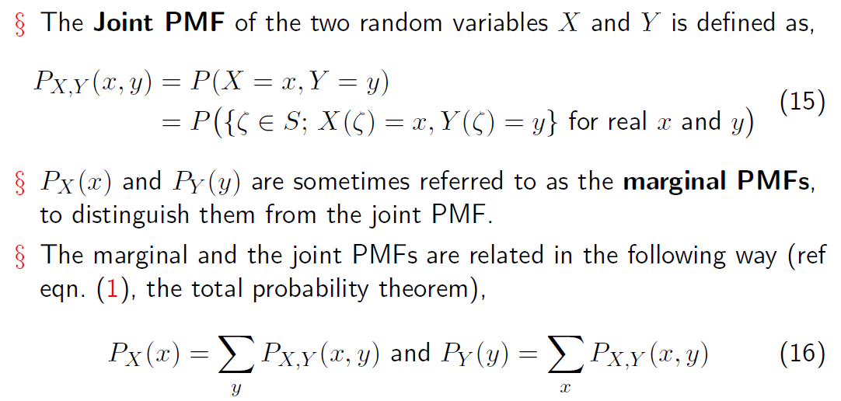
Agenda Elements of Probability
Two Random Variables
Random Variables
CS60077

Slide 51
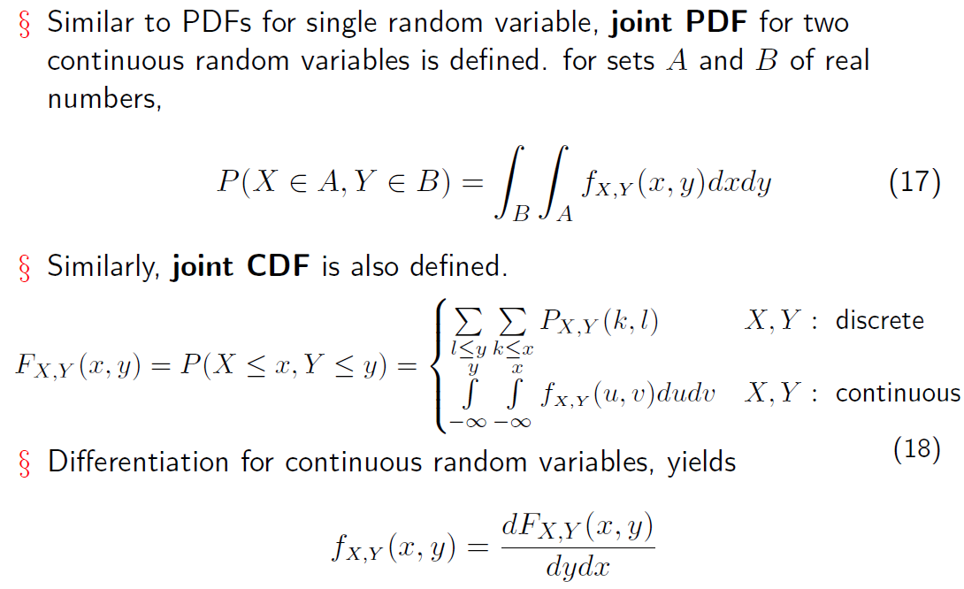
Agenda Elements of Probability
Two Random Variables
Random Variables

Slide 52
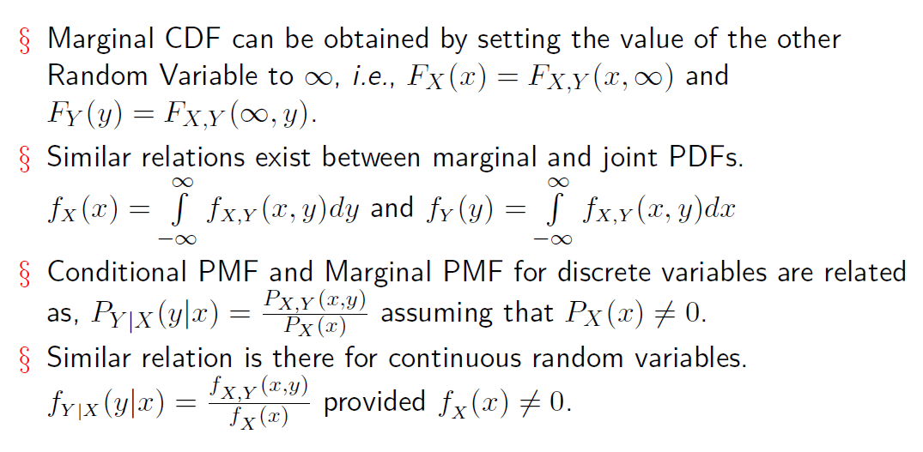
Agenda Elements of Probability
Some Useful Relations
Random Variables

Slide 53
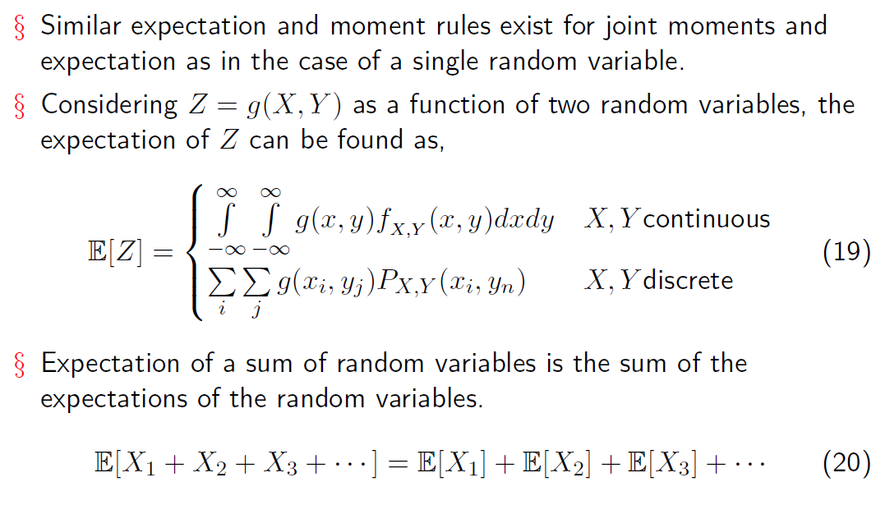
Agenda Elements of Probability
Joint Expectations
Random Variables

Slide 54
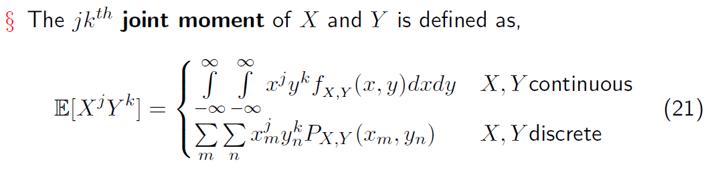
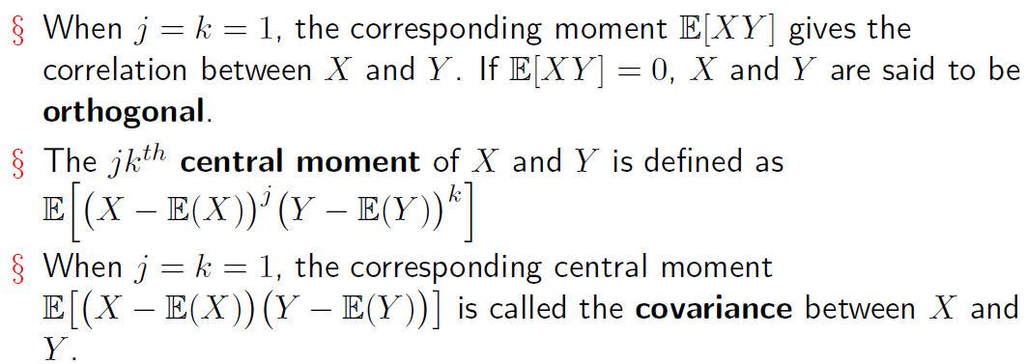
Joint Moments, Correlation, and Covariance Covariance
Agenda Elements of Probability Random Variables

Slide 55
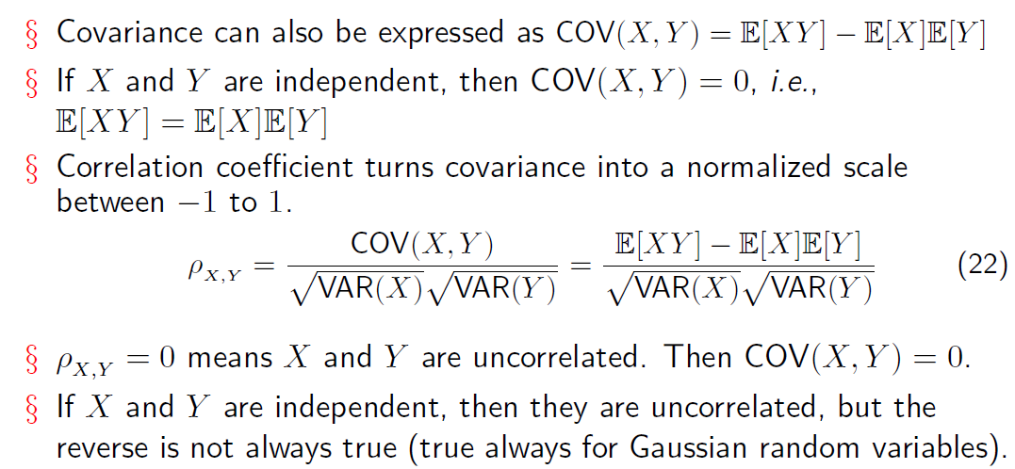
Joint Moments, Correlation, and Covariance Covariance
Agenda Elements of Probability Random Variables

Slide 56
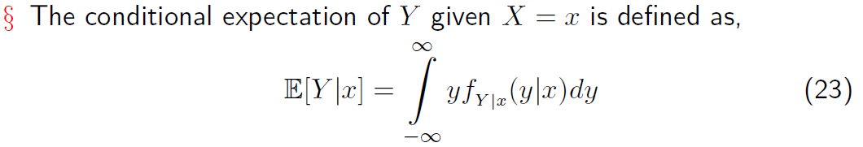
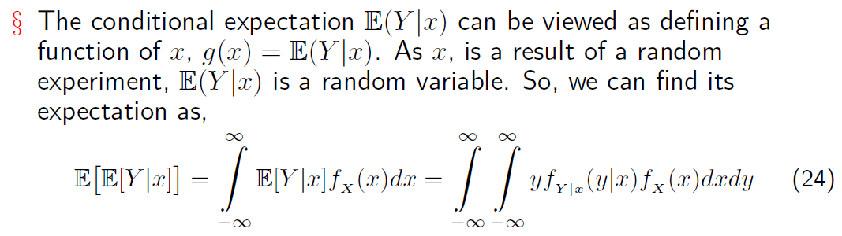
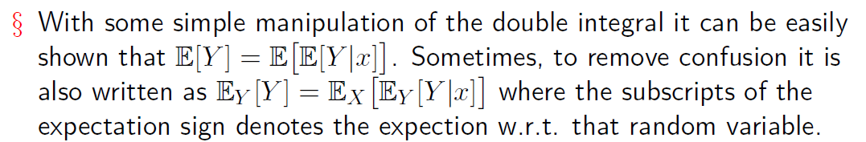
Agenda Elements of Probability
Conditional Expectation
Random Variables

Slide 57
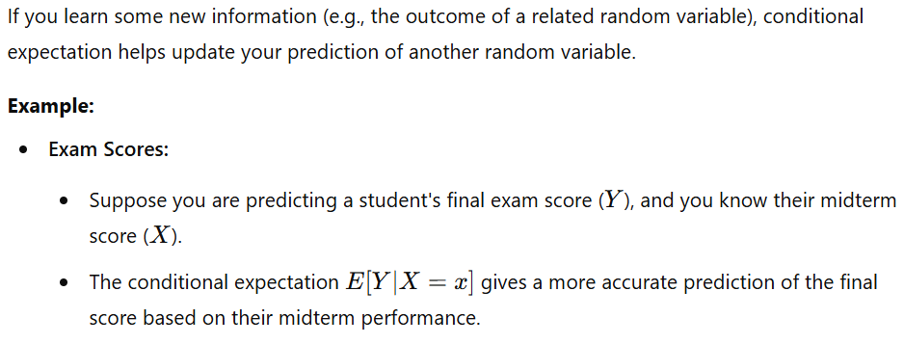
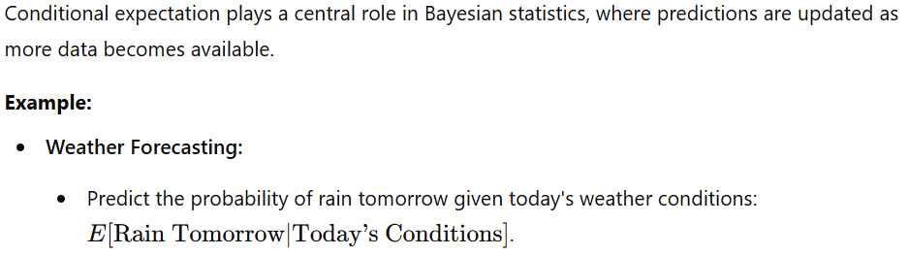
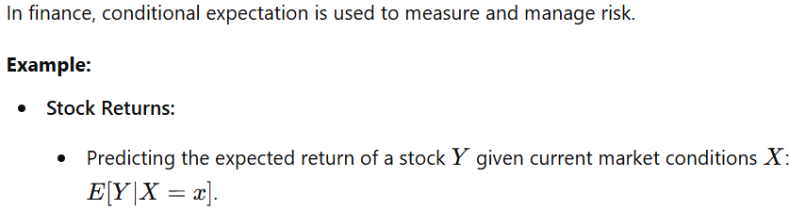
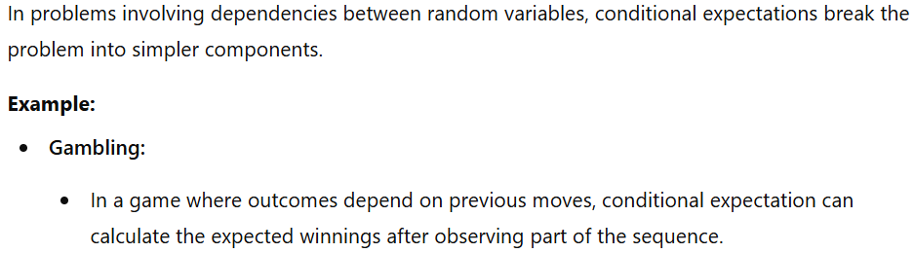
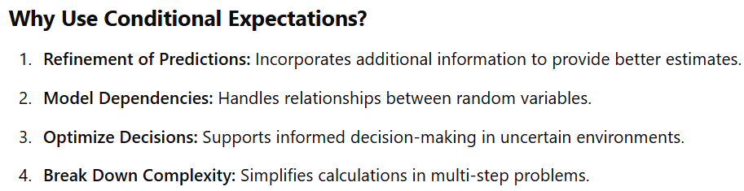
Agenda Elements of Probability
Conditional Expectation
Random Variables
Conditional expectation is used in probability theory to find the expected value of a random variable given some known information. It provides a way to refine or update our expectations based on additional data.

Slide 58
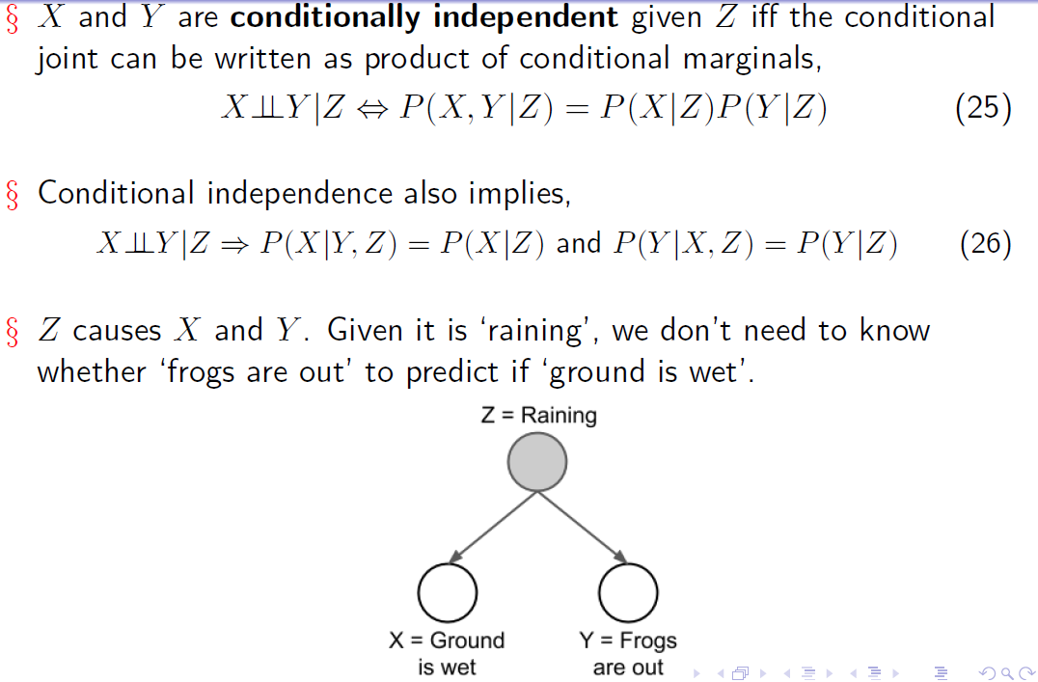
Agenda Elements of Probability
Conditional Independence
Random Variables

Slide 59

Agenda Elements of Probability
Multiple Random Variables
Random Variables
CS60077

Slide 60

Agenda Elements of Probability
Multiple Random Variables
Random Variables
CS60077

Slide 61

Agenda Elements of Probability
Multiple Random Variables
Random Variables

Slide 62

Agenda Elements of Probability
Multiple Random Variables
Random Variables

Slide 63

Agenda Elements of Probability
Multiple Random Variables
Random Variables
n

