Slide 1
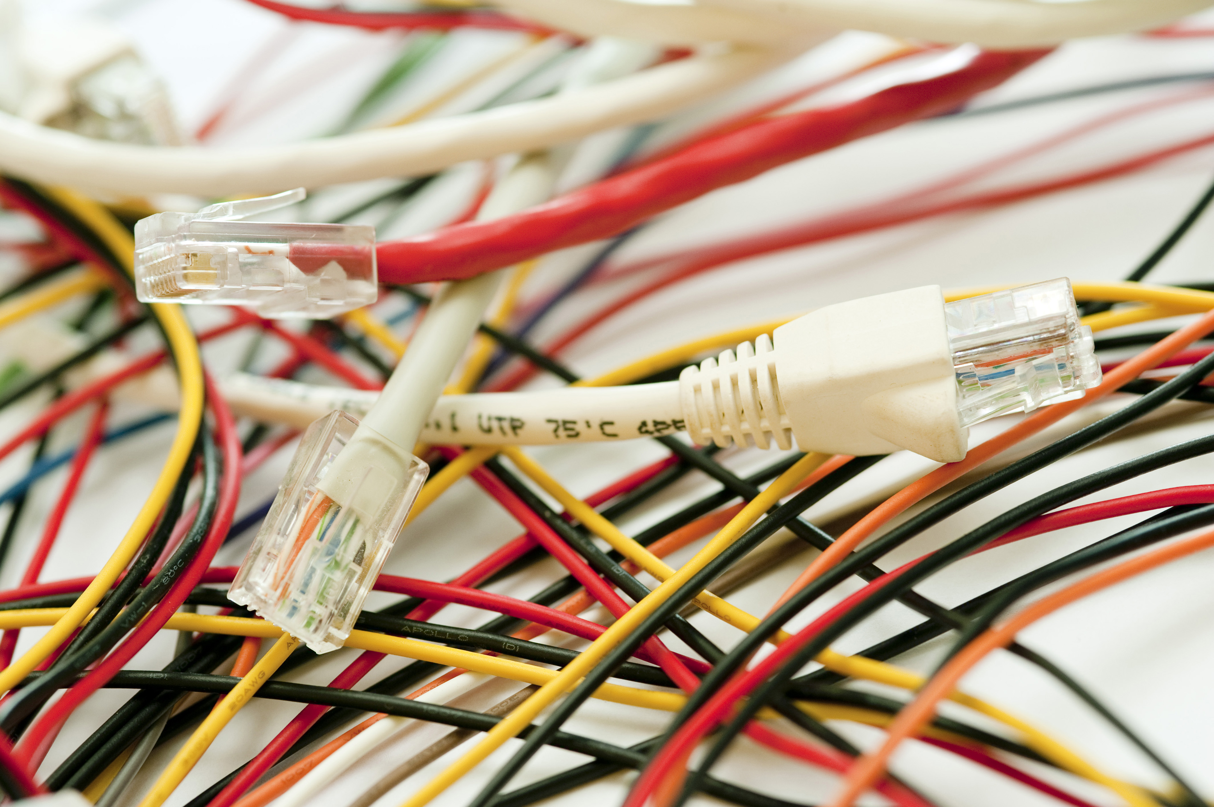
Electrical Wire Types for Electrical Systems
Name : Ayush Kumar Prajapati
Department : Computer Science and Engineering
Section: PU
Roll no: 4
IEE AAT

Slide 2
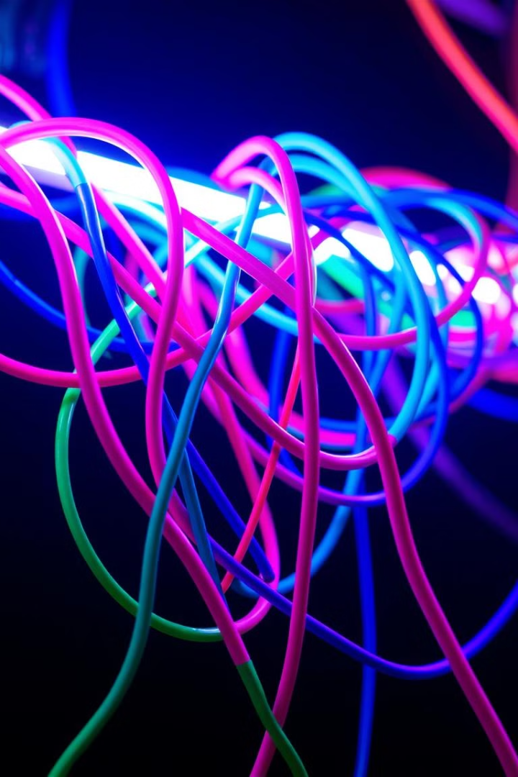
Electrical Wire Types for Electrical Systems
This presentation explores common electrical wire types, their properties, and application.
Vulcanized Indian Rubber (V.I.R.) Wires
Construction & Features
Applications
Rubber insulation
Low/medium voltage
Tinned conductor
Older installations
Cotton braiding
Wax coating

Slide 3

Tough Rubber Sheathed (T.R.S.) Wires
Construction & Features
Applications
V.I.R. with tough rubber sheath
Industrial and commercial installations
Moisture, wear, and damage resistance
Temporary outdoor wiring
Single, twin, and three-core versions

Slide 4
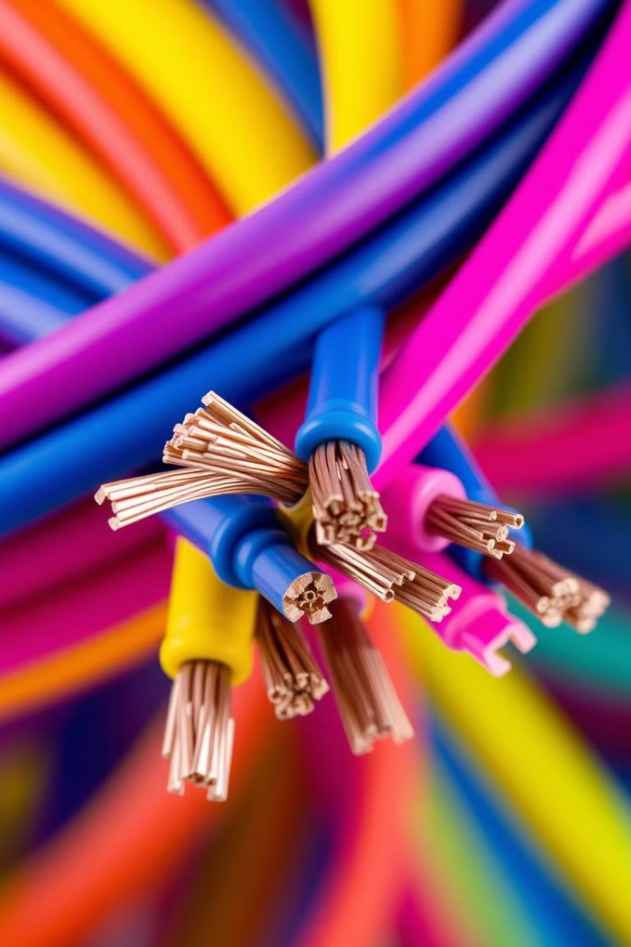
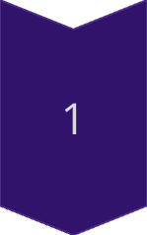
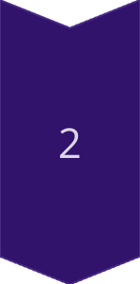
Poly Vinyl Chloride (P.V.C.) Wires
Most Common
PVC thermoplastic insulation
Moisture, chemical, and wear resistance
Widely Used
Household wiring
Industrial electrical systems
Indoor and outdoor applications

Slide 5
Lead Alloy Sheathed Wires
Construction & Features
Applications
Outer lead sheath for protection
Underground installations
Moisture-prone environments
Industries and damp environments
0.12 cm thick sheath

Slide 6
Weatherproof Wires
Construction & Features
Applications
Fibrous yarn saturated with waterproof compound
Service connections from power lines to buildings
Rain, humidity, and UV radiation resistance
Agricultural applications and outdoor lighting

Slide 7
Flexible Wires
Construction & Features
Applications
Multiple fine strands
Household appliances
PVC insulation
Automotive wiring
Frequent movement applications
Portable electrical devices

Slide 8
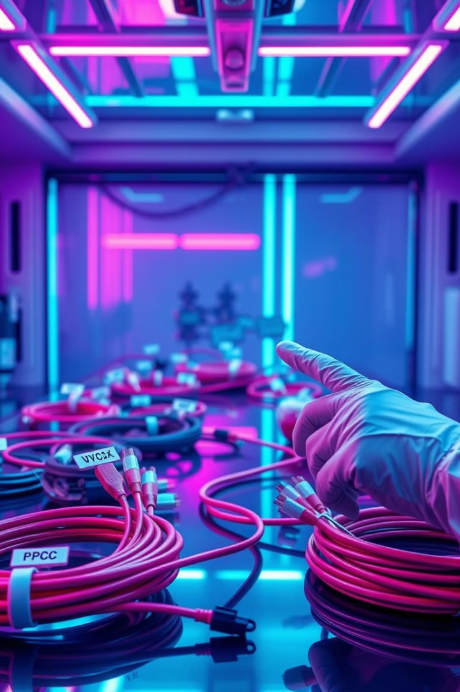
Choosing the Right Wire
1
Insulation Material
2
Mechanical Strength
Determines resistance to moisture, heat, and chemicals
Impact resistance, flexibility, and durability
3
Environmental Conditions
Exposure to moisture, temperature, and UV radiation

