Slide 1


EXPLORATORY DATA ANALYSIS AND VISUALIZATION ON World Development Indicators
STUDENT DETAIL:
AYUSH SAXENA SHRIVASTAVA

Slide 2
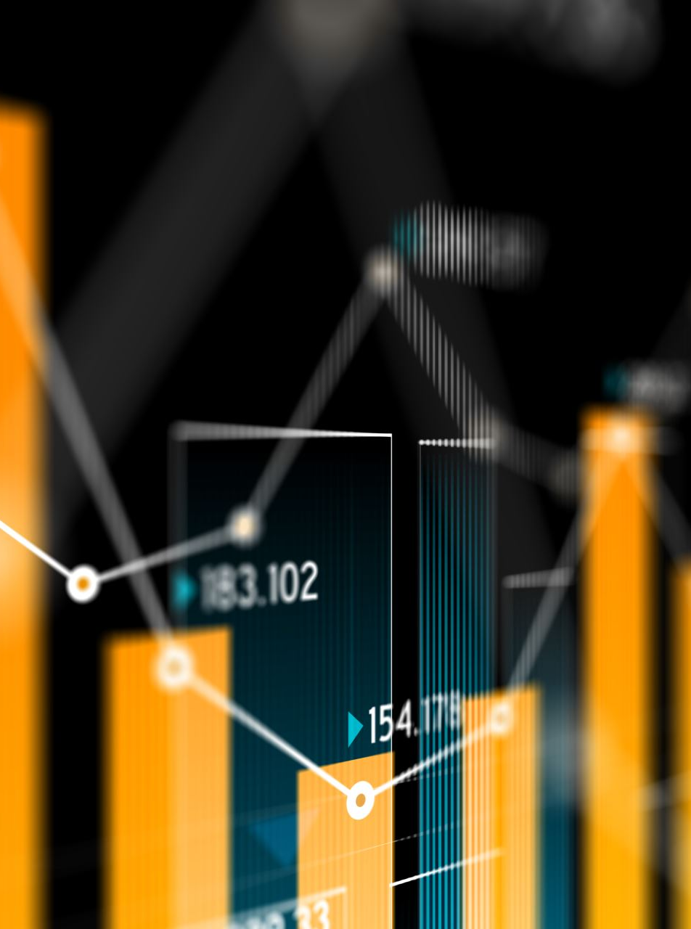

PROJECT OBJECTIVES
Goal:
To perform exploratory data analysis and visualization on a subset of the World Development Indicators dataset using Python.
Specific Objectives:
Demonstrate data loading, cleaning, wrangling, and descriptive analysis techniques.
Compare trends in key development indicators (Life Expectancy, Access to Electricity, etc.) across selected developed and developing nations between 2000-2022.
Investigate the relationship between economic status (GDP per capita) and social outcomes (Life Expectancy, Health Expenditure) for the year 2022.
Highlight differences in per capita health expenditure among these nations in 2022.

Slide 3
Data Set Description
Source: World Bank - World Development Indicators (WDI)
Link: https://datacatalog.worldbank.org/search/dataset/0037712/World-Development-Indicators
Original Data: Contains a vast collection of development indicators for countries worldwide, spanning from 1960 onwards. The initial format is "wide," with years as columns
Subset Used for Analysis:
  Countries (8): Brazil (BRA), Canada (CAN), China (CHN), Germany (DEU), India (IND), Japan (JPN), South Africa (ZAF), United States (USA).
  Indicators (5):
    Access to Electricity (% of population) - EG.ELC.ACCS.ZS
    Current Health Expenditure per capita (US$) - SH.XPD.CHEX.PC.CD
    GDP per capita (current US$) - NY.GDP.PCAP.CD
    Life Expectancy at birth (years) - SP.DYN.LE00.IN
    Urban Population (% of total) - SP.URB.TOTL.IN.ZS (Chosen as key indicators reflecting economic status, infrastructure, and health outcomes).
  Years: Original data spans 1960-2022. Analysis focused on 2000-2022 due to better data completeness in this period for the selected indicators and countries.

Slide 4

Data loading
Objective: Load the raw CSV data into a Pandas DataFrame.
Libraries Imported: Pandas, NumPy, Matplotlib.

Slide 5
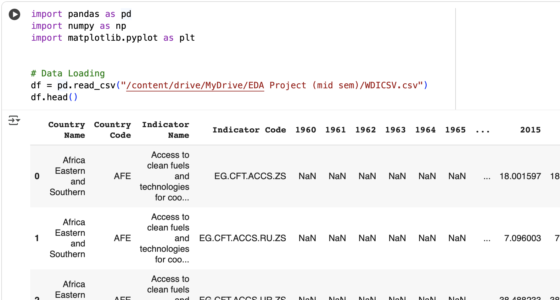

Slide 6
Filtering & Data Wrangling (Melting)
Objective: Select only the required countries and indicators, then reshape the data from wide to long format using melt for easier analysis.
Steps:
Defined lists for target Countries and Indicator_codes.
Filtered the DataFrame df based on these lists.
Selected relevant columns (Country Name, Country Code, Indicator Name, Indicator Code, and year columns 1960-2022).
Applied the melt function to convert year columns into rows, creating 'Year' and 'Value' columns.
Converted 'Year' to integer and 'Value' to numeric (handling potential errors).

Slide 7
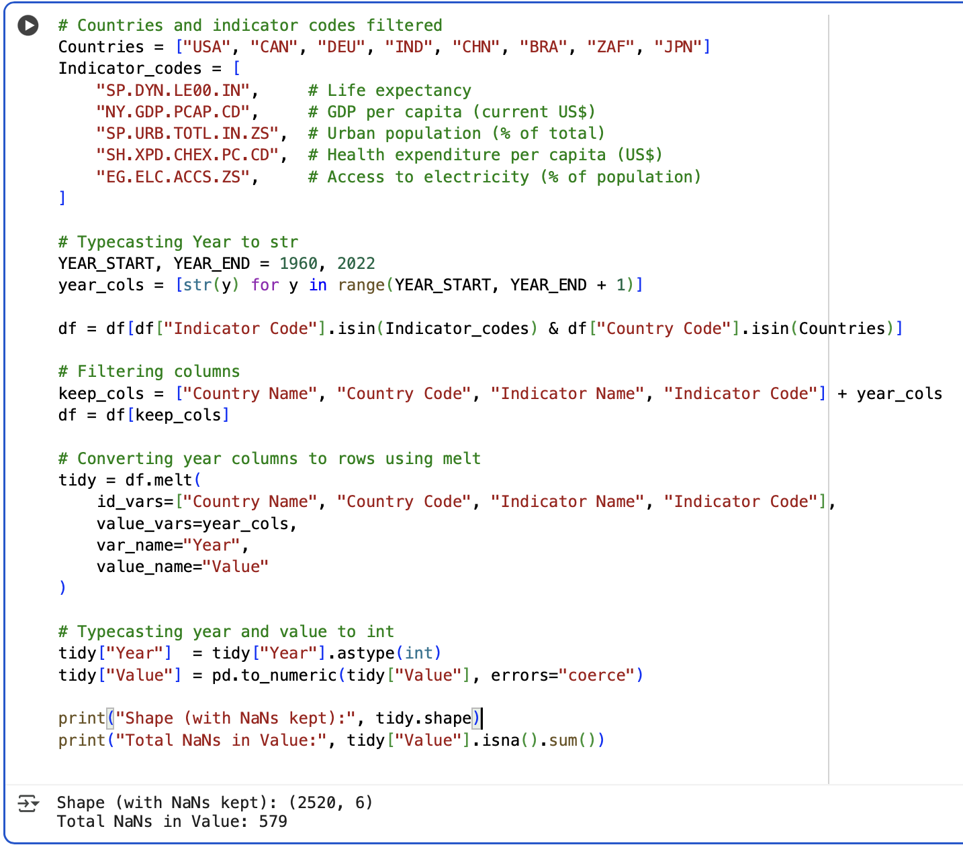
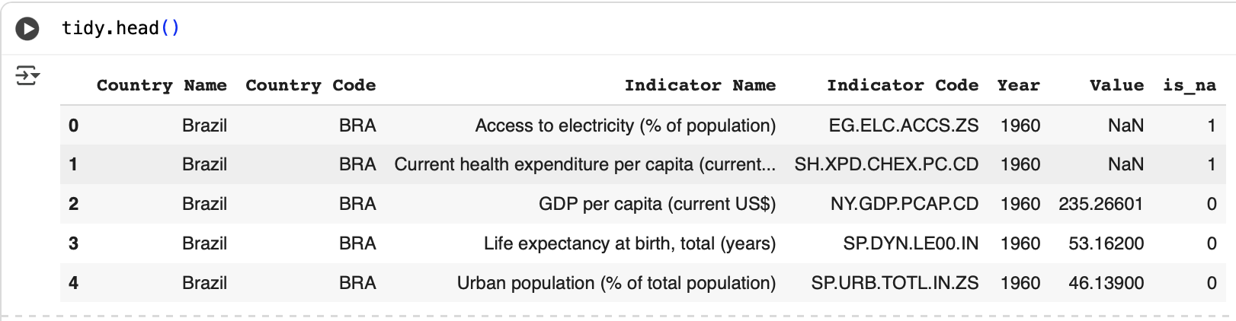

Slide 8

Data Cleaning (Missing Value Analysis)
Objective: Identify and quantify missing data (NaNs) to determine the optimal time range for reliable analysis.
Method:
  Created a helper column is_na (1 if Value is NaN, 0 otherwise).
  Grouped the tidy DataFrame by 'Year' and summed the is_na column to get a count of missing values per year.
  Examined the head (early years) and tail (recent years) of these counts.

Slide 9
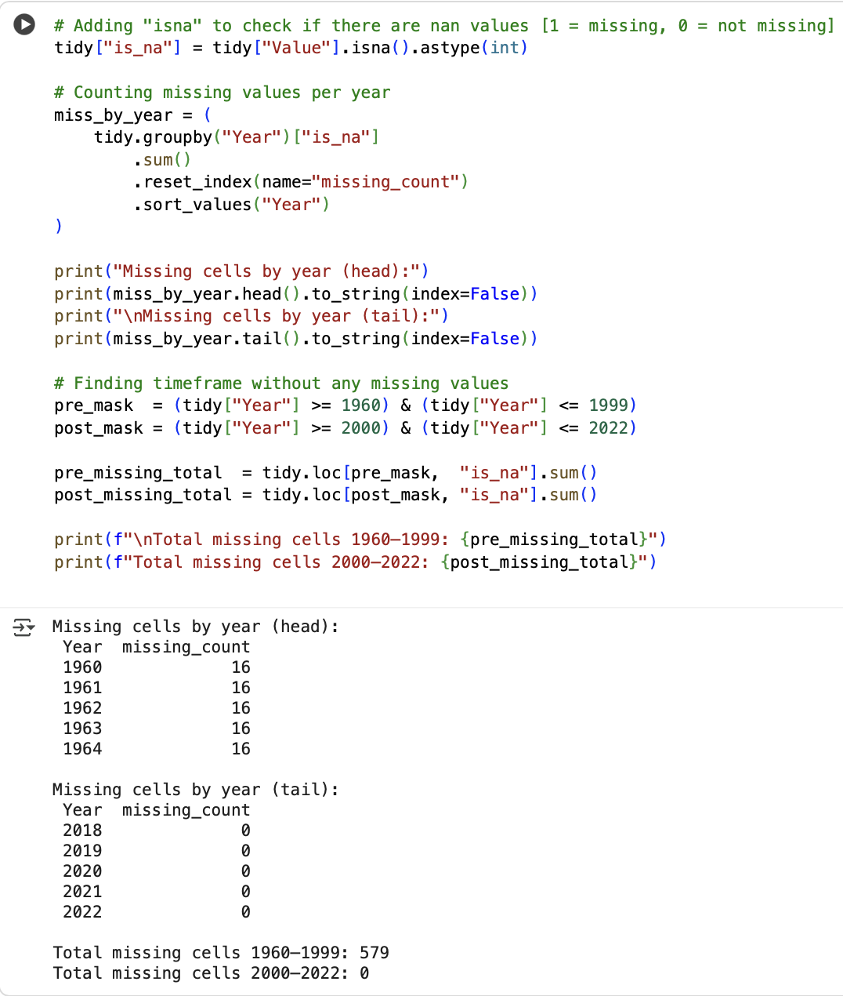
The analysis confirmed zero missing values for the selected subset between 2000 and 2022. This period was chosen for further analysis.

Slide 10
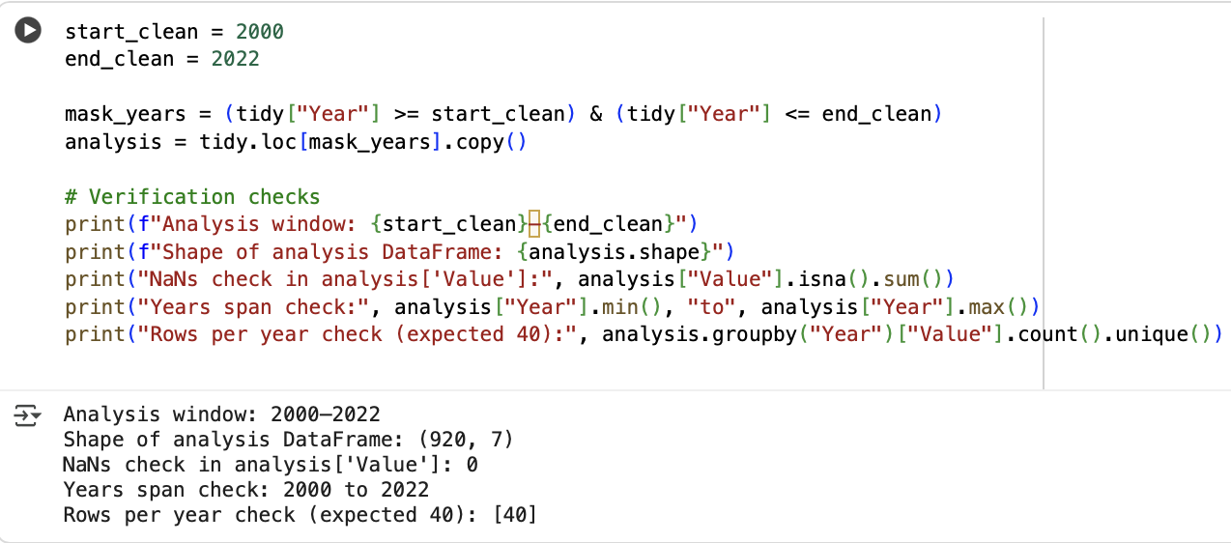
Creating Final Analysis DataFrame
Objective: Isolate the clean data (2000-2022) into a dedicated DataFrame analysis and verify its integrity.

Slide 11
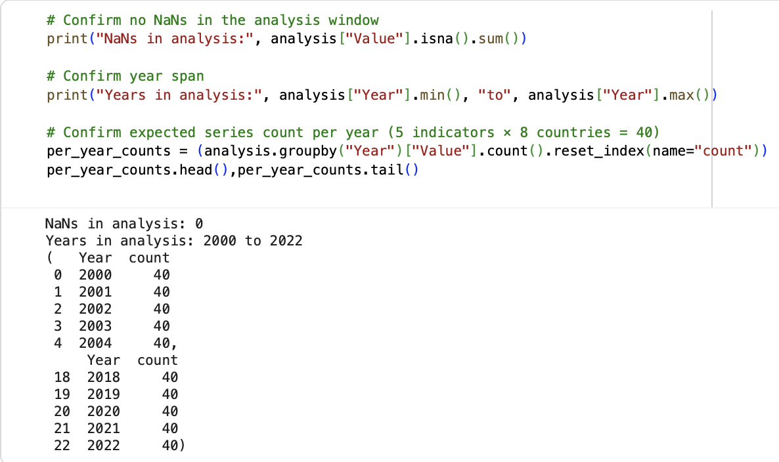

Slide 12
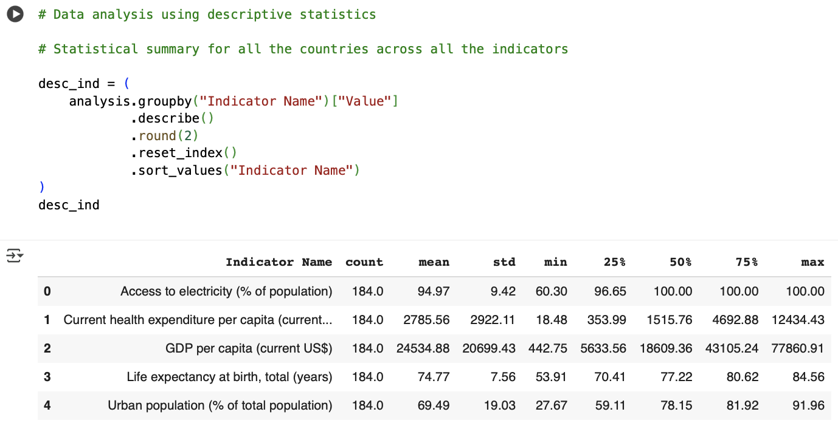
Descriptive Statistics (Overall Indicators)
Objective: Understand the general distribution (mean, spread, range) of each selected indicator across all 8 countries during the 2000-2022 period.

Slide 13
Descriptive Statistics Per Country (2000-2022)
Objective: Examine summary statistics (mean, min, max, std dev, quartiles) for each indicator, broken down by individual country, across the entire 2000-2022 analysis period. This helps understand the typical range and variation for each country over time.

Slide 14
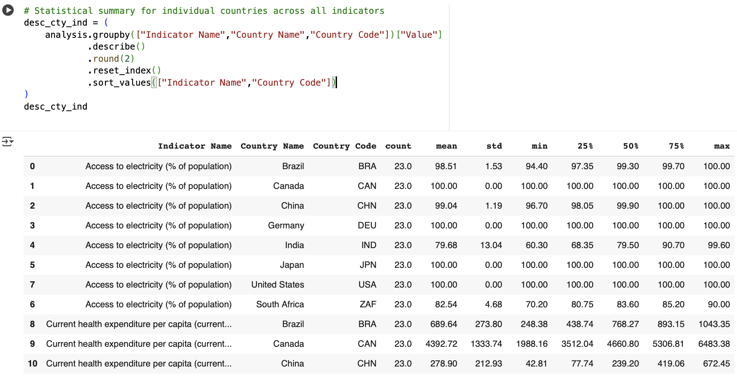
Insights: This provides a detailed statistical profile for each country regarding each indicator over the selected timeframe, showing central tendency, dispersion, and range of values experienced during 2000-2022.

Slide 15
Latest Year (2022) Analysis: Rankings & Correlation
Objective: Focus specifically on the most recent year (2022) to understand current rankings between countries for each indicator and to assess how the indicators relate to each other in that specific year.

Slide 16
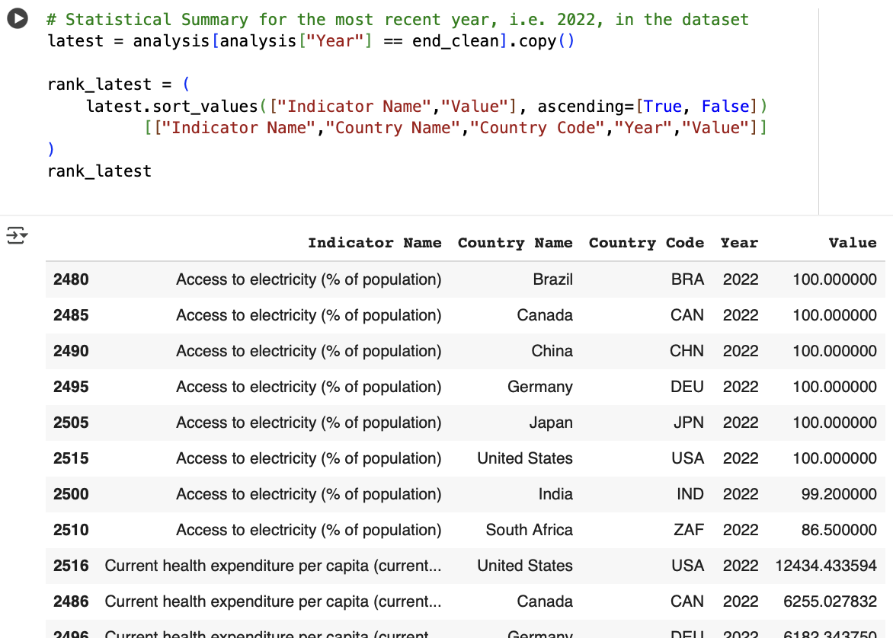
Identifies the leading and lagging countries for each specific indicator in 2022.

Slide 17
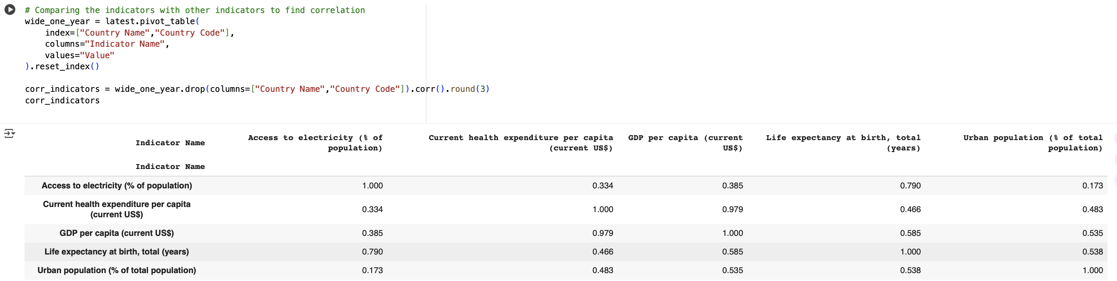
Reveals the strength and direction of linear relationships between pairs of indicators in 2022 (e.g., strong positive correlation between GDP p.c. and Health Expenditure p.c.).

Slide 18
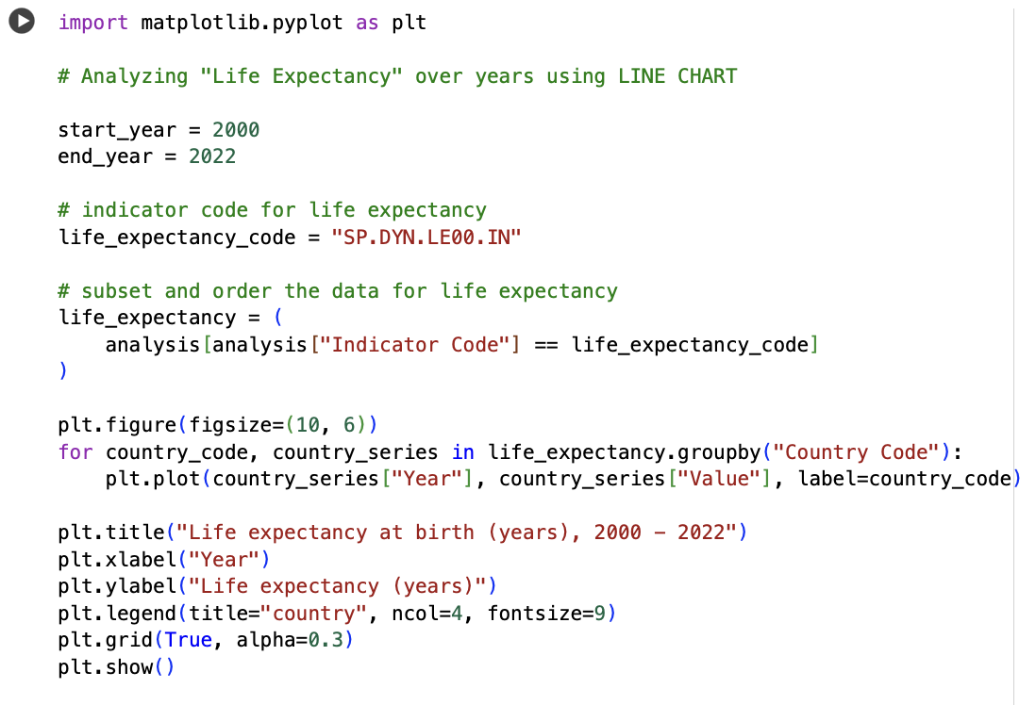
LINE CHART: Life Expectancy Trends (Code & Plot)
Objective: Visualize and compare the change in Life Expectancy over time (2000-2022) for each country.

Slide 19
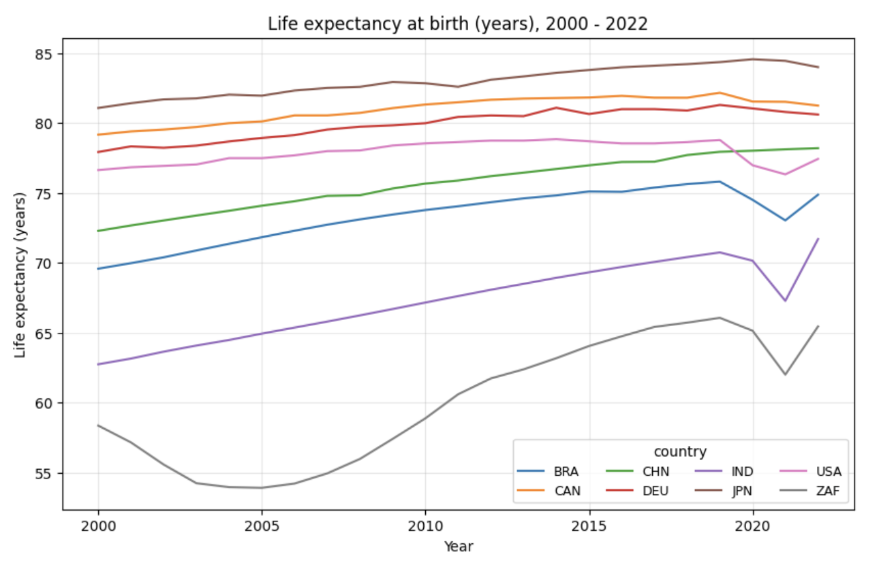
Line chart

Slide 20
LINE CHART: Description
Question Answered: How has life expectancy changed from 2000-2022 for these countries, and how do they compare?
Visualization Design:
  Type: Line chart. Chosen because it's effective for showing trends of continuous data (life expectancy) over time (years).
  Marks: Lines (one distinct line representing each country).
  Channels:
    X-Position encodes Year (quantitative).
    Y-Position encodes Life Expectancy (quantitative).
    Color encodes Country Code (categorical), allowing differentiation between lines.
How it Answers the Question:
  The slope of each line shows the trend (increasing, decreasing, fluctuating) for that country over the 22-year period.
  The vertical position allows comparison of absolute life expectancy levels between countries at any given year.
  Differences in slopes indicate different rates of change.
  Reveals overall increase for most, Japan's high level, and South Africa's distinct pattern (dip and recovery).

Slide 21
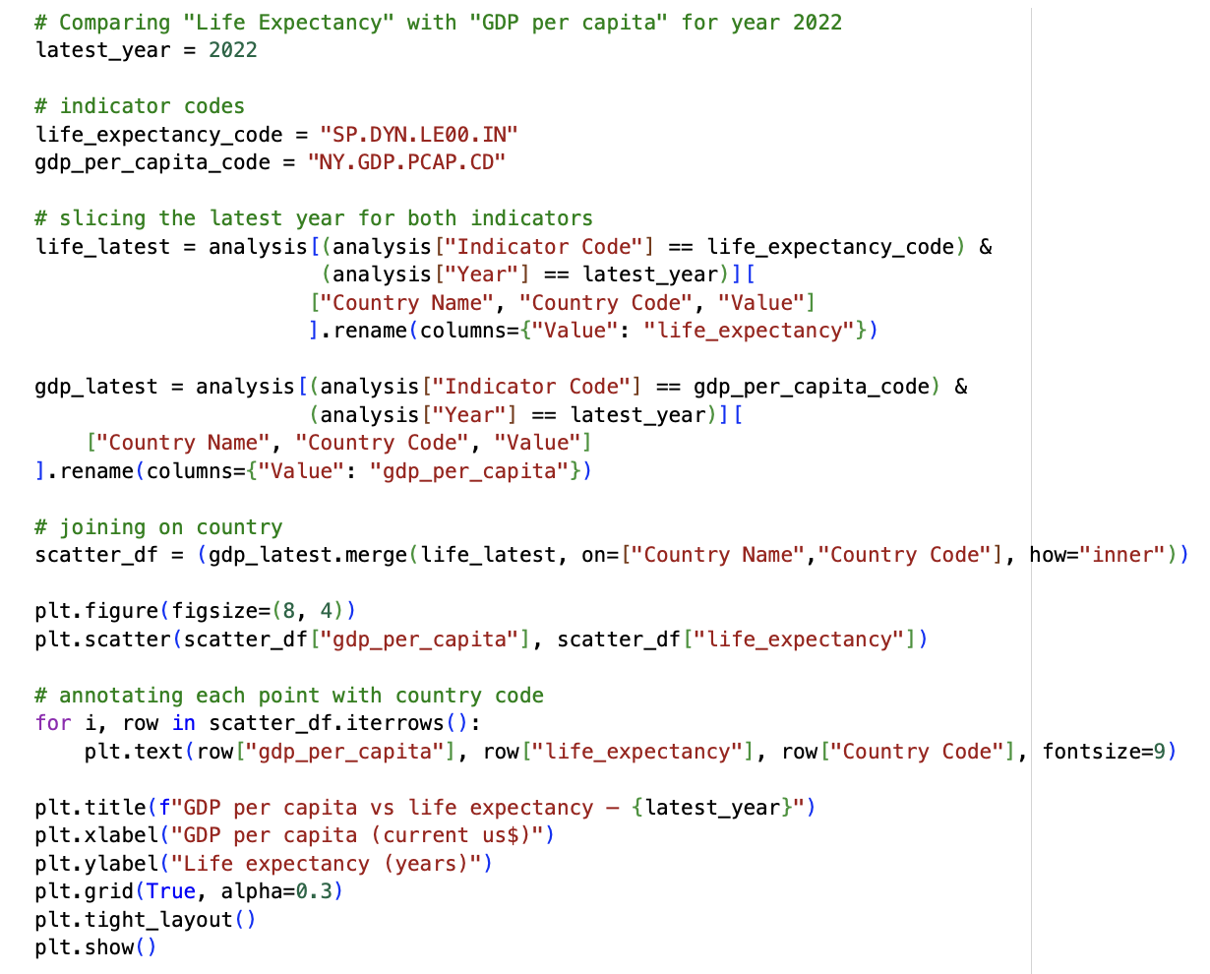
SCATTER PLOT: GDP vs. Life Expectancy (Code & Plot)
Objective: Explore the potential relationship between national wealth (GDP per capita) and health outcome (Life Expectancy) specifically for the year 2022.

Slide 22
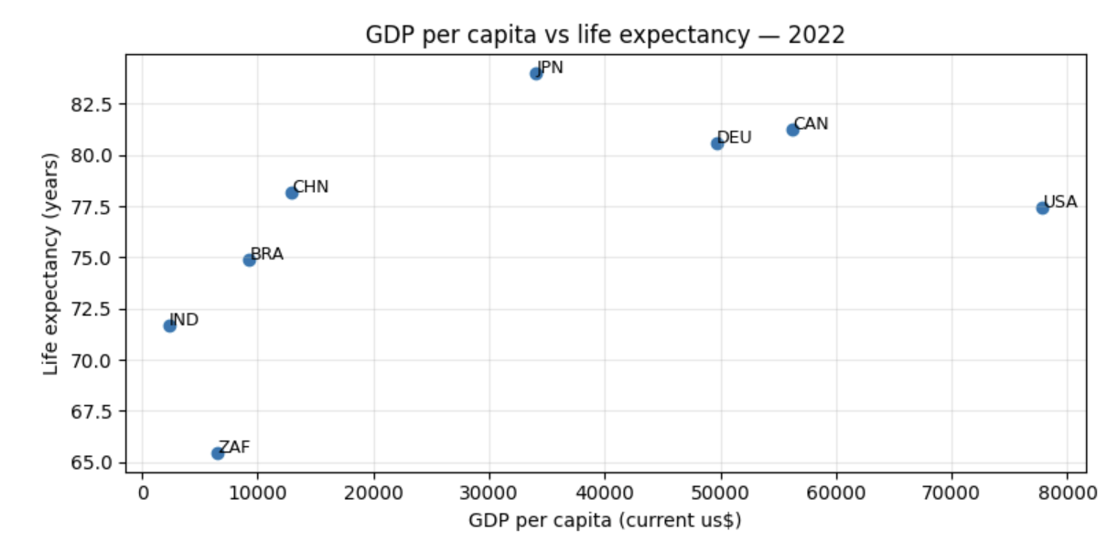
SCATTER PLOT

Slide 23
SCATTER PLOT: Description
Question Answered: Is there a relationship between a country's GDP per capita and its life expectancy in 2022 for this group?
Visualization Design:
Type: Scatter plot. Standard choice for visualizing the relationship (correlation) between two quantitative variables at a specific point in time (2022).
Marks: Points (each point represents one country).
Channels:
  X-Position encodes GDP per capita (quantitative).
  Y-Position encodes Life Expectancy (quantitative).
  Text Label annotates each point with its Country Code (categorical identifier).
How it Answers the Question:
The pattern of points indicates the type and strength of the relationship. A general upward trend is visible, suggesting a positive association.
Allows identification of individual country positions relative to the trend in 2022 (e.g., US high GDP, mid-range life expectancy in this group; IND/ZAF lower on both).
Visually supports the moderate positive correlation (r = 0.585) found in the 2022 correlation matrix.

Slide 24
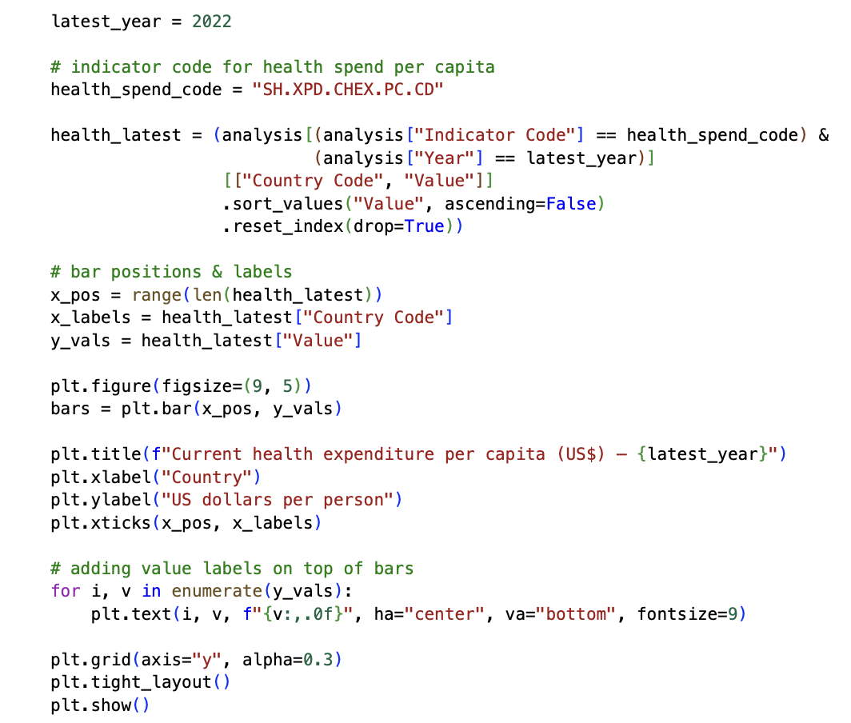
BAR CHART: Health Expenditure Comparison (Code & Plot)
Objective: Clearly compare the magnitude of per capita health spending across the selected countries specifically in 2022.

Slide 25
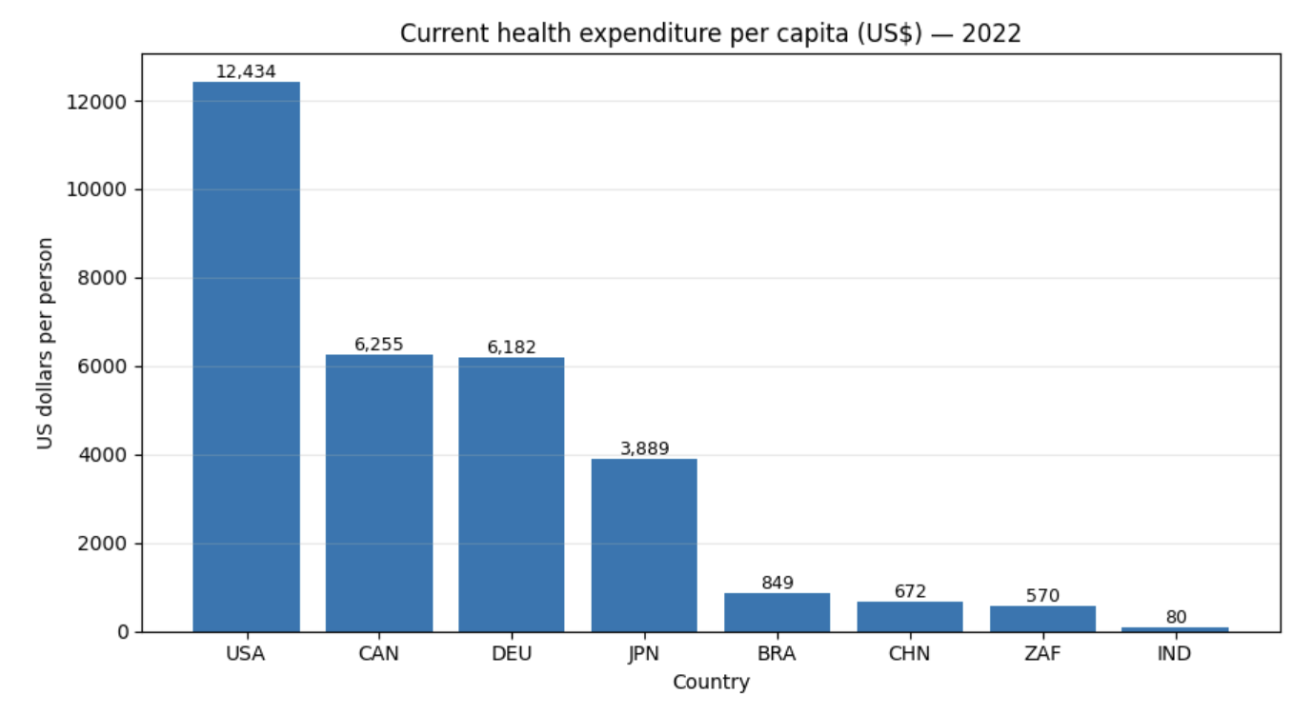
BAR CHART

Slide 26
BAR CHART: Description
Question Answered: How does health expenditure per capita differ across these eight countries in 2022?
Visualization Design:
Type: Bar chart. Best choice for comparing the magnitude of a quantitative variable across distinct categories (countries) at a single point in time (2022).
Marks: Bars (one bar per country).
Channels:
  X-Position encodes Country Code (categorical).
  Y-Length (Height) encodes Health Expenditure p.c. (quantitative).
  Text Label annotates each bar top with the precise value (quantitative).
Bars are sorted descending by value (as per your code) to facilitate easier ranking and comparison for 2022.
How it Answers the Question:
The length of the bars provides an immediate visual comparison of spending levels in 2022.
Clearly highlights the significant difference in spending, particularly the high expenditure in the USA in 2022.
Allows easy ranking of countries by health expenditure for 2022.

Slide 27
Conclusion
Process Summary: Successfully loaded, wrangled (using melt), cleaned (addressed NaNs by selecting 2000-2022), and analyzed a subset of the World Development Indicators dataset using Pandas. Generated descriptive statistics (both over the 2000-2022 period and focusing on 2022) and created three distinct visualizations (line, scatter, bar) using Matplotlib to explore trends and relationships.
Key Findings:
  Trends (2000-2022): Life expectancy generally increased across the selected nations during this period, though significant variations in levels and specific country trends (like South Africa's recovery) were evident.
  Relationships (2022): A moderate positive association (r=0.585) was observed between GDP per capita and life expectancy in 2022, confirming findings from the correlation analysis for that year. However, the relationship isn't perfectly linear, suggesting other factors are influential.
  Comparison (2022): Per capita health expenditure varied dramatically across the countries analyzed in 2022, with the US spending significantly more than others in the group.
Overall: The project successfully applied EDA and visualization techniques to extract meaningful comparative insights from real-world tabular data, showing both longitudinal trends (2000-2022) and specific cross-sectional relationships (2022).

Slide 28

THANK YOU!

