Slide 1

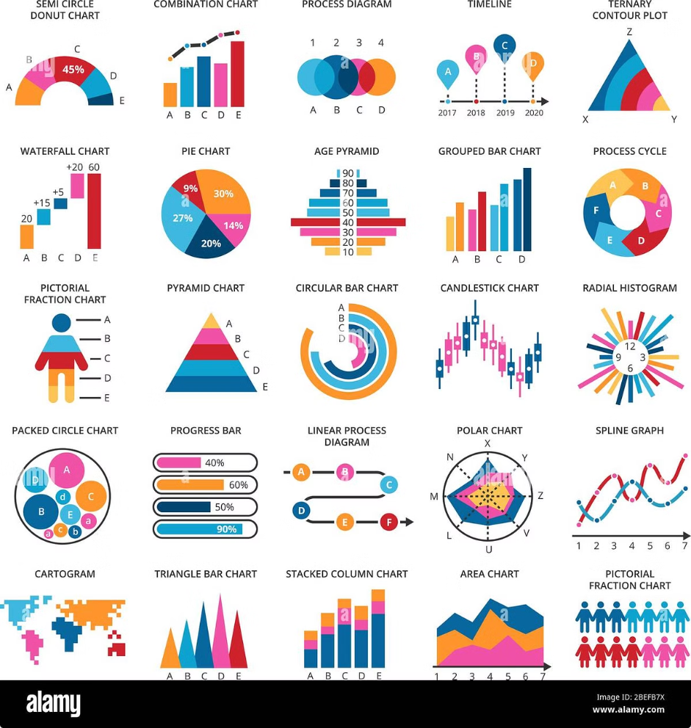
Real-Time Fraud Detection
This presentation outlines the development of a real-time fraud detection system for financial transactions using machine learning. The project aims to identify and prevent fraudulent activities in financial transactions by leveraging advanced machine learning algorithms.
Team Members: Ayush Sharma, Shraman, Nitesh, Shadman, Lukshmi

Slide 2
Project Objective
The objective of this project is to create a real-time fraud detection system for financial transactions using machine learning.
Goal
Approach
To develop a system that can identify and prevent fraudulent activities in financial transactions.
Leveraging advanced machine learning algorithms to analyze transaction data and detect suspicious patterns.

Slide 3
Project Workflow
1
Environment Setup
Setting up the necessary software and libraries for the project, including Python, MySQL, Docker, Scikit-learn, Pytest, and Git/GitHub.
2
Version Control with Git/GitHub
Utilizing Git for version control and GitHub for collaborative code management, ensuring efficient tracking of changes and code sharing among team members.
3
Database Integration (MySQL)
Integrating MySQL for database management, storing and retrieving transaction data for analysis and model training.
4
Model Development (Various ML models)
Developing and evaluating various machine learning models, including logistic regression, random forest, naive Bayes, KNN, SVM, and decision tree, to identify the most effective model for fraud detection.
5
Testing (Using Pytest)
Thorough testing of the developed models and system using Pytest to ensure accuracy, reliability, and robustness.
6
Containerization (Docker)
Containerizing the application using Docker for efficient deployment and portability, ensuring consistent execution across different environments.
7
UI Representation
Developing a user-friendly interface for visualizing the results of the fraud detection system, providing insights and actionable information to users.

Slide 4
Tools and Technologies
Python (pandas for data manipulation)
MySQL (for database management)
Docker (for containerization)
Scikit-learn (for machine learning models)
Pytest (for testing)
Git/GitHub (for version control)

Slide 5
Dataset Used
Credit card fraud detection datasets (creditcard.csv)
Source: Kaggle - Credit Card Fraud Detection
The project utilized credit card fraud detection datasets, specifically the "creditcard.csv" file.
The dataset was sourced from Kaggle, a platform for data science and machine learning competitions, under the "Credit Card Fraud Detection" category.

Slide 6
My Contributions
Installation of required software
Created GitHub repository
Installing the necessary software and libraries for the project, including Python, MySQL, Docker, Scikit-learn, Pytest, and Git/GitHub.
Created the GitHub repository for the project, providing a centralized platform for collaborative code management and version control.
Integrated MySQL database
Built models (mainly logistic regression; also tested random forest, naive Bayes, KNN, SVM, and decision tree)
Integrated the MySQL database, enabling the storage and retrieval of transaction data for analysis and model training.
Performed basic analysis and undersampling (also tried oversampling)
Containerized the application with Docker and uploaded the image to Docker Hub for team access
Conducted basic analysis of the dataset and implemented undersampling techniques to address class imbalance. Also explored oversampling methods.
Containerized the application using Docker, ensuring efficient deployment and portability. Then uploaded the Docker image to Docker Hub, making it accessible to the entire team.

Slide 7

Contributions of Other Members
Sharaman
Installation, GitHub repo creation, MySQL integration, oversampling, code merging, UI development
Nitesh
Installation, GitHub repo creation, MySQL integration, and testing with Pytest
Shadman
Installation, GitHub repo creation, MySQL integration, random forest model development, data analysis, Docker containerization
Lakshmi
Installation, GitHub repo creation, MySQL integration, decision tree model development

Slide 8
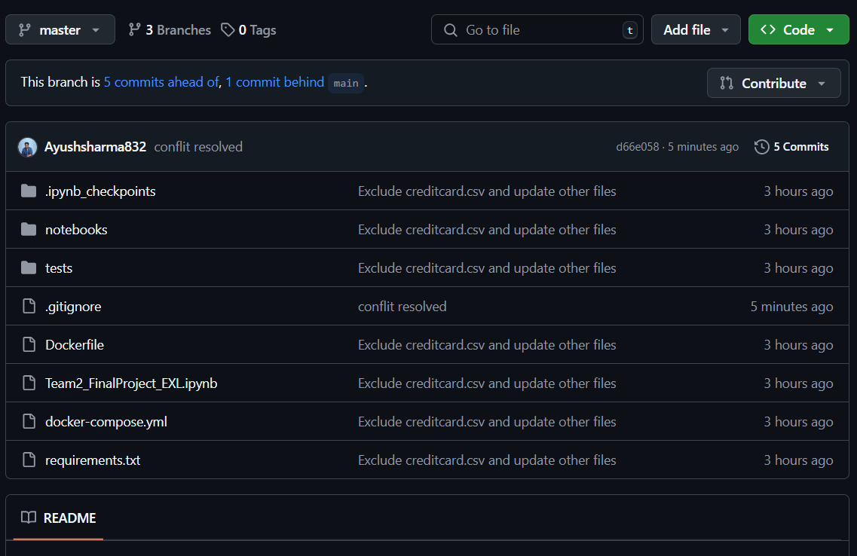
Images of Project
Git Hub :

Slide 9
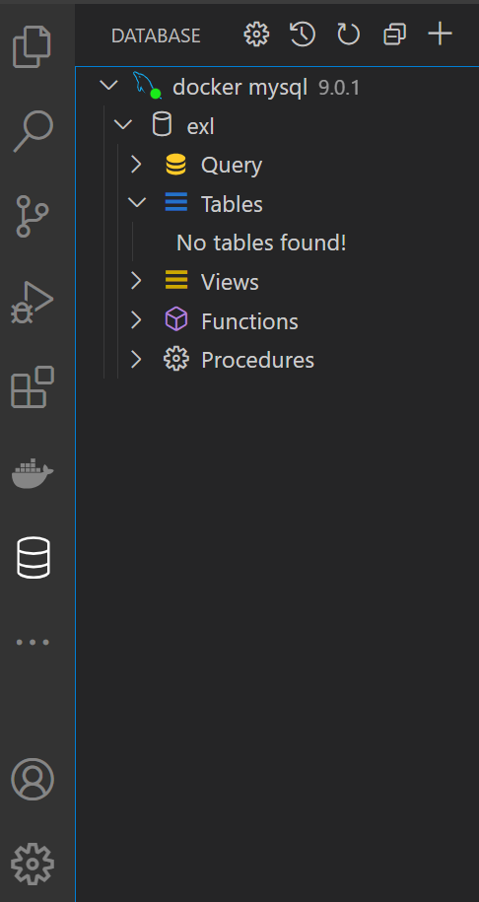
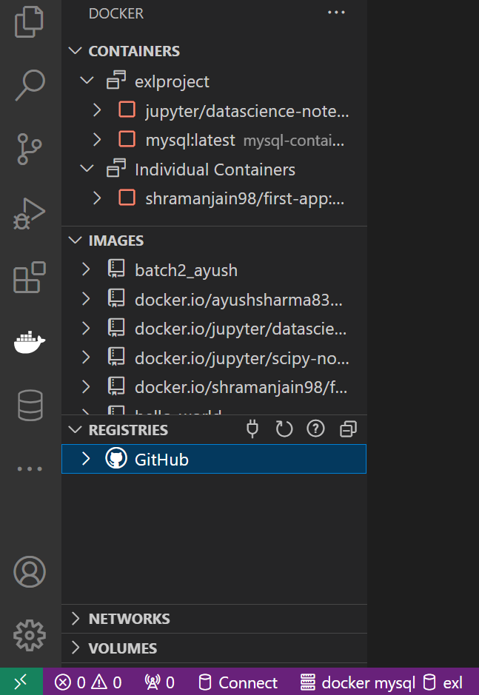
Images of Project
Docker in VS Code
Mysql Docker Container in VS Code :

Slide 10
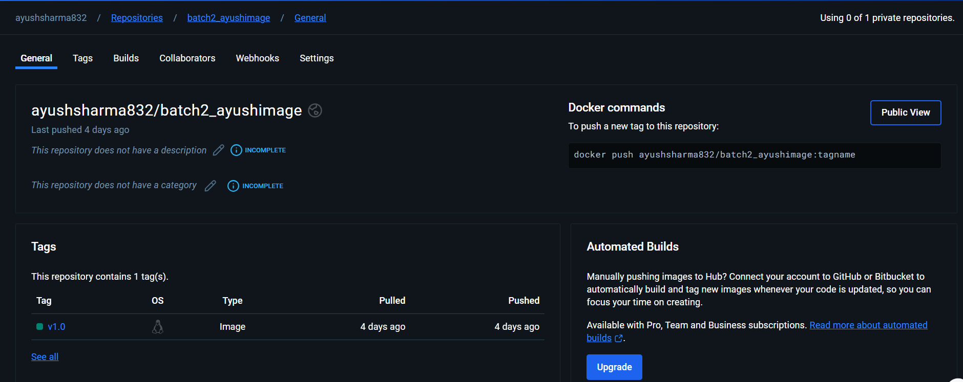
Images of Project
Docker Hub Image

Slide 11
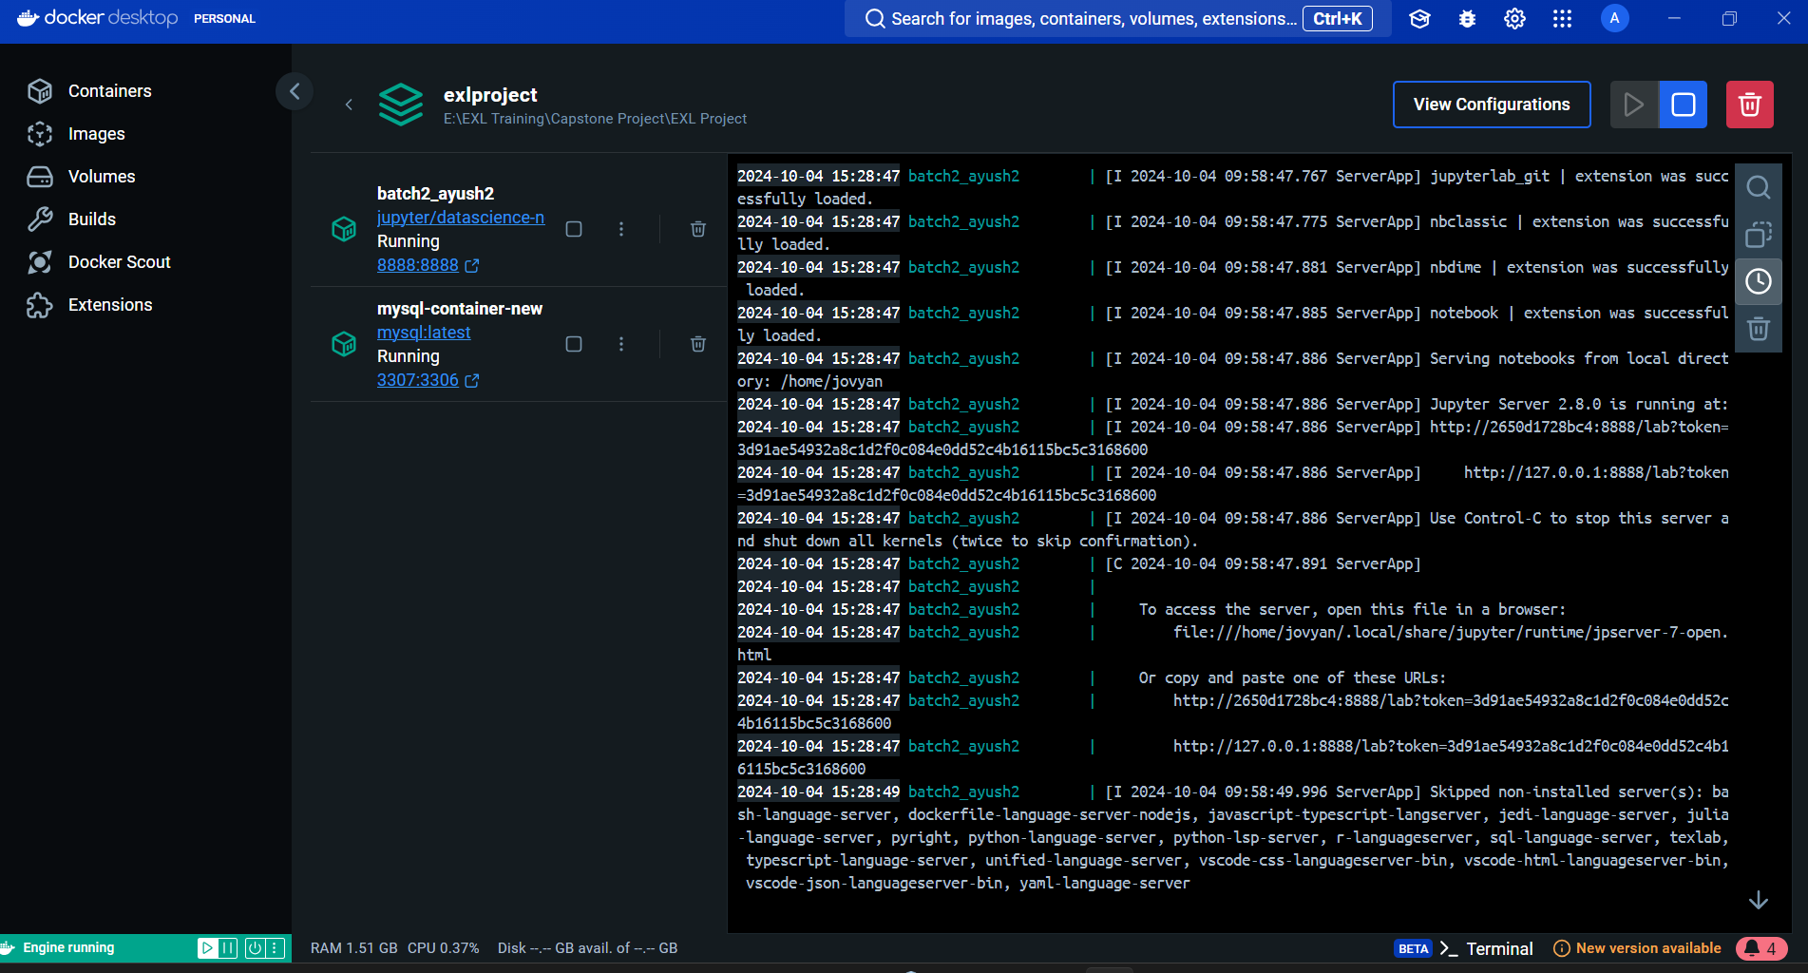
Images of Project
Docker Containers Running (mysql and jupyter) - in GUI

Slide 12
Images of Project
Docker Containers Running (mysql and jupyter) - in CMD

Slide 13
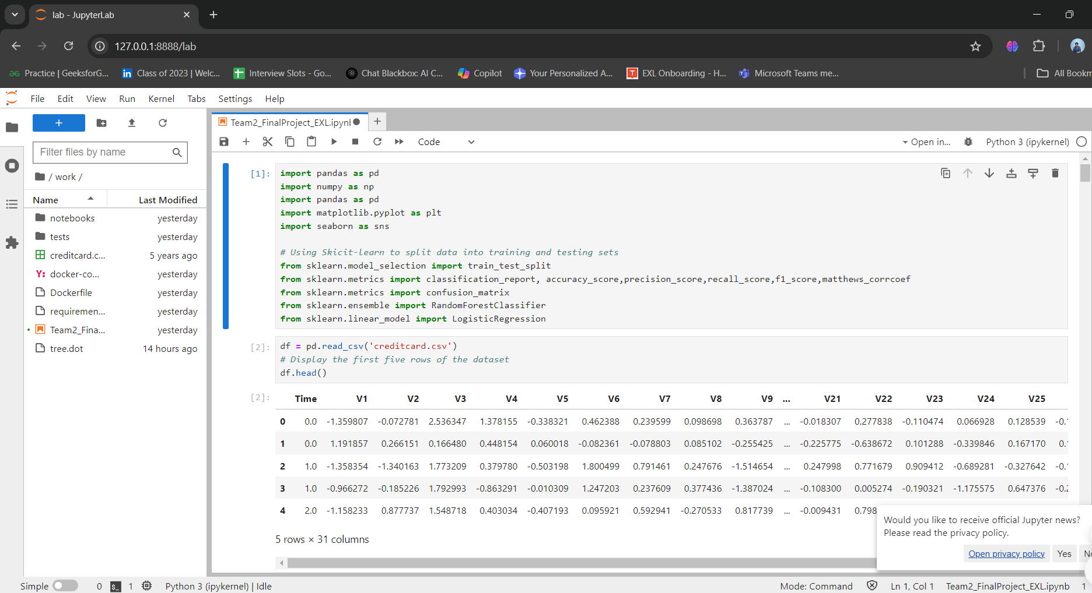
Images of Project
Docker Containers Run Through Localhost

Slide 14
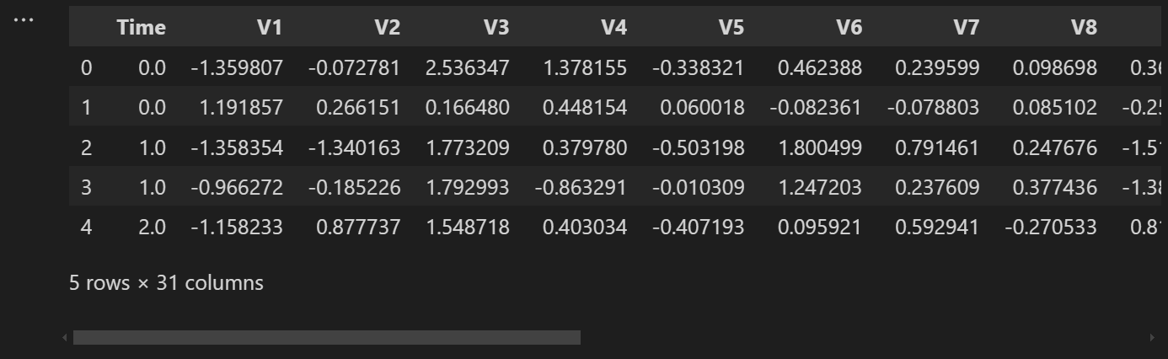
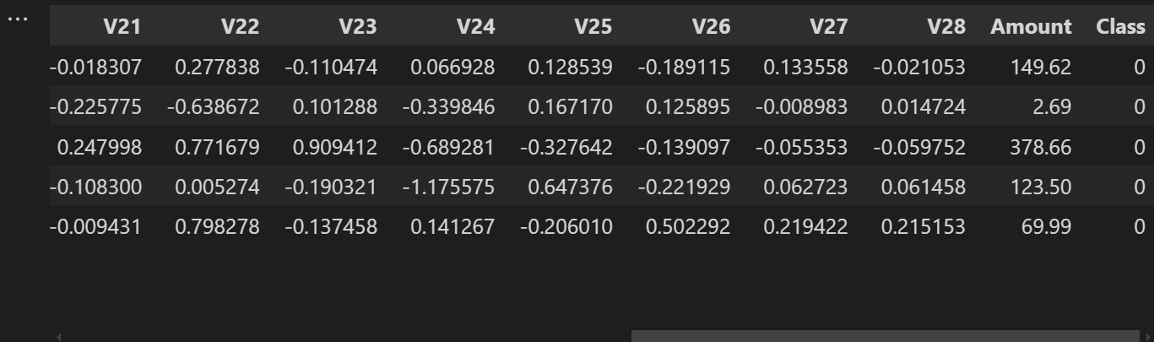
Images of Project
Dataset Head()

Slide 15
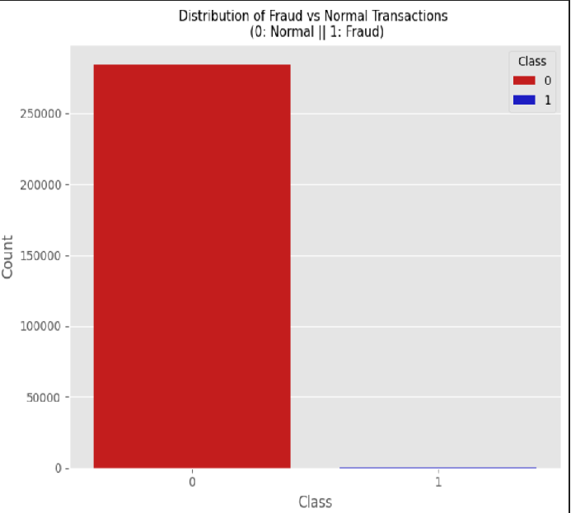
Images of Project
Imbalanced Dataset:
- Around 5 Hundred Fraud Transaction Dataset
- Around 3 Lakh Normal Transaction Dataset
- Highly Imbalanced Dataset

Slide 16
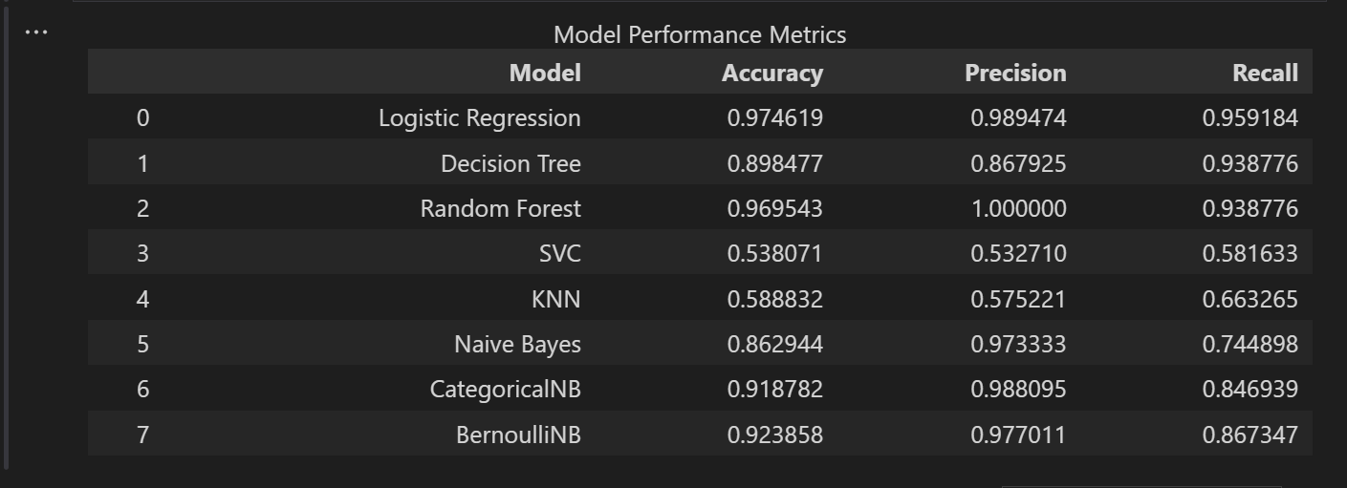
Images of Project
Accuracy, Precision, Recall Obtained Using the Models Using Undersampling Without Proper Preprocessing:

Slide 17
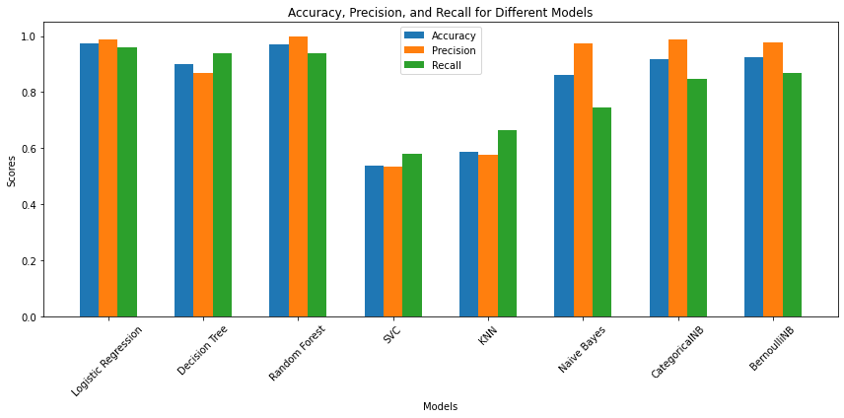
Images of Project
Accuracy, Precision, Recall Obtained Using the Models Using Undersampling Without Proper Preprocessing:

Slide 18
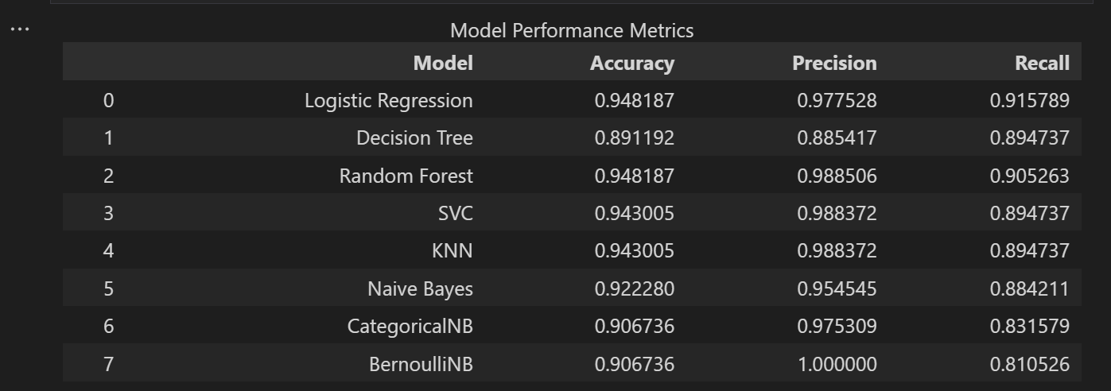
Images of Project
Accuracy, Precision, Recall Obtained Using the Models Using Undersampling With Proper Preprocessing:

Slide 19
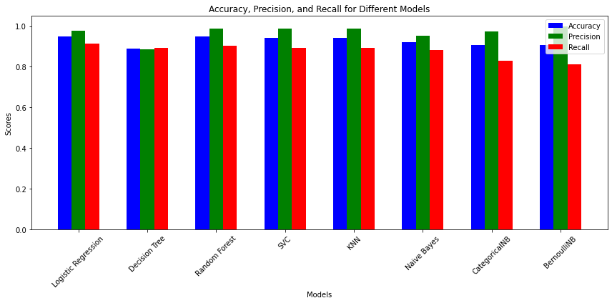
Images of Project
Accuracy, Precision, Recall Obtained Using the Models Using Undersampling With Proper Preprocessing:

Slide 20
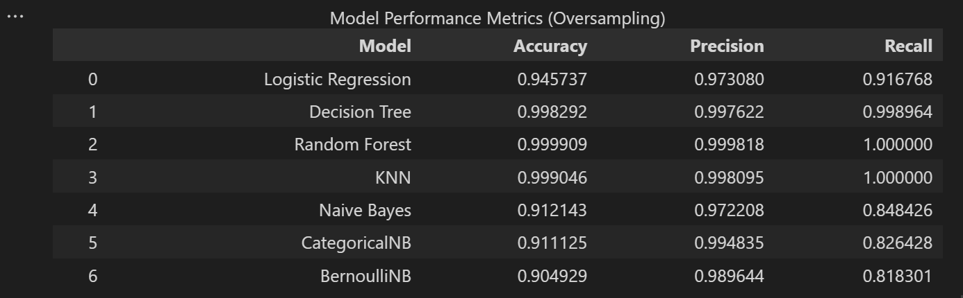
Images of Project
Accuracy, Precision, Recall Obtained Using the Models Using Oversampling:
Note : Removed SVC model as laptop was not able to execute around 6 lakh of dataset in svc or svc linear model.

Slide 21
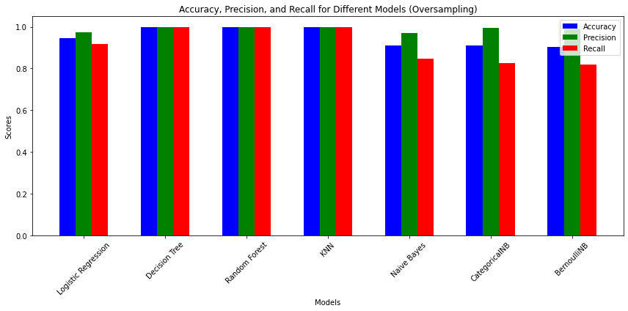
Images of Project
Accuracy, Precision, Recall Obtained Using the Models Using Oversampling:

Slide 22
- Choose Logistic Regression model as the final model due to its consistency of result in both oversampling and undersampling and as it was less prone to overfitting.
THANK YOU

