Slide 1
ESW Presentation
Topic-Waste Detection and Management
DATE – 1/10/24

Slide 2
OCT WEEK-1 EVALS
Team Name- Sheta Ke Kptaanz
Name of Members-
Ayush Sheta
2. Kavya Bhalodi
3. Shivam Gupta
4. Soham Sadavarte
Professor Name- Sachin Chaudhari

Slide 3
TIMELINE
3. Training YOLOV8 model
2. Creating Custom DataSet
1. Data Collection

Slide 4
Weekly Progress Report
Task-1: Waste & Data Collection- Collected different types of waste objects and took relevant photos in different angles to create the dataset for augmentation and training of our YOLOV8 model.
Task-2 : Creating Our Own Dataset- Uploading the collected photos and data to the roboflow to create our custom dataset with appropriate annotations and labelings.
Task-3 Training & Testing YOLOv8 Model-
Used Roboflow to train and test the YOLOv8 model with our custom dataset, optimizing parameters for accuracy and testing the model on a separate test dataset for validation.

Slide 5
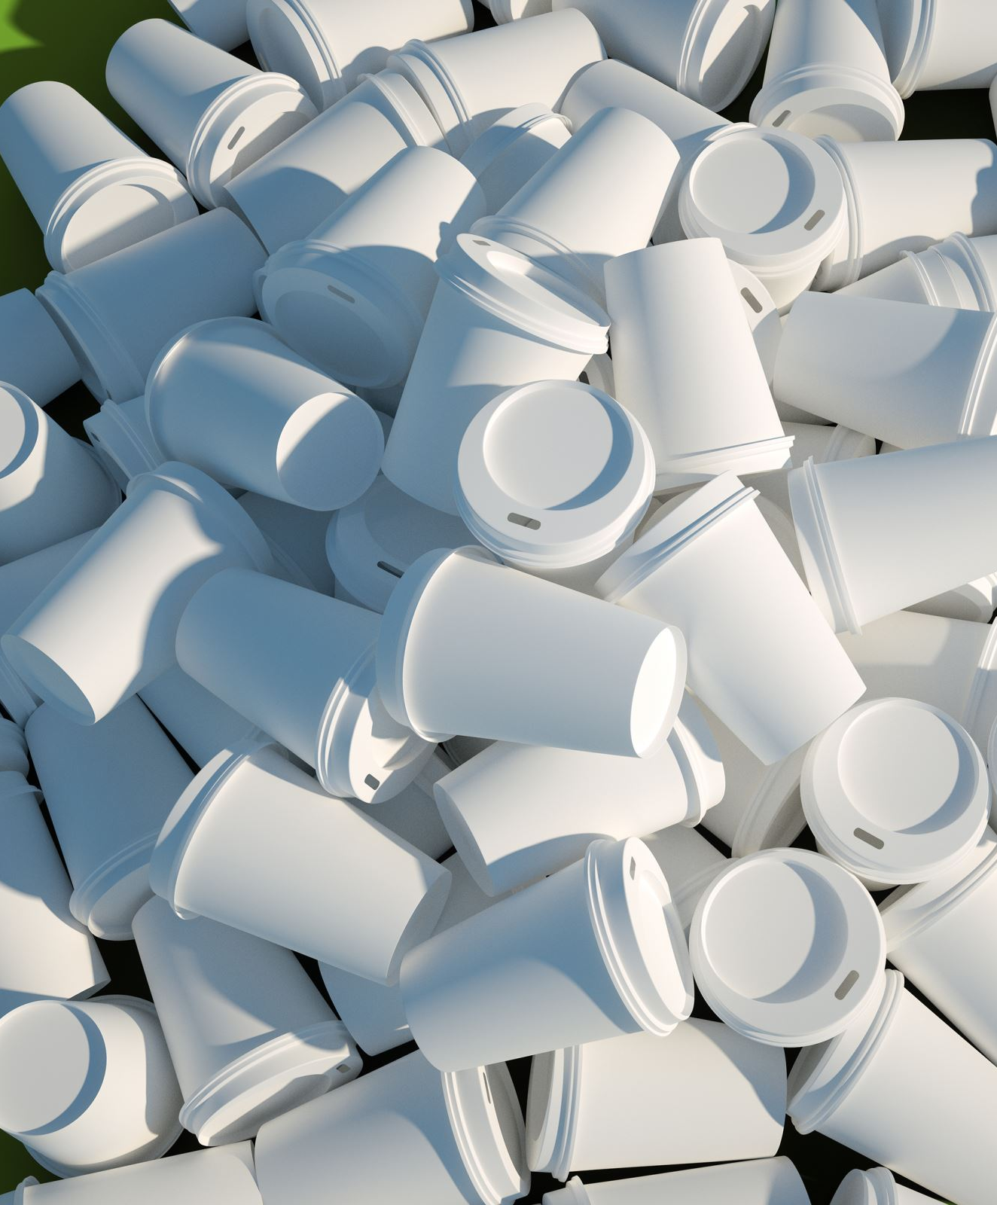
WASTE & DATA COLLECTION
Amount of data collected- Approximately 200-300 images of different types of waste objects were collected thus making the project versatile.
Different Types of Wastes Collected-
1. Plastic Bottles
2. Cardboard
3. Metal Cans
4. Snackbags
5. Paper Waste

Slide 6
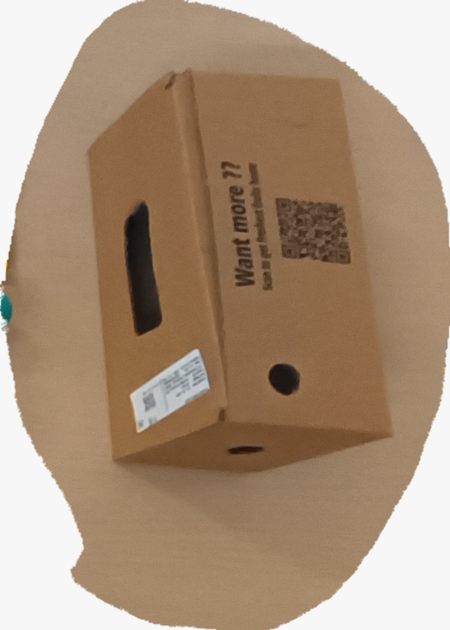
Sample of the waste we are detecting and segregating.
r

Slide 7
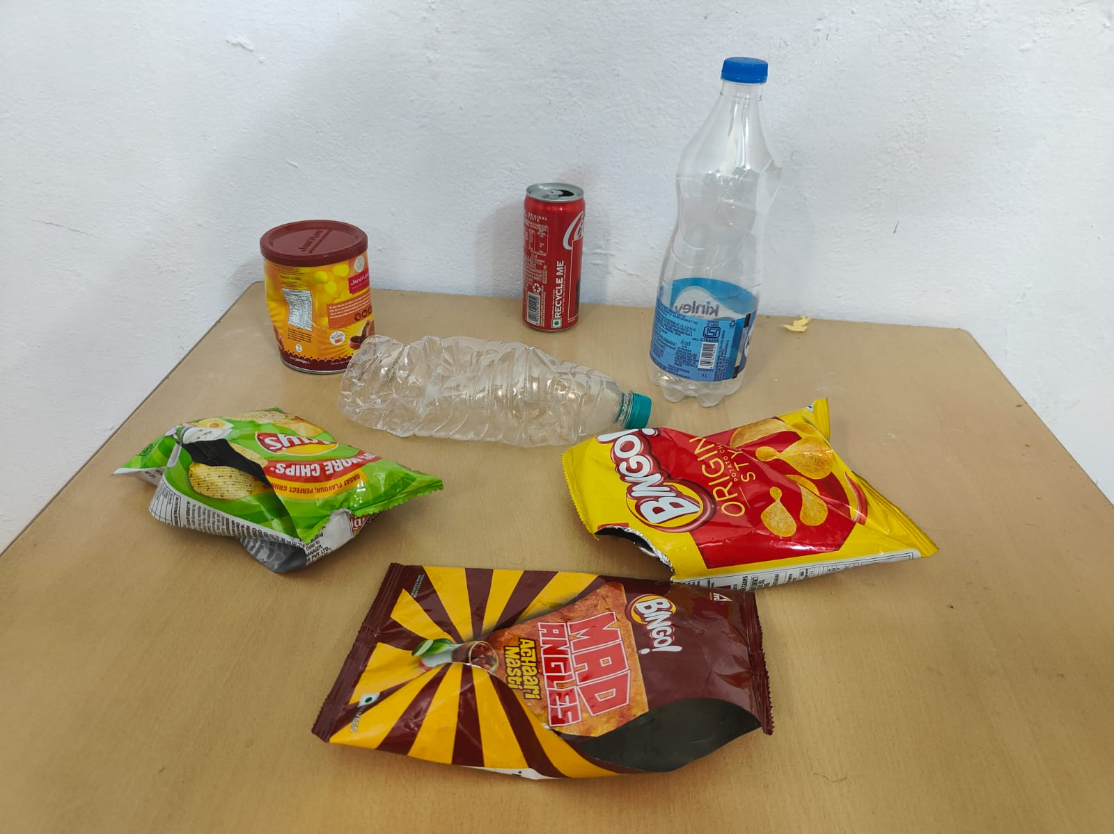
Different types of waste objects in a single frame.

Slide 8
Creating our own dataset
Setting up Roboflow
Researched different compatible and easy-to-operate datasets. Surfed websites like Kaggle, ImageNet, and Roboflow. Finally, decided to create the dataset on Roboflow.
Creating Custom Dataset
Watched relevant YouTube videos on how to set up or initialize the dataset and uploaded stored pictures.
Annotation and Labeling
Applied labels to waste objects, such as giving the label "Plastic Bottle" to various bottles including drinking water bottles, packaged bottles, and crushed or crumbled bottles.
Used layers to cover the waste objects in the image and mapped them to classes corresponding to specific waste types.

Slide 9
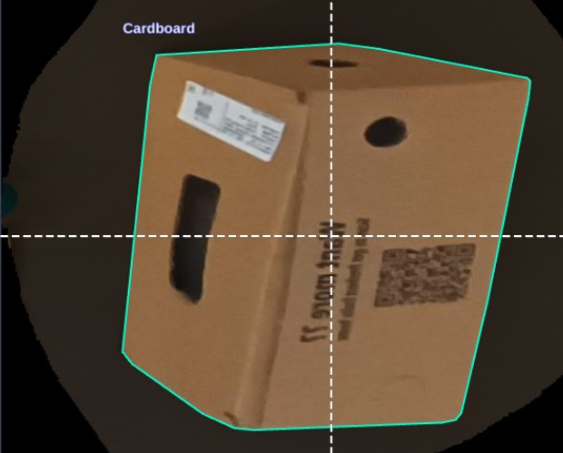
Sample ANNOTATION

Slide 10
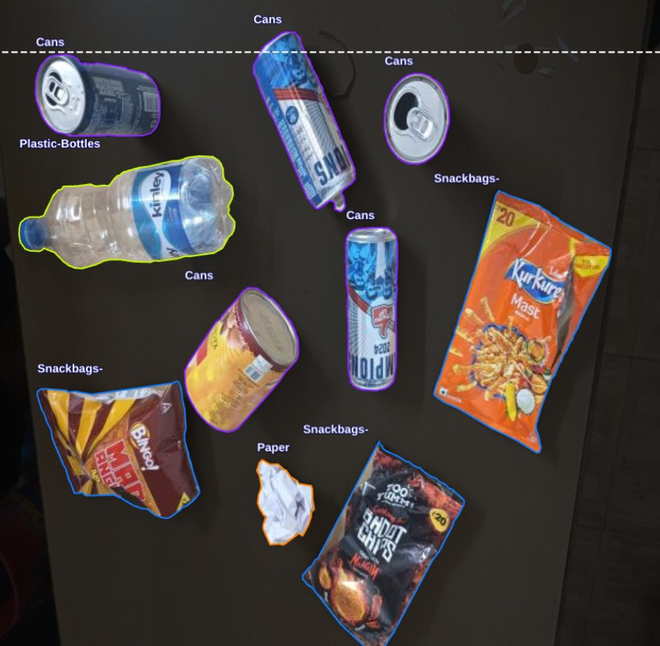
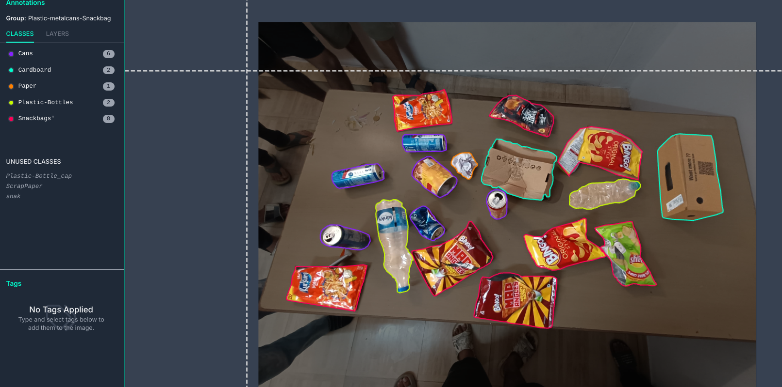
Different wastes annotated in a single frame.

Slide 11
Augmentation & Preprocessing
Preprocessing- Properly orienting the images using auto orient and then resizing stretching the image to 640*640. This is the preprocessing phase.
Augmentation- Performed transitions and transforms to the images already present in the dataset to increase the number of images in dataset. Basically, we have applied the h-v flip operation. This will help us making our model more accurate and precise.

Slide 12
Training & Validating the model
Training Phase- After creating our own custom dataset we have trained the waste detection and segregation model using YOLOV8. After successfully training the model we were able to generate the required files (the .pt files).
Validation- We used the .pt files generated (as mentioned above) to validate our model. We also used YOLOV8 to validate our model.

Slide 13
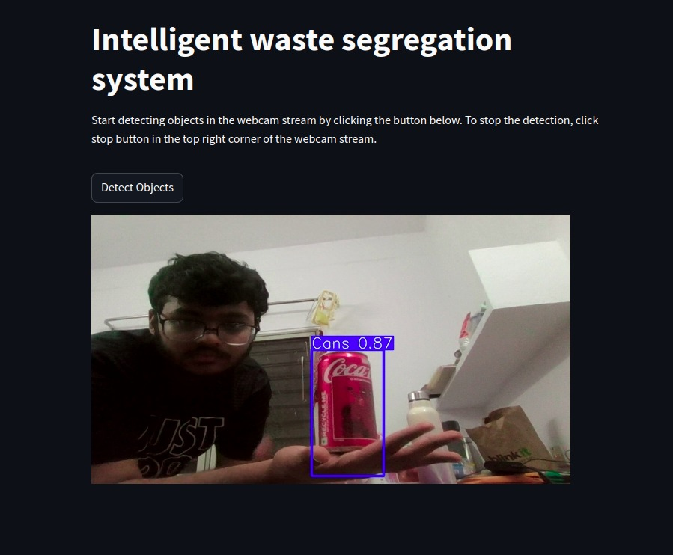
Some insights into the model testing phase

Slide 14
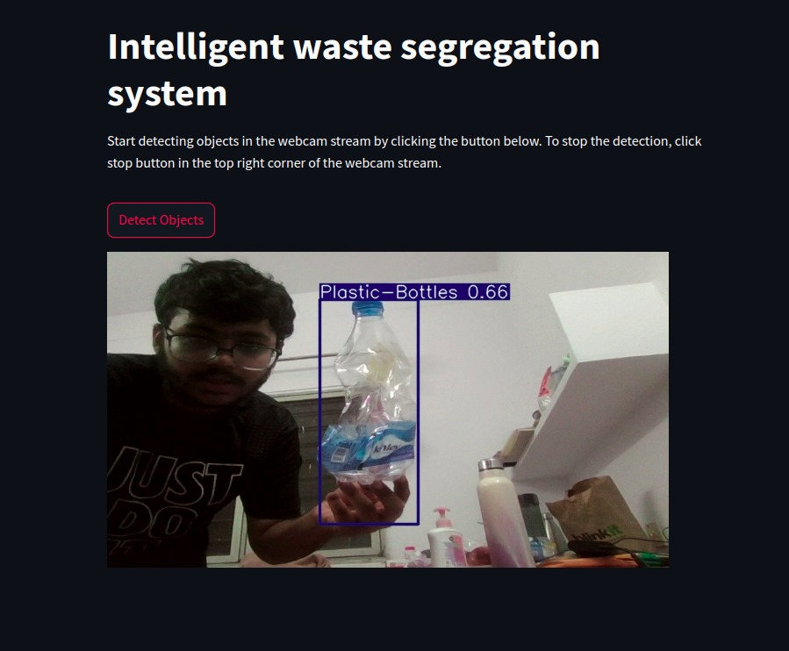
Stress Testing
Testing the accuracy of the model using crumbled plastic bottle. (since actual waste is thrown like that)

Slide 15
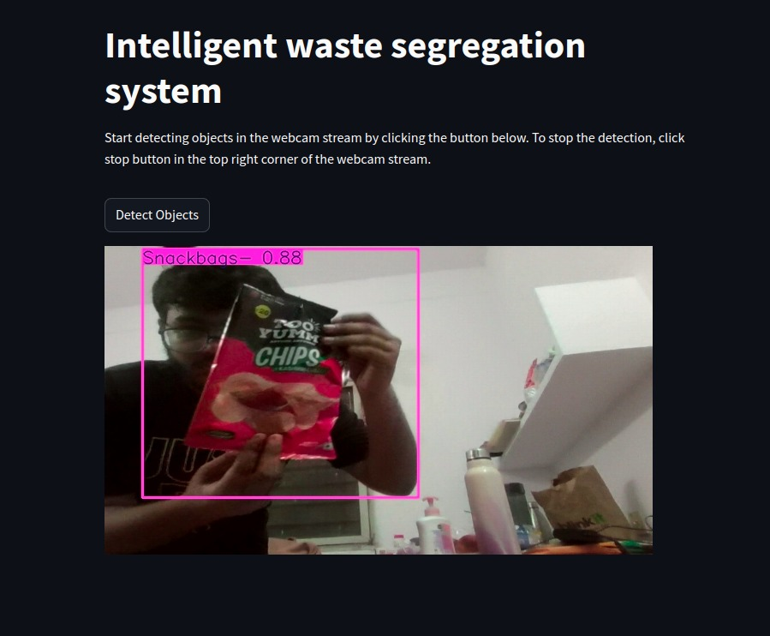
Checking the versatility of the model using snackbags

Slide 16
THANK YOU !!!

