Slide 1

WASTE MANAGEMENT
Weekly Report October 2nd Week Results and Analysis
October 7,2024 Authored By: Sheta Ke Kaptaanz
Presented to: Sachin Chaudhari

Slide 2
Team Name-Sheta Ke Kaptaanz
Contributors:
Ayush Sheta
Soham Sadavarte
Kavya Bhalodi
Shivam Gupta
Professor: Sachin Chaudhari
T.A - ANSH SHAH

Slide 3
Timeline
• Task-1: Expansion of dataset
• Task2: Uploading and running the model on QIDK kit

Slide 4
DATASET EXPANSION & MODIFICATION
Adding More Images to Dataset: We clicked more and more photos and also uploaded images from internet (ImageNet to be precise).
Annotating the added images: We annotated the added images making the model more accurate and reliable.
Augmentation: Performed transitions and transforms to the images already present in the dataset to increase the number of images in dataset. Basically, we have applied the h-v flip operation.

Slide 5
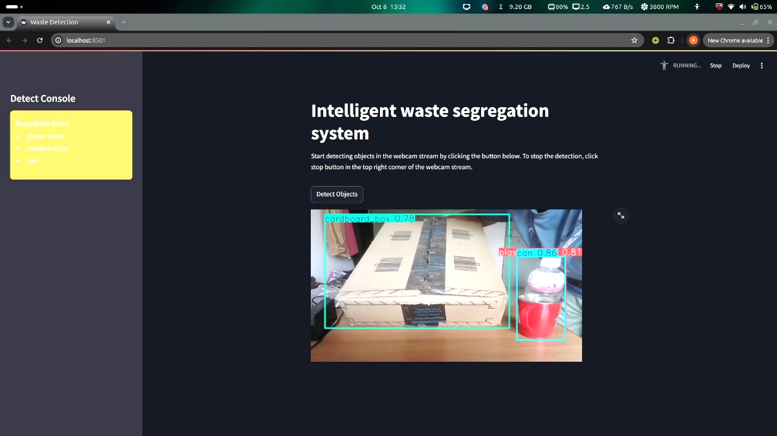
EXAMPLE OF MODEL TESTING

Slide 6
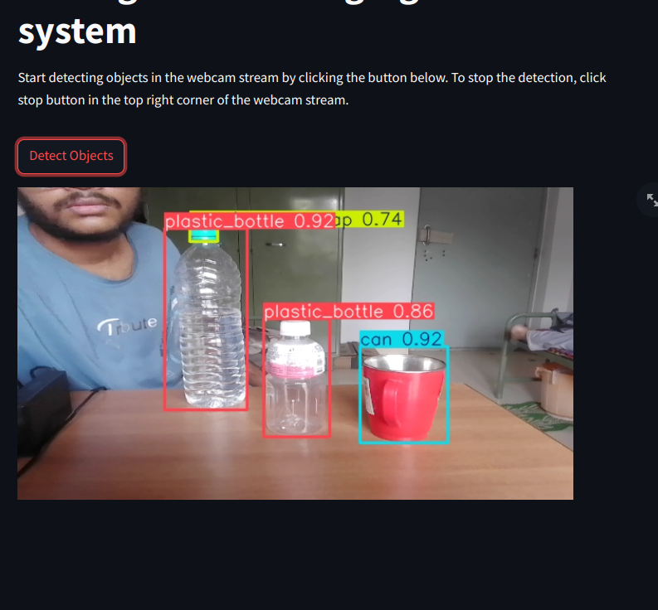
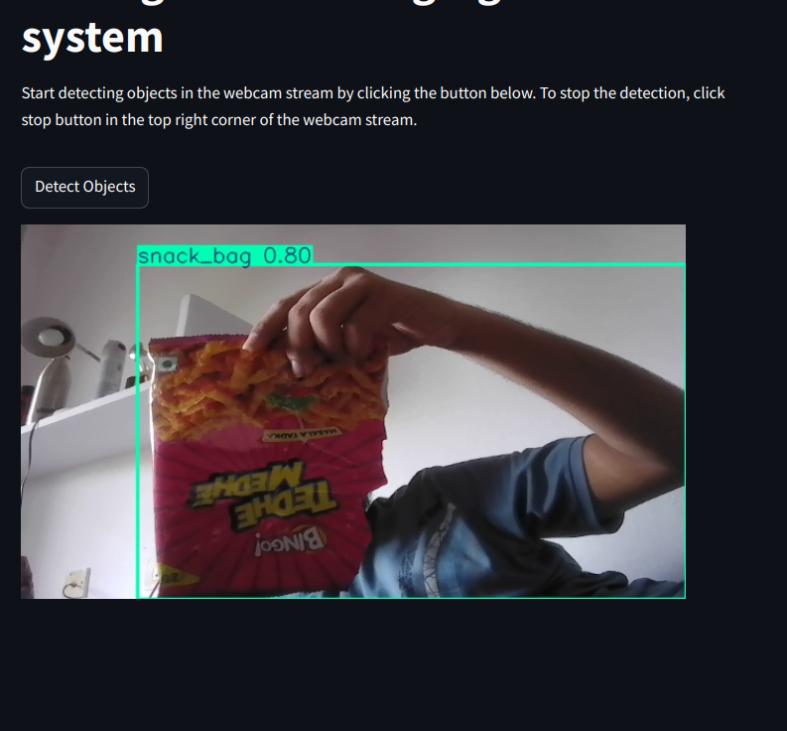
EXAMPLE OF MODEL TESTING

Slide 7
Adding Images to Dataset
Uploading Images: We clicked more photos and extensively surfed the internet and added an exhaustive collection of images (from Kaggle and ImageNet) making the total image count to 9342!!!
Annotating Images: We annotated nearly all the images over a span of 3-4 days thus making our model more accurate and precise than ever.

Slide 8
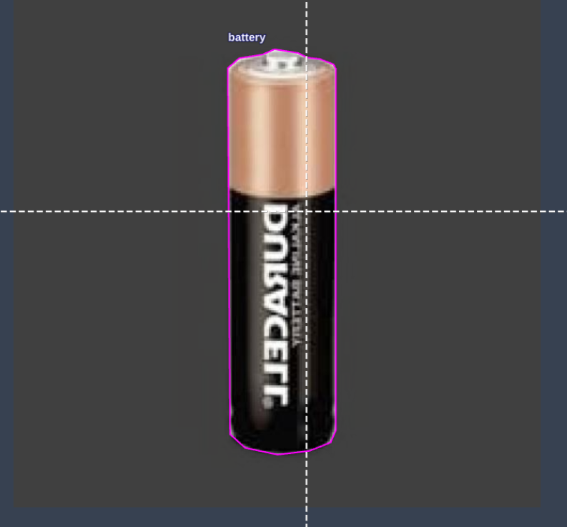
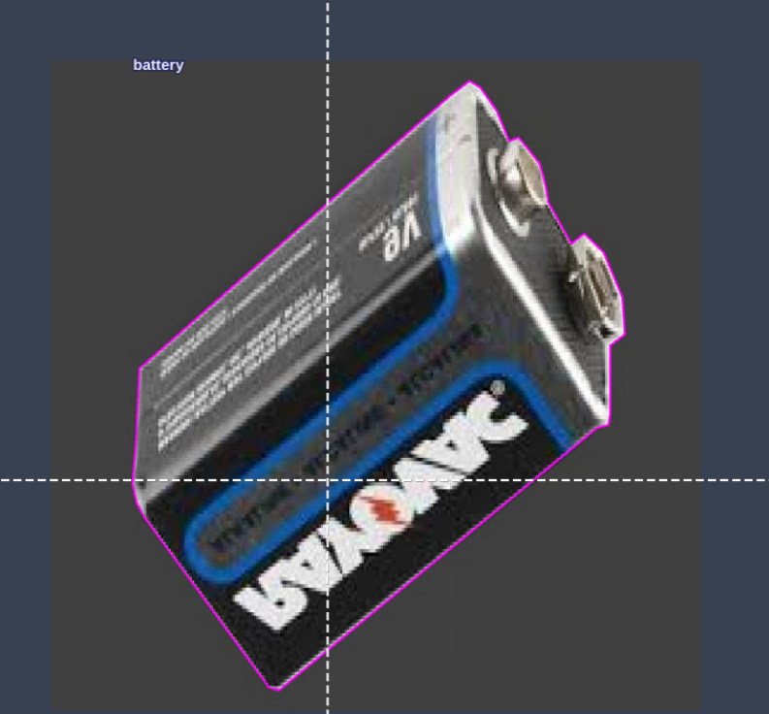
Testing the model
To effectively test the model we implemented the following steps:
1. Waste Collection: We collected different types of wastes and added their images in addition to images of waste articles we already had in our dataset. We even added images of electrical wastes like electrical cells, batteries etc to our dataset so that the model becomes more versatile in detecting waste.
2. Testing the model: We tested our model in various ways. First, we detected solitary waste objects by testing only one object at a time and then successfully examined the scenario where different wastes are present in a single frame.

Slide 9
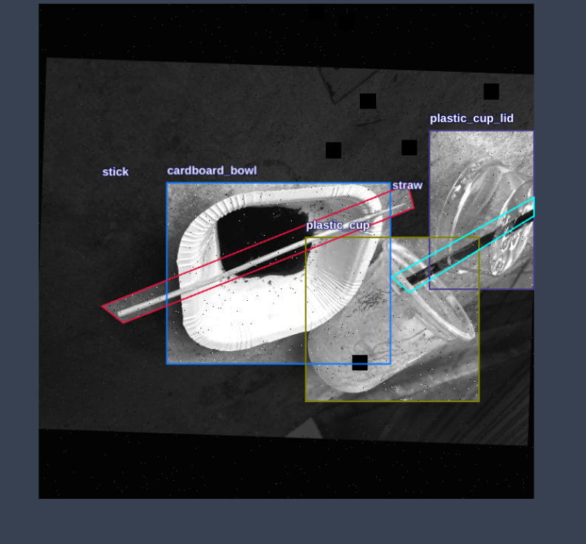
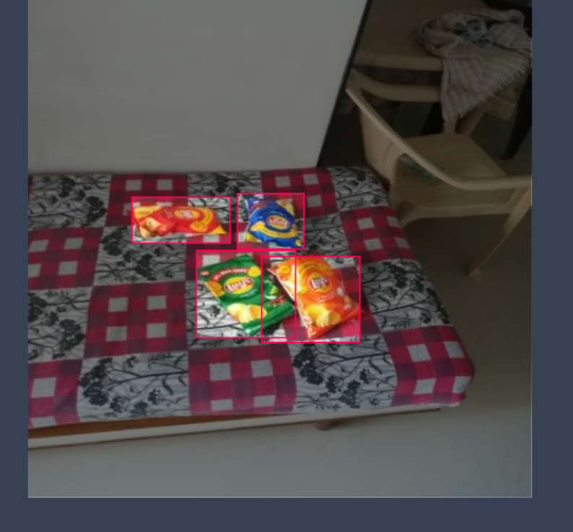
Major updates in model
Added more snackbags
Plates and spoons (disposables)
like in canteens
Batteries and cells
Straws

Slide 10
Model Deployment
Uploading Model to QIDK kit:
We followed the following procedure to upload our model to the QIDK kit (android model) -
1. Environment Setup
Before starting, we ensured that Android Studio was installed on our Linux machine. We downloaded Android Studio from the official website and installed the necessary components, including the SDK. The following configurations were necessary:
Selected Kotlin DSL for Gradle configuration.
Created a new Android project called esw within Android Studio.
Once Android Studio was properly set up, we proceeded to the next steps to integrate the .dlc model.

Slide 11
Image add kar bhala

Slide 12
Model Deployment (contd.)
2. Project Initialization-
After creating the project, we followed these steps:
Created the assets Directory:
In the app/src/main directory, we manually created an assets folder to store our .dlc model file. This directory will later be used to access the model file at runtime.
Uploaded the .dlc Model:
We dragged and dropped the model.dlc file into the assets directory.

Slide 13
Model Deployment (contd.)
3. SDK Integration:
To run the model on the device, we integrated Qualcomm's Neural Processing SDK by adding the following dependency to our build.gradle.kts file (as we are using Kotlin DSL):
Kotlin
dependencies { implementation("com.qualcomm.qti.neuralnetwork:neural-network:1.23.0")
}
We synced the project to ensure that all the dependencies were correctly implemented without errors.

Slide 14
Model Deployment (contd.)
4. Model Loading and Execution
To run the .dlc model, we followed these steps:
ModelRunner Class Creation: We created a new Kotlin class ModelRunner.kt in the com.example.esw package. This class manages model loading, execution, and resource management. The class was designed to load the model from the assets folder, run the model on input data, and then release resources upon completion.

Slide 15
Model Deployment
We also tried to deploy our model using Jupyter notebook when the former method failed (using Android Studio App) to give us the desired results.
For implementing this method we watched the Qualcomm tutorial on how to deploy the YOLO-NAS (closely related to YOLO-V8) model on QIDK kit.

Slide 16
Model Deployment (contd.)
We executed the following steps sequentially:
Model Conversion to ONNX: The PyTorch model was converted to ONNX format, which keeps the model structure intact across different frameworks.
ONNX to DLC Conversion: Using Qualcomm's SNPE tool, the ONNX model was converted to DLC format, optimized for Qualcomm hardware.
Model Quantization: The DLC model was quantized to make it faster and more efficient for use on edge devices, with minimal accuracy loss.

Slide 17
Model Deployment (contd.)
Input Data Preparation: Images were converted into .raw format to be compatible with the QIDK kit for testing.
Deployment on QIDK Kit: The model and input images were uploaded to the QIDK kit, but the model didn’t work as expected during testing.
Troubleshooting: The issue could be due to data compatibility or hardware-specific problems, and further testing is needed to find the solution.

Slide 18
Kuch photo daaldo app studio / progress ka

Slide 19
CONCLUSION
Despite issues with deployment, progress was made in expanding the dataset, adding new classes, and improving annotations. Further troubleshooting will help fix the inference issue on the QIDK kit.

Slide 20

THANK YOU

