Slide 1

Waste Detection and Segregation using Computer Vision and Algorithms :
This project explores the potential of computer vision and algorithms for efficient waste management.
Under guidance of : Dr. Sachin Chaudhari

Slide 2
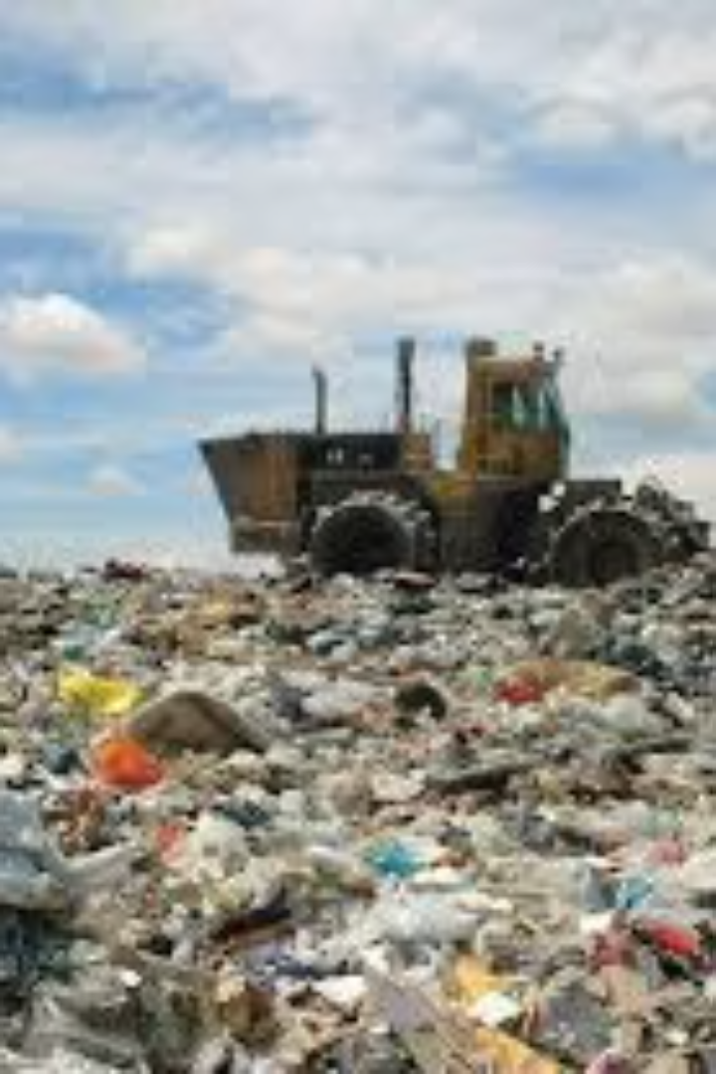
The grave problem of managing ever growing waste in India
Due to ever growing population the amount of waste generated is rising at and alarming exponential rate and hence managing this waste becomes a severe menace for the administrative authorities.
We strive to solve this problem using our own model which aims at detecting different wastes and then segregating them into classes for better waste disposal.

Slide 3
Problem statement
Waste Detection
Waste Segregation
We were bestowed with the problem of Detecting different waste items and then effectively Segregating them for better waste disposal and management.​
Our project focuses on using computer vision algorithms to detect different waste types and segregate them into three categories:​
Recyclable Waste​
Non-Recyclable Waste​
Hazardous Waste

Slide 4
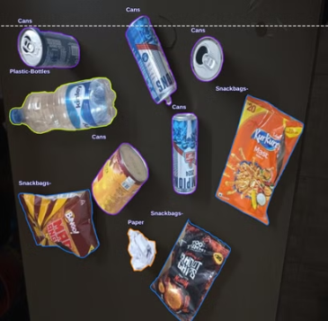
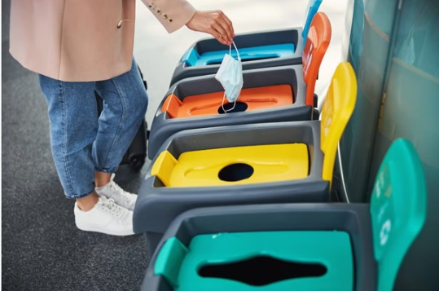
Solution Vision
Vision
The 3 Types of Waste
To develop a Smart Waste Segregator Model (SSM) that detects, classifies, and directs waste for proper disposal using a YOLOv8-based computer vision model.
Our model aims to categorize waste into these three types:
RECYCLABLE ['cardboard_box','can','plastic_bottle_cap','plastic_bottle']\
NON_RECYCLABLE = ['plastic_bag','scrap_paper','plastic_cup','snack_bag','plastic_box','straw','plastic_cup_lid','cardboard_bowl','plastic_spoon'
HAZARDOUS = ['battery','light_bulb']

Slide 5




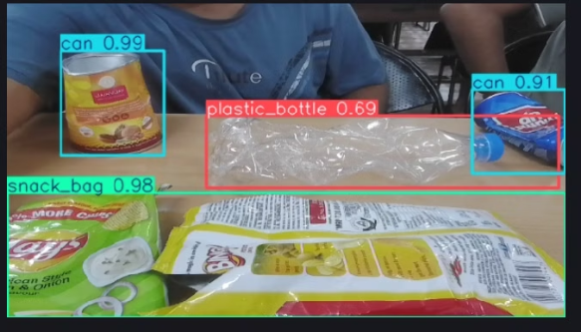
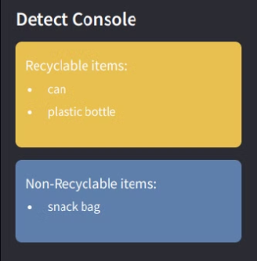
PROPOSED PIPELINE
Data Input
Image Classification
Waste Disposal
Segregated Waste
Real-time image capture of waste items.
Using YOLOv8 to classify waste into one of the three categories.
Directing waste to appropriate bins.
Outputs sorted into different categories for recycling, disposal, or special handling.

Slide 6
Timeline (how we have proceded):
Data Collection
1
Collecting Images of waste
2
Dataset Creation
Annotating the images collected followed by augmentation and preprocessing and then ultimately creating our own custom dataset to uphold these images.
Model Training
3
Training of Model on our custom dataset using YOLOv8.
4
Dataset Expansion
Expansion of dataset to enhance the accuracy and reliability of the model to a larger extent.
Stress Testing
5
crumbled cans and water bottles
and did analysis of our model
Model Robustness Testing
6
QIDK Kit Integration
Testing the robustness of our trained model considering and analysing different scenarios.
Tried uploading and running the model on QIDK kit using Android Studio app.
Hardware Implementation
7
Implementing the hardware architecture to run our trained YOLOv8 model.

Slide 7
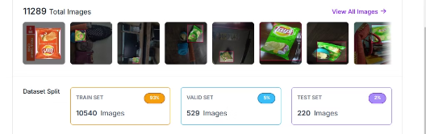
1. Dataset Creation and model training
Data Collection
1
We collected around 1213 various images all over IIITH campus and 3000 more images from an available dataset, making a total of 4566 images in our dataset.
2
Annotation
We annotated those 4566 images on the Roboflow app. Over 15 Waste Classes:
Preprocessing and Augmentation
3
15 waste classes further into 3 types:
We properly oriented and resized the images, then applied a 40% horizontal-vertical flip to augment the 11289 images in our dataset. This will help make our model more accurate.
Recylable , Non Recylable , Hazardous
4
Training And Testing
We trained our model on our custom dataset using YOLOv8.
Now that we have a solid dataset and an initial model trained, we are moving forward with statistical analysis to evaluate its accuracy and identify areas for improvement. This is an ongoing process, and we are committed to refining the model until it can reliably detect and segregate waste with high precision.

Slide 8
5. Statistical Analysis of our model (initial phase) :
Amount of data
Types of wastes included
Augmentation Percentage
4500 images
a) Paper Wastes b) Cans c) Cardboard wastes d) Snackbags
40 percent
Au applied
Class-wise analysis
Model Accuracy Analysis
Horizontal-Vertical flip operations used on 20% images Model Precision Percentage
a) Paper-100% b) Cans-90% c) Snackbags- 51% d) Cardboard Wastes - 100%
Accuracy Percentage- 95%
Precision Percentage-71.3%

Slide 9
Challenges Faced
Technical Challenges
Hardware Challenges
Other Challenges
1.) Over-Augmentation leading to inaccuracy in our model. ​
1.) Realizing physical interpretation of this model using an apt and perfect hardware is a big challenge. ​
1.) Despite our utmost efforts to design the model in an accurate and reliable manner some inefficacies might have crept in. ​
2.) Ensuring the compatibility of our model on a plethora of technical devices including QIDK Android setup. ​
3.) The reliability of the model is dependent upon the light conditions and the model thereby requires further processing for smooth functioning under variable light conditions. ​

Slide 10
QIDK kit : An Overview
The QIDK kit is optimized for AI workloads, offering efficient inference for models like YOLOv8 with minimal latency.
Built-in support for camera modules and other peripherals made it easy to set up and deploy the system for real-time waste detection.
The kit is designed for low-power applications, making it ideal for waste management systems that need to operate continuously.
Problems faced while working with this kit:
While suitable for smaller models, the QIDK kit struggles with larger, more complex models that demand more computation power.
Customizing the software environment for model deployment required detailed knowledge of the kit's architecture and debugging through trial and error.

Slide 11
Conclusion
1
Our model has real-life implications
2
The model can have industry-level applications
that can certainly help solve the proposed problem statement.
to effectively manage generated wastes.
However, to implement the model on a large scale with towering efficiency envisaging environmental sustainability, work still needs to be done and there’s a long way to go.

Slide 12
Contributors (TEAM NAME - SHETA KE KPTAANZ)
Ayush Sheta
Soham Sadavarte
Kavya Bhalodi
Shivam Gupta
Teaching Assistant: Ansh Shah

Slide 13
Thank You

