Slide 1
Tracking F&B Consumption
Team Blitzkrieg

Slide 2
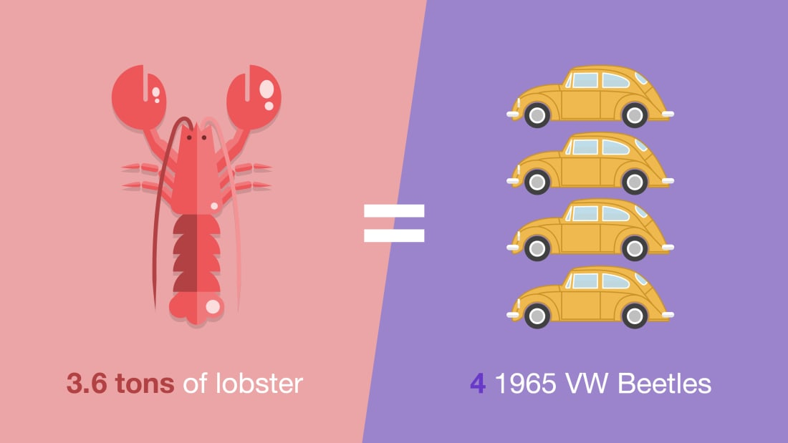
Problem statement
On an average, chefs cook huge array of food. - 58 million bread rolls - 15 million croissants - 13 million eggs - 4,300 tons of chicken - 3.6 tons of lobster.
Shelf life from cooking to eating - 72 hours
According to the International Air Transport Association, airlines produced 5.2 million tons of waste last year and will produce over 10 million tons annually by 2030.

Slide 3
Value Proposition
“SnakeEye” is an AI-based system integration platform that uses Object detection & Deep learning techniques to detect & classify F&B into three types
Untouched
Leftovers
Consumed
Our algorithm will then count the number of times each category has appeared and correspondingly update it in the database.
Video recordings from cabin security / conveyer
R-CNN Algorithm
Count of Leftover, Consumed & Untouched F&B
Input
Output

Slide 4
Current Scenario:
Presently, there is lot of manual intervention involved in terms of counting the wasted meals.
Then the numbers are entered manually in a spreadsheet.
Wastage(%) is then computed based on the capacity of the flight.
Proposed solution:
Having a system in place that automatically counts & classifies meals
Store the count in the database along with other details of the flight from the API ( Capacity, Number of people, Gender, Age, Diet & so on )
Dashboarding everything in a single place for management to track.

Slide 5
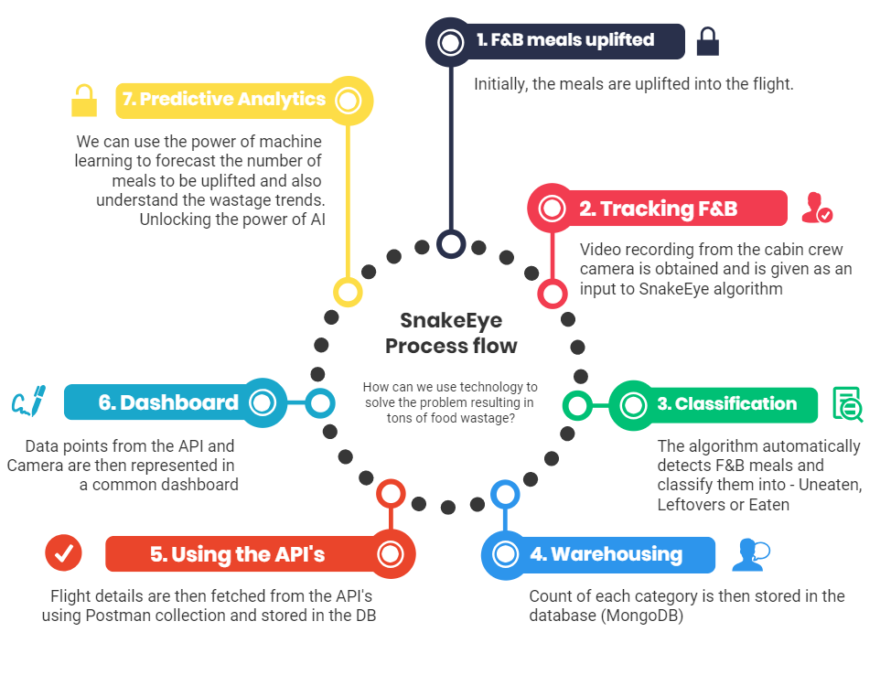

Slide 6
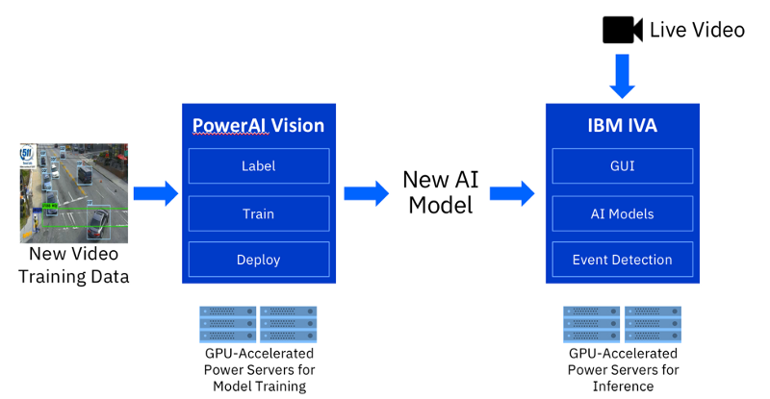
Core Architecture

Slide 7
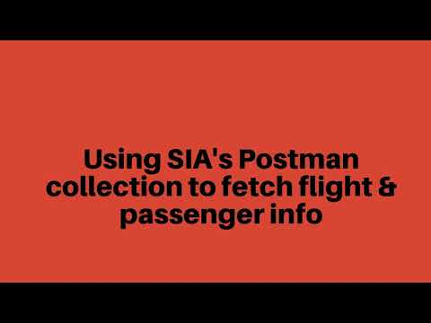
Demo
(Click on the play icon)
Link - https://youtu.be/R-N4GLBP7N8

Slide 8
Other Applications - Tracking Inventory
SnakeEye’s algorithm can also be used to track Inventory thus addressing to second problem statement.
This will happen in four stages -
Algorithm runs on camera recordings from washing area
Counts and categories kitchen items such as spoons, plates etc
This is stored in backend along with other flight info fetched from API’s
Reflected in a real-time dashboard for management

Slide 9
Core Technology:
1. Deep learning:
R-CNN implemented using Python & Tensorflow
2. API’s Provided by SIA:
/flightschedule, /flight/passenger, /equipment/loadplan - Using Postman collection to fetch data into the database.
3. Dashboarding:
Node.js, D3.js and MongoDB
4. Predictive Modeling:
Python, Scikit-Learn, Numpy & Pandas

Slide 10
Cost to implement:
Cabin waste costs the industry $500mn per year, according to IATA, a figure that it says is rising faster than waste volumes thanks to growing disposal costs.
SnakeEye’s one-time implementation cost includes
Hardware & Infrastructure costs
Server (for Deep learning)
Systems integration & maintenance
Aside from reducing F&B wastage, the platform will also greatly enhance customer service.
Collated data helps in understanding customer behaviour, thereby providing a personalized service.

Slide 11
How can we use Machine learning?
Predicting count of F&B meals to be uplifted for a particular flight based on historic trends
Studying consumer behaviour and dietary preferences
Discover the trend leading to wastage wrt gender, age, demographics

Slide 12
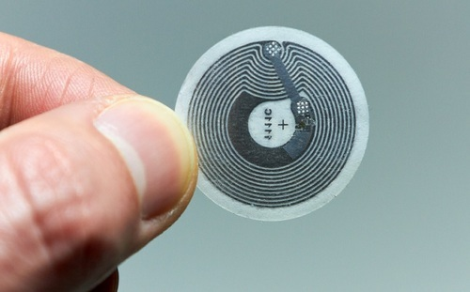
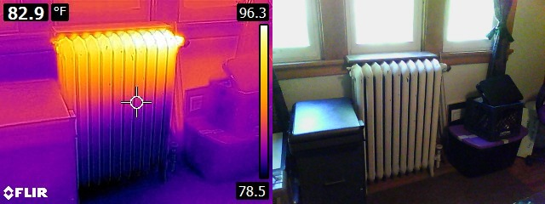
Is there any other way to track F&B consumption?
Technology | Description
 | Using NFC tags on the cover of F&B package. Gives us a direct count to opened meals
 | Using IR/ Heatmap camera to count meals showing higher temperature indicating that its has been consumed

Slide 13
Roadmap
Jan 2019
Sep 2019
April 2019
December 2019
Start with cabin crew monitoring in 100 flights
Machine learning & Predictive modeling
2019 |  |  |  | 2020
Dashboarding & Analytics
Scaling to 500 flights

Slide 14

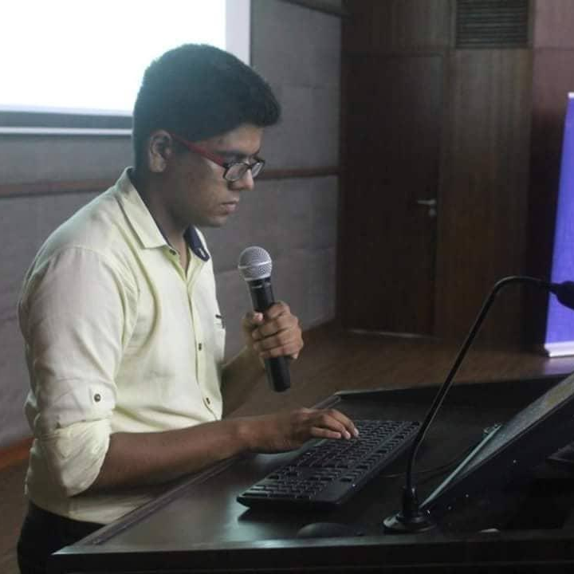
Team Blitzkrieg
Naman Doshi
Ayush Verma
Data Scientist. Data Science Weekly; Blibli.com; Prefers “Jupyter” over earth.
Backend Dev. Postman API Tools; Nokia Siemens; Turns coffee into code.

Slide 15
Sources -
Research paper - Fast R-CNN for Object detection & Pattern recognition
Code repository - Github
Video demo - YouTube
Presentation - Google Slides
Dashboard - Demo

Slide 16
Thank you

