Slide 1
Lead Scoring Case Study using Logistic Regression
Learner Name :
Ayushya Nagar

Slide 2
Content
PROBLEM STATEMENT
BUSINESS OBJECTIVE
OVER APPROACH
EDA
CORELATION
MODEL EVALUATION
OBSERVATION
CONCLUSION

Slide 3
Problem Statement
X Education sells online courses to the working professionals. X Education is getting a lot of leads, But their lead conversion rate is very poor. For example, they acquire 100 leads in a day, only about 30 of them are converted.
To make it more efficient, the company wishes to identify the most potential leads, also known as ‘Hot Leads’.
If they successfully identify this set of leads, the lead conversion rate coould go up as the sales team will now be focusing more on communicating with the potential leads rather than making calls to everyone.

Slide 4
Business Objectives
X education wants us to build a model and assign a lead score between 0-100 which can used a potential leads, higher the score means hot lead
The CEO wants to target lead conversion rate of 80%
They want the model to be able to handle future constraints as well.

Slide 5
Overall Approach
Importing the data and inspecting the data frame
Data preparation
EDA
Dummy Creation
Test-Train split
Featuring scaling
Model building
Model Evaluation
Making Prediction on Test Set
Conclusion

Slide 6
EDA
Univariate Analysis , Bivariate Analysis

Slide 7
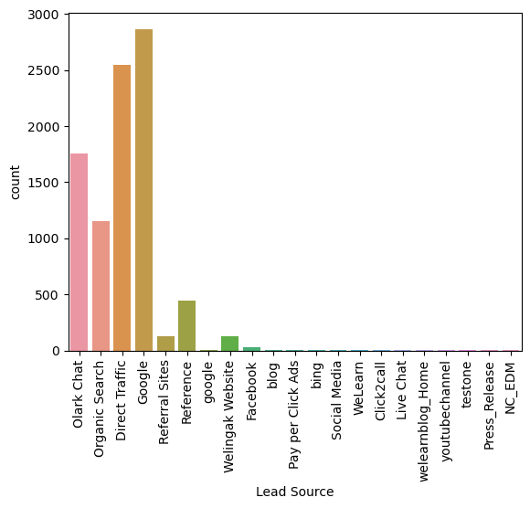
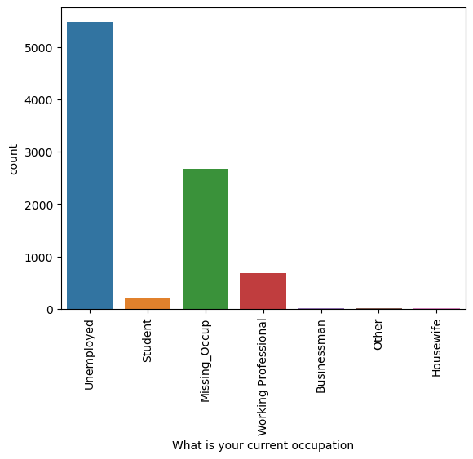
Univariate Analysis
LEAD SOURCE :
Google is the main source of getting the leads
WHAT IS YOUR CURRENT OCCUPATION
Majority of the leads are unemployed

Slide 8
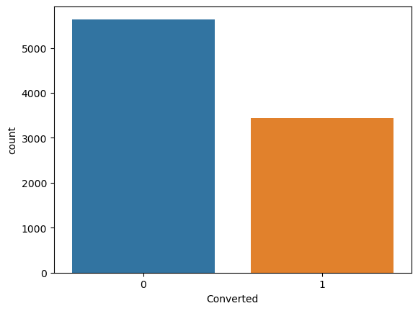
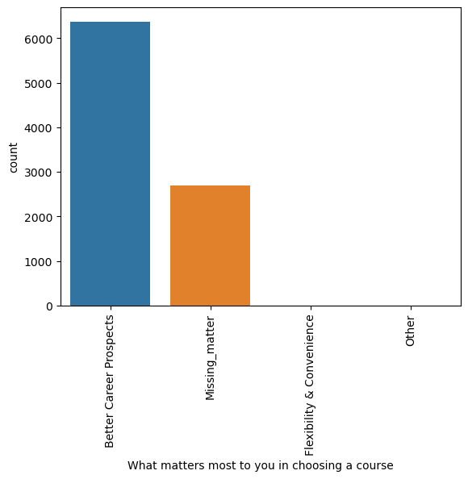
Univariate Analysis
WHAT MATTERS MOST TO YOU IN CHOOSING A COURSE :
Most of the enquiries are looking for the better career prospects out of the course
CONVERTED
More than 50% is the rate of conversion of the leads into orders

Slide 9
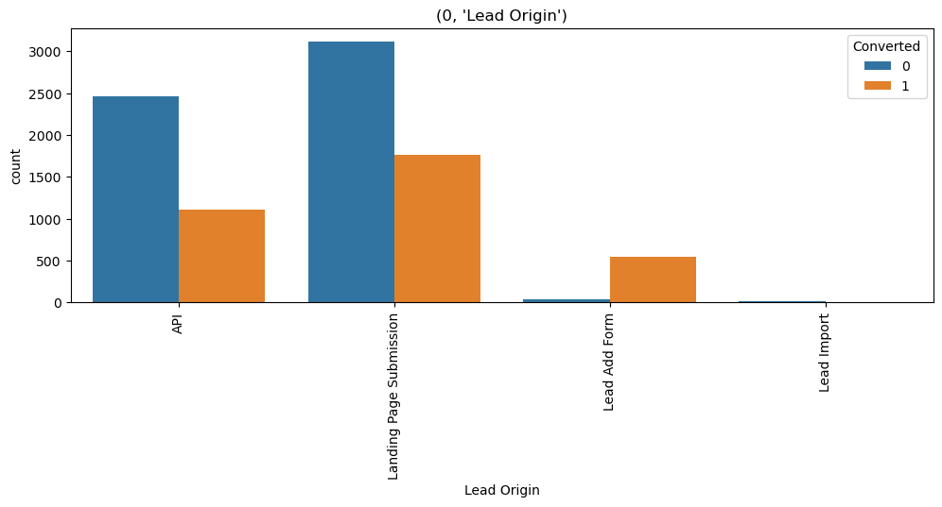
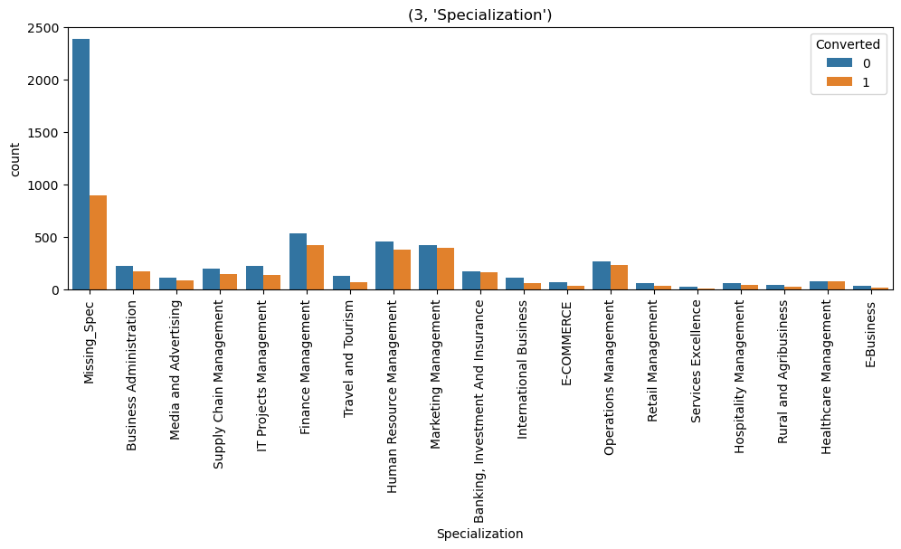
Bivariate Analysis
LEAD ORIGIN
Maximum numbers of leads are converted from landing page submission
SPECIALIZATION :
Maximum numbers of lead conversion are into a finance management specialization

Slide 10
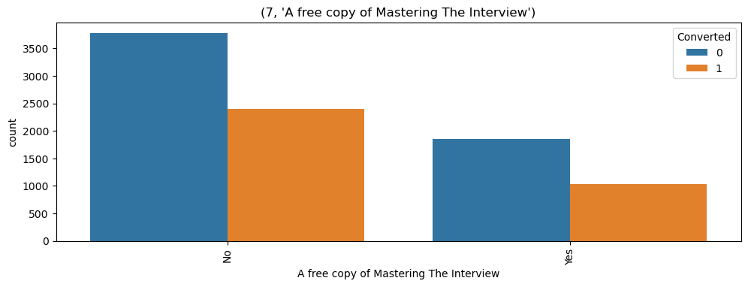
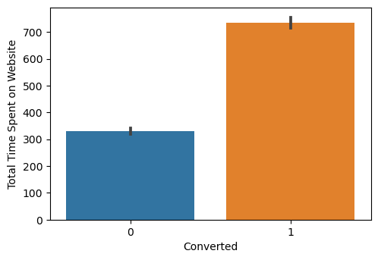
Bivariate Analysis
A FREE COPY OF MASTERING INTERVIEW
Conversion rate is high on leads who do not want a free copy of Mastering Interviews
TOTAL TIME SPENT ON WEB SITE
Conversion rate is high for the leads who spent maximum time on web site

Slide 11
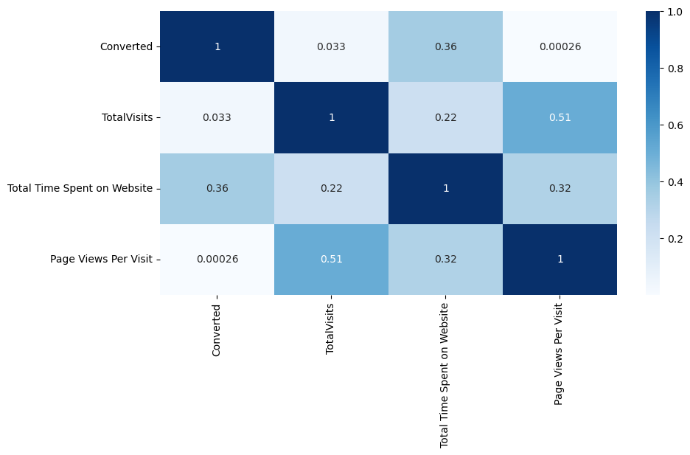
Correlation
There is no High Correlation in any of the numeric variables so all these numeric variables play vital role.

Slide 12
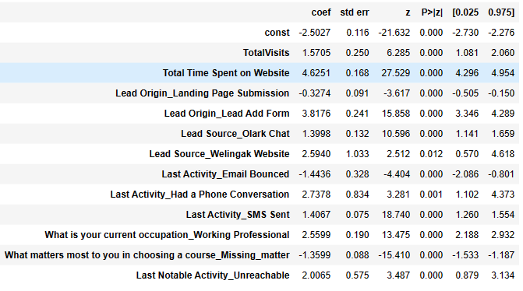
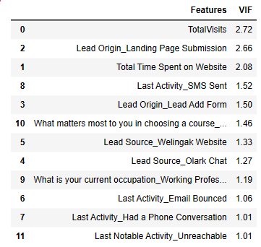
Model Building
Splitting in to train and test set
Feature Scaling
Build the first model
Use RFE to eliminate less relevant
variables
Built the next model
Eliminate variables bases on
high p-values and VIF values
Predict using train set
On the basis of confusion matrix
evaluate accuracy and other metric
Predict using test set
On the basis of confusion matrix
evaluate accuracy and other metric
FINAL MODEL

Slide 13
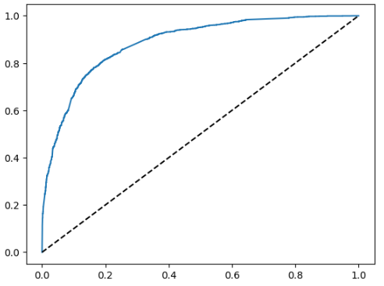
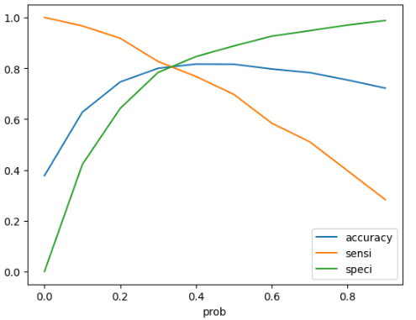
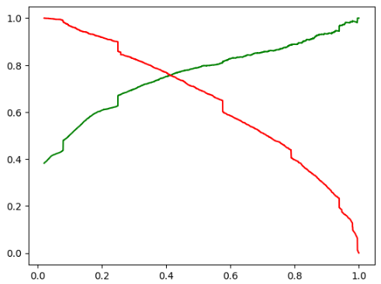
ROC Curve With Optimal Cutoff
The area under the curve of the ROC is 0.88 which is quite good.
Optimal Cut off Probability is 0.35 for Sensitivity and Specificity.
Optimal Cutoff Probability is 0.4 for Precision and Recall.

Slide 14
Model Evaluation – Sensitivity , Specificity , Precision and Recall on Train Set and Test Set
AS per the Confusion matrix of Train set
Accuracy:-81.01
Sensitivity:-79.9
Specificity:- 81.6
As Per the Confusion Matrix of Test Set
Accuracy:-81.64
Precision:-75.12
Recall:-76.77
3155
708
3268
595
407
1817
544
1797

Slide 15
Model Evaluation –Precision and Recall on Train Set and Test Set
AS per the Confusion matrix of Test set
Accuracy:-79.95
Sensitivity:-77.12
Specificity:- 81.68
As Per the Confusion Matrix of Test Set
Accuracy:-80.55
Precision:-74.43
Recall:-74.35
1391
258
1347
302
231
799
259
751

Slide 16
Conclusion
While we have checked both Sensitivity-Specificity as well as Precision and Recall Metrics, we have considered the optimal cut off based on Sensitivity and Specificity for calculating the final prediction.
Accuracy, Sensitivity and Specificity values of test set are around 80%, 78% and 82% which are approximately closer to the respective values calculated using trained set.
Also the lead score calculated in the trained set of data shows the conversion rate on the final predicted model is around 80%
Hence overall this model seems to be good.

Slide 17
Recommendations
The Top 3 variable to contribute most towards the probability of lead getting covered on the basis of coefficient Total Time Spent on Website,Lead Origin_Lead Add Form and Last Activity_Had a Phone Conversation
Finance management , Marketing management and Human resource are having a high conversion rates . We can target these customers as a hot leads.
Google is the main lead source, we can focus more on this to make all contents available to get hot leads
Leads having last activity as ‘SMS Sent’ can be focused as they are having high conversion rate
From lead origin, its observed that the rate of conversion is more from landing page submission
We can focus on the leads having occupation as “unemployed” as the conversion rate is high
Target the leads tagged with “ will revert after reading the email” as they have high count and conversion rate
Focus more on the leads who do not want a free copy of mastering interviews as the conversion rate of such leads are high

