Slide 1
PRESENTED BY
AI-POWERED LEGALTECH PROJECT
Ayush Yadav
CONTRACT
Roll No. 2329304
B.Tech CSE · Section 4-C
AI
SUBMITTED TO
Ms. Mandeep Kaur
AI-POWERED CONTRACT RISK ANALYZER
INSTITUTION
PCTE Institute of Engineering
and Technology, Ludhiana
Intelligent Contract Analysis Using AI, RAG & Automated Risk Detection
DOCUMENT AI
RISK SCORING
SMART REDLINE
B.Tech CSE · Academic Year 2026–2027
FastAPI · Python · React/TypeScript · ChromaDB · LangChain · OpenAI · SQLite · ReportLab

Slide 2
02
THE PROBLEM
Why contract review needs automation
TRADITIONAL APPROACH
VOLUME & LENGTH
Contracts span dozens of pages with dense legal language
📄 LONG CONTRACT
Dozens of pages, dense clauses
↓
MISSED CLAUSES
👁 MANUAL REVIEW
Critical risk clauses can easily be overlooked manually
Lawyer reads every clause carefully
↓
TIME COST
⏱ TIME & COST
Manual legal review is slow and often expensive
Hours of billable legal work required
↓
⚠ MISSED RISKS
ACCESSIBILITY
Key risky clauses can be overlooked
Non-legal users struggle to interpret complex legal terms
ContractAI · PCTE Institute of Engineering and Technology, Ludhiana · Ayush Yadav 2329304

Slide 3
03
THE CONTRACTAI SOLUTION
A browser-based AI contract risk analysis platform
ANALYSIS PIPELINE
📤
Document Ingestion
Accepts PDF & DOCX contracts — PyMuPDF + python-docx
UPLOAD
▼
Clause Extraction
TEXT EXTRACTION
🔍
Identifies 15+ legal clause categories with regex NLP
▼
CLAUSE DETECT
▼
🤖
AI + RAG Analysis
RAG / SCORING
GPT-4o-mini + ChromaDB + Rule Engine (40/40/20 weights)
▼
REDLINE
📊
Risk Score & Redline
▼
0–100 composite score with AI-suggested safer clauses
PDF REPORT
ContractAI · PCTE Institute of Engineering and Technology, Ludhiana · Ayush Yadav 2329304

Slide 4
04
SYSTEM WORKFLOW
End-to-end flow: from document upload to risk dashboard
1
USER
6
ChromaDB / RAG INDEXING
↓
↓
2
PDF / DOCX UPLOAD
7
AI + RULE ENGINE
→
↓
↓
3
TEXT EXTRACTION
8
RISK SCORING (0–100)
↓
↓
4
CLAUSE EXTRACTION
9
REDLINE GENERATION
↓
↓
5
METADATA EXTRACTION
10
DASHBOARD + PDF REPORT
ContractAI · PCTE Institute of Engineering and Technology, Ludhiana · Ayush Yadav 2329304

Slide 5
05
TECHNOLOGY STACK
Technologies verified in the actual implementation
BACKEND
DOCUMENT PROCESSING
AI / LLM
• Python 3.x
• PyMuPDF (fitz)
• OpenAI GPT-4o-mini
• FastAPI
• python-docx
• LangChain
• Uvicorn
• PDF & DOCX Parsing
• NLP Rule Matching
• SQLAlchemy ORM
RAG / VECTOR SEARCH
FRONTEND
DATABASE & REPORTS
• ChromaDB (Persistent)
• React 19 + TypeScript
• SQLite via SQLAlchemy
• Vector Embeddings
• Vite + TailwindCSS
• ReportLab PDF Generation
• Semantic Search
• Recharts
• lucide-react
ContractAI · PCTE Institute of Engineering and Technology, Ludhiana · Ayush Yadav 2329304

Slide 6
06
AI-POWERED CONTRACT ANALYSIS
The RAG + Rule Engine pipeline that drives risk detection
NLP Processing
RAG PIPELINE
Tokenizes & segments raw contract text
CLAUSE TEXT
Embeddings
▼
Converts clause text into high-dimensional vectors
EMBEDDING GENERATION
ChromaDB
▼
CHROMADB VECTOR STORE
Persistent vector store — semantic clause retrieval
▼
RAG Context Layer
SIMILAR CLAUSE RETRIEVAL
Retrieves top-3 similar legal-risk knowledge chunks
▼
LLM (GPT-4o-mini)
LLM + CONTEXT PROMPT
Explains risk & generates redline suggestion
▼
Rule Engine (40%)
RISK EXPLANATION
Deterministic regex patterns for known risk terms
Composite Score = Rule Engine × 0.40 + LLM Score × 0.40 + RAG Score × 0.20
ContractAI · PCTE Institute of Engineering and Technology, Ludhiana · Ayush Yadav 2329304

Slide 7
07
RISK ANALYSIS
Composite scoring formula + AI-generated redline alternatives
COMPOSITE RISK SCORE FORMULA
EXAMPLE REDLINE (from redline_service.py)
Overall Score =
(Rule Engine × 0.40)
+ (LLM Score × 0.40)
+ (RAG Score × 0.20)
ORIGINAL CLAUSE
"Each party shall indemnify and hold harmless the other against any and all losses, claims, damages, liabilities and expenses…"
RISK TIERS
LOW
0–30
MEDIUM
31–65
HIGH
66–100
RISK IDENTIFIED
Unlimited mutual indemnity — potentially high financial exposure with no liability cap.
AI-SUGGESTED REDLINE
15+ clause categories: Indemnity · Liability · Termination · Non-Compete · IP · Data Protection · Force Majeure …
"Each party (Indemnifying Party) shall defend and indemnify the other against direct third-party losses arising directly from gross negligence or material breach, subject to the Limitation of Liability cap set forth herein."
ContractAI · PCTE Institute of Engineering and Technology, Ludhiana · Ayush Yadav 2329304

Slide 8
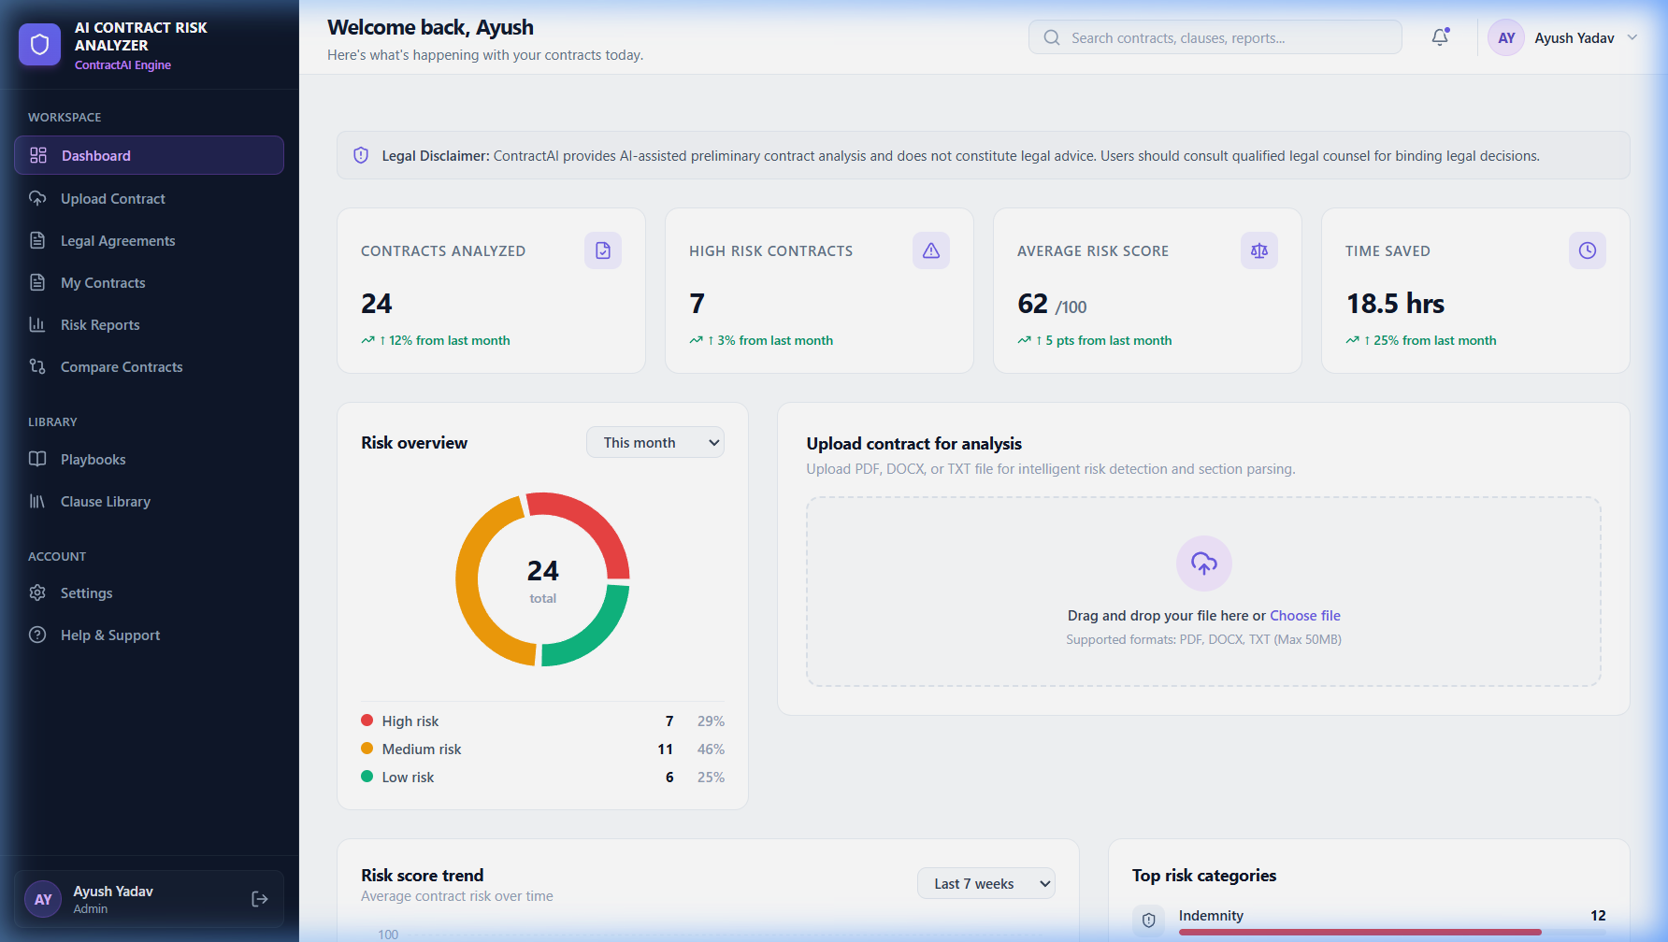
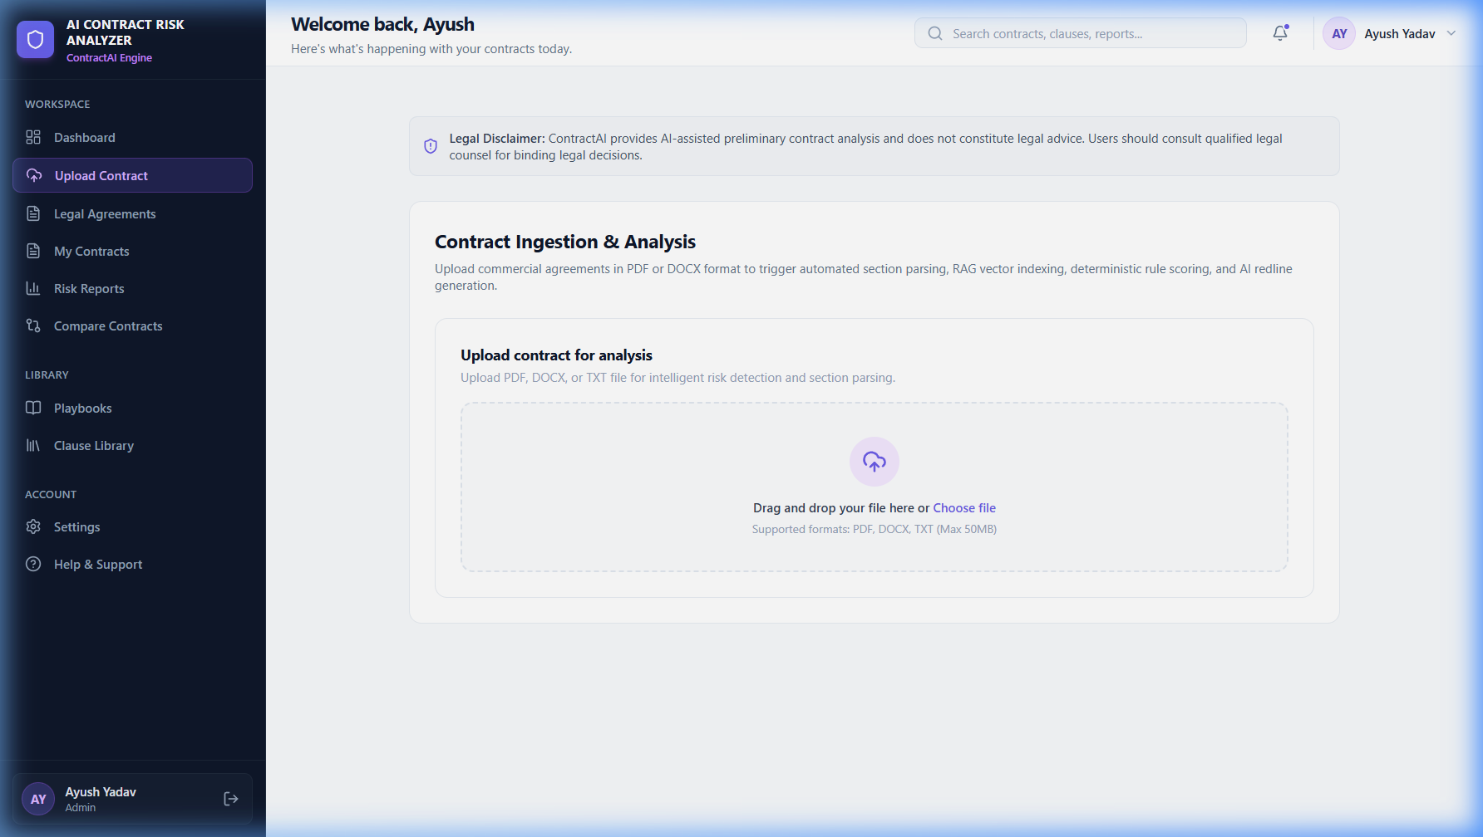
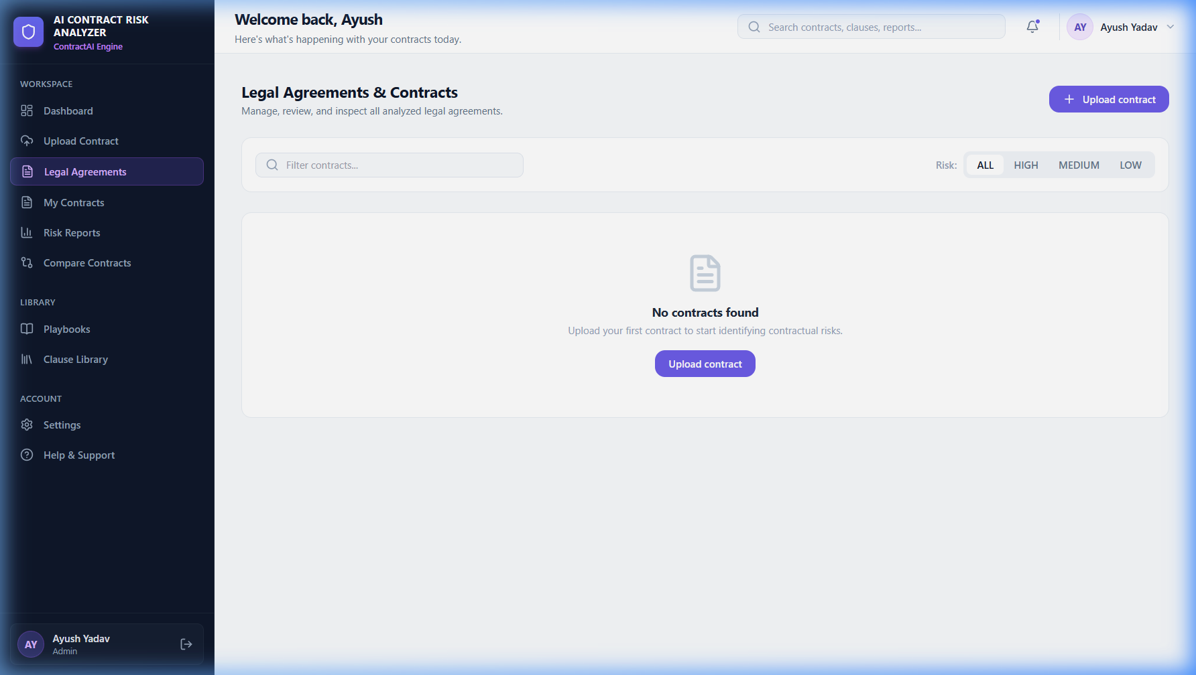
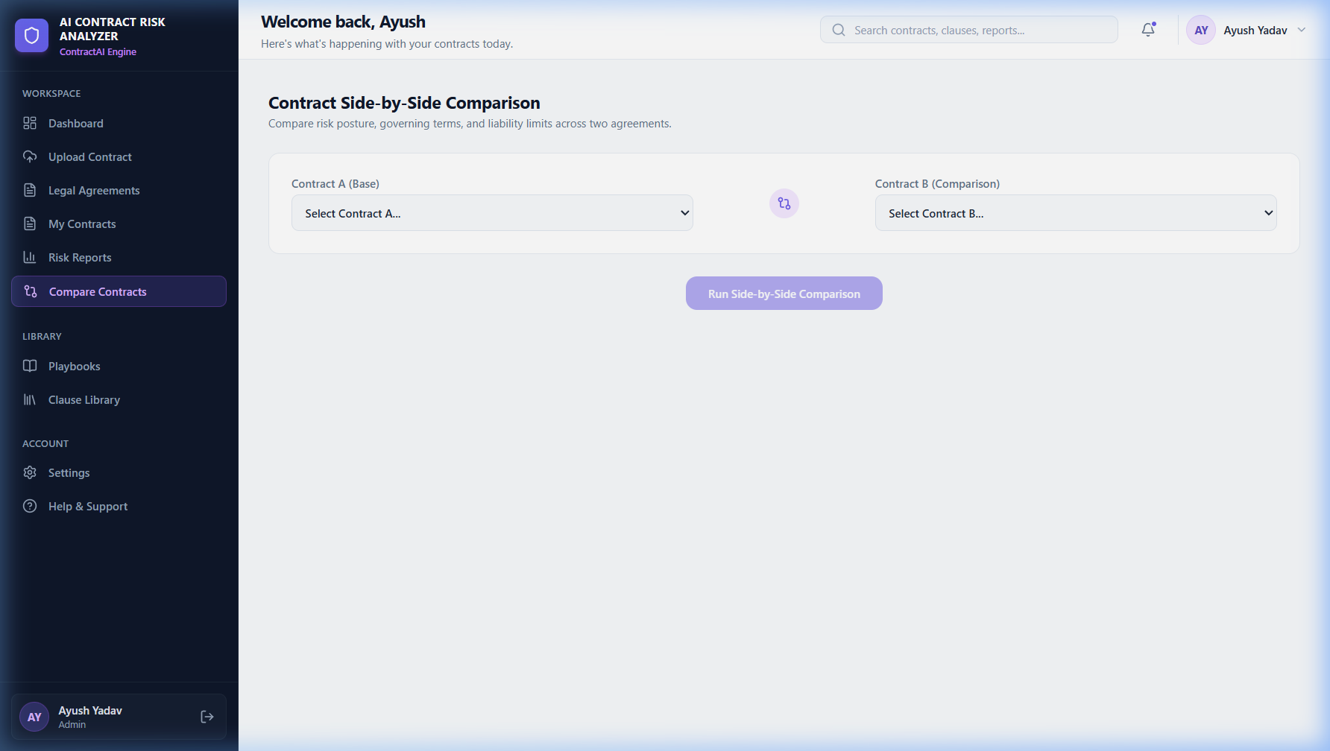
08
KEY FEATURES
Actual running application — screenshots from the live system
Risk Dashboard
Contract Upload
Metrics · Risk Overview · Upload Zone
PDF / DOCX Ingestion & Analysis Pipeline
Legal Agreements
Contract Comparison
Contract Registry with Risk-Level Filtering
Side-by-Side Risk Posture Comparison
ContractAI · PCTE Institute of Engineering and Technology, Ludhiana · Ayush Yadav 2329304

Slide 9
09
RESULTS & BENEFITS
What the system delivers
SYSTEM CAPABILITIES
BEFORE vs AFTER
✓
Automated first-pass contract review
BEFORE ContractAI
📄 Long contract received
✓
15+ legal clause categories detected automatically
👁 Manual clause-by-clause review
✓
⏱ Hours of legal work required
AI + Rule-based risk scoring (composite 0–100)
❌ Risk clauses potentially missed
✓
Plain-English risk explanations for each clause
▼
✓
AFTER ContractAI
AI-suggested safer clause alternatives (redlines)
📤 Upload PDF or DOCX file
✓
Structured PDF executive summary report
🤖 AI analyzes in seconds
📊 Risk dashboard opened instantly
✓
Centralized dashboard for contract management
✅ Actionable redline insights ready
ContractAI · PCTE Institute of Engineering and Technology, Ludhiana · Ayush Yadav 2329304

Slide 10
10
CONCLUSION & FUTURE SCOPE
Summary and roadmap for ContractAI
CONCLUSION
ContractAI demonstrates how AI, NLP, RAG and rule-based analysis can be combined to perform automated preliminary contract risk analysis through a web-based platform. The system integrates FastAPI, ChromaDB, OpenAI GPT-4o-mini, React/TypeScript and ReportLab to deliver risk scoring, clause detection, plain-English explanations, AI redlines and PDF reports.
FUTURE SCOPE
→
OCR support for scanned / image contracts
→
Advanced contract comparison engine
→
Richer domain-specific legal knowledge base
→
Human-in-the-loop legal review workflow
→
Fine-tuned legal-domain LLM models
→
Enterprise integrations (CRM / ERP / e-Sign)
→
Multilingual contract analysis
→
Role-based access control for legal teams
THANK YOU
Questions? · Ayush Yadav · Roll No. 2329304 · B.Tech CSE 4-C · Submitted to Ms. Mandeep Kaur

