Slide 1
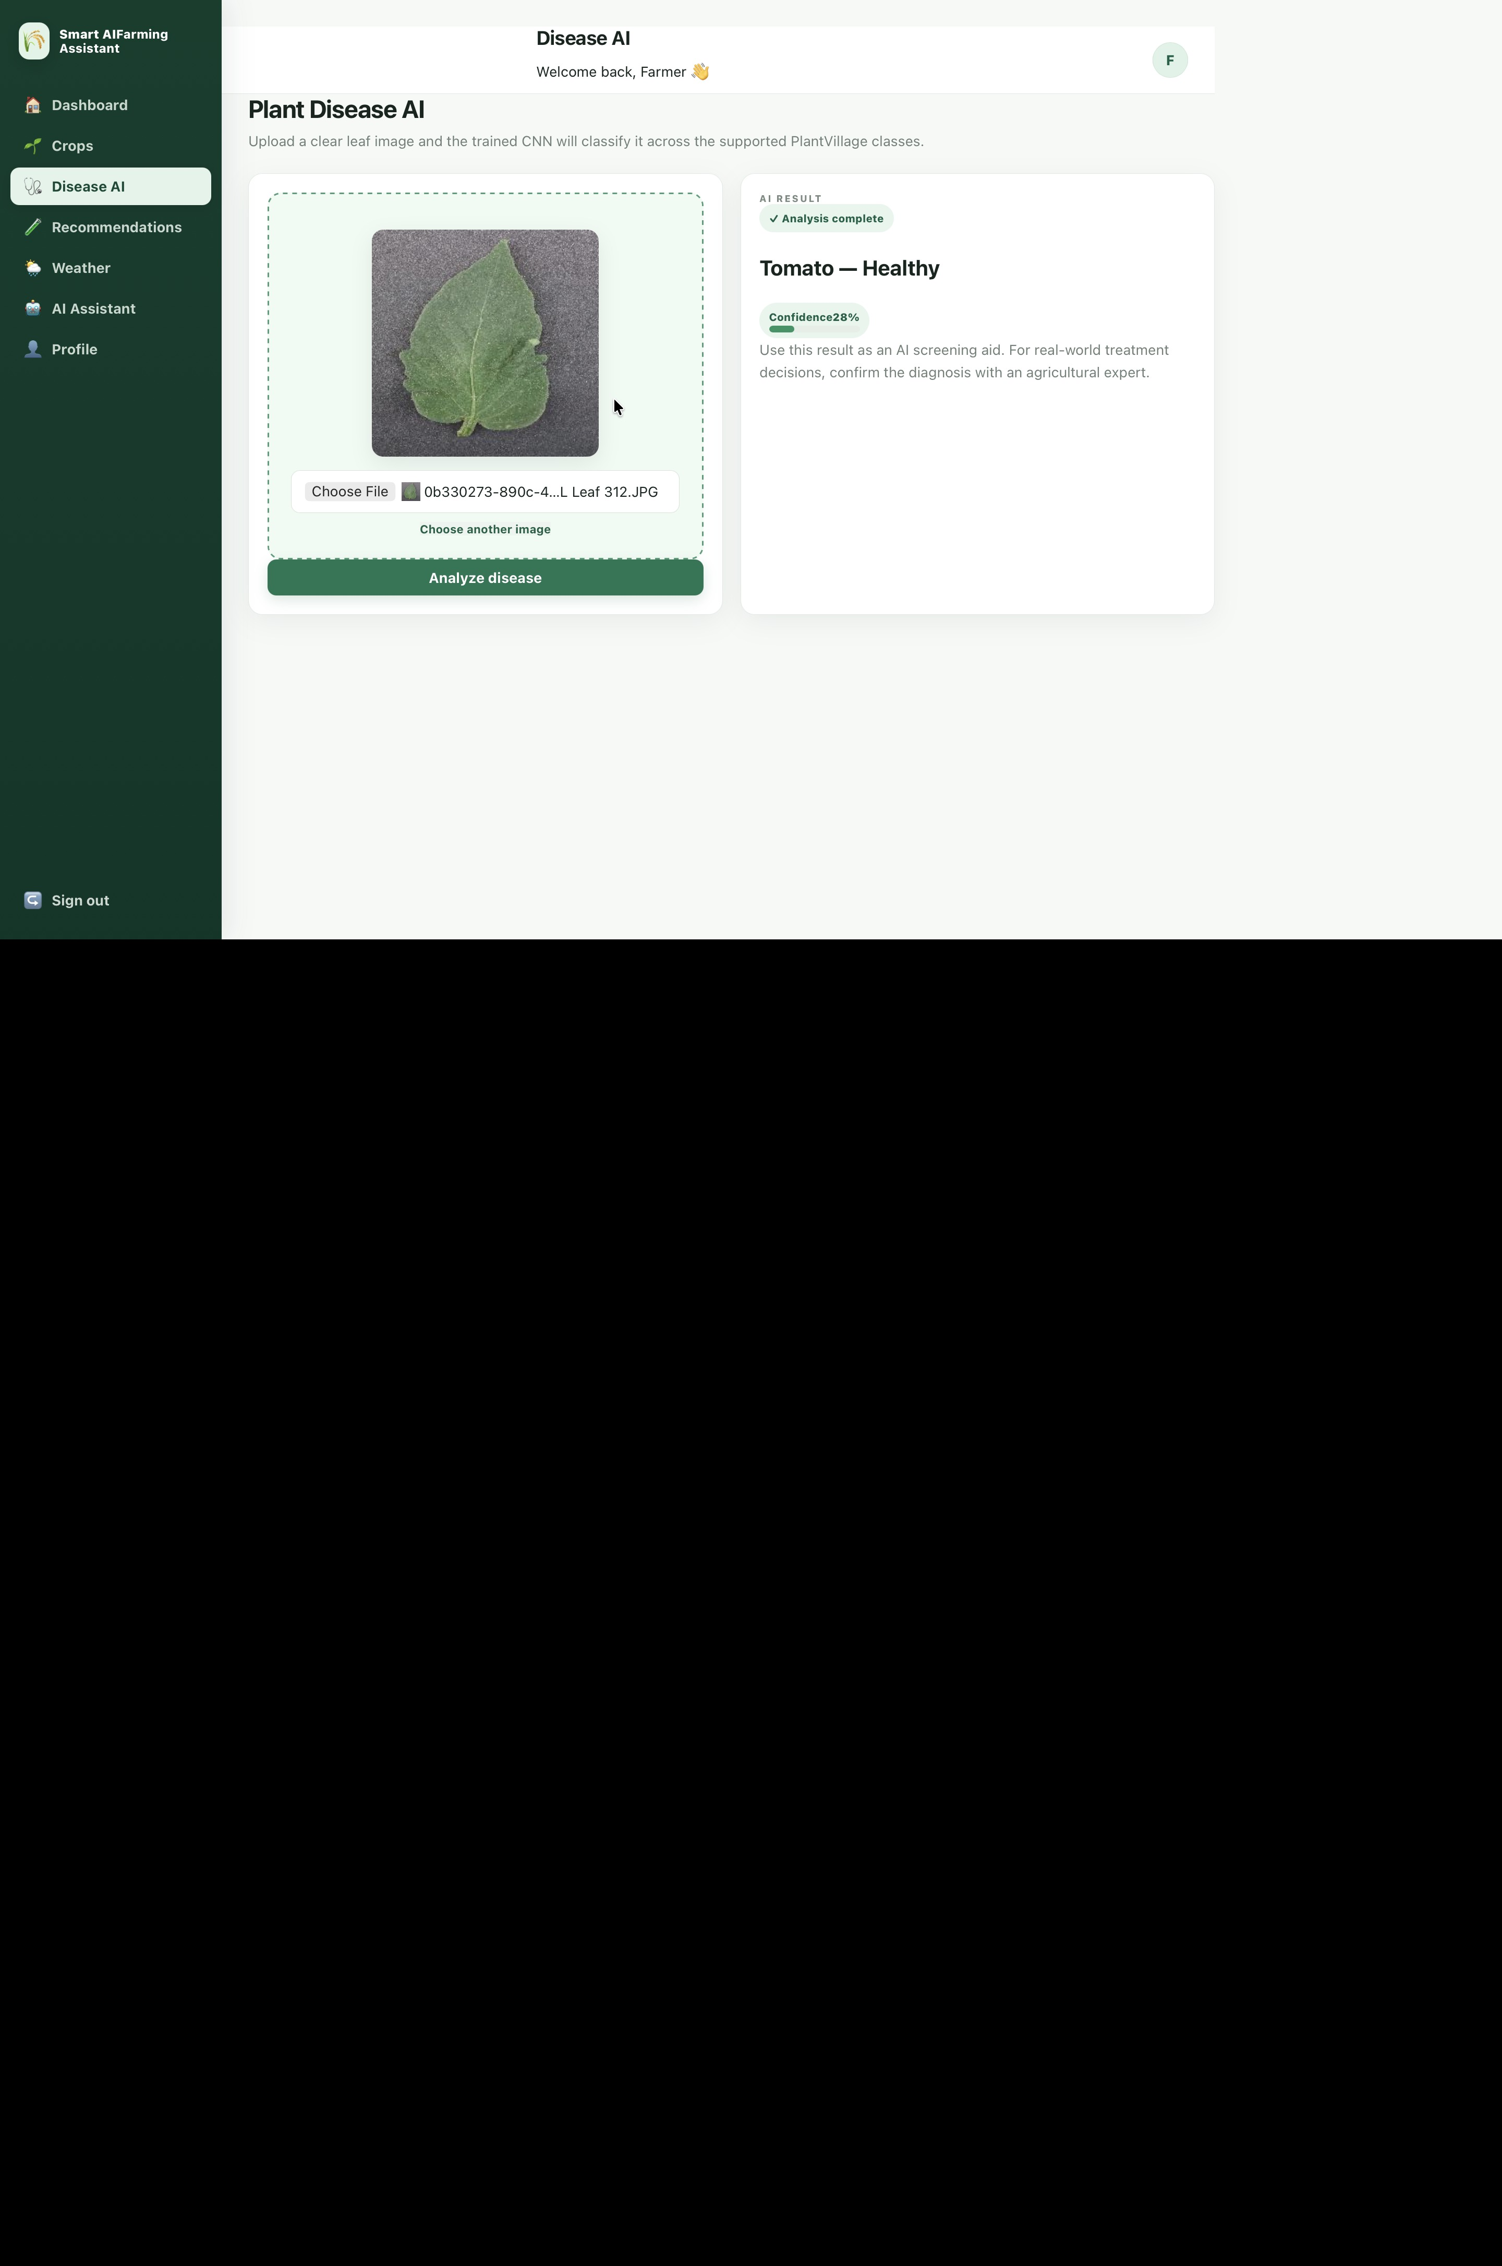
SMART AI
FARMING ASSISTANT
AI-powered crop health monitoring & plant disease diagnosis
MERN-style web architecture + FastAPI + PyTorch + PostgreSQL
Project Presentation
Smart Agriculture • Computer Vision • Decision Support
Healthy crop screening

Slide 2
1. Problem Statement
Why smart crop diagnosis is needed
👁
Manual inspection
⏱
Delayed intervention
🌱
Limited decision support
Disease identification depends on visual observation and agricultural expertise. This can be slow when many plants must be checked.
Late recognition of crop stress or disease can reduce the opportunity for timely management.
Farmers need a simple digital workflow that combines image-based diagnosis with useful recommendations.
Project response
1
Upload
2
Analyze
3
Report
4
Act
Farmer uploads a leaf image.
PyTorch CNN processes the image.
System returns class, confidence and status.
Recommendation supports the next field check.
SMART AI FARMING ASSISTANT
2

Slide 3
2. Objectives
Core goals of the Smart AI Farming Assistant
🌿
Crop management
🧠
AI diagnosis
📊
Actionable output
Maintain digital crop records and support routine monitoring.
Classify supported PlantVillage disease/health classes from leaf images.
Show predicted class, confidence, status and recommendation.
🌦️
Farm context
🔐
Secure access
🚀
Deployable system
Provide weather, recommendations and assistant features around the diagnosis workflow.
Provide authentication and user-linked farm data.
Run the complete application with Docker Compose and PostgreSQL.
SMART AI FARMING ASSISTANT
3

Slide 4
3. Proposed System Workflow
End-to-end flow from farmer input to AI-assisted decision support
01
02
03
04
05
06
Login
Crop
Image
AI
Result
Action
Authentication
Select / manage crop
Upload leaf image
CNN inference
Class + confidence
Recommendation / follow-up
Key design idea
Keep the farmer-facing workflow simple: one image upload → one AI result → clear next-step guidance.
SMART AI FARMING ASSISTANT
4

Slide 5
4. System Architecture
Application layers used in the implemented project
Frontend
React + Vite
Web UI • Dashboard • Disease AI • Crops • Weather • Assistant
Backend
FastAPI
Auth • Crop APIs • Diagnosis API • Recommendations • History
AI Layer
PyTorch CNN
128×128 preprocessing • 38 classes • inference • confidence
Data Layer
PostgreSQL
Users • Crops • Diagnosis records • timestamps
Deployment
Docker Compose
Frontend + Backend + PostgreSQL services
SMART AI FARMING ASSISTANT
5

Slide 6
5. Technology Stack
Technologies used across the project
⚛
React
⚡
Vite
🐍
FastAPI
🔥
PyTorch
Frontend UI
Frontend tooling
REST API backend
CNN training & inference
🐘
PostgreSQL
🐳
Docker
🧩
SQLAlchemy
🔐
JWT / Auth
Relational database
Containerized deployment
Database ORM
Protected user workflow
Implementation style
Modular web application with separate presentation, API, ML and persistence layers.
SMART AI FARMING ASSISTANT
6

Slide 7
6. AI Model & Dataset
Training setup used for the disease classification module
PlantVillage images
Classes
Images selected
Epochs
54,305
38
23,774
25
Dataset size
Supported labels
Final training run
Training duration
CNN pipeline
Input
128×128×3
Conv 32
+ ReLU
+ Pool
Conv 64
+ ReLU
+ Pool
Conv 128
+ ReLU
+ Pool
Conv 256
+ GAP
Linear
38 classes
Best validation accuracy: 96.64%
SMART AI FARMING ASSISTANT
7

Slide 8
7. Training Results
Final training run metrics from the project
Training accuracy
96.76%
Validation accuracy
96.49%
Best validation
96.64%
💾
Model artifact
🐳
Reproducible deployment
weights/disease_model.pt + weights/classes.json
Docker image rebuilt after model update
SMART AI FARMING ASSISTANT
8

Slide 9
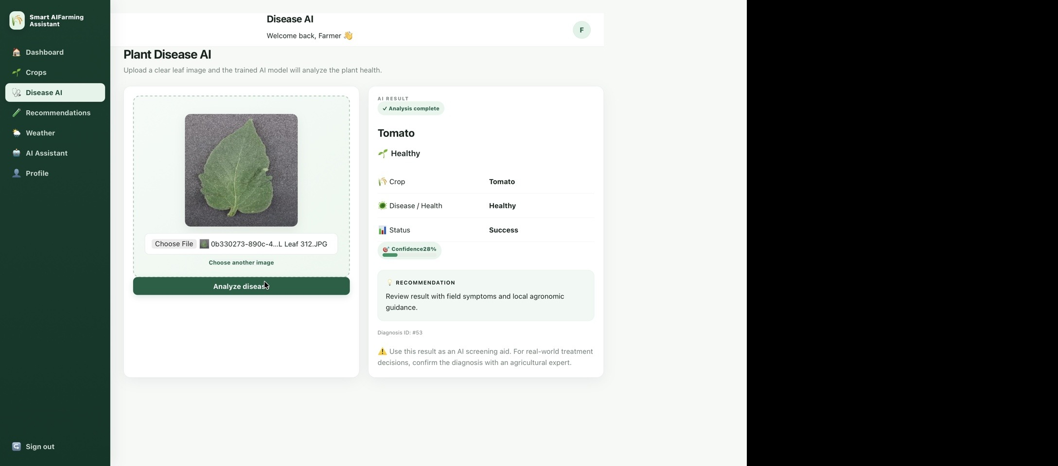
8. Working Prototype — Disease AI
Actual project interface captured during testing
Upload → Analyze → Result → Recommendation
SMART AI FARMING ASSISTANT
9

Slide 10
9. Implemented Features
What the current web application provides
🔐
Authentication
🌱
My Crops
🩺
Disease AI
💡
Recommendations
User login / protected application flow
Create and manage crop records
Leaf image upload and CNN classification
Diagnosis-linked agronomic guidance
🌦️
Weather
🤖
AI Assistant
👤
Profile
🗃️
History
Weather information module
Conversational assistant interface
User profile area
Diagnosis records stored in PostgreSQL
SMART AI FARMING ASSISTANT
10

Slide 11
10. Diagnosis Logic
Two-path inference used to improve behavior on known dataset images
🔎
SHA-256 exact match
🧠
CNN inference
1
✓
If the uploaded bytes exactly match an indexed dataset image, the known class is returned directly.
Otherwise, the PyTorch CNN predicts the most likely supported class.
Image upload
Result
Important limitation
The model is trained for supported PlantVillage classes; arbitrary real-world photos can differ from the training distribution, so AI output should be treated as screening support.
SMART AI FARMING ASSISTANT
11

Slide 12
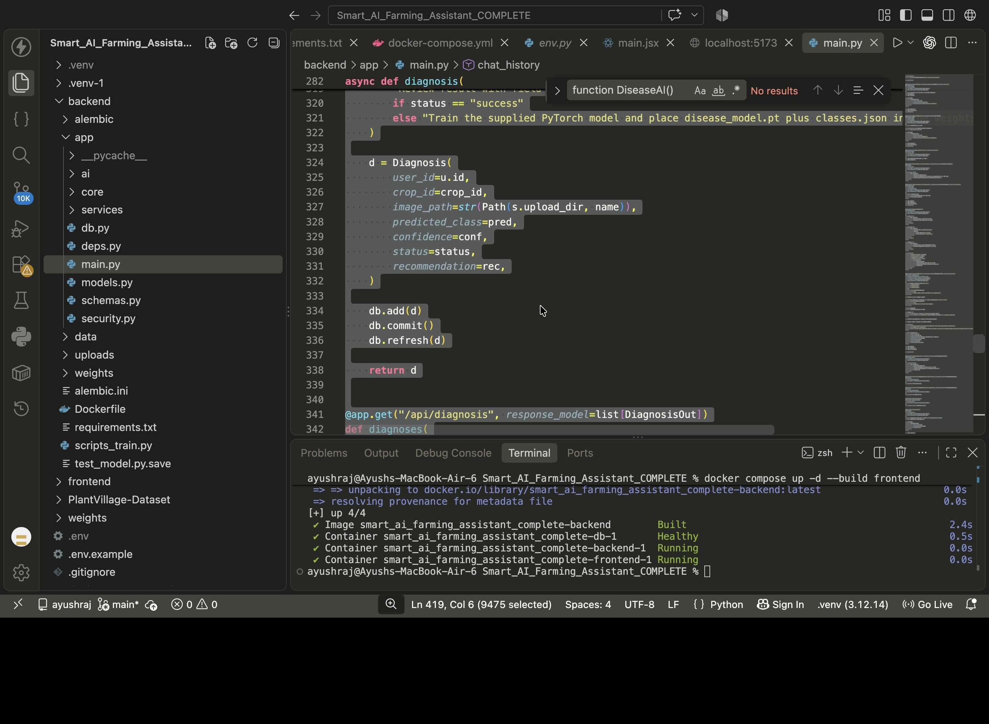
11. Backend & Deployment Evidence
FastAPI diagnosis endpoint and Docker Compose deployment
🌐
API
POST /api/diagnosis accepts multipart image upload.
🗄️
Persistence
Diagnosis result is stored with user, crop, image path, prediction, confidence and status.
🐳
Containers
Frontend, backend and PostgreSQL run through Docker Compose.
SMART AI FARMING ASSISTANT
12

Slide 13
12. Literature Survey — Recent Research
Five recent studies relevant to AI-based crop disease diagnosis
2025
AI and IoT-powered edge device optimized for crop pest and disease detection
Sources
Lightweight CNN + edge/Raspberry Pi deployment; emphasizes low-power real-time inference.
• Nature / Scientific Reports
2025
A dual-branch model combining convolution and vision transformer for crop disease classification
Combines local CNN features with global Transformer features for PlantVillage classification.
• PLOS ONE
2025
TinyML for Plant Disease Detection: Efficient Edge AI Solutions for Apple and Mango Leaves
• ScienceDirect
MobileNetV2/TinyML approach for resource-constrained real-time disease detection.
• MDPI Agronomy
2024
Vision Transformer and Smartphone-Based Plant Disease Detection for Smart Agriculture
Smartphone-oriented ViT approach for tomato disease recognition.
• ScienceDirect / Heliyon
2024
A novel hierarchical framework for plant leaf disease detection using residual vision transformer
Hierarchical residual ViT/ResNet approach evaluated on PlantVillage and other datasets.
Research sources verified from publisher pages (2024–2025).
SMART AI FARMING ASSISTANT
13

Slide 14
13. Critical Analysis & Research Gap
How the project relates to current research directions
●
What research shows
●
Current project position
●
Next research steps
• CNNs remain effective for leaf-image classification.
• ViT / hybrid CNN–Transformer models improve representation of local + global features.
• Edge/TinyML research focuses on low latency and low resource use.
• Smartphone and IoT workflows improve practical accessibility.
• Uses a compact custom CNN for a practical web prototype.
• Uses PlantVillage with 38 supported classes.
• Provides a complete application around the model: auth, crop records, recommendations and persistence.
• Dockerized deployment makes the system reproducible.
• Collect field images with varied lighting/backgrounds.
• Evaluate class-wise precision/recall/F1 and confusion matrix.
• Add explainability (e.g., Grad-CAM).
• Compare CNN with lightweight ViT/hybrid models.
• Validate recommendations with agronomic expertise.
SMART AI FARMING ASSISTANT
14

Slide 15
14. Conclusion & Future Scope
A complete AI-assisted farming web platform has been implemented around a plant-disease classification workflow.
96.64%
38
23,774
5+
Best validation accuracy
Supported classes
Images in final training run
Major research directions covered
Future scope
Field-domain adaptation • stronger model comparison • explainable AI • richer crop/weather context • mobile/edge deployment
Thank You
Questions & Discussion
SMART AI FARMING ASSISTANT
15

Slide 16
15. References
Selected sources used for the literature survey
1. Nyakuri, J.P. et al. (2025). AI and IoT-powered edge device optimized for crop pest and disease detection. Scientific Reports 15, 22905.
2. Meng, Q. et al. (2025). A dual-branch model combining convolution and vision transformer for crop disease classification. PLOS ONE 20(4), e0321753.
3. TinyML for Plant Disease Detection: Efficient Edge AI Solutions for Apple and Mango Leaves (2025). Procedia Computer Science 258, 2870–2877.
4. ViT-SmartAgri: Vision Transformer and Smartphone-Based Plant Disease Detection for Smart Agriculture (2024). Agronomy 14(2), 327.
5. A novel hierarchical framework for plant leaf disease detection using residual vision transformer (2024). Heliyon 10, e29912.
6. Project implementation evidence: React/Vite frontend, FastAPI backend, PyTorch model, PostgreSQL database and Docker Compose deployment.
SMART AI FARMING ASSISTANT
16

