Slide 1

DeS DAWAT-e-SHAAN
A Project Report
Submitted by
SAPNA GUPTA
University Roll No.: 1505410121
In partial fulfillment of the degree of
Bachelor of Technology
In
Computer Science and Engineering
BBDNITM
April , 2018

Slide 2
ACKNOWLEDGEMENT
It is my esteemed pleasure to present this report on the DAWAWT-E-SHAAN.
I would like to thank all my team members-Sahil Sharma , Saloni Agarwal and Prateek Gulati in supporting me at various stages of this project .
Secondly I would like to thank my project guide , Ms. Shubha Mishra ma’am , Head of Department of Computer Science and Engineering Department for providing us the required guidelines and constant support while making this project.
Also I would like to thank Ms. Seethalaxmi Ma’am Director of Babu Banarsi Das National Institute of Technology and Management for providing me the suitable environment for exploring through the project.
Last but not the least I would like to thank my parents for providing us all necessary facilities for carrying the project successfully.
Thanking You Sapna Gupta

Slide 3
CANDIDATE’S DECLARATION
I hereby certify that the work done which is being presented in the project entitled……………………….in partial fulfillment of the requirements for the award of the degree of Bachelor of Technology , Computer Science & Engineering and submitted in the Department of Computer Science and Engineering of the BBDNITM, Lucknow is an authentic record of my own carried out during a period from……………to ………… under the supervision of …………….., Professor Dept. of Computer Science and Engineering , BBDNITM , Lucknow.
The matter presented in the dissertation has not been submitted by me for the award of any other degree of this or any other Institute.
(Sapna Gupta)
This is to certify that the above statement made by the candidate is correct to the best of my knowledge.
(Name of Supervisor)
……………………. Date:
.......................
(Name of Supervisor)
……………………..

Slide 4
Table of contents
1.Abstract………………………………………………………………………...Page iv
2.SRS Specification…………………………………………………………..…Page 1-5
3.DFD(Level0,Level1,Level2).................................................Page6-7
4.ER Diagrams…………………………………………….Page 8-9
5.Use-case diagram……………………………………….Page 10
6.sequence diagram………………………………………..Page 11 7.Coding …………………………………….Page12

Slide 5
ABSTRACT:
The Dawat-e-Shaan system aims at enabling customers for reserving hotel
rooms by just logging on to the website. On part of the administrator , his
responsibility is to check for room availability. The project aims at building a web based application for small and medium sized hotels.
Through this it becomes quite convenient for the user to find hotels and bed and breakfast while they are new to
the town or city ;they just have to do the booking via their PC.Also on part of the administrator, he checks for the availability of rooms and reserves a room for the
customers without performing a lot of manual administrative work.
****************************

Slide 6
SRS SPECIFICATION
Authors: Sapna Gupta, Sahil Sharma , Saloni Agarwal and Prateek Gulati.
INTRODUCTION:
Purpose: The major purpose of our project is to develop a hotel management system,thereby creating a
web-based application for finding small or medium hotels, inns, bed &breakfast(B&Bs).It focuses on room booking of customers to the appropriate hotel in which free rooms are available.
The project is build at front-end as well as at back-end via PhP technology apart from other web development language as HTML, CSS, Javascript, XML,Jquery etc.
Document Convention: This SRS document has been presented using a simple format. The side headings as well as the main headings has been made bold and underlined to point area of specific interest. Rest of the document has been written using Times New Roman format.
Intended audience: This SRS has been mainly prepared specially for those people,who face difficulties while looking for availability of hotels when in a new city,town or country.
Project Scope: The main objective of this SRS is to provide an efficient online portal for a Hotel Management System. The system’s main goal is to provide details regarding the following tasks which it’ll be able to perform efficiently and with much ease; as:
Providing booking details.
Information about rooms availability
Customer’s check in details
Customer’s check out details
Enabling the customers to have a secured online transaction while they are making payments online.
Order details
References:
Wikipedia
Hotelopro an portal for booking hotels.

Slide 7
Overall Description:
Project Perspective:
Through this SRS document the end-users i.e., the customers will be easily able to look for availability of hotels
and rooms,which earlier involved a lot of paperwork. The manual system involved lots of problems regarding calculations and also produced bulk of filing system, so in contrary to all these, the Hotel management system aims at eliminating all these anomalies.
The final outcome of this project is going to give a much better performance as compared to the conventional file system that each and every hotel used to possess earlier.
Product Function:
The Hotel Management System aims at performing the following functions, as:
Making hotel room bookings.
Checking for availability of rooms.
Updating new guests(Add,Delete,Update)
Managing Room details(Add,Delete,Update)
Setting up rates for rooms
Taking Backups
Email Notifications
2.3User Class and Characteristics:
User Class | Description
1.Admin | Responsible for storing all the customer’s details.Besides this he also updates room information i.e.checking rooms availability.
2.Customer | Provide customer details as first name,last name,address,phone no.,days of stay,room type wanting to book,etc.
3.Managers | Provide details regarding hotels,inns,etc . The details may include hotel name,no. of rooms,location,etc.
2.4Operating Environment: The project is web-based and can be opened via any
web-browser as Mozilla,Chrome,IE,Opera,etc.
2.5Design and implementation constraint: There are no constraints present in the project at this point, as its a simple online room booking system.

Slide 8
Specific Requirement:
Functional Requirement:
The project shall be able to book rooms.
It shall be able to check status of the rooms,i.e.,filled or free.
It shall be able to add customer details onto the database.
It shall be able to delete the customer who leaves the hotel.
Hardware interfaces: Proper internet connection and PC is required.
Software interfaces:
At the back-end the software operates on MySQL database apart from ASP.NET technology.The database stores information about the hotel rooms whether they are available or filled.It stores customer details including the first name,last name,address ,contact no.,day of stay ,etc.
As far as the coding is concerned, it is done in NETBEANS by using PhP.
Communication interface:
The system uses internet connection for making this project a dynamic web-based application.

Slide 9
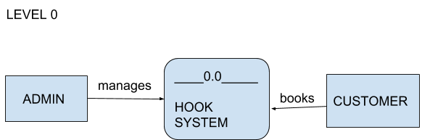
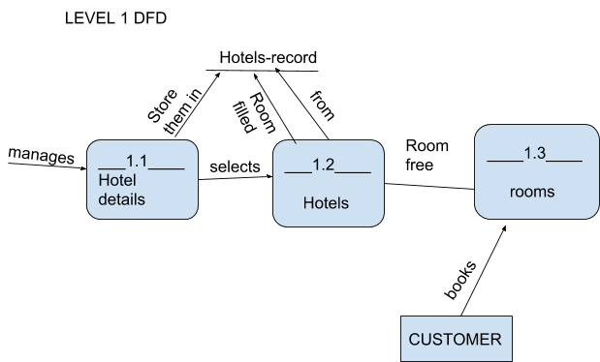
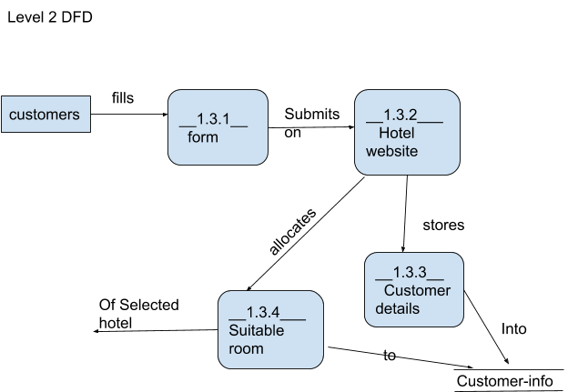
DATA FLOW DIAGRAM

Slide 10
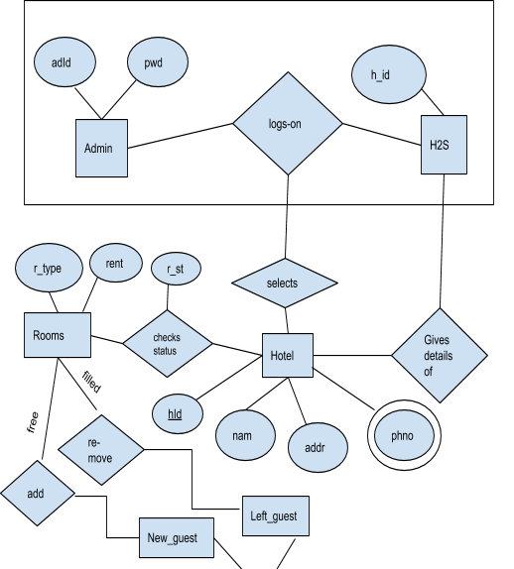
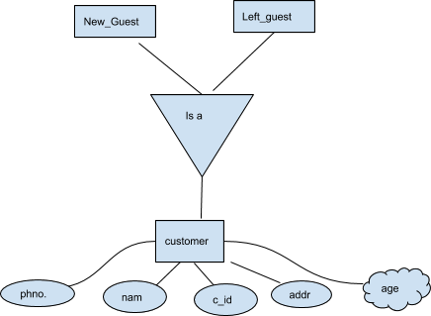
ER-DIAGRAM

Slide 11
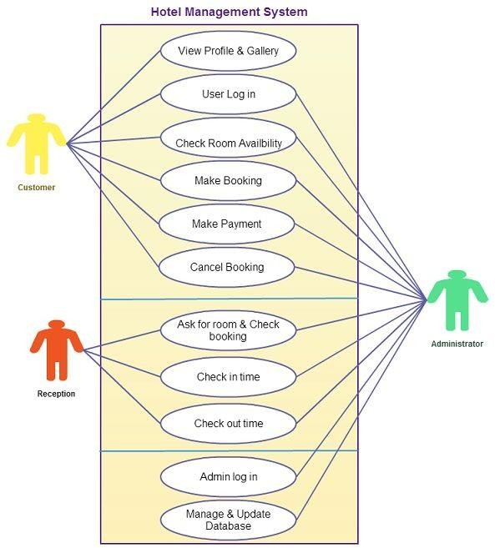
USE CASE DIAGRAM

Slide 12
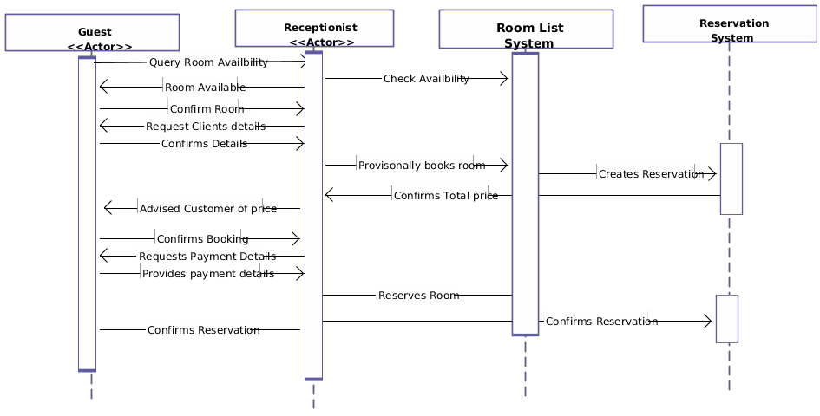
SEQUENCE DIAGRAM

