Slide 1
WEB
WEB TECHNOLOGIES · ALL MINI PROJECTS
All my mini projects
in one presentation
Aykhan Dadashov · Web Technologies · RNU
Notes:
Hello, my name is Aykhan Dadashov. This presentation puts together all the mini projects I made in the Web Technologies class: the Foundations projects, Intermediate HTML and CSS, the JavaScript course, Advanced HTML and CSS, and my project idea CareerBridge.

Slide 2
01
Overview of my mini projects
Project | Course | What I practised | Live
Rock Paper Scissors | Foundations | functions, conditionals, DOM events | ayxan1110.github.io/odin-rock-paper-scissors/
Etch-a-Sketch | Foundations | loops, DOM creation, mouse events | ayxan1110.github.io/odin-etch-a-sketch/
Calculator | Foundations | state, keyboard support, no eval() | ayxan1110.github.io/odin-calculator/
Sign-up Form | Intermediate HTML & CSS | forms, validation, Flexbox | ayxan1110.github.io/odin-sign-up-form/
Admin Dashboard | Intermediate HTML & CSS | CSS Grid, SVG icons | ayxan1110.github.io/odin-admin-dashboard/
Library | JavaScript | constructors, prototypes, dialog | ayxan1110.github.io/odin-library/
Tic Tac Toe | JavaScript | factory functions, module pattern | ayxan1110.github.io/odin-tic-tac-toe/
Homepage | Advanced HTML & CSS | responsive design, accessibility | ayxan1110.github.io/odin-homepage/
CareerBridge | Project idea (11.11) | AI agents, product pitch, prototype | ayxan1110.github.io/careerbridge-prototype/
Notes:
Here is the overview of all nine mini projects: three from Foundations, two from Intermediate HTML and CSS, two from the JavaScript course, the Homepage from Advanced HTML and CSS, and my project idea CareerBridge. All of them are live on GitHub Pages.

Slide 3
PART 1
Foundations (Open Course)
JavaScript Basics: Rock Paper Scissors, Etch-a-Sketch, Calculator
Notes:
The first part is the Foundations course, the open course of The Odin Project, with the JavaScript Basics section.

Slide 4
02
Lessons in JavaScript Basics
1
2
3
4
5
Variables and Operators
Installing Node.js
Data Types and Conditionals
JavaScript Developer Tools
Function Basics
6
7
8
9
10
Problem Solving
Understanding Errors
Project: Rock Paper Scissors
Clean Code
Loops and Arrays
11
12
13
14
15
DOM Manipulation and Events
Revisiting Rock Paper Scissors
Project: Etch-a-Sketch
Object Basics
Project: Calculator
Notes:
JavaScript Basics has fifteen lessons. The yellow ones are the projects. The lessons start with variables and operators, then data types, functions, problem solving and errors, then arrays and loops, the DOM and objects. Between them there are three projects: Rock Paper Scissors, Etch-a-Sketch and the Calculator as the final project of Foundations.

Slide 5
03
Variables, operators, data types, conditionals
let and const – const cannot be reassigned, let can; we do not use var
Operators – + - * / % ** and ++ / --, careful with "5" + 2 = "52"
8 data types – string, number, bigint, boolean, undefined, null, symbol, object
Comparison – always use === (strict) instead of ==
Conditionals – if / else if / else, switch, the ternary operator
Logical operators – && (and), || (or), ! (not)
basics.js
const name = "Aykhan"; // cannot change
let score = 0; // can change
score++; // 1
"5" + 2; // "52" (string)
"5" * 2; // 10 (number)
5 === "5"; // false (strict)
if (score >= 5) {
console.log("You win!");
} else if (score === 0) {
console.log("Start playing");
} else {
console.log("Keep going");
}
const text = score > 0 ? "yes" : "no";
Notes:
In the first lessons I learned how to store data in variables. We use const when the value does not change and let when it changes. Then operators, and one tricky thing: plus with a string joins the text, but multiply converts it to a number. JavaScript has eight data types. To compare values we use triple equals, because it also checks the type. For decisions we use if, else if and else, switch, or the short ternary operator.

Slide 6
04
Tools, functions, problem solving, errors
Node.js and DevTools
Function basics
Node runs JavaScript outside the browser. In Chrome DevTools I used the Console, the Elements panel and breakpoints in Sources to go through code line by line.
Parameters and arguments, return values, function declarations, function expressions and arrow functions. Function scope keeps variables inside.
Problem solving
Understanding errors
First understand the problem, then plan, write pseudocode and divide it into small steps. Then turn every step into code.
Read the error message and the line number. ReferenceError: variable not defined. SyntaxError: wrong code. TypeError: wrong type of value.
Notes:
These lessons were about tools and the way of thinking. I installed Node.js to run JavaScript in the terminal, and I learned the Chrome developer tools, especially the console and breakpoints. In function basics I learned parameters, return values and arrow functions. The problem solving lesson teaches to first understand the problem, plan and write pseudocode before coding. And understanding errors taught me to read the error message and the line number, and the most common error types.

Slide 7
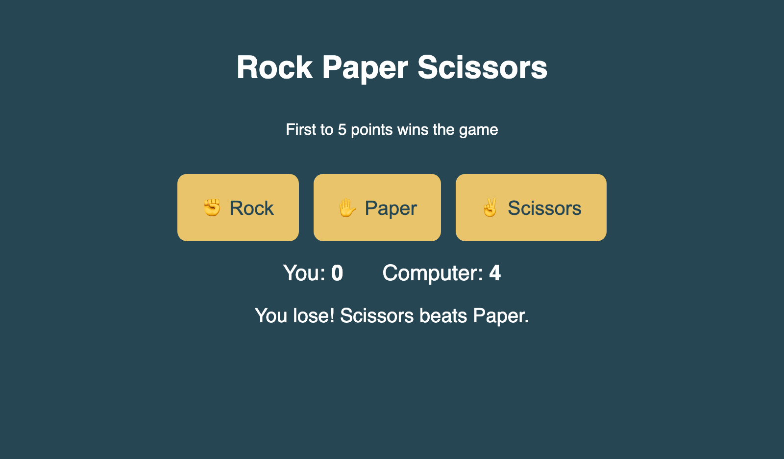
05
Project: Rock Paper Scissors
Computer choice with Math.random()
playRound() compares the two choices
Score for human and computer
First to 5 points wins the game
UI with buttons (Revisiting RPS lesson)
Live ayxan1110.github.io/odin-rock-paper-scissors/
Code github.com/Ayxan1110/odin-rock-paper-scissors
Notes:
My first project was Rock Paper Scissors. The computer choice uses Math.random, which gives a number between 0 and 1, and I split it into three parts for rock, paper and scissors. The playRound function compares the choices with conditionals and updates the score. First the game worked only in the console, and later in the lesson Revisiting Rock Paper Scissors I added buttons and showed the result on the page. The first player to reach 5 points wins, and then a Play again button appears.

Slide 8
06
Clean code, loops and arrays
Clean code – good names (camelCase), consistent indentation, comments explain why
Arrays – ordered lists, index starts at 0; push, pop, slice, splice, includes
Loops – for, while, and for...of to repeat code
Array methods – map, filter, reduce, forEach – shorter than loops
Used in my projects – for loop in Etch-a-Sketch, forEach in RPS, includes() in the Calculator
arrays.js
const numbers = [1, 2, 3, 4, 5];
for (let i = 0; i < numbers.length; i++) {
console.log(numbers[i]);
}
// new array, every number doubled
numbers.map((n) => n * 2);
// [2, 4, 6, 8, 10]
// only even numbers
numbers.filter((n) => n % 2 === 0);
// [2, 4]
// add everything together
numbers.reduce((sum, n) => sum + n, 0);
// 15
Notes:
The Clean Code lesson explained how to write code that other people can read: clear variable names, the same indentation everywhere and comments that explain why and not what. Then I learned arrays, lists where the first index is zero, and loops to repeat code. The most useful part were the array methods map, filter and reduce, which make the code much shorter than a normal for loop. I used forEach and includes in my projects.

Slide 9
07
DOM manipulation and events
DOM – the page as a tree of nodes that JavaScript can change
Select – querySelector() and querySelectorAll()
Create and add – createElement(), appendChild(), append()
Change – textContent, classList, style, setAttribute()
Events – addEventListener("click", ...), the event object, bubbling
dom.js
const container =
document.querySelector("#container");
const button = document.createElement("button");
button.textContent = "Click me";
button.classList.add("btn");
container.appendChild(button);
button.addEventListener("click", (event) => {
console.log(event.target); // the button
button.style.backgroundColor = "gold";
});
// many elements at once
document.querySelectorAll(".square")
.forEach((sq) => sq.remove());
Notes:
The DOM is the Document Object Model, the page as a tree of elements, and JavaScript can read and change it. I learned to select elements with querySelector, to create new ones with createElement and add them to the page with appendChild. We can change the text, the classes and the style. With addEventListener we react to clicks, key presses or mouse movement. The event object tells us which element was clicked. All my three projects use these methods.

Slide 10
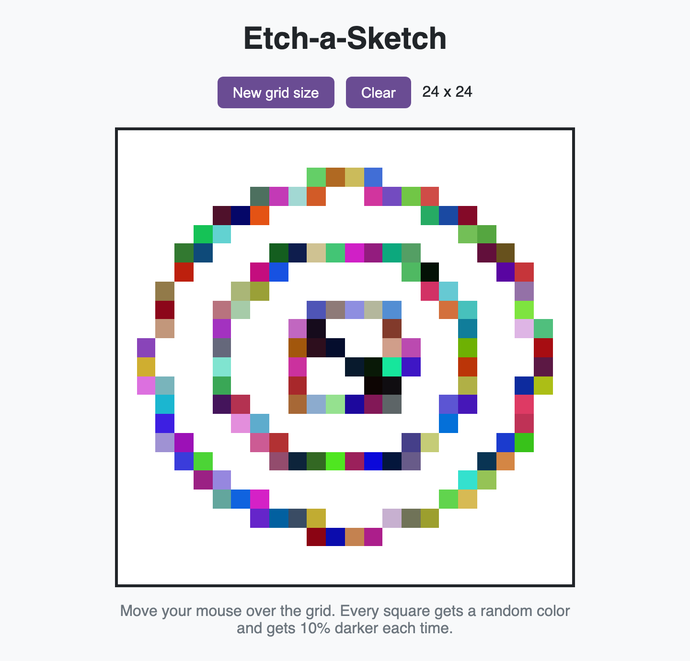
08
Project: Etch-a-Sketch
16 x 16 grid made with a JavaScript loop
Flexbox with flex-wrap keeps it in a 480px box
Squares change color on mouseenter
Button with prompt() for a new size (max 100)
Extra: random RGB and 10% darker every pass
Live ayxan1110.github.io/odin-etch-a-sketch/
Code github.com/Ayxan1110/odin-etch-a-sketch
Notes:
The second project is Etch-a-Sketch, something between a drawing pad and an etch-a-sketch toy. The grid is not written in HTML, it is created with a loop in JavaScript. The container always has the same size, and every square gets its width in percent, so any grid size fits. When the mouse enters a square, it changes color. With the New grid size button I ask the user with prompt how many squares per side, up to one hundred. I also did the extra credit: every pass gives a random color and makes the square ten percent darker, so after ten passes it is black.

Slide 11
09
Object basics
Objects – store data as key: value pairs
Add, change, delete – user.age = 23, delete user.age
Check a key – "name" in user, or loop with for...in
Reference – copying an object copies the reference, not the data
Array of objects – very common, e.g. a list of users or books
objects.js
const user = {
name: "Aykhan",
city: "Riga",
};
user.age = 23; // add
user.city = "Baku"; // change
delete user.age; // remove
"name" in user; // true
const copy = user; // same object!
copy.name = "Test";
user.name; // "Test"
const users = [{ name: "A", age: 20 },
{ name: "B", age: 31 }];
users.find((u) => u.age > 30); // B
Notes:
Object basics introduced objects, which store data as key and value pairs. We can add, change and delete properties, and check if a key exists with the in operator. One important thing: when we copy an object to another variable, we copy only the reference, so both variables point to the same object, and changing one changes both. We also practiced arrays of objects with methods like find and filter.

Slide 12
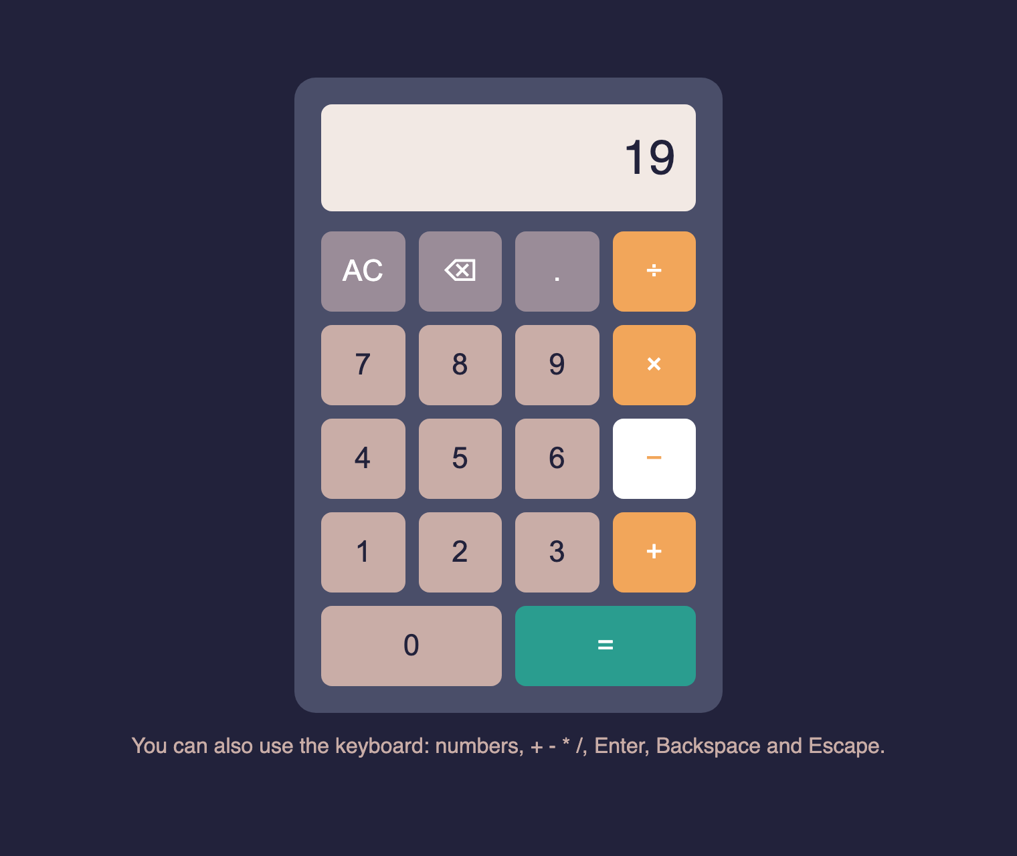
10
Project: Calculator
add, subtract, multiply, divide + operate()
One pair at a time: 12 + 7 − shows 19
Rounds long decimals to fit the screen
Error message when dividing by 0
Extra: decimal, backspace, keyboard
Live ayxan1110.github.io/odin-calculator/
Code github.com/Ayxan1110/odin-calculator
Notes:
The final project of Foundations is the Calculator. First I wrote the four math functions and an operate function that calls the right one. The calculator works on one pair of numbers at a time, so if I type 12 plus 7 and then minus, it shows 19 first. Long decimals are rounded, and dividing by zero shows a message instead of breaking. For extra credit I added the decimal point, a backspace button and keyboard support. I did not use eval.

Slide 13
11
Calculator: how the logic works
firstNumber
operator
currentInput
the number before the operator
+ − × ÷ that was pressed
the number on the display
Press | firstNumber | operator | currentInput | Display
1, 2 | empty | empty | 12 | 12
+ | 12 | + | 12 | 12
7 | 12 | + | 7 | 7
− | 19 | − | 19 | 19
1, = | empty | empty | 18 | 18
Notes:
To explain how the calculator works, it remembers three things: the first number, the operator and the current input. In the table you can see the example 12 plus 7 minus 1. When I press plus, the 12 is saved as the first number. When I type 7, it becomes the current input. When I press minus, the calculator first calculates 12 plus 7, so 19 becomes the first number and minus the new operator. When I press 1 and equals, it calculates 19 minus 1 and shows 18. If two operators are pressed in a row, only the operator changes.

Slide 14
PART 2
Intermediate HTML and CSS
Sign-up Form, Admin Dashboard and my profile page
Notes:
The second part is Intermediate HTML and CSS, with forms and CSS Grid.

Slide 15
12
Intermediate HTML and CSS: what I covered
Intermediate HTML
Intermediate CSS
Forms
Grid
Introduction
SVG
Tables
Default Styles
CSS Units
More Text Styles
More CSS Properties
Advanced Selectors
Positioning
CSS Functions
Custom Properties
Browser Compatibility
Frameworks and Preprocessors
Form Basics
Form Validation
Project: Sign-up Form
Introduction to Grid
Creating a Grid
Positioning Grid Elements
Advanced Grid Properties
Using Flexbox and Grid
Project: Admin Dashboard
Notes:
The Intermediate HTML and CSS course has four parts. First, intermediate HTML concepts like SVG and tables. Then a big part about intermediate CSS: default styles, units, text styles, more properties, advanced selectors, positioning, CSS functions, custom properties, browser compatibility and frameworks. Then forms, with the Sign-up Form project, and finally CSS Grid, with the Admin Dashboard project.

Slide 16
13
SVG and tables
SVG – vector images written in XML, they stay sharp at any size
viewBox – the coordinate system of the drawing, so it can scale
Shapes – <circle>, <rect>, <path>; colors with fill and stroke
Tables – only for tabular data, not for page layout
Table tags – <table>, <tr>, <th>, <td>, <thead>, <tbody>, colspan
intermediate.html
<!-- a simple SVG icon -->
<svg viewBox="0 0 100 100" width="80">
<circle cx="50" cy="50" r="40"
fill="gold" stroke="black" />
</svg>
<!-- a simple table -->
<table>
<thead>
<tr><th>Subject</th><th>Mark</th></tr>
</thead>
<tbody>
<tr><td>Web Tech</td><td>9</td></tr>
<tr><td>Programming</td><td>8</td></tr>
</tbody>
</table>
Notes:
SVG is a format for vector images. Instead of pixels, the image is described with shapes in XML, so it stays sharp at any size and we can change its colors with CSS. The viewBox defines the coordinate system. Tables are for data in rows and columns, like marks, and not for building the layout of a page. A table has rows with tr, header cells with th and normal cells with td, and we can group rows with thead and tbody.

Slide 17
14
Default styles, units and text
Default styles
CSS units
Every browser has its own default styles (margins on body, sizes of headings). A CSS reset or normalize makes the start the same in every browser.
Absolute: px. Relative: em (parent font size), rem (root font size), % and vh / vw (viewport). I use rem for font sizes and px for borders.
More text styles
More CSS properties
font-family with fallbacks, Google Fonts or @font-face, font-weight, letter-spacing, line-height, text-transform, text-shadow and text-overflow: ellipsis.
background shorthand, border-radius, box-shadow, overflow, opacity. Small properties that make a page look finished.
Notes:
Every browser has default styles, for example the body has a margin of 8 pixels, so many developers use a CSS reset. In the units lesson I learned the difference between absolute units like pixels and relative units: em depends on the parent font size, rem on the root font size, and vh and vw on the size of the window. Then more text styles like custom fonts, line height and ellipsis for long text, and some useful properties like border-radius, box-shadow and overflow.

Slide 18
15
Advanced selectors
Child and sibling – > (direct child), + (next sibling), ~ (all next siblings)
Pseudo-classes – a state: :hover, :focus, :first-child, :nth-child()
Pseudo-elements – a part: ::before, ::after, ::first-letter, ::marker
Attribute selectors – [type="email"], [href^="https"]
Result – I can style elements without adding many extra classes
selectors.css
/* only direct children */
.menu > li { display: inline-block; }
/* every second row of a table */
tr:nth-child(even) { background: #f2f2f2; }
/* input that has focus */
input:focus { outline: 2px solid gold; }
/* add an icon before a link */
a[href^="https"]::before {
content: "↗ ";
}
/* paragraph right after a heading */
h2 + p { font-size: 1.2rem; }
Notes:
Advanced selectors help to select elements more exactly, without putting a class on everything. With the greater-than sign we select only direct children, and with plus and tilde the siblings. Pseudo-classes describe a state, like hover or focus, or a position like nth-child. Pseudo-elements like before and after style a part of an element or add content. And attribute selectors select elements by their attributes, for example all links that start with https.

Slide 19
16
Positioning
static – the default, normal flow of the page
relative – moves from its normal place, keeps its space
absolute – taken out of the flow, placed inside the closest positioned parent
fixed – stays in the same place on the screen when scrolling
sticky – normal until you scroll to it, then it sticks
position.css
.card {
position: relative; /* parent */
}
.badge {
position: absolute; /* inside .card */
top: 10px;
right: 10px;
}
header {
position: sticky; /* my profile nav */
top: 0;
}
Notes:
Positioning decides where an element is placed. Static is the default. Relative moves an element from its normal place. Absolute takes the element out of the normal flow and places it relative to the closest parent that has a position, that is why we often put position relative on the parent. Fixed elements stay on the screen when we scroll, like a chat button, and sticky works like normal until we scroll to it. I used sticky for the navigation on my profile page.

Slide 20
17
CSS functions and custom properties
calc() – mix units, e.g. 100% minus the header height
min(), max(), clamp() – sizes that adapt to the screen
Custom properties – variables like --main-color, used with var()
Scope – defined on :root they work everywhere, on an element only inside it
Themes – change a few variables to make a dark theme
functions.css
:root {
--ink: #1b1b22;
--accent: #f7df1e;
}
h1 {
/* min 40px, max 68px, grows with screen */
font-size: clamp(40px, 7vw, 68px);
color: var(--ink);
}
main {
height: calc(100vh - 70px);
}
.button {
background: var(--accent, gold);
}
Notes:
CSS also has functions. calc lets me mix units, for example the full height of the screen minus the header. min, max and clamp make sizes responsive without media queries. On my profile page the name uses clamp, so it is never smaller than 40 pixels and never bigger than 68. Custom properties are variables in CSS. I define them on root and use them with var, so if I want to change the main color, I change it in one place.

Slide 21
18
Browsers, frameworks, preprocessors
Browser compatibility
Frameworks
Not every browser supports every new feature. I check caniuse.com before I use something new, and test in Chrome, Firefox and Safari.
Bootstrap and Tailwind give ready classes and components, so you write less CSS. But first you need to understand normal CSS.
Preprocessors
My choice
Sass, Less and PostCSS add features like nesting, mixins and loops, and compile to normal CSS. Today CSS itself has variables and nesting.
For these projects I used plain CSS without frameworks, to practice the basics that the course teaches.
Notes:
These lessons were more theory. Browser compatibility means that not all browsers support the same features, so we check websites like caniuse. Frameworks like Bootstrap and Tailwind give ready-made classes, and preprocessors like Sass add features like nesting and compile into normal CSS. The course says it is important to know plain CSS first, so in my projects I used only plain CSS.

Slide 22
19
Forms and form validation
<form> – action and method say where the data is sent
<label for> – connects text with an input, better for accessibility
Input types – email, tel, password, number, date, checkbox, radio
Validation – required, minlength, maxlength, min, max, pattern
Styling – :valid, :invalid and :user-invalid show errors
form.html
<form action="/signup" method="post">
<label for="email">Email</label>
<input type="email" id="email"
name="email" required>
<label for="password">Password</label>
<input type="password" id="password"
name="password" minlength="8"
required>
<button>Create Account</button>
</form>
/* red border only after the user typed */
input:user-invalid { border-color: red; }
Notes:
Forms are how users send data to a website. Every input should have a label connected with the for attribute, which helps screen readers and makes the label clickable. There are many input types, and the browser shows a different keyboard on the phone for email or tel. With attributes like required, minlength and pattern the browser checks the data before sending, and with pseudo-classes like invalid we can show the errors in red.

Slide 23
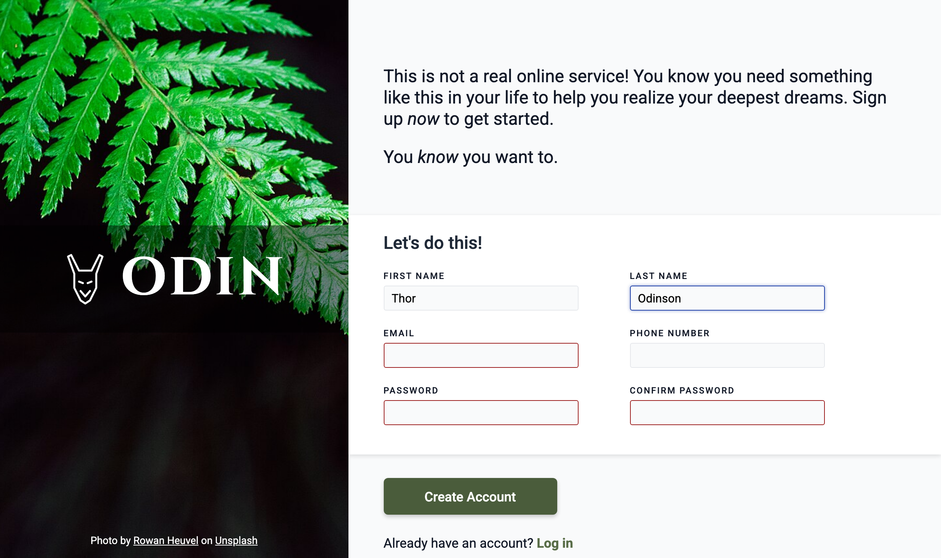
20
Project: Sign-up Form
Two columns made with Flexbox
Image side with logo and photo credit
Labels, input types and required fields
Red border only after the user interacts
Small script checks that passwords match
Live ayxan1110.github.io/odin-sign-up-form/
Code github.com/Ayxan1110/odin-sign-up-form
Notes:
My first project in this course is the Sign-up Form. The layout has two parts made with Flexbox: an image on the left with the logo, and the form on the right. Every input has a label and the correct type, and the required fields are checked by the browser. The red border appears only after the user has interacted with the field, so the form is not red from the start. I also added a small script that checks that the two passwords are the same.

Slide 24
21
CSS Grid
Grid container – display: grid turns children into grid items
Tracks – grid-template-columns / rows, the fr unit, repeat()
Gap – space between rows and columns
Placing items – grid-column: 1 / 3, grid-row, grid-template-areas
Responsive – repeat(auto-fit, minmax(240px, 1fr)) without media queries
grid.css
.dashboard {
display: grid;
grid-template-columns: 250px 1fr;
grid-template-rows: auto 1fr;
min-height: 100vh;
}
.sidebar {
grid-row: 1 / 3; /* full height */
}
.cards {
display: grid;
grid-template-columns:
repeat(auto-fit, minmax(240px, 1fr));
gap: 20px;
}
Notes:
CSS Grid is a two-dimensional layout system, so it controls rows and columns at the same time. With grid-template-columns I define the columns, and the fr unit shares the free space. Items can be placed exactly with grid-column and grid-row, for example the sidebar goes over two rows. The most useful trick is repeat with auto-fit and minmax, which makes the cards wrap automatically on small screens without any media query.

Slide 25
22
Flexbox or Grid?
Flexbox: one direction
Grid: two directions
Good for a row or a column of items: a navigation bar, buttons in a row, centering one thing. The content decides the size.
Good for the whole page layout or a gallery of cards, where rows and columns must line up. The layout decides the size.
Together
Advanced grid
In the Admin Dashboard the page and the cards use Grid, and the header, buttons and items inside a card use Flexbox.
auto-fill vs auto-fit, minmax(), implicit tracks with grid-auto-rows, and naming lines and areas.
Notes:
A common question is when to use Flexbox and when Grid. Flexbox works in one direction, a row or a column, and is perfect for navigation bars and buttons. Grid works in two directions, so it is better for the page layout and for galleries of cards. Usually we use both together: in my Admin Dashboard the big layout and the project cards use Grid, and the smaller parts inside use Flexbox.

Slide 26
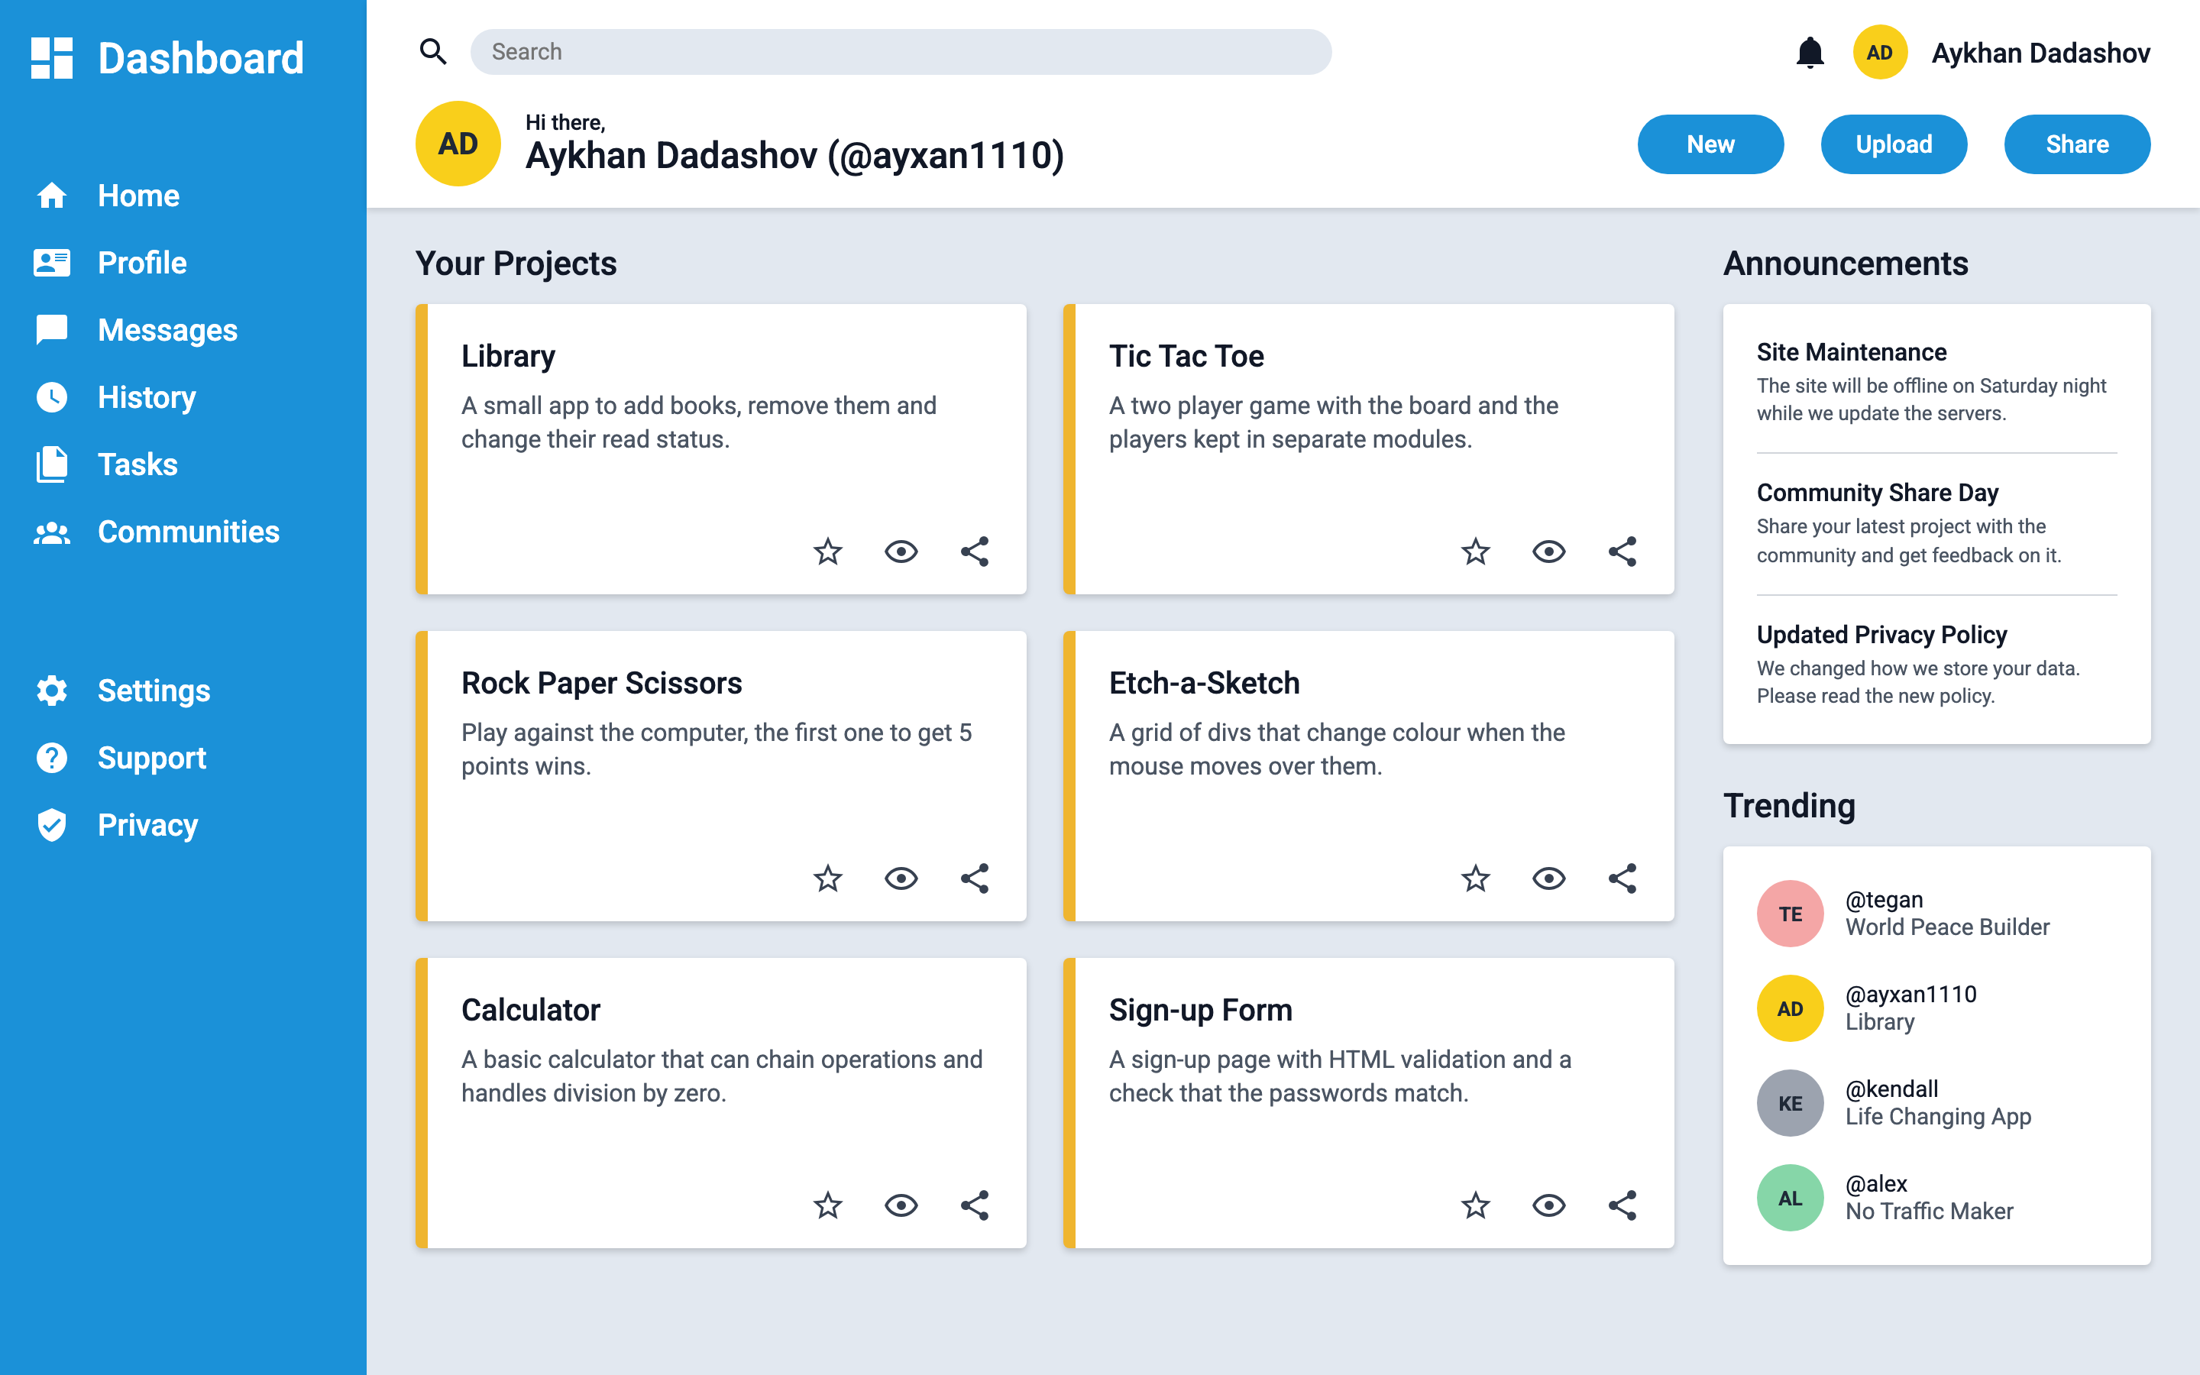
23
Project: Admin Dashboard
Page layout made with CSS Grid
Sidebar with icons (inline SVG)
Header with search, avatar and buttons
Project cards in a responsive grid
Announcements and Trending in the right column
Live ayxan1110.github.io/odin-admin-dashboard/
Code github.com/Ayxan1110/odin-admin-dashboard
Notes:
The final project of the course is the Admin Dashboard. The whole page is a grid: the sidebar on the left, the header on top and the main content. The icons are SVG icons from Material Design Icons. The project cards are also a grid, and they show my real projects. On the right there are announcements and trending users. Inside the cards and the header I used Flexbox to align the items.

Slide 27
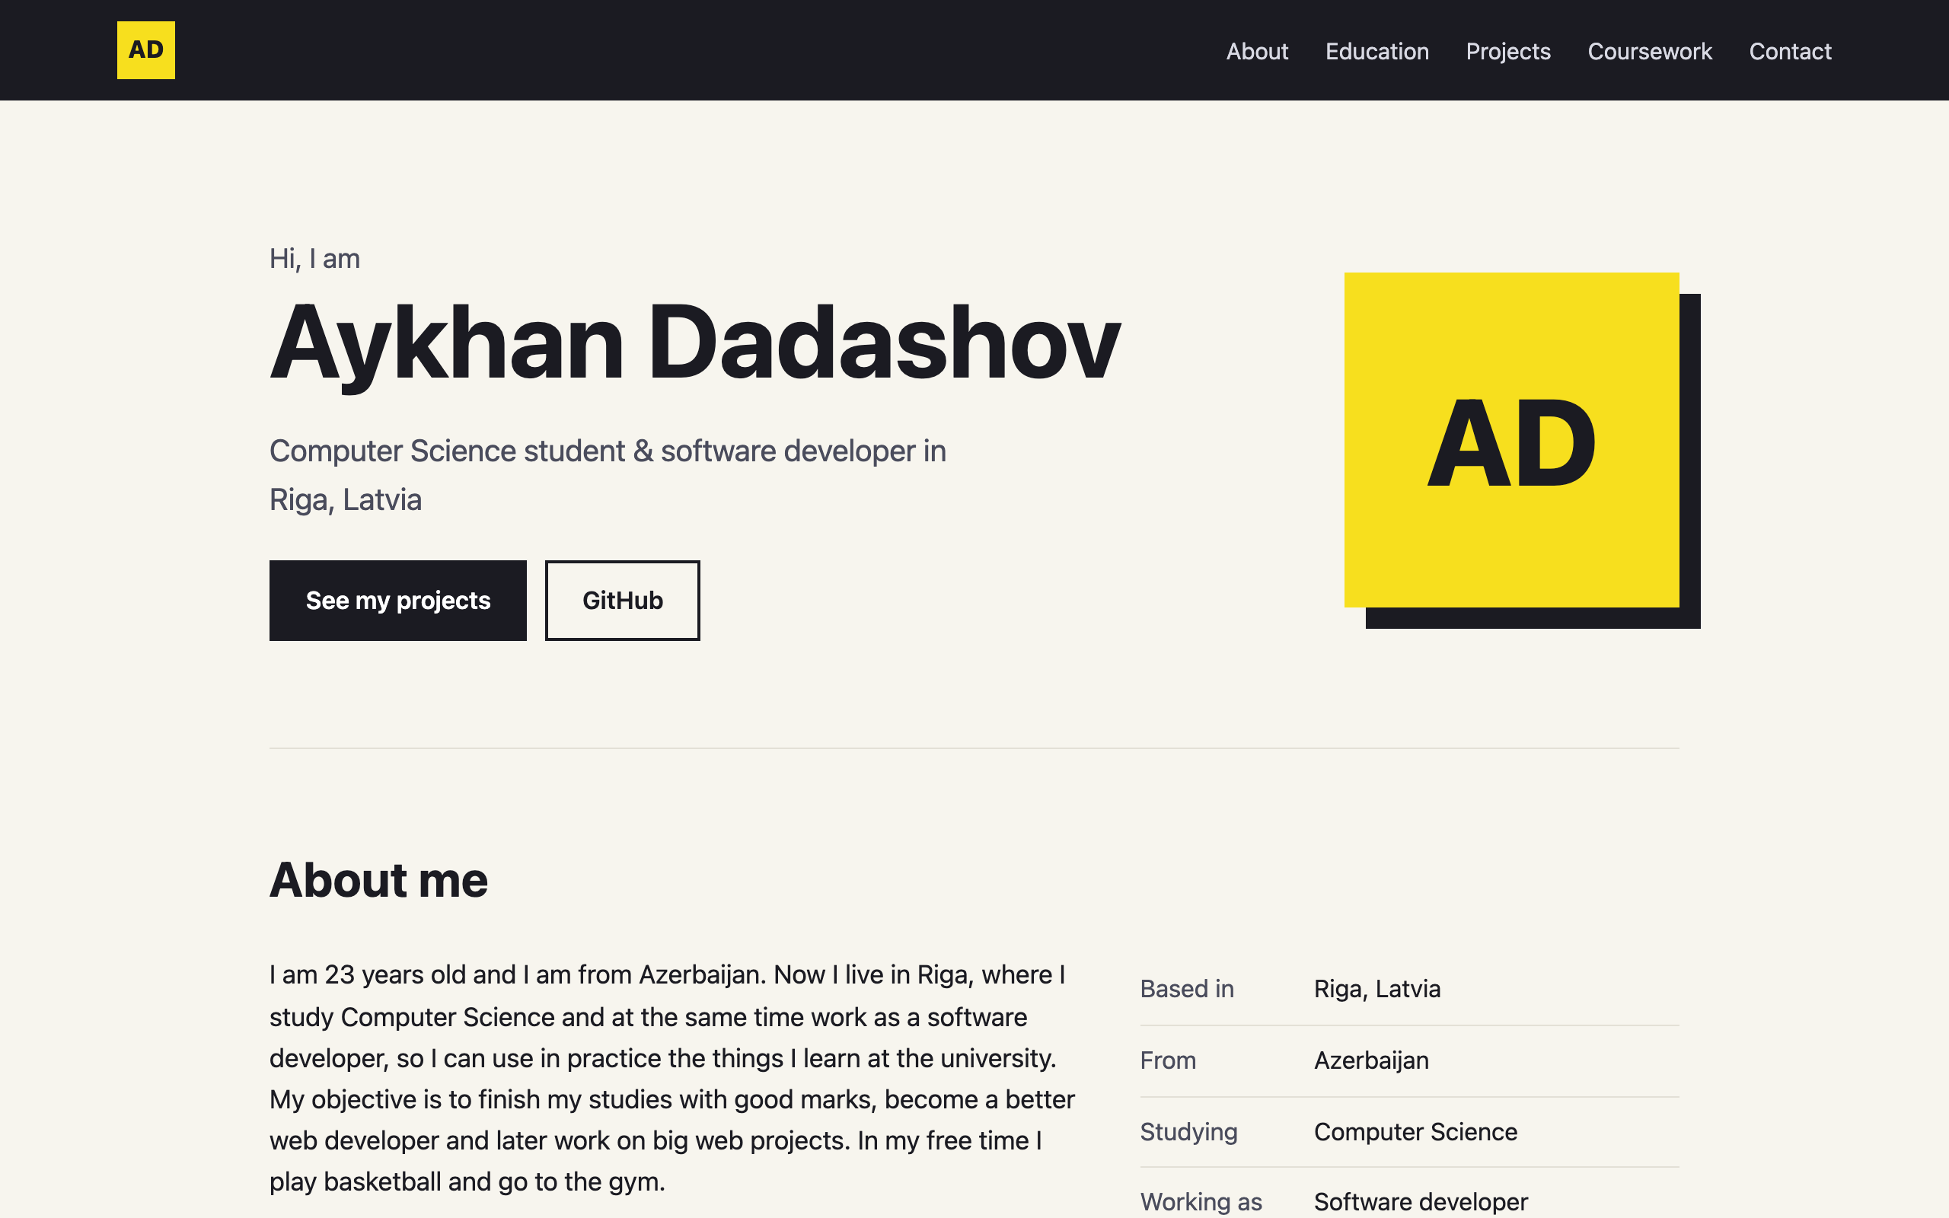
24
My profile page on GitHub Pages
Hosted for free with GitHub Pages
About me, education and skills
Cards linking to all my projects
Table with all Web Technologies tasks
Sticky nav, CSS variables, clamp(), Grid
Live ayxan1110.github.io/
Code github.com/Ayxan1110/Ayxan1110.github.io
Notes:
This is my profile page, and it is live on GitHub Pages. When a repository is called username dot github dot io, GitHub publishes it as the main website of the account. The page has an about me section, my education and skills, cards with links to all my projects and a table with all the tasks of this subject. Here I used things from the course like a sticky navigation, CSS variables, clamp for the font size and Grid for the cards.

Slide 28
PART 3
JavaScript course
Organizing your JavaScript code: Library and Tic Tac Toe
Notes:
The third part is the JavaScript course, about organizing code with objects, constructors and factory functions.

Slide 29
25
What I covered
1
2
3
4
Introduction: How This Course Will Work
Organizing Your JavaScript Code
Organizing Code with Objects
Object Constructors
5
6
7
Project: Library
Factory Functions and the Module Pattern
Project: Tic Tac Toe
Notes:
These are the lessons I completed. The yellow cards are the projects. First there is the introduction to the course, then the lessons about objects, object constructors and factory functions. After the theory lessons I made a project to practice: Library after object constructors, and Tic Tac Toe after factory functions and the module pattern.

Slide 30
26
Introduction: how the course works
Builds on Foundations – we already know variables, functions, loops and the DOM
Focus on structure – not only "does it work", but how to keep code clean when the project grows
Read, then build – each lesson has articles and knowledge checks, and every few lessons there is a project
Ask for help – the course recommends the Odin community on Discord when you are stuck
14
lessons in "Organizing Your JavaScript Code"
4
projects in the section: Library, Tic Tac Toe, Restaurant Page, Todo List
2
projects done so far: Library and Tic Tac Toe
Notes:
The JavaScript course continues after the Foundations course. In Foundations we learned the basics, and now the goal is to learn how to organize our code, so that it is still easy to read when a project becomes bigger. Every lesson has reading materials and knowledge check questions, and after some lessons there is a project. The section Organizing Your JavaScript Code has 14 lessons and 4 projects. I finished the first two projects: Library and Tic Tac Toe.

Slide 31
27
Organizing code with objects
Object literal – groups data that belongs together in one place
Dot or bracket notation – player.name or player["name"] (brackets work with variables)
Methods – functions inside an object, so data and behaviour live together
this – inside a method it points to the object that called it
Result – instead of many separate variables, one object keeps the code organized
objects.js
// without objects: loose variables
const playerOneName = "Aykhan";
const playerOneMarker = "X";
// with an object: grouped together
const playerOne = {
name: "Aykhan",
marker: "X",
sayHello() {
return `Hi, I am ${this.name}`;
},
};
playerOne.name; // "Aykhan"
playerOne["marker"]; // "X"
playerOne.sayHello(); // "Hi, I am Aykhan"
Notes:
In this lesson I learned why objects are useful for organizing code. On the left side of the code you can see the problem: if we have many players, we need many separate variables. With an object literal all the data of one player is in one place. We can read properties with dot notation or bracket notation. Bracket notation is useful when the property name is in a variable. Objects can also have methods, and inside a method the keyword this means the object itself.

Slide 32
28
Object constructors and prototypes
Constructor – a normal function we call with new to create many similar objects
new – creates an empty object, sets this to it and returns it
Prototype – every object has one; methods there are shared, not copied
Prototype chain – if a property is not found, JS looks in the prototype
Inheritance – Object.setPrototypeOf(Child.prototype, Parent.prototype)
constructor.js
function Book(title, author, pages, read) {
if (!new.target) throw Error("Use new");
this.title = title;
this.author = author;
this.pages = pages;
this.read = read;
}
// one shared function for all books
Book.prototype.toggleRead = function () {
this.read = !this.read;
};
const hobbit = new Book("The Hobbit",
"Tolkien", 295, true);
hobbit.toggleRead(); // read = false
Notes:
When we need many objects of the same type, writing every object literal by hand is a lot of repetition. An object constructor is a function that we call with the new keyword. new creates a new empty object, connects it to the prototype, runs the function with this pointing to the new object and returns it. I also added a check with new.target, so the constructor throws an error if someone forgets new. Methods like toggleRead are put on the prototype, so all books share one function instead of each book having its own copy. If JavaScript does not find a property on the object, it looks up the prototype chain.

Slide 33
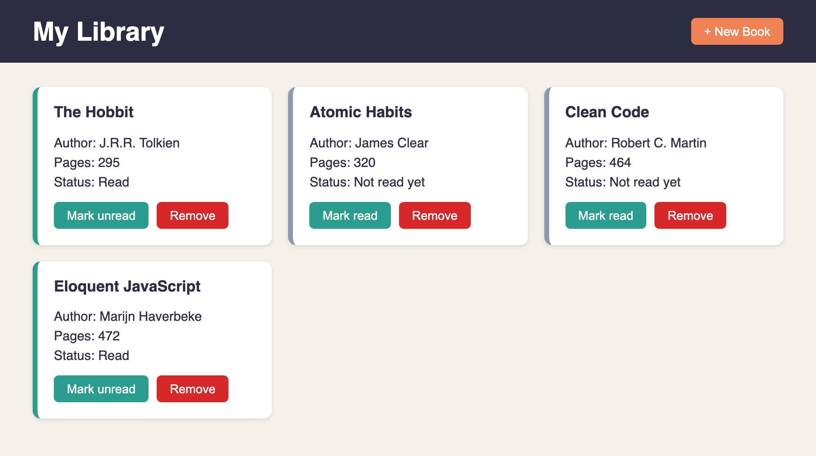
29
Project: Library
Shows all books as cards from the myLibrary array
"New Book" opens a <dialog> with a form
Remove a book with its button
Toggle read / not read with a prototype method
Every book has a unique id from crypto.randomUUID()
Live ayxan1110.github.io/odin-library/
Code github.com/Ayxan1110/odin-library
Notes:
This is my Library project. All books are stored in an array called myLibrary. Every book is an object made with the Book constructor. The page shows each book as a card with title, author, number of pages and read status. With the New Book button a dialog with a form opens. Each card has a button to change the read status and a button to remove the book. Now I will show it live in the browser.

Slide 34
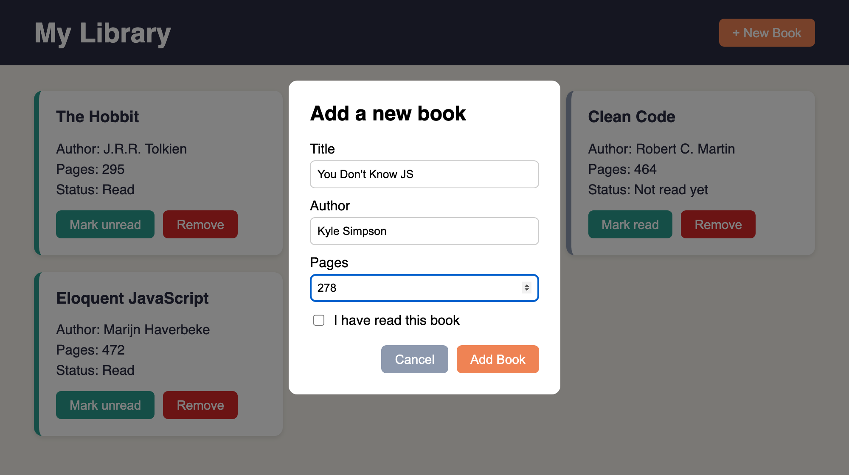
30
Library: how I built it
1
Open
Click on "New Book" calls dialog.showModal()
2
Submit
preventDefault() stops the page reload, then I read the input values
3
Store
addBookToLibrary() creates new Book(...) and pushes it to myLibrary
4
Display
The form inside <dialog>, opened with showModal()
displayBooks() clears the container and draws a card for every book
5
Connect
Each card has data-id, so Remove finds the right book in the array
Notes:
Here is how the Library works step by step. When I click New Book, the dialog opens with showModal. When the form is submitted, I call preventDefault, because by default a form tries to send the data to a server and reloads the page. Then I read the values from the inputs and call addBookToLibrary, which creates a new Book object and pushes it into the array. After that, displayBooks clears the container and creates the cards again from the array, so the page always shows exactly what is in the array. Every card has a data-id attribute with the id of the book, and this is how the Remove button knows which book to delete from the array.

Slide 35
31
Factory functions and the module pattern
Scope – variables live inside the function or block where they are declared
Closure – an inner function remembers the variables of its outer function
Factory function – a function that returns an object, no new and no this needed
Private variables – only reachable through the returned functions
Module (IIFE) – a factory that runs one time, for things we need only once
factory.js
// factory: we can make many players
function createPlayer(name, mark) {
return { name, mark };
}
const p1 = createPlayer("Aykhan", "X");
// module: runs once, board stays private
const Gameboard = (function () {
const board = ["", "", "", "", "",
"", "", "", ""];
const getBoard = () => board;
const placeMark = (i, mark) => {
if (board[i] !== "") return false;
board[i] = mark;
return true;
};
return { getBoard, placeMark };
})();
Notes:
This lesson explained another way to create objects. A factory function is a function that simply returns an object, so we do not need new or this. Because of closures, the functions inside can still use the variables of the outer function after it has finished, and those variables are private: from outside you cannot change them directly, only through the functions we return. The module pattern is the same idea, but the function is wrapped in an IIFE, an immediately invoked function expression, so it runs only once. This is good for things where we need exactly one, like the game board.

Slide 36
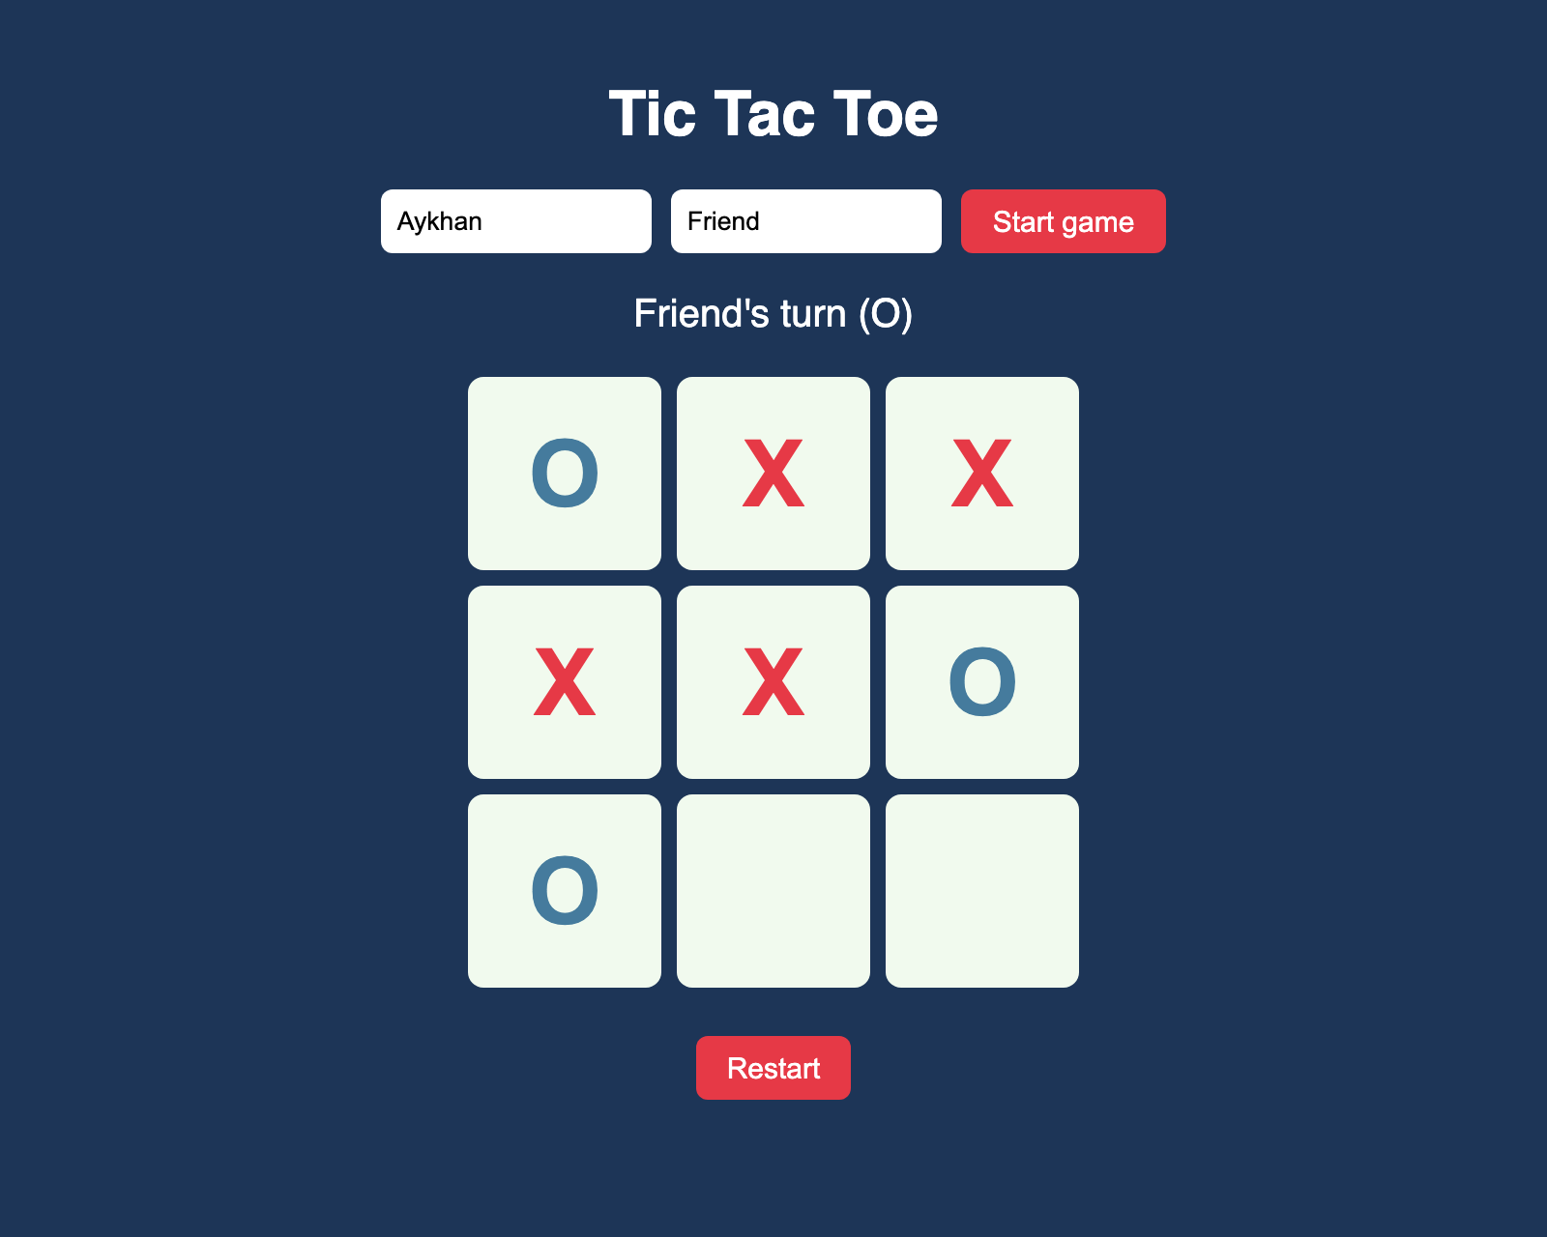
32
Project: Tic Tac Toe
Two players enter their names
Click a cell to place X or O
Taken cells cannot be clicked again
Detects all 8 winning lines and a tie
Restart button starts a new round
Live ayxan1110.github.io/odin-tic-tac-toe/
Code github.com/Ayxan1110/odin-tic-tac-toe
Notes:
My second project is Tic Tac Toe. The players write their names and press Start. Then they click on the cells and the game places X or O. You cannot click a cell that is already taken. The game checks all 8 winning lines, 3 rows, 3 columns and 2 diagonals, and shows who won or if it is a tie. With Restart you can play again. Let me show it in the browser.

Slide 37
33
Tic Tac Toe: code structure
Gameboard
module · IIFE
Private board array.
getBoard(), placeMark(), reset()
GameController
DisplayController
module · IIFE
module · IIFE
Whose turn it is, win and tie check.
start(), playRound(index)
The only part that uses the DOM.
render(), click and form events
createPlayer()
factory function
Returns { name, mark }.
Called twice: X and O
Game logic works without the DOM, so it can be played in the console
Notes:
The main goal of this project was to have as little global code as possible. I split the code into four parts. Gameboard is a module made with an IIFE, because there is only one board. The board array is private, other code can only use getBoard, placeMark and reset. createPlayer is a factory function, because we need two players. GameController is a module that knows whose turn it is, places the mark on the board and checks for a winner or a tie. DisplayController is the only part that touches the DOM: it draws the board and listens to the clicks. Because of this split, the game logic works even without the page, I could test it in the console first.

Slide 38
34
Problems I solved
form.title was empty
Books were duplicated
A <form> already has a built-in title property, so form.title did not return my input. I used document.querySelector("#title") instead.
Every time I added a book, all cards were added again. displayBooks() now clears the container first and then draws the array.
Win on the last move
Nine click listeners
If someone wins with the 9th move, the game must not say "tie". I check for a winner first and only then for a full board.
Instead of adding a listener to every cell, I add one listener on the board and read data-index from the clicked cell (event delegation).
Notes:
Here are some problems I had while building the projects and how I fixed them. First, in the Library I wanted to read the title input with form.title, but a form element already has its own title property, so it was empty. I changed it to querySelector. Second, books appeared two times, because I added new cards without removing the old ones, so now displayBooks clears the container first. Third, in Tic Tac Toe a win on the last move was counted as a tie, so I check the winner before checking if the board is full. And finally, instead of nine event listeners I used one listener on the board, this is called event delegation.

Slide 39
PART 4
Advanced HTML and CSS
Animation, accessibility, responsive design and the Homepage
Notes:
The fourth part is Advanced HTML and CSS: animation, accessibility and responsive design.

Slide 40
35
Advanced HTML and CSS: what I covered
Animation
Accessibility
Responsive Design
Transforms
Transitions
Keyframes
Introduction to Web Accessibility
WCAG
Semantic HTML
Accessible Colors
Keyboard Navigation
Meaningful Text
WAI-ARIA
Accessibility Auditing
Introduction to Responsive Design
Natural Responsiveness
Responsive Images
Media Queries
Project: Homepage
Notes:
The course has three parts. Animation, with transforms, transitions and keyframes. Accessibility, which is the biggest part, with eight lessons about making websites usable for everyone. And responsive design, which ends with the Homepage project.

Slide 41
36
Transforms and transitions
transform – move, rotate, scale or skew an element without changing the layout
Functions – translate(), rotate(), scale(), skew(), and 3D versions
transition – animates a change between two states, like on :hover
Parts – property, duration, timing function (ease) and delay
Performance – animate transform and opacity, they are cheap for the browser
animation.css
.card {
transition: transform 0.25s ease,
box-shadow 0.25s ease;
}
/* lift the card on hover */
.card:hover {
transform: translateY(-6px);
box-shadow: 0 12px 24px rgb(0 0 0 / 0.15);
}
/* small rotation on the logo */
.logo:hover {
transform: rotate(-6deg);
}
Notes:
Transforms change how an element looks: we can move it with translate, rotate it, scale it or skew it, and the rest of the layout does not move. A transition animates the change between two states, for example the normal state and the hover state. We define which property changes, how long it takes and the timing function. The course recommends to animate mostly transform and opacity, because the browser can do them very fast. In my Homepage the project cards go up a little on hover.

Slide 42
37
Keyframes
@keyframes – define the steps of an animation with from / to or percentages
animation – name, duration, timing, delay, iteration-count, direction
Difference – a transition needs a trigger, keyframes can run on their own and loop
fill-mode – keeps the styles of the first or last keyframe
Use it carefully – too much movement can be distracting
keyframes.css
@keyframes bounce {
0% { transform: translateY(0); }
50% { transform: translateY(-20px); }
100% { transform: translateY(0); }
}
.ball {
animation-name: bounce;
animation-duration: 1s;
animation-timing-function: ease-in-out;
animation-iteration-count: infinite;
}
/* shorthand */
.ball { animation: bounce 1s infinite; }
Notes:
Keyframes are for more complex animations. With the keyframes rule I describe the steps of the animation, for example at 0, 50 and 100 percent. Then I connect it to an element with the animation property, where I set the duration, the timing and how many times it repeats. The main difference with transitions is that a transition needs a change of state, like hover, but a keyframe animation can start by itself and loop forever, like this bouncing ball.

Slide 43
38
Web accessibility and WCAG
Why accessibility
WCAG
Many people use the web with a screen reader, only the keyboard, zoom or with colour blindness. An accessible site works for all of them, and it is also better for SEO.
The Web Content Accessibility Guidelines. Four principles (POUR): Perceivable, Operable, Understandable, Robust, and three levels A, AA and AAA. Most sites aim for AA.
Semantic HTML
Accessible colours
Use the right element: <button> for actions, <a> for links, <nav>, <main>, <header>, headings in order. Screen readers understand the page from these elements.
Text needs enough contrast with the background: at least 4.5:1 for normal text (AA). Never use only colour to show information, like errors.
Notes:
Web accessibility means that people with disabilities can use the website, for example people who use a screen reader, only a keyboard, or who cannot see some colours. The WCAG guidelines describe how to do it, with four principles: perceivable, operable, understandable and robust, and three levels. The most important practical thing is semantic HTML: when we use the correct elements, like button, nav and main, the screen reader understands the page. Colours also need enough contrast, at least 4.5 to 1 for normal text.

Slide 44
39
Keyboard navigation and meaningful text
Keyboard – everything must work with Tab, Enter and Space
Focus styles – never remove the outline without a better :focus-visible style
Skip link – lets keyboard users jump over the navigation
Meaningful text – links like "View Library code" instead of "click here"
alt text – describe what the image shows; empty alt for decoration
a11y.html
<!-- first element in the body -->
<a class="skip-link" href="#main">Skip to content</a>
.skip-link {
position: absolute;
top: -100px; /* hidden above */
}
.skip-link:focus {
top: 0; /* visible on Tab */
}
a:focus-visible {
outline: 3px solid var(--accent);
}
<img src="library.jpg"
alt="Library app with book cards">
Notes:
Many users navigate only with the keyboard, so every link and button must be reachable with Tab and usable with Enter. The focus outline shows where you are, so we should never remove it, or we replace it with a better focus-visible style. A skip link is the first element on the page: it is hidden, but when you press Tab it appears and lets you jump directly to the main content. I added one to my Homepage. Text should also be meaningful: a screen reader user often hears only the list of links, so 'click here' tells nothing. And images need alt text that describes them.

Slide 45
40
WAI-ARIA and accessibility auditing
What ARIA is
First rule of ARIA
Attributes that give extra information to screen readers: role, aria-label, aria-labelledby, aria-hidden, aria-expanded, aria-live.
Don't use ARIA if a native HTML element can do it. A <button> is better than a <div role="button">. No ARIA is better than bad ARIA.
In my Homepage
Auditing
aria-labelledby connects each section to its heading, aria-label names the navigation, and aria-hidden hides decorative SVG icons.
Lighthouse in Chrome DevTools, the axe extension and WAVE find many problems automatically. Then I test by hand with the keyboard and zoom.
Notes:
WAI-ARIA is a set of attributes that give extra information to assistive technology, for example a label for an icon button, or aria-hidden to hide decorative icons. But the first rule of ARIA is to not use it when a normal HTML element already does the job. In my Homepage I used aria-labelledby for the sections, aria-label for the navigation and aria-hidden for the icons. To check accessibility we can use tools like Lighthouse, axe or WAVE, and then test by hand with only the keyboard.

Slide 46
41
Natural responsiveness and responsive images
Responsive design – one website that works on phone, tablet and desktop
Natural responsiveness – avoid fixed widths; use max-width, %, Flexbox and Grid
Viewport meta tag – required, or phones show a zoomed-out desktop page
Images – max-width: 100% so they shrink with the container
srcset and sizes – the browser downloads the right image size
responsive.html
<meta name="viewport" content="width=device-width">
img { max-width: 100%; height: auto; }
/* cards wrap by themselves, no media query */
.projects {
display: grid;
grid-template-columns:
repeat(auto-fit, minmax(280px, 1fr));
}
<img src="library-800.jpg"
srcset="library-400.jpg 400w,
library-800.jpg 800w"
sizes="(min-width: 960px) 340px, 90vw"
alt="Library app">
Notes:
Responsive design means one website that looks good on every screen. The course teaches that most of the work is natural responsiveness: if we avoid fixed widths and use max-width, Flexbox and Grid, the page already adapts. The viewport meta tag is required, otherwise the phone shows a small desktop version. For images, max-width 100 percent makes them shrink, and with srcset and sizes the browser chooses the smallest image that is good enough, so phones download less data. My Homepage uses this for all project screenshots.

Slide 47
42
Media queries
@media – apply CSS only when a condition is true, like a minimum width
Mobile first – write phone styles first, then add min-width queries
Breakpoints – choose them where the design breaks, not for specific devices
Other features – prefers-color-scheme, prefers-reduced-motion, print
My breakpoints – 640px (tablet) and 960px (desktop)
media.css
/* phone first: no media query */
.hero-inner { display: grid; }
/* tablet and up */
@media (min-width: 640px) {
.hero { padding: 4rem 0; }
}
/* desktop: text left, portrait right */
@media (min-width: 960px) {
.hero-inner {
grid-template-columns: 1fr 340px;
}
}
@media (prefers-reduced-motion: reduce) {
* { transition: none !important; }
}
Notes:
Media queries apply CSS only when a condition is true, usually a screen width. The course recommends mobile first: I write the styles for phones first, and then add min-width media queries for bigger screens. Breakpoints should be where the design starts to look bad, not for specific phones. In my Homepage I have two breakpoints: 640 pixels for tablets and 960 pixels for desktop, where the hero becomes two columns. There is also prefers-reduced-motion, which turns off animations for people who get dizzy from movement.

Slide 48
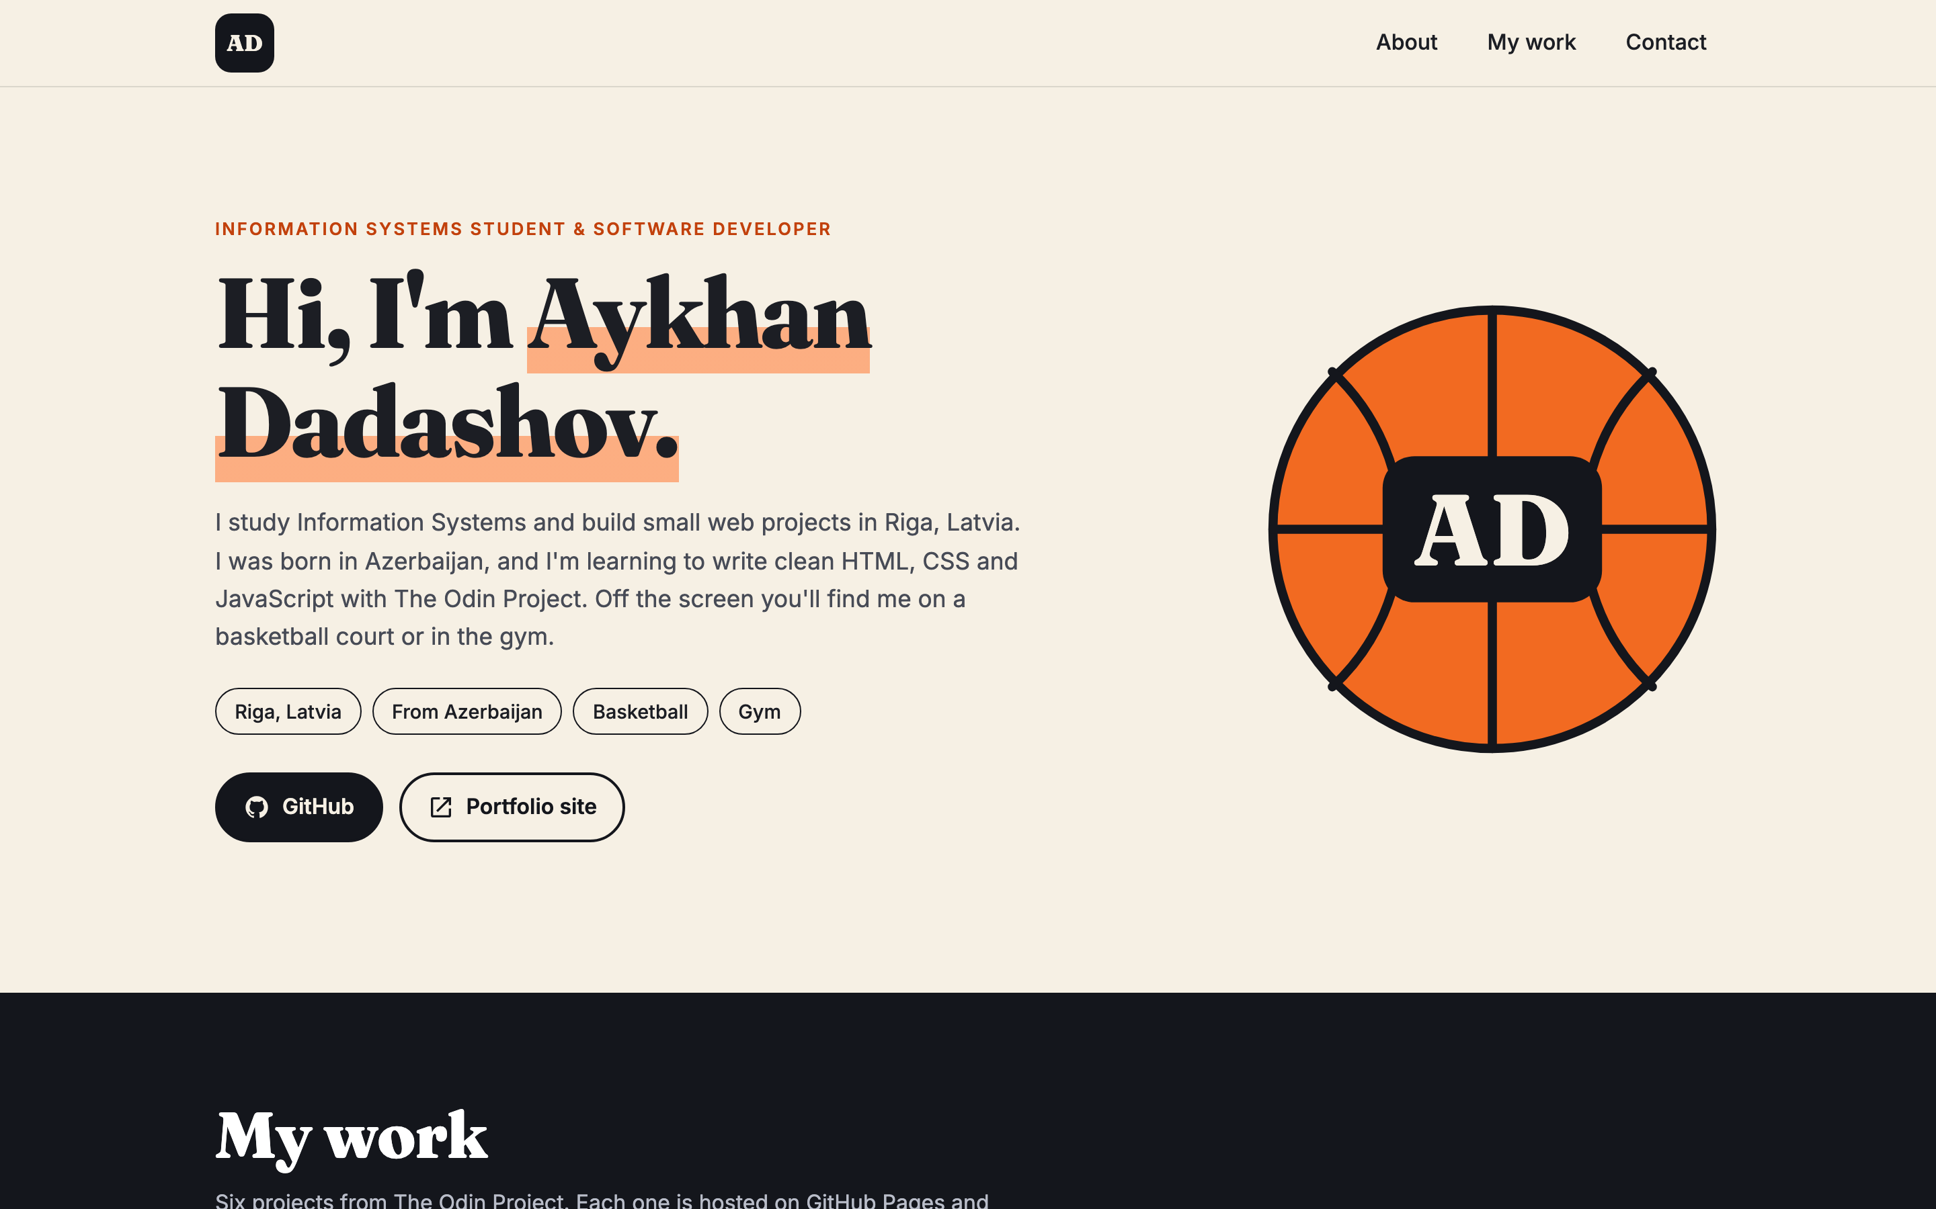
43
Project: Homepage
Personal homepage with my real projects
Mobile first, breakpoints at 640px and 960px
Responsive images with srcset and sizes
Hover transitions on cards and the logo
Skip link, focus styles, reduced motion
Live ayxan1110.github.io/odin-homepage/
Code github.com/Ayxan1110/odin-homepage
Notes:
The project of this course is the Homepage, a personal page where I show my projects. It works from 320 pixels up to 1920 pixels wide. The project grid changes from one column on phones to three columns on desktop. The screenshots use srcset, so phones load small images. Cards and the logo have hover transitions, and everything works with the keyboard, with a skip link and visible focus styles. If the user prefers reduced motion, the animations are turned off.

Slide 49
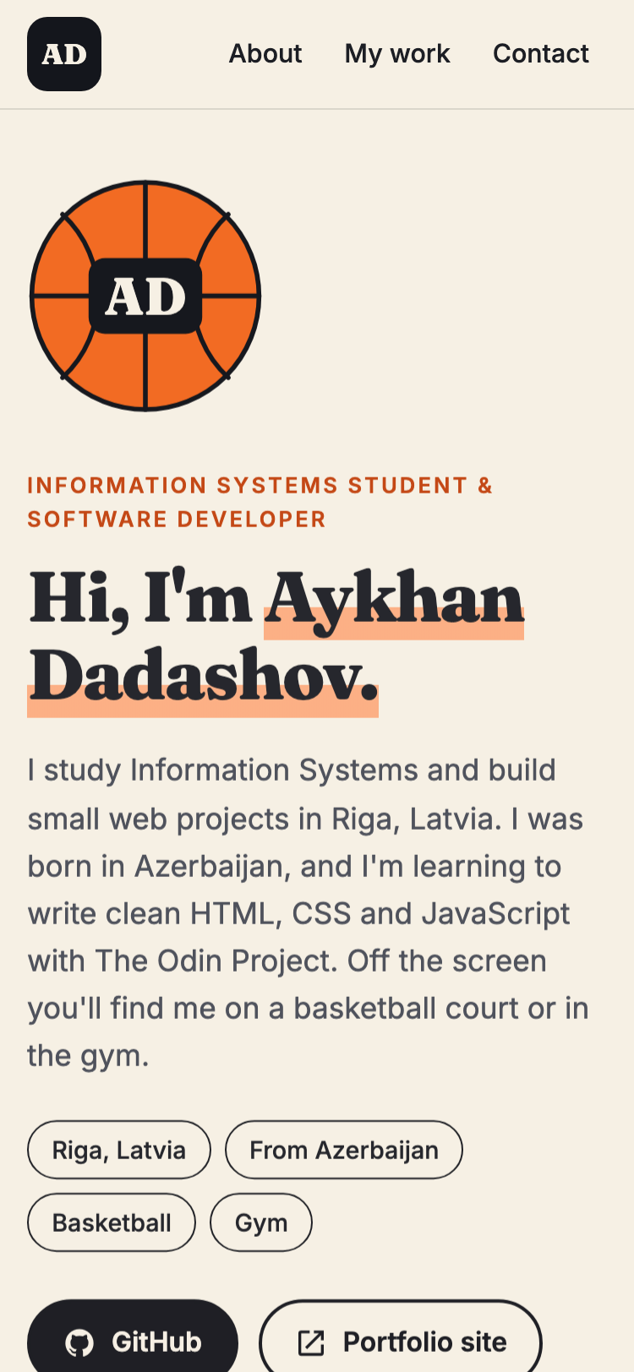
44
Homepage on phone and desktop
Same HTML, different layout: one column on the phone, two columns on desktop
Notes:
Here you can see the same page on a phone and on a desktop. The HTML is exactly the same, only the CSS changes with the media queries and the auto-fit grid. On the phone the portrait is on top and the projects are in one column, on the desktop the hero has two columns and the projects are in three columns. Now I will show it live in the browser and also navigate it only with the keyboard.

Slide 50
PART 5
Project idea: CareerBridge
An AI career coach for international students in Latvia
Notes:
The last part is my project idea, CareerBridge, which I pitched on the 11th of November.

Slide 51
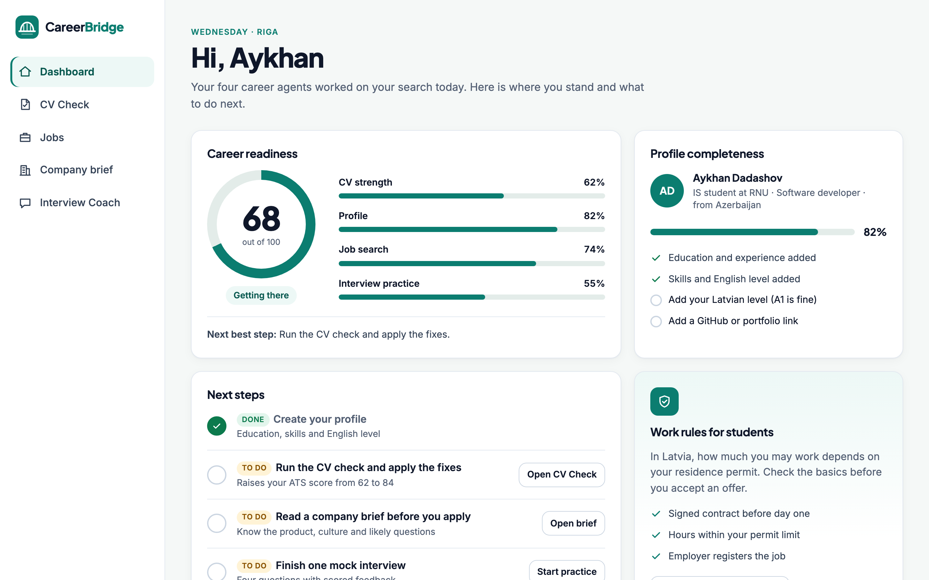
45
CareerBridge in one slide
Problem – only 43% of non-EU graduates stayed in Latvia to work in 2024 (58% in 2022)
Solution – four AI agents: CV check, job scout, company brief, interview coach
Human in control – the student approves every CV and application
Model – free for students, Pro €4.99 / month, licences for universities, job posts for employers
Based on – 7 GitHub repos I reviewed, like awesome-llm-apps, STORM and ai-employees
Prototype ayxan1110.github.io/careerbridge-prototype/
Notes:
CareerBridge is an AI career coach for international students. The problem is that fewer than half of non-EU graduates stay to work in Latvia. Four AI agents help with the CV, the job search, company research and interview practice, and the student is always in control. The full pitch has its own presentation, and the prototype is live.

Slide 52
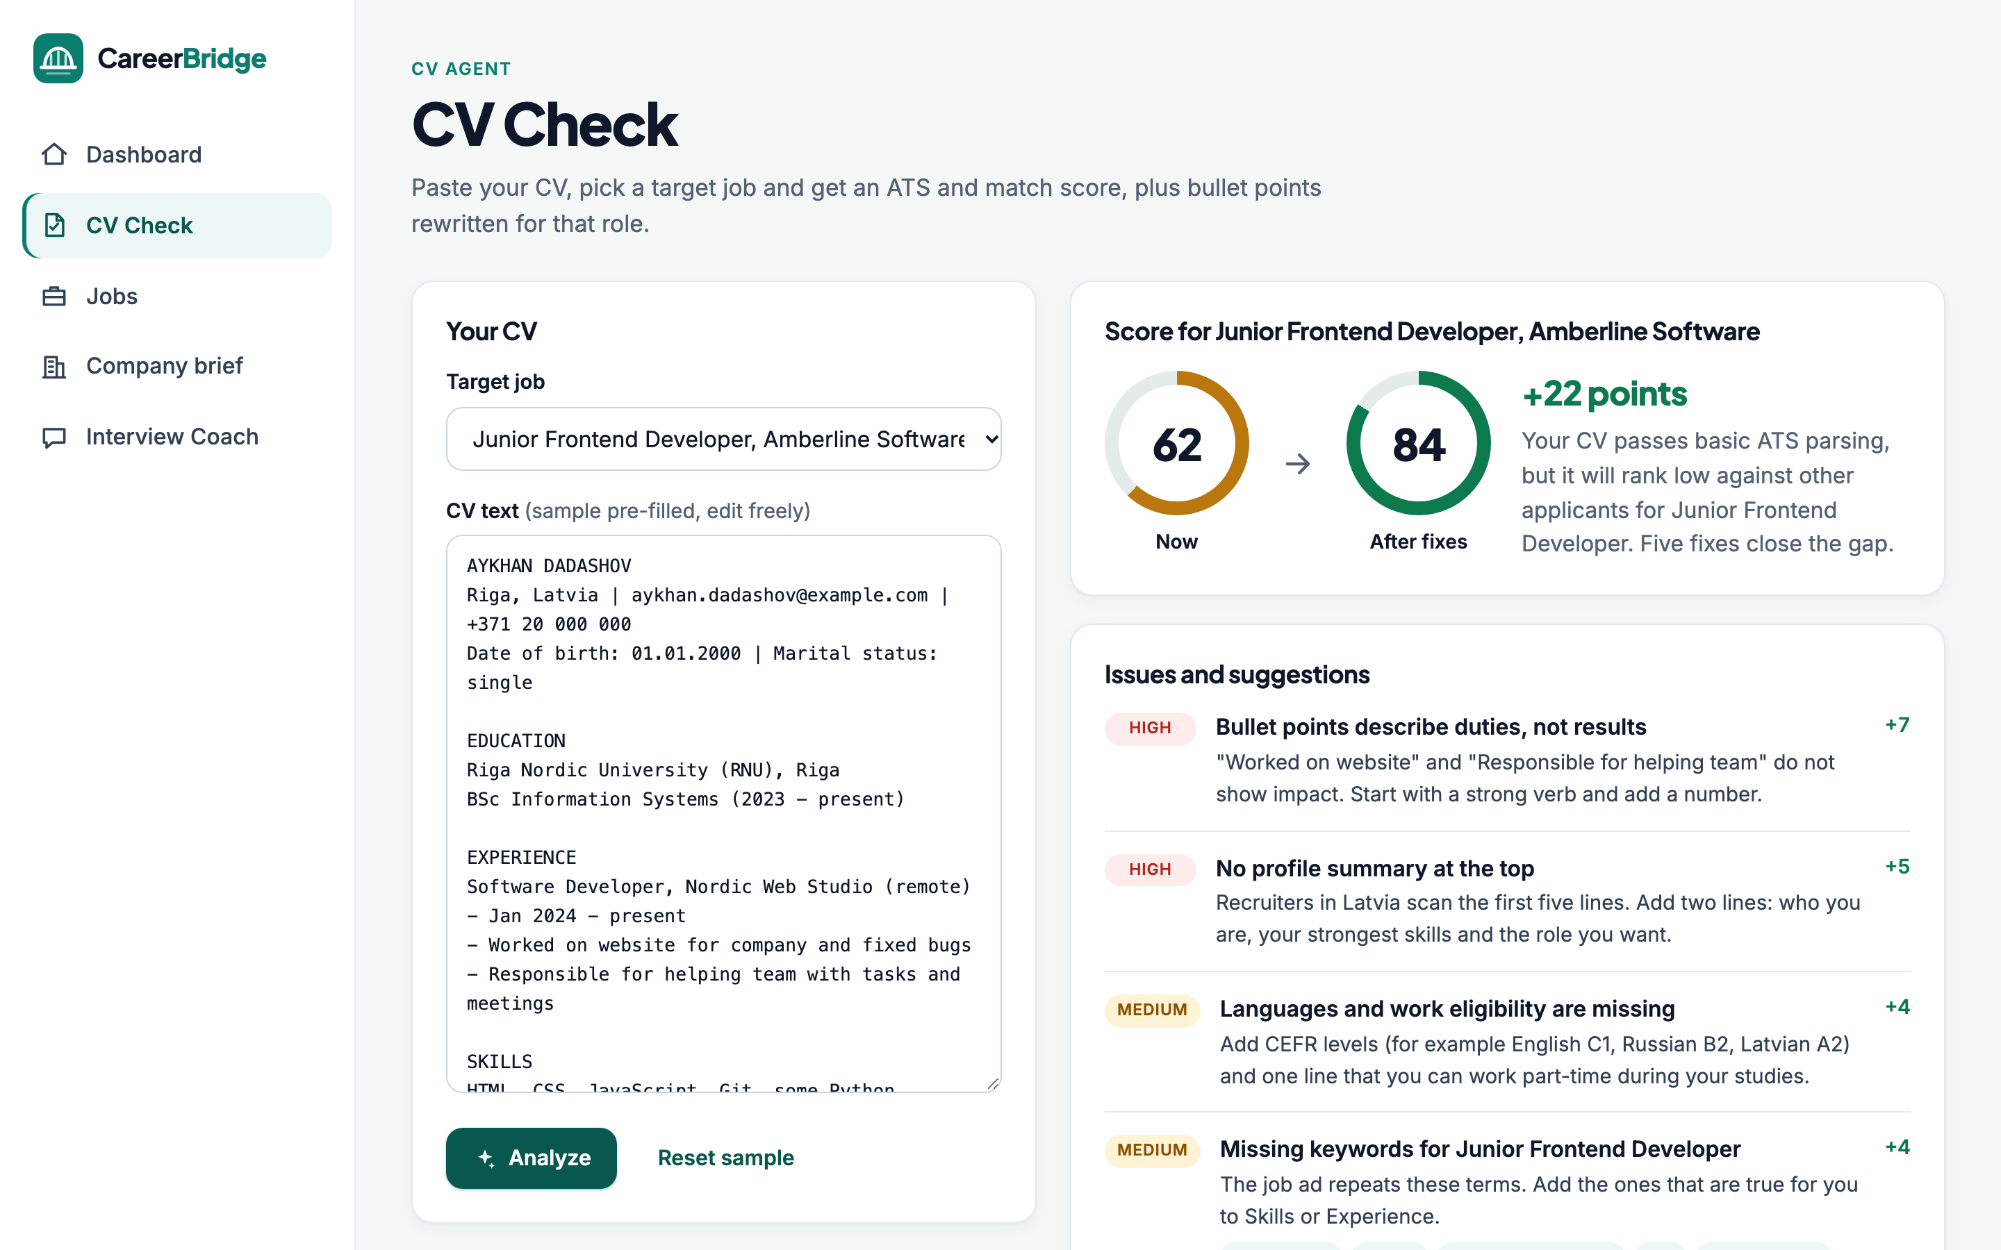
46
CareerBridge: clickable prototype
Dashboard with a career readiness score
CV Check: score 62 → 84 with fixes
Jobs with match % and real filters
Company brief with citations
Interview Coach with feedback
Live ayxan1110.github.io/careerbridge-prototype/
Code github.com/Ayxan1110/careerbridge-prototype
Notes:
The prototype has five screens. Here is the CV check, where the score goes from 62 to 84 after the fixes. It works with demo data, and I built it with plain HTML, CSS and JavaScript.

Slide 53
47
All links
Project | Code on GitHub
Rock Paper Scissors | github.com/Ayxan1110/odin-rock-paper-scissors
Etch-a-Sketch | github.com/Ayxan1110/odin-etch-a-sketch
Calculator | github.com/Ayxan1110/odin-calculator
Sign-up Form | github.com/Ayxan1110/odin-sign-up-form
Admin Dashboard | github.com/Ayxan1110/odin-admin-dashboard
Library | github.com/Ayxan1110/odin-library
Tic Tac Toe | github.com/Ayxan1110/odin-tic-tac-toe
Homepage | github.com/Ayxan1110/odin-homepage
CareerBridge | github.com/Ayxan1110/careerbridge-prototype
Profile with everything | ayxan1110.github.io/
Notes:
These are the links to the code of every project. Everything is also on my profile page, ayxan1110.github.io. Thank you for watching!

