Slide 1
CERT
WEB TECHNOLOGIES · MY CERTIFICATES
My certificates
Aykhan Dadashov · Web Technologies · RNU
Notes:
Hello, my name is Aykhan Dadashov. In this presentation I show all my certificates in one place.

Slide 2
01
Overview
Certificate | Issued by | Date
Frontend Developer (React) | HackerRank | 02 Dec 2024
Magebit Summer Bootcamp 2025 | Magebit, Riga | 11 July 2025
Notes:
Here is the list of my certificates with who issued them and when.

Slide 3
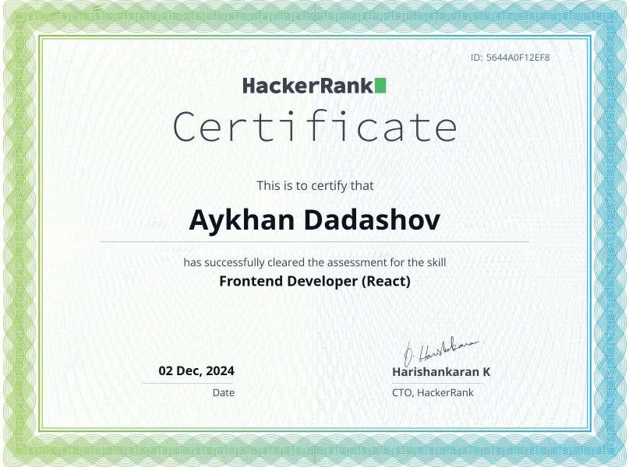
02
Frontend Developer (React)
Issued by
HackerRank
Date
02 Dec 2024
Timed skill test for front-end development with React
Passed on HackerRank, verifiable online
Certificate ID: 5644A0F12EF8
Verify online
hackerrank.com/certificates/5644a0f12ef8
Notes:
My first certificate is the HackerRank Frontend Developer certificate for React, from December 2024. To get it I passed a timed skills test about React and JavaScript. You can verify it with the link on the slide.

Slide 4
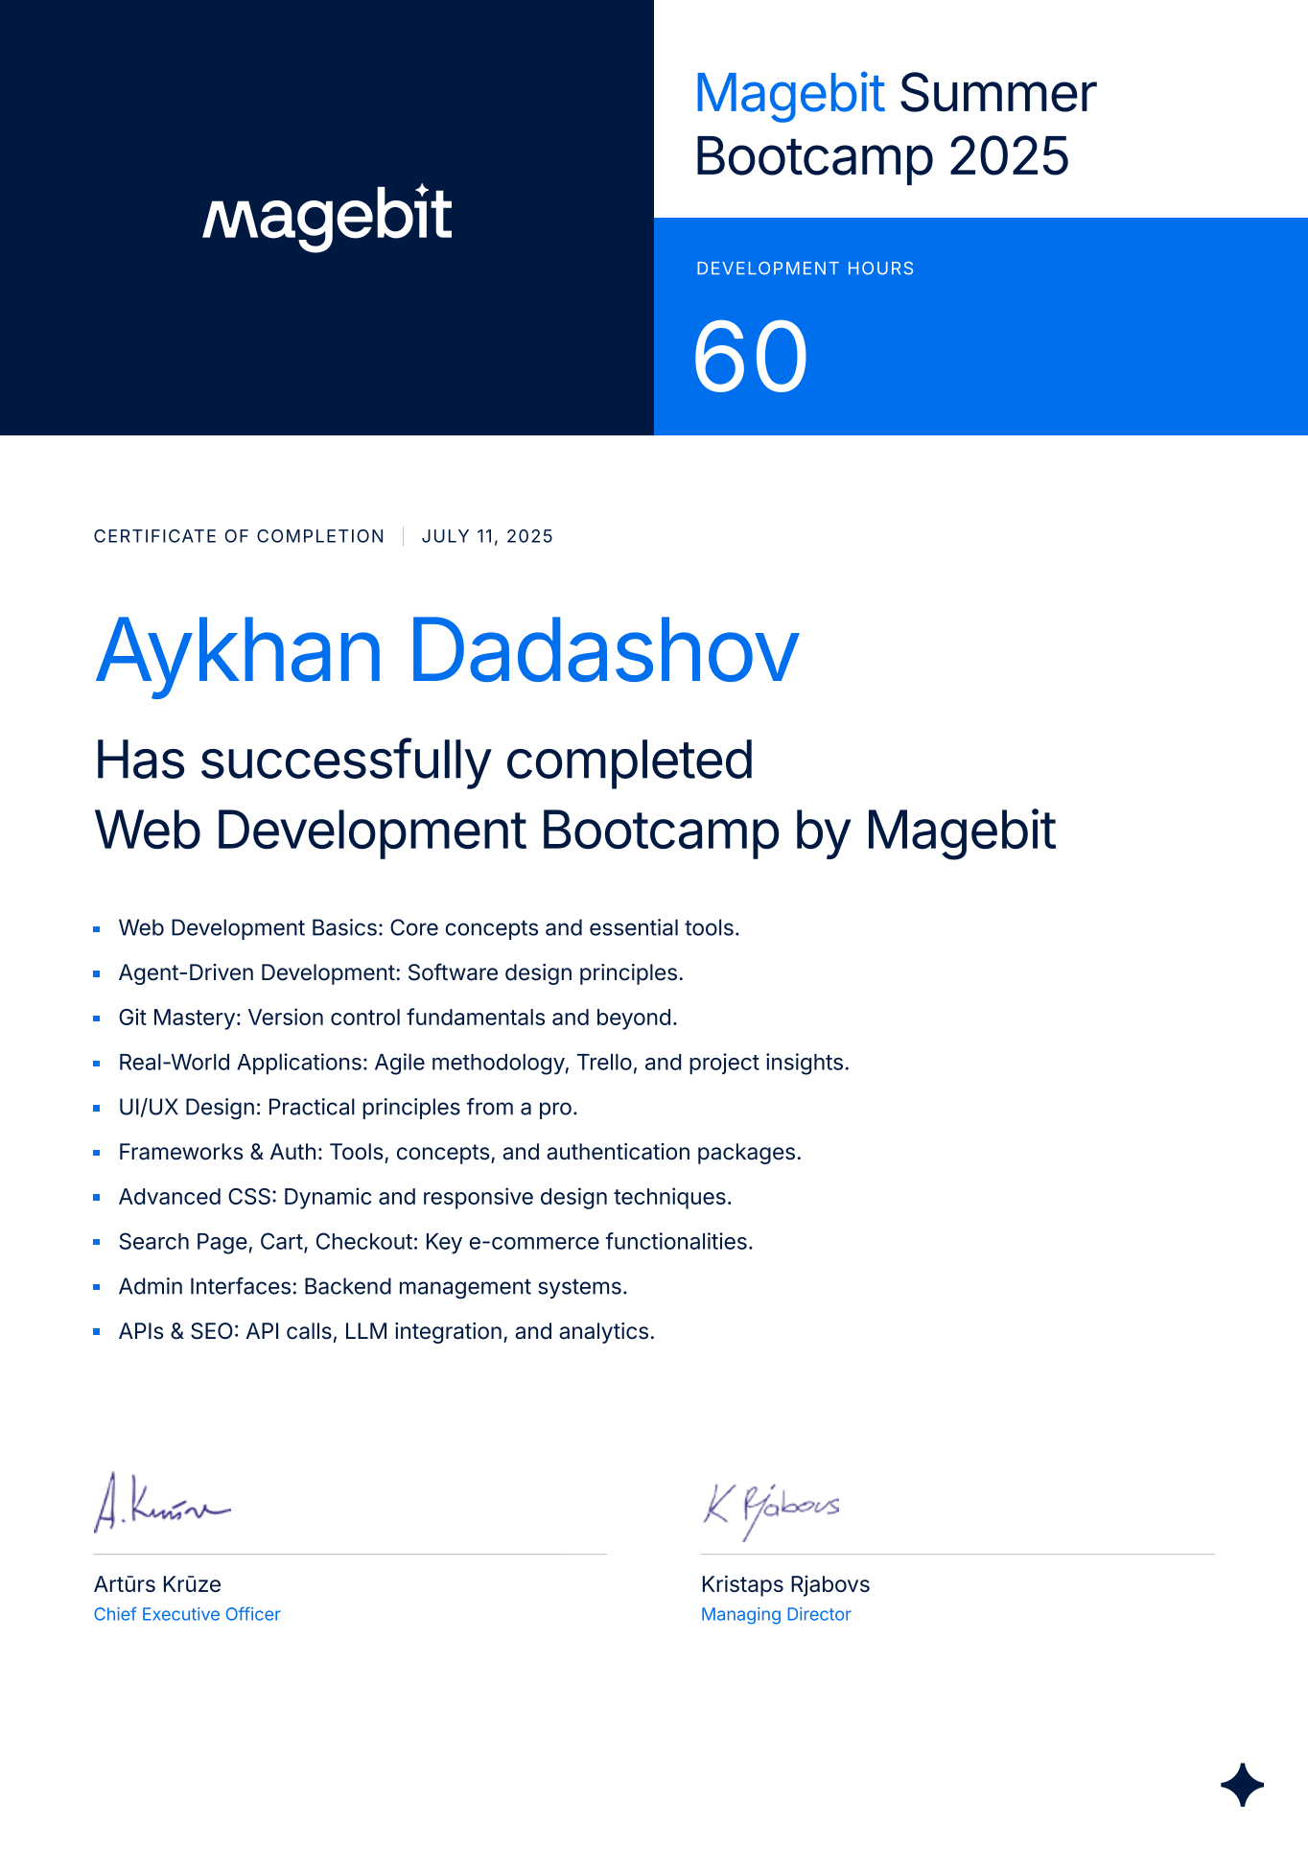
03
Magebit Summer Bootcamp 2025
Issued by
Magebit, Riga
Date
11 July 2025
Web Development Bootcamp, 60 development hours
Git, advanced CSS, frameworks and auth, APIs and LLM integration
Built an e-commerce site in Laravel: search, cart, checkout, admin
Our project won Best Overall Project (1st place)
Notes:
My second certificate is from the Magebit Summer Bootcamp 2025 in Riga, finished on the 11th of July 2025, with 60 development hours. We learned Git, advanced CSS, frameworks and authentication, and API and LLM integration. I built an e-commerce website with Laravel, with search, cart, checkout and an admin panel, and our project won first place as the best overall project.

