Slide 1
AI CAREER COACH FOR INTERNATIONAL STUDENTS
CareerBridge
From "I study in Latvia" to "I work in Latvia"
Aykhan Dadashov · ISMA, Information Systems · Web Technologies · 11.11.2026
Notes:
Hello, I'm Aykhan Dadashov. I came to Riga from Azerbaijan, I study Information Systems at ISMA and I work as a software developer. My project is CareerBridge, an AI career coach for international students in Latvia. It helps them go from studying in Latvia to working in Latvia.

Slide 2
01 · EXECUTIVE SUMMARY
One coach that gets international students hired
Problem
About 11,900 international students study in Latvia, but fewer than half of non-EU graduates stay to work here.
Solution
CareerBridge: four AI agents that fix your CV, find jobs you can actually take, research the company and train you for the interview.
Market
Start with ~7,000 non-EU students in Latvia, then the Baltics and the EU.
Model
Free for students, Pro €4.99 / month, licences for universities, paid job posts for employers.
Ask
Pilot with ISMA's career centre in spring 2027 and an incubator grant to build the MVP.
CareerBridge
Notes:
In short: thousands of international students study in Latvia, but most of them leave or work below their level after graduation. CareerBridge is a team of four AI agents that gets them job-ready. Students use it for free, and universities and employers pay. I want to start with a pilot at ISMA.

Slide 3
02 · INTRODUCTION · PROBLEM ANALYSIS
Students come, but talent leaves
11,900
43%
20 h
Non-EU graduates more often work in less qualified jobs than Latvian graduates [2]
international students in Latvia in 2025/26 [1]
of non-EU graduates stayed to work or look for work in 2024, down from 58% in 2022 [2]
per week: the work limit for bachelor students during term [3]
Why is this a problem?
Wrong CV format – local recruiters expect a different CV than at home
Language wall – many ads need Latvian; English-friendly jobs are hard to find
No network – students don't know which companies hire foreigners
Rules – unsure about work hours and permits, employers are unsure too
[1] Invest Latvia [2] BICEPS study via LETA, 29.11.2025 [3] EU Immigration Portal, Apr 2025
CareerBridge
Notes:
Here is the problem. Almost twelve thousand international students study in Latvia. But in 2024 only 43 percent of non-EU graduates stayed to work, and this number is going down every year. And the ones who stay often work below their qualification. I saw why with my friends and myself: the CV format is different, many jobs need Latvian, we have no network, and nobody explains the work rules.

Slide 4
03 · INTRODUCTION · MISSION & VISION
Why CareerBridge exists
Mission
Vision
Give every international student in Latvia a personal career coach that makes them job-ready, so their talent is used here.
By 2030, the go-to career platform for international students in the Baltics and Europe.
Objective
Goals for the first year
Close the gap between studying and working: better CVs, honest job matching and real interview practice, using AI agents with a human in control.
1,500
+20
students using it
points CV score on average
30%
3
get an interview in 6 weeks
partner universities
CareerBridge
Notes:
Our mission is to give every international student a personal career coach, so their talent stays and is used in Latvia. The vision is to become the main career platform for international students in the Baltics and Europe by 2030. In the first year the goals are 1,500 students, a 20 point better CV score, 30 percent of users getting an interview within six weeks, and three partner universities.

Slide 5
04 · SOLUTION
A team of four AI agents, one goal: your first job
CV Agent
Job Scout
Company Brief
Interview Coach
Scores your CV for a job, explains what is missing and rewrites bullet points in the local style.
Finds jobs you can really take: English OK, 20 h/week for students, hybrid, junior. Shows a match %.
Writes a short cited brief about the company before you apply or interview (STORM-style).
Mock interviews in chat with feedback on clarity, relevance and the STAR structure.
1
2
3
4
Human in control: CareerBridge never applies or sends anything by itself. The student approves every CV and every application, and a human career advisor reviews hard cases.
CareerBridge
Notes:
The solution is a team of four AI agents. The CV agent scores and rewrites your CV for a specific job. The job scout finds jobs you can actually take, in English and with student hours. The company research agent writes a short brief with sources before your interview, and the interview coach trains you with mock interviews. Important: the AI never applies for you. You approve everything.

Slide 6
05 · FRAMEWORK · TECHNOLOGY
How it is built
Web app
Ideas taken from the repos I reviewed
Next.js + Tailwind CSS · responsive, works on the phone
awesome-llm-apps – the recruitment agent team, turned around for job seekers
STORM – research, outline and cited writing for company briefs
ai-employees / markus – agents with roles, logs and human approval
novel-agent – a review loop with scores before output
API and agents
NestJS (Node.js) · agent orchestration with LangGraph · Claude LLM API
Data
PostgreSQL + pgvector (CV and job embeddings) · job board APIs · web search for STORM briefs
Analytics with PostHog · GDPR: data stored in the EU, the user can delete everything
CareerBridge
Notes:
For the technology I use what I already work with as a developer: Next.js for the web app, NestJS for the API, and PostgreSQL with pgvector for semantic matching between CVs and jobs. At work I built semantic search with vector embeddings, so this is the same skill. The agents run with LangGraph and the Claude API. From the repos I reviewed, I took the recruitment agent team idea, STORM for the cited company briefs, the human approval from ai-employees and Markus, and the review loop from novel-agent.

Slide 7
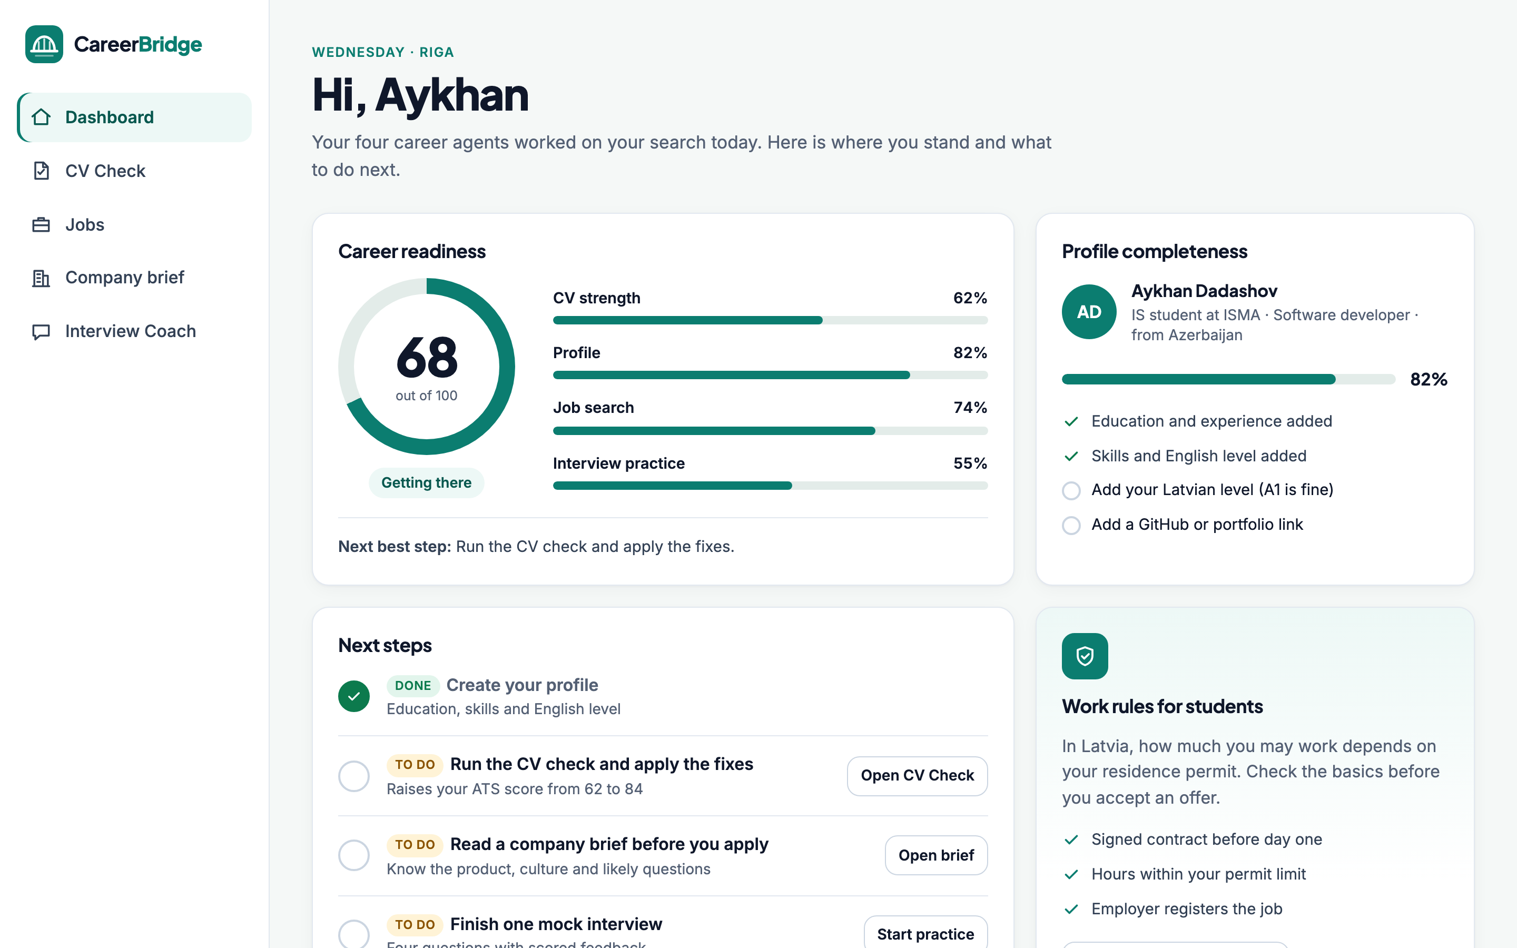
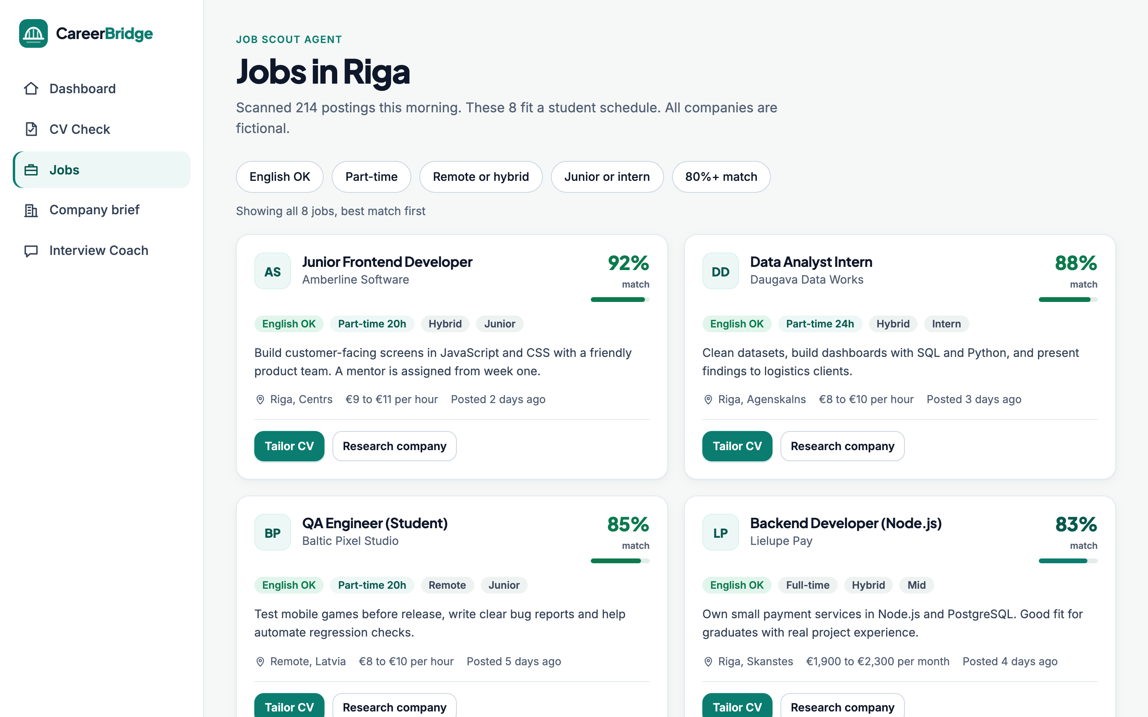
06 · FRAMEWORK · PROTOTYPE
Clickable prototype
Dashboard: readiness score, next steps and what each agent did
Jobs: match %, filters for English and student hours
Live demo: ayxan1110.github.io/careerbridge-prototype
CareerBridge
Notes:
I also built a clickable prototype. Here is the dashboard with the career readiness score and the jobs page with match percentages and filters. Let me quickly show the CV check and the interview coach live.

Slide 8
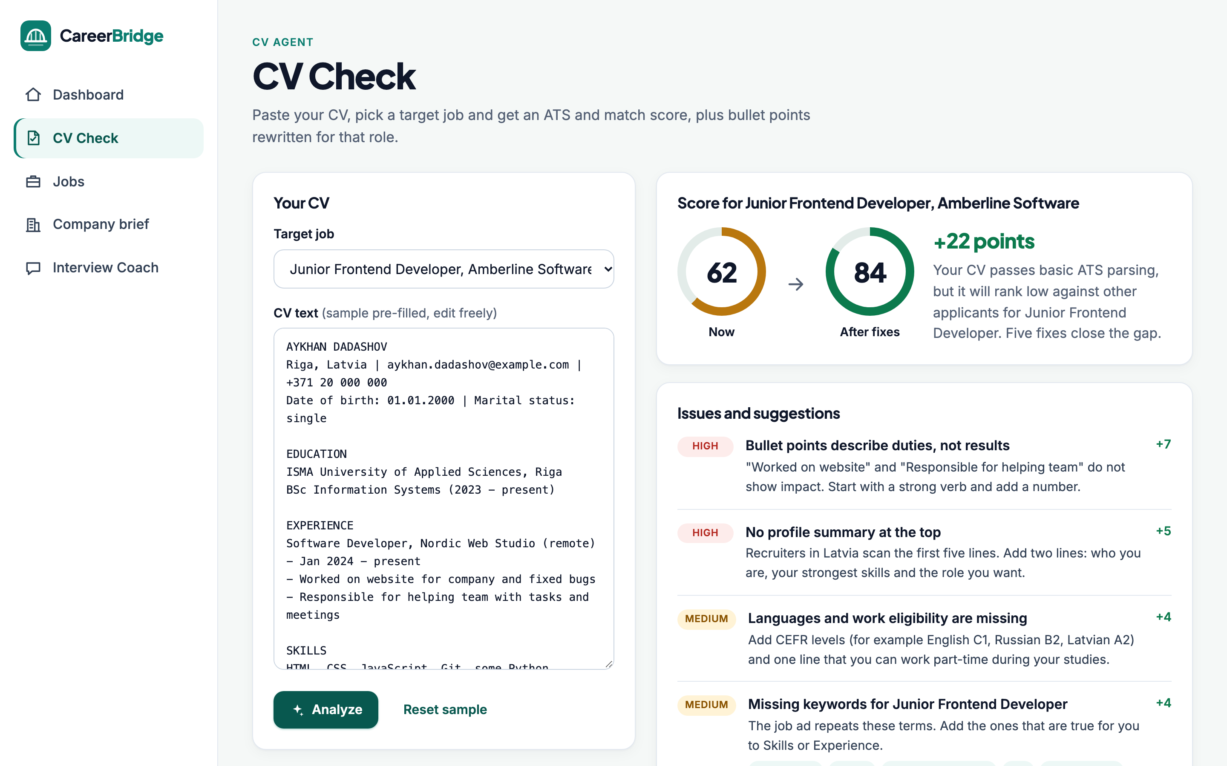
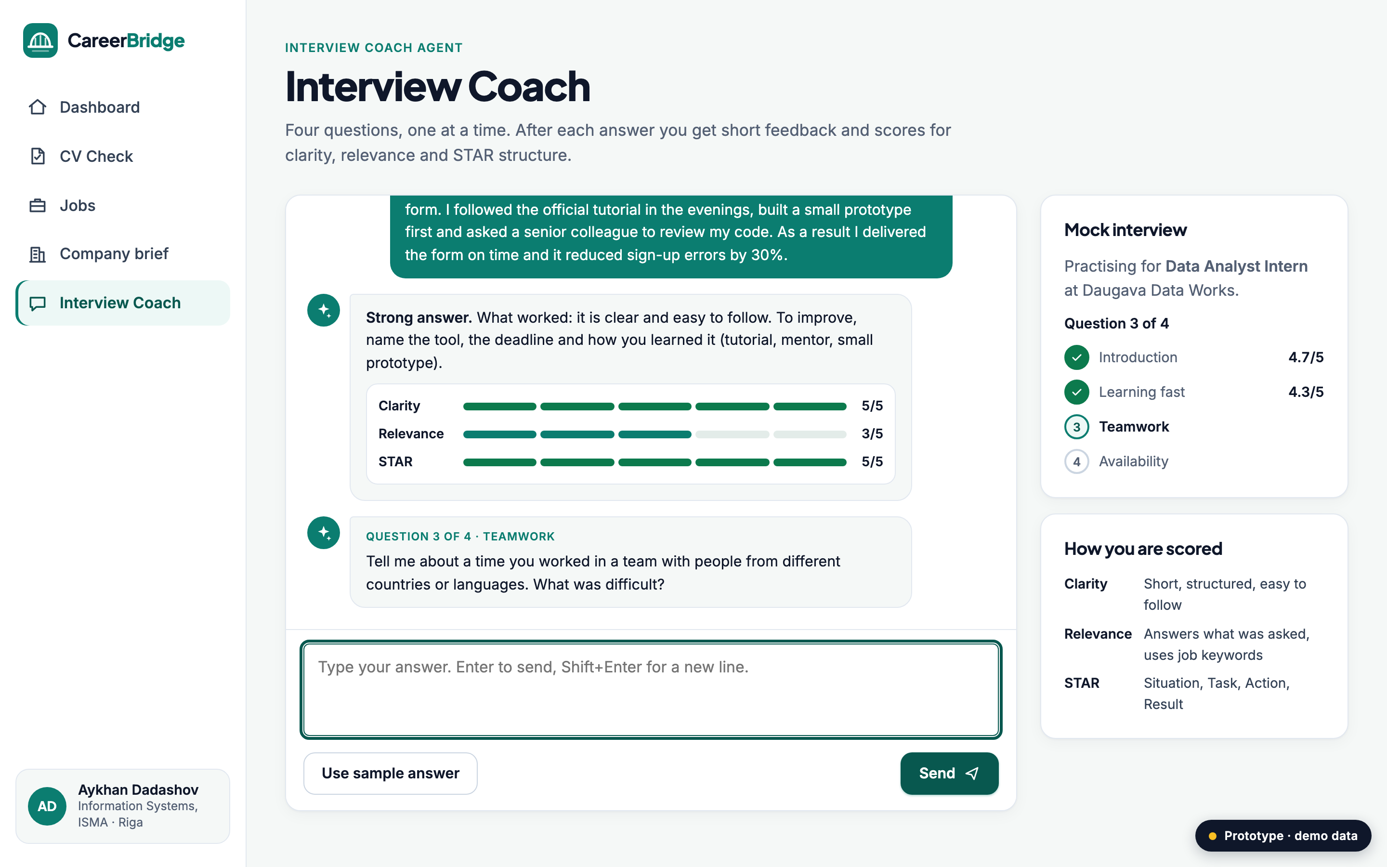
07 · FRAMEWORK · PROTOTYPE
CV check and interview coach
CV Agent: score 62 → 84, with the issues to fix
Interview Coach: feedback and scores after every answer
CareerBridge
Notes:
The CV agent shows the score before and after, and rewrites weak bullet points so they show results. The interview coach asks typical questions and gives a score for clarity, relevance and the STAR structure after each answer. The prototype uses demo data; the real version will call the AI agents.

Slide 9
08 · FRAMEWORK · APPLICATION SCREENING PROCESS
From sign-up to job offer
1. Sign up
2. CV check
3. Match
4. Prepare
5. Apply
6. Feedback
student status and visa type are checked
AI score + fixes, student approves
only jobs the student can legally take
company brief + mock interview
student sends, we track the result
outcome improves the next matches
Screening for employers
Quality checks
Employers get a shortlist of candidates whose skills match the job and whose work hours and permit fit. The student decides if their profile is shared.
Every AI output is scored by a reviewer agent first. Facts in a CV must come from the student's own data, the AI cannot invent experience.
CareerBridge
Notes:
This is the screening process. The student signs up, and we check student status and visa type, because it decides how many hours they can work. Then the CV check, matching only jobs they can legally take, preparation, and the application, which the student sends. The result feeds back into better matches. Employers get a shortlist of candidates that really fit, but only if the student agrees. And a reviewer agent checks every AI output, and the AI can never invent experience.

Slide 10
09 · FRAMEWORK · VALUE PROPOSITION
Value for every side
Students
Universities
Employers
A CV that local recruiters understand
Jobs that fit their hours and language
Confidence before interviews
Free core version
Better graduate employment numbers
Career support that scales to 1,000s of students
Reports for international offices
Pre-screened, ready candidates
Clear info on work rights
Access to English-speaking talent
CareerBridge
Notes:
CareerBridge gives value to three groups. Students get a CV that works locally, jobs that fit, and confidence. Universities get better graduate employment numbers, which the ministry is asking them for, and career support that scales. And employers get pre-screened candidates who are ready, and clear information about work rights.

Slide 11
10 · ANALYSIS · MARKET SEGMENTATION
Who are the users?
EU international students
Bachelor students
need part-time jobs (20 h/week) and their first CV
11,900 in Latvia
Master students
career entry, internships and full-time roles
Fresh graduates
~7,000 non-EU
need a job to stay: the biggest pain
Top origins
India, Uzbekistan, Ukraine, Sri Lanka (2024 graduates)
Sources: Invest Latvia; BICEPS via LETA (2025). EU market = next step, not counted yet.
CareerBridge
Notes:
Our users are international students. We start with about seven thousand non-EU students in Latvia, who have the biggest problems, then all twelve thousand international students, and later the Baltics and the EU. Inside this group there are three segments: bachelor students looking for part-time jobs, master students looking for their first career job, and fresh graduates who need a job to stay. Most of them come from India, Uzbekistan, Ukraine and Sri Lanka.

Slide 12
11 · ANALYSIS · SWOT
SWOT analysis
S
W
Strengths
Weaknesses
Founder is an international student and a developer
AI makes coaching cheap and available 24/7
Focus on local rules and language
Small home market
Depends on LLM API costs and quality
No brand yet
O
T
Opportunities
Threats
Labour shortage, especially in IT
Universities need better employment numbers
Same problem in every EU country
Stricter migration rules for students
LinkedIn or job boards add similar AI tools
AI mistakes could hurt trust
CareerBridge
Notes:
In the SWOT analysis, our strength is that I am the user myself and a developer, and AI makes coaching cheap and always available. The weaknesses are the small home market and the dependency on AI costs. The opportunities are the labour shortage and the fact that every EU country has the same problem. The threats are stricter migration rules, big platforms copying the idea, and AI mistakes, which we reduce with human approval.

Slide 13
12 · ANALYSIS · MARKETING COMMUNICATION
Reach students where they already are
University partners
Student ambassadors
Short videos
Career centres and international offices recommend it at orientation week
One ambassador per big community: Indian, Uzbek, Sri Lankan, Ukrainian students
TikTok / Instagram Reels: "fix my CV in 60 seconds" before-and-after
Community chats
LinkedIn
Referral
Helpful posts in WhatsApp and Telegram groups of each nationality
Success stories of students who got hired, tagging the employers
Invite a friend, both get one month of Pro for free
CareerBridge
Notes:
For marketing we go where students already are. The universities recommend us during orientation week, student ambassadors spread it in their national communities, and short before-and-after videos show how a CV improves in 60 seconds. We also post in the WhatsApp and Telegram groups, share success stories on LinkedIn, and use a referral program with a free month of Pro.

Slide 14
13 · ANALYSIS · PRODUCT PORTFOLIO
Products and prices
STUDENTS
STUDENTS
UNIVERSITIES
EMPLOYERS
Free
Pro
Campus
Hire
€0
€4.99 / month
from €3,000 / year
€99 / job post
CV score and 3 fixes
Job Scout with filters
1 mock interview / month
Unlimited CV rewrites
Company briefs
Unlimited interview coach
Pro for all students
Dashboard and reports
Branding for the career centre
Job post to matched students
Pre-screened shortlist
Work-rights info pack
CareerBridge
Notes:
The product portfolio has four parts. Free for every student, so nobody is left out. Pro for €4.99 a month with unlimited rewrites, company briefs and interview practice. Campus, a licence for universities that gives Pro to all their students, and Hire for employers, who pay per job post and get a pre-screened shortlist.

Slide 15
14 · ANALYSIS · ORGANIZATION STRUCTURE
A small human team plus AI "employees"
Founder & CEO
Aykhan · product + engineering
CTO / AI engineer
Growth lead
Career advisor
Ambassadors
agents, data, security
universities, marketing
part-time, human review
student communities
AI team (works 24/7, every action logged and approved by a human)
CV Agent
Job Scout
Company Research
Interview Coach
Reviewer Agent
CareerBridge
Notes:
The organization is small. I am the founder, responsible for product and engineering. In the first year we need a CTO for the AI part, a growth lead for universities and marketing, a part-time career advisor for human review, and student ambassadors. Next to them is the AI team, like in the ai-employees and Markus repos: five agents that work all the time, but every action is logged and approved by a human.

Slide 16
15 · ANALYSIS · FINANCIAL PLAN
Financial plan (first 3 years, estimates)
 | 2027 | 2028 | 2029
Users | 1,500 | 8,000 | 25,000
Pro (10%) | €6k | €40k | €150k
Universities | €6k | €40k | €90k
Employers | €2k | €15k | €60k
Revenue | €14k | €95k | €300k
Costs | €45k | €120k | €230k
Costs = AI API (~€0.50 per active user / month), hosting, marketing, salaries from 2028. Year 1 is funded by an incubator grant and a university pilot. Break-even in 2029.
CareerBridge
Notes:
Here is the financial plan for three years. These are estimates. In 2027, the pilot year, we make about 14 thousand euros and spend about 45, which an incubator grant and the university pilot cover. In 2028 we grow to 8,000 users and in 2029 to 25,000 users across the Baltics, with 300 thousand euros revenue from Pro subscriptions, universities and employers. The biggest cost is the AI API, about fifty cents per active user per month. We plan to break even in 2029.

Slide 17
16 · ANALYSIS · ROADMAP
Business development roadmap
Q1 2027
Q2 2027
Q4 2027
2028
2029
MVP
Coach
Campus
Baltics
EU
CV Agent + Job Scout, pilot at ISMA
Interview Coach + Company Research
3 universities in Riga, employer portal
Estonia and Lithuania, mobile app
Poland and Germany, break-even
CareerBridge
Notes:
The roadmap: in the first quarter of 2027 we launch the MVP with the CV agent and the job scout as a pilot at ISMA. In the second quarter we add the interview coach and company research. By the end of 2027 three universities in Riga and the employer portal. In 2028 we expand to Estonia and Lithuania with a mobile app, and in 2029 to Poland and Germany.

Slide 18
17 · RESULTS & IMPACT
Expected results and impact on society
Result / output
User audience
A working prototype today. After the pilot: students with job-ready CVs, more interviews, and data on which skills employers in Latvia want from international graduates.
International students and graduates in Latvia, their universities' career centres, and employers that hire English-speaking talent.
Impact on society
Talent that Latvia educated stays and works here, which helps the labour shortage and pays back the investment in education. Graduates work at their real level, not below it, and integrate faster. And the same approach can help international students in every EU country.
CareerBridge
Notes:
The result today is a working prototype. After the pilot we expect better CVs, more interviews, and also useful data about what employers want. The users are international students, career centres and employers. The impact on society is that the talent Latvia educated stays here, helps with the labour shortage, and works at the right level. And this can work in any EU country.

Slide 19
CONCLUSION
Why me, why now
Career
It joins my two worlds: building AI and semantic search as a developer, and living the problem as an international student.
Society
Latvia needs skilled people, and thousands of them are already here, studying.
Now
AI agents finally make personal coaching cheap enough to give to every student.
Thank you! Questions?
Notes:
To conclude: this project fits my career, because it joins what I do as a developer, AI and semantic search, with what I live as an international student. It helps society, because Latvia needs skilled people and many are already here studying. And now is the right time, because AI agents make personal coaching cheap enough for every student. Thank you, I'm happy to answer your questions.

Slide 20
19 · APPENDIX
The GitHub repositories I reviewed
Repository | What it is | What I use
awesome-llm-apps | 100+ runnable AI agent and RAG apps (Apache-2.0, very active) | Recruitment agent team, turned around for job seekers
awesome-llm | Reading list of LLM papers, models and tools | Tool choices: LangChain, Ollama, Ragas for evaluation
ai-employees | AI "employee" kits with roles, schedules and approvals | Human approval before anything is sent
markus | Platform for AI agent teams with review and trust levels | Reviewer agent and task review flow
storm | Stanford: researches a topic and writes a cited article | Cited company briefs
novel-agent | LangGraph agents that write and review novel chapters | Score-based review loop
Claude-Book | Novel writing with Claude Code agents and a style "bible" | Fixed style guide for consistent CVs
CareerBridge
Notes:
This slide is for the Q and A: the seven repositories I reviewed, what each one is and what I took from it for CareerBridge.

