Slide 1
CSS
THE ODIN PROJECT · ADVANCED HTML AND CSS
Advanced
HTML and CSS
Aykhan Dadashov · Web Technologies · 11.11.2026
Notes:
Hello, my name is Aykhan Dadashov. In this presentation I will show the Advanced HTML and CSS course of The Odin Project. It has three parts: animation, accessibility and responsive design. At the end I will show my project, the Homepage, and explain how I made it responsive and accessible.

Slide 2
01
Advanced HTML and CSS: what I covered
Animation
Accessibility
Responsive Design
Transforms
Transitions
Keyframes
Introduction to Web Accessibility
WCAG
Semantic HTML
Accessible Colors
Keyboard Navigation
Meaningful Text
WAI-ARIA
Accessibility Auditing
Introduction to Responsive Design
Natural Responsiveness
Responsive Images
Media Queries
Project: Homepage
Notes:
The course has three parts. Animation, with transforms, transitions and keyframes. Accessibility, which is the biggest part, with eight lessons about making websites usable for everyone. And responsive design, which ends with the Homepage project.

Slide 3
02
Transforms and transitions
transform – move, rotate, scale or skew an element without changing the layout
Functions – translate(), rotate(), scale(), skew(), and 3D versions
transition – animates a change between two states, like on :hover
Parts – property, duration, timing function (ease) and delay
Performance – animate transform and opacity, they are cheap for the browser
animation.css
.card {
transition: transform 0.25s ease,
box-shadow 0.25s ease;
}
/* lift the card on hover */
.card:hover {
transform: translateY(-6px);
box-shadow: 0 12px 24px rgb(0 0 0 / 0.15);
}
/* small rotation on the logo */
.logo:hover {
transform: rotate(-6deg);
}
Notes:
Transforms change how an element looks: we can move it with translate, rotate it, scale it or skew it, and the rest of the layout does not move. A transition animates the change between two states, for example the normal state and the hover state. We define which property changes, how long it takes and the timing function. The course recommends to animate mostly transform and opacity, because the browser can do them very fast. In my Homepage the project cards go up a little on hover.

Slide 4
03
Keyframes
@keyframes – define the steps of an animation with from / to or percentages
animation – name, duration, timing, delay, iteration-count, direction
Difference – a transition needs a trigger, keyframes can run on their own and loop
fill-mode – keeps the styles of the first or last keyframe
Use it carefully – too much movement can be distracting
keyframes.css
@keyframes bounce {
0% { transform: translateY(0); }
50% { transform: translateY(-20px); }
100% { transform: translateY(0); }
}
.ball {
animation-name: bounce;
animation-duration: 1s;
animation-timing-function: ease-in-out;
animation-iteration-count: infinite;
}
/* shorthand */
.ball { animation: bounce 1s infinite; }
Notes:
Keyframes are for more complex animations. With the keyframes rule I describe the steps of the animation, for example at 0, 50 and 100 percent. Then I connect it to an element with the animation property, where I set the duration, the timing and how many times it repeats. The main difference with transitions is that a transition needs a change of state, like hover, but a keyframe animation can start by itself and loop forever, like this bouncing ball.

Slide 5
04
Web accessibility and WCAG
Why accessibility
WCAG
Many people use the web with a screen reader, only the keyboard, zoom or with colour blindness. An accessible site works for all of them, and it is also better for SEO.
The Web Content Accessibility Guidelines. Four principles (POUR): Perceivable, Operable, Understandable, Robust, and three levels A, AA and AAA. Most sites aim for AA.
Semantic HTML
Accessible colours
Use the right element: <button> for actions, <a> for links, <nav>, <main>, <header>, headings in order. Screen readers understand the page from these elements.
Text needs enough contrast with the background: at least 4.5:1 for normal text (AA). Never use only colour to show information, like errors.
Notes:
Web accessibility means that people with disabilities can use the website, for example people who use a screen reader, only a keyboard, or who cannot see some colours. The WCAG guidelines describe how to do it, with four principles: perceivable, operable, understandable and robust, and three levels. The most important practical thing is semantic HTML: when we use the correct elements, like button, nav and main, the screen reader understands the page. Colours also need enough contrast, at least 4.5 to 1 for normal text.

Slide 6
05
Keyboard navigation and meaningful text
Keyboard – everything must work with Tab, Enter and Space
Focus styles – never remove the outline without a better :focus-visible style
Skip link – lets keyboard users jump over the navigation
Meaningful text – links like "View Library code" instead of "click here"
alt text – describe what the image shows; empty alt for decoration
a11y.html
<!-- first element in the body -->
<a class="skip-link" href="#main">Skip to content</a>
.skip-link {
position: absolute;
top: -100px; /* hidden above */
}
.skip-link:focus {
top: 0; /* visible on Tab */
}
a:focus-visible {
outline: 3px solid var(--accent);
}
<img src="library.jpg"
alt="Library app with book cards">
Notes:
Many users navigate only with the keyboard, so every link and button must be reachable with Tab and usable with Enter. The focus outline shows where you are, so we should never remove it, or we replace it with a better focus-visible style. A skip link is the first element on the page: it is hidden, but when you press Tab it appears and lets you jump directly to the main content. I added one to my Homepage. Text should also be meaningful: a screen reader user often hears only the list of links, so 'click here' tells nothing. And images need alt text that describes them.

Slide 7
06
WAI-ARIA and accessibility auditing
What ARIA is
First rule of ARIA
Attributes that give extra information to screen readers: role, aria-label, aria-labelledby, aria-hidden, aria-expanded, aria-live.
Don't use ARIA if a native HTML element can do it. A <button> is better than a <div role="button">. No ARIA is better than bad ARIA.
In my Homepage
Auditing
aria-labelledby connects each section to its heading, aria-label names the navigation, and aria-hidden hides decorative SVG icons.
Lighthouse in Chrome DevTools, the axe extension and WAVE find many problems automatically. Then I test by hand with the keyboard and zoom.
Notes:
WAI-ARIA is a set of attributes that give extra information to assistive technology, for example a label for an icon button, or aria-hidden to hide decorative icons. But the first rule of ARIA is to not use it when a normal HTML element already does the job. In my Homepage I used aria-labelledby for the sections, aria-label for the navigation and aria-hidden for the icons. To check accessibility we can use tools like Lighthouse, axe or WAVE, and then test by hand with only the keyboard.

Slide 8
07
Natural responsiveness and responsive images
Responsive design – one website that works on phone, tablet and desktop
Natural responsiveness – avoid fixed widths; use max-width, %, Flexbox and Grid
Viewport meta tag – required, or phones show a zoomed-out desktop page
Images – max-width: 100% so they shrink with the container
srcset and sizes – the browser downloads the right image size
responsive.html
<meta name="viewport" content="width=device-width">
img { max-width: 100%; height: auto; }
/* cards wrap by themselves, no media query */
.projects {
display: grid;
grid-template-columns:
repeat(auto-fit, minmax(280px, 1fr));
}
<img src="library-800.jpg"
srcset="library-400.jpg 400w,
library-800.jpg 800w"
sizes="(min-width: 960px) 340px, 90vw"
alt="Library app">
Notes:
Responsive design means one website that looks good on every screen. The course teaches that most of the work is natural responsiveness: if we avoid fixed widths and use max-width, Flexbox and Grid, the page already adapts. The viewport meta tag is required, otherwise the phone shows a small desktop version. For images, max-width 100 percent makes them shrink, and with srcset and sizes the browser chooses the smallest image that is good enough, so phones download less data. My Homepage uses this for all project screenshots.

Slide 9
08
Media queries
@media – apply CSS only when a condition is true, like a minimum width
Mobile first – write phone styles first, then add min-width queries
Breakpoints – choose them where the design breaks, not for specific devices
Other features – prefers-color-scheme, prefers-reduced-motion, print
My breakpoints – 640px (tablet) and 960px (desktop)
media.css
/* phone first: no media query */
.hero-inner { display: grid; }
/* tablet and up */
@media (min-width: 640px) {
.hero { padding: 4rem 0; }
}
/* desktop: text left, portrait right */
@media (min-width: 960px) {
.hero-inner {
grid-template-columns: 1fr 340px;
}
}
@media (prefers-reduced-motion: reduce) {
* { transition: none !important; }
}
Notes:
Media queries apply CSS only when a condition is true, usually a screen width. The course recommends mobile first: I write the styles for phones first, and then add min-width media queries for bigger screens. Breakpoints should be where the design starts to look bad, not for specific phones. In my Homepage I have two breakpoints: 640 pixels for tablets and 960 pixels for desktop, where the hero becomes two columns. There is also prefers-reduced-motion, which turns off animations for people who get dizzy from movement.

Slide 10
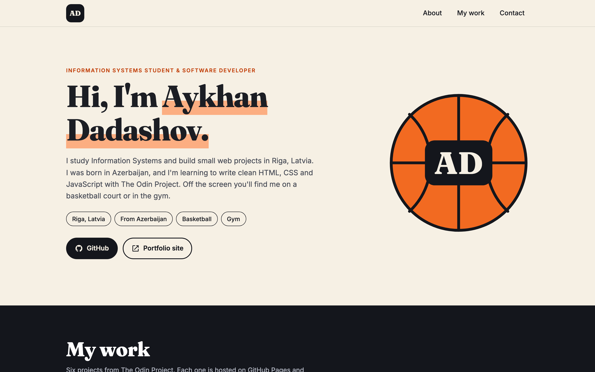
09
Project: Homepage
Personal homepage with my real projects
Mobile first, breakpoints at 640px and 960px
Responsive images with srcset and sizes
Hover transitions on cards and the logo
Skip link, focus styles, reduced motion
Live ayxan1110.github.io/odin-homepage/
Code github.com/Ayxan1110/odin-homepage
Notes:
The project of this course is the Homepage, a personal page where I show my projects. It works from 320 pixels up to 1920 pixels wide. The project grid changes from one column on phones to three columns on desktop. The screenshots use srcset, so phones load small images. Cards and the logo have hover transitions, and everything works with the keyboard, with a skip link and visible focus styles. If the user prefers reduced motion, the animations are turned off.

Slide 11
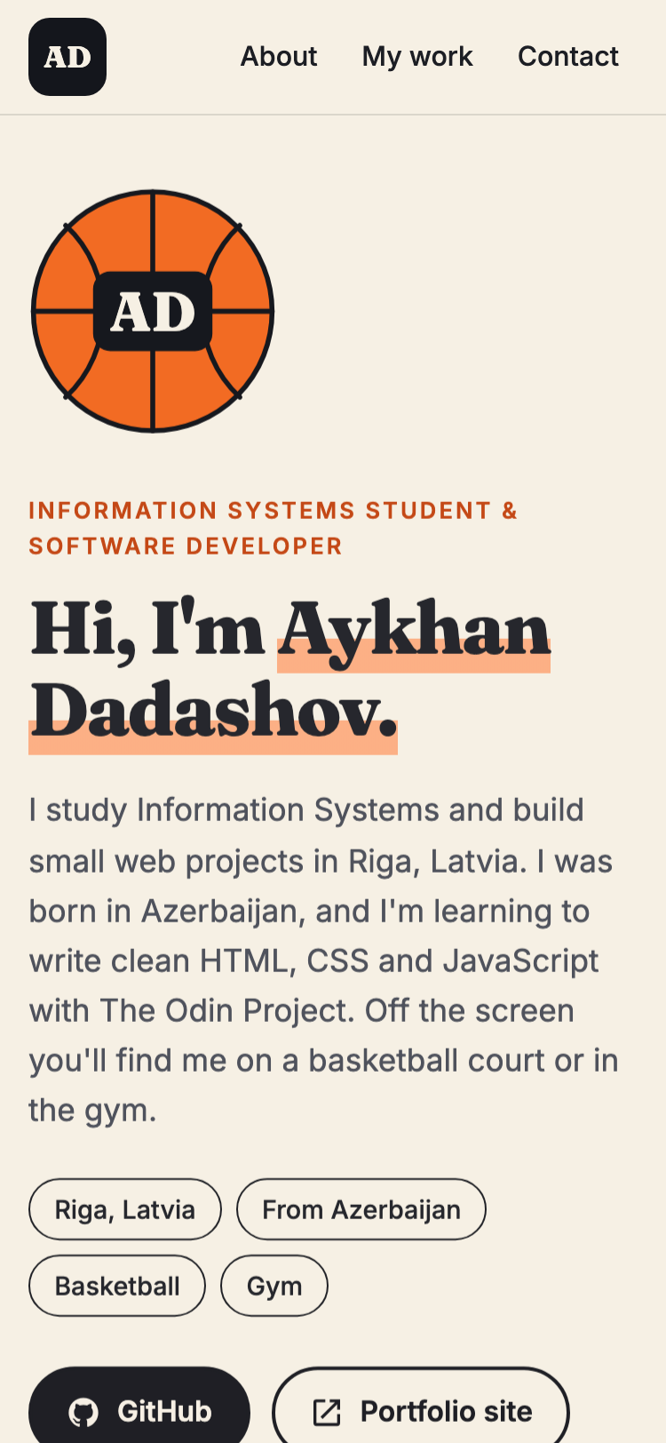
10
Homepage on phone and desktop
Same HTML, different layout: one column on the phone, two columns on desktop
Notes:
Here you can see the same page on a phone and on a desktop. The HTML is exactly the same, only the CSS changes with the media queries and the auto-fit grid. On the phone the portrait is on top and the projects are in one column, on the desktop the hero has two columns and the projects are in three columns. Now I will show it live in the browser and also navigate it only with the keyboard.

Slide 12
11
Projects on GitHub
Homepage
ayxan1110.github.io/odin-homepage/
github.com/Ayxan1110/odin-homepage
Profile page
ayxan1110.github.io/
github.com/Ayxan1110/Ayxan1110.github.io
Thank you!
Notes:
My Homepage project is on GitHub and live on GitHub Pages, and all my coursework is on my profile page. Thank you for watching!

