Slide 1
TOP
THE ODIN PROJECT · ALL ASSIGNMENTS
Intermediate HTML & CSS
and JavaScript
Aykhan Dadashov · Web Technologies · 21.10.2026
Notes:
Hello, my name is Aykhan Dadashov. In this presentation I will show all the assignments I did from The Odin Project: first the Intermediate HTML and CSS course with the Sign-up Form and the Admin Dashboard, and then the JavaScript course with the Library and Tic Tac Toe projects.

Slide 2
01
Intermediate HTML and CSS: what I covered
Intermediate HTML
Intermediate CSS
Forms
Grid
Introduction
SVG
Tables
Default Styles
CSS Units
More Text Styles
More CSS Properties
Advanced Selectors
Positioning
CSS Functions
Custom Properties
Browser Compatibility
Frameworks and Preprocessors
Form Basics
Form Validation
Project: Sign-up Form
Introduction to Grid
Creating a Grid
Positioning Grid Elements
Advanced Grid Properties
Using Flexbox and Grid
Project: Admin Dashboard
Notes:
The Intermediate HTML and CSS course has four parts. First, intermediate HTML concepts like SVG and tables. Then a big part about intermediate CSS: default styles, units, text styles, more properties, advanced selectors, positioning, CSS functions, custom properties, browser compatibility and frameworks. Then forms, with the Sign-up Form project, and finally CSS Grid, with the Admin Dashboard project.

Slide 3
02
SVG and tables
SVG – vector images written in XML, they stay sharp at any size
viewBox – the coordinate system of the drawing, so it can scale
Shapes – <circle>, <rect>, <path>; colors with fill and stroke
Tables – only for tabular data, not for page layout
Table tags – <table>, <tr>, <th>, <td>, <thead>, <tbody>, colspan
intermediate.html
<!-- a simple SVG icon -->
<svg viewBox="0 0 100 100" width="80">
<circle cx="50" cy="50" r="40"
fill="gold" stroke="black" />
</svg>
<!-- a simple table -->
<table>
<thead>
<tr><th>Subject</th><th>Mark</th></tr>
</thead>
<tbody>
<tr><td>Web Tech</td><td>9</td></tr>
<tr><td>Programming</td><td>8</td></tr>
</tbody>
</table>
Notes:
SVG is a format for vector images. Instead of pixels, the image is described with shapes in XML, so it stays sharp at any size and we can change its colors with CSS. The viewBox defines the coordinate system. Tables are for data in rows and columns, like marks, and not for building the layout of a page. A table has rows with tr, header cells with th and normal cells with td, and we can group rows with thead and tbody.

Slide 4
03
Default styles, units and text
Default styles
CSS units
Every browser has its own default styles (margins on body, sizes of headings). A CSS reset or normalize makes the start the same in every browser.
Absolute: px. Relative: em (parent font size), rem (root font size), % and vh / vw (viewport). I use rem for font sizes and px for borders.
More text styles
More CSS properties
font-family with fallbacks, Google Fonts or @font-face, font-weight, letter-spacing, line-height, text-transform, text-shadow and text-overflow: ellipsis.
background shorthand, border-radius, box-shadow, overflow, opacity. Small properties that make a page look finished.
Notes:
Every browser has default styles, for example the body has a margin of 8 pixels, so many developers use a CSS reset. In the units lesson I learned the difference between absolute units like pixels and relative units: em depends on the parent font size, rem on the root font size, and vh and vw on the size of the window. Then more text styles like custom fonts, line height and ellipsis for long text, and some useful properties like border-radius, box-shadow and overflow.

Slide 5
04
Advanced selectors
Child and sibling – > (direct child), + (next sibling), ~ (all next siblings)
Pseudo-classes – a state: :hover, :focus, :first-child, :nth-child()
Pseudo-elements – a part: ::before, ::after, ::first-letter, ::marker
Attribute selectors – [type="email"], [href^="https"]
Result – I can style elements without adding many extra classes
selectors.css
/* only direct children */
.menu > li { display: inline-block; }
/* every second row of a table */
tr:nth-child(even) { background: #f2f2f2; }
/* input that has focus */
input:focus { outline: 2px solid gold; }
/* add an icon before a link */
a[href^="https"]::before {
content: "↗ ";
}
/* paragraph right after a heading */
h2 + p { font-size: 1.2rem; }
Notes:
Advanced selectors help to select elements more exactly, without putting a class on everything. With the greater-than sign we select only direct children, and with plus and tilde the siblings. Pseudo-classes describe a state, like hover or focus, or a position like nth-child. Pseudo-elements like before and after style a part of an element or add content. And attribute selectors select elements by their attributes, for example all links that start with https.

Slide 6
05
Positioning
static – the default, normal flow of the page
relative – moves from its normal place, keeps its space
absolute – taken out of the flow, placed inside the closest positioned parent
fixed – stays in the same place on the screen when scrolling
sticky – normal until you scroll to it, then it sticks
position.css
.card {
position: relative; /* parent */
}
.badge {
position: absolute; /* inside .card */
top: 10px;
right: 10px;
}
header {
position: sticky; /* my profile nav */
top: 0;
}
Notes:
Positioning decides where an element is placed. Static is the default. Relative moves an element from its normal place. Absolute takes the element out of the normal flow and places it relative to the closest parent that has a position, that is why we often put position relative on the parent. Fixed elements stay on the screen when we scroll, like a chat button, and sticky works like normal until we scroll to it. I used sticky for the navigation on my profile page.

Slide 7
06
CSS functions and custom properties
calc() – mix units, e.g. 100% minus the header height
min(), max(), clamp() – sizes that adapt to the screen
Custom properties – variables like --main-color, used with var()
Scope – defined on :root they work everywhere, on an element only inside it
Themes – change a few variables to make a dark theme
functions.css
:root {
--ink: #1b1b22;
--accent: #f7df1e;
}
h1 {
/* min 40px, max 68px, grows with screen */
font-size: clamp(40px, 7vw, 68px);
color: var(--ink);
}
main {
height: calc(100vh - 70px);
}
.button {
background: var(--accent, gold);
}
Notes:
CSS also has functions. calc lets me mix units, for example the full height of the screen minus the header. min, max and clamp make sizes responsive without media queries. On my profile page the name uses clamp, so it is never smaller than 40 pixels and never bigger than 68. Custom properties are variables in CSS. I define them on root and use them with var, so if I want to change the main color, I change it in one place.

Slide 8
07
Browsers, frameworks, preprocessors
Browser compatibility
Frameworks
Not every browser supports every new feature. I check caniuse.com before I use something new, and test in Chrome, Firefox and Safari.
Bootstrap and Tailwind give ready classes and components, so you write less CSS. But first you need to understand normal CSS.
Preprocessors
My choice
Sass, Less and PostCSS add features like nesting, mixins and loops, and compile to normal CSS. Today CSS itself has variables and nesting.
For these projects I used plain CSS without frameworks, to practice the basics that the course teaches.
Notes:
These lessons were more theory. Browser compatibility means that not all browsers support the same features, so we check websites like caniuse. Frameworks like Bootstrap and Tailwind give ready-made classes, and preprocessors like Sass add features like nesting and compile into normal CSS. The course says it is important to know plain CSS first, so in my projects I used only plain CSS.

Slide 9
08
Forms and form validation
<form> – action and method say where the data is sent
<label for> – connects text with an input, better for accessibility
Input types – email, tel, password, number, date, checkbox, radio
Validation – required, minlength, maxlength, min, max, pattern
Styling – :valid, :invalid and :user-invalid show errors
form.html
<form action="/signup" method="post">
<label for="email">Email</label>
<input type="email" id="email"
name="email" required>
<label for="password">Password</label>
<input type="password" id="password"
name="password" minlength="8"
required>
<button>Create Account</button>
</form>
/* red border only after the user typed */
input:user-invalid { border-color: red; }
Notes:
Forms are how users send data to a website. Every input should have a label connected with the for attribute, which helps screen readers and makes the label clickable. There are many input types, and the browser shows a different keyboard on the phone for email or tel. With attributes like required, minlength and pattern the browser checks the data before sending, and with pseudo-classes like invalid we can show the errors in red.

Slide 10
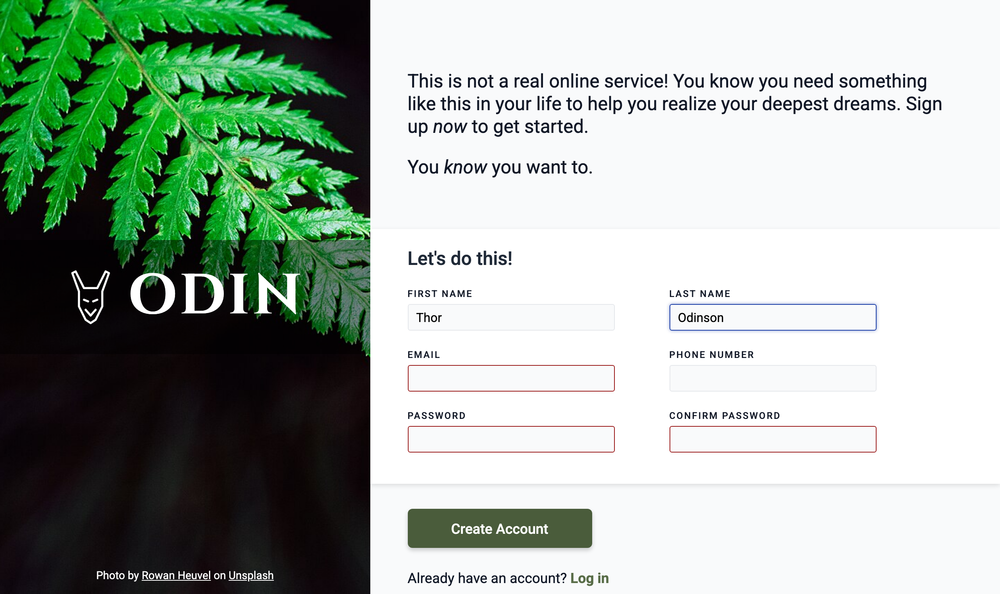
09
Project: Sign-up Form
Two columns made with Flexbox
Image side with logo and photo credit
Labels, input types and required fields
Red border only after the user interacts
Small script checks that passwords match
Live ayxan1110.github.io/odin-sign-up-form/
Code github.com/Ayxan1110/odin-sign-up-form
Notes:
My first project in this course is the Sign-up Form. The layout has two parts made with Flexbox: an image on the left with the logo, and the form on the right. Every input has a label and the correct type, and the required fields are checked by the browser. The red border appears only after the user has interacted with the field, so the form is not red from the start. I also added a small script that checks that the two passwords are the same.

Slide 11
10
CSS Grid
Grid container – display: grid turns children into grid items
Tracks – grid-template-columns / rows, the fr unit, repeat()
Gap – space between rows and columns
Placing items – grid-column: 1 / 3, grid-row, grid-template-areas
Responsive – repeat(auto-fit, minmax(240px, 1fr)) without media queries
grid.css
.dashboard {
display: grid;
grid-template-columns: 250px 1fr;
grid-template-rows: auto 1fr;
min-height: 100vh;
}
.sidebar {
grid-row: 1 / 3; /* full height */
}
.cards {
display: grid;
grid-template-columns:
repeat(auto-fit, minmax(240px, 1fr));
gap: 20px;
}
Notes:
CSS Grid is a two-dimensional layout system, so it controls rows and columns at the same time. With grid-template-columns I define the columns, and the fr unit shares the free space. Items can be placed exactly with grid-column and grid-row, for example the sidebar goes over two rows. The most useful trick is repeat with auto-fit and minmax, which makes the cards wrap automatically on small screens without any media query.

Slide 12
11
Flexbox or Grid?
Flexbox: one direction
Grid: two directions
Good for a row or a column of items: a navigation bar, buttons in a row, centering one thing. The content decides the size.
Good for the whole page layout or a gallery of cards, where rows and columns must line up. The layout decides the size.
Together
Advanced grid
In the Admin Dashboard the page and the cards use Grid, and the header, buttons and items inside a card use Flexbox.
auto-fill vs auto-fit, minmax(), implicit tracks with grid-auto-rows, and naming lines and areas.
Notes:
A common question is when to use Flexbox and when Grid. Flexbox works in one direction, a row or a column, and is perfect for navigation bars and buttons. Grid works in two directions, so it is better for the page layout and for galleries of cards. Usually we use both together: in my Admin Dashboard the big layout and the project cards use Grid, and the smaller parts inside use Flexbox.

Slide 13
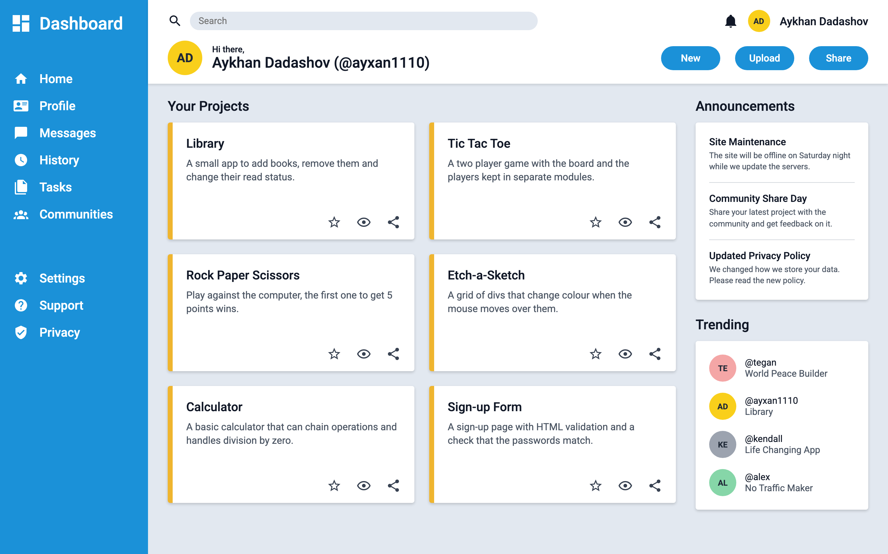
12
Project: Admin Dashboard
Page layout made with CSS Grid
Sidebar with icons (inline SVG)
Header with search, avatar and buttons
Project cards in a responsive grid
Announcements and Trending in the right column
Live ayxan1110.github.io/odin-admin-dashboard/
Code github.com/Ayxan1110/odin-admin-dashboard
Notes:
The final project of the course is the Admin Dashboard. The whole page is a grid: the sidebar on the left, the header on top and the main content. The icons are SVG icons from Material Design Icons. The project cards are also a grid, and they show my real projects. On the right there are announcements and trending users. Inside the cards and the header I used Flexbox to align the items.

Slide 14
13
What I covered
1
2
3
4
Introduction: How This Course Will Work
Organizing Your JavaScript Code
Organizing Code with Objects
Object Constructors
5
6
7
Project: Library
Factory Functions and the Module Pattern
Project: Tic Tac Toe
Notes:
These are the lessons I completed. The yellow cards are the projects. First there is the introduction to the course, then the lessons about objects, object constructors and factory functions. After the theory lessons I made a project to practice: Library after object constructors, and Tic Tac Toe after factory functions and the module pattern.

Slide 15
14
Introduction: how the course works
Builds on Foundations – we already know variables, functions, loops and the DOM
Focus on structure – not only "does it work", but how to keep code clean when the project grows
Read, then build – each lesson has articles and knowledge checks, and every few lessons there is a project
Ask for help – the course recommends the Odin community on Discord when you are stuck
14
lessons in "Organizing Your JavaScript Code"
4
projects in the section: Library, Tic Tac Toe, Restaurant Page, Todo List
2
projects done so far: Library and Tic Tac Toe
Notes:
The JavaScript course continues after the Foundations course. In Foundations we learned the basics, and now the goal is to learn how to organize our code, so that it is still easy to read when a project becomes bigger. Every lesson has reading materials and knowledge check questions, and after some lessons there is a project. The section Organizing Your JavaScript Code has 14 lessons and 4 projects. I finished the first two projects: Library and Tic Tac Toe.

Slide 16
15
Organizing code with objects
Object literal – groups data that belongs together in one place
Dot or bracket notation – player.name or player["name"] (brackets work with variables)
Methods – functions inside an object, so data and behaviour live together
this – inside a method it points to the object that called it
Result – instead of many separate variables, one object keeps the code organized
objects.js
// without objects: loose variables
const playerOneName = "Aykhan";
const playerOneMarker = "X";
// with an object: grouped together
const playerOne = {
name: "Aykhan",
marker: "X",
sayHello() {
return `Hi, I am ${this.name}`;
},
};
playerOne.name; // "Aykhan"
playerOne["marker"]; // "X"
playerOne.sayHello(); // "Hi, I am Aykhan"
Notes:
In this lesson I learned why objects are useful for organizing code. On the left side of the code you can see the problem: if we have many players, we need many separate variables. With an object literal all the data of one player is in one place. We can read properties with dot notation or bracket notation. Bracket notation is useful when the property name is in a variable. Objects can also have methods, and inside a method the keyword this means the object itself.

Slide 17
16
Object constructors and prototypes
Constructor – a normal function we call with new to create many similar objects
new – creates an empty object, sets this to it and returns it
Prototype – every object has one; methods there are shared, not copied
Prototype chain – if a property is not found, JS looks in the prototype
Inheritance – Object.setPrototypeOf(Child.prototype, Parent.prototype)
constructor.js
function Book(title, author, pages, read) {
if (!new.target) throw Error("Use new");
this.title = title;
this.author = author;
this.pages = pages;
this.read = read;
}
// one shared function for all books
Book.prototype.toggleRead = function () {
this.read = !this.read;
};
const hobbit = new Book("The Hobbit",
"Tolkien", 295, true);
hobbit.toggleRead(); // read = false
Notes:
When we need many objects of the same type, writing every object literal by hand is a lot of repetition. An object constructor is a function that we call with the new keyword. new creates a new empty object, connects it to the prototype, runs the function with this pointing to the new object and returns it. I also added a check with new.target, so the constructor throws an error if someone forgets new. Methods like toggleRead are put on the prototype, so all books share one function instead of each book having its own copy. If JavaScript does not find a property on the object, it looks up the prototype chain.

Slide 18
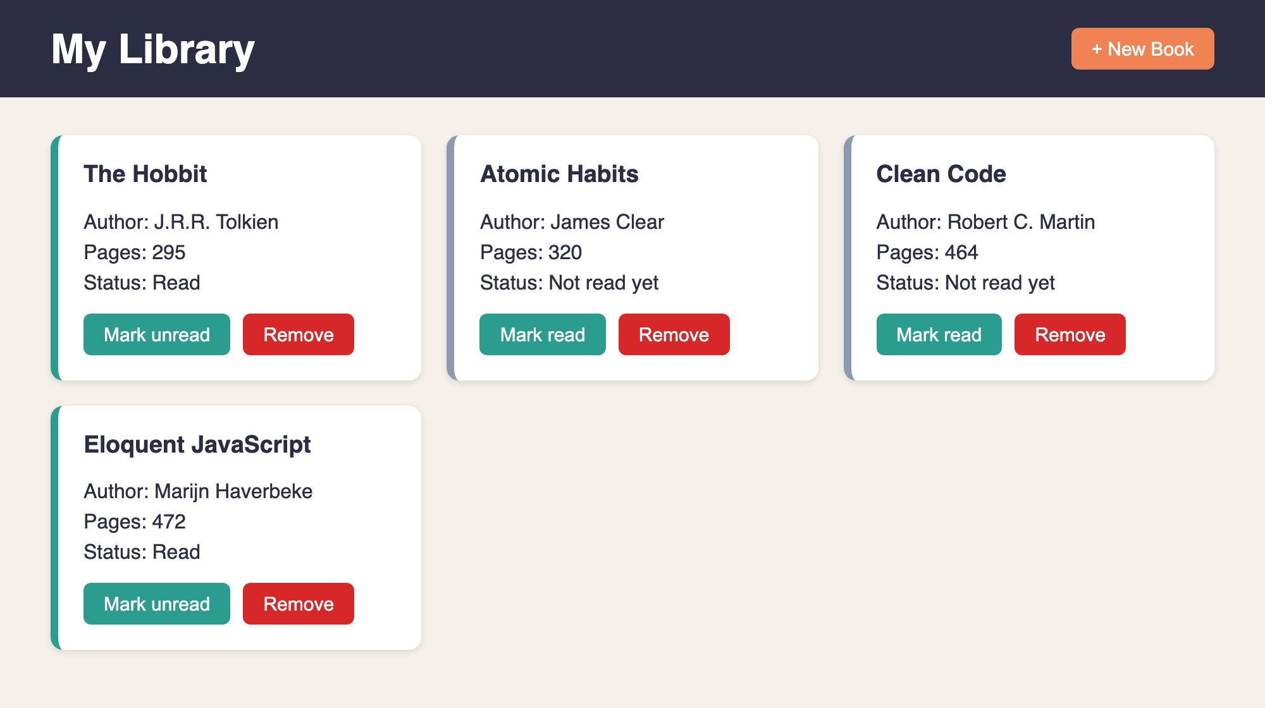
17
Project: Library
Shows all books as cards from the myLibrary array
"New Book" opens a <dialog> with a form
Remove a book with its button
Toggle read / not read with a prototype method
Every book has a unique id from crypto.randomUUID()
Live ayxan1110.github.io/odin-library/
Code github.com/Ayxan1110/odin-library
Notes:
This is my Library project. All books are stored in an array called myLibrary. Every book is an object made with the Book constructor. The page shows each book as a card with title, author, number of pages and read status. With the New Book button a dialog with a form opens. Each card has a button to change the read status and a button to remove the book. Now I will show it live in the browser.

Slide 19
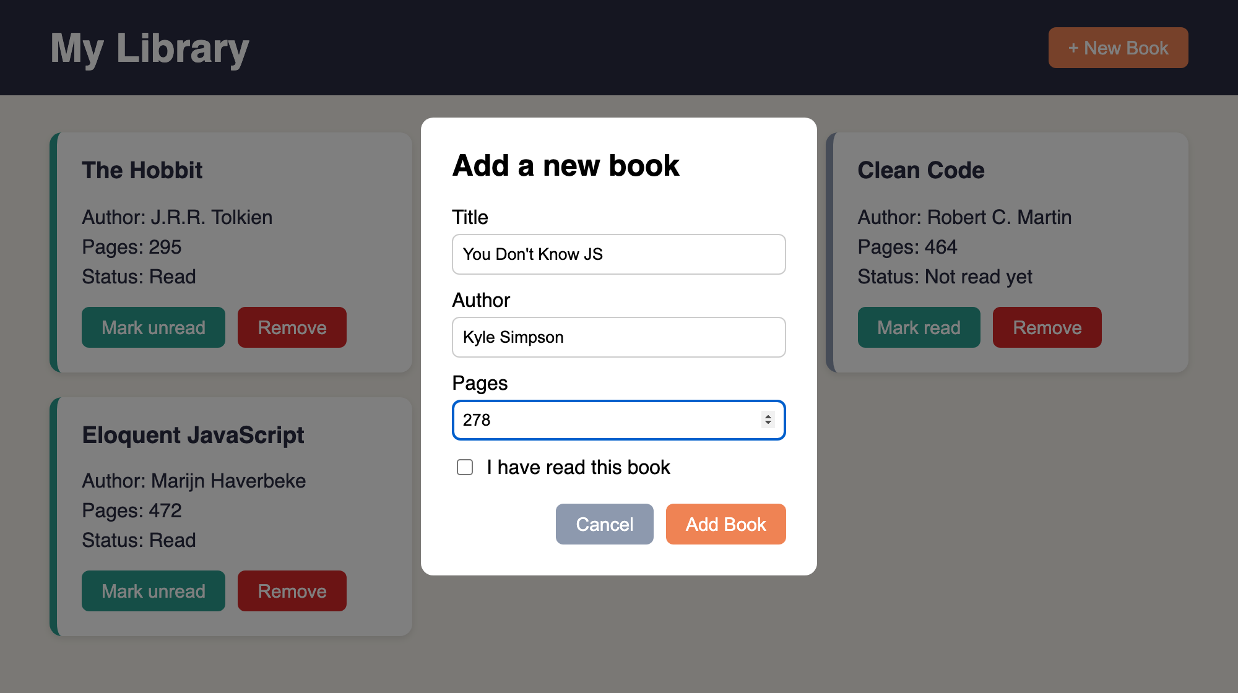
18
Library: how I built it
1
Open
Click on "New Book" calls dialog.showModal()
2
Submit
preventDefault() stops the page reload, then I read the input values
3
Store
addBookToLibrary() creates new Book(...) and pushes it to myLibrary
4
Display
The form inside <dialog>, opened with showModal()
displayBooks() clears the container and draws a card for every book
5
Connect
Each card has data-id, so Remove finds the right book in the array
Notes:
Here is how the Library works step by step. When I click New Book, the dialog opens with showModal. When the form is submitted, I call preventDefault, because by default a form tries to send the data to a server and reloads the page. Then I read the values from the inputs and call addBookToLibrary, which creates a new Book object and pushes it into the array. After that, displayBooks clears the container and creates the cards again from the array, so the page always shows exactly what is in the array. Every card has a data-id attribute with the id of the book, and this is how the Remove button knows which book to delete from the array.

Slide 20
19
Factory functions and the module pattern
Scope – variables live inside the function or block where they are declared
Closure – an inner function remembers the variables of its outer function
Factory function – a function that returns an object, no new and no this needed
Private variables – only reachable through the returned functions
Module (IIFE) – a factory that runs one time, for things we need only once
factory.js
// factory: we can make many players
function createPlayer(name, mark) {
return { name, mark };
}
const p1 = createPlayer("Aykhan", "X");
// module: runs once, board stays private
const Gameboard = (function () {
const board = ["", "", "", "", "",
"", "", "", ""];
const getBoard = () => board;
const placeMark = (i, mark) => {
if (board[i] !== "") return false;
board[i] = mark;
return true;
};
return { getBoard, placeMark };
})();
Notes:
This lesson explained another way to create objects. A factory function is a function that simply returns an object, so we do not need new or this. Because of closures, the functions inside can still use the variables of the outer function after it has finished, and those variables are private: from outside you cannot change them directly, only through the functions we return. The module pattern is the same idea, but the function is wrapped in an IIFE, an immediately invoked function expression, so it runs only once. This is good for things where we need exactly one, like the game board.

Slide 21
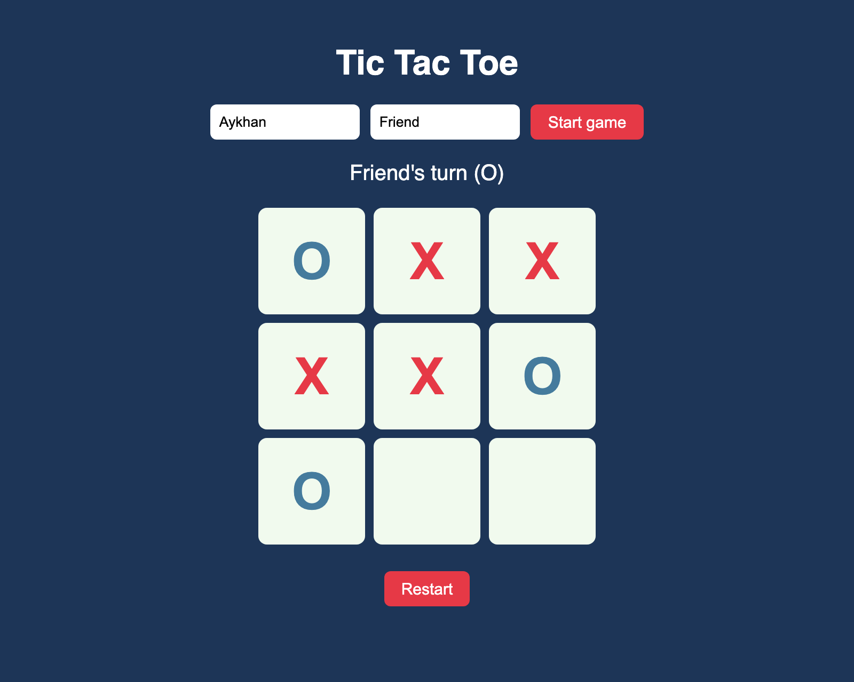
20
Project: Tic Tac Toe
Two players enter their names
Click a cell to place X or O
Taken cells cannot be clicked again
Detects all 8 winning lines and a tie
Restart button starts a new round
Live ayxan1110.github.io/odin-tic-tac-toe/
Code github.com/Ayxan1110/odin-tic-tac-toe
Notes:
My second project is Tic Tac Toe. The players write their names and press Start. Then they click on the cells and the game places X or O. You cannot click a cell that is already taken. The game checks all 8 winning lines, 3 rows, 3 columns and 2 diagonals, and shows who won or if it is a tie. With Restart you can play again. Let me show it in the browser.

Slide 22
21
Tic Tac Toe: code structure
Gameboard
module · IIFE
Private board array.
getBoard(), placeMark(), reset()
GameController
DisplayController
module · IIFE
module · IIFE
Whose turn it is, win and tie check.
start(), playRound(index)
The only part that uses the DOM.
render(), click and form events
createPlayer()
factory function
Returns { name, mark }.
Called twice: X and O
Game logic works without the DOM, so it can be played in the console
Notes:
The main goal of this project was to have as little global code as possible. I split the code into four parts. Gameboard is a module made with an IIFE, because there is only one board. The board array is private, other code can only use getBoard, placeMark and reset. createPlayer is a factory function, because we need two players. GameController is a module that knows whose turn it is, places the mark on the board and checks for a winner or a tie. DisplayController is the only part that touches the DOM: it draws the board and listens to the clicks. Because of this split, the game logic works even without the page, I could test it in the console first.

Slide 23
22
Problems I solved
form.title was empty
Books were duplicated
A <form> already has a built-in title property, so form.title did not return my input. I used document.querySelector("#title") instead.
Every time I added a book, all cards were added again. displayBooks() now clears the container first and then draws the array.
Win on the last move
Nine click listeners
If someone wins with the 9th move, the game must not say "tie". I check for a winner first and only then for a full board.
Instead of adding a listener to every cell, I add one listener on the board and read data-index from the clicked cell (event delegation).
Notes:
Here are some problems I had while building the projects and how I fixed them. First, in the Library I wanted to read the title input with form.title, but a form element already has its own title property, so it was empty. I changed it to querySelector. Second, books appeared two times, because I added new cards without removing the old ones, so now displayBooks clears the container first. Third, in Tic Tac Toe a win on the last move was counted as a tie, so I check the winner before checking if the board is full. And finally, instead of nine event listeners I used one listener on the board, this is called event delegation.

Slide 24
23
Projects on GitHub
Sign-up Form
ayxan1110.github.io/odin-sign-up-form/
github.com/Ayxan1110/odin-sign-up-form
Admin Dashboard
ayxan1110.github.io/odin-admin-dashboard/
github.com/Ayxan1110/odin-admin-dashboard
Library
ayxan1110.github.io/odin-library/
github.com/Ayxan1110/odin-library
Tic Tac Toe
ayxan1110.github.io/odin-tic-tac-toe/
github.com/Ayxan1110/odin-tic-tac-toe
Profile page
ayxan1110.github.io/
github.com/Ayxan1110/Ayxan1110.github.io
Thank you!
Notes:
These are all my projects from The Odin Project, they are on my GitHub account Ayxan1110 and live on GitHub Pages. My profile page has links to all of them. Thank you for watching!

