Slide 1
CSS
THE ODIN PROJECT · INTERMEDIATE HTML AND CSS
Intermediate
HTML and CSS
Aykhan Dadashov · Web Technologies · 14.10.2026
Notes:
Hello, my name is Aykhan Dadashov. In this presentation I will show the Intermediate HTML and CSS course of The Odin Project: what I learned in every part, my two projects, the Sign-up Form and the Admin Dashboard, and my profile page that is live on GitHub.

Slide 2
01
Intermediate HTML and CSS: what I covered
Intermediate HTML
Intermediate CSS
Forms
Grid
Introduction
SVG
Tables
Default Styles
CSS Units
More Text Styles
More CSS Properties
Advanced Selectors
Positioning
CSS Functions
Custom Properties
Browser Compatibility
Frameworks and Preprocessors
Form Basics
Form Validation
Project: Sign-up Form
Introduction to Grid
Creating a Grid
Positioning Grid Elements
Advanced Grid Properties
Using Flexbox and Grid
Project: Admin Dashboard
Notes:
The Intermediate HTML and CSS course has four parts. First, intermediate HTML concepts like SVG and tables. Then a big part about intermediate CSS: default styles, units, text styles, more properties, advanced selectors, positioning, CSS functions, custom properties, browser compatibility and frameworks. Then forms, with the Sign-up Form project, and finally CSS Grid, with the Admin Dashboard project.

Slide 3
02
SVG and tables
SVG – vector images written in XML, they stay sharp at any size
viewBox – the coordinate system of the drawing, so it can scale
Shapes – <circle>, <rect>, <path>; colors with fill and stroke
Tables – only for tabular data, not for page layout
Table tags – <table>, <tr>, <th>, <td>, <thead>, <tbody>, colspan
intermediate.html
<!-- a simple SVG icon -->
<svg viewBox="0 0 100 100" width="80">
<circle cx="50" cy="50" r="40"
fill="gold" stroke="black" />
</svg>
<!-- a simple table -->
<table>
<thead>
<tr><th>Subject</th><th>Mark</th></tr>
</thead>
<tbody>
<tr><td>Web Tech</td><td>9</td></tr>
<tr><td>Programming</td><td>8</td></tr>
</tbody>
</table>
Notes:
SVG is a format for vector images. Instead of pixels, the image is described with shapes in XML, so it stays sharp at any size and we can change its colors with CSS. The viewBox defines the coordinate system. Tables are for data in rows and columns, like marks, and not for building the layout of a page. A table has rows with tr, header cells with th and normal cells with td, and we can group rows with thead and tbody.

Slide 4
03
Default styles, units and text
Default styles
CSS units
Every browser has its own default styles (margins on body, sizes of headings). A CSS reset or normalize makes the start the same in every browser.
Absolute: px. Relative: em (parent font size), rem (root font size), % and vh / vw (viewport). I use rem for font sizes and px for borders.
More text styles
More CSS properties
font-family with fallbacks, Google Fonts or @font-face, font-weight, letter-spacing, line-height, text-transform, text-shadow and text-overflow: ellipsis.
background shorthand, border-radius, box-shadow, overflow, opacity. Small properties that make a page look finished.
Notes:
Every browser has default styles, for example the body has a margin of 8 pixels, so many developers use a CSS reset. In the units lesson I learned the difference between absolute units like pixels and relative units: em depends on the parent font size, rem on the root font size, and vh and vw on the size of the window. Then more text styles like custom fonts, line height and ellipsis for long text, and some useful properties like border-radius, box-shadow and overflow.

Slide 5
04
Advanced selectors
Child and sibling – > (direct child), + (next sibling), ~ (all next siblings)
Pseudo-classes – a state: :hover, :focus, :first-child, :nth-child()
Pseudo-elements – a part: ::before, ::after, ::first-letter, ::marker
Attribute selectors – [type="email"], [href^="https"]
Result – I can style elements without adding many extra classes
selectors.css
/* only direct children */
.menu > li { display: inline-block; }
/* every second row of a table */
tr:nth-child(even) { background: #f2f2f2; }
/* input that has focus */
input:focus { outline: 2px solid gold; }
/* add an icon before a link */
a[href^="https"]::before {
content: "↗ ";
}
/* paragraph right after a heading */
h2 + p { font-size: 1.2rem; }
Notes:
Advanced selectors help to select elements more exactly, without putting a class on everything. With the greater-than sign we select only direct children, and with plus and tilde the siblings. Pseudo-classes describe a state, like hover or focus, or a position like nth-child. Pseudo-elements like before and after style a part of an element or add content. And attribute selectors select elements by their attributes, for example all links that start with https.

Slide 6
05
Positioning
static – the default, normal flow of the page
relative – moves from its normal place, keeps its space
absolute – taken out of the flow, placed inside the closest positioned parent
fixed – stays in the same place on the screen when scrolling
sticky – normal until you scroll to it, then it sticks
position.css
.card {
position: relative; /* parent */
}
.badge {
position: absolute; /* inside .card */
top: 10px;
right: 10px;
}
header {
position: sticky; /* my profile nav */
top: 0;
}
Notes:
Positioning decides where an element is placed. Static is the default. Relative moves an element from its normal place. Absolute takes the element out of the normal flow and places it relative to the closest parent that has a position, that is why we often put position relative on the parent. Fixed elements stay on the screen when we scroll, like a chat button, and sticky works like normal until we scroll to it. I used sticky for the navigation on my profile page.

Slide 7
06
CSS functions and custom properties
calc() – mix units, e.g. 100% minus the header height
min(), max(), clamp() – sizes that adapt to the screen
Custom properties – variables like --main-color, used with var()
Scope – defined on :root they work everywhere, on an element only inside it
Themes – change a few variables to make a dark theme
functions.css
:root {
--ink: #1b1b22;
--accent: #f7df1e;
}
h1 {
/* min 40px, max 68px, grows with screen */
font-size: clamp(40px, 7vw, 68px);
color: var(--ink);
}
main {
height: calc(100vh - 70px);
}
.button {
background: var(--accent, gold);
}
Notes:
CSS also has functions. calc lets me mix units, for example the full height of the screen minus the header. min, max and clamp make sizes responsive without media queries. On my profile page the name uses clamp, so it is never smaller than 40 pixels and never bigger than 68. Custom properties are variables in CSS. I define them on root and use them with var, so if I want to change the main color, I change it in one place.

Slide 8
07
Browsers, frameworks, preprocessors
Browser compatibility
Frameworks
Not every browser supports every new feature. I check caniuse.com before I use something new, and test in Chrome, Firefox and Safari.
Bootstrap and Tailwind give ready classes and components, so you write less CSS. But first you need to understand normal CSS.
Preprocessors
My choice
Sass, Less and PostCSS add features like nesting, mixins and loops, and compile to normal CSS. Today CSS itself has variables and nesting.
For these projects I used plain CSS without frameworks, to practice the basics that the course teaches.
Notes:
These lessons were more theory. Browser compatibility means that not all browsers support the same features, so we check websites like caniuse. Frameworks like Bootstrap and Tailwind give ready-made classes, and preprocessors like Sass add features like nesting and compile into normal CSS. The course says it is important to know plain CSS first, so in my projects I used only plain CSS.

Slide 9
08
Forms and form validation
<form> – action and method say where the data is sent
<label for> – connects text with an input, better for accessibility
Input types – email, tel, password, number, date, checkbox, radio
Validation – required, minlength, maxlength, min, max, pattern
Styling – :valid, :invalid and :user-invalid show errors
form.html
<form action="/signup" method="post">
<label for="email">Email</label>
<input type="email" id="email"
name="email" required>
<label for="password">Password</label>
<input type="password" id="password"
name="password" minlength="8"
required>
<button>Create Account</button>
</form>
/* red border only after the user typed */
input:user-invalid { border-color: red; }
Notes:
Forms are how users send data to a website. Every input should have a label connected with the for attribute, which helps screen readers and makes the label clickable. There are many input types, and the browser shows a different keyboard on the phone for email or tel. With attributes like required, minlength and pattern the browser checks the data before sending, and with pseudo-classes like invalid we can show the errors in red.

Slide 10
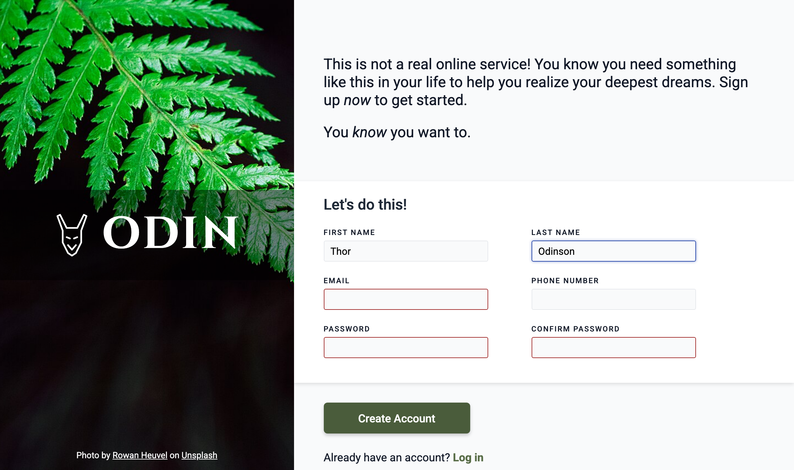
09
Project: Sign-up Form
Two columns made with Flexbox
Image side with logo and photo credit
Labels, input types and required fields
Red border only after the user interacts
Small script checks that passwords match
Live ayxan1110.github.io/odin-sign-up-form/
Code github.com/Ayxan1110/odin-sign-up-form
Notes:
My first project in this course is the Sign-up Form. The layout has two parts made with Flexbox: an image on the left with the logo, and the form on the right. Every input has a label and the correct type, and the required fields are checked by the browser. The red border appears only after the user has interacted with the field, so the form is not red from the start. I also added a small script that checks that the two passwords are the same.

Slide 11
10
CSS Grid
Grid container – display: grid turns children into grid items
Tracks – grid-template-columns / rows, the fr unit, repeat()
Gap – space between rows and columns
Placing items – grid-column: 1 / 3, grid-row, grid-template-areas
Responsive – repeat(auto-fit, minmax(240px, 1fr)) without media queries
grid.css
.dashboard {
display: grid;
grid-template-columns: 250px 1fr;
grid-template-rows: auto 1fr;
min-height: 100vh;
}
.sidebar {
grid-row: 1 / 3; /* full height */
}
.cards {
display: grid;
grid-template-columns:
repeat(auto-fit, minmax(240px, 1fr));
gap: 20px;
}
Notes:
CSS Grid is a two-dimensional layout system, so it controls rows and columns at the same time. With grid-template-columns I define the columns, and the fr unit shares the free space. Items can be placed exactly with grid-column and grid-row, for example the sidebar goes over two rows. The most useful trick is repeat with auto-fit and minmax, which makes the cards wrap automatically on small screens without any media query.

Slide 12
11
Flexbox or Grid?
Flexbox: one direction
Grid: two directions
Good for a row or a column of items: a navigation bar, buttons in a row, centering one thing. The content decides the size.
Good for the whole page layout or a gallery of cards, where rows and columns must line up. The layout decides the size.
Together
Advanced grid
In the Admin Dashboard the page and the cards use Grid, and the header, buttons and items inside a card use Flexbox.
auto-fill vs auto-fit, minmax(), implicit tracks with grid-auto-rows, and naming lines and areas.
Notes:
A common question is when to use Flexbox and when Grid. Flexbox works in one direction, a row or a column, and is perfect for navigation bars and buttons. Grid works in two directions, so it is better for the page layout and for galleries of cards. Usually we use both together: in my Admin Dashboard the big layout and the project cards use Grid, and the smaller parts inside use Flexbox.

Slide 13
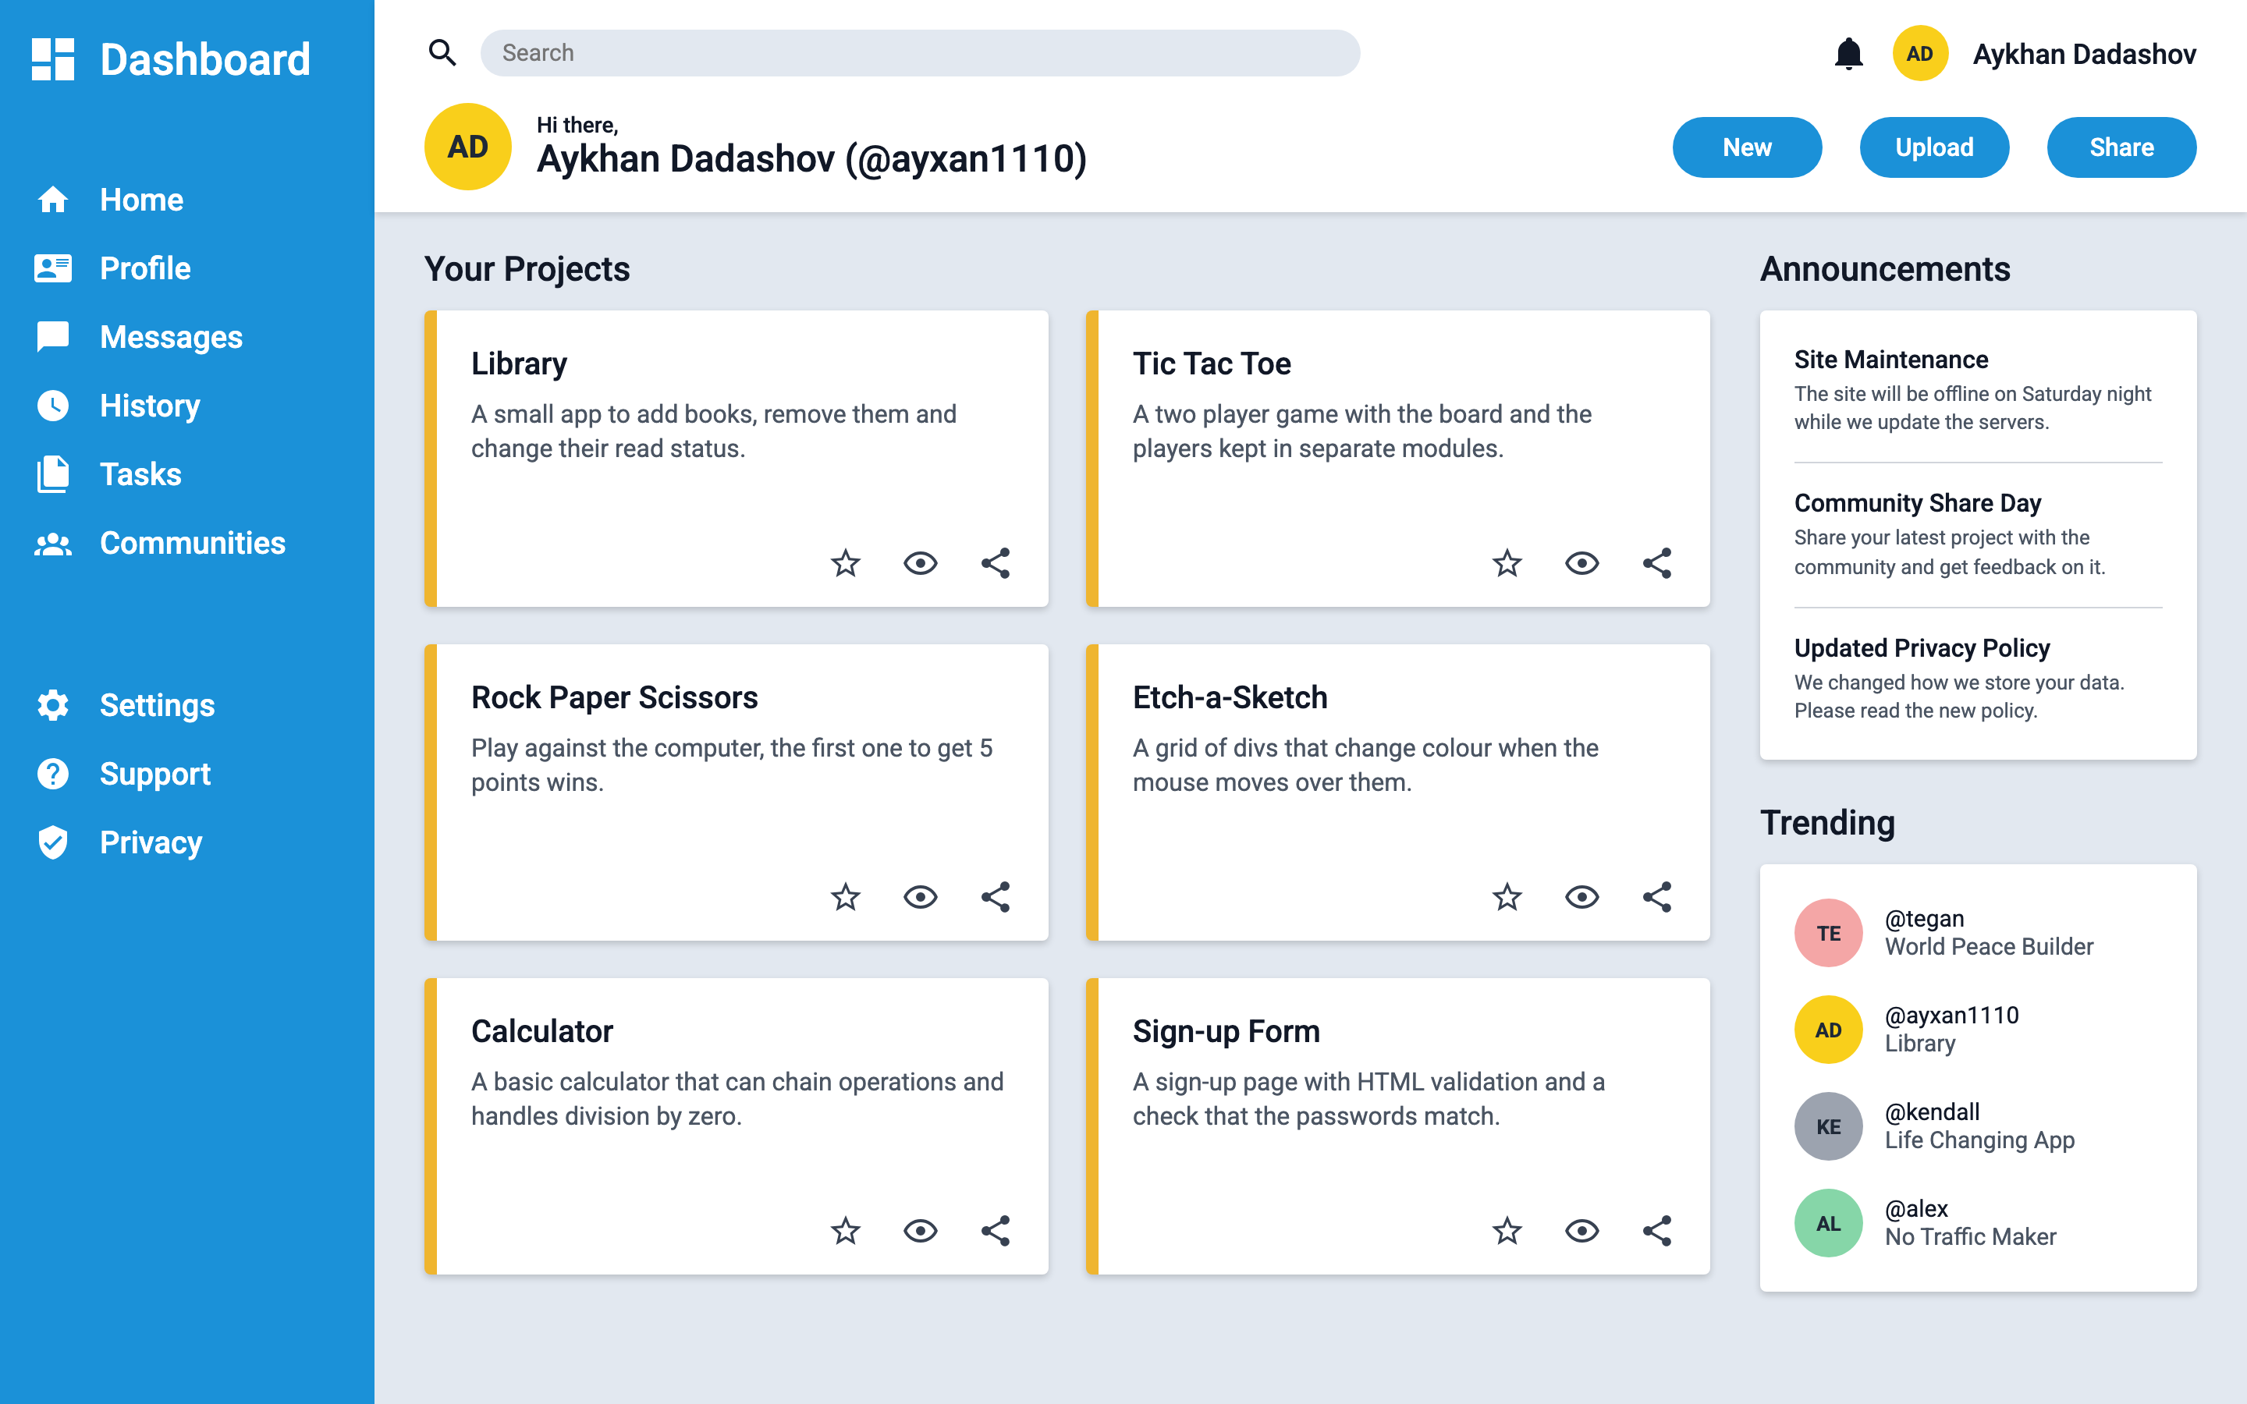
12
Project: Admin Dashboard
Page layout made with CSS Grid
Sidebar with icons (inline SVG)
Header with search, avatar and buttons
Project cards in a responsive grid
Announcements and Trending in the right column
Live ayxan1110.github.io/odin-admin-dashboard/
Code github.com/Ayxan1110/odin-admin-dashboard
Notes:
The final project of the course is the Admin Dashboard. The whole page is a grid: the sidebar on the left, the header on top and the main content. The icons are SVG icons from Material Design Icons. The project cards are also a grid, and they show my real projects. On the right there are announcements and trending users. Inside the cards and the header I used Flexbox to align the items.

Slide 14
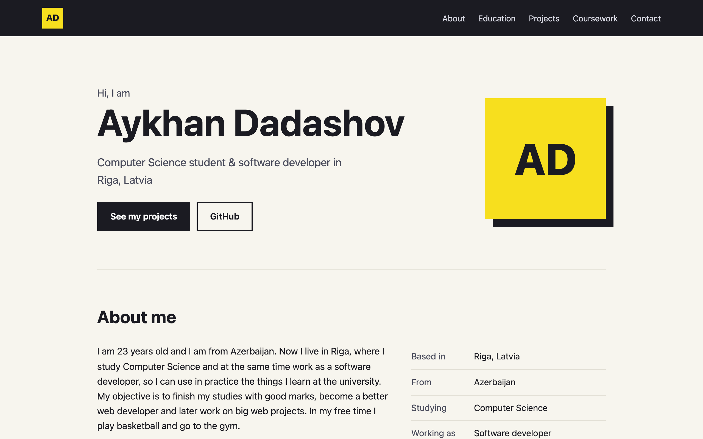
13
My profile page on GitHub Pages
Hosted for free with GitHub Pages
About me, education and skills
Cards linking to all my projects
Table with all Web Technologies tasks
Sticky nav, CSS variables, clamp(), Grid
Live ayxan1110.github.io/
Code github.com/Ayxan1110/Ayxan1110.github.io
Notes:
This is my profile page, and it is live on GitHub Pages. When a repository is called username dot github dot io, GitHub publishes it as the main website of the account. The page has an about me section, my education and skills, cards with links to all my projects and a table with all the tasks of this subject. Here I used things from the course like a sticky navigation, CSS variables, clamp for the font size and Grid for the cards.

Slide 15
14
Projects on GitHub
Sign-up Form
ayxan1110.github.io/odin-sign-up-form/
github.com/Ayxan1110/odin-sign-up-form
Admin Dashboard
ayxan1110.github.io/odin-admin-dashboard/
github.com/Ayxan1110/odin-admin-dashboard
Profile page
ayxan1110.github.io/
github.com/Ayxan1110/Ayxan1110.github.io
Thank you!
Notes:
Here are the links to my projects and my profile page. Everything is on my GitHub account Ayxan1110. Thank you for watching!

