Slide 1
JS
THE ODIN PROJECT · FOUNDATIONS
JavaScript Basics
Aykhan Dadashov · Web Technologies · 28.10.2026
Notes:
Hello, my name is Aykhan Dadashov. In this presentation I will show the JavaScript Basics section of the Foundations course of The Odin Project. I will go through the lessons and show the three projects I made: Rock Paper Scissors, Etch-a-Sketch and the Calculator.

Slide 2
01
Lessons in JavaScript Basics
1
2
3
4
5
Variables and Operators
Installing Node.js
Data Types and Conditionals
JavaScript Developer Tools
Function Basics
6
7
8
9
10
Problem Solving
Understanding Errors
Project: Rock Paper Scissors
Clean Code
Loops and Arrays
11
12
13
14
15
DOM Manipulation and Events
Revisiting Rock Paper Scissors
Project: Etch-a-Sketch
Object Basics
Project: Calculator
Notes:
JavaScript Basics has fifteen lessons. The yellow ones are the projects. The lessons start with variables and operators, then data types, functions, problem solving and errors, then arrays and loops, the DOM and objects. Between them there are three projects: Rock Paper Scissors, Etch-a-Sketch and the Calculator as the final project of Foundations.

Slide 3
02
Variables, operators, data types, conditionals
let and const – const cannot be reassigned, let can; we do not use var
Operators – + - * / % ** and ++ / --, careful with "5" + 2 = "52"
8 data types – string, number, bigint, boolean, undefined, null, symbol, object
Comparison – always use === (strict) instead of ==
Conditionals – if / else if / else, switch, the ternary operator
Logical operators – && (and), || (or), ! (not)
basics.js
const name = "Aykhan"; // cannot change
let score = 0; // can change
score++; // 1
"5" + 2; // "52" (string)
"5" * 2; // 10 (number)
5 === "5"; // false (strict)
if (score >= 5) {
console.log("You win!");
} else if (score === 0) {
console.log("Start playing");
} else {
console.log("Keep going");
}
const text = score > 0 ? "yes" : "no";
Notes:
In the first lessons I learned how to store data in variables. We use const when the value does not change and let when it changes. Then operators, and one tricky thing: plus with a string joins the text, but multiply converts it to a number. JavaScript has eight data types. To compare values we use triple equals, because it also checks the type. For decisions we use if, else if and else, switch, or the short ternary operator.

Slide 4
03
Tools, functions, problem solving, errors
Node.js and DevTools
Function basics
Node runs JavaScript outside the browser. In Chrome DevTools I used the Console, the Elements panel and breakpoints in Sources to go through code line by line.
Parameters and arguments, return values, function declarations, function expressions and arrow functions. Function scope keeps variables inside.
Problem solving
Understanding errors
First understand the problem, then plan, write pseudocode and divide it into small steps. Then turn every step into code.
Read the error message and the line number. ReferenceError: variable not defined. SyntaxError: wrong code. TypeError: wrong type of value.
Notes:
These lessons were about tools and the way of thinking. I installed Node.js to run JavaScript in the terminal, and I learned the Chrome developer tools, especially the console and breakpoints. In function basics I learned parameters, return values and arrow functions. The problem solving lesson teaches to first understand the problem, plan and write pseudocode before coding. And understanding errors taught me to read the error message and the line number, and the most common error types.

Slide 5
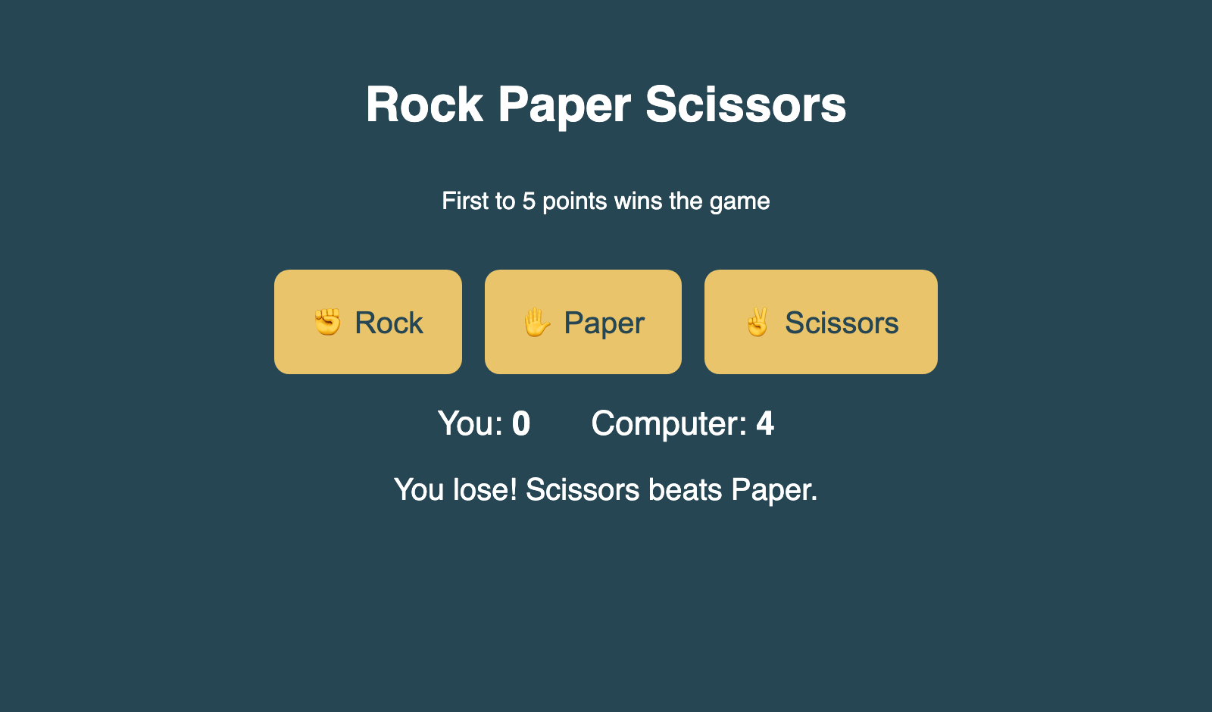
04
Project: Rock Paper Scissors
Computer choice with Math.random()
playRound() compares the two choices
Score for human and computer
First to 5 points wins the game
UI with buttons (Revisiting RPS lesson)
Live ayxan1110.github.io/odin-rock-paper-scissors/
Code github.com/Ayxan1110/odin-rock-paper-scissors
Notes:
My first project was Rock Paper Scissors. The computer choice uses Math.random, which gives a number between 0 and 1, and I split it into three parts for rock, paper and scissors. The playRound function compares the choices with conditionals and updates the score. First the game worked only in the console, and later in the lesson Revisiting Rock Paper Scissors I added buttons and showed the result on the page. The first player to reach 5 points wins, and then a Play again button appears.

Slide 6
05
Clean code, loops and arrays
Clean code – good names (camelCase), consistent indentation, comments explain why
Arrays – ordered lists, index starts at 0; push, pop, slice, splice, includes
Loops – for, while, and for...of to repeat code
Array methods – map, filter, reduce, forEach – shorter than loops
Used in my projects – for loop in Etch-a-Sketch, forEach in RPS, includes() in the Calculator
arrays.js
const numbers = [1, 2, 3, 4, 5];
for (let i = 0; i < numbers.length; i++) {
console.log(numbers[i]);
}
// new array, every number doubled
numbers.map((n) => n * 2);
// [2, 4, 6, 8, 10]
// only even numbers
numbers.filter((n) => n % 2 === 0);
// [2, 4]
// add everything together
numbers.reduce((sum, n) => sum + n, 0);
// 15
Notes:
The Clean Code lesson explained how to write code that other people can read: clear variable names, the same indentation everywhere and comments that explain why and not what. Then I learned arrays, lists where the first index is zero, and loops to repeat code. The most useful part were the array methods map, filter and reduce, which make the code much shorter than a normal for loop. I used forEach and includes in my projects.

Slide 7
06
DOM manipulation and events
DOM – the page as a tree of nodes that JavaScript can change
Select – querySelector() and querySelectorAll()
Create and add – createElement(), appendChild(), append()
Change – textContent, classList, style, setAttribute()
Events – addEventListener("click", ...), the event object, bubbling
dom.js
const container =
document.querySelector("#container");
const button = document.createElement("button");
button.textContent = "Click me";
button.classList.add("btn");
container.appendChild(button);
button.addEventListener("click", (event) => {
console.log(event.target); // the button
button.style.backgroundColor = "gold";
});
// many elements at once
document.querySelectorAll(".square")
.forEach((sq) => sq.remove());
Notes:
The DOM is the Document Object Model, the page as a tree of elements, and JavaScript can read and change it. I learned to select elements with querySelector, to create new ones with createElement and add them to the page with appendChild. We can change the text, the classes and the style. With addEventListener we react to clicks, key presses or mouse movement. The event object tells us which element was clicked. All my three projects use these methods.

Slide 8
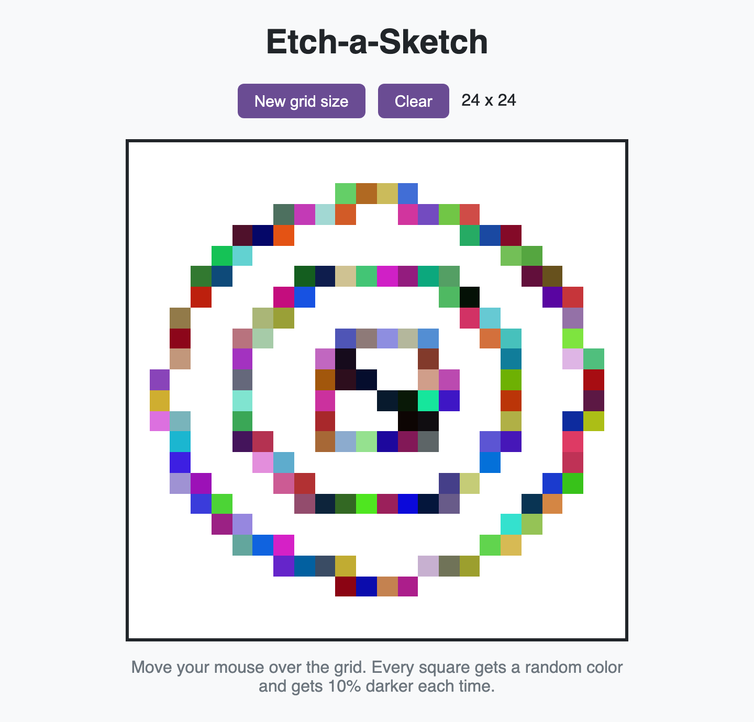
07
Project: Etch-a-Sketch
16 x 16 grid made with a JavaScript loop
Flexbox with flex-wrap keeps it in a 480px box
Squares change color on mouseenter
Button with prompt() for a new size (max 100)
Extra: random RGB and 10% darker every pass
Live ayxan1110.github.io/odin-etch-a-sketch/
Code github.com/Ayxan1110/odin-etch-a-sketch
Notes:
The second project is Etch-a-Sketch, something between a drawing pad and an etch-a-sketch toy. The grid is not written in HTML, it is created with a loop in JavaScript. The container always has the same size, and every square gets its width in percent, so any grid size fits. When the mouse enters a square, it changes color. With the New grid size button I ask the user with prompt how many squares per side, up to one hundred. I also did the extra credit: every pass gives a random color and makes the square ten percent darker, so after ten passes it is black.

Slide 9
08
Object basics
Objects – store data as key: value pairs
Add, change, delete – user.age = 23, delete user.age
Check a key – "name" in user, or loop with for...in
Reference – copying an object copies the reference, not the data
Array of objects – very common, e.g. a list of users or books
objects.js
const user = {
name: "Aykhan",
city: "Riga",
};
user.age = 23; // add
user.city = "Baku"; // change
delete user.age; // remove
"name" in user; // true
const copy = user; // same object!
copy.name = "Test";
user.name; // "Test"
const users = [{ name: "A", age: 20 },
{ name: "B", age: 31 }];
users.find((u) => u.age > 30); // B
Notes:
Object basics introduced objects, which store data as key and value pairs. We can add, change and delete properties, and check if a key exists with the in operator. One important thing: when we copy an object to another variable, we copy only the reference, so both variables point to the same object, and changing one changes both. We also practiced arrays of objects with methods like find and filter.

Slide 10
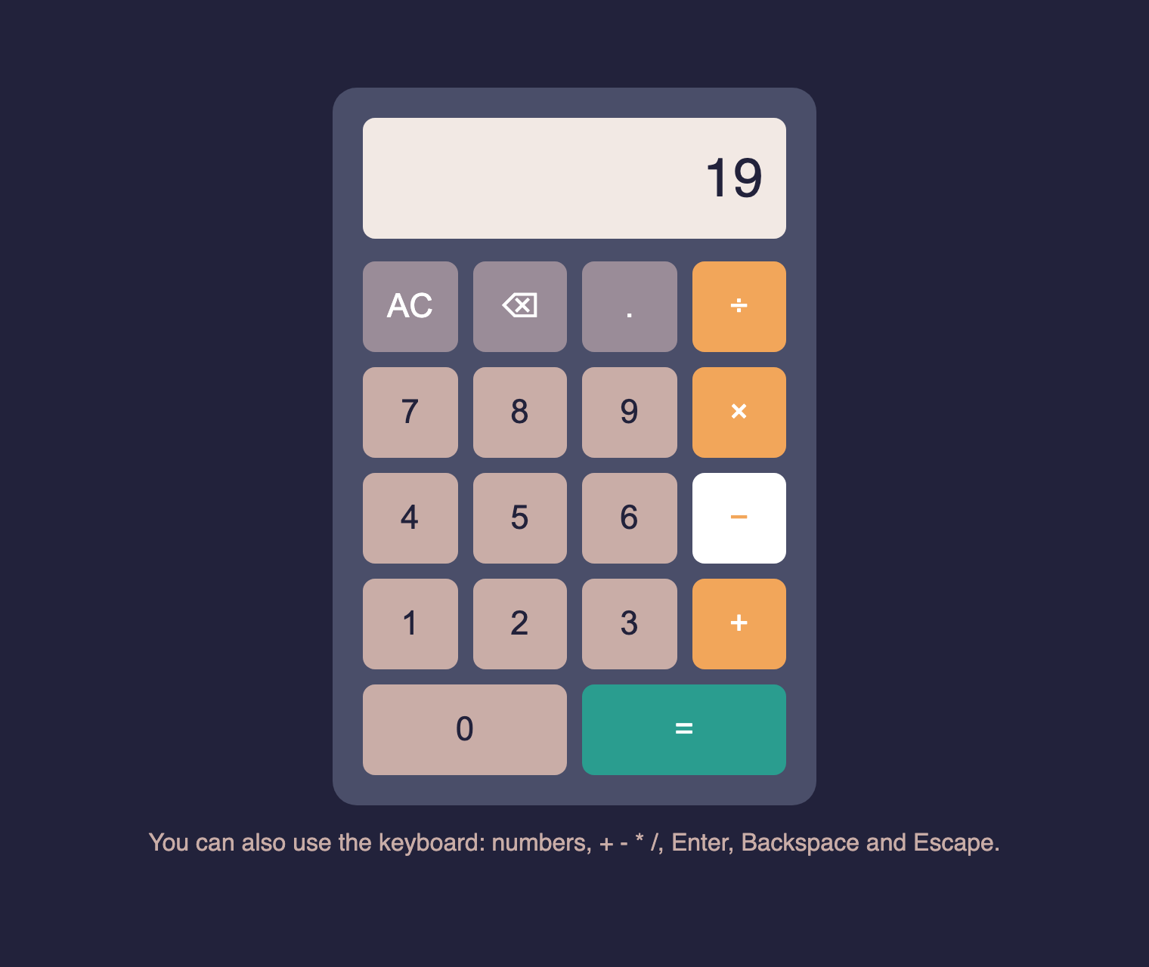
09
Project: Calculator
add, subtract, multiply, divide + operate()
One pair at a time: 12 + 7 − shows 19
Rounds long decimals to fit the screen
Error message when dividing by 0
Extra: decimal, backspace, keyboard
Live ayxan1110.github.io/odin-calculator/
Code github.com/Ayxan1110/odin-calculator
Notes:
The final project of Foundations is the Calculator. First I wrote the four math functions and an operate function that calls the right one. The calculator works on one pair of numbers at a time, so if I type 12 plus 7 and then minus, it shows 19 first. Long decimals are rounded, and dividing by zero shows a message instead of breaking. For extra credit I added the decimal point, a backspace button and keyboard support. I did not use eval.

Slide 11
10
Calculator: how the logic works
firstNumber
operator
currentInput
the number before the operator
+ − × ÷ that was pressed
the number on the display
Press | firstNumber | operator | currentInput | Display
1, 2 | empty | empty | 12 | 12
+ | 12 | + | 12 | 12
7 | 12 | + | 7 | 7
− | 19 | − | 19 | 19
1, = | empty | empty | 18 | 18
Notes:
To explain how the calculator works, it remembers three things: the first number, the operator and the current input. In the table you can see the example 12 plus 7 minus 1. When I press plus, the 12 is saved as the first number. When I type 7, it becomes the current input. When I press minus, the calculator first calculates 12 plus 7, so 19 becomes the first number and minus the new operator. When I press 1 and equals, it calculates 19 minus 1 and shows 18. If two operators are pressed in a row, only the operator changes.

Slide 12
11
Projects on GitHub
Rock Paper Scissors
ayxan1110.github.io/odin-rock-paper-scissors/
github.com/Ayxan1110/odin-rock-paper-scissors
Etch-a-Sketch
ayxan1110.github.io/odin-etch-a-sketch/
github.com/Ayxan1110/odin-etch-a-sketch
Calculator
ayxan1110.github.io/odin-calculator/
github.com/Ayxan1110/odin-calculator
Thank you!
Notes:
All three projects are on my GitHub account Ayxan1110 and they are live with GitHub Pages. These are the links. Thank you for watching!

