Slide 1
JS
THE ODIN PROJECT · JAVASCRIPT COURSE
Organizing Your
JavaScript Code
Aykhan Dadashov · Web Technologies · 28.10.2026
Notes:
Hello, my name is Aykhan Dadashov. In this presentation I will show what I learned in the JavaScript course of The Odin Project: the introduction and the first part of the section "Organizing Your JavaScript Code". I will explain the lessons and then show my two projects, the Library and Tic Tac Toe, and how I built them.

Slide 2
01
What I covered
1
2
3
4
Introduction: How This Course Will Work
Organizing Your JavaScript Code
Organizing Code with Objects
Object Constructors
5
6
7
Project: Library
Factory Functions and the Module Pattern
Project: Tic Tac Toe
Notes:
These are the lessons I completed. The yellow cards are the projects. First there is the introduction to the course, then the lessons about objects, object constructors and factory functions. After the theory lessons I made a project to practice: Library after object constructors, and Tic Tac Toe after factory functions and the module pattern.

Slide 3
02
Introduction: how the course works
Builds on Foundations – we already know variables, functions, loops and the DOM
Focus on structure – not only "does it work", but how to keep code clean when the project grows
Read, then build – each lesson has articles and knowledge checks, and every few lessons there is a project
Ask for help – the course recommends the Odin community on Discord when you are stuck
14
lessons in "Organizing Your JavaScript Code"
4
projects in the section: Library, Tic Tac Toe, Restaurant Page, Todo List
2
projects done so far: Library and Tic Tac Toe
Notes:
The JavaScript course continues after the Foundations course. In Foundations we learned the basics, and now the goal is to learn how to organize our code, so that it is still easy to read when a project becomes bigger. Every lesson has reading materials and knowledge check questions, and after some lessons there is a project. The section Organizing Your JavaScript Code has 14 lessons and 4 projects. I finished the first two projects: Library and Tic Tac Toe.

Slide 4
03
Organizing code with objects
Object literal – groups data that belongs together in one place
Dot or bracket notation – player.name or player["name"] (brackets work with variables)
Methods – functions inside an object, so data and behaviour live together
this – inside a method it points to the object that called it
Result – instead of many separate variables, one object keeps the code organized
objects.js
// without objects: loose variables
const playerOneName = "Aykhan";
const playerOneMarker = "X";
// with an object: grouped together
const playerOne = {
name: "Aykhan",
marker: "X",
sayHello() {
return `Hi, I am ${this.name}`;
},
};
playerOne.name; // "Aykhan"
playerOne["marker"]; // "X"
playerOne.sayHello(); // "Hi, I am Aykhan"
Notes:
In this lesson I learned why objects are useful for organizing code. On the left side of the code you can see the problem: if we have many players, we need many separate variables. With an object literal all the data of one player is in one place. We can read properties with dot notation or bracket notation. Bracket notation is useful when the property name is in a variable. Objects can also have methods, and inside a method the keyword this means the object itself.

Slide 5
04
Object constructors and prototypes
Constructor – a normal function we call with new to create many similar objects
new – creates an empty object, sets this to it and returns it
Prototype – every object has one; methods there are shared, not copied
Prototype chain – if a property is not found, JS looks in the prototype
Inheritance – Object.setPrototypeOf(Child.prototype, Parent.prototype)
constructor.js
function Book(title, author, pages, read) {
if (!new.target) throw Error("Use new");
this.title = title;
this.author = author;
this.pages = pages;
this.read = read;
}
// one shared function for all books
Book.prototype.toggleRead = function () {
this.read = !this.read;
};
const hobbit = new Book("The Hobbit",
"Tolkien", 295, true);
hobbit.toggleRead(); // read = false
Notes:
When we need many objects of the same type, writing every object literal by hand is a lot of repetition. An object constructor is a function that we call with the new keyword. new creates a new empty object, connects it to the prototype, runs the function with this pointing to the new object and returns it. I also added a check with new.target, so the constructor throws an error if someone forgets new. Methods like toggleRead are put on the prototype, so all books share one function instead of each book having its own copy. If JavaScript does not find a property on the object, it looks up the prototype chain.

Slide 6
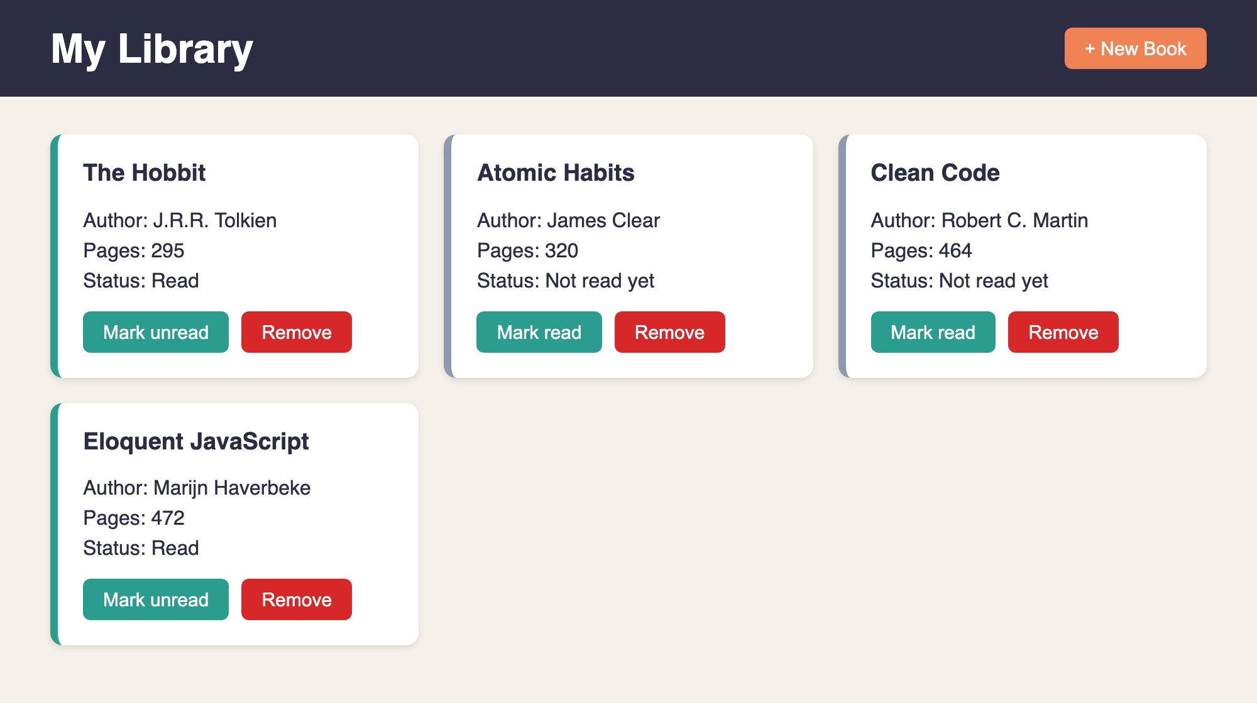
05
Project: Library
Shows all books as cards from the myLibrary array
"New Book" opens a <dialog> with a form
Remove a book with its button
Toggle read / not read with a prototype method
Every book has a unique id from crypto.randomUUID()
Live ayxan1110.github.io/odin-library/
Code github.com/Ayxan1110/odin-library
Notes:
This is my Library project. All books are stored in an array called myLibrary. Every book is an object made with the Book constructor. The page shows each book as a card with title, author, number of pages and read status. With the New Book button a dialog with a form opens. Each card has a button to change the read status and a button to remove the book. Now I will show it live in the browser.

Slide 7
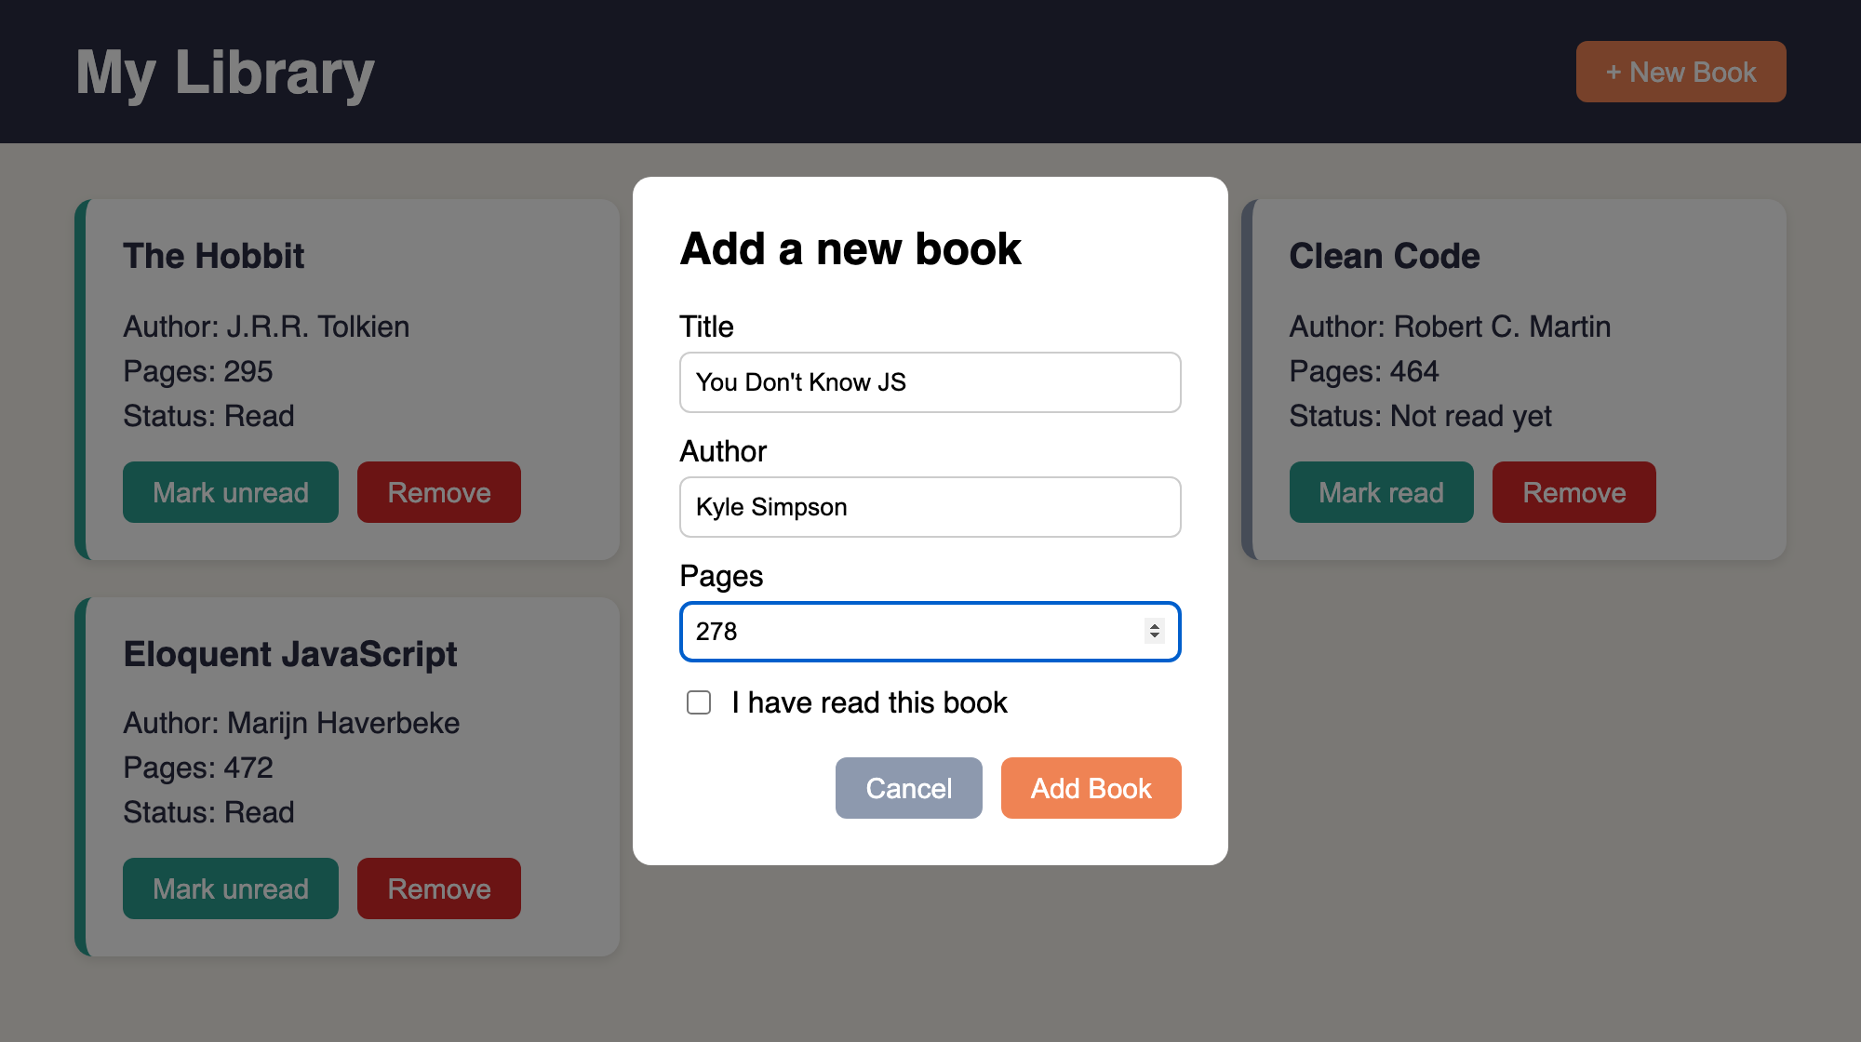
06
Library: how I built it
1
Open
Click on "New Book" calls dialog.showModal()
2
Submit
preventDefault() stops the page reload, then I read the input values
3
Store
addBookToLibrary() creates new Book(...) and pushes it to myLibrary
4
Display
The form inside <dialog>, opened with showModal()
displayBooks() clears the container and draws a card for every book
5
Connect
Each card has data-id, so Remove finds the right book in the array
Notes:
Here is how the Library works step by step. When I click New Book, the dialog opens with showModal. When the form is submitted, I call preventDefault, because by default a form tries to send the data to a server and reloads the page. Then I read the values from the inputs and call addBookToLibrary, which creates a new Book object and pushes it into the array. After that, displayBooks clears the container and creates the cards again from the array, so the page always shows exactly what is in the array. Every card has a data-id attribute with the id of the book, and this is how the Remove button knows which book to delete from the array.

Slide 8
07
Factory functions and the module pattern
Scope – variables live inside the function or block where they are declared
Closure – an inner function remembers the variables of its outer function
Factory function – a function that returns an object, no new and no this needed
Private variables – only reachable through the returned functions
Module (IIFE) – a factory that runs one time, for things we need only once
factory.js
// factory: we can make many players
function createPlayer(name, mark) {
return { name, mark };
}
const p1 = createPlayer("Aykhan", "X");
// module: runs once, board stays private
const Gameboard = (function () {
const board = ["", "", "", "", "",
"", "", "", ""];
const getBoard = () => board;
const placeMark = (i, mark) => {
if (board[i] !== "") return false;
board[i] = mark;
return true;
};
return { getBoard, placeMark };
})();
Notes:
This lesson explained another way to create objects. A factory function is a function that simply returns an object, so we do not need new or this. Because of closures, the functions inside can still use the variables of the outer function after it has finished, and those variables are private: from outside you cannot change them directly, only through the functions we return. The module pattern is the same idea, but the function is wrapped in an IIFE, an immediately invoked function expression, so it runs only once. This is good for things where we need exactly one, like the game board.

Slide 9
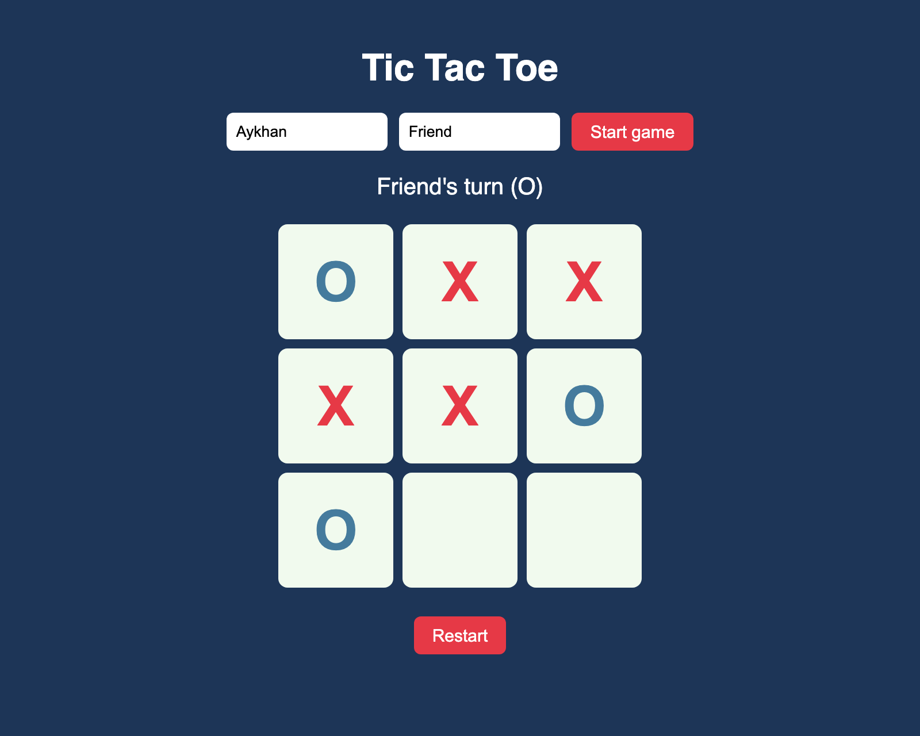
08
Project: Tic Tac Toe
Two players enter their names
Click a cell to place X or O
Taken cells cannot be clicked again
Detects all 8 winning lines and a tie
Restart button starts a new round
Live ayxan1110.github.io/odin-tic-tac-toe/
Code github.com/Ayxan1110/odin-tic-tac-toe
Notes:
My second project is Tic Tac Toe. The players write their names and press Start. Then they click on the cells and the game places X or O. You cannot click a cell that is already taken. The game checks all 8 winning lines, 3 rows, 3 columns and 2 diagonals, and shows who won or if it is a tie. With Restart you can play again. Let me show it in the browser.

Slide 10
09
Tic Tac Toe: code structure
Gameboard
module · IIFE
Private board array.
getBoard(), placeMark(), reset()
GameController
DisplayController
module · IIFE
module · IIFE
Whose turn it is, win and tie check.
start(), playRound(index)
The only part that uses the DOM.
render(), click and form events
createPlayer()
factory function
Returns { name, mark }.
Called twice: X and O
Game logic works without the DOM, so it can be played in the console
Notes:
The main goal of this project was to have as little global code as possible. I split the code into four parts. Gameboard is a module made with an IIFE, because there is only one board. The board array is private, other code can only use getBoard, placeMark and reset. createPlayer is a factory function, because we need two players. GameController is a module that knows whose turn it is, places the mark on the board and checks for a winner or a tie. DisplayController is the only part that touches the DOM: it draws the board and listens to the clicks. Because of this split, the game logic works even without the page, I could test it in the console first.

Slide 11
10
Problems I solved
form.title was empty
Books were duplicated
A <form> already has a built-in title property, so form.title did not return my input. I used document.querySelector("#title") instead.
Every time I added a book, all cards were added again. displayBooks() now clears the container first and then draws the array.
Win on the last move
Nine click listeners
If someone wins with the 9th move, the game must not say "tie". I check for a winner first and only then for a full board.
Instead of adding a listener to every cell, I add one listener on the board and read data-index from the clicked cell (event delegation).
Notes:
Here are some problems I had while building the projects and how I fixed them. First, in the Library I wanted to read the title input with form.title, but a form element already has its own title property, so it was empty. I changed it to querySelector. Second, books appeared two times, because I added new cards without removing the old ones, so now displayBooks clears the container first. Third, in Tic Tac Toe a win on the last move was counted as a tie, so I check the winner before checking if the board is full. And finally, instead of nine event listeners I used one listener on the board, this is called event delegation.

Slide 12
11
Projects on GitHub
Library
ayxan1110.github.io/odin-library/
github.com/Ayxan1110/odin-library
Tic Tac Toe
ayxan1110.github.io/odin-tic-tac-toe/
github.com/Ayxan1110/odin-tic-tac-toe
Thank you!
Notes:
Both projects are uploaded to my GitHub account Ayxan1110 and they are live with GitHub Pages, here are the links. Thank you for watching!

