Slide 1

Asynchronous Programming

Slide 2
Today’s Lesson
MultiTasking
MultiThreading
Synchronous
Asynchronous
Data Encryption
Data Decryption

Slide 3
Thread
A thread is defined as the execution path of a program. Each thread defines a unique flow of control. If your application involves complicated and time consuming operations, then it is often helpful to set different execution paths or threads, with each thread performing a particular job.
Threads are lightweight processes. One common example of use of thread is implementation of concurrent programming by modern operating systems. Use of threads saves wastage of CPU cycle and increase efficiency of an application.
So far we wrote the programs where a single thread runs as a single process which is the running instance of the application. However, this way the application can perform one job at a time. To make it execute more than one task at a time, it could be divided into smaller threads.
Notes:
https://www.tutorialspoint.com/csharp/csharp_multithreading.htm

Slide 4
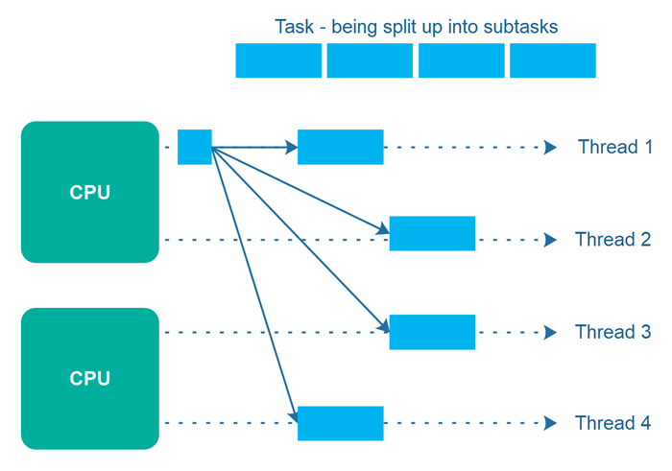
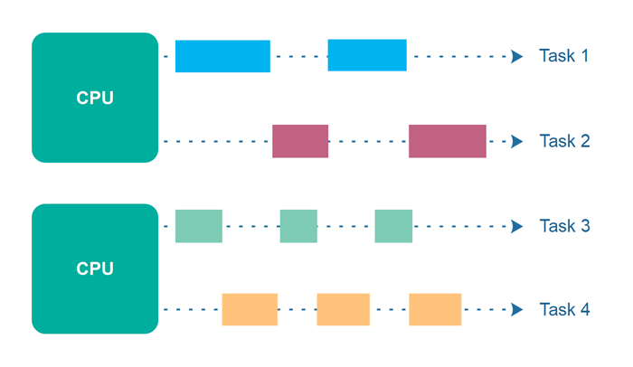
Concurrency and Parallelism

Slide 5
CPU-bound & I/O-bound
The core of async programming is the Task and Task<T> objects, which model asynchronous operations. They are supported by the async and await keywords. The model is fairly simple in most cases:
For I/O-bound code, you await an operation that returns a Task or Task<T> inside of an async method.
For CPU-bound code, you await an operation that is started on a background thread with the Task.Run method.
The await keyword is where the magic happens. It yields control to the caller of the method that performed await, and it ultimately allows a UI to be responsive or a service to be elastic
Notes:
https://docs.microsoft.com/en-us/dotnet/csharp/async#main

Slide 6
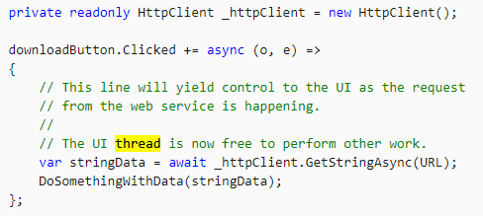
I/O-bound
You want to download some data from server, but not block the UI
Notes:
https://docs.microsoft.com/en-us/dotnet/csharp/async#main

Slide 7
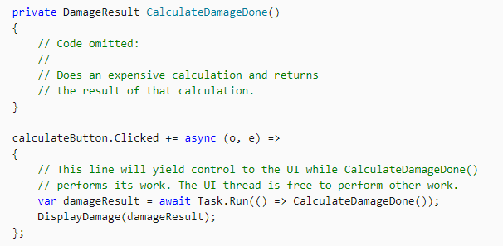
CPU-bound
On button click a “expensive” calculation has to be done on the server side
Notes:
https://docs.microsoft.com/en-us/dotnet/csharp/async#main

Slide 8
Race condition
Example race condition. Increment and decrement
Notes:
https://www.c-sharpcorner.com/UploadFile/1d42da/thread-locking-in-C-Sharp/

Slide 9
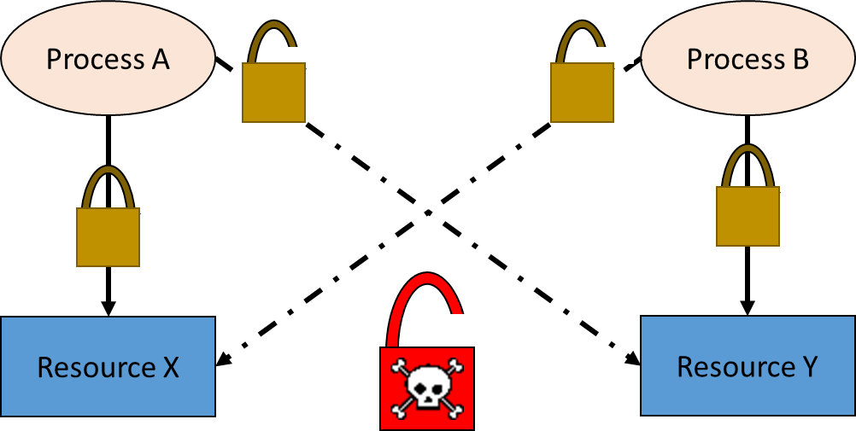
DeadLock
Notes:
public void Foo()
{
object lock1 = new object();
object lock2 = new object();
Console.WriteLine("Starting...");
var task1 = Task.Run(() =>
{
lock (lock1)
{
Thread.Sleep(1000);
lock (lock2)
{
Console.WriteLine("Finished Thread 1");
}
}
});
var task2 = Task.Run(() =>
{
lock (lock2)
{
Thread.Sleep(1000);
lock (lock1)
{
Console.WriteLine("Finished Thread 2");
}
}
});
Task.WaitAll(task1, task2);
Console.WriteLine("Finished...");
}

Slide 10
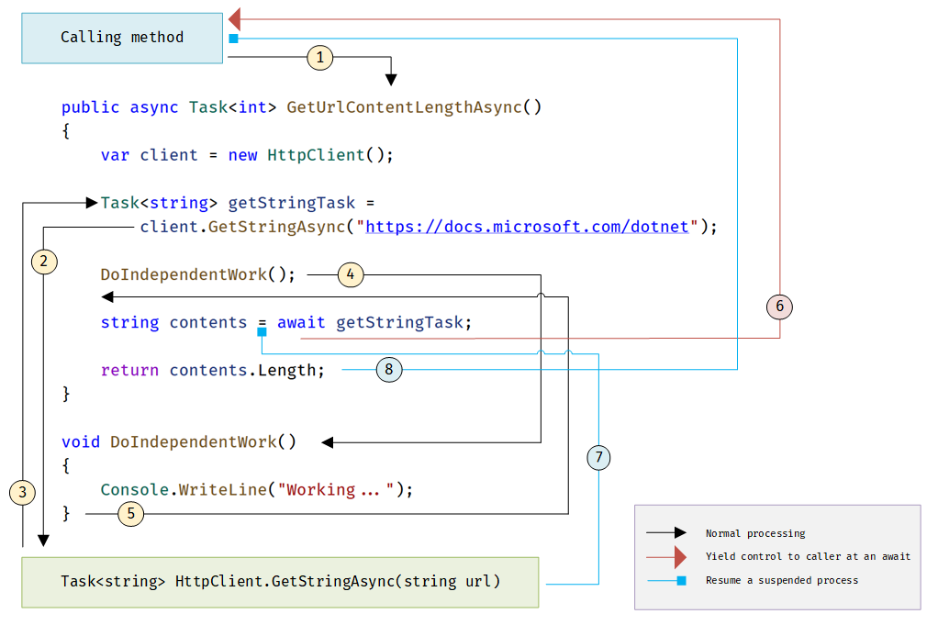
What happens in an async method

Slide 11
Remarks
Async code can be used for both I/O-bound and CPU-bound code, but differently for each scenario.
Async code uses Task<T> and Task, which are constructs used to model work being done in the background.
The async keyword turns a method into an async method, which allows you to use the await keyword in its body.
When the await keyword is applied, it suspends the calling method and yields control back to its caller until the awaited task is complete.
await can only be used inside an async methods

Slide 12
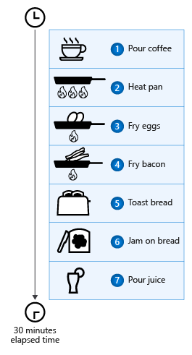
Example: Make Breakfast - Sync
namespace AsyncBreakfast { class Program { static void Main(string[] args) { Coffee cup = PourCoffee(); Console.WriteLine("coffee is ready"); Egg eggs = FryEggs(2); Console.WriteLine("eggs are ready"); Bacon bacon = FryBacon(3); // ← Halal Bacon Console.WriteLine("bacon is ready"); Toast toast = ToastBread(2); ApplyButter(toast); ApplyJam(toast); Console.WriteLine("toast is ready"); Juice oj = PourOJ(); Console.WriteLine("oj is ready"); Console.WriteLine("Breakfast is ready!"); }
Notes:
See the list of the called methods with delays here: https://docs.microsoft.com/en-us/dotnet/csharp/programming-guide/concepts/async/

Slide 13
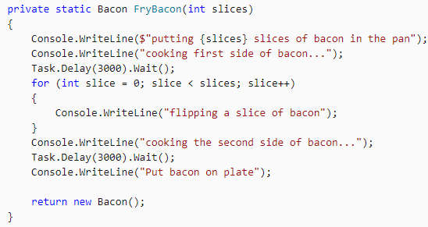
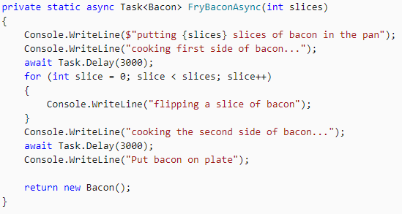
Bacon Becomes:
Notes:
See the list of the called methods with delays here: https://docs.microsoft.com/en-us/dotnet/csharp/programming-guide/concepts/async/

Slide 14
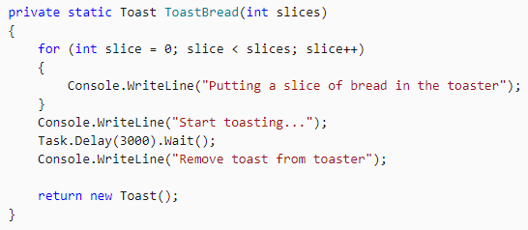
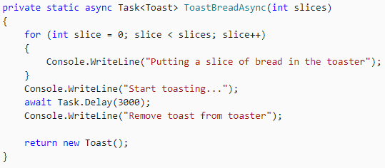
ToastBread Becomes:
Notes:
See the list of the called methods with delays here: https://docs.microsoft.com/en-us/dotnet/csharp/programming-guide/concepts/async/

Slide 15
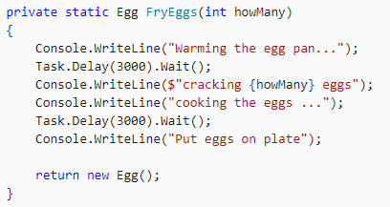
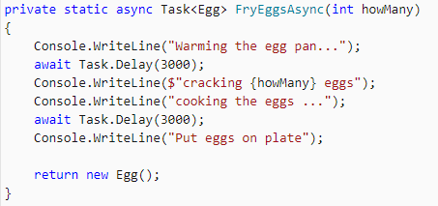
Eggs Becomes:
Notes:
See the list of the called methods with delays here: https://docs.microsoft.com/en-us/dotnet/csharp/programming-guide/concepts/async/

Slide 16
Await Task...
We have multiple waiting options with task
await task
Wait/await for a task to complete
await Task.WhenAny
Wait/await for one of a collection of tasks to complete
await Task.WhenAll
Wait/await for every one of a collection of tasks to complete
await Task.Delay
Wait/await for a period of time
Task.Run
Set the Task on queue to run on threadPool

Slide 17
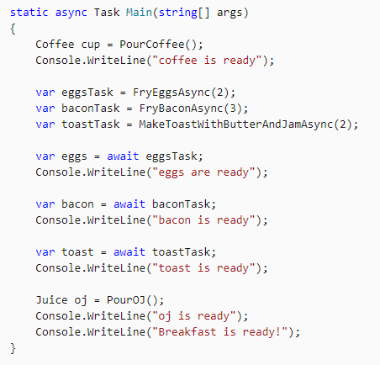
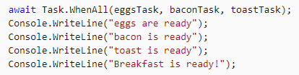
Main method: possible variations
OR
Notes:
See the list of the called methods with delays here: https://docs.microsoft.com/en-us/dotnet/csharp/programming-guide/concepts/async/

Slide 18
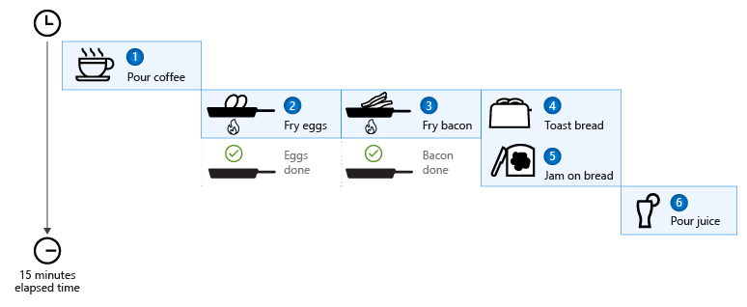
The End Result

Slide 19
MultiTasking
Multitasking refers to allowing the user to perform multiple tasks at the same time.
The user can listen to music running in the background, while writing a blog.
Hence, the computer is performing multiple tasks for the user. Each task requires resources.
Since the computer has limited resources, the number of tasks performed at the same time are also limited.

Slide 20
MultiThreading
Multithreading is used to perform multiple tasks.
Each task can have multiple threads.
In a multithreaded application, the user can do more in a short span of time than a single thread application.
Today, almost every application uses multiple threading.
An application or a process can have a user interface thread that manages interactions with the user and background worker threads that perform other tasks.

Slide 21
Cancel list of Tasks
static readonly CancellationTokenSource s_cts = new CancellationTokenSource(); static readonly HttpClient s_client = new HttpClient { MaxResponseContentBufferSize = 1_000_000 }; static readonly IEnumerable<string> s_urlList = new string[] { "https://docs.microsoft.com", "https://docs.microsoft.com/aspnet/core", "https://docs.microsoft.com/azure", "https://docs.microsoft.com/azure/devops", "https://docs.microsoft.com/dotnet", "https://docs.microsoft.com/dynamics365", "https://docs.microsoft.com/education", "https://docs.microsoft.com/enterprise-mobility-security", "https://docs.microsoft.com/gaming", "https://docs.microsoft.com/graph", "https://docs.microsoft.com/microsoft-365", "https://docs.microsoft.com/office", "https://docs.microsoft.com/powershell" };

Slide 22
Thanks!

