Slide 1


Analysis
27 June 2023

Slide 2

THE TEAM
İbrahim Özcan
Sinan Yeşil

Slide 3
OUTLINE
We analyzed;
Download numbers, profits and prices by categories.
Top apps that are downloaded based on their popularity and size.
Top installed apps in each category
in order to get latest trends based on numerical data.

Slide 4





TOOLS
Google Colab as IDE
Power BI for visualization
Python as language
Discord and Whatsapp
for communication

Slide 5
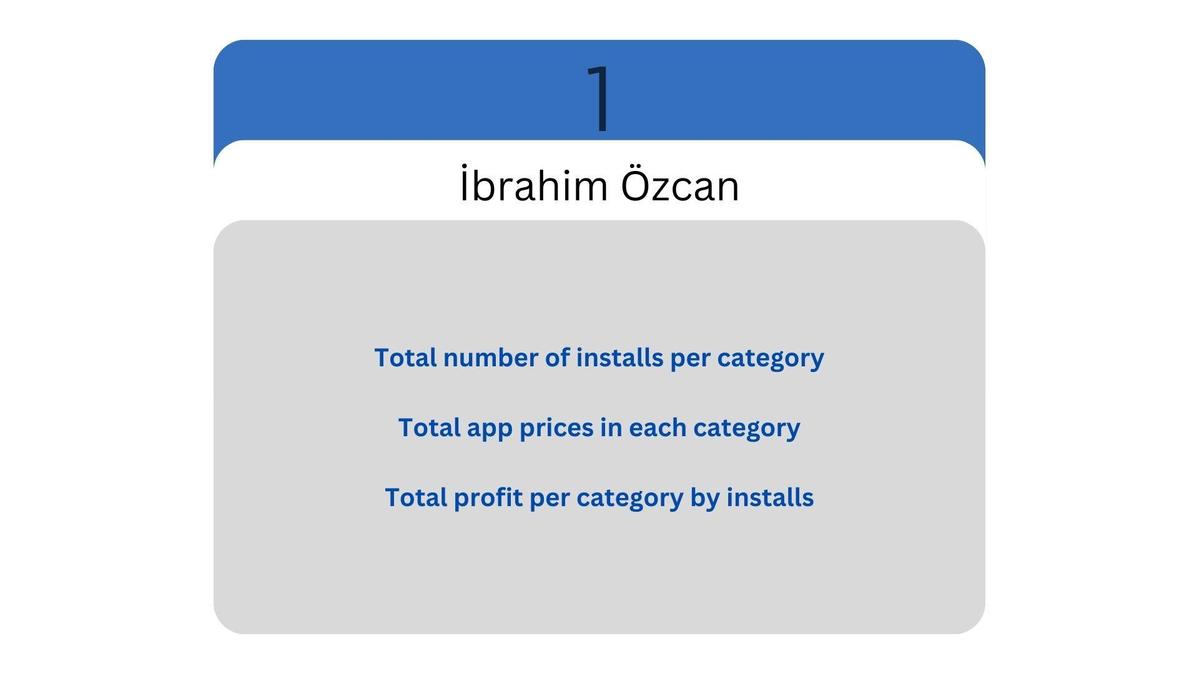
KEY POINTS

Slide 6
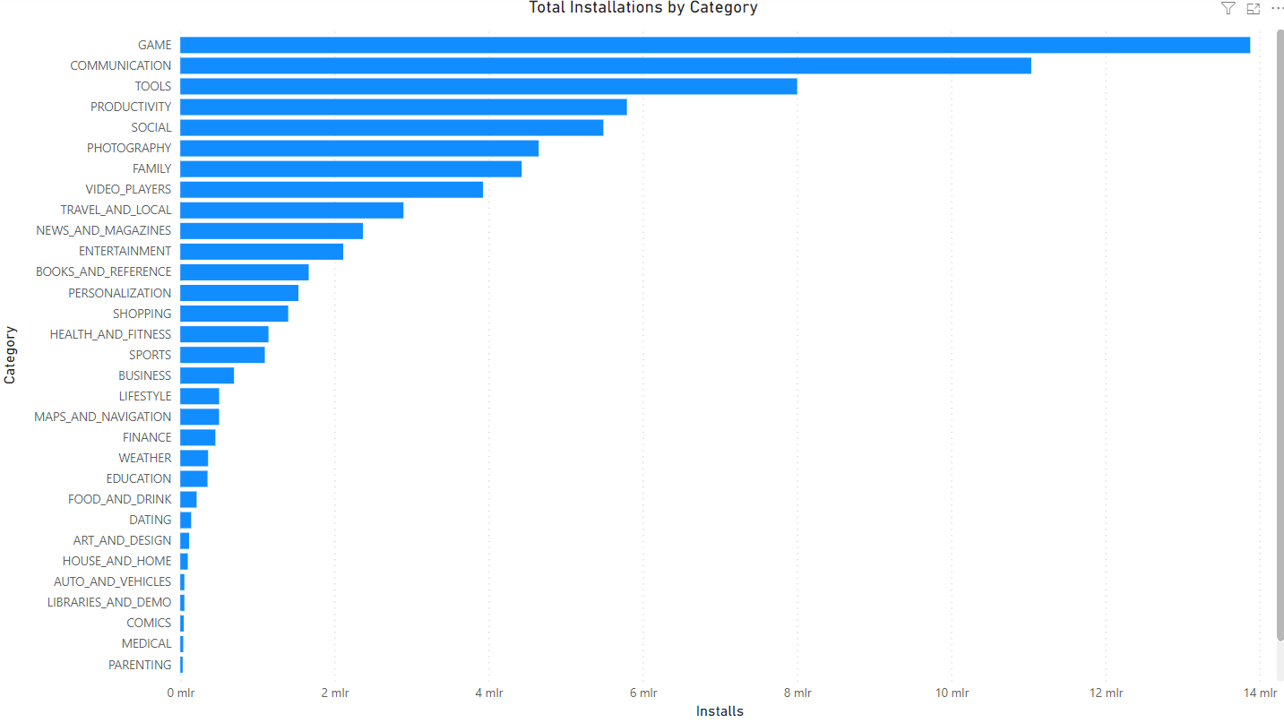

Slide 7
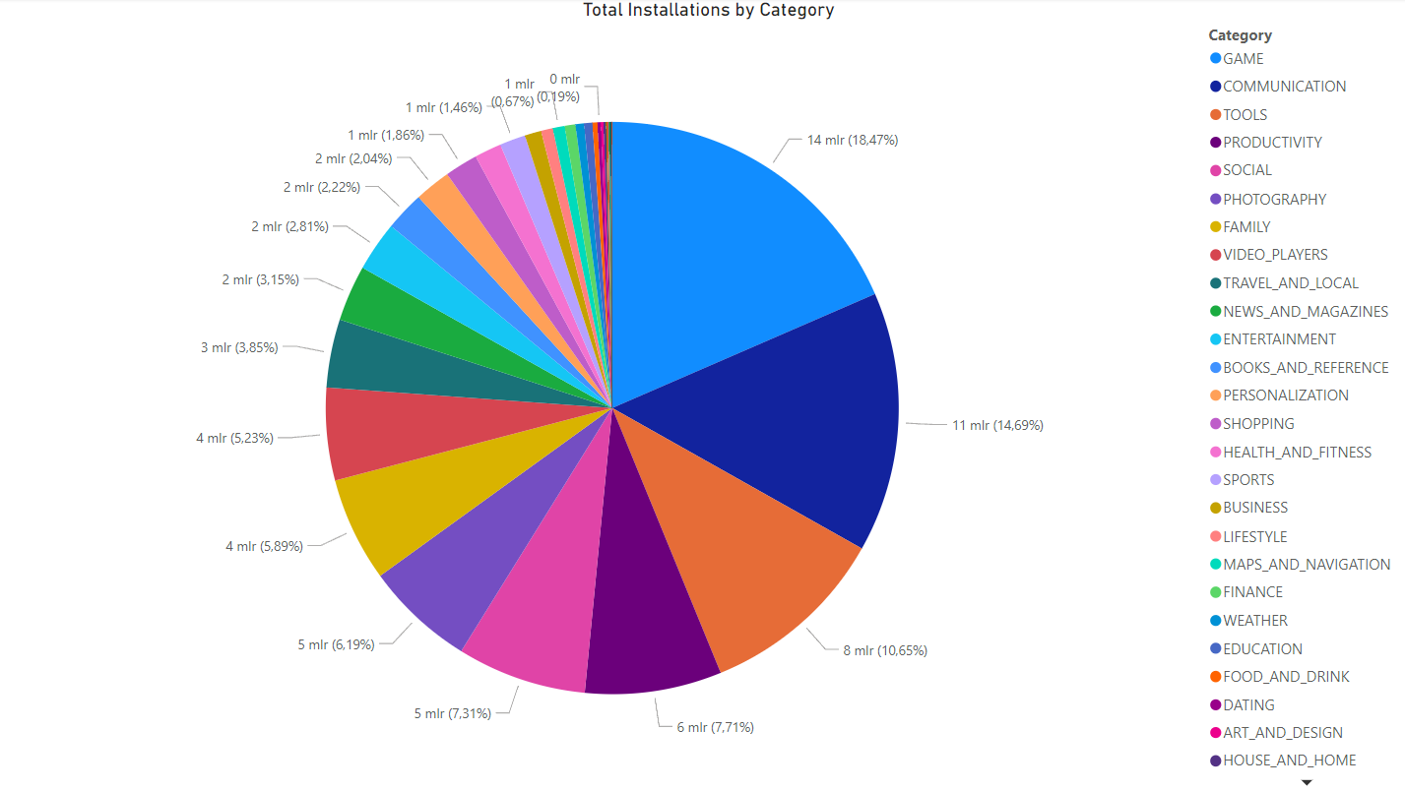

Slide 8
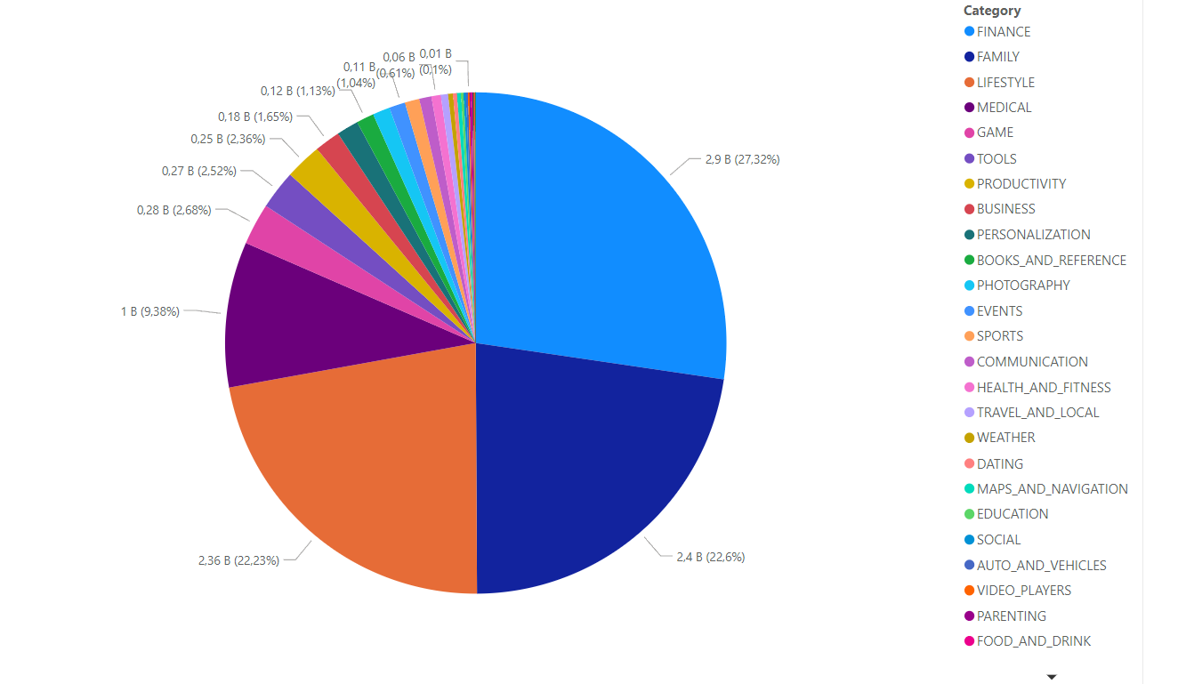
TOTAL APP PRICES PER CATEGORY

Slide 9
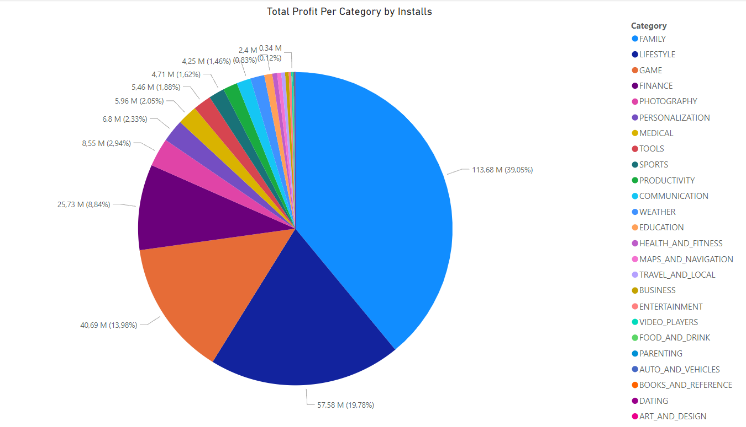
The most profit is made by family category, even though it sits on the 7th place in downloads.
We can argue that children/family spendings are the main target to profit in the playstore

Slide 10
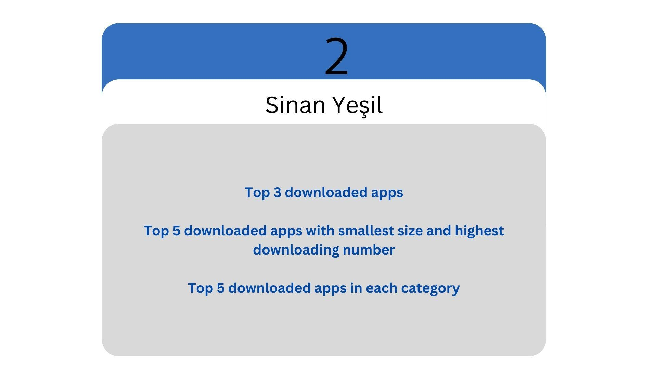
KEY POINTS

Slide 11
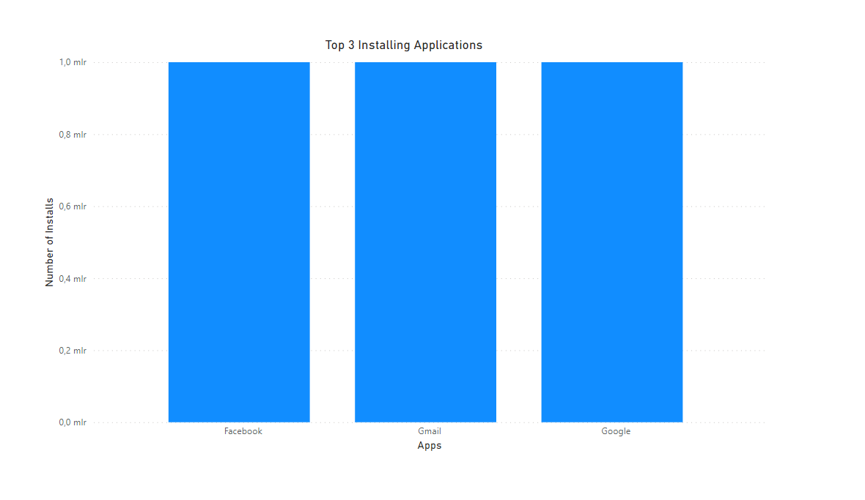
As we can see from the barchart the top three most downloaded apps are from social, tools and communication categories

Slide 12
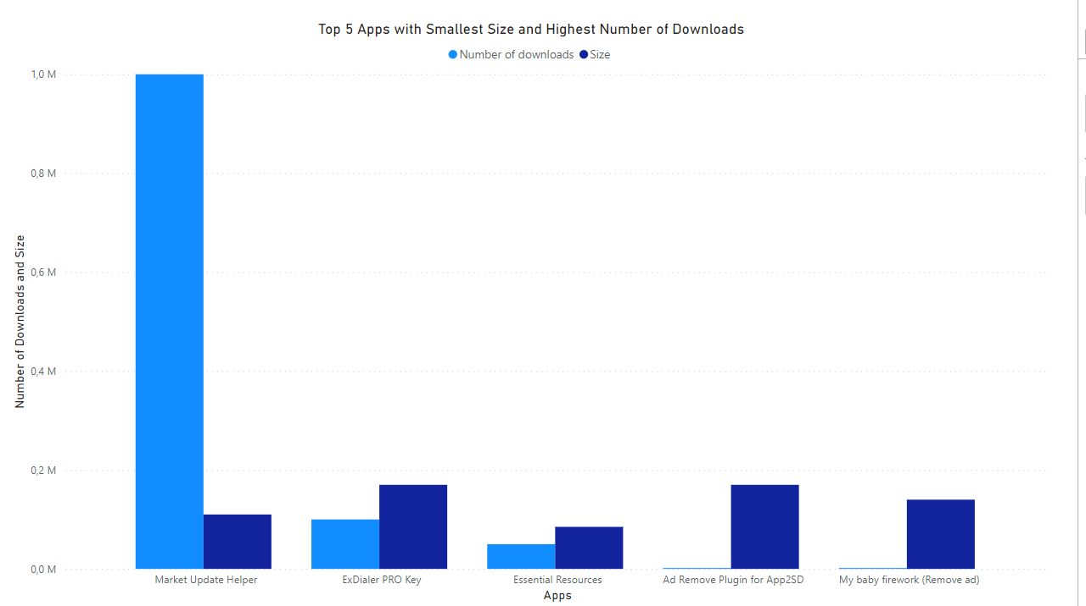
LIBRARIES_AND_DEMO
COMMUNICATION
PRODUCTIVITY
FAMILY
LIBRARIES_AND_DEMO

Slide 13
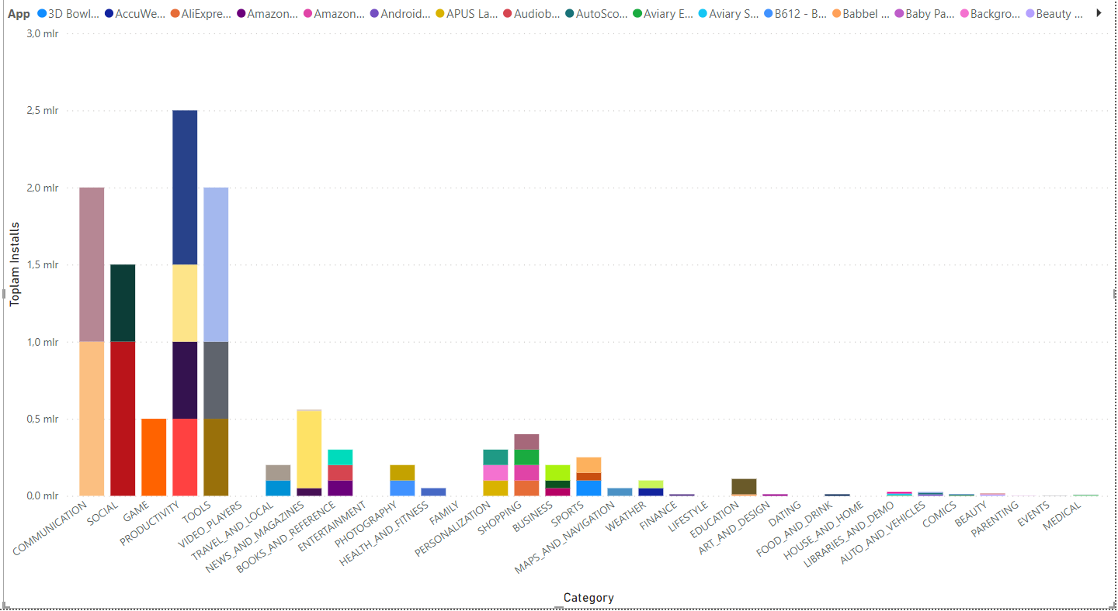
TOP 5 APPS INSTALLED PER CATEGORY

Slide 14
CONCLUSION
Game category is the most installed but in profit its the 3rd largest
Market share is 13.98%, in profit $40.9B.
Family category is the most profitable but it 7th in installed.
This can be due to parents/children spending a lot on family, but also the app prices are the highest.
Market share is 39.05%, in profit $113.68B, closest is Lifestyle with $57.58B

Slide 15
Thank you for listening

