Slide 1

Northwind Sales Analysis
16 May 2023

Slide 2

Meet the team
Team Leader: Sinan Yeşil
Data Analyst: İbrahim Özcan
Data Analyst: Parahat Atekov

Slide 3




TOOLS
Github for sharing code
DBeaver as DB management tool
Discord and Whatsapp
for communication

Slide 4
Brief
We will analyse;
Sales amounts between the years per country.
Top and bottom sales countries and their product categories.
Comparisons between them regarding shipping times and discount rates.
Employee performance.

Slide 5
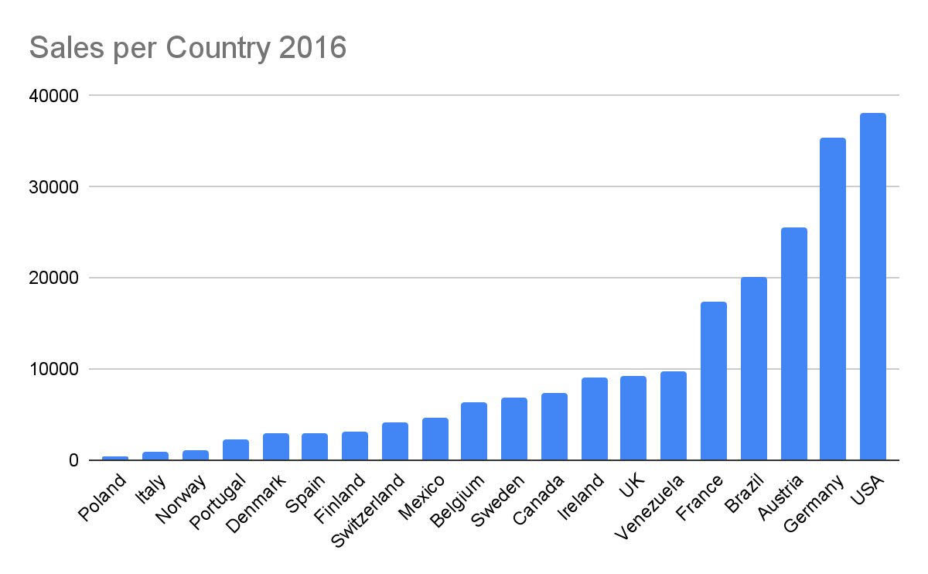
Total Sales Amount: 208.084k in 20 Countries

Slide 6
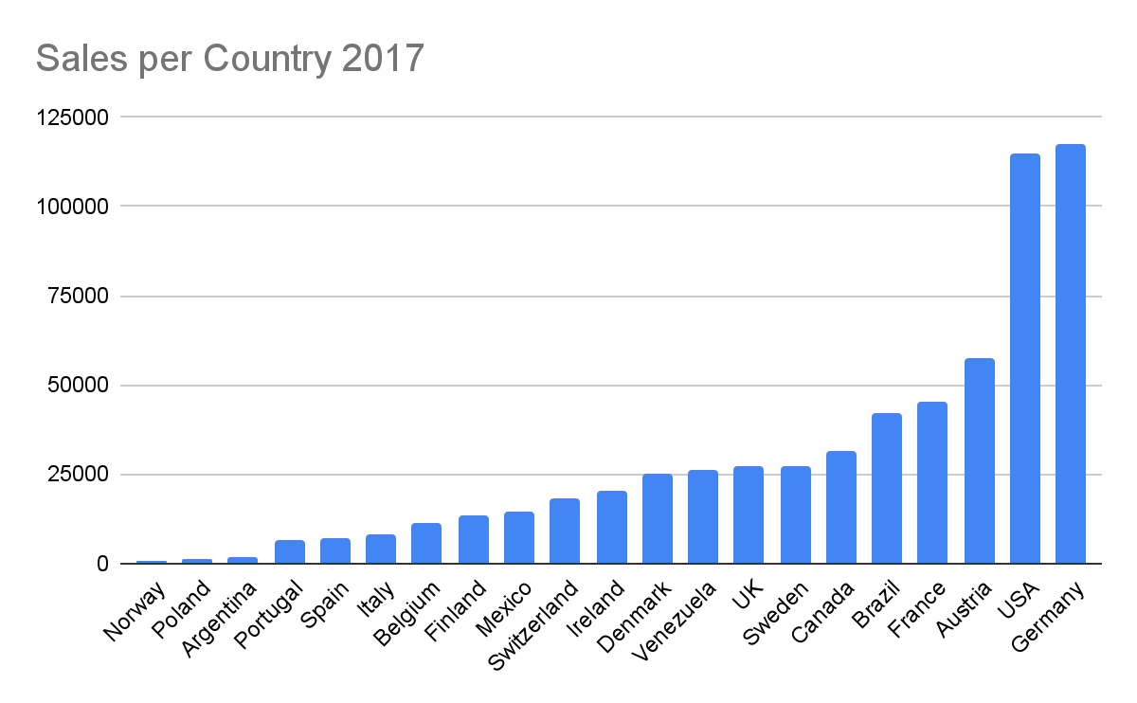
Total Sales Amount: 617.085k in 21 Countries

Slide 7
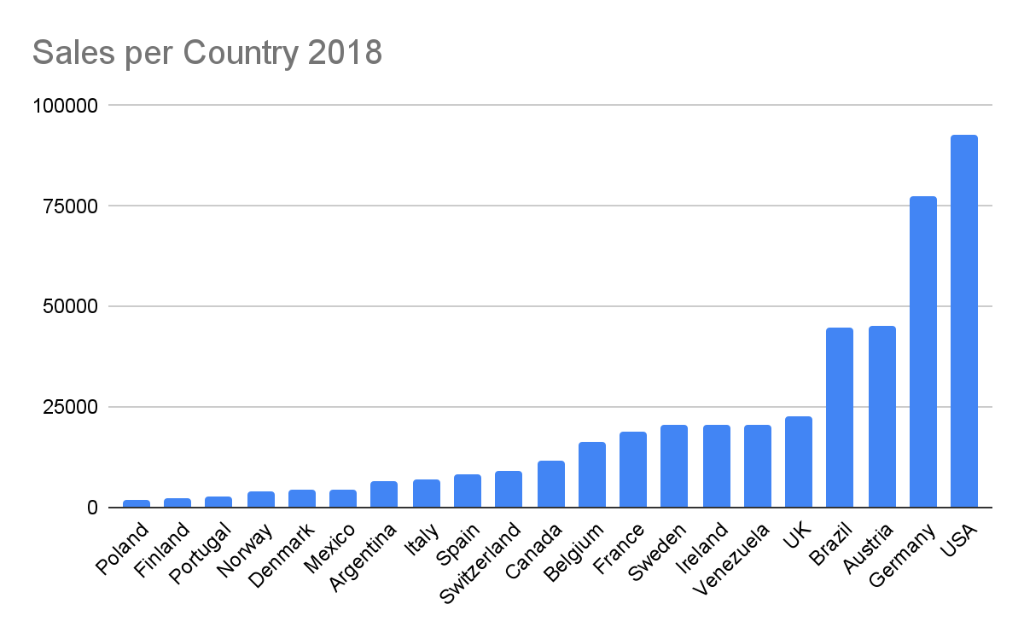
Total Sales Amount: 440.624k in 21 Countries

Slide 8
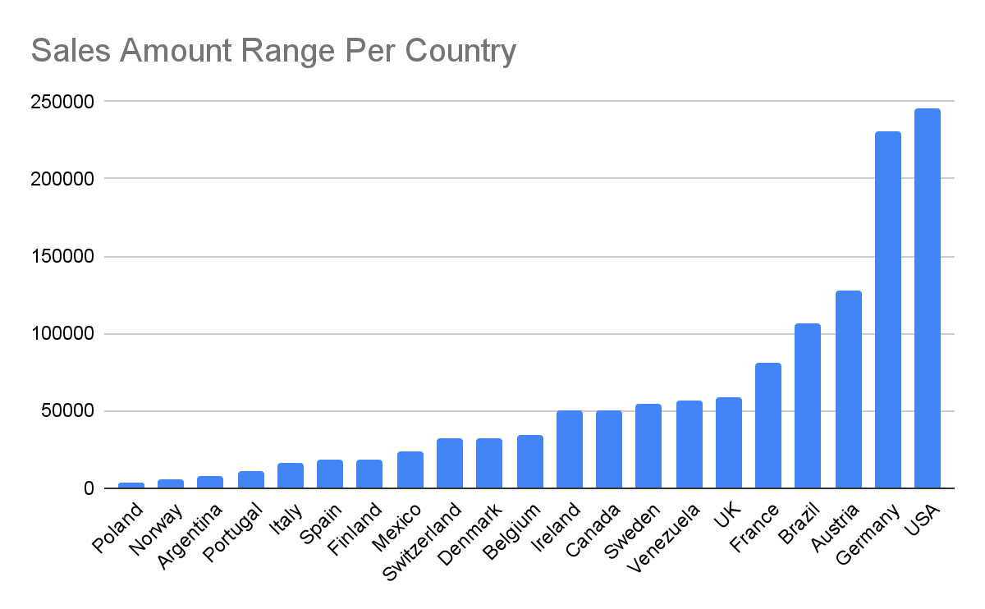

Slide 9
Total Sales per Country with Discount
 | Total Sales | Discount Rate
USA | 245585 | 20
Austria | 128004 | 20
Canada | 50196 | 20
Switzerland | 31693 | 15
Belgium | 33824 | 5
Finland | 18810 | 5
Italy | 15770 | 5

Slide 10
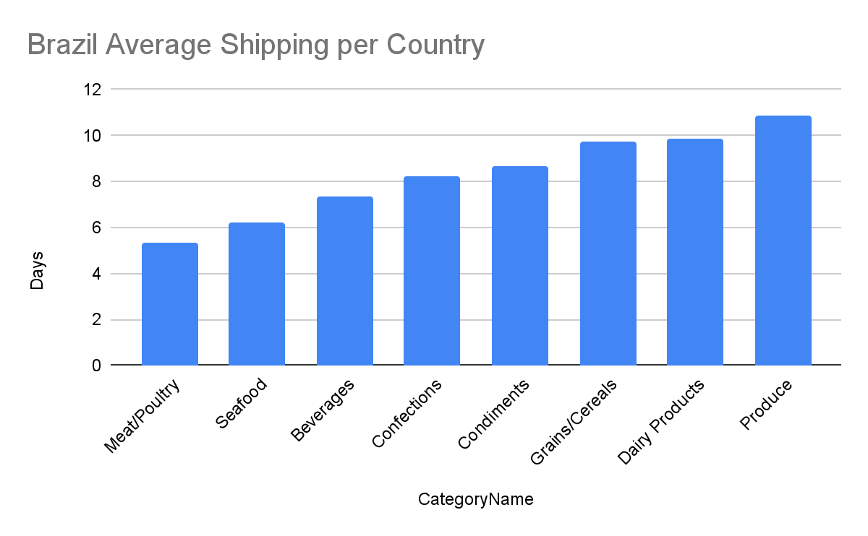
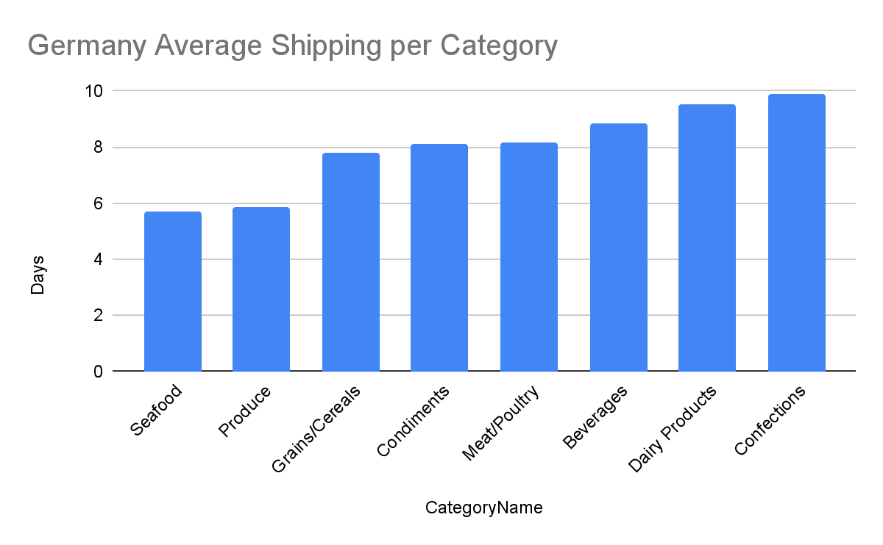
Average Shipping Days on Countries with High Sales

Slide 11
Difference between Required and Actual Shipping Dates
Brazil
Germany
Orders | Delay
Order 1 | +24
Order 2 | +8
Order 3 | +26
Order 4 | +17
Order 5 | +22
Order 6 | +21
Order 7 | +20
Orders | Delay
Order 1 | +37
Order 2 | +18
Order 3 | +20
Order 4 | +21
Order 5 | +24
Order 6 | +25

Slide 12
Shipped Product Categories in Low Sales Regions
Category Name | Countries
Condiments | Norway, Poland
Confections | Norway, Poland
Beverages | Norway, Poland
Dairy Products | Norway, Poland
Seafood | Norway, Poland
Meat/Poultry | Norway, Poland
Produce | Norway, Poland

Slide 13
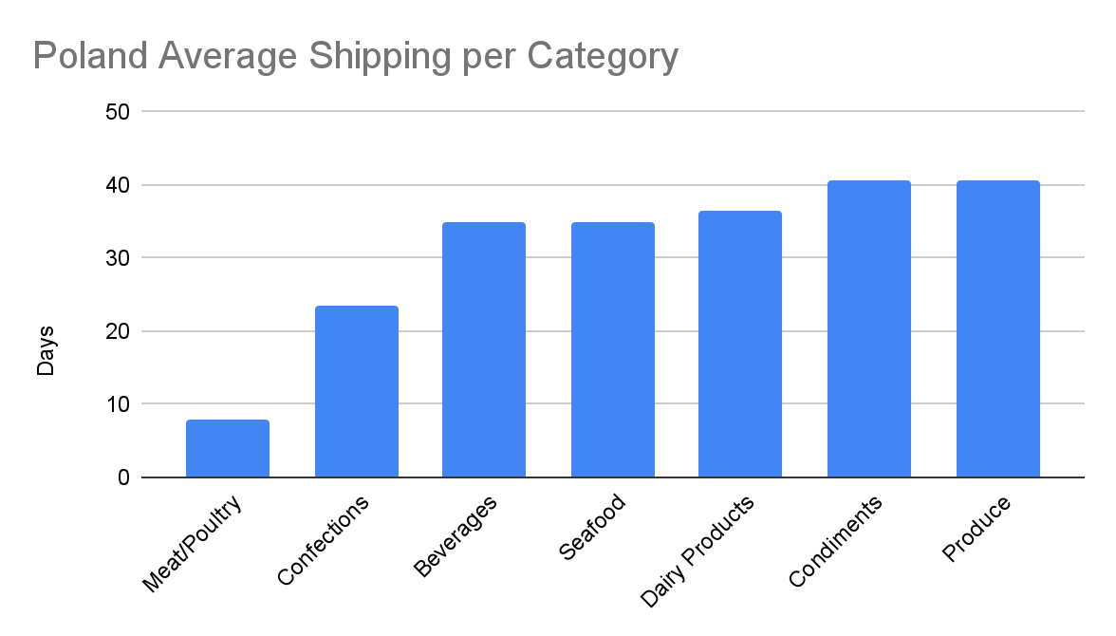
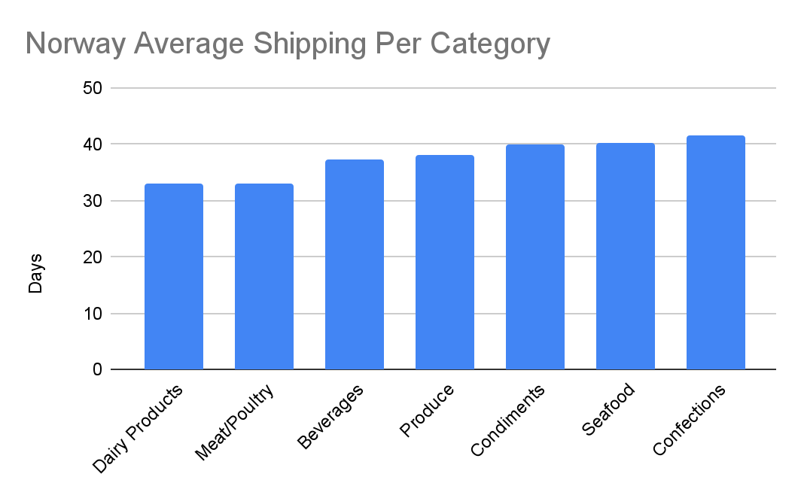
Average Shipping Days for Low Sales Countries

Slide 14
Difference between Required and Actual Shipping Dates
Poland
Norway
Orders | Delay
Order 1 | -7
Order 2 | -10
Order 3 | 20
Order 4 | -9
Order 5 | -23
Order 6 | -30
Order 7 | -11
Orders | Delay
Order 1 | -5
Order 2 | -5
Order 3 | -10
Order 4 | -12
Order 5 | -15
Order 6 | -26

Slide 15
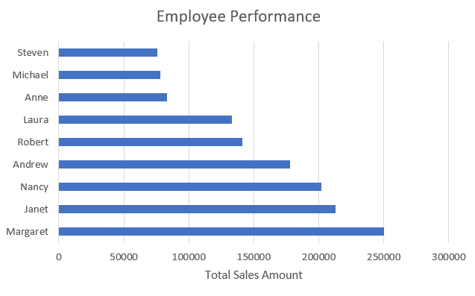
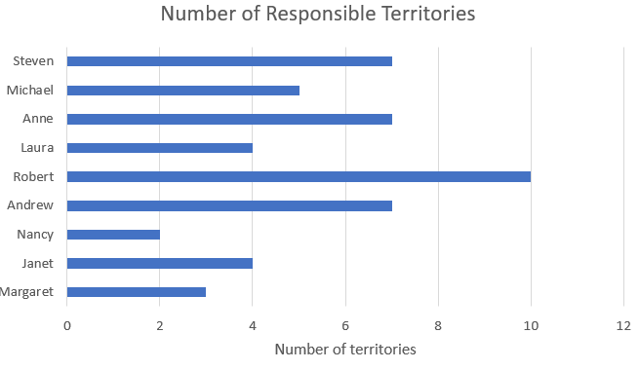
Employee Performance

Slide 16
Conclusion
We increased our sales %200 and network with one more country in 2017.
Our sales decreased in 2018 compared to 2017 with approximately 33% in sales.
In total there are only two countries with low sales, Poland and Norway.
Out of 21 countries, we have delays on shipments on these two countries.
Shipping time has direct impact on sales.
We shouldn’t overload our employees with territories since it has a direct affect on their performance

Slide 17
Thank You

