Slide 1
Clustering Neighborhoods in Toronto
Based on cultural food venues

Slide 2
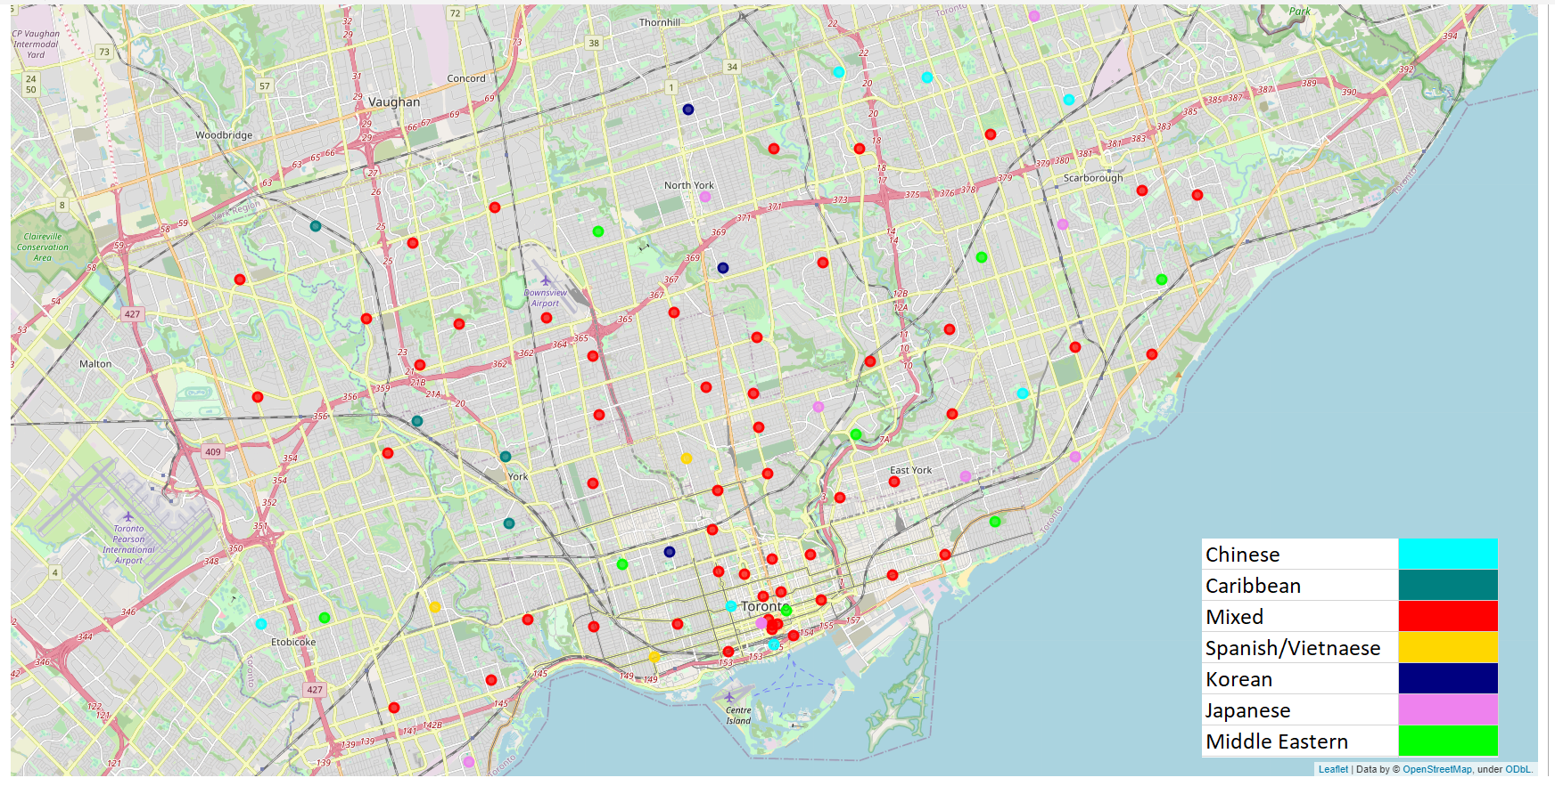
Map of Toronto Neighborhoods

Slide 3
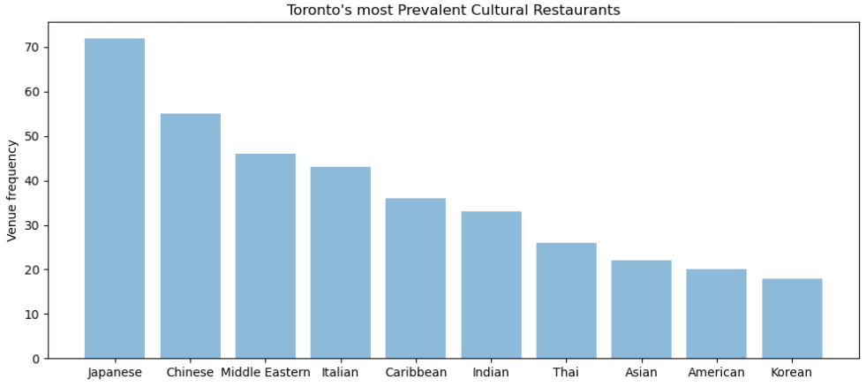
Most frequent cultural venues

Slide 4
Cluster frequency
Cluster # | Culture Label | Area %
0 | Chinese | 7.87
1 | Caribbean | 4.49
2 | Mixed | 60.67
3 | Spanish/Vietnamese | 3.37
4 | Korean | 3.37
5 | Japanese | 11.24
6 | Middle Eastern | 8.99

Slide 5
Chinese Cluster
 | Neighbourhood | 1st Most Common Venue | 2nd Most Common Venue | 3rd Most Common Venue
Postal Code
M9C | Eringate, Bloordale Gardens, Old Burnhamthorpe... | Chinese | Vietnamese | Turkish
M2H | Hillcrest Village | Chinese | Japanese | Vietnamese
M5J | Harbourfront East, Union Station, Toronto Islands | Chinese | Japanese | Vietnamese
M1L | Golden Mile, Clairlea, Oakridge | Indian | Chinese | Turkish
M1S | Agincourt | Chinese | Vietnamese | Cantonese
M5T | Kensington Market, Chinatown, Grange Park | Chinese | Japanese | Cantonese
M1W | Steeles West, L'Amoreaux West | Chinese | Indian | Middle Eastern

Slide 6
Caribbean Cluster
 | Neighbourhood | 1st Most Common Venue | 2nd Most Common Venue | 3rd Most Common Venue
Postal Code
M9L | Humber Summit | Caribbean | Italian | Vietnamese
M6M | Del Ray, Mount Dennis, Keelsdale and Silverthorn | Caribbean | Vietnamese | Turkish
M6N | Runnymede, The Junction North | Caribbean | Vietnamese | Turkish
M9N | Weston | Caribbean | Afghan | Thai

Slide 7
Spanish and Vietnamese Cluster
 | Neighbourhood | 1st Most Common Venue | 2nd Most Common Venue | 3rd Most Common Venue
Postal Code
M6K | Brockton, Parkdale Village, Exhibition Place | Spanish | French | Vietnamese
M5P | Forest Hill North & West, Forest Hill Road Park | French | Vietnamese | Turkish
M8X | The Kingsway, Montgomery Road, Old Mill North | Spanish | Vietnamese | Greek

Slide 8
Korean Cluster
 | Neighbourhood | 1st Most Common Venue | 2nd Most Common Venue | 3rd Most Common Venue
Postal Code
M6G | Christie | Korean | Vietnamese | African
M2M | Willowdale, Newtonbrook | Korean | Middle Eastern | Chinese
M2P | York Mills West | Korean | Vietnamese | Greek

Slide 9
Japanese Cluster
 | Neighbourhood | 1st Most Common Venue | 2nd Most Common Venue | 3rd Most Common Venue
Postal Code
M4C | Woodbine Heights | Middle Eastern | Japanese | Greek
M4G | Leaside | Japanese | American | Middle Eastern
M1N | Birch Cliff, Cliffside West | Japanese | Vietnamese | Greek
M2N | Willowdale, Willowdale East | Japanese | Middle Eastern | Mexican
M1P | Dorset Park, Wexford Heights, Scarborough Town... | Asian | Japanese | Vietnamese
M7R | Canada Post Gateway Processing Centre | Mexican | Japanese | Thai
M1V | Milliken, Agincourt North, Steeles East, L'Amo... | Japanese | Vietnamese | Greek
M8V | New Toronto, Mimico South, Humber Bay Shores | Asian | Japanese | Vietnamese
M5W | Stn A PO Boxes | Mexican | Japanese | Thai
M7Y | Business reply mail Processing Centre, South C... | Mexican | Japanese | Thai

Slide 10
Middle Eastern Cluster
 | Neighbourhood | 1st Most Common Venue | 2nd Most Common Venue | 3rd Most Common Venue
Postal Code
M9B | West Deane Park, Princess Gardens, Martin Grov... | Middle Eastern | Chinese | Filipino
M5C | St. James Town | Middle Eastern | American | Japanese
M4E | The Beaches | Asian | Middle Eastern | Vietnamese
M3H | Bathurst Manor, Wilson Heights, Downsview North | Middle Eastern | Mediterranean | Korean
M4H | Thorncliffe Park | Indian | Middle Eastern | African
M6H | Dufferin, Dovercourt Village | Middle Eastern | Vietnamese | Portuguese
M1J | Scarborough Village | Indian | Middle Eastern | Greek
M1R | Wexford, Maryvale | Middle Eastern | Vietnamese | Greek

Slide 11
The remaining neighborhoods
The remaining 60% of neighborhoods were too heavily mixed to provide any meaningful distinction
You may view the entire list of neighborhoods and their top 3 venues here: https://github.com/Ayy753/Coursera_Capstone/blob/main/All_clusters.csv

