Slide 1
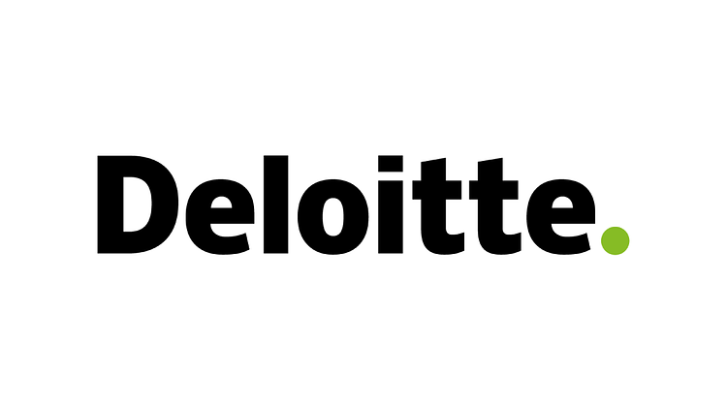
THE FUNDAMENTALS OF CLOUD

Slide 2

Cloud computing- The basics
Definition
The delivery of computing services such as storage, databases and software over the internet is termed as cloud computing.
The user can access files and applications from any device which is connected to the internet. The past updates, changes and progress made in the documents are all saved and visible when viewed from another device
What "cloud" really means
The phrase "cloud" is a metaphor for internet. Hence, cloud computing simply refers to internet-based computing.
An instance of use cloud computing in our everyday life is emails.
What cloud computing can do
With cloud computing, one can quickly build, deploy, test and scale applications, easily store and recover data, and access the same from anywhere, anytime on any device!
Page 1

Slide 3
Cloud computing- The five key characteristics
On- Demand Self Service
Services on cloud are provided without any human interaction required. Consumers can provision computing capabilities automatically on their own.
Broad Network Access
The cloud computing capabilities can be accessed on a number of different devices like PCs, tablets. The only and main requirement being access to the internet from that device.
Resource Pooling
Many resources are pooled to serve multiple consumers. The consumers need not know the location where the resources are stored. The have easier access to the resources.
Rapid Elasticity
According to the consumers' needs, the capabilities can be scaled up or down. The capabilities are unlimited from the consumer. They are modified according to the requirement.
Measured Service
Resources are purchased and consumed as per the need of the consumer. Cloud computing cuts the additional expenses for hardware and is hence, comparatively more cost efficient.
Page 2

Slide 4
Cloud computing- Capabilities offered
Software as a Service (SaaS)
Complete software product provided, which is run and managed by the service provider.
Software applications are available on demand over the internet.
All updates, upgrades, maintenance and infrastructure is managed by the cloud provider host.
Example: Google Apps and Dropbox
​
Infrastructure as a service (Iaas)
The infrastructure such as servers, storage, database and virtual machines are rented from the cloud providers.
Gives the highest level of flexibility and management to the users
Provides virtualized computing resources over the internet.
Example: Google Compute Engine
​
Platform as a service (Paas)
On demand environment provided to develop, test, manage and maintain applications.
Consumers need not set up the underlying infrastructure.
Developers are provided with all tools for application development over the internet
Example: Heroku
​
Page 3

Slide 5
Resources:
https://azure.microsoft.com/en-us/overview/what-is-cloud-computing/#benefits
https://www.paranet.com/blog/bid/128263/The-5-Essential-Characteristics-of-Cloud-Computing
https://www2.deloitte.com/au/en/pages/deloitte-private/articles/cloud-computing-deloitte-private.html
https://aws.amazon.com/what-is-cloud-computing/
https://searchcloudcomputing.techtarget.com/definition/Infrastructure-as-a-Service-IaaS
Page 4

Slide 6
Thank you!

