Slide 1
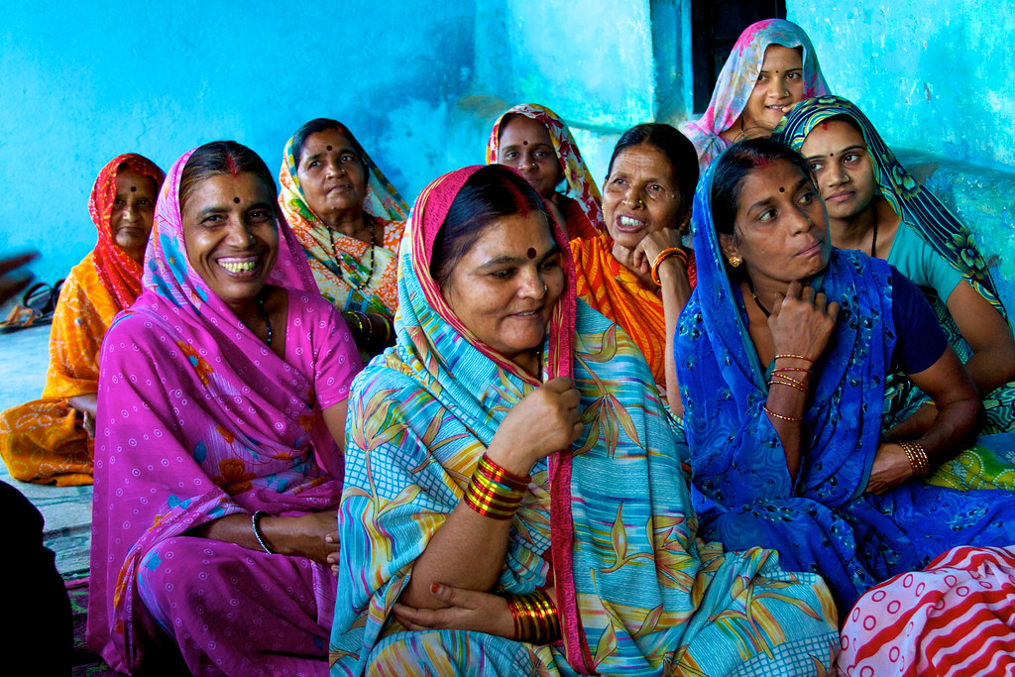
TEAM SARANG
PRESENTS

Slide 2

PROJECT
GRIHALAKSHMI

Slide 3
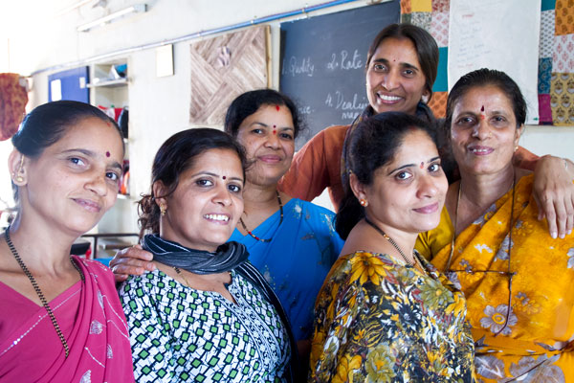
THEME: WOMEN EMPOWERMENT
Empowerment: “Empowerment is defined as the process of becoming stronger and more confident, especially in controlling one's life and claiming one's rights”
Swami Vivekananda, one of the greatest sons of India, quoted that, “There is no chance for the welfare of the world unless the condition of women is improved, It is not possible for a bird to fly on only one wing.”
However, the 21st century saw a transcending change in women’s role from being a simple homemaker to a career-oriented woman.
Overcoming the traditional mindsets,
women today, are standing tall and
Working towards shouldering
responsibilities with men in all fields.

Slide 4
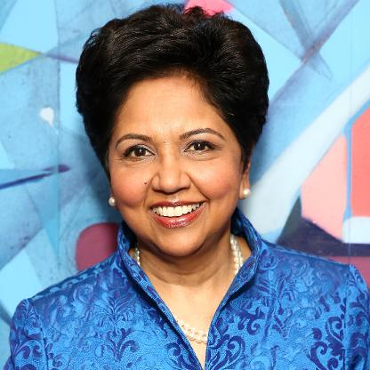
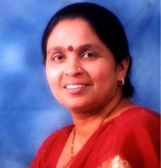

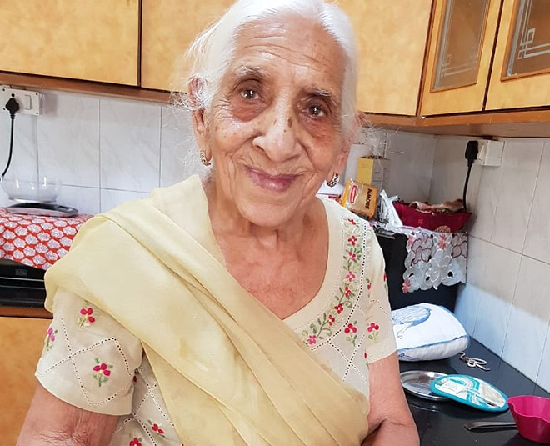

Slide 5

PROBLEM STATEMENT
Problem Statement number: AS119
Disruptive innovation for women empowerment. Provide open ideas for empowering women and design tools for enabling them. This is an open platform to provide ideas where best idea will win.
Organization : Ministry of Women and Child Development

Slide 6
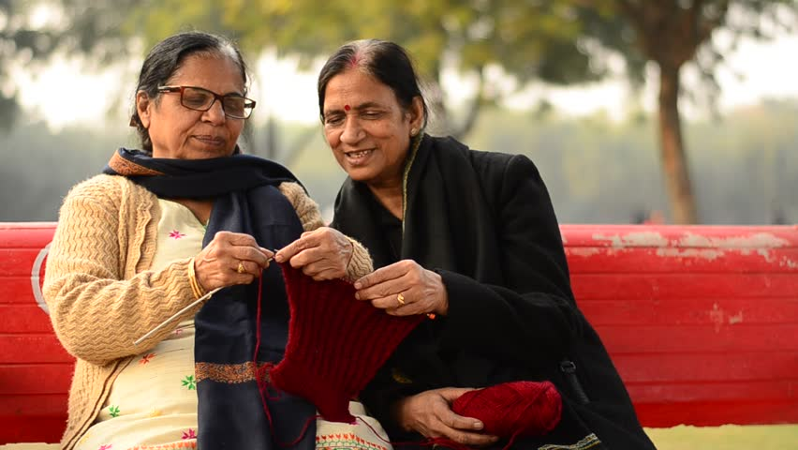
MORE ON THE PROB:
Women across the world and especially in India had a very different set of responsibilities as compared to that of men- Homemaking! While men were expected to go out and earn their family’s livelihoods, the women would stay back to take care of the home. Women then didn’t know what it was like to “follow passion” and “growing career”. What women did know was how to make a house a home- having a lingering fragrance of a tasty home cooked meal, having clothes neatly tucked away and so on.

Slide 7
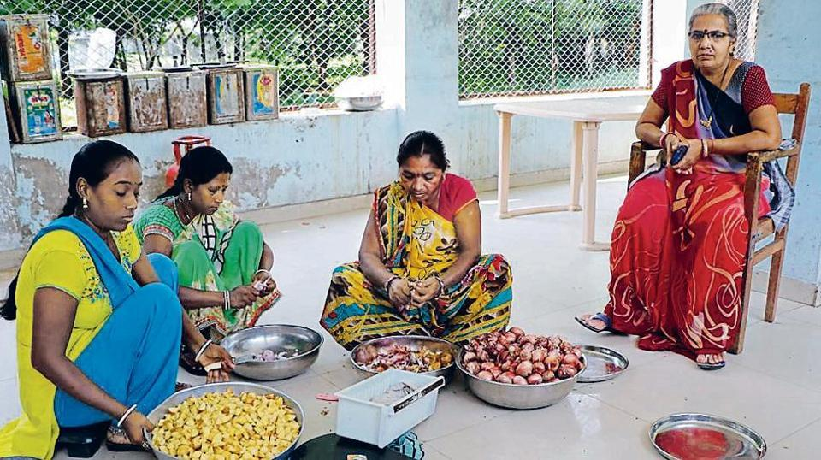
MORE ON THE PROB:
Technically speaking, women today have redefined “homemaking”. These new- age homemakers are in fact an unstoppable force now- not restricting themselves to just real estate jobs but moving up the ladder to leadership roles in real estate companies. These new- age homemakers are here to stay and will continue to add to the business and the economy as a whole.
The successful presence of women in almost every field has a great impact on women entrepreneurship.

Slide 8
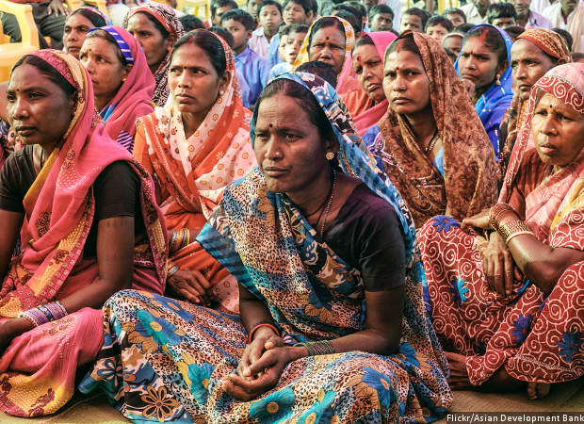
STORY:
The story of two women entrepreneurs- Priyashri Mani and Nishita Vasanth wroughting their own enterprise in Pali hills in Kodaikanal district of Tamilnadu by availing loans under Scheme of Indian Govt
Harbhajan Kaur, 90yr old Entrepreneur, besan burfi business

Slide 9
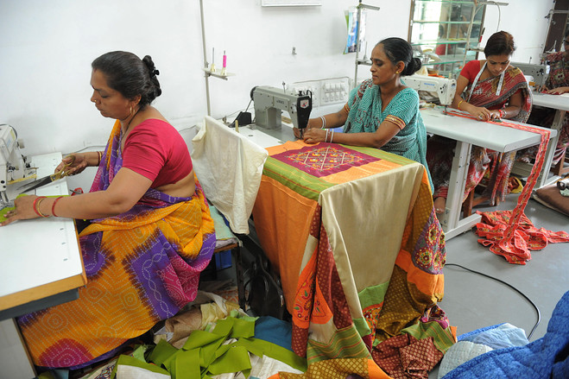
STATISTICS:
India is ranked 108th among 146 countries in World Economic Forum (WEF) gender gap index

Slide 10


ABOUT PROJECT
‘GRIHALAKSHMI’
ABSTRACT:
Women are the pillars of society and when women are empowered, the whole world is empowered.
Women Empowerment through Empowered Women.

Slide 11
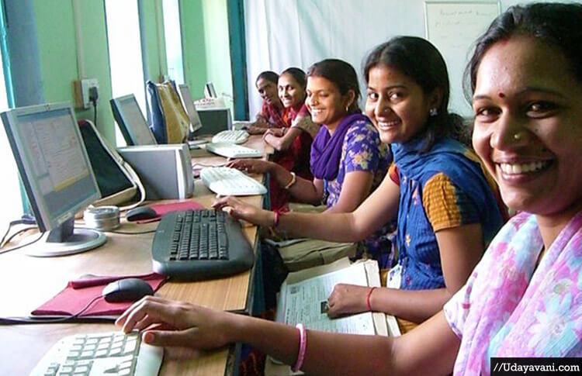
We aim to Empower Women by providing them a Community.
An opportunity for them to connect with women with similar interests.
To form SHGs and avail benefits of several related schemes.
An opportunity to learn and grow.
An opportunity to develop their own businesses.
An opportunity to help, and Empower Like-minded, strong women.
Contribution to their income as well as the nation’s economy.

Slide 12
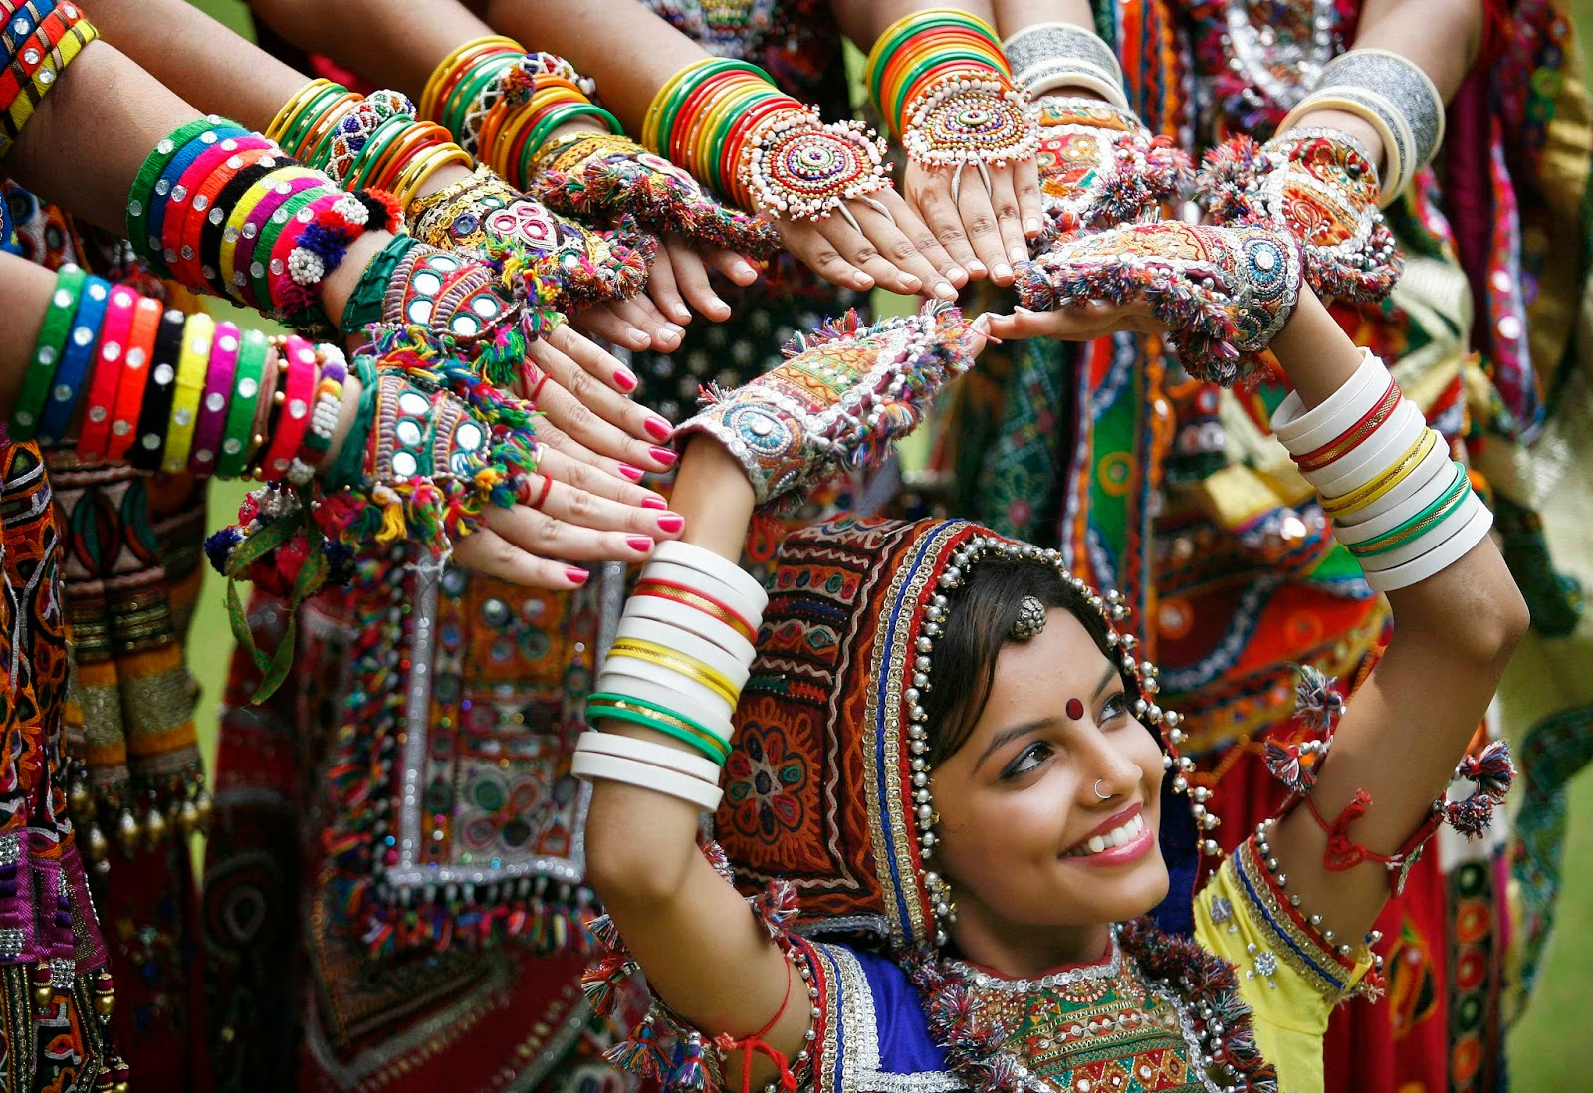
So, let us join our hands together and empower the
‘GRIHLAKSHMI’!

Slide 13
TEAM sarang
AAYUSHI BANSAL AMANDEEP KAUR DRISHTI GUPTA SRINIDHI AYYAGARI

Slide 14
IMAGE CREDITS
https://live.staticflickr.com/4108/5103267884_79c5b192c2_b.jpg
https://c.stocksy.com/a/nhB900/z9/2189951.jpg?1571214735
https://resize.indiatvnews.com/en/resize/newbucket/715_-/2016/05/indian-women-1462604589.jpg
https://ichef.bbci.co.uk/news/410/cpsprodpb/17284/production/_108625849_gettyimages-163285226.jpg
http://www.indianwomenblog.org/wp-content/uploads/2015/12/cover_women.jpg?ver=1
https://www.timescontent.com/photos/preview/566672/International-Women's-Day.jpg
https://content3.jdmagicbox.com/comp/bangalore/j5/080pxx80.xx80.181002142918.g9j5/catalogue/annapurna-food-products-jayanagar-7th-block-bangalore-food-product-manufacturers-1ng7nz8stj.jpg
https://d2rw7fmapbgpu6.cloudfront.net/beta-sf608504prep.storefront.co.za/pictures/636675046178882208/t1-(432x720).jpg?maxwidth=710
https://im.indiatimes.in/content/2019/Sep/90s_memories_1567765641_725x725.jpg
http://www.taipeitimes.com/images/2015/10/15/p06-151015-307.jpg
https://counterview1.files.wordpress.com/2017/09/shg.jpg
https://www.hindustantimes.com/rf/image_size_960x540/HT/p2/2017/10/11/Pictures/_2a111306-ae28-11e7-839f-5e4b0d653fbd.jpg
https://www.theigc.org/wp-content/uploads/2017/03/indian-women-working.jpg
https://i.etsystatic.com/9243231/r/il/b1b2cd/1760281554/il_570xN.1760281554_ogh9.jpg
https://artwork.wallartprints.com/media/catalog/category/indian-patterns.gif
https://4.imimg.com/data4/TB/HA/MY-271218/traditional-indian-hand-block-printed-fabric-500x500.jpg
https://5.imimg.com/data5/TW/FM/MY-271218/indigo-hand-block-printed-fabric-500x500.jpg
http://www.gujaraticulture.org/wp-content/uploads/2016/11/nv-3.jpg
https://archive.indiaspend.com/wp-content/uploads/olympic_620.jpg
https://ak9.picdn.net/shutterstock/videos/1021521439/thumb/1.jpg
https://www.freepngimg.com/thumb/technology/32333-4-technology-transparent.png
https://www.pinclipart.com/picdir/big/377-3774601_hr-projects-consulting-services-diseo-del-trabajo-en.png

