Slide 1
Encryption & Decryption System Using Assembly Language
Caesar Cipher & ROT13 Hybrid Cipher

Slide 2
Introduction
Data security is increasingly important in modern systems.
Cryptography helps protect data from unauthorized access.
This project demonstrates encryption and decryption using x86 Assembly Language.
Implements Caesar Cipher and ROT13 Hybrid Cipher.
Uses DOS interrupts (INT 21h) and low-level programming techniques.
Provides a menu-driven interface for user interaction.

Slide 3
Caesar Cipher
The Caesar Cipher is a substitution cipher where each character is shifted by a fixed key value.
Features:
Supports uppercase letters (A–Z)
Supports lowercase letters (a–z)
Non-alphabetic characters remain unchanged

Slide 4
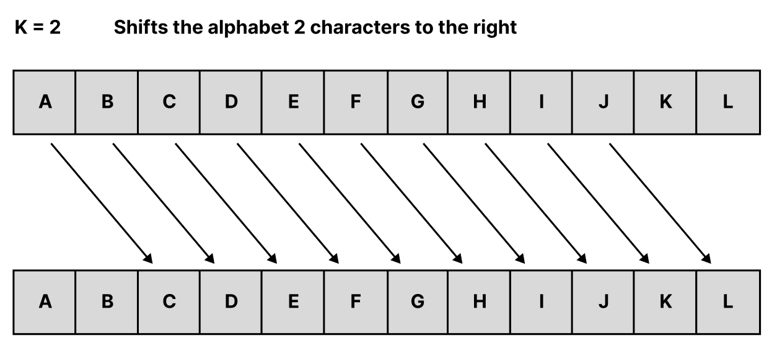
Encrypted Char = (Original Char + Key)mod 26.

Slide 5
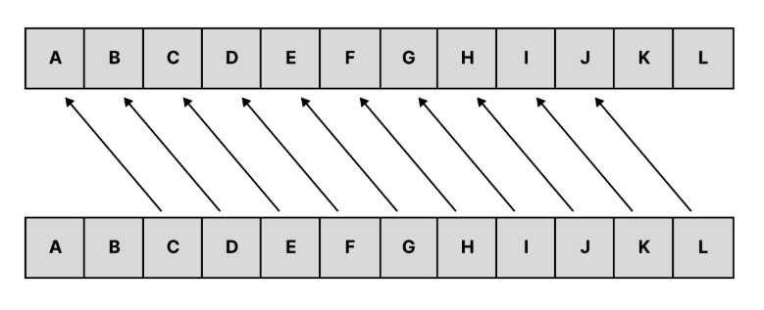
Original=(Encrypted−Key+26)mod26

Slide 6
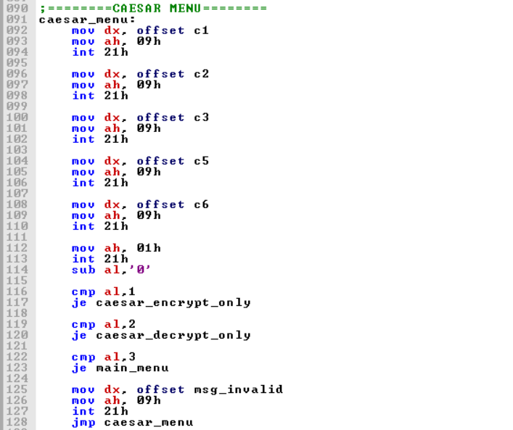
Menu

Slide 7
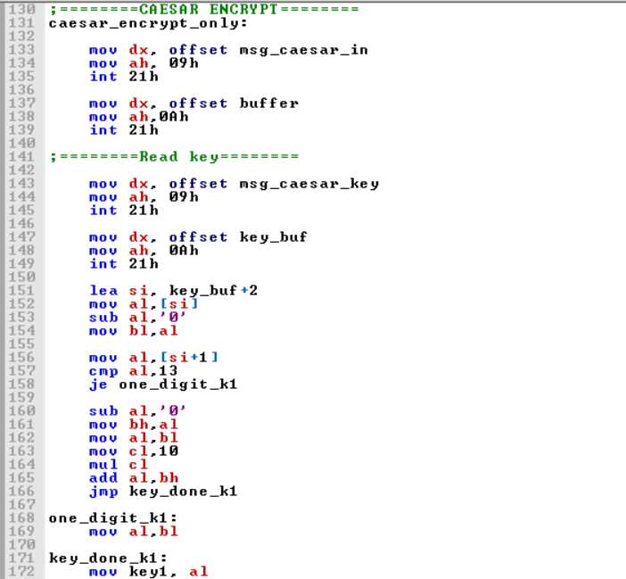
Encryption

Slide 8
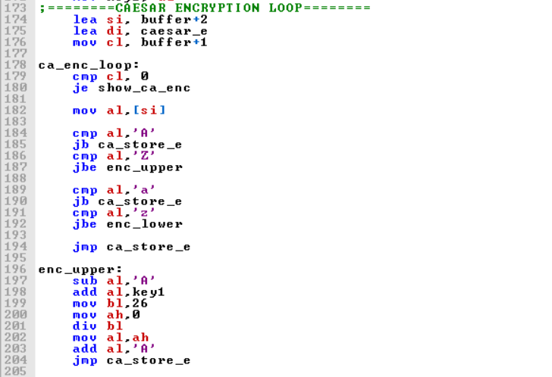

Slide 9
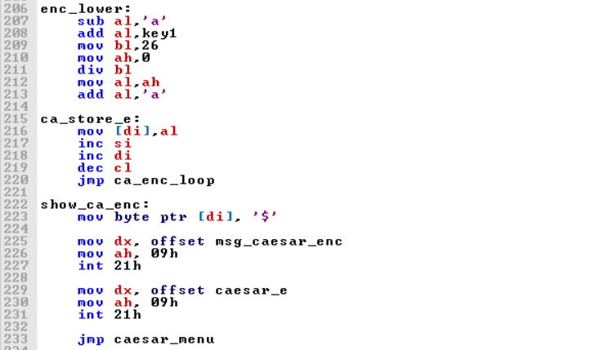

Slide 10
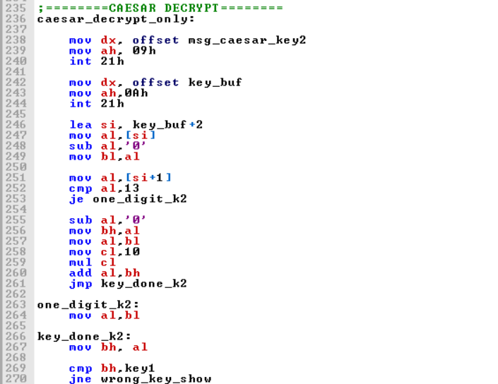
Decryption

Slide 11
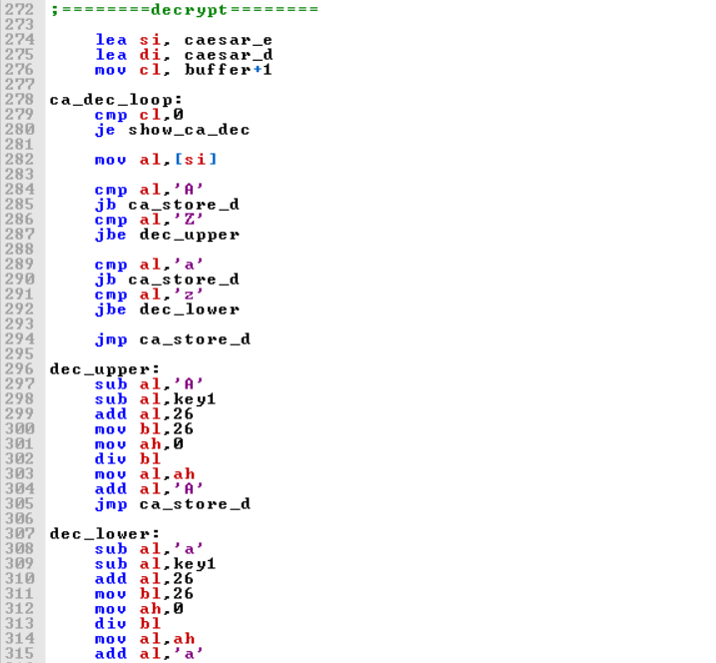

Slide 12
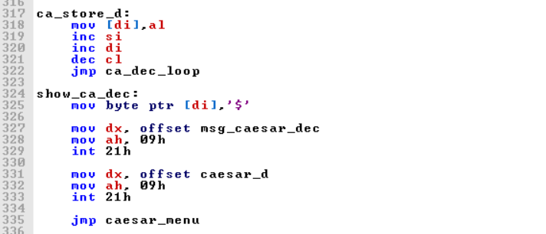

Slide 13
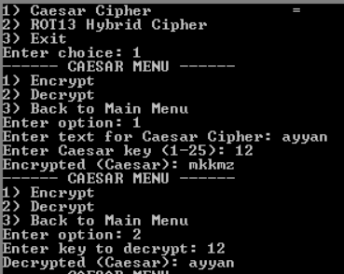
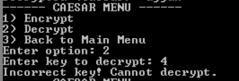
Output

Slide 14
ROT13 Cipher
The ROT13 Hybrid Cipher is implemented using bitwise operations instead of simple character substitution.
It combines two reversible techniques:
Bitwise rotation
XOR operation
This hybrid approach increases complexity compared to classical ROT13.

Slide 15
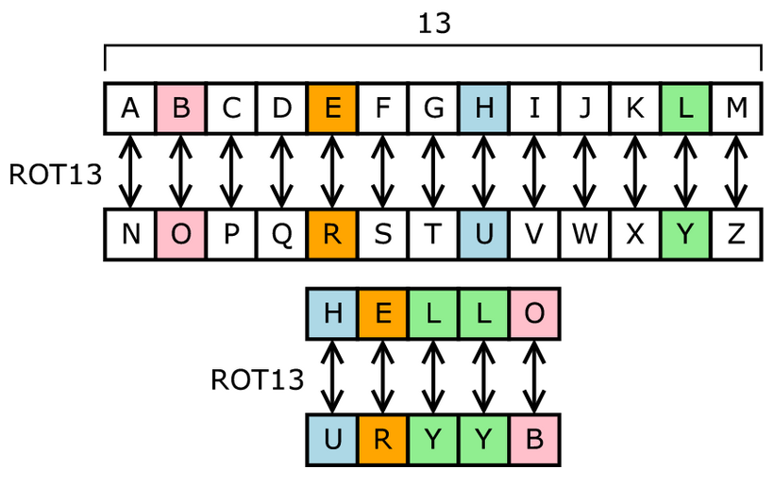
ROL AL, 3
XOR AL, 13h

Slide 16
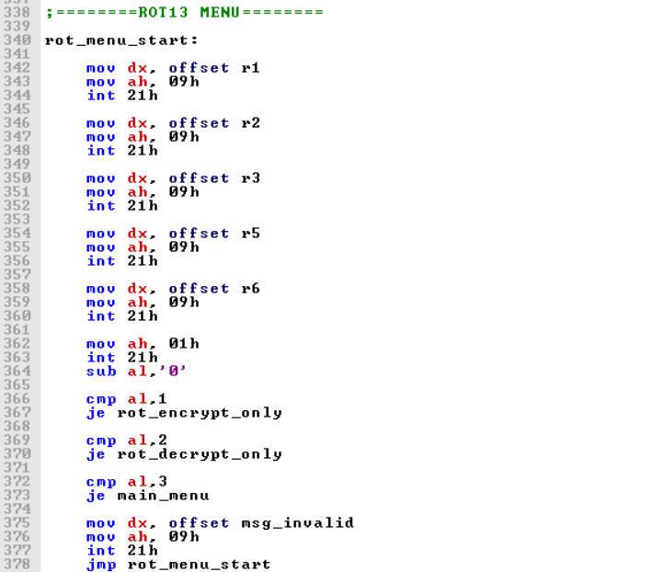
Menu

Slide 17
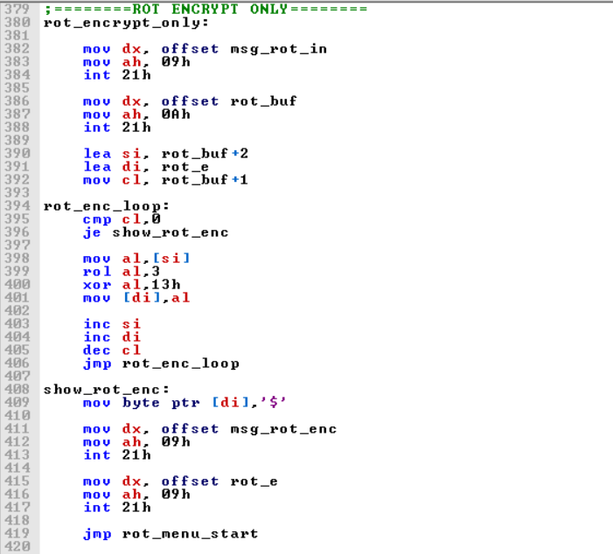
Encryption

Slide 18
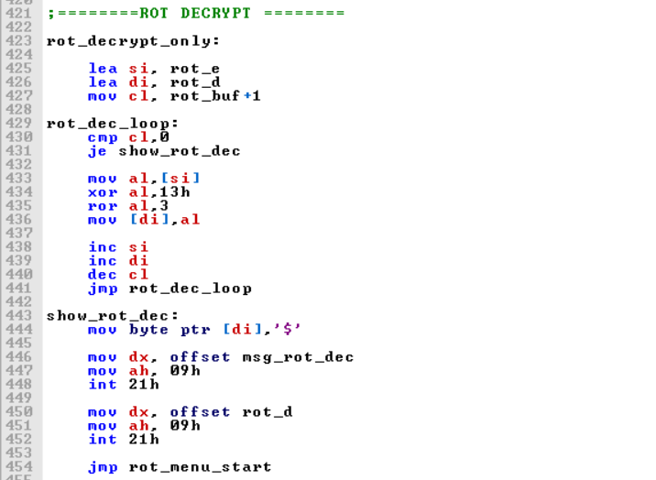
Decryption

Slide 19
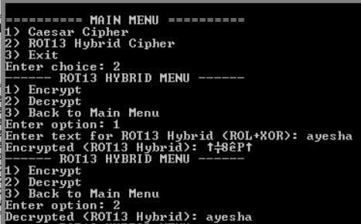
Output

Slide 20
Conclusion
The project successfully implements an encryption and decryption system using x86 Assembly Language.
Classical cryptographic techniques, including the Caesar Cipher and ROT13 Hybrid Cipher, were implemented and tested.
The use of DOS interrupts (INT 21h) enabled efficient handling of user input and output.
The menu-driven structure improved usability and program flow.
The ROT13 Hybrid Cipher showed how bitwise operations (ROL, ROR, XOR) can enhance encryption complexity.
Overall, the project strengthened understanding of assembly language programming and basic cryptographic principles.

