Slide 1

Employee Data Analysis using Excel
STUDENT NAME: AYYANAR K
REGISTER NO:312218454
NMID: 12BC4405244FFD4A6DC43CE2CD624049
DEPARTMENT: B.Com General
COLLEGE: GOVERNMENT ARTS AND SCIENCE COLLEGE PERUMBAKKAM

Slide 2
Employee Salary Analysis using Excel
BY AYYANAR K B.COM

Slide 3


AGENDA
Problem Statement
Project Overview
End Users
Our Solution and Proposition
Dataset Description
Modelling Approach
Results and Discussion
Conclusion
3/21/2024 Annual Review

Slide 4

PROBLEM STATEMENT
The goal is to analyze the salary distribution within the employee dataset to identify patterns, disparities, and factors influencing compensation. This involves examining key metrics such as average salary, salary variance, and the impact of variables like job role, experience, and education on pay. The analysis will also look for any potential gender or ethnic pay gaps. Ultimately, the aim is to provide actionable insights to ensure fair and competitive compensation practices.

Slide 5
Employee types
Gender | (ALL)
Count of Name | Employee type
Department | Fixed Term | Permanent | Temporary | Grand Total
Accounting | 4 | 13 | 3 | 20
Business Development | 4 | 15 | 2 | 21
Engineering | 3 | 6 | 4 | 13
Human Resources | 4 | 6 | 2 | 12
Legal | 2 | 12 | 4 | 18
Marketing | 1 | 8 | 1 | 10
NULL | 1 | 7 |  | 8
Product Management | 3 | 12 | 3 | 18
Research and Development | 1 | 11 | 3 | 15
Sales | 1 | 7 | 1 | 9
Services | 3 | 11 | 2 | 16
Support | 3 | 11 | 3 | 17
Training | 5 | 8 | 6 | 19
Grand Total | 35 | 127 | 34 | 196

Slide 6

PROJECT OVERVIEW
The project involves analyzing employee salary data to uncover key trends and insights. The goal is to identify patterns in compensation, such as average salary by department, job role, and experience level. Additionally, the project will explore disparities based on gender, location, or other demographic factors. The analysis will provide actionable recommendations for ensuring fair and competitive pay within the organization. Finally, the project will deliver a comprehensive report with visualizations to support data-driven decision-making on salary structures

Slide 7
employee chart

Slide 8
WHO ARE THE END USERS?
The primary end users of the salary analysis are HR professionals and organizational leaders who make compensation decisions. This includes HR managers, payroll specialists, and executives responsible for ensuring fair pay practices. Additionally, diversity and inclusion officers may use the analysis to monitor and address any pay disparities. Lastly, financial analysts and business strategists could utilize the data to align compensation strategies with company goals

Slide 9

OUR SOLUTION AND ITS VALUE PROPOSITION
CONDITIONAL FORMETING - MISSING VALUES
FILTERING - REMOVE BLANKS
GRAPH - DATA ANALYSIS
FORMULA -SALARY CALCULATION
PIVOT- SUMMARY

Slide 10
Dataset Description
employee deprtment 13
fitering all blanks
find pivottable graphs
3 types of placement
1) fixed and temporvery

Slide 11

THE "WOW" IN OUR SOLUTION
Accurate employee salary data is a critical component of any organization's human resources management. When maintained in Excel, this data allows for seamless calculations, tracking, and analysis of salary trends over time. Excel's powerful functions enable HR professionals to compare salaries across departments, assess pay equity, and ensure compliance with industry standards.

Slide 12

MODELLING
DATA SET - EMPLOYEES SALARY
1) FIXED TERM
2) PERMEANT EMPLOYEE
3) TEMPROARY EMPLOYEE

Slide 13
RESULTS
13

Slide 14
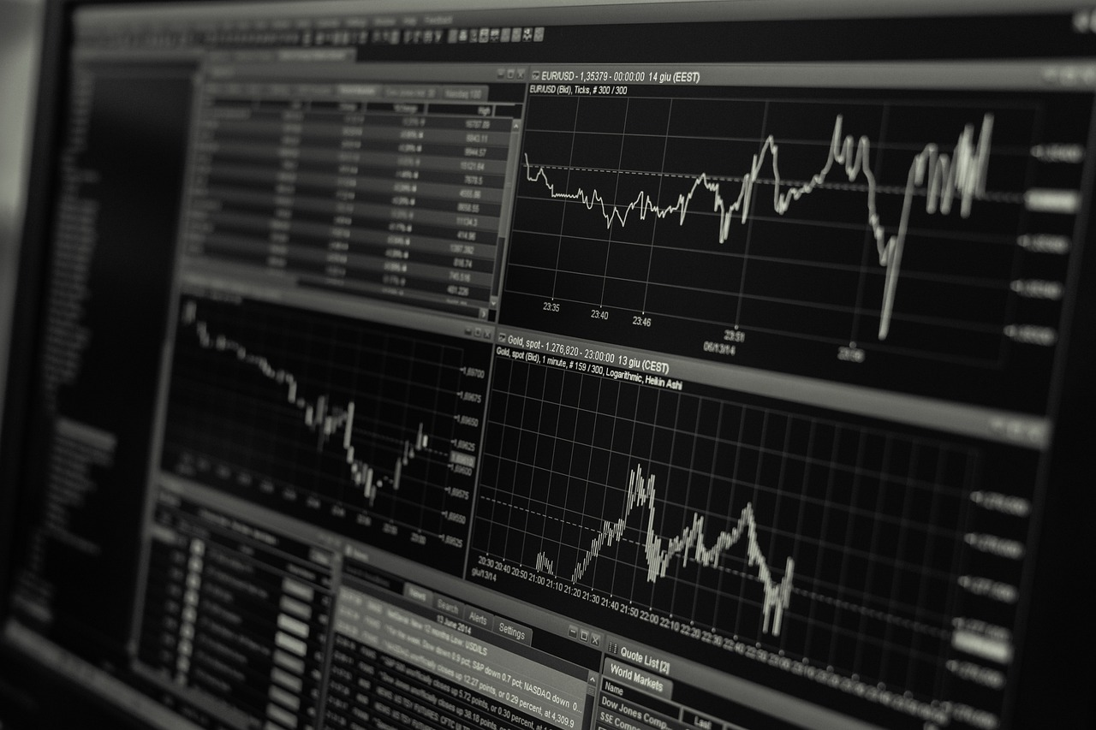
conclusion
Calculating employee salaries in Excel involves organizing your dataset and applying appropriate formulas. Begin by setting up columns for key information such as hours worked, hourly rate, and any deductions. To compute gross pay, use a formula For taxes or other deductions, apply formulas that calculate percentages. Sum up all necessary components using functions like `SUM` to ensure accuracy. Finally, format the cells for currency to clearly display the calculated salaries. This structured approach in Excel enables efficient and precise salary calculations for all employees

