Slide 1
Auto - cropping
Akshay Ayyanchira

Slide 2





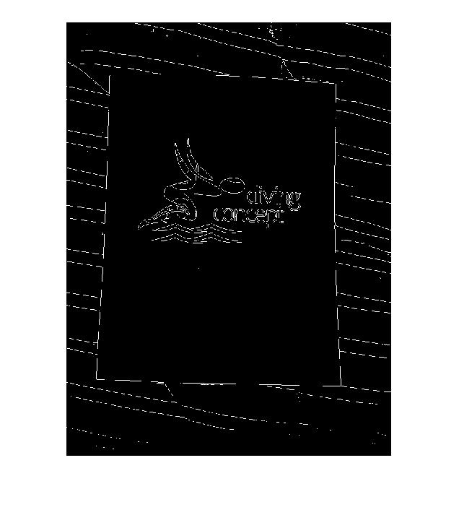

Pre Processing
HISTOGRAM EQUALIZATION
IMADJUST
EDGE
BWAREAOPEN

Slide 3
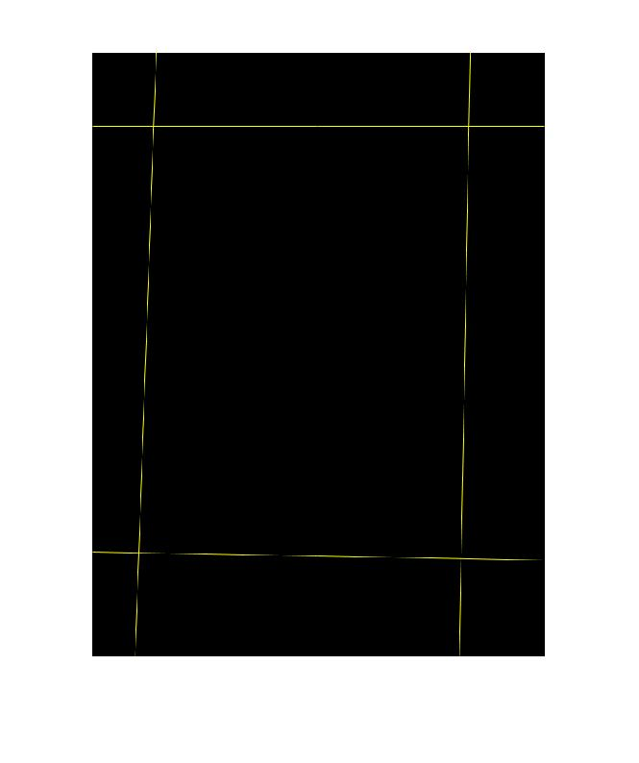
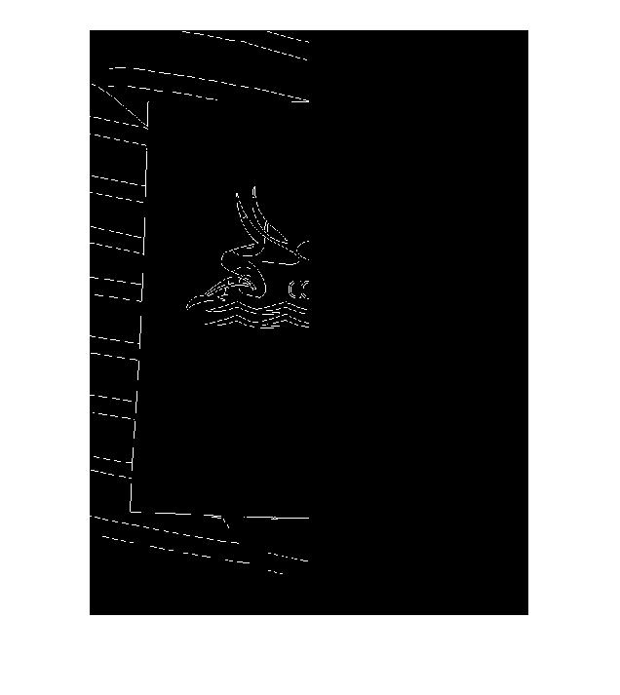

Now Hough Transform Steps
Find the Left Edge
Predict Parallel and Adjacent inclination
Do Hough with known inclination

Slide 4
Score : 48 out of 50
Time : 35 seconds

Slide 5
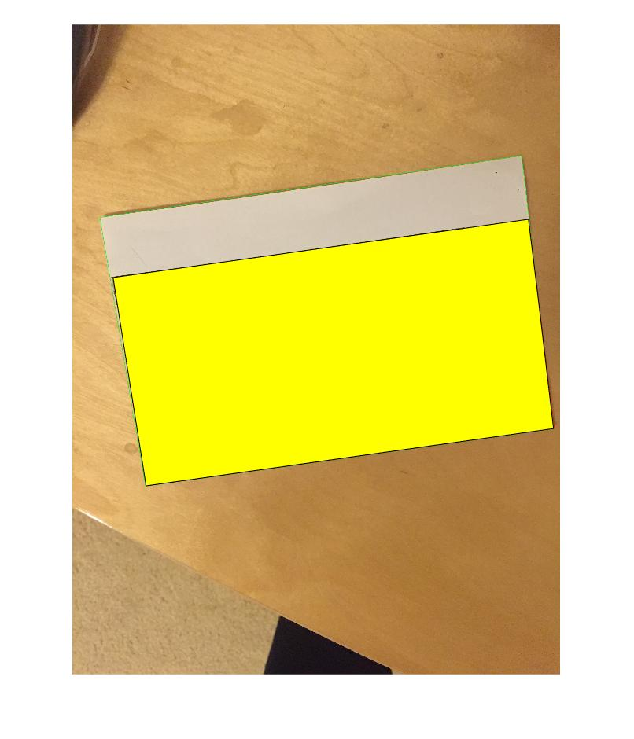
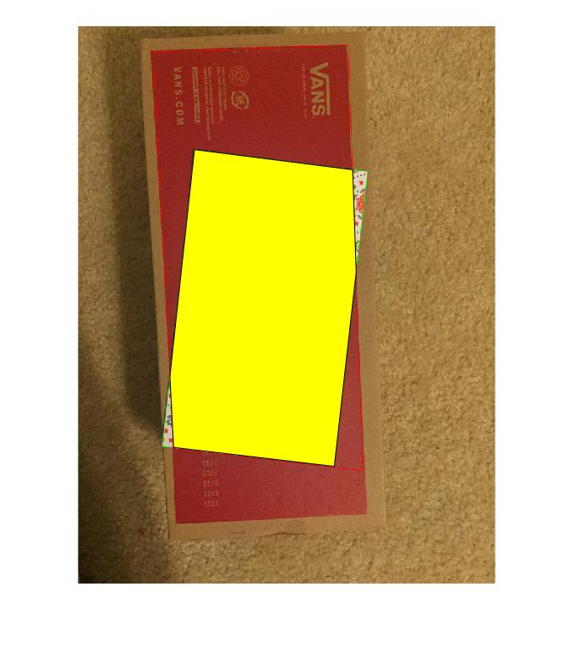
Failed Scenarios

Slide 6
Pros
Cons
Works with tilted document
Trapezoidal cropping is possible
Fails when documents has lines in it
Algorithm can fail when documents are placed over each other

Slide 7
Thank you

