Slide 1
GROUP-6
Ayyappa .T
Sukumar Reddy .Ch
Gayatri
Under the Guidance of:
Prof. Shivanjali Khare

Slide 2
ReinforcementLearning for Traveling Sales Man Problem

Slide 3
Objective
The Objective of Traveling Salesman Problem (TSP) is to visit the set of cities optimally or with minimum cost.
We are using model free approaches of Q-Learning and Policy Gradient approaches of Reinforcement Learning for solving the above problem.
The TSP is a NP Hard problem which implies that the computational complexity of the problem increases when the number of cities increases and the computation also depends on the distance between the cities.
From the methods we are following we will find out the which method is optimal in terms of our measure.

Slide 4
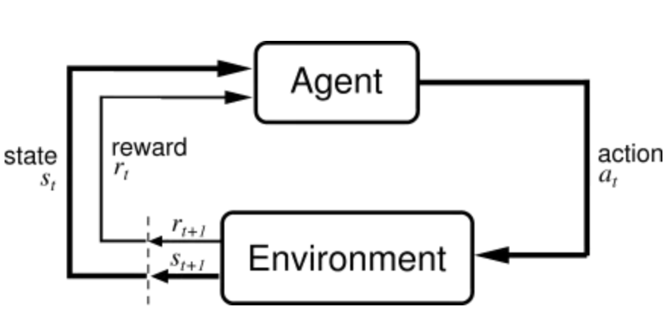
Problem and Solution Model
For solving the TSP there are some things that should be declared globally ie., for solving the TSP we require
Environment , states , actions, agent, value function, reward, policy, MDP etc…
We are solving TSP using Model Free RL Algorithms since it is better for scaling and flexible.
MFRL uses experience to directly learn state action values or policies as both plays the same role in reaching the optimal behavior we desire without estimation and world model.
MFRL agent relies on the trail and error method for finding out the optimal policy.
Q - Learning and Policy gradient are two major approaches in MFRL.

Slide 5
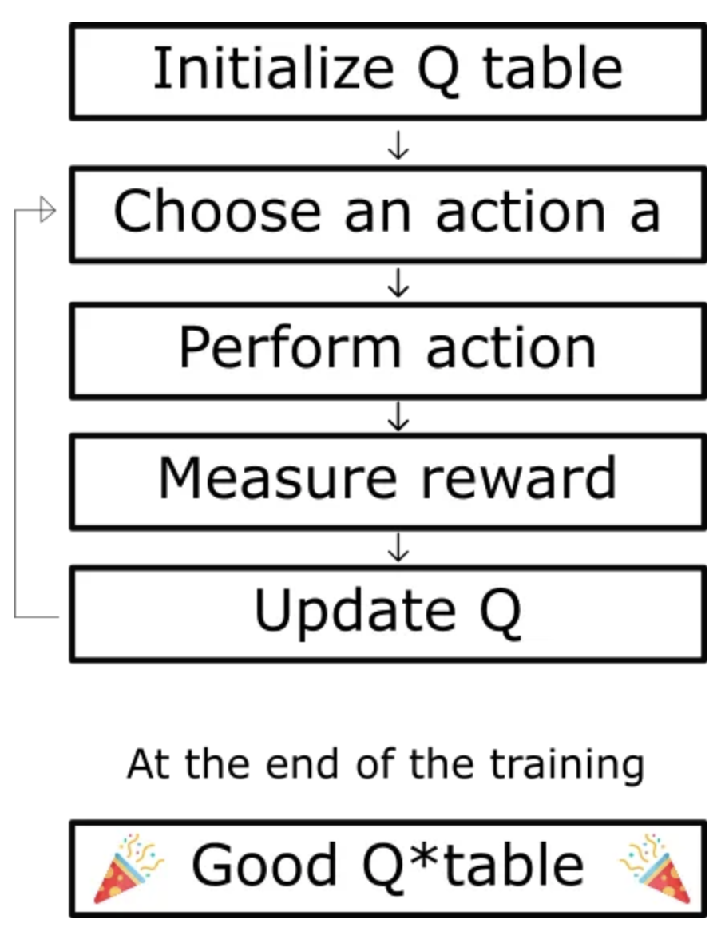
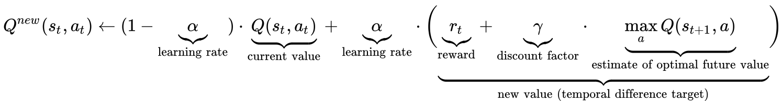
Q-Learning Algorithm for TSP
Q-table is a 2d matrix of state and action Q(s,a).
Actions can are taken in Q-learning are random and always less than exploration rate i.e., Q(s,a) with probability ϵ, then max(Q(s,a)) is 1-ϵ where( 0<ϵ<1).
During each iteration, the agent selects an action based on the current state. The choice of action involves a trade-off between exploration (trying new paths) and exploitation (choosing the best-known path)
The Q-table is initialized after taking the state-action pair.
Perform the chosen action, transition to the next state, and receive a reward(negative distance between the cities) as we are trying minimize the total distance travelled. 𝛾 is discount factor which affects the rewards.
We tune the hyper-parameters until we can observe a convergence.

Slide 6
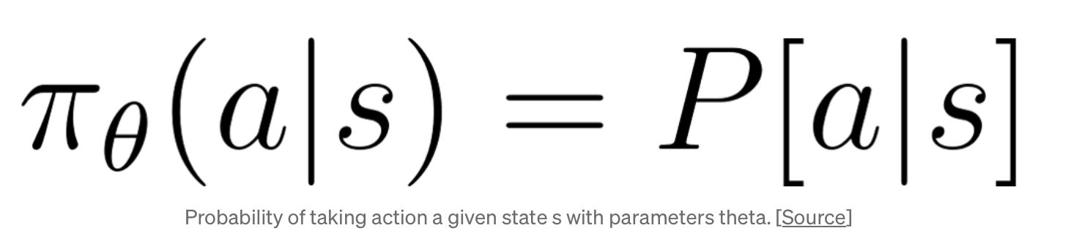
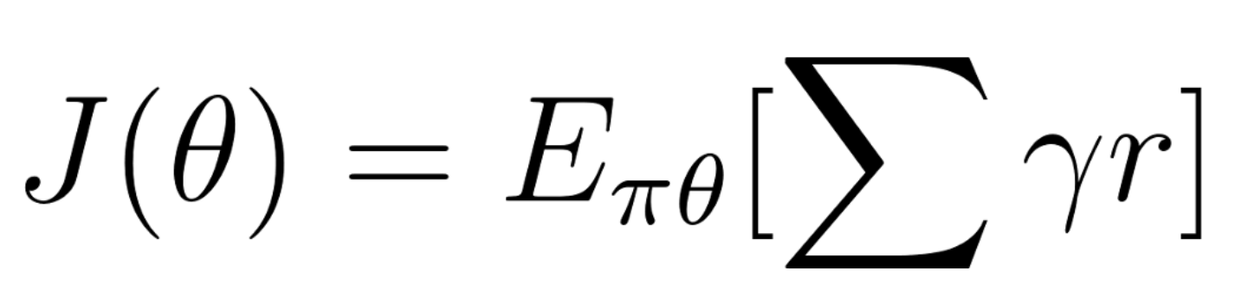
Policy Gradient
Step1: For Policy gradient we have to create a policy net based on the input size, hidden layers and output size we selected rely as the activation and the soft for the convetion of raw values to interpretable values.
Step 2: The loss function we considered here is
loss= -log (prob) * r
Step3: The policy is which the agent will follow for taking the next action i.e.
Step4: The objective of our agent is to maximize the “expected” reward when following a policy π. Like any Machine Learning setup, we define a set of parameters θ to parametrize this policy — π_θ (also written a π for brevity). If we represent the total reward for a given trajectory τ as r(τ), we arrive at the following definition.

Slide 7


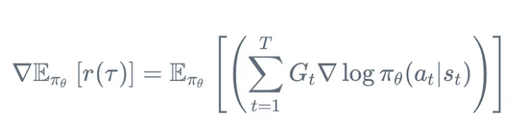
Step5: After getting a value the gradient step is then based on the update on the policy which is
Step6: Then the policy gradient theorem is the derivative of the expected reward is the expectation of the product of the reward and gradient of the log of the policy π_θ .
Step7: And for reinforcing it we find the difference of the previous policy and the present policy which is represented as
And after calculating the loss these values will converted from raw format to interpretable format.

Slide 8
Outputs
We can observe that both the algorithm converges but the initial loss of Q-Learning is comparatively lower.

Slide 9
Thank you

