Slide 1
Program
BITM-Data Analysis for Business Decision Making Graduate Certificate
Course
1200_INTRODUCTION TO DATA ANALYSIS
Prof. Aruna Dorai
FINAL PROJECT
Submitted by
AYYAPPA MADU
100827123

Slide 2
Introduction :
As per the Mr. John Hughes interest, I’m going to perform the three algorithms – SVM, Naïve Bayes Algorithm and Decision tree for illness study dataset.
Compare the results of all three models to determine the best model for the given illness study dataset.

Slide 3
Naïve Bayes Classifier:
Supervised machine learning algorithm used for classification problems.
Built on Bayes Theorem, because of its Naïve assumption of Conditional Independence among predictors it is called Naïve Bayes Theorem.
It assumes that all the features in a class are unrelated to each other.
To understand better, we will see Bayes Theorem.

Slide 4
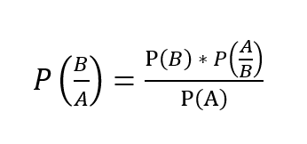
Bayes Theorem:
Let’s take two events A and B. We use the below formula to calculate posterior probability P(B/A) using P(B), P(A), P(A/B).
Where P(B/A) is the posterior probability, P(B) is the prior probability,
when we have two or more features, it is difficult to calculate the posterior probability as sometimes, we can get a zero-probability problem.
So, we take the Naïve assumption of conditional independence to calculate posterior probability.

Slide 5
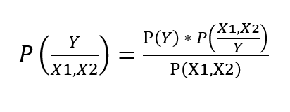
When we have, Predictors: [ X1, X2 ] and Target: Y
The formula to calculate the posterior probability is-
Taking Conditional Independence for P(X1, X2/Y=1),
This is the formula to calculate the posterior probability using Naïve Bayes Classifier.

Slide 6
Support Vector Machine (SVM)
It is a supervised machine learning algorithm by which we can perform Regression and Classification.
The most popular Supervised Learning algorithms, which is used for both Classification as well as Regression problems. However, primarily, it is used for Classification problems in Machine Learning.
The goal of the SVM algorithm is to create the best line or decision boundary that can segregate n-dimensional space into classes so that we can easily put the new data point in the correct category in the future. This best decision boundary is called a hyperplane.
SVM chooses the extreme points/vectors that help in creating the hyperplane. These extreme cases are called as support vectors, and hence algorithm is termed as Support Vector Machine.

Slide 7
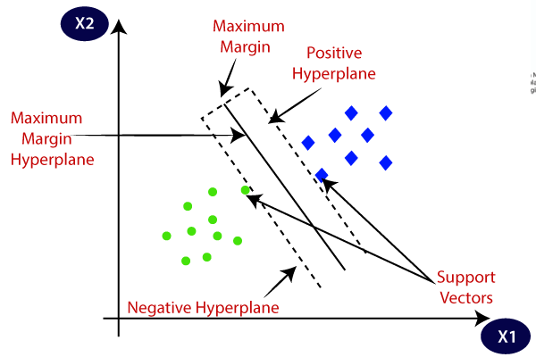
Plot 01: Describes the different categories that are classified using a decision boundary or hyperplane.

Slide 8
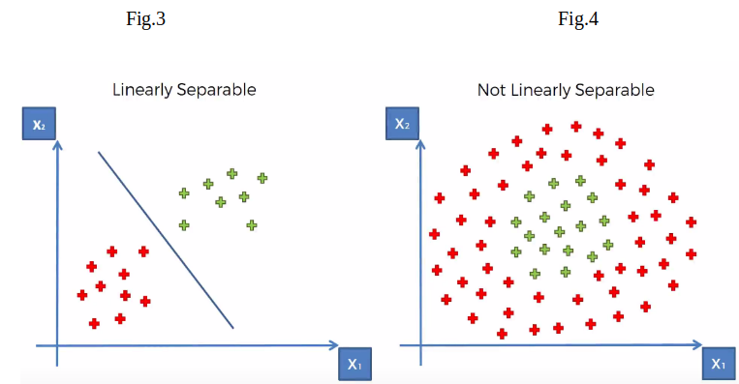
SVM can be of two types:
Linear SVM : Linear SVM is used for linearly separable data.
If a dataset can be classified into two classes by using a single straight line, then such data is termed as linearly separable data, and classifier is used called as Linear SVM classifier.
Non-linear SVM : Non-Linear SVM is used for non-linearly separated data.
If a dataset cannot be classified by using a straight line, then such data is termed as non-linear data and classifier used is called as Non-linear SVM classifier.

Slide 9
Decision Tree
A Supervised learning technique that can be used for both classification and Regression problems, but mostly it is preferred for solving Classification problems.
It is a graphical representation for getting all the possible solutions to a problem/decision based on given conditions.
It is called a decision tree because, like a tree, it starts with the root node, which expands on further branches and constructs a tree-like structure. In order to build a tree, we use the CART algorithm, which stands for Classification and Regression Tree algorithm. A decision tree simply asks a question, and based on the answer (Yes/No), it further split the tree into subtrees
In a Decision tree, there are two nodes, which are the Decision Node and Leaf Node. Decision nodes are used to make any decision and have multiple branches, whereas Leaf nodes are the output of those decisions and do not contain any further branches. The decisions or the test are performed based on features of the given dataset.

Slide 10
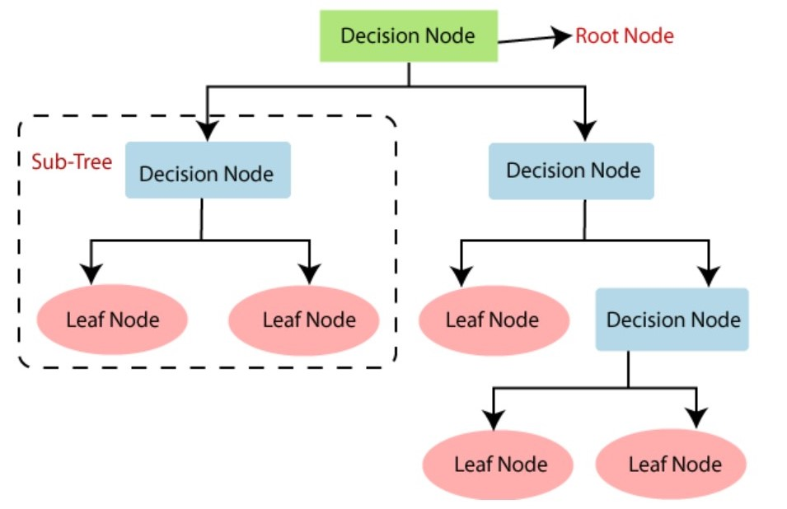

Slide 11
Key Statistics of illness study dataset
http://localhost:8888/notebooks/Documents/FINAL%20PROJECT.ipynb
The basic key statistics were presented in the html for the dataset.
Where we try to compare the values of diagnosis categorical values B and M.
Key Insights from the statistics
There is a significant difference between the diagnosis M and B in every parameter.
Diagnosis M (Malignant) got high values compared to B (Benign) which represents higher number of Benign patients in illnessstudy dataset.
Variance between the M and B defines the Illness and no-illness between parameters.

Slide 12
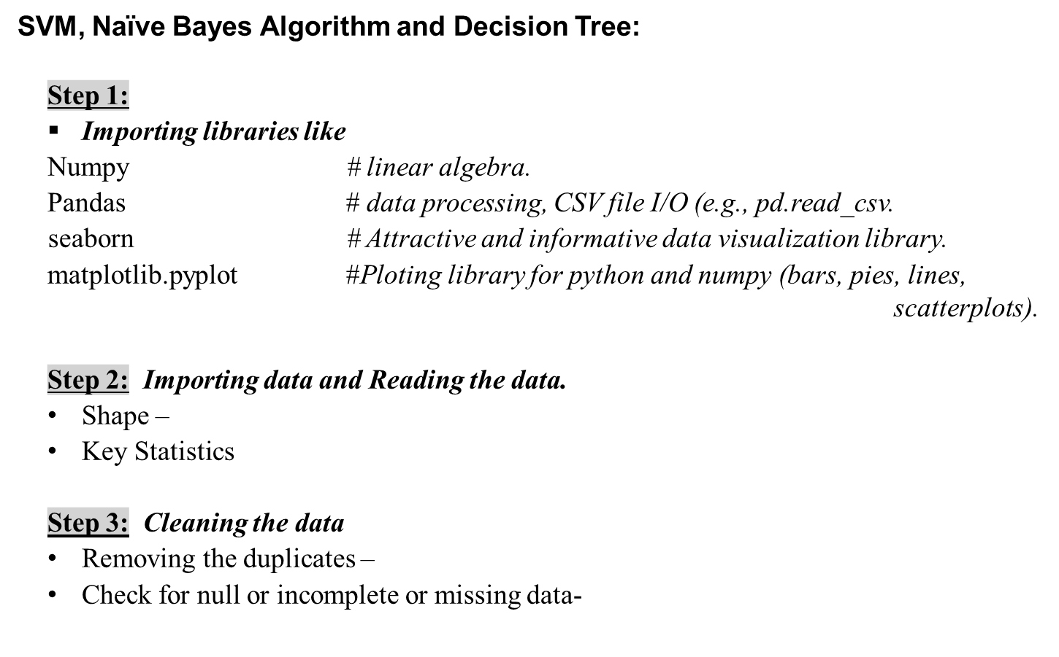

Slide 13
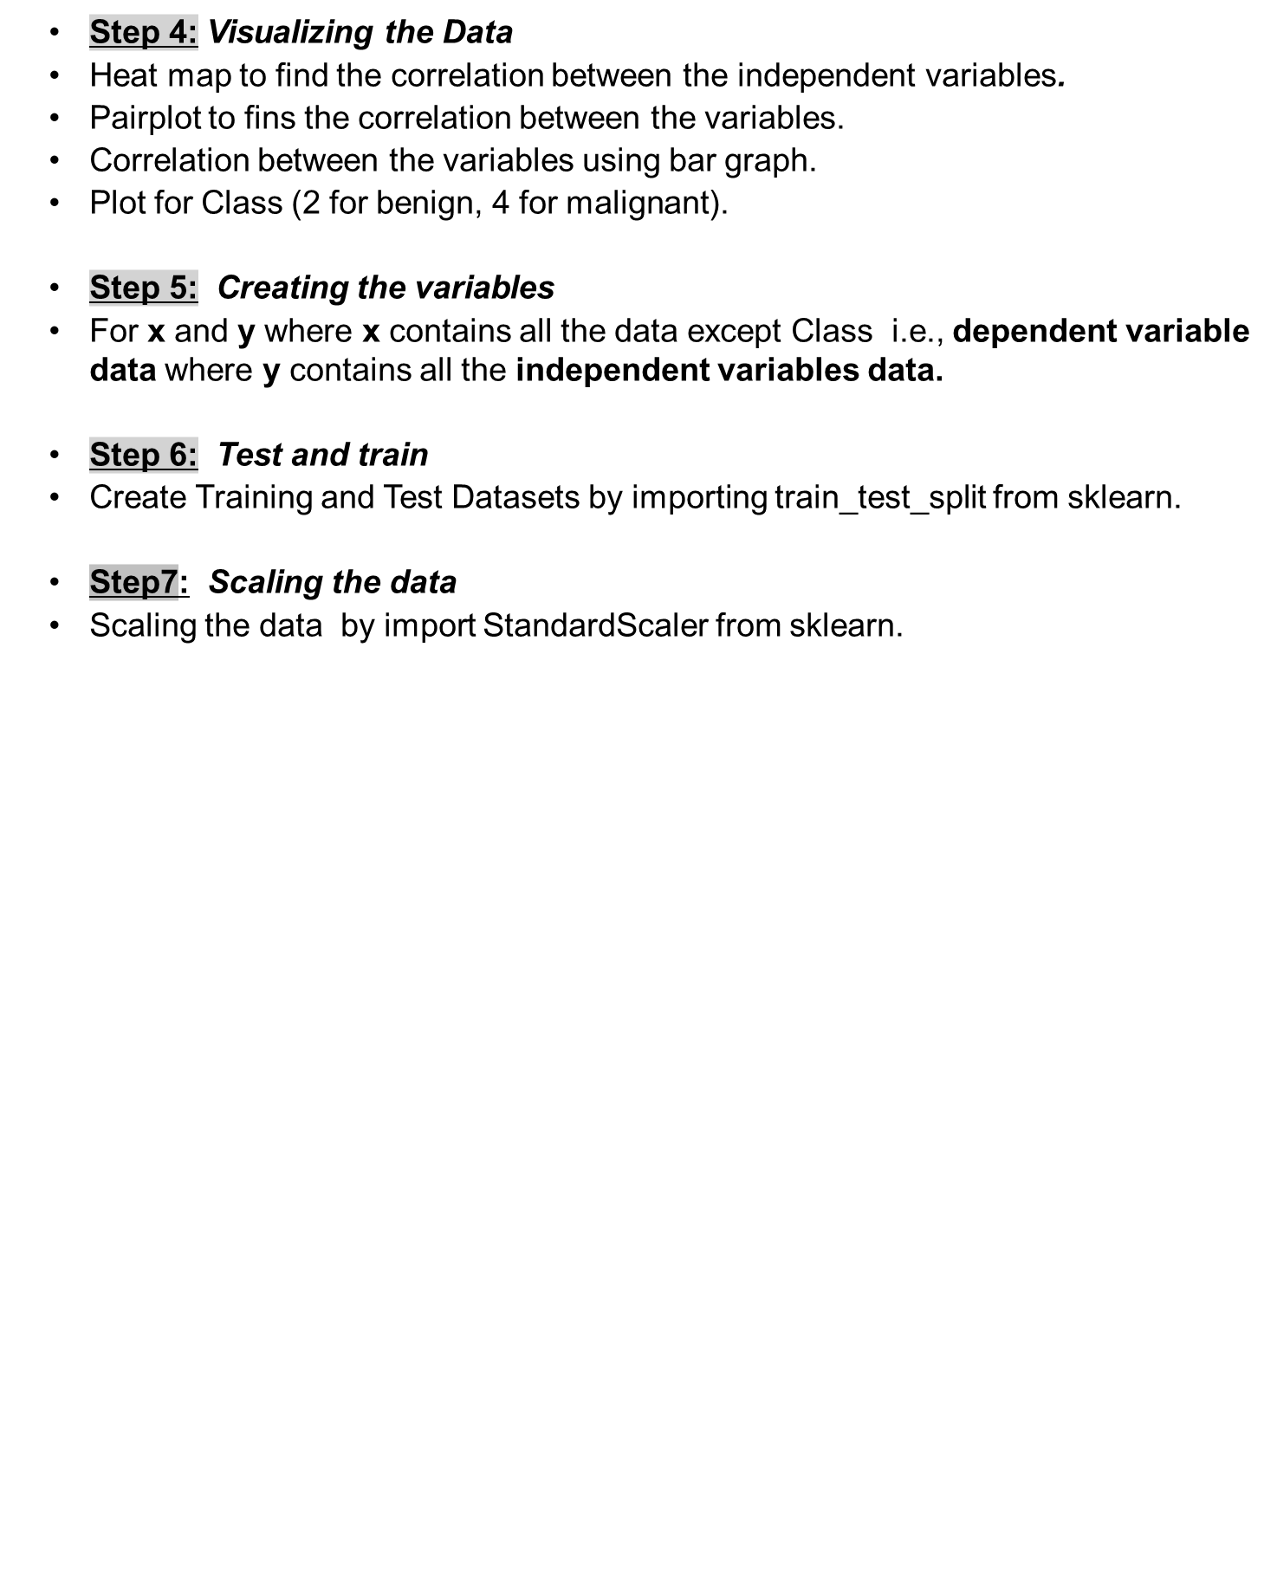

Slide 14
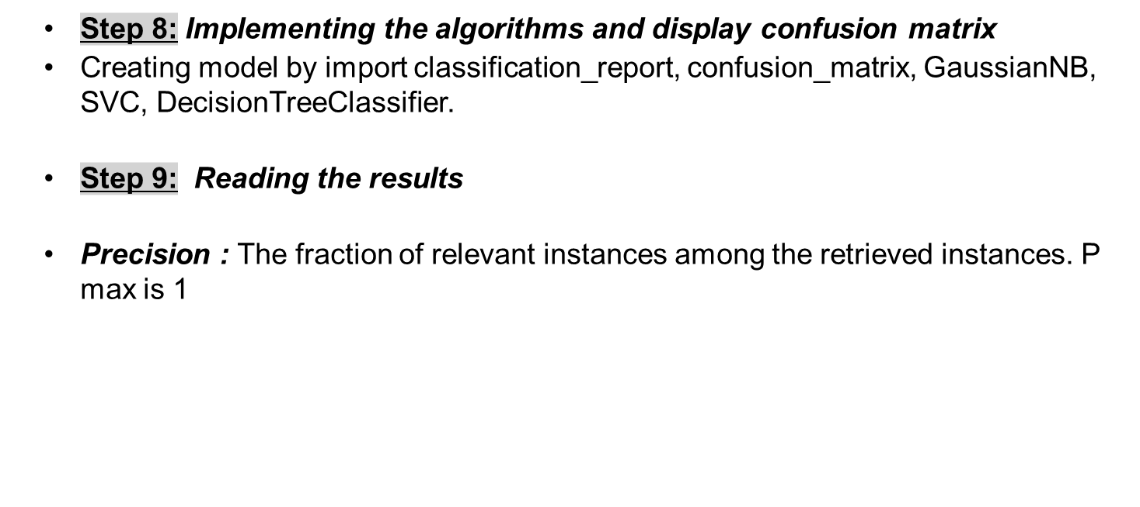
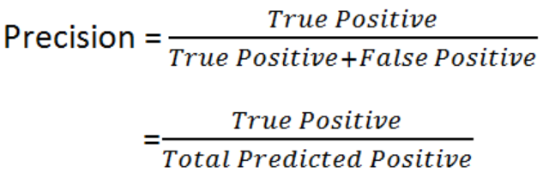

Slide 15
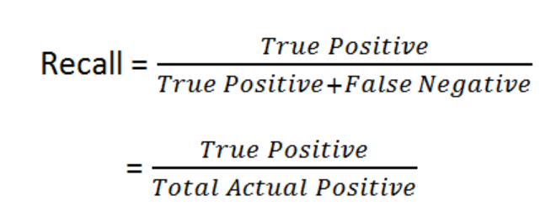

Recall : The fraction of relevant instances that were retrieved.
Recall ideally be 1 for good classifier
F1 Scores : F1 which is a function of Precision and Recall.
It becomes 1 only when precision and recall are both 1

Slide 16
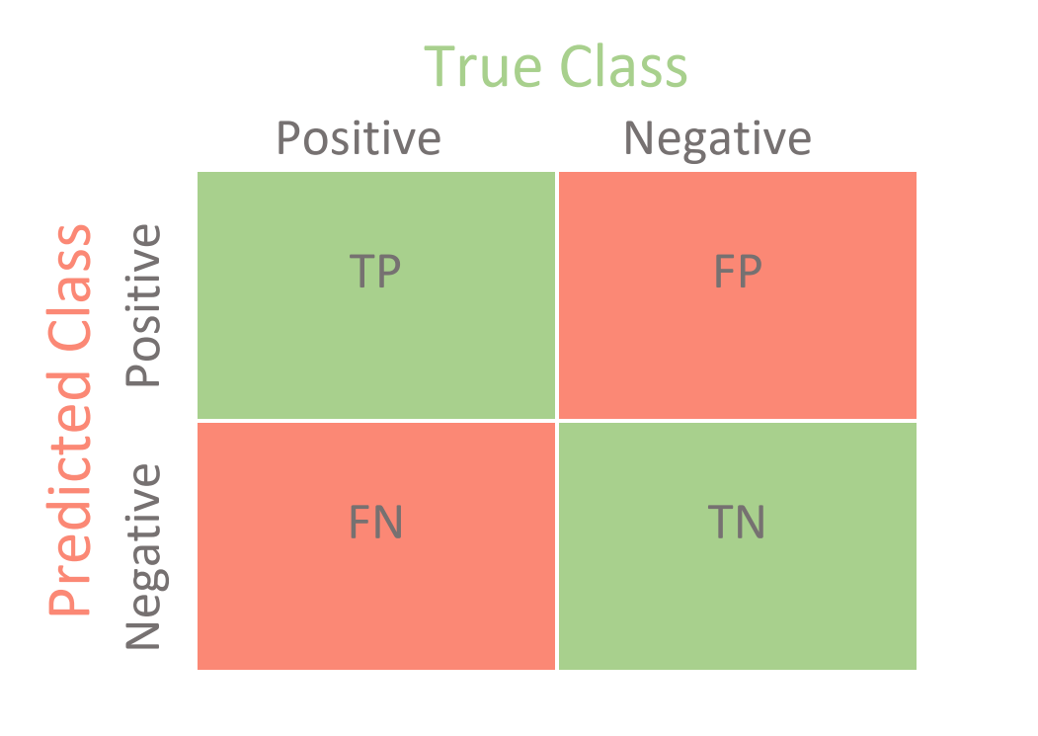
Confusion Matrix:
The confusion matrix which is required to compute the accuracy
of the machine learning algorithm in classifying the data into its corresponding labels.

Slide 17
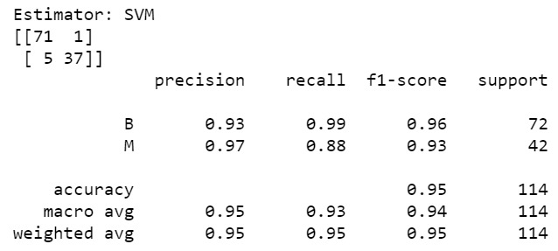
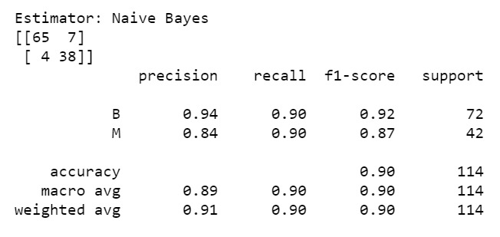
SVM - Linear
Naive Bayes
Comparison of SVM Linear vs Naïve Bayes
SVM - Precision for class B is 93% and class M is 97%
Naïve Bayes – Precision for class B is 94% and class M is 84%
Accuracy of SVM model - 95% is better than the accuracy of Naïve Bayes which is 91%.
So, between SVM linear and Naïve Bayes, we choose SVM Linear.

Slide 18
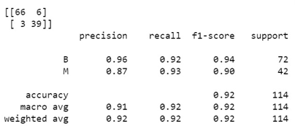
SVM- Non- linear
SVM - Linear
Comparison of SVM Non-Linear vs Naïve Bayes
SVM Non-Linear - Precision for class B is 96% and class M is 87%
SVM Linear– Precision for class B is 93% and class M is 97%
Accuracy of SVM Linear model - 95% is better than the accuracy of SVM Non-Linear which is 92%.
We choose SVM Linear, between SVM Linear vs SVM Non-Linear.

Slide 19
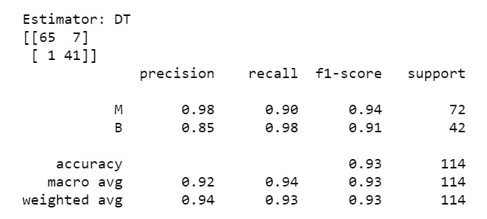
Decision Tree
Comparison of SVM Linear vs Decision Tree
SVM Linear - Precision for class B is 93% and class M is 97%
Decision Tree – Precision for class B is 85% and class M is 98%
Accuracy of SVM model - 95% is better than the accuracy of Decision tree which is 94%.
So, we choose SVM Linear between SVM Linear and Decision tree.

Slide 20

Confusion Matrix Comparison for all the Models
 | SVM LINEAR | NAÏVE BAYES | DECISION TREE | SVM (non- linear)
TRUE POSITIVE | 71 | 65 | 65 | 66
FALSE POSITIVE | 1 | 7 | 7 | 6
TRUE NEGATIVE | 37 | 38 | 39 | 41
FALSE NEGATIVE | 5 | 4 | 3 | 1
ACCURACY(%) | 95 | 91 | 94 | 92
BEST MODEL

Slide 21
Best Model for illness study dataset
To check the correct prediction, we must check the confusion matrix object and add the predicted results diagonally which will be the number of correct predictions and then divide by the total number of predictions.
That gives, 92.9% for Decision tree, 90.3% for Naïve Bayes, 94.7% for SVM Linear and 92.1% for SVM Non-Linear model.
Hence, of all three models, I recommend SVM-Linear model to be utilized for illness study dataset to Mr. John Hughes for his analysis.

Slide 22
Improvements to increase the effectiveness of SVM model:
Outliers in the model:
The presence of outlier values in the preparing information frequently decreases the accuracy of a show or leads to a one-sided demonstrate. It leads to inaccurate predictions.
Typically, because we don’t analyze the behavior and relationship with other factors accurately. So, it is critical the exception values.
Feature Engineering
The method where you consequently or physically select those features which contribute most to your forecast variable or output in which you're interested in.
Having insignificant features in your information can diminish the exactness of the models and make your show learn based on unimportant features.

Slide 23
References:
https://medium.com/analytics-vidhya/confusion-matrix-accuracy-precision-recall-f1-score
https://nylapirani.medium.com/how-to-build-a-basic-breast-cancer-model-machine-learning-9bae53c40f18
https://towardsdatascience.com/case-study-breast-cancer-classification-svm-2b67d668bbb7
https://www.javatpoint.com/machine-learning-decision-tree-classification-algorithm

