Slide 1

Program
BITM-Data Analysis for Business Decision Making Graduate Certificate
Course
2204-02 - STATISTICAL PRED MODELLING
Prof. Sam Plati
Assignment – 2
Logistic Regression
Submitted by
AYYAPPA MADU
100827123

Slide 2
Table of content
01 Analysis Statement…………………………………………………………………….….3
02 Logistic Regression……………………………………………………………………….4
03 Learning curve for the logistical regression model……………………………………… 4
04 Standard and optimized logistical regression model…………….………………………..5
05 ROC/AUC Curve for Optimized Model…………………………………………….……6
06 Evaluation………………………………………………………………………………...6
07 Recommendations………………………………………………………………………...7

Slide 3
01 Analysis Statement
As per the Mr. John Hughes interest I’m going to perform the standard and optimized Logistic regression model for the heart failure data set to predict the deceased patient during the follow-up period.

Slide 4
2.0 Logistic Regression :
A binary classification algorithm used when the response variable is dichotomous (1 or 0).
The model is an approximation model, we can improve the help of model with L1- LASSO (reduced to zero) and L2- RIDGE (close to zero but not zero).
assumptions made by Binomial Logistical Regression:
The response variable must follow a binomial distribution.
Logistic Regression assumes a linear relationship between the independent variables and the link function (logit).
The dependent variable should have mutually exclusive and exhaustive categories.

Slide 5
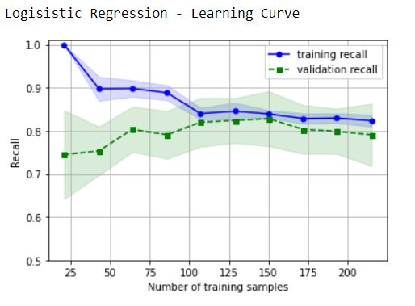
03 Learning curve for the logistical regression model:
The validation curve starts at 0.75 progressed to 0.79.
Thought the training set starts at 1, decreased to 0.84 with increase in samples.
The training and testing (validation) recall curves are relatively close with a gap less than 0.05.
Therefore, they have low variance and with nullable amount of bias.

Slide 6
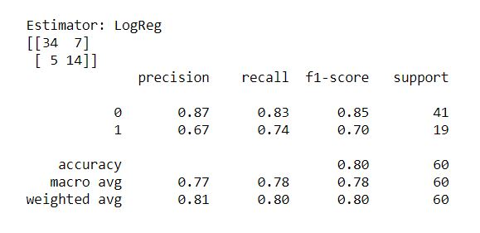
04 Standard and optimized logistical regression model
Standard Model results
Since the dataset is imbalanced with 203 and 96, we will consider F1 score instead of Precision and recall values.
i.e., The weighted average is 0.80, which is a good model.

Slide 7
Optimized Model results
Since the dataset is imbalanced with 203 and 96, we will consider F1 score instead of Precision and recall values.
i.e., The weighted average is 0.80. which is a good model.

Slide 8
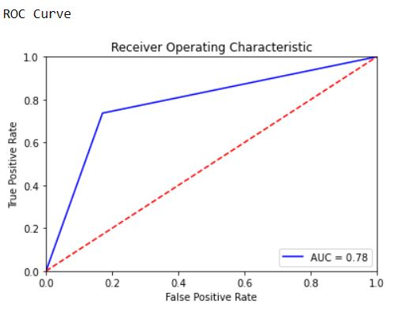
ROC/AUC Curve for Optimized Model
The first metric F1 shows result 80% of accuracy where as, the second metrics results shows that, the ROC Curves indicates that the model is accuracy of 78% which is close, and we can say that the model is doing GOOD in predicting the results.

Slide 9
Recommendations
The standard and optimized Regression model is good.
We can still improve with better feature selection and with more data.
We can predict better with a balanced dataset.

