Slide 1

Program
BITM-Data Analysis for Business Decision Making Graduate Certificate
Course
2204-02 - STATISTICAL PRED MODELLING
Prof. Sam Plati / Ritwick Dutta
Assignment – 4
Regularization
Submitted by
AYYAPPA MADU
100827123

Slide 2
Analysis Statement
As per the Mr. John Hughes interest, I’m going to perform the Regularization techniques for the abalone data.

Slide 3
Outliers:
They are data records that differ dramatically from all others, they distinguish themselves in one or more characteristics. In other words, an outlier is a value that escapes normality and can (and probably will) cause anomalies in the results obtained through algorithms and analytical systems. There, they always need some degrees of attention.
The method of finding an outliers is depending up on the quartiles of the data which we are going to use on our dataset.
The dataset that we used consisted of 4177 rows for all eight columns after removing outliers. We now have a dataset of 4024 rows, which means 153 rows have been removed as outliers

Slide 4
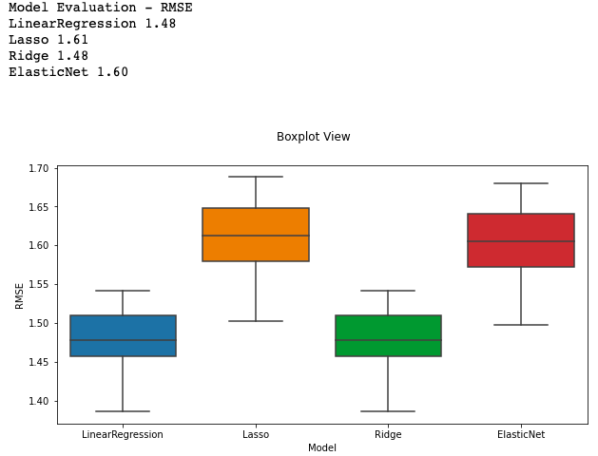
Model Analysis:
We cleaned the data using Tukey to remove outliers.
Plot with Models on X axis and RMSE on Y-axis illustrates the distribution of RMSE for various models.
The Box plots describes the data range along with the skewness in the numerical data provided through displaying the data quartiles and averages.
On Y-axis the standard deviation of the residuals RMSE describes concentrated data is around the line of best fit.

Slide 5
The lowest RMSE values indicates the better fit.
This result is the same for linear regression and Ridge, where the median value, 1,48, and also minimum is close to median where as the RMSE for Lasso and Elastic Net is higher than the other two, respectively.
There are slightly longer lower whiskers for all 4 models, which indicates the below-median value has more data points.

Slide 6
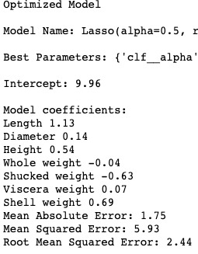
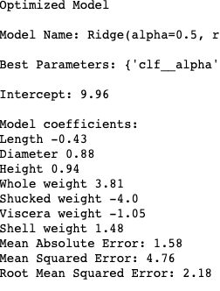
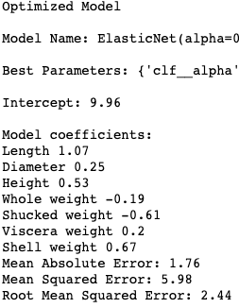
Optimized Regularization models- Classification Report

Slide 7
Intercept : The intercept is same for all the three models 9.96 . Its the minimum values of the function on the y-axis.
Model coefficients: No coefficients are zero, but they varies with respect to models. A positive coefficient specifies the independent variable increases the dependent variable tends to increases, negative coefficient means independent variable increases, the dependent variable tends to decrease(i.e.. reverse proportion.)
Regression model: Performance is based on MAE, MSE and RMSE.
MAE values are 1.75 and 1.76 for Lasso and Elastic nets while the MAE value for Ridge is 1.58, the lowest among the three.
The Ridge model has the lowest MSE(4.76), ahead of Lasso(5.93) and Elastic net (5.98).
Furthermore, Ridge model also has a low RMSE of 2.18 compared to Lasso and Elastic Net models with a 2.44 value each. Therefore, The Ridge model performs well here as well.

Slide 8
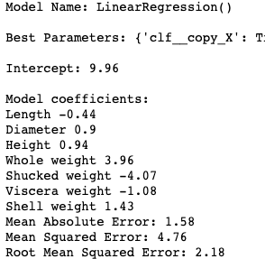
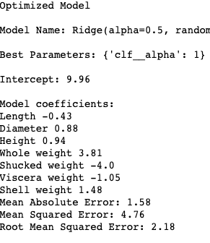
Optimized Regularization Models VS Optimized Linear Regression Model
Based on the performance we choose to compare Ridge model with regression model.

Slide 9
Comparison
The Optimize regularization model ridge and optimize linear regression model performance is very similar.
In comparison of optimized linear regression model with the elastic net and Lasso the performance based on RMSE MSE and MAE we can opt regression. The performance of optimize linear regression after removing outliers is good.
Lasso is ideal when we got a lot of significant varying features but this result in interpretable as it eliminates the features.
Here we don’t need to eliminate the features so as the performance of Ridge is better compared to the other models.
We can conclude that the Ridge and optimize linear regression are performing well.

Slide 10
Recommendations
After implemented different regularization methods to over com the overfitting but observed that the Ridge model is performing very close to the optimize linear regression model.
I suggest to improve the Data collect method as we eliminated some data to treat outliers.
Also, I recommend Mr. John Hughes to use different Regression methods like Logistic, Polynomial and Stepwise Regression.

