Slide 1

Intel Unnati Industrial Training Program 2024

Slide 2
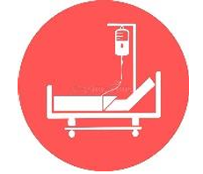
PROBLEM STATEMENT
Statement no : 7
Innovative Monitoring System for TeleICU Patients Using Video Processing and Deep Learning

Slide 3
Unique Idea Brief : Real-Time Video Processing Continuous high-definition video feed capture
Real-time processing to detect critical events
Deep Learning-Based Detection and Tracking
Custom-trained YOLOv8 model for high-accuracy detection
Recognizes specific patient behaviors and conditions
Automated Annotation and Reporting
Annotates and tracks patient movements
Compiles annotated videos for detailed visual reports
User-Friendly Interface and Alerts
Displays real-time video feeds with annotations
Generates alerts for critical behaviors for prompt intervention
Scalability and Integration
Supports monitoring multiple patients simultaneously
Integrates with existing hospital infrastructure and cloud-based storage

Slide 4
Process flow
Dataset Preparation Image Collection: Gather and organize images into /images/train and /images/val directories.
Labeling : Use CVAT (Computer Vision Annotation Tool) to create annotations for each image. Save label files in YOLO format (<class_id> <x_center> <y_center> <width> <height>).
Label Verification and Normalization Verification Script: Run a Python script to ensure each image has a corresponding label file and that all labels are correctly formatted and normalized.
Training the YOLOv8 Model
Model Configuration: Set up YOLOv8 configuration, specifying paths to the training and validation datasets.
Training Execution: Run the training script, ensuring the training dataset and labels are correctly referenced.

Slide 5
5 . Model Evaluation and Fine-tuning
Validation: Evaluate the model on the validation dataset to check for accuracy and performance.
Fine-tuning: Adjust model parameters, retrain if necessary, and address any issues such as overfitting or underfitting.
6 . Deployment and Testing
Export Model: Save the trained model for deployment.
Testing: Test the model on new images to ensure it performs well in real-world scenarios.

Slide 6
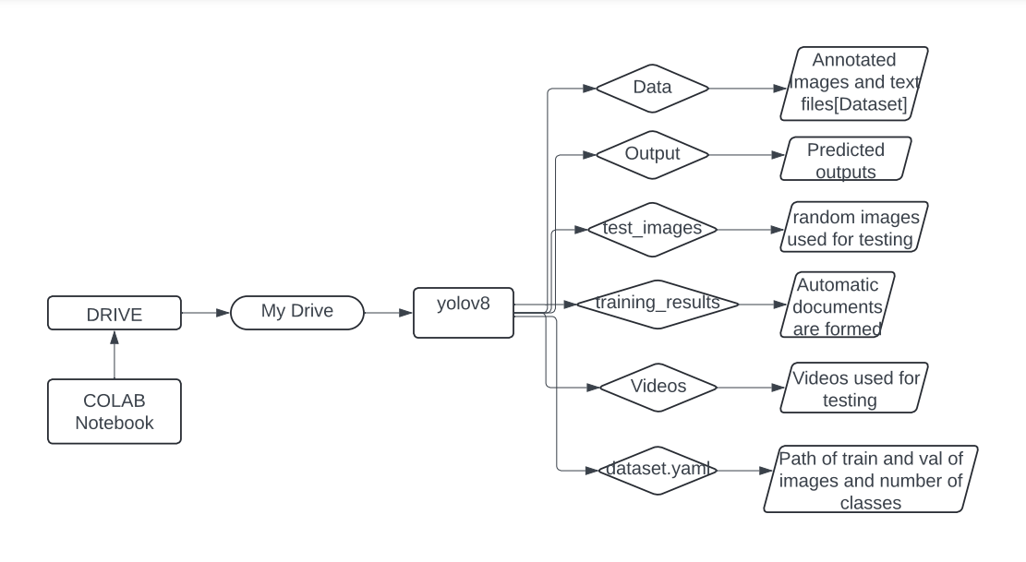
ARCHITECTURE DIAGRAM

Slide 7
DIRECTORY STRUCTURE
/content/drive/MyDrive/yolov8/data/
├── images/
│ ├── train/
│ │ ├── image1.jpg
│ │ ├── image2.jpg
│ │ └── ...
│ └── val/
│ ├── image1.jpg
│ └── ...
└── labels/
├── train/
│ ├── image1.txt
│ ├── image2.txt
│ └── ...
└── val/
├── image1.txt
└── ...

Slide 8
Technologies used
1. YOLOv8 (You Only Look Once version 8) Description: YOLOv8 is a state-of-the-art real-time object detection model. It is known for its speed and accuracy. Usage: Training an object detection model using labeled images. YOLOv8 uses a specific format for labels and images, requiring careful preparation of datasets.
2. Google Drive Description: A cloud storage service by Google. Usage: Storing and sharing datasets (images and labels) for your project. You've provided links to files stored on Google Drive, which include images and possibly label files.
3. Label Files (YOLO Format) Description: Text files that contain annotation data for object detection. Each line in a file corresponds to one object, with the format: <class_id> <x_center> <y_center> <width> <height> Usage: These files are necessary for training the YOLOv8 model, and they need to be correctly formatted and placed in the directories.
directories
directories.
4. Python Scripts Description: Custom scripts to verify and preprocess datasets. Usage: Checking the existence and format of label files, normalizing coordinates, and ensuring the directory structure is correct.
5 . CVAT (Computer Vision Annotation Tool) Description: CVAT is an open-source tool designed for annotating video and image data for computer vision tasks. Usage: It is used to create, manage, and export accurate and detailed annotations (bounding boxes, polygons, points, etc.) for training machine learning models in various computer vision applications.

Slide 9
Team members and contribution:
[Team Member 1 : K . Gouthami]
Contributions:
Prepared and organized the dataset.
Verified and normalized label files.
Managed the CVAT annotation tool for labeling images.
Managed project timelines and deliverables.
[Team Member 2 : Ayyapu Reddy Dande]
Contributions:
Annotated images for training.
Implemented the YOLOv8 model training.
Fine-tuned model hyperparameters for optimal performance.
[Team Member 3 : P . Vaishnavi]
Contributions:
Developed scripts for dataset verification and normalization.
Managed the CVAT annotation tool for labeling images.
Handled data augmentation and preprocessing.
The trained model is tested and executed.

Slide 10
Thank you

